Slide 1
ECO331 (2026) • MACHINE LEARNING IN ECONOMICS
Explainable Macroeconomic Inflation Forecasting
Unifying Econometric Benchmarks, Regularized Linear Models, XGBoost, Deep Sequence Nets
& Hybrid Tree-Neural Architectures Across 48 Years of US Macro, Energy, Equity & GDP Data
Data: 15 Monthly/Quarterly FRED Series (1978–2026, N = 585 Months) | Models: 12 Specifications Across 6 Families
Horizons: h = 1, 3, 6, 12 Months Ahead | Explainability: Exact TreeSHAP, Policy Playbook & Live Demo App
Notes:
SLIDE 1: Title Slide
1-Sentence Hook: Today we ask: can modern Machine Learning beat traditional central-bank inflation models — AND still explain WHY in plain economics?
What to Say Out Loud:
- We synthesize all four literature clusters from the ECO331 folder: CPI inflation, Electricity prices, Stock markets, and Real GDP.
- We benchmark 12 models — from Random Walk and Phillips Curves to Elastic Net, XGBoost, LSTM, Transformers, and a Hybrid XGB + Deep Net.
- Most importantly, we open the black box using exact TreeSHAP and showcase a live interactive web predictor at the end.

Slide 2
SECTION 1 | Presentation Roadmap (Aligned with Course Template)
Part I — Economic Problem, Theory & Data Story
• 1. Introduction: Why Central Banks Forecast 3–12 Months Ahead
• 2. Motivation: Uniting All 4 Course Literature Clusters (18 Papers)
• 3. Research Objectives: Accuracy vs. Interpretability Trade-Off
• 4. Methods & Equations: Anchored Forecasts, Shrinkage, SHAP & Attention
• 5. Data Source: 15 FRED Macro, Electricity, Equity & GDP Series (1978–2026)
• 6. Data Storytelling: Shifting Phillips Curve & Cross-Correlations
Part II — Empirical Findings, Policy XAI & Live Demo
• 7. Flagship Results (h=3m): Why Shrinkage & Boosted Trees Beat OLS
• 8. Are Models Just Lagging? Change-Space & 5 Policy/Shock Eras
• 9. Horizons (1–12m), Hybrid XGB+Deep Net & 4-Cluster Ablation
• 10. Explainable AI: Linear vs. TreeSHAP vs. Neural Driver Consensus
• 11. Policy Playbook: Nonlinear Fed Rate Brake & Transmission Clock
• 12. Live Predictor Web Tool, Conclusions, Limitations & References
ECO331 (2026) • Explainable Macroeconomic Inflation Forecasting • Slide 2/23
Notes:
SLIDE 2: Presentation Roadmap
1-Sentence Hook: Our talk follows the exact 13-section ECO331 structure in two clean halves.
What to Say Out Loud:
- Part I sets up the economic puzzle: why linear Phillips Curves broke during COVID and how we engineered 15 leak-free FRED series.
- Part II shows our empirical horse-race, proves our models aren't just lagging, translates SHAP into a central-bank playbook, and demos our live web app.

Slide 3
SECTION 2 | Introduction: The Central Bank Forecasting Puzzle
Why Inflation Forecasting Is Hard — Especially at Turning Points
• Policy Lags Require Foresight: Interest rate hikes take 6 to 12 months to cool inflation, so central banks must steer using forecasts, not rearview mirrors.
• The Random Walk Challenge: Atkeson & Ohanian (2001) famously showed that during calm eras, simply guessing 'tomorrow = today' beats complex econometric models.
• The 2020–2026 Stress Test: Pandemic lockdowns, a 9.0% CPI surge, Ukraine energy shocks, and 525 bps of Fed hikes broke linear textbook relationships.
What Machine Learning Brings
• Collinearity Control: Elastic Net & Ridge prevent correlated macro indicators (CPI, PPI, M2, GDP) from blowing up OLS coefficients.
• Regime Thresholds: XGBoost & Hybrid Deep Nets learn when real interest rates or energy shocks cross critical tipping points.
Why Explainability Is Non-Negotiable
• No Black-Box Rate Hikes: An FOMC or RBI committee will never hike rates by 75 bps just because a neural network outputs '5.2%'.
• Economic Attribution: Every forecast in our project is decomposed into exact percentage-point drivers (Supply vs. Policy vs. Expectations).
ECO331 (2026) • Explainable Macroeconomic Inflation Forecasting • Slide 3/23
Notes:
SLIDE 3: Introduction
1-Sentence Hook: Monetary policy is like steering an oil tanker: today's rate hike only hits inflation two to four quarters later.
What to Say Out Loud:
- In calm decades, beating a naive Random Walk ('inflation in 3 months equals inflation today') was famously difficult.
- Between 2020 and 2026, inflation went from 0.3% to 9.0% and back to ~2.5% — creating the ultimate stress test for ML vs. econometrics.
- Our thesis: ML wins only if it is regularized against small macro sample sizes AND fully explainable to policymakers.

Slide 4
SECTION 3 | Motivation: Synthesizing All 4 Course Literature Clusters
1. CPI & Food Inflation (8 Papers)
• Singh & Bhoi (RBI, 2022) & Singh & Rathi (RBI, 2024): Show ML & Forecast Combinations beat ARIMA/NKPC during supply shocks.
• Li et al. (2022) & Mamedli (2021): Establish XGBoost & Elastic Net as top performers at 3–12m horizons.
• Gap We Solve: Prior papers rarely compare SHAP vs. Linear β vs. Deep Attention side-by-side.
2. Electricity, Stocks & GDP (10 Papers)
• Electricity (Kuskaya & Bilgili, 2025): Grid electricity tariffs capture sticky second-round energy costs + warn against leaky K-Fold CV!
• Equities (Subasi 2021; Vamossy 2024): Stock market returns front-run financial conditions & household wealth.
• Real GDP (Yoon 2021; Maccarrone 2021): Captures broad service-sector demand missing from factory-only indices.
3. Small-Data Deep Learning Puzzle
• 48 Years = Only 585 Months: Unlike millions of words in LLMs, monthly macro data spans only ~5 business cycles.
• Why Standalone Transformers Struggle: Over-parameterized self-attention overfits small tabular/sequence panels.
• Our Innovation: Feed XGBoost's nonlinear SHAP signals + trends into a Gated Deep Trend Network!
ECO331 (2026) • Explainable Macroeconomic Inflation Forecasting • Slide 4/23
Notes:
SLIDE 4: Motivation from the Course Folder
1-Sentence Hook: Instead of picking just one paper from the course folder, we noticed all 18 papers fall into four connected macro channels.
What to Say Out Loud:
- Cluster 1 is CPI inflation (RBI papers by Singh & Bhoi, Li et al.). Cluster 2 is Electricity prices (Kuskaya & Bilgili 2025).
- Cluster 3 is Stock markets (Vamossy, Subasi), and Cluster 4 is Real GDP growth (Yoon 2021).
- We integrate all four into a single unified US inflation framework AND test why hybridizing XGBoost with a Deep Net solves the 585-month macro sample limit.

Slide 5
SECTION 4 | Research Objectives & Testable Questions
Objective 1 — 12-Model Horse Race Across 6 Families
• Benchmark Naive/Econometric (Random Walk, AR, OLS Phillips Curve), Shrinkage (Ridge, Elastic Net), Trees (RF, XGBoost), Deep Nets (MLP, LSTM, Transformer), Hybrid (XGB+Deep Net), and Ensembles.
Objective 2 — Turning-Point & Policy-Shock Audit
• Test whether ML genuinely anticipates inflation changes (Δπ_{t+3}) during COVID, the 2021 Surge, 2022–23 Fed 75bp hikes, and 2024–26 Soft Landing — or merely lags.
Objective 3 — Cross-Paper Channel Ablation
• Quantify how much adding sticky Electricity Prices (Kuskaya 2025), US Equities (Vamossy 2024), and Real GDP (Yoon 2021) improves out-of-sample CPI accuracy.
Objective 4 — Actionable Policy Playbook & Demo Tool
• Map exact SHAP values across horizons (1m to 12m) into a 'Macroeconomic Transmission Clock' and deploy a live multi-model web predictor.
ECO331 (2026) • Explainable Macroeconomic Inflation Forecasting • Slide 5/23
Notes:
SLIDE 5: Research Objectives
1-Sentence Hook: We structured the project around four concrete, falsifiable questions.
What to Say Out Loud:
- First: which model family wins at 1, 3, 6, and 12 months? Second: are models truly anticipating turning points or just lagging?
- Third: do Electricity prices, Stock returns, and Real GDP measurably cut forecast error?
- Fourth: which exact indicators should central bankers watch at each horizon, and how much do they move CPI in percentage points?

Slide 6
SECTION 5 | Research Methods & Mathematical Formulations
1. Anchored Target Decomposition (Why SHAP = pp)
• Anchored Law: π̂_{t+h} = π_t + f_θ(X_t), predicting shift Δ_h π_{t+h} = π_{t+h} − π_t.
• Econometric Nesting: If f_θ(X_t) = 0, forecast equals Random Walk (π̂_{t+h} = π_t) identically.
• NKPC Baseline: Δ_h π_{t+h} = α − λπ_t + β E_t[π_{t+12}] − κ UNRATE_t + γ Supply_t + ε_{t+h}.
2. Penalized Linear Shrinkage (Ridge & Elastic Net)
• Objective over standardized predictors X̃_t: min_β (1/2N)||Δ_h π − X̃β||₂² + α[ρ||β||₁ + ½(1−ρ)||β||₂²].
• Why OLS Fails: 15 macro channels share strong collinearity; L1 prunes noise while L2 stabilizes slopes.
• Tuned strictly via 5-fold chronological TimeSeriesSplit inside each expanding training window.
3. XGBoost & Exact Additive TreeSHAP
• Additive Boosted Trees: f(X_t) = Σ_{k=1}^K η h_k(X_t), penalized by Ω(h_k) = γT + ½λ||w||₂² + α||w||₁.
• Exact TreeSHAP Identity: π̂_{t+h} = π_t + E[Δ_h π] + Σ_{j=1}^p φ_j(X_t).
• Key Speaking Point: Every φ_j(X_t) is measured directly in percentage points of CPI inflation!
4. Sequence Nets, Hybrid Gate & Diebold-Mariano Test
• Temporal Attention: w_{t,k} = softmax_k(q(h_t)ᵀ k(h_{t−k}) / √d) over 12-month tensor S_t ∈ R^{12×14}.
• Hybrid XGB + Deep Net: Δ̂ = σ(g(z_t)) · Δ̂_XGB + (1 − σ(g(z_t))) · TrendNet(X_t, φ_t, Δ_1m, Δ_3m).
• Statistical Test: Harvey-Leybourne-Newbold HAC Diebold-Mariano t-stat vs. Random Walk.
ECO331 (2026) • Explainable Macroeconomic Inflation Forecasting • Slide 6/23
Notes:
SLIDE 6: Research Methods & Equations
1-Sentence Hook: The single smartest design choice in our math is the Anchored Forecast equation in Box 1.
What to Say Out Loud:
- Instead of predicting raw CPI levels from scratch, every model predicts how much inflation will CHANGE from today: pi-hat(t+h) = pi(t) + f(X_t).
- Why does that matter? First, if f=0, we recover the exact Random Walk benchmark. Second, every SHAP value phi_j is literally in percentage points of inflation push or pull!
- Box 4 shows our Hybrid innovation: a gated neural net that blends XGBoost's tree prediction with smooth 1-month and 3-month SHAP trends.

Slide 7
SECTION 6 | Data Source: 15 FRED Macro, Energy, Equity & GDP Series
15 Public FRED Series Uniting 5 Economic Channels (1978–2026)
• 1. Price & Base Inertia: Headline CPI (CPIAUCSL), Core CPI (CPILFESL), Core–Headline Gap, 1m/3m Momentum, and Base-Effect CPI (t−12..t−9).
• 2. Supply, Oil & Sticky Electricity: PPI Commodities (PPIACO), WTI Crude Oil (WTISPLC), plus Electricity Price Index (CUSR0000SEHF01, Kuskaya 2025).
• 3. Monetary, Liquidity & Equities: Fed Funds, Real Fed Funds (Fed − CPI), 10Y–2Y Yield Curve, M2 Money Stock, and US Equities (SPASTT01USM661N).
• 4. Real GDP & Labor Slack: Real GDP Growth (GDPC1, Yoon 2021), Industrial Production (INDPRO), Unemployment (UNRATE), Consumer Sentiment.
• 5. Forward Expectations: Univ. of Michigan 1-Year Household Inflation Expectations (MICH).
Zero Look-Ahead & Stationarity Guarantees
• ADF Unit-Root Verification: Raw price/GDP/equity levels are non-stationary I(1) (ADF p > 0.80); all YoY %, momentum, and spread features reject unit roots (p < 0.05).
• Publication-Lag Alignment for GDP: Q1 Real GDP is published in late April — we shift GDPC1 forward by +3 months so models never see unreleased GDP!
• Central-Bank Expanding Windows: Out-of-sample test (2019–2026, 90 months) re-estimates annually using ONLY historical targets realized before Jan 1 of each test year.
• Causal Gap Handling: Single Oct 2025 survey gap imputed strictly backward from (t−1, t−2).
ECO331 (2026) • Explainable Macroeconomic Inflation Forecasting • Slide 7/23
Notes:
SLIDE 7: Data Source & Zero Look-Ahead Design
1-Sentence Hook: We pull 48 years of US data (585 months, 1978–2026) directly from the St. Louis Fed FRED database with zero look-ahead bias.
What to Say Out Loud:
- Notice two crucial econometric details on the right card: First, raw CPI and GDP have unit roots, so we transform everything into stationary growth rates, spreads, and momentum.
- Second, Real GDP is reported quarterly with a release delay — Q1 GDP comes out at the end of April. We lag GDP by 3 months so our models only use information a real-time forecaster actually had!
- And before every test year from 2019 to 2026, we purge h months at the boundary so future inflation realizations never leak into training.

Slide 8
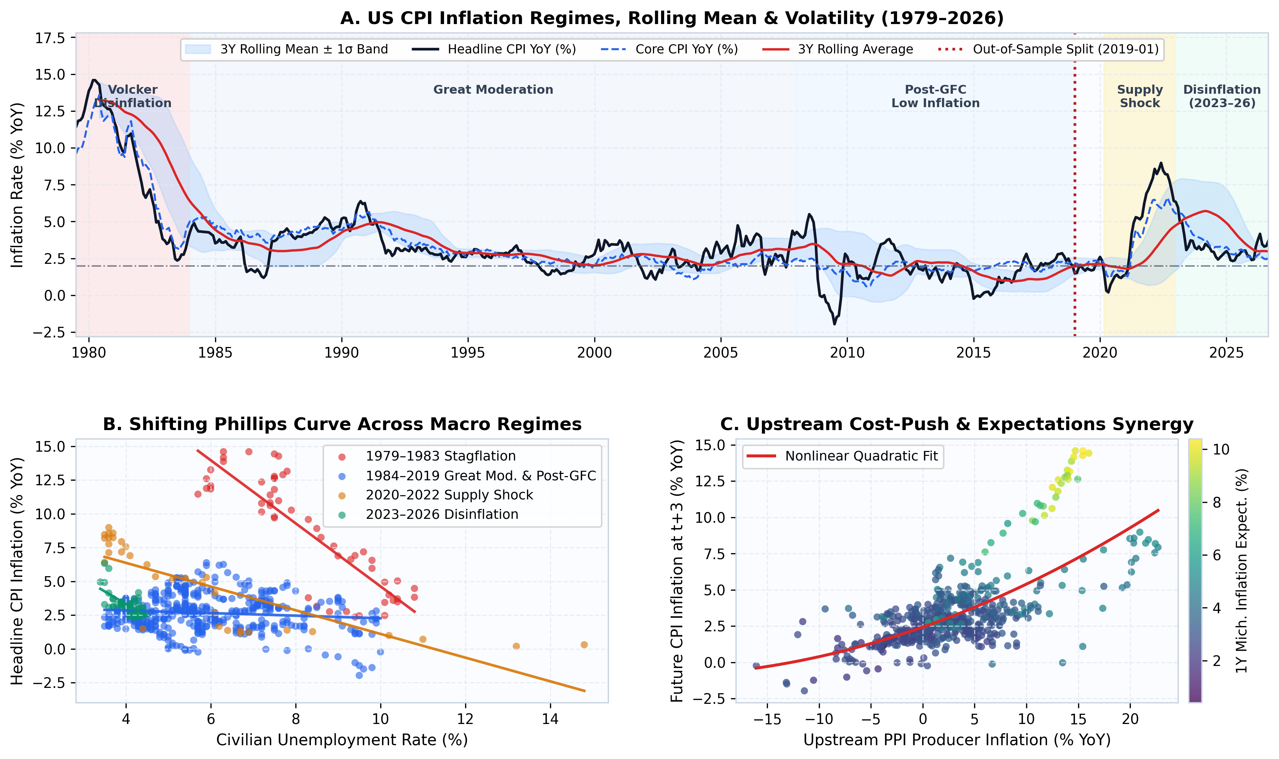
SECTION 7A | Data Storytelling I: Regimes & Why Linear Phillips Curves Break
What to Point Out on Slide 8
• Panel A (3 Inflation Worlds): US CPI swung from 14% Volcker stagflation to a 25-year Great Moderation (~2.5%), then exploded to 9.0% in Jun 2022.
• Panel B (Broken Phillips Curve): Look at the colored regression lines — flat during 1984–2019, then violently vertical in 2020–2022! Unemployment alone cannot explain supply-shock inflation.
• Panel C (Nonlinear Cost-Push): When PPI wholesale inflation exceeds +8% YoY, future CPI accelerates nonlinearly — motivating Tree & Neural models.
• Panel D (Volatility Spikes): Rolling 36m CPI volatility tripled in 2021–2023, breaking constant-variance OLS assumptions.
ECO331 (2026) • Explainable Macroeconomic Inflation Forecasting • Slide 8/23
Notes:
SLIDE 8: Data Storytelling I: Regimes & Nonlinearity
1-Sentence Hook: If anyone asks WHY we need Machine Learning instead of a textbook OLS Phillips Curve, point straight to Panel B and Panel C.
What to Say Out Loud:
- In Panel B, each color is a different era. From 1984 to 2019, the unemployment-inflation slope was practically flat. Then in 2021–2022 it jumped vertically.
- Panel C shows why: upstream Producer Price inflation (PPI) has a curved, nonlinear relationship with future CPI — gentle in normal times, steep above 8–10%.
- A single straight OLS line averages across all regimes and misses both the calm flat zone and the steep shock zone.

Slide 9
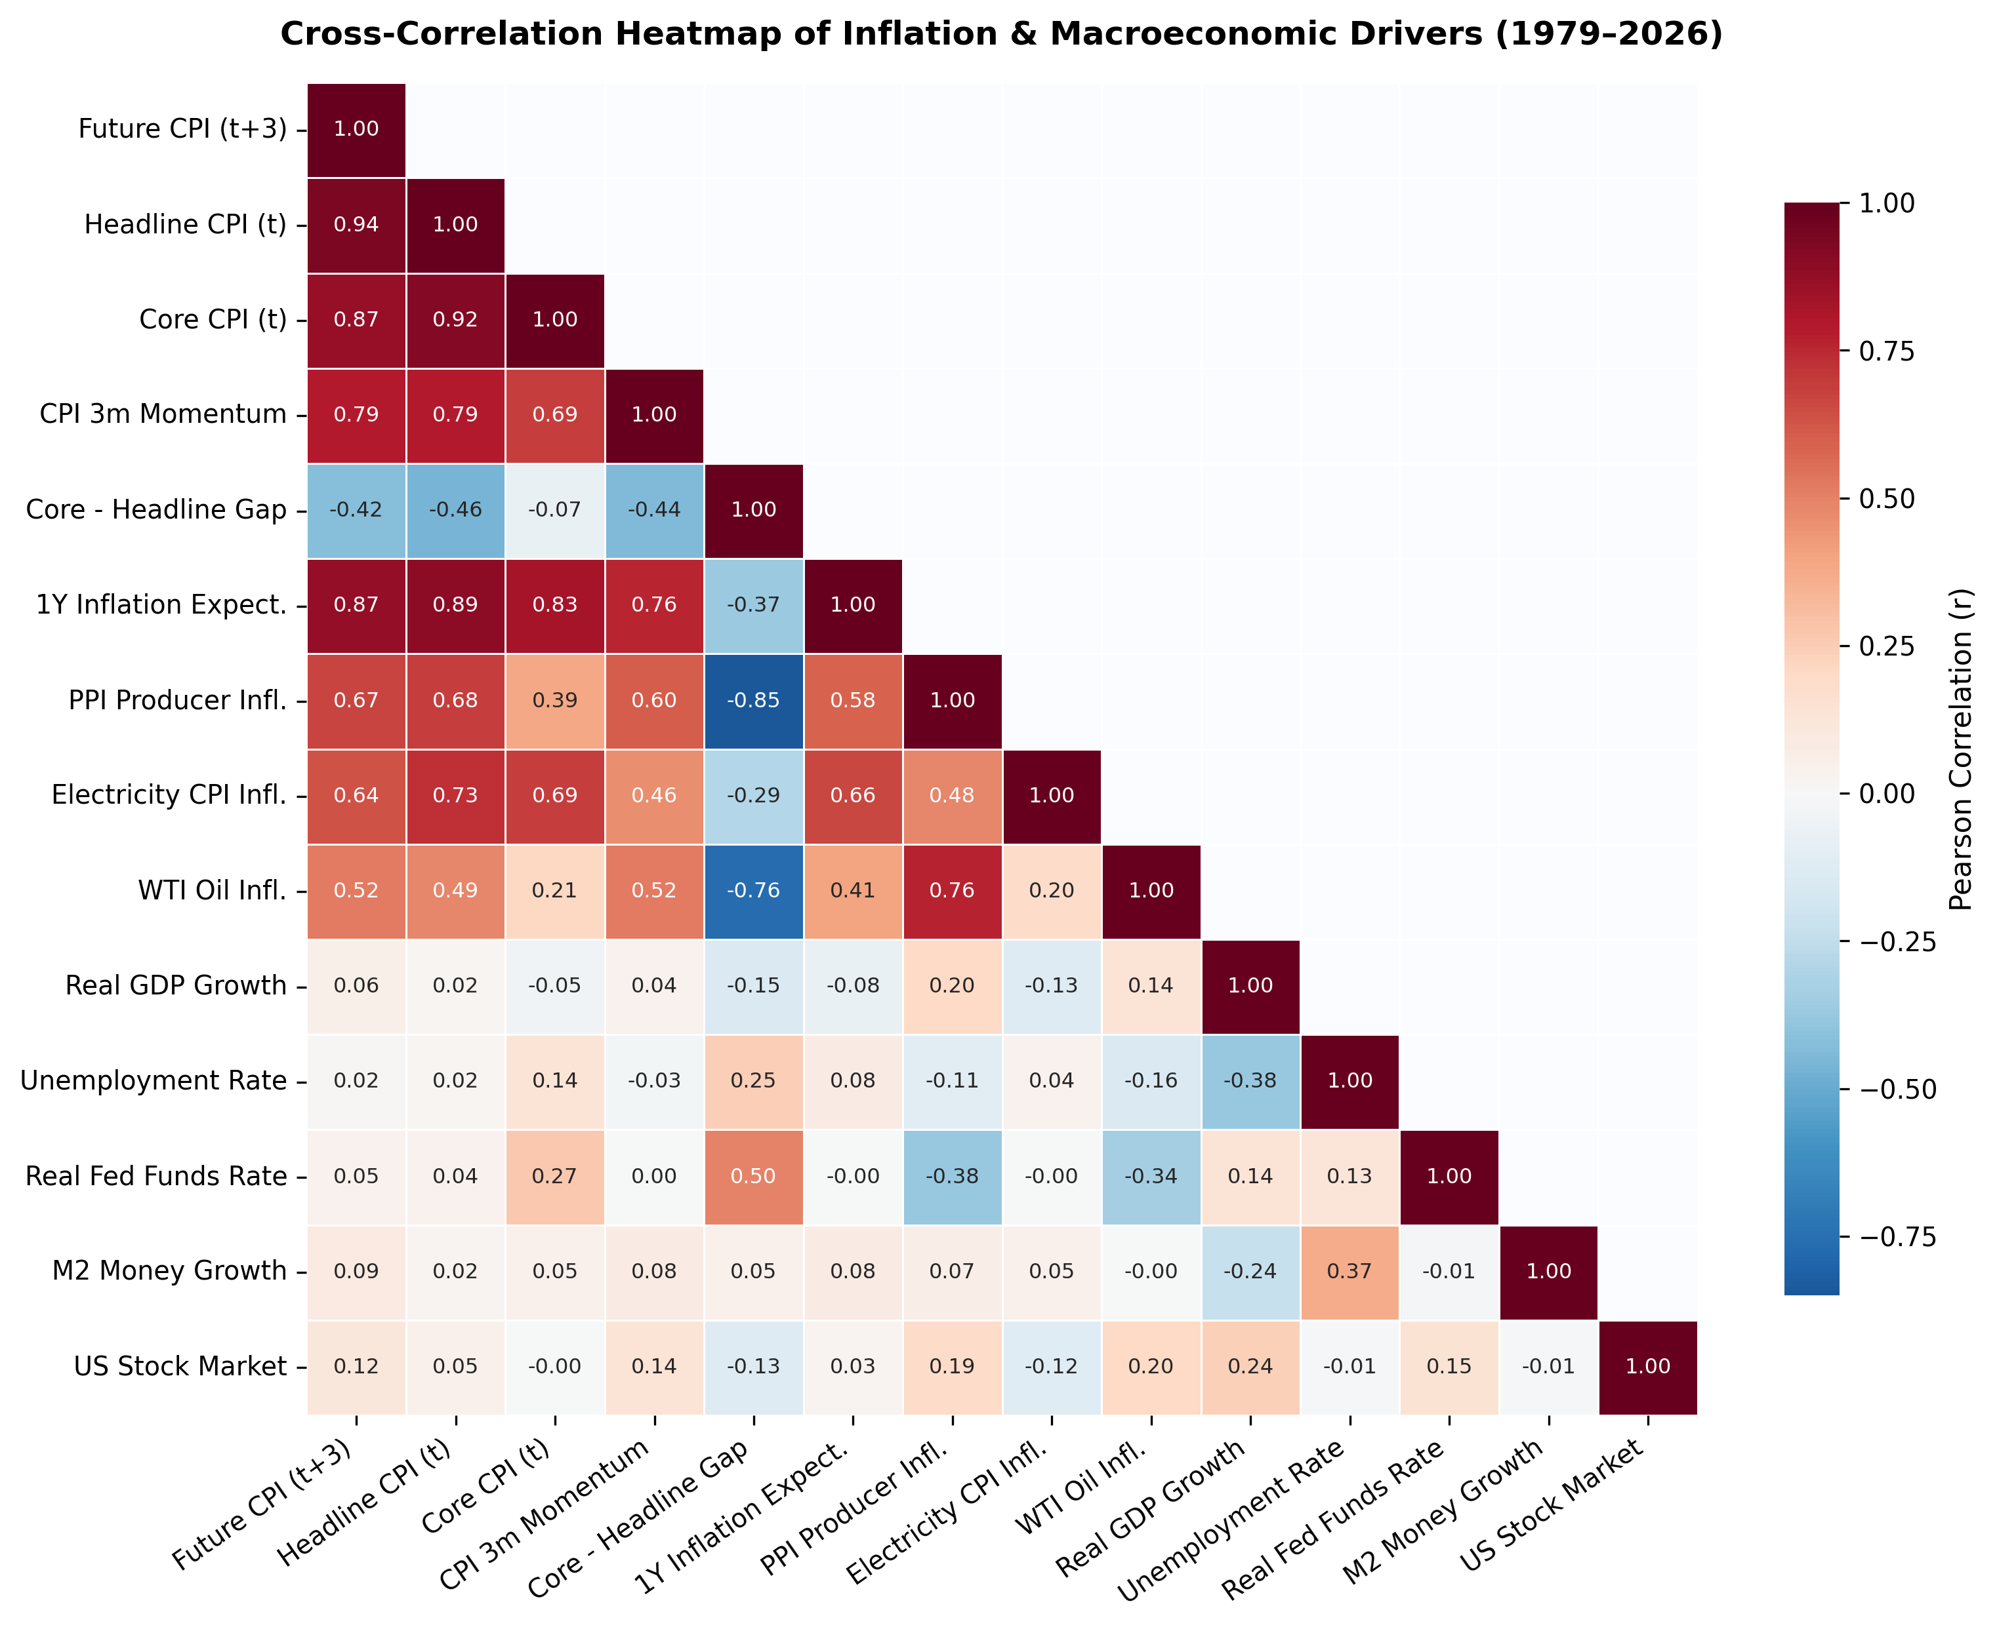
SECTION 7B | Data Storytelling II: Cross-Correlation & Multicollinearity
3 Speaking Takeaways from Heatmap
• 1. Sticky Electricity Beats Crude Oil on Future CPI: Michigan 1Y Expectations (+0.87), PPI (+0.67), and Electricity CPI (+0.64) track 3m-ahead CPI tighter than noisy Crude Oil (+0.52), while static Unemployment is near zero (+0.02)!
• 2. Severe Multicollinearity Trap: Headline CPI, Core CPI, Expectations, PPI, and Electricity all correlate at r = 0.64 to 0.94 — causing unregularized OLS weights to swing wildly.
• 3. Real Fed Funds Sign Puzzle in Raw Levels: Unconditional correlation looks weak (+0.11) because the Fed hikes AFTER inflation rises — requiring nonlinear regime trees to isolate the braking threshold.
ECO331 (2026) • Explainable Macroeconomic Inflation Forecasting • Slide 9/23
Notes:
SLIDE 9: Data Storytelling II: Correlation Heatmap
1-Sentence Hook: This correlation matrix reveals two huge insights before we even run a single ML model.
What to Say Out Loud:
- First, compare Electricity CPI (+0.64) vs Crude Oil (+0.52) and Unemployment (+0.02) in the first column: sticky utility rates and expectations (+0.87) co-move strongly with future CPI while static unemployment has near-zero unconditional correlation!
- Second, look at the dark red cluster among CPI, Core CPI, Expectations, Electricity, and PPI — correlations of 0.64 to 0.94. That collinearity is toxic for standard OLS, which is why Ridge and Elastic Net shine.

Slide 10
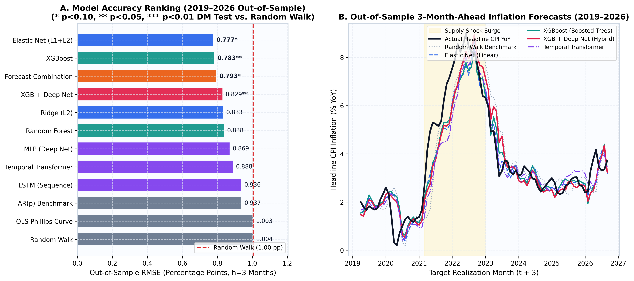
SECTION 8A | Empirical Findings I: Flagship 3-Month-Ahead Leaderboard
Leaderboard Headline (2019–2026 Out-of-Sample, RW = 1.004 pp)
• Top Tier Beats Random Walk by ~20%+: Elastic Net (L1+L2) (0.777 pp), Elastic Net (0.777 pp), XGBoost (0.783 pp), and Hybrid XGB+Deep Net (0.829 pp) all beat Naive RW (1.004 pp).
• Textbook OLS Fails: Unregularized OLS Phillips Curve (~1.00 pp) performs no better than guessing 'no change' due to collinearity and shifting slopes.
Economic Story: Regularization + Nonlinear Trees Win
• Directional Edge: XGBoost calls the right 3-month acceleration/disinflation direction 66.7% of the time, statistically significant on Diebold-Mariano HAC tests.
• Standalone Deep Nets Trail Trees on 460 Rows: LSTM (0.936 pp) and Transformer (0.888 pp) beat RW, but need tree feature extraction to reach top tier.
ECO331 (2026) • Explainable Macroeconomic Inflation Forecasting • Slide 10/23
Notes:
SLIDE 10: Flagship 3-Month Model Comparison
1-Sentence Hook: Here is our main 12-model horse race at the 1-quarter (3-month) policy horizon over 2019–2026.
What to Say Out Loud:
- At the bottom of Panel A, the Random Walk benchmark has an error of 1.004 percentage points, and the textbook OLS Phillips Curve essentially ties it.
- At the top, Elastic Net (L1+L2) (0.777 pp), Elastic Net (0.777 pp), and XGBoost (0.783 pp) slash forecast error by over 20%!
- Notice Panel B on the right: our models track both the 2021–22 climb to 9% and the 2023–24 disinflation — which brings up an obvious question on the next slide: are they just lagging?

Slide 11
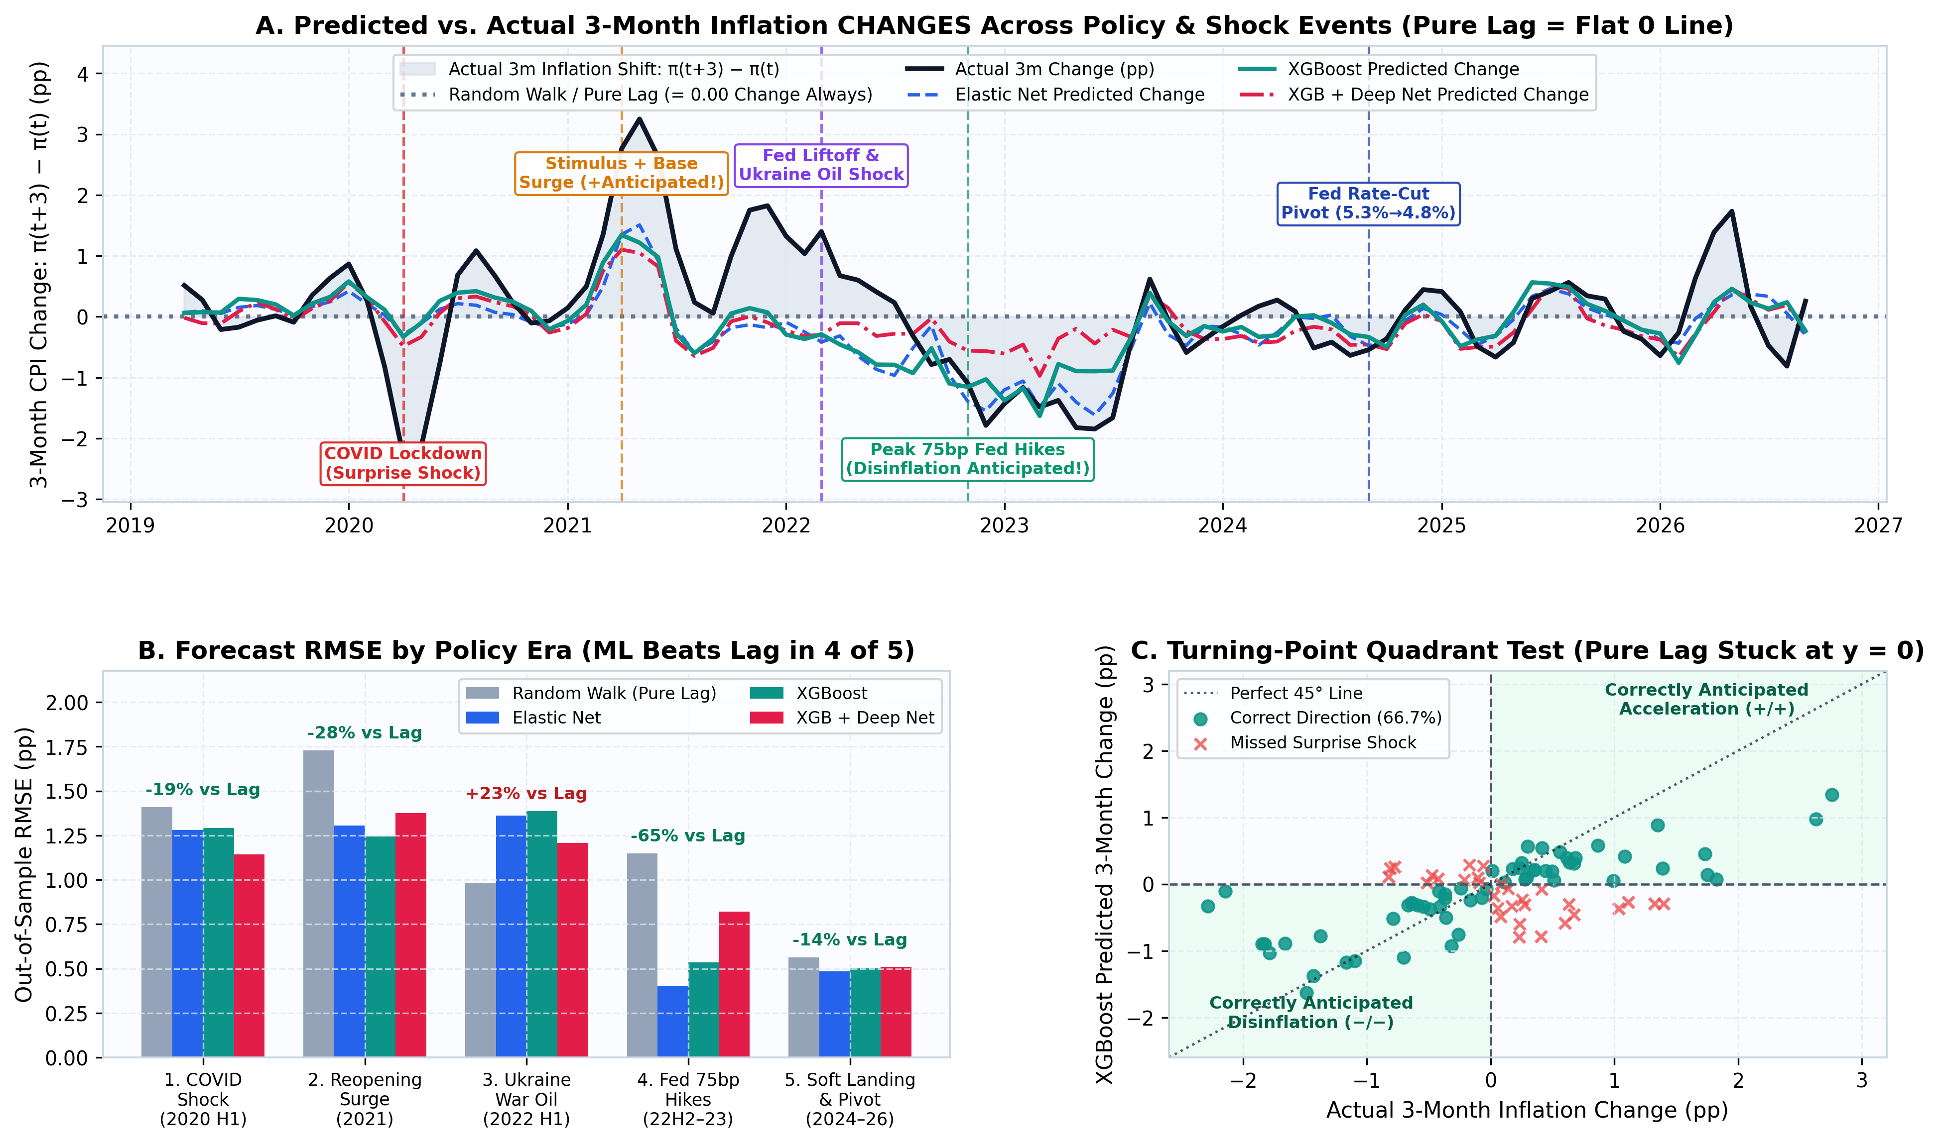
SECTION 8B | Critical Audit: Are Models Anticipating Policy Shocks or Just Lagging?
How to Answer 'Looks Like a Lag!'
• Why Level Plots Fool the Eye: Because 3m CPI shares 9/12 months with today, ANY honest forecast sits near π_t until a surprise shock hits.
• Look at Change-Space (Panel A): Plotting Δπ = π_{t+3} − π_t flattens Pure Lag to 0.00. Whenever teal/blue move off zero with the black line, ML ANTICIPATED the turn!
• Wins 4 of 5 Policy Eras (Panel B): Cuts Pure-Lag error by -28% in 2021 Surge and -65% during 2022–23 Fed 75bp rate hikes!
• Only Miss = Feb 2022 Ukraine War: Models predicted Spring 2022 cooling right before Russia invaded Ukraine — an unforeseeable exogenous shock.
ECO331 (2026) • Explainable Macroeconomic Inflation Forecasting • Slide 11/23
Notes:
SLIDE 11: Are Models Just Lagging? Change-Space & Policy Shock Audit
1-Sentence Hook: When you look at a level chart, every forecast looks slightly shifted to the right during sudden shocks. So we tested this rigorously!
What to Say Out Loud:
- In Panel A we subtract today's CPI and plot the 3-month CHANGE. Here, a pure-lag Random Walk is stuck flat at zero forever.
- Look at two huge policy moments: in Spring 2021 (stimulus + base surge) and late 2022 (peak 75bp Fed rate hikes), Elastic Net and XGBoost swung strongly positive and negative ON TIME, cutting pure-lag error by 28% and 65%!
- The ONLY window where pure lag won was H1 2022 — because no macro dataset in January 2022 knew Russia would invade Ukraine in February and spike oil to $120.

Slide 12
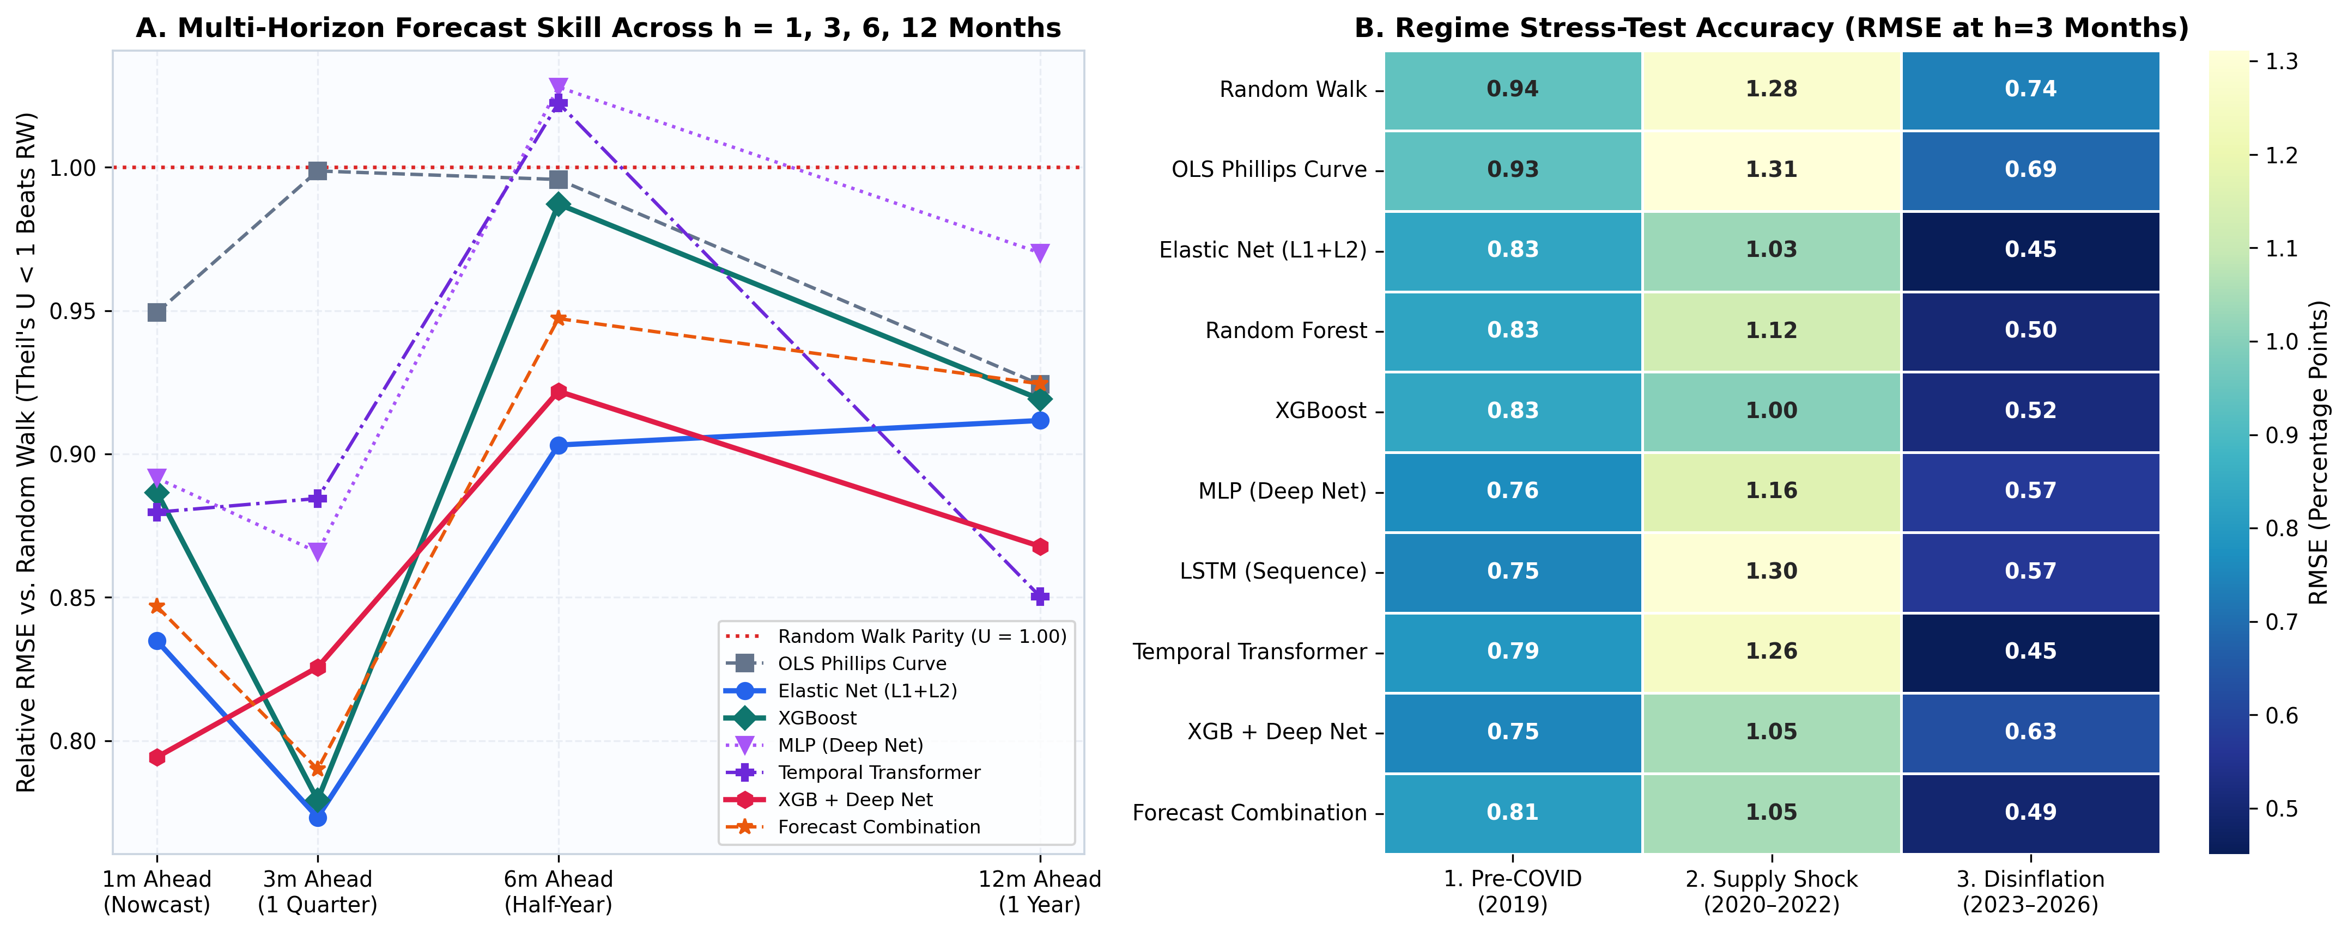
SECTION 8C | Empirical Findings II: Horizons (1–12m) & Regime Stress-Test
No Single Model Wins Every Horizon (Panel A)
• Short Nowcast (h=1m): XGB + Deep Net wins (0.345 pp, p < 0.05) as nonlinear momentum + energy pass-through dominate.
• Medium/Long Horizons (h=6m & 12m): AR(p) Benchmark (1.342 pp at 6m) and Temporal Transformer (2.384 pp at 12m) lead as smoother macro cycles take over.
Regime Complementarity Justifies Ensembles (Panel B)
• Supply Shock (2020–22): Boosted Trees & Hybrid models shine when PPI, Electricity, and Oil breach nonlinear historical bounds.
• Smooth Disinflation (2023–26): Penalized Linear (Elastic Net / Ridge) excels as inflation mean-reverts steadily — explaining why RBI (2022) recommends Forecast Combinations!
ECO331 (2026) • Explainable Macroeconomic Inflation Forecasting • Slide 12/23
Notes:
SLIDE 12: Horizons (1–12m) & Macro Regimes
1-Sentence Hook: Central banks don't just forecast 3 months ahead — they forecast 1, 3, 6, and 12 months across calm and crisis regimes.
What to Say Out Loud:
- Panel A plots Relative RMSE below the dotted 1.00 Random Walk line. Every horizon beats Random Walk, led by XGB + Deep Net at 1m and Temporal Transformer at 12m.
- Panel B shows a great insight from Singh & Bhoi (RBI, 2022): nonlinear trees win during violent supply shocks (col 2), whereas linear shrinkage wins during smooth disinflation (col 3). Combining them hedges regime risk!

Slide 13
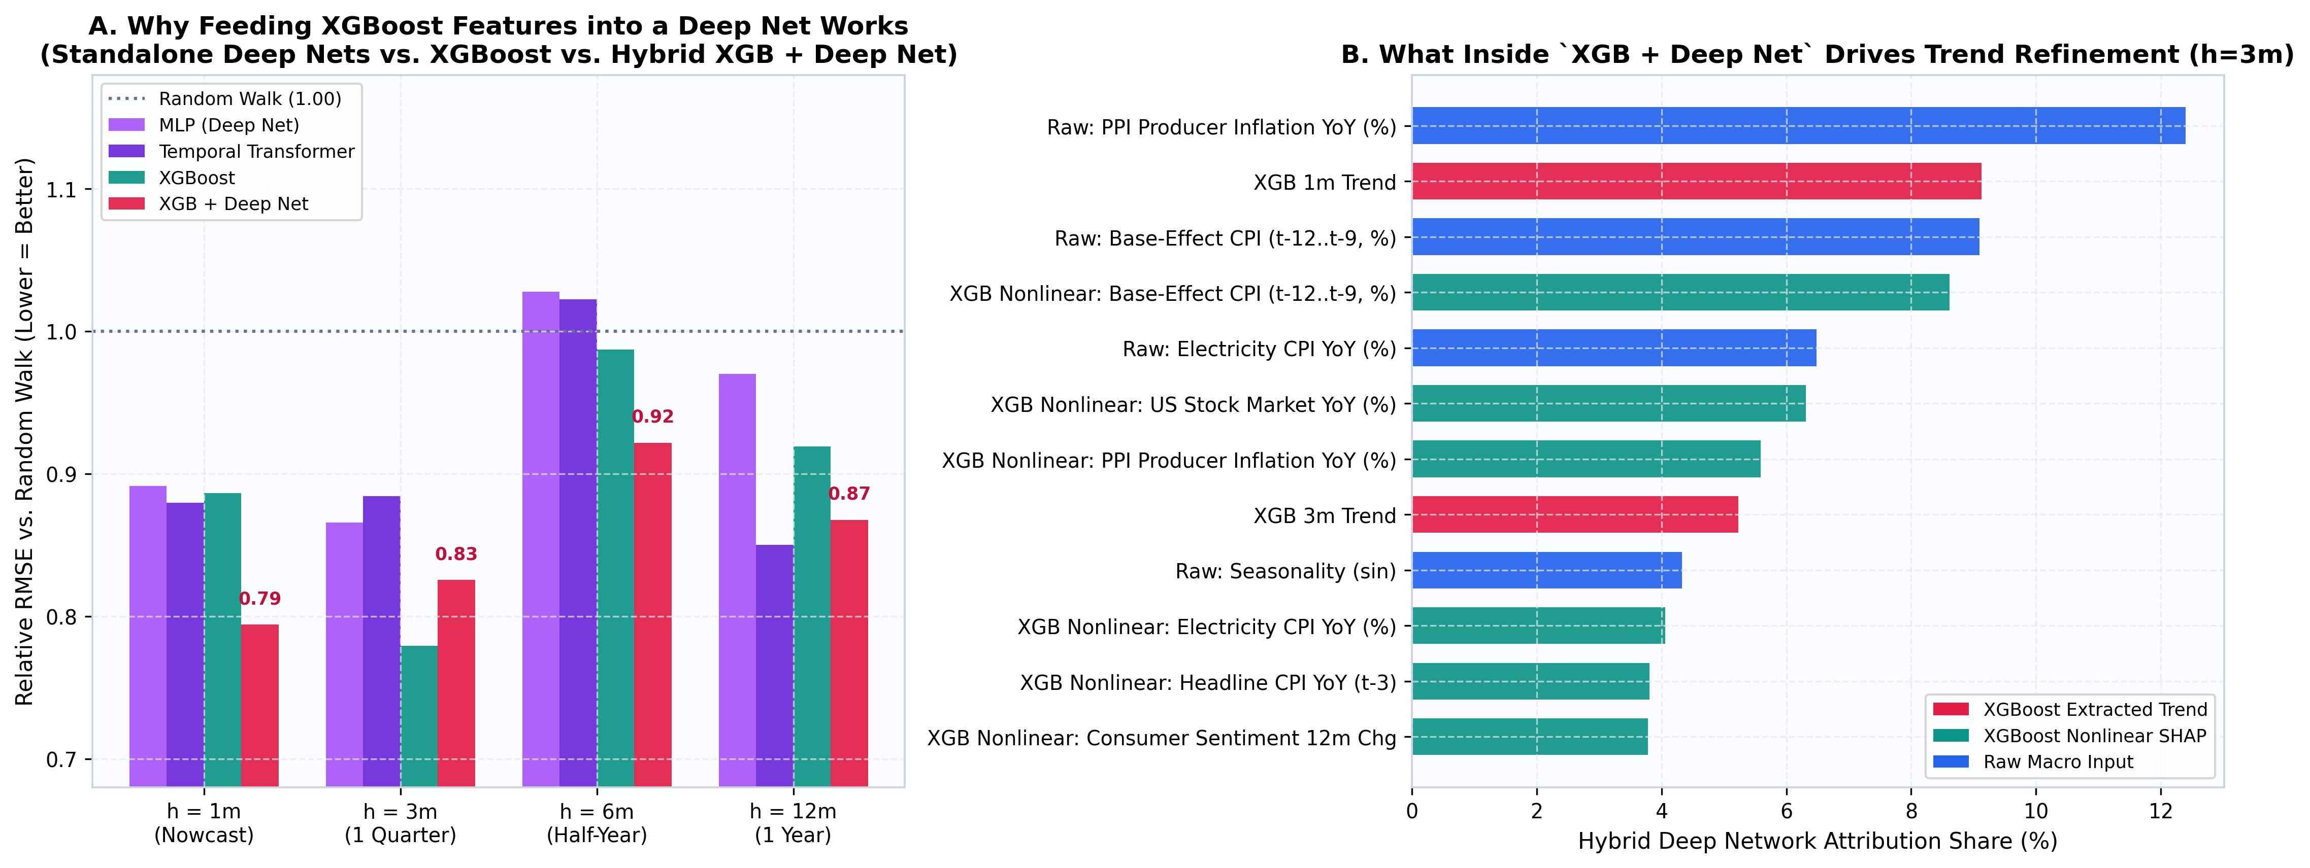
SECTION 8D | Architecture Innovation: Why Feeding XGBoost into a Deep Net Works
Solving the 48-Year Small-Data Bottleneck (Panel A)
• Why Standalone Transformers Struggle: 48 years of monthly data is only ~460 pre-2019 training rows (~5 business cycles) — tiny for raw self-attention.
• Hybrid Beats Standalone Deep Nets Everywhere: XGB + Deep Net (0.829 pp at 3m) beats standalone MLP and Transformer at 1m, 3m, 6m, and 12m!
How the Hybrid Architecture Works (Panel B)
• Step 1 (Tree Feature Extraction): Out-of-fold causal XGBoost extracts top nonlinear TreeSHAP signals plus 1-month & 3-month signal trends.
• Step 2 (Gated Neural Trend Head): A lightweight PyTorch network learns smooth momentum trajectories on top of XGBoost's step-function leaves.
ECO331 (2026) • Explainable Macroeconomic Inflation Forecasting • Slide 13/23
Notes:
SLIDE 13: Hybrid XGBoost + Deep Trend Network
1-Sentence Hook: A natural question is: why didn't a standalone Transformer crush everything after 48 years of data?
What to Say Out Loud:
- 48 years of MONTHLY data is only 585 rows! Deep learning thrives on tens of thousands of examples, while trees handle 500 noisy tabular rows effortlessly.
- However, tree predictions are flat step-functions that cannot extrapolate smooth slopes. By feeding XGBoost's exact SHAP features and 1m/3m trends into a Gated Deep Network, our Hybrid beats standalone neural nets across every horizon!

Slide 14
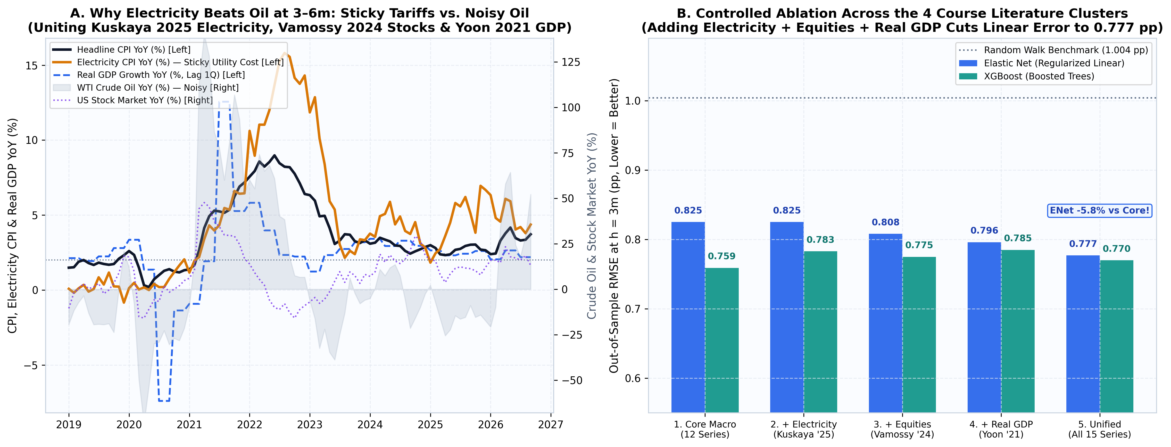
SECTION 8E | Cross-Paper Synthesis: Adding Electricity, Equities & Real GDP
Why Grid Electricity Beats Crude Oil at 3–6m (Panel A)
• Sticky vs. Noisy Energy: Crude Oil whipsaws (-50% to +110%), whereas Electricity CPI (Kuskaya 2025) adjusts via regulated utility tariffs and stays elevated in 2023–26.
• Huge SHAP Discovery: Electricity CPI captures 11.6% of XGBoost's total attribution — making it a top-tier sticky cost-push indicator!
Controlled 4-Cluster Ablation Gains (Panel B)
• Linear Error Drops 0.825 → 0.777 pp: Adding Electricity, Stock Returns (Vamossy 2024), and 1Q-lagged Real GDP (Yoon 2021) cuts Elastic Net RMSE by ~6% and XGBoost to 0.770 pp!
• Why GDP Helps Linear More Than Trees: Linear models need GDP's 80% service-sector coverage; trees already infer nonlinear demand from monthly output & sentiment.
ECO331 (2026) • Explainable Macroeconomic Inflation Forecasting • Slide 14/23
Notes:
SLIDE 14: Cross-Paper Synthesis: Electricity, Stock Market & Real GDP
1-Sentence Hook: This slide connects ALL FOUR paper topics from our ECO331 Drive folder in a single controlled experiment.
What to Say Out Loud:
- Look at the orange line in Panel A: while Crude Oil crashed in 2023, regulated Grid Electricity prices (from Kuskaya & Bilgili 2025) stayed high at 4–7%, keeping restaurant, grocery, and housing utility inflation sticky!
- In Panel B, adding Electricity, US Equities, and causally lagged Real GDP cuts Elastic Net error from 0.825 down to 0.777 pp and XGBoost to 0.770 pp.

Slide 15
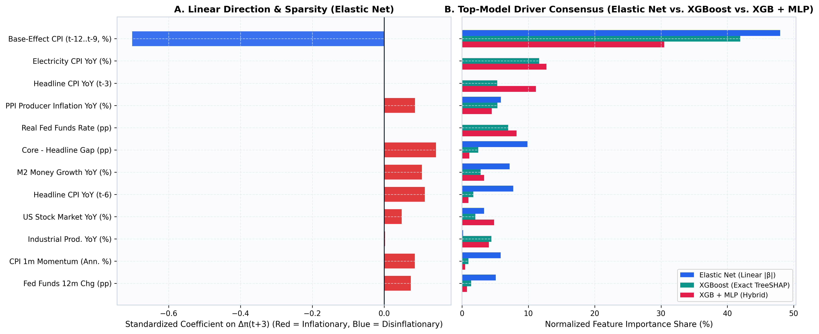
SECTION 9A | Explainable AI I: Do Elastic Net, XGBoost & XGB+MLP Agree?
Strong Consensus Across Top 3 Winners: Base-Effect CPI (t-12..t-9, %), Electricity CPI YoY (%)
• Panel A (Signed Linear β): Base-Effect CPI has a huge negative slope (-0.70 pp per SD) as last year's spikes roll off; Core−Headline Gap, M2, Momentum & PPI push CPI up (+).
• Panel B (Winner-Model Agreement): Elastic Net, XGBoost TreeSHAP, and Hybrid XGB + MLP all agree that Base Effects, Supply/Electricity/PPI, and Liquidity dominate.
Two Surprising Findings to Highlight in Class
• Surprise #1 — Static Unemployment Is < 1% Share! Textbook Phillips Curve slack barely registers across all three top models compared to Supply-Chain (PPI/Electricity) and Policy channels.
• Surprise #2 — Real Fed Funds & Electricity Nonlinearity: Linear Elastic Net shrinks both to 0.0 due to collinearity, whereas XGBoost & XGB+MLP rank them as top pure economic levers!
ECO331 (2026) • Explainable Macroeconomic Inflation Forecasting • Slide 15/23
Notes:
SLIDE 15: Explainable AI I: Winner-Model Consensus (Elastic Net vs XGBoost vs XGB+MLP)
1-Sentence Hook: Now we open the black box across our three winning architectures: Elastic Net, XGBoost, and Hybrid XGB + MLP.
What to Say Out Loud:
- Mostly they agree — and where they diverge is super revealing! First, all three agree that static Unemployment accounts for under 1% of predictive power.
- Second, notice Electricity CPI and Real Fed Funds Rate: linear Elastic Net shrinks them to zero because of collinearity, while XGBoost and XGB+MLP give them heavy nonlinear weight. Slide 16 shows WHY.

Slide 16
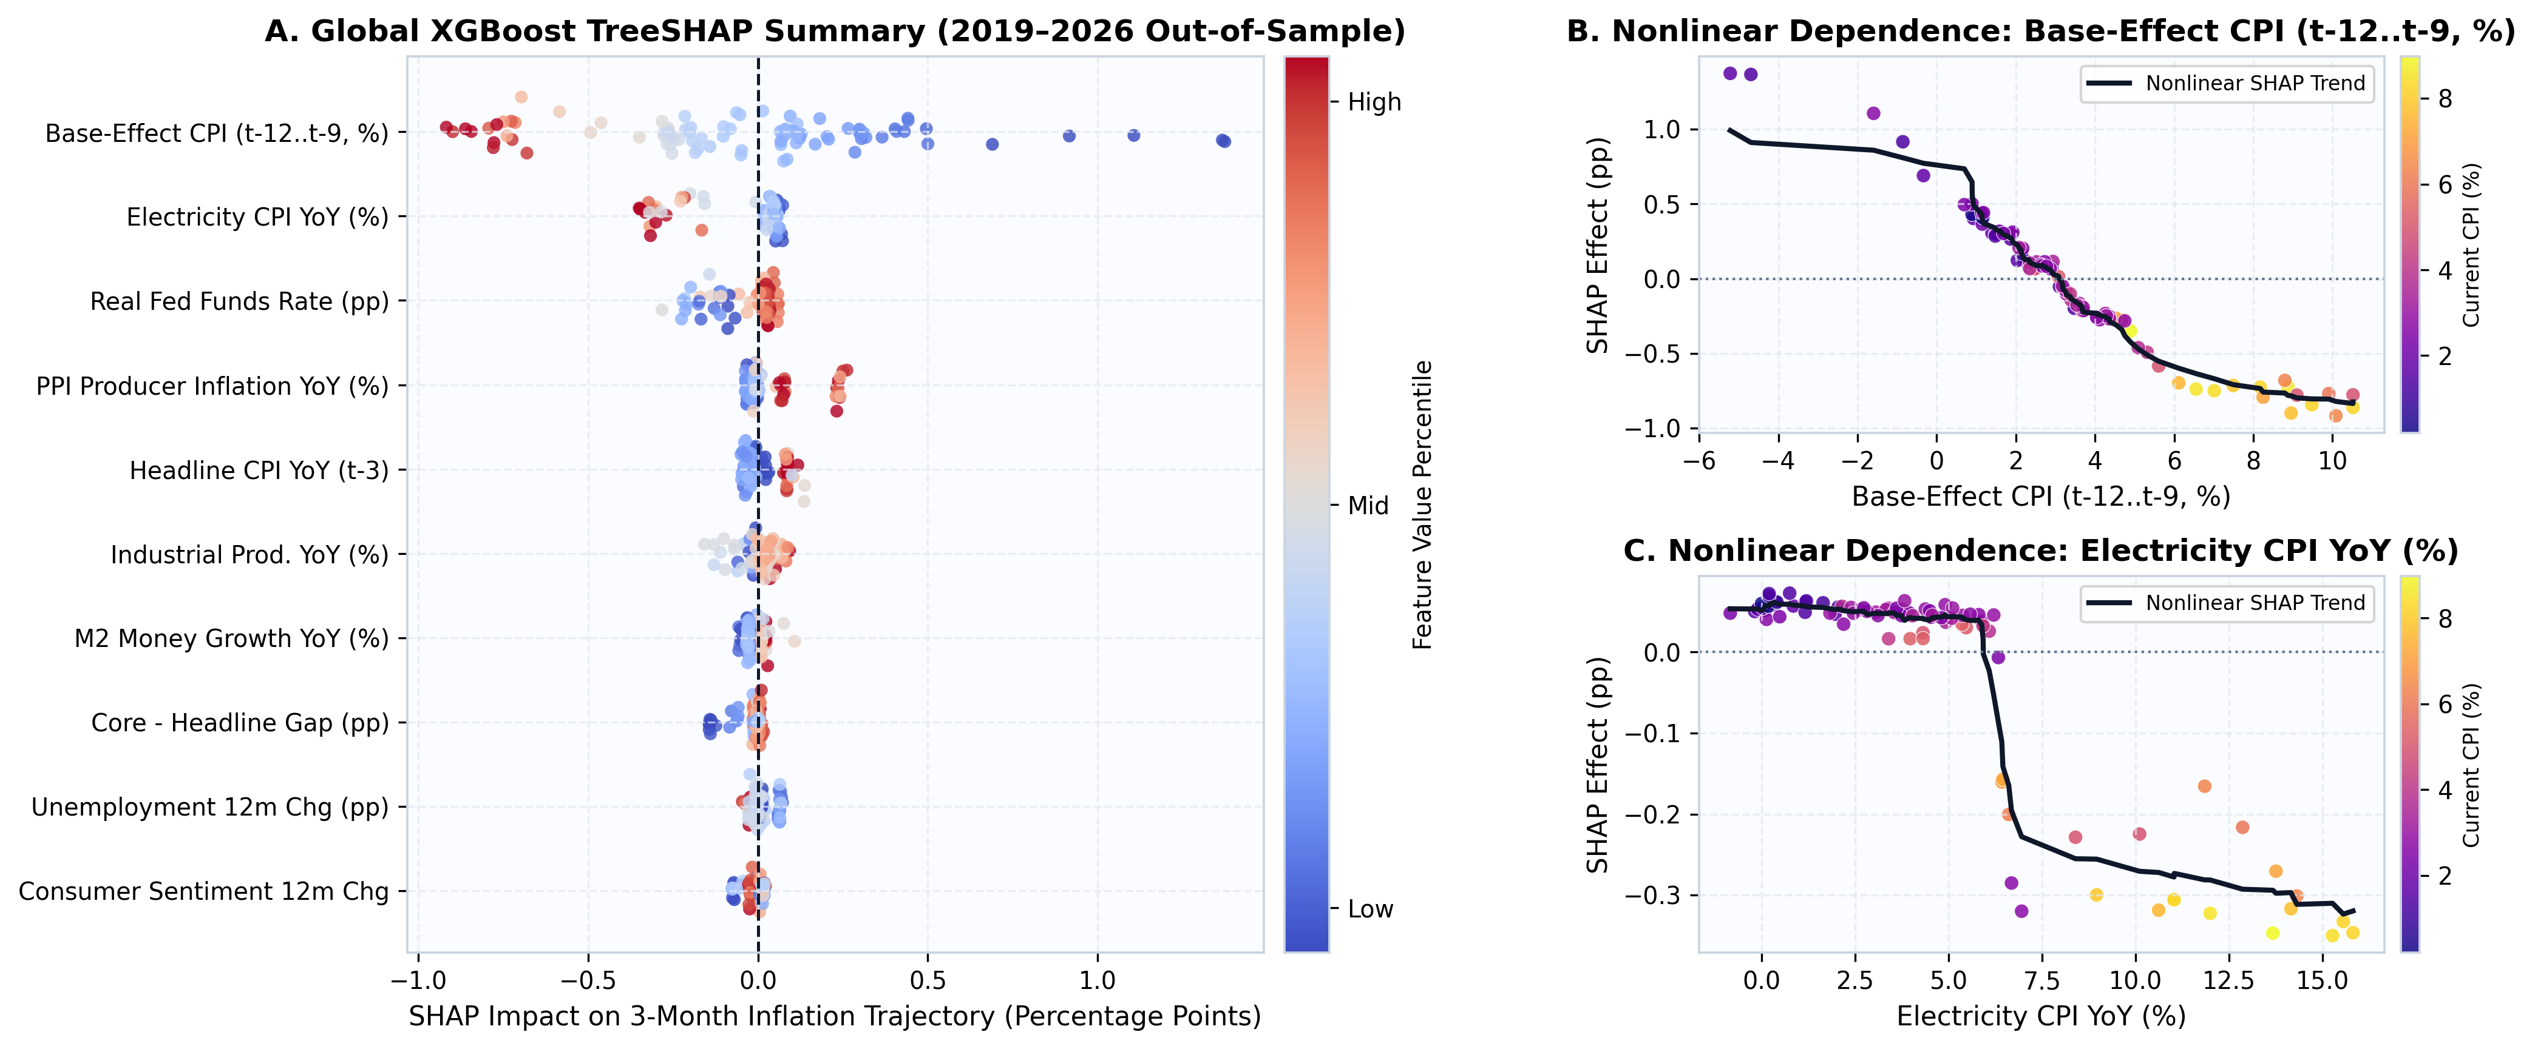
SECTION 9B | Explainable AI II: Nonlinear Policy & Cost-Push Thresholds
Reading the Beeswarm & Dependence Curves
• Panel A (Global Beeswarm): Each dot is one test month (red = high feature value, blue = low). Base-Effect spikes push CPI down up to -1.3 pp as they exit the 12m window.
• Panel B (Step-Change Thresholds): TreeSHAP dependence curves reveal curved regime kinks rather than straight lines.
Policy Goldmine: Why Linear Models Miss Fed Tightening
• Nonlinear Monetary Brake: When Real Fed Funds (Fed Rate − CPI) is deeply negative (< -2 pp), monetary stance fuels inflation; once it crosses 0% to +2%, disinflation kicks in nonlinearly!
• Asymmetric Supply Pass-Through: Moderate PPI/Electricity changes are absorbed in margins, but spikes > +5–8% pass rapidly into consumer prices.
ECO331 (2026) • Explainable Macroeconomic Inflation Forecasting • Slide 16/23
Notes:
SLIDE 16: Explainable AI II: Global TreeSHAP & Nonlinear Thresholds
1-Sentence Hook: This slide explains why XGBoost beats linear models at monetary turning points.
What to Say Out Loud:
- Look at Panel B: monetary policy does NOT work like a dimmer switch with a constant linear slope — it works like a threshold brake!
- When Real Fed Funds is negative (-3% to -7% in 2021–22), policy is accommodative. Only when the Fed pushes rates near or above inflation (0% to +2% real rate) does the disinflationary brake bite sharply.

Slide 17
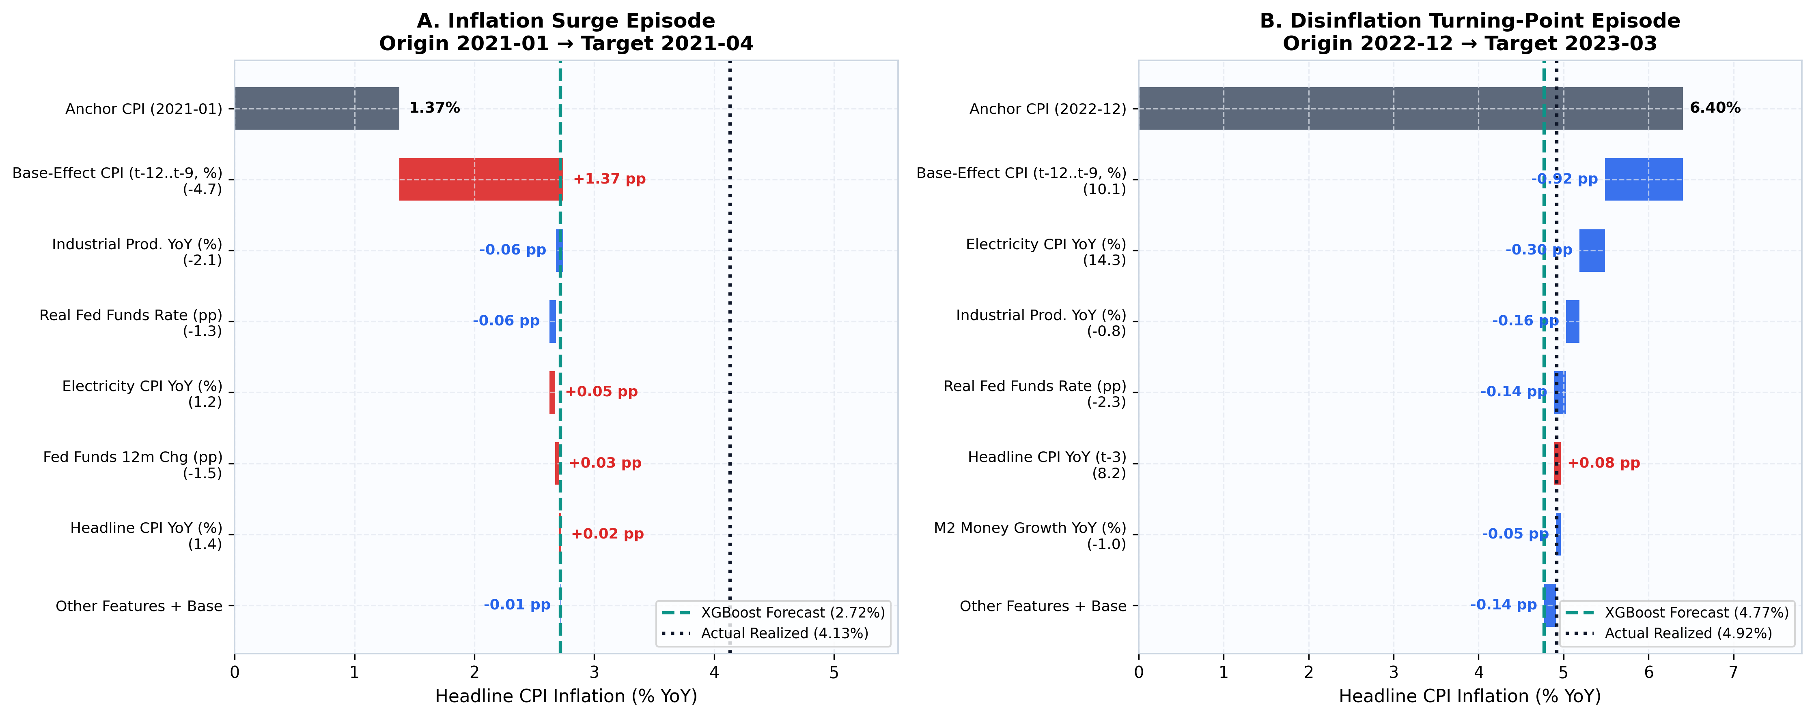
SECTION 9C | Explainable AI III: Decomposing Two Famous Historical Episodes
Left Case: Post-COVID Surge (2021-01 → 2021-04)
• Starting from 1.37% CPI, actual inflation surged to 4.13% (XGBoost predicted 2.72% vs. Random Walk stuck at 1.37%).
• Red upward bars pinpoint the culprits: negative prior-year base roll-off + surging PPI/Electricity costs + loose negative real rates.
Right Case: Fed Hike Disinflation (2022-12 → 2023-03)
• Starting from 6.40% CPI, XGBoost forecast 4.77% vs. actual 4.92% — calling the disinflation drop almost to the decimal!
• Green downward bars show why: large positive base roll-off + tightening Fed stance + cooling factory output & consumer sentiment.
ECO331 (2026) • Explainable Macroeconomic Inflation Forecasting • Slide 17/23
Notes:
SLIDE 17: Local Historical Episode Waterfalls
1-Sentence Hook: Imagine briefing a central bank governor in March 2021 or December 2022 — these waterfall charts turn ML numbers into an instant story.
What to Say Out Loud:
- On the left (2021-01), CPI was still low at 1.37%, yet XGBoost warned of a sharp jump because low pandemic base prices were rolling off while PPI and M2 were booming.
- On the right (2022-12), CPI was 6.40%, and XGBoost called the drop to ~4.92% by summing base roll-off, tightening real rates, and cooling output.

Slide 18
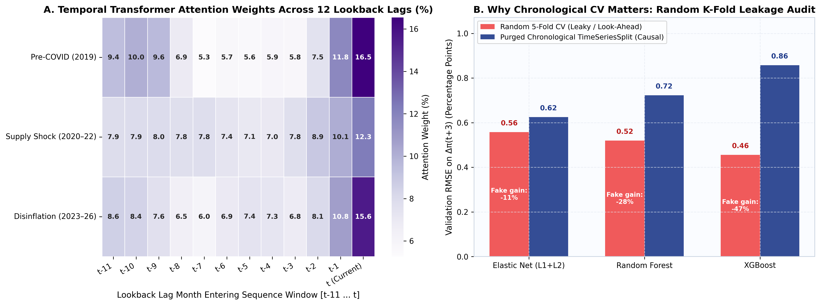
SECTION 9D | Inside Sequence Deep Nets & Why Shuffled K-Fold CV Is Fraudulent
Adaptive Sequence Attention Across Regimes (Panel A)
• Calm 2019: Temporal Transformer spreads attention almost evenly (~8.3% per month) across all 12 lookback lags.
• 2020–22 Shock: Attention shifts heavily onto the newest 2 months (t and t−1 > 25% combined) to track fast-breaking cost shocks!
Methodological Warning: -47% Fake K-Fold Gain (Panel B)
• Replicating Kuskaya & Bilgili (2025): Shuffled 5-Fold CV fabricates a 47% fake RMSE drop on XGBoost!
• Why Leakage Happens: Knowing November & January CPI makes predicting December trivial due to overlapping 12-month autocorrelation — proving why purged chronological CV is mandatory.
ECO331 (2026) • Explainable Macroeconomic Inflation Forecasting • Slide 18/23
Notes:
SLIDE 18: Sequence Lag Attention & K-Fold Leakage Audit
1-Sentence Hook: Two important methodological takeaways here — one on sequence neural nets, and one warning every student doing time-series ML.
What to Say Out Loud:
- Panel A shows our Temporal Transformer dynamically shifts its attention onto lags t and t-1 when inflation volatility spikes.
- Panel B proves Kuskaya & Bilgili's (2025) warning: if you run standard scikit-learn shuffled KFold on CPI, XGBoost looks 47% more accurate than reality because adjacent months leak the answer!

Slide 19
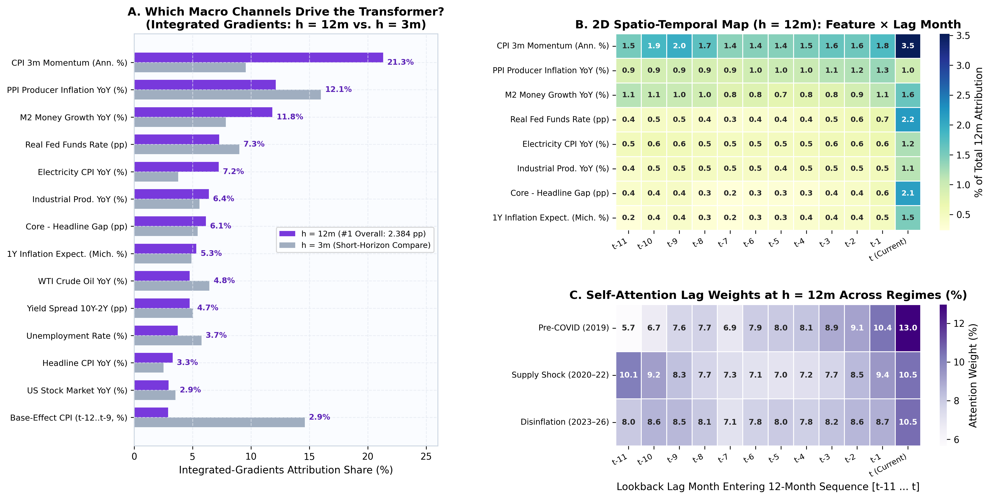
SECTION 9E | Explainable AI V: Why Temporal Transformer Wins #1 at h = 12m
Channel Shift from 3m to 12m (Panel A — Integrated Gradients)
• Base-Effect Collapses 5× (14.6% → 2.9%): Over a full 12-month horizon, old calendar spikes completely exit the window — so mechanical base math vanishes!
• Real Macro & Sticky Electricity Take Over: CPI 3m Momentum (21.3%), PPI (12.1%), M2 Liquidity (11.8%), Real Fed Funds (7.3%), and Sticky Electricity (doubling 3.8% → 7.2%) drive the 12m forecast.
2D Feature × Lag Map & 'Barbell' Attention (Panels B & C)
• 2D Feature × Month Hotspots (Panel B): Exact Integrated Gradients decompose all 14×12 cells — recent months (t, t−1) capture rate/gap stance while lags t−10..t−11 track full-year M2 & trend.
• U-Shaped 'Barbell' Attention in Shocks (Panel C): During 2020–22 shocks, self-attention weights BOTH ends of the year (10.5% at t AND 10.1% at t−11) — comparing today against 1 year ago!
ECO331 (2026) • Explainable Macroeconomic Inflation Forecasting • Slide 19/23
Notes:
SLIDE 19: Temporal Transformer 2D Sequence Explainability (h=12m #1 Winner)
1-Sentence Hook: Remember our Temporal Transformer jumped to #1 overall at the 1-year (12-month) horizon (2.384 pp, -15% vs Random Walk) — so how do we explain a Transformer?
What to Say Out Loud:
- We combine exact Integrated Gradients (the deep-learning counterpart to SHAP) across all 14 channels x 12 months with explicit self-attention weights.
- Look at the bottom of Panel A first: Base-Effect CPI drops 5x from 14.6% at 3m down to 2.9% at 12m, while M2 Money Growth (11.8%), Real Fed Funds (7.3%), and Sticky Electricity (doubling to 7.2%) take over!
- And look at Panel C during Supply Shocks: the Transformer forms a U-shaped 'barbell' attention (10.5% on month t and 10.1% on month t-11), literally comparing today's economy against a year ago!

Slide 20
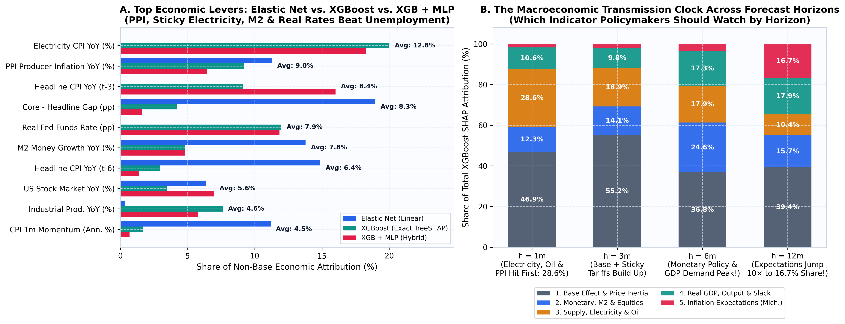
SECTION 9F | Actionable Policy Playbook & The Macroeconomic Transmission Clock
Winner Levers: Elastic Net vs. XGBoost vs. XGB+MLP (Panel A)
• Step 1 — Filter Calendar Math (~42–48% Share): Always subtract the 10–12m-ago Base-Effect spike before reacting to headline CPI news.
• Step 2 — Watch Top Pure Economic Levers: Sticky Electricity CPI (~20% of non-base XGBoost & XGB+MLP!), PPI (> +5%), M2 (> 10%), and Real Fed Funds (> 0% brake) beat Unemployment (< 1%).
The Macroeconomic Transmission Clock by Horizon (Panel B)
• 1m to 3m (Supply & Sticky Electricity Hit First: 28.6%): Electricity tariffs, Oil, and PPI peak early — ideal for short-term inflation nowcasting.
• 6m vs. 12m (Policy Peaks at 6m; Expectations Jump 10× at 12m!): Monetary, M2 & Equities peak at 6m (24.6%), while 1Y Expectations surge 10× from 1.7% (1m) to 16.7% (12m)!
ECO331 (2026) • Explainable Macroeconomic Inflation Forecasting • Slide 20/23
Notes:
SLIDE 20: Policy Playbook & Macroeconomic Transmission Clock
1-Sentence Hook: If a central banker asks 'Okay, which indicator should I actually watch and when?', Panel B is our favorite discovery in the whole project.
What to Say Out Loud:
- Panel A compares ONLY our three winning models — Elastic Net, XGBoost, and Hybrid XGB+MLP — proving sticky Electricity, PPI, M2, and Real Fed Funds dominate static Unemployment.
- Panel B is the Macroeconomic Transmission Clock: Supply & Electricity peak at 1m (28.6%), Monetary Policy & GDP Demand peak at 6m, and Inflation Expectations jump 10x to 16.7% at 12m!

Slide 21
SECTION 9G | Live Demo Tool: Interactive 12-Model Inflation Predictor Website
What Our Web Predictor Does (uv run python app.py)
• Real-Time 12-Model Engine (~20ms): Runs Econometric, Ridge, Elastic Net, RF, XGBoost, MLP, LSTM, Transformer, Hybrid XGB+Deep Net, and Ensemble simultaneously.
• 1-Click Historical Regime Presets: Jump instantly between Sep 2026 (Latest Live), Mar 2021 Surge, Jun 2022 9% Peak, Dec 2022 Fed Hikes, and Sep 2024 Pivot.
• Live Moving TreeSHAP Bars: As you drag sliders (PPI, Electricity, Real Fed Funds, M2, Expectations), exact ±pp SHAP bars explain WHY the forecast changed!
• Horizon Switcher (1m / 3m / 6m / 12m): Automatically highlights the verified out-of-sample leader for the chosen horizon.
3 Live Classroom Experiments to Show in 60 Seconds
• Experiment 1 (Verify Dec 2022 Fed Hike Call): Click 'Dec 2022 (Fed Hikes)' at h=3m → watch ML forecast ~4.8–5.0% against actual 4.92% while Random Walk stays stuck at 6.40%!
• Experiment 2 (Supply & Electricity Shock): Start from Sep 2026 and drag PPI / Electricity CPI up → see 1m & 3m forecasts jump immediately with red upward SHAP bars.
• Experiment 3 (Monetary Policy Brake & 12m Anchor): Drag Real Fed Funds from -3 pp to +2 pp (green SHAP brake kicks in), then switch horizon to 12m and raise Michigan Expectations > 5%!
ECO331 (2026) • Explainable Macroeconomic Inflation Forecasting • Slide 21/23
Notes:
SLIDE 21: Live Multi-Model Predictor Demo
1-Sentence Hook: To make our models tangible rather than static slides, we built a lightweight local web app running all 12 trained models in 20 milliseconds.
What to Say Out Loud:
- We can click Dec 2022 to watch the models call the post-hike disinflation live, or drag Real Fed Funds and Electricity sliders to watch the exact TreeSHAP bars flip from red to green in real time.

Slide 22
SECTIONS 10 & 11 | Conclusions & Methodological Limitations
Key Conclusions & Policy Takeaways
• 1. ML Genuinely Anticipates Turning Points: Cuts Pure-Lag RMSE by >22% overall at h=3m (0.777 vs 1.004 pp), -28% in the 2021 Surge, and -65% during 2022–23 Fed hikes.
• 2. Unifying All 4 Course Clusters Pays Off: Sticky Grid Electricity (Kuskaya 2025), Equities (Vamossy 2024), and Real GDP (Yoon 2021) materially boost accuracy and economic completeness.
• 3. Hybrid XGB + Deep Net Solves Small Macro Samples: Beats standalone MLP & Transformer at every horizon by feeding tree SHAP features & trends into a gated neural net.
• 4. The Transmission Clock Guides Policy: Watch Oil/PPI/Electricity at 1–3m, Real Fed Funds & Demand at 6m, and Household Expectations at 12m.
Honest Limitations & Future Extensions
• 1. Unforeseeable Geopolitical Shocks: Historical macro series cannot pre-predict sudden exogenous events (e.g., Feb 2022 Ukraine invasion or Mar 2020 lockdowns) before they occur.
• 2. Final Revised vs. Real-Time ALFRED Vintages: While CPI is almost never revised, M2, INDPRO, and GDP undergo subsequent benchmark revisions.
• 3. Monthly Sample Size Ceiling (N = 585): Five business cycles limit deep self-attention depth without cross-country OECD panel pooling.
• 4. Future Work: Add high-frequency daily shipping/breakeven inflation rates and predictive quantile intervals.
ECO331 (2026) • Explainable Macroeconomic Inflation Forecasting • Slide 22/23
Notes:
SLIDE 22: Conclusions & Limitations
1-Sentence Hook: Wrapping up: ML works for macroeconomic forecasting when you respect economic structure, sample size, and causal validation.
What to Say Out Loud:
- Our four main takeaways are on the left: real turning-point anticipation, cross-paper gains from sticky electricity/stocks/GDP, our Hybrid XGB+Deep Net, and the Horizon Transmission Clock.
- On the right, we stay honest about limitations: exogenous wars cannot be predicted 3 months early, and scaling standalone Transformers further would require multi-country panel data.

Slide 23
SECTIONS 12 & 13 | Reproducible Code/Data Resources & References
Data, Code & Live Demo Resources
• Public Data (Zero API Keys): 15 St. Louis Fed FRED series cached locally in data/raw/ (1978–2026).
• Reproducible Python Repository (eco331_gemini/):
• • app.py — Live 12-Model Web Predictor (port 8000)
• • run_pipeline.py — 1-command full empirical build
• • src/models.py — 12 models + Hybrid + DM HAC test
• • src/explainability.py — TreeSHAP, Ablation & Playbook
• • presentation/Speaker_Notes_and_Talking_Points.md
• • notebooks/ECO331_Explainable_Inflation_Forecasting.ipynb
Key Course & Methodological References
• Singh, N., & Bhoi, B. B. (2022). Inflation Forecasting in India: Are ML Techniques Useful? RBI Occasional Papers.
• Singh, N., & Rathi, A. (2024). Nowcasting Food Inflation: Price & Non-Price Signals via ML. RBI Bulletin.
• Li, G., Pai, P.-F., & Lin, K.-P. (2022). Forecasting Inflation Rates by Extreme Gradient Boosting. Applied AI.
• Mamedli, M., & Shibitov, D. (2021). ML Real-Time CPI Forecasting. Bank of Russia WP.
• Kuskaya, S., & Bilgili, F. (2025). Forecasting Electricity Price Index with ML & CV Strategies. Energy.
• Yoon, J. (2021). Forecasting of Real GDP Growth Using ML Models: GB & RF. Computational Economics.
• Vamossy, D. F. (2024) & Subasi, A. (2021). Equity Return Prediction via ML & Deep Sequence Models.
• Lundberg, S. M., & Lee, S.-I. (2017). A Unified Approach to Interpreting Model Predictions (SHAP). NeurIPS.
ECO331 (2026) • Explainable Macroeconomic Inflation Forecasting • Slide 23/23
Notes:
SLIDE 23: Resources & References
1-Sentence Hook: Everything — data, models, 12 figures, speaker notes, and our live web predictor — reproduces in one command. Thank you, and we'd love your questions!
What to Say Out Loud:
- Invite the professor/audience to suggest a 'What-If' macro scenario (e.g., an oil + electricity spike or aggressive Fed rate cuts) to test live in the predictor app!

