Slide 1
FORECASTING UNDER SCARCITY
Predicting wheat yield
eight weeks before harvest
How a layered model turns satellites, weather and history into an honest probability forecast —
explained from zero, with every step of the arithmetic shown on one real district.
119
5 March
265 kg/ha
80.9%
districts across Haryana,
Punjab & Uttar Pradesh
the forecast date — 8 weeks
before the April–May harvest
typical error, about 5.9%
of an average harvest
of harvests landed inside the
model's stated 80% ranges
Notes:
Frame: this is a forecasting problem where the hard constraint is scarce ground truth, not model size. Everything in the talk follows from that. The four numbers: scale, timing, accuracy, honesty.

Slide 2
ROADMAP
What this presentation covers, in the order it happens
The problem
What must be predicted, when, and why it is genuinely hard
1
The data
Five sources, and the one fact about them that shaped the whole design
2
The model, stage by stage
A conservative base + four corrections — each with its math and a real number
3
From number to probability
How one forecast becomes 19 quantiles and honest event probabilities
4
One district, end to end
Rewari, Haryana, 2022 — every stage of the arithmetic on real output
5
Results, honesty & lessons
Accuracy, calibration, why March beats January, and what did not work
6
Notes:
Promise the audience: by the end they can re-derive the final forecast for one district by hand. That is the test of understanding.

Slide 3
BEFORE ANYTHING ELSE
Eight words — nothing later assumes more than this
Yield grain produced per unit of land, in kg/ha (kilograms per hectare; a hectare is a 100 m × 100 m square). Wheat here averages about 4,500 kg/ha.
District the administrative unit being forecast. 119 of them, averaging 3,400 km² — each roughly the size of Rhode Island.
Season one wheat crop: sown in November, harvested April–May. “Season 2022” = sown Nov 2022, cut in spring 2023.
Forecast clock the date the answer is due: 5 March. Nothing observed after that date may be used — enforced in code.
Typical error (RMSE) how far off predictions usually are: square every error, average them, take the square root. Squaring punishes big misses harder than small ones.
Quantile a cut-point of a distribution. The 10% quantile is the yield with a 10% chance of NOT being reached; the 50% quantile is the middle.
Calibration whether stated probabilities are honest: everything called “20% likely” should happen about 20% of the time.
Coverage the test of an uncertainty range: publish an 80% range for 100 districts, count how many actual harvests landed inside. The answer should be 80.
Notes:
Spend 90 seconds here. Quantile, calibration and coverage are the three that pay off later — check the audience is comfortable before moving on.

Slide 4
PART 1 · THE PROBLEM
On 5 March, predict what every district will harvest in May
Why 5 March? Wheat is sown in November and cut in April–May. By early March the plant has stopped growing leaves and started filling grain — enough of the season is visible to say something useful, and enough time remains for the answer to matter to grain procurement, storage and price policy.
1
The crop is not finished
WHAT THE MODEL PRODUCES
(for every district, every season)
A heatwave in late March can destroy 20% of a harvest that looked healthy on 5 March. That damage has not happened yet — it cannot be observed, only allowed for.
A point forecast one best estimate, in kg/ha
2
Districts are large and varied
19 quantiles the full range of plausible outcomes, from q05 to q95
A single district average hides a lot: half a district can fail while the other half thrives.
P(yield rises) the chance the harvest beats last season
3
Ground truth arrives once a year
Only a handful of harvests exist to check the model against — and neighbouring districts fail together in a bad year, so those checks are far less independent than the row count suggests. This problem dominates every design choice that follows.
P(fall > 5 / 10 / 20 / 30%) the probabilities that matter for food security
Notes:
Key sentence: 'the third problem — scarce, correlated ground truth — dominates everything.' The model produces a distribution, not a number; that is the product.

Slide 5
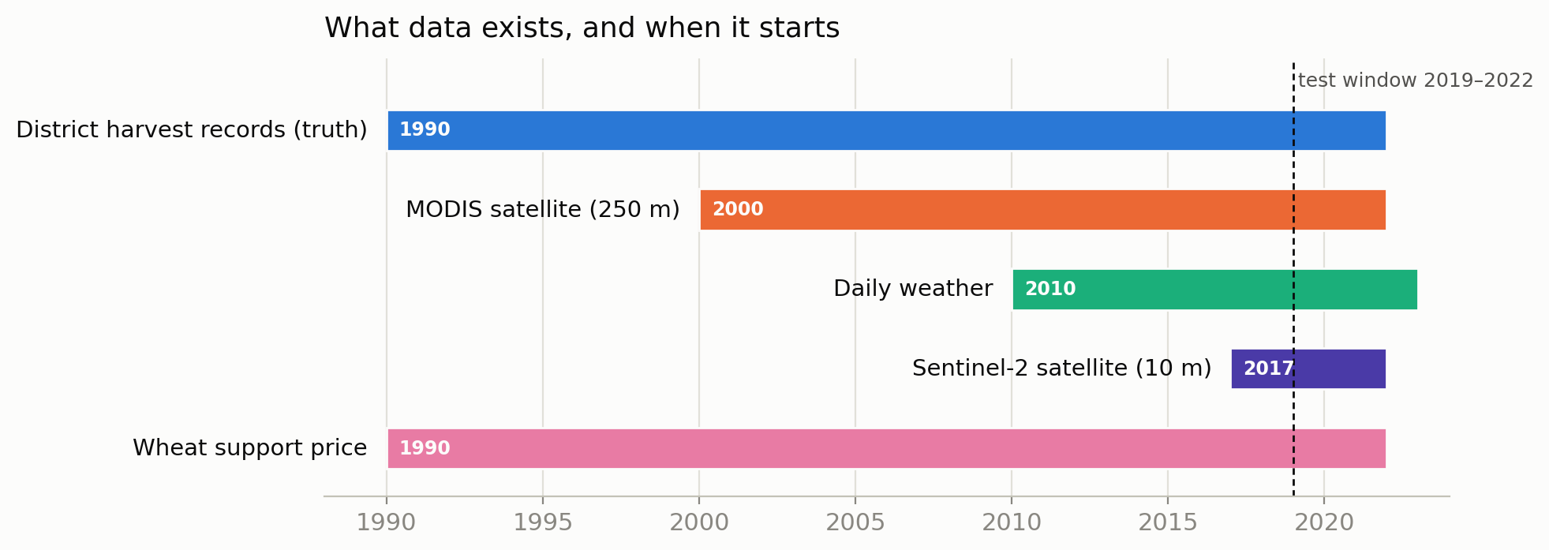
PART 2 · THE DATA
Five sources — and the asymmetry that shaped the design
THE MOST CONSEQUENTIAL FACT
The sharpest satellite, Sentinel-2, only starts in 2017. An earlier version of this project keyed its whole design to Sentinel — which left only four harvests (2019–2022) to test against. MODIS is blurrier but reaches back to 2000 — nineteen testable seasons. Noticing that asymmetry — trading image sharpness for evaluation depth — produced most of the improvements in this work.
Source | What it contributes | Volume
Harvest records, 1990– | ground truth + history to learn from | 3,658 district-seasons
MODIS satellite, 2000– | coarse (250 m) but long crop record | 2,737 rows + 169,809 tiles
Daily weather, 2010– | temperature, rain, sunlight, humidity | 546,805 district-days
Sentinel-2, 2017– | sharp (10 m) but recent crop views | 2,142 rows × 126 measures
Support price | economic signal | annual
Notes:
The timeline picture is the argument: the newest data source is the shortest one. Four test seasons vs nineteen is the difference between anecdote and evidence.

Slide 6
PART 2 · THE DATA
Strict causality: the model may not peek at the future
A forecast dated 5 March must be computable on 5 March. That sounds obvious, but it is the easiest thing to get subtly wrong — so it is enforced in code, not by convention.
Weather observations — nothing after 4 March enters any feature
WHY SO STRICT?
A model that accidentally sees even a little of the future scores brilliantly in testing and fails in real use. With only a few seasons to test on, such leaks are almost impossible to notice after the fact — so they are made impossible up front.
Satellite images — nothing after 5 March, anywhere in the pipeline
Weather forecasts — must have been published at least 2 days before the clock
Training seasons — for a test season, nothing from that season or later is used — not even the averages that standardise inputs
Notes:
For a paper: this is the 'no leakage' section reviewers look for. The subtle one is the last: even normalisation statistics respect the cutoff.

Slide 7
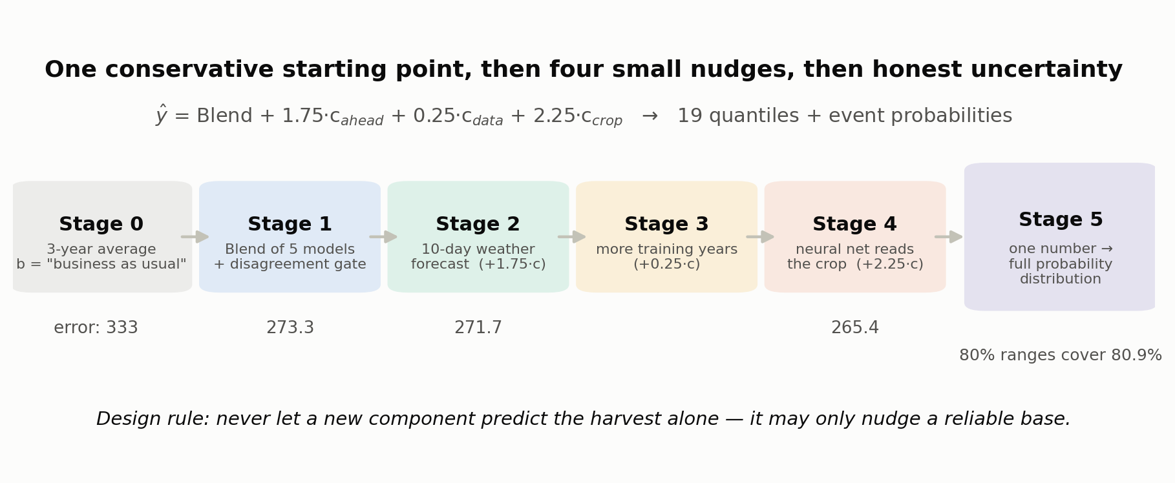
PART 3 · THE MODEL
The whole model in one equation
ŷ = Blend + 1.75 · c_ahead + 0.25 · c_data + 2.25 · c_crop
ŷ is the forecast in kg/ha. Each c is a correction — a small, separately-measured adjustment from one new source of information. A fifth stage then turns this single number into a full probability distribution.
The design principle: start from something conservative and reliable; let each new source of information nudge it; never let a new component predict the harvest alone. A model given free rein on scarce data fits noise.
Notes:
Read the equation aloud once. The multipliers (1.75, 0.25, 2.25) express how much each correction is trusted — they were fitted on early seasons and frozen.

Slide 8
PART 3 · THE MODEL
Every correction is measured like a drug trial
Each correction is defined as the difference between two otherwise identical models — same rows, same settings, same random seeds — differing only in whether the new information is present. That difference isolates exactly what the new information contributes, the way a drug trial isolates a drug by treating the placebo group identically in every other respect.
Model A (treatment) sees everything, plus the new
information (e.g. the weather forecast)
−
Model B (control) identical in every respect,
except the new information is withheld
=
c
the correction
Why the multipliers on each correction? Averaging models pulls estimates toward the middle, so the raw difference understates the true effect — the multiplier scales it back up (1.75 for weather-ahead, 2.25 for crop vision). And when a signal is believed but cannot be measured precisely, it is deliberately shrunk (0.25 for the training-data correction). Both numbers were chosen on early seasons and frozen before later ones were scored.
Notes:
This is the paper's methodological backbone: correction = treatment minus control on matched runs. Multipliers: amplify what averaging dampened; shrink what can't be trusted.

Slide 9
STAGE 0 · THE STARTING POINT
Deliberately dull: a weighted average of the last three harvests
b = 0.60·y(last year) + 0.25·y(2 yrs ago) + 0.15·y(3 yrs ago)
ON ITS OWN
333
Why this works. Yield is persistent: a district that produced 4,500 kg/ha for three years will probably do so again — irrigation, soil and farming practice change slowly. Recent years get more weight because they are more informative. The weights were fitted once on history, then frozen; they are close to what you would guess.
kg/ha typical error, using the three-year average alone
68
Worked example (illustrative): a district harvested 4,300, then 4,500, then 4,600 kg/ha in the last three years: b = 0.60×4,600 + 0.25×4,500 + 0.15×4,300 = 2,760 + 1,125 + 645 = 4,530 kg/ha
kg/ha — everything else in this presentation, combined, is worth about this much on top. The baseline does most of the work; the craft is in the last 20%.
The quiet trick that matters most: every model downstream predicts the residual r = y_actual − b — how much this season differs from business as usual. The models never have to learn that one district is richer than another; they only learn what is unusual, which is the part that actually varies.
Notes:
Residualisation is the transferable idea: predict the deviation from a persistent baseline, not the level. The illustrative arithmetic is on-slide so a reader can reproduce it.

Slide 10
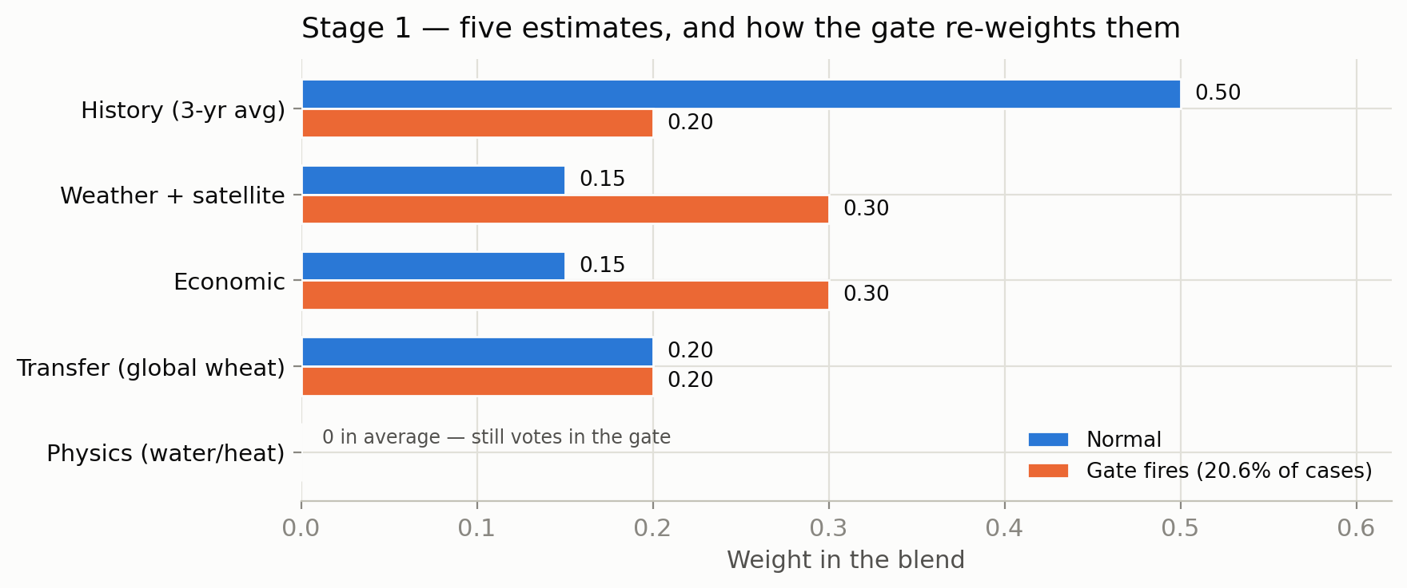
STAGE 1 · THE BLEND
Five estimates, one average — each wrong in a different way
THE FIVE, IN PLAIN WORDS
History (0.50) the three-year average from Stage 0
Weather + satellite (0.15) what has been observed up to 5 March
Economic (0.15) last year's prices and support-price changes
Why five and not one? Each estimate looks at something different — history, this season's weather and satellite images, prices, wheat behaviour learned in other countries, and crop physics — and each is wrong in a different way. Averaging cancels independent mistakes. Why keep a model with weight zero? The physics estimate wasn't adding accuracy, so it gets no weight in the average — but its direction (up vs down) is still informative, so it still votes in the gate on the right.
Transfer (0.20) a model trained on wheat elsewhere in the world, applied here — it imports general knowledge about how wheat responds to weather that 119 districts alone cannot teach
Physics (0.00) soil water balance and heat stress
Notes:
The transfer model is the interesting one for a paper: cross-country pre-training for a data-poor region. Physics voting but not averaging shows direction and level are separable signals.

Slide 11
STAGE 1 · THE DISAGREEMENT GATE
Normally trust history — unless the evidence gangs up against it
Let L be last season's yield. Each non-history estimate casts a vote on direction only — is this year going up or down?
INTUITION
Most years, last year is the best guide, so history dominates. But when several independent models — each looking at this season's actual weather and satellite data — all say “this year is different”, continuing to lean on last year is the wrong bet. The gate is that judgment, written as arithmetic.
s = sign(estimate − L) ∈ {−1, 0, +1}, S = sum of the 4 votes
If a majority agree (|S| ≥ 2) and they disagree with what history implies, the gate fires: history's weight collapses from 0.50 to 0.20, and the season-aware models take over.
normal: Blend_raw = 0.50·H + 0.15·R + 0.15·E + 0.20·C
gate fires: Blend_raw = 0.20·H + 0.30·R + 0.30·E + 0.20·C
20.6%
Worked vote (illustrative): L = 4,580. Weather-satellite says 4,340 (−1), economic says 4,610 (+1), transfer says 4,400 (−1), physics says 4,470 (−1). S = −2 → a majority say “down”. History says “flat”. The gate fires and the blend stops leaning on last year.
of district-seasons fire the gate — rare enough that history usually rules, common enough to matter in the years that matter.
Notes:
The gate is an if-statement, not a learned parameter — auditable and explainable. Majority voting on direction is robust when levels are noisy.

Slide 12
STAGE 1 · MOVEMENT CALIBRATION
Averaging makes the blend timid — so its movement is amplified
Averaging five estimates pulls every forecast toward the middle, so the blend systematically moves less than reality does. The fix: amplify its movement away from last season by a single fitted factor.
A NOTE ON FALSE PRECISION
The original code carried 1.5001443110. Ten significant figures, fitted from two seasons, is storytelling — the difference from 1.50 is 0.0013 kg/ha, roughly one grain per square metre. It was rounded.
Blend = L + 1.50 × (Blend_raw − L)
Where 1.50 comes from. Take historical cases. Let x be how far the raw blend moved from last year, and z how far the truth actually moved. Find the single rescaling factor that maps one onto the other by least squares: ŝ = Σ xᵢzᵢ / Σ xᵢ² (ordinary regression through the origin) It came out near 1.5: the truth typically moves about 50% further than the blend dares to.
STAGE 1 SCORECARD
273.3 kg/ha typical error Stage 1 does the heavy lifting: about 59 of the 68 kg/ha of total improvement over the naive average happens here.
Real numbers — Rewari 2022: last season L = 4,580; the published blend is 4,274.7. Working backwards: the raw blend had moved (4,274.7 − 4,580)/1.5 = −203.5, i.e. sat at 4,376.5. The calibration pushed a timid “down a bit” to a committed “down 305” — and the truth fell 430.
Notes:
Movement calibration = one-parameter regression through origin on movements, not levels. The Rewari back-calculation shows the audience the formula is real.

Slide 13
STAGE 2 · WEATHER AHEAD
What changes when a model is allowed to see the 10-day forecast?
Ten-day weather forecasts exist on 5 March. Rather than dumping them in as extra inputs, the model runs the drug-trial design from earlier: train four models that differ only in whether forecast weather is available, and read off the difference.
c_ahead = ( ŷ_full + ŷ_effect + ŷ_broad ) / 3 − ŷ_no-forecast then ŷ += 1.75 · c_ahead
Why three forecast-aware models?
Why × 1.75?
Rewari 2022, real numbers
There are several reasonable ways to summarise a weather forecast — raw values, departures from normal, derived stress measures. Averaging three avoids betting everything on one choice.
Same logic as movement calibration: a difference of averaged models understates the real effect, so it is scaled up. The multiplier was chosen on early seasons, then frozen before later ones were looked at.
The February–March forecast looked mildly favourable: c_ahead = +12.7, so the forecast moves up 1.75 × 12.7 = +22.3, from 4,274.7 to 4,297.0.
Result: 271.7 kg/ha — an improvement of 1.6. Small, but bought with a clean experiment: it is exactly the value of the forecast, nothing else.
Notes:
The design keeps attribution clean: +1.6 kg/ha is exactly what the 10-day forecast is worth, because everything else was held fixed.

Slide 14
STAGE 3 · THE TRAINING-DATA CORRECTION
Not a modelling idea — a bookkeeping fix, honestly downweighted
The satellite-aware models were trained on 2017 onwards — because Sentinel starts in 2017. But 78 of the measures doing most of the work (weather, soil, economics) reach back to 2013. Four seasons of usable training data were being thrown away because one late-arriving source sat in the same table. Fixing it grows training examples from 238 to 952.
⚠ THE WEAKEST COMPONENT
Three tests, increasing severity: · production features, 4 seasons: +3.35 — helps · simpler baseline, 7 seasons: helps in 4 of 7 — a coin flip · same procedure, different features, three dates: −35.4 / +21.8 / −19.7 — the sign flips at random Widening a training window is not a general improvement. It helps when the features carry signal, hurts when they don't — and with four seasons you cannot know which case you are in.
c_data = ŷ(trained from 2013) − ŷ(trained from 2017)
ŷ += 0.25 · c_data
Why only a quarter of it? The two models disagree by 87 kg/ha on average — a big, noisy signal. Taking 25% keeps the useful part without importing the noise. This is shrinkage: the correct response to a signal you believe in but cannot measure precisely.
Kept at a heavily shrunk 0.25 — and stated plainly: the model beats the earlier version even without this correction (268.3 vs 269.5). Both choices are defensible; the honest framing is on the slide.
Rewari 2022: the two models disagree by c_data = −39.09 kg/ha. Shrunk: 0.25 × (−39.09) = −9.77. The forecast moves from 4,297.0 to 4,287.2.
Notes:
For a paper this is a gift: a component retained at reduced weight, with the evidence against it printed beside it. That is what honest reporting looks like.

Slide 15
STAGE 4 · CROP VISION
The neural network: learning the recipe instead of fixing it
The satellite sees the crop; the question is how to turn a large messy pile of satellite measurements into a few numbers a prediction model can use. The obvious approach — summary statistics like average greenness — works, but the recipe is fixed by the analyst in advance and treats every part of a district as interchangeable. A neural network learns the recipe. Formally it is just a function:
f : (large messy pile) ⟶ ℝ¹⁶ (sixteen numbers)
…and the whole design question is which sixteen numbers. What it is shown, for one district in one season:
Input | Shape | Meaning, in plain words
Crop condition | 3 × 126 | 6 satellite indices × 3 ways of viewing the district × 7 time summaries — at three dates (Jan / Feb / Mar)
Past weather | 6 × 16 | six time windows of observed weather before 5 March
Forecast weather | 10 × 16 | ten five-day windows of forecast weather ahead
Each row is a token — one bundle of numbers the network treats as a unit; 19 tokens in total. The six satellite indices measure different things: overall greenness, chlorophyll, water content, and senescence (how far the crop has begun to dry down). At an earlier clock, the not-yet-observed March token is masked — made invisible — so the network cannot accidentally learn from data that would not exist in real use.
Notes:
Define 'token' here and 'attention' next slide — the two words that make transformers sound harder than they are. f: R^large -> R^16 is the whole job description.

Slide 16
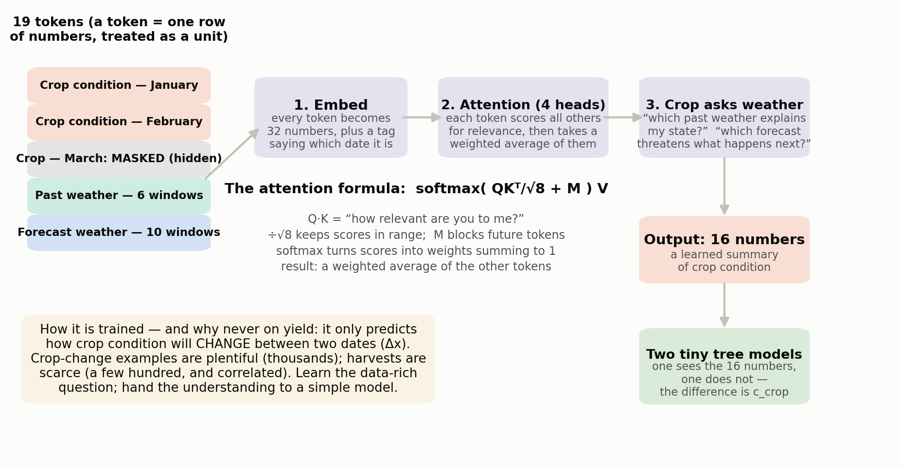
STAGE 4 · THE MATHEMATICS OF ATTENTION
Each token asks every other: “how relevant are you to me?”
READING THE FORMULA
Q, K, V — from each token, three vectors are computed by learned matrices: a query (what I'm looking for), a key (what I contain), a value (what I'll pass on). QKᵀ — every query dotted with every key: a big score means “you are relevant to me”. ÷√8 — keeps scores in a sensible range (they grow with dimension). softmax — turns scores into positive weights that sum to 1.
In one sentence: each token looks at all the others, decides how much each one matters, and takes a weighted average of their content. Four heads do this in parallel with different learned matrices — so the network can attend to several things at once — and the network runs in 32 dimensions (each head gets 8). The crop token then queries the two weather streams separately: “which past weather explains the state I am in?” and “which forecast weather threatens what happens next?” Total size: 67,359 learned numbers — deliberately tiny.
Notes:
Demystify: attention = data-dependent weighted averaging. The mask M is the causality guarantee inside the network. 67k parameters — about one layer of a small language model.

Slide 17
STAGE 4 · THE SUPPORTING PIECES
Four bits of neural-net vocabulary, each in one honest sentence
Residual connection ( +q )
LayerNorm
the input is added back to a layer's output, so information can skip the layer entirely if the layer turns out to be unhelpful. Layers become optional refinements, not obligatory filters.
rescales a vector to mean 0 and standard deviation 1, keeping numbers in a stable range as they pass through layers — without it, values drift and training destabilises.
Feed-forward network (FFN)
GELU
after attention mixes information across tokens, a small two-layer network processes each token on its own: 32 → 64 → 32 numbers.
the activation function between those layers — like a smooth on/off valve that lets small negative values leak through slightly instead of zeroing them abruptly. Smoother valves train more stably.
h_fused = LayerNorm( q + c_past + c_future ) FFN(h) = W₂ · GELU(W₁h + b₁) + b₂
Everything on this slide is standard transformer machinery — the design choices that matter are what it is fed (previous slide) and what it is trained on (next slide).
Notes:
Keep this slide fast — it inoculates the audience against jargon. The novelty of the project is not here.

Slide 18
STAGE 4 · HOW IT IS TRAINED
The central design decision: the network never sees a harvest
“How does wheat develop?” is a data-rich question — thousands of examples. “What will yield be?” is a data-poor one — a few hundred, and correlated. So the network learns the rich question, and hands its understanding to a simple model for the poor one.
THE LOSS FUNCTION — WHAT “LEARNING” MEANS HERE
L = SmoothL1( predicted Δx̃ , actual Δx̃ )
+ 0.08 · BCE( direction )
It is trained to predict how crop condition will change between two dates: Δx = x(next date) − x(current date)
SmoothL1 behaves like squared error for small mistakes (smooth, easy to optimise) and like absolute error for large ones — so a single outlier cannot dominate training. The BCE term is a bonus task: also predict merely whether each measure goes up or down. Adding an easier, related task is a standard way to stabilise training; the 0.08 keeps it minor. Training cost: ~45 minutes on a laptop GPU.
Robust standardisation. Satellite measures have wildly different scales, and satellite data contains junk (clouds, sensor faults). So each change is standardised with medians, which ignore outliers, instead of means, which are dragged around by them: m = median(Δx), s = 1.4826 · median|Δx − m|, Δx̃ = (Δx − m)/s
That middle quantity is the median absolute deviation; the constant 1.4826 makes it comparable to a standard deviation for well-behaved data, so the scaled numbers stay interpretable.
Notes:
This is self-supervised pre-training in miniature: learn representation on the plentiful task, transfer to the scarce one. The same pattern as language models, at 1/1,000,000 the size.

Slide 19
STAGE 4 · FROM 16 NUMBERS TO A CORRECTION
Two tiny tree models — and a finding worth a paper section
The network outputs 16 numbers per district. Two otherwise identical decision-tree ensembles are trained — one given those numbers, one not. (A decision-tree ensemble asks a sequence of yes/no questions like “was February hotter than normal?” and averages hundreds of tiny question-trees.)
A FINDING WORTH PRESENTING
The earlier model fed 30 numbers into this stage. Six were plain averages of raw satellite indices needing no network at all. Measured against actual errors, they contributed nothing — correlation 0.024, indistinguishable from zero — and made accuracy worse. Dropping those six and eight other weak inputs leaves 16, which score better than all 30 — and can be trusted at nearly double the weight (2.25 vs 1.25). Removing features let the remaining signal be believed harder.
c_crop = ŷ(with the 16) − ŷ(without)
ŷ += 2.25 · c_crop
Deliberately tiny trees: 350 trees of depth 2 — each asks only two yes/no questions — with strong complexity penalties, two random starts averaged. Depth 2 is a constraint chosen because so few harvests exist to fit on.
Rewari 2022: the network saw a struggling crop the weather models had missed. c_crop = −55.84, amplified: 2.25 × (−55.84) = −125.65. The forecast drops from 4,287.2 to 4,161.6 — and the harvest came in at 4,150.
Notes:
2.25x on a 55-kg/ha signal moved Rewari 126 kg/ha — the single biggest stage move in the worked example, and the one that landed the forecast on the truth.

Slide 20
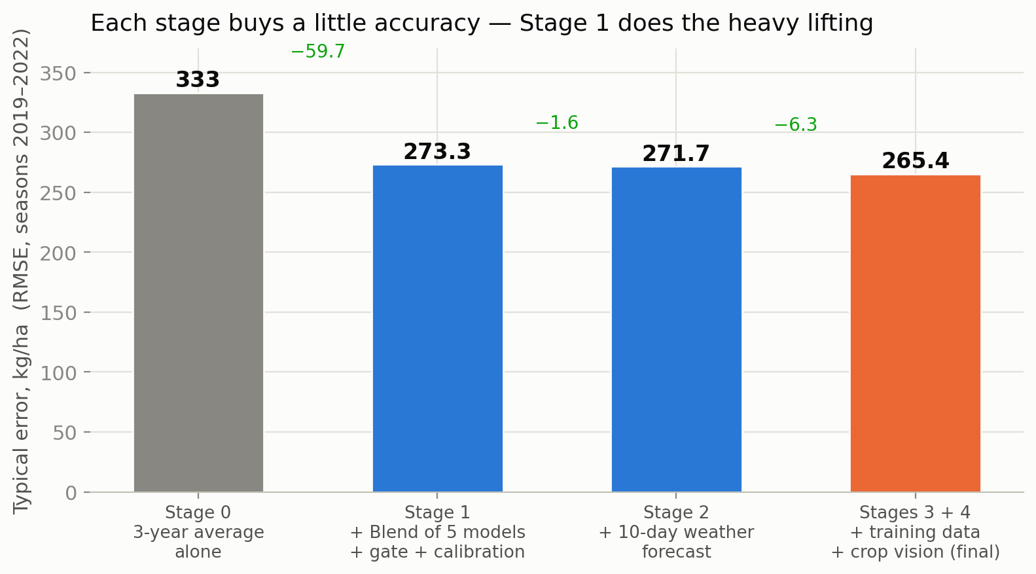
STAGE 4 · PREVENTING THE MODEL FROM CHEATING
Two mechanisms, both essential
Time cutoffs
District cross-fitting
For a test season, nothing from that season or later is used anywhere — not for the network, not for the trees, not even for computing the averages used to standardise inputs. The test season simply does not exist during training.
Districts are split into three groups. The 16 numbers for a district in group 1 come from a network trained without group 1. Otherwise the numbers could look useful merely because the network had memorised those districts.
Why both? Time cutoffs stop the model from seeing the future. Cross-fitting stops it from seeing itself — from being rewarded for recognising districts rather than understanding crops. Each closes a leak the other cannot.
Accuracy after each stage — the running score so far.
Notes:
Cross-fitting is the less obvious leak: a network can score well by memorising district identity. Three-fold split means every district's features come from a model that never saw it.

Slide 21
STAGE 5 · FROM ONE NUMBER TO A DISTRIBUTION
Use the errors the model actually made — not an assumed bell curve
The idea: if the model has historically come in 300 kg/ha below reality 10% of the time, then the 10% quantile sits 300 below the new forecast. Past honesty about your own mistakes is the best available guide to future uncertainty.
1
Collect past errors
WHY THE THREE-WAY MAXIMUM?
For every district-season already forecast: eᵢ = yᵢ(actual) − ŷᵢ. Only seasons before the one being forecast are allowed.
It is a safety net. A district with a freakishly stable recent history would otherwise be assigned an implausibly narrow forecast range. The floor of 7% of normal yield (and an absolute floor of 150 kg/ha) prevents overconfidence that the data cannot support.
2
Put errors on a common scale
A 300 kg/ha error means something different in a stable district than a volatile one. Each error is divided by a district-specific size: aᵢ = max( SD of recent yields, 7% of normal yield, 150 ) uᵢ = eᵢ / aᵢ
IN PLAIN WORDS
uᵢ answers: “by how many typical district-sized wobbles did the forecast miss?” Those scaled misses, pooled across history, form the shape of the model's uncertainty.
3
Weight every season equally
If season t has nₜ districts, each row gets weight wᵢ = 1/nₜ — otherwise a season with more districts would dominate the error distribution.
Notes:
Non-parametric conformal-style intervals: no Gaussian assumption anywhere. The scaling step is what lets one shared error shape serve 119 different districts.

Slide 22
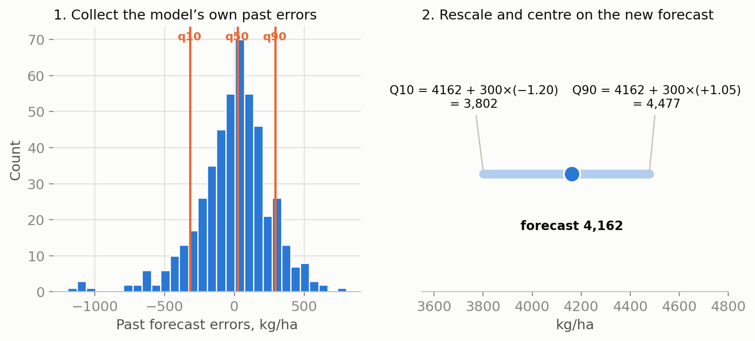
STAGE 5 · THE CALCULATION, FINISHED
Weighted quantiles, then rescale onto the new forecast
4
Read weighted quantiles of the scaled errors
Sort the u values ascending; the j-th value gets cumulative position cⱼ = ( Σₖ≤ⱼ wₖ − ½wⱼ ) / Σ wₖ (the −½wⱼ centres each observation in its own weight, avoiding a half-step bias). Interpolate to read the value at each of 19 levels: 0.05, 0.10, …, 0.95. Call the result u_α — the shape.
5
Rescale and centre on the new forecast
Q_α = ŷ(new) + a(new) · u_α
THE ARITHMETIC, BY HAND
Past scaled errors give u₀.₁₀ = −1.20 and u₀.₉₀ = +1.05. A district has forecast 4,162 with scale a = 300: Q₁₀ = 4,162 + 300×(−1.20) = 3,802 Q₉₀ = 4,162 + 300×(+1.05) = 4,477 So the 80% range runs 3,802 – 4,477 kg/ha.
6
Clean up
Apply a running maximum so quantiles cannot cross (q75 must never sit below q50 — possible when levels are estimated separately), then clip to the physically possible range 500–7,000 kg/ha. One deleted parameter: the earlier model multiplied the shape by 0.95 to look sharper. It bought 0.15 of score and cost honesty — “80%” intervals covered 78.4%. At scale 1.00 they cover 80.9%. Simpler and more accurate.
Notes:
Walk the arithmetic slowly — it is the moment the whole probability machinery becomes hand-checkable. Note the deleted 0.95: sharpness bought with dishonesty was removed.

Slide 23
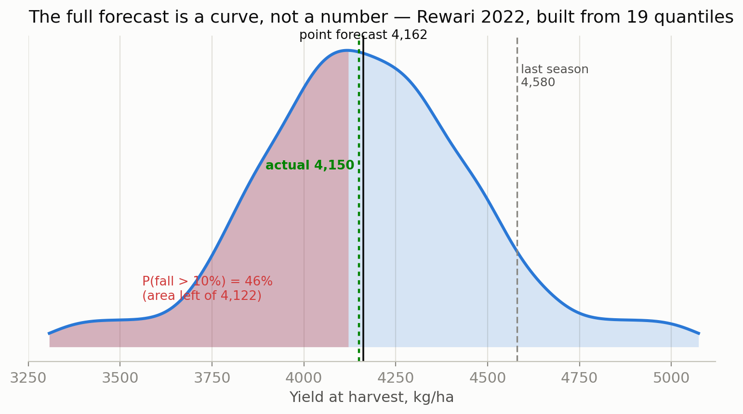
STAGE 5 · FROM QUANTILES TO A CURVE
The 19 quantiles ARE the distribution — the curve is just its slope
THE TWO OBJECTS
F(y) — the cumulative curve: the probability the harvest comes in at or below y. The quantiles pin it down at 19 points: F(Q_α) = α. f(y) — the density (bell) curve: its slope. Between adjacent quantiles:
f ≈ (α₂ − α₁)/(Q₂ − Q₁)
Reading it: where two quantiles sit close together, a lot of probability is packed into a small range of yields, so the curve is tall. Where they are far apart, probability is thinly spread, so the curve is low. Nineteen points make a jagged slope, so it is smoothed with a small Gaussian kernel (width = 1/25th of the forecast range) and rescaled so the area under it is exactly 1, as any probability density must be.
Notes:
The density plot is for communication; every probability the model publishes is computed from F, the step-interpolated CDF, not from the smoothed curve.

Slide 24
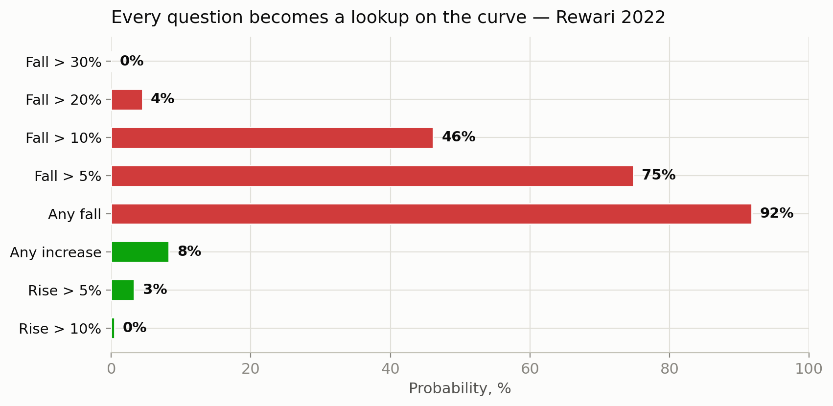
STAGE 5 · ANSWERS PEOPLE ACTUALLY ASK FOR
Every question becomes a lookup on F
P(yield rises) = 1 − F( y_last )
P(fall worse than p%) = F( (1−p) · y_last )
Between the 19 known points, F is filled in by straight lines; two artificial endpoints (400 kg/ha beyond the outermost quantiles, at probability 0 and 1) make it defined everywhere. Worked, Rewari 2022: last season 4,580, so “fall worse than 10%” asks for F(0.90 × 4,580) = F(4,122). The forecast 4,162 sits just above 4,122 — so nearly half the probability mass lies below: 46%.
Why relative to last season? Because that is the question decision-makers actually hold: “will we have less wheat than last year, and how much less?” Absolute yield numbers only acquire meaning against a reference the audience already knows.
Notes:
F(4122)=46% is readable straight off the previous slide's curve — connect the two visually for the audience.

Slide 25
PART 5 · ONE DISTRICT, END TO END
Rewari, Haryana — harvest of 2022
Last season this district harvested 4,580 kg/ha. It is 5 March. What will this year bring?
Every number that follows is from the model's actual output files.
4,580
5 March
?
kg/ha last season
the forecast clock
harvest, due in May
Notes:
From here to the results section, one district carries the whole story. Everything is traceable to forecast_probabilities.csv.

Slide 26
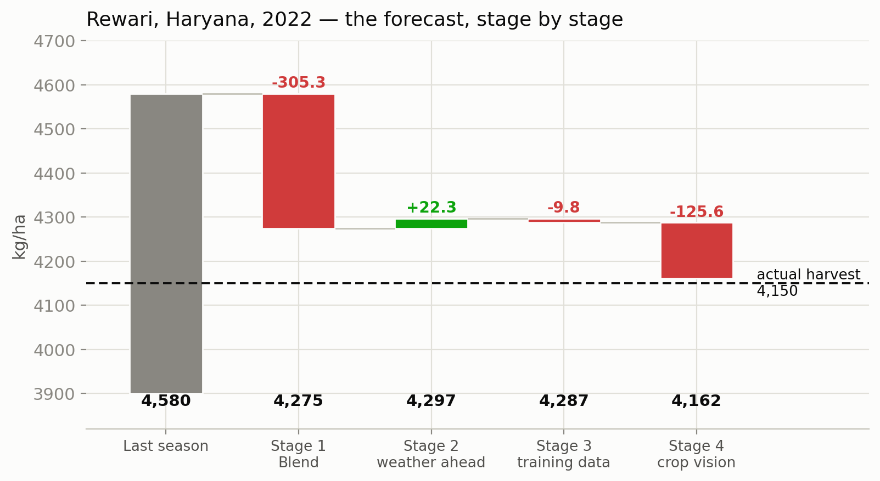
REWARI 2022 · STAGE BY STAGE
Watch the forecast move as each stage adds its information
Step | Value | What happened
Last season | 4,580 | the starting reference
Stage 1 — Blend | 4,274.7 | history, weather, satellite and transfer all point down
Stage 2 — weather ahead | 4,297.0 | 10-day forecast mildly favourable: +22.3
Stage 3 — training data | 4,287.2 | 2013+ training nudges it −9.8
Stage 4 — crop vision | 4,161.6 | the network sees a struggling crop: −125.6
Actual harvest | 4,150.0 | error: 11.6 kg/ha — 0.3%
final = 4,297.01 + 0.25×(−39.09) + 2.25×(−55.84)
= 4,297.01 − 9.77 − 125.65 = 4,161.59
The earlier model said 4,261.7 — an error of 111.7. The network did the work here: it detected crop distress the weather-and-history models missed entirely.
Notes:
The full arithmetic is on the slide — invite the audience to check it on a phone calculator. 4297.01 − 9.77 − 125.65 = 4161.59.

Slide 27
REWARI 2022 · THE FULL FORECAST
This is the slide to spend time on
Quantile | Yield | Read as
q05 | 3,707 | 1-in-20 worst case
q10 | 3,822 | bottom of the 80% range
q25 | 3,986 | pessimistic
q50 | 4,162 | the point forecast
q75 | 4,352 | optimistic
q90 | 4,529 | top of the 80% range
q95 | 4,674 | 1-in-20 best case
WHAT HAPPENED
The harvest came in at 4,150 — a 9.4% fall. The model had said a fall was 92% likely, and placed the outcome right at the 10%-fall boundary. The point forecast missed by 11.6 kg/ha.
Question | Answer
Will yield increase? | 8%
Fall more than 5%? | 75%
Fall more than 10%? | 46%
Fall more than 20%? | 4%
Fall more than 30%? | 0%
Why a distribution beats a number: “Yield will be 4,162” is brittle and usually wrong. “Yield will very likely fall, most probably to around 4,150, with a 1-in-20 chance of dropping below 3,707” is both true and actionable.
Notes:
The headline sentence pattern for any district: expected level, direction probability, and tail risk — all relative to last season.

Slide 28
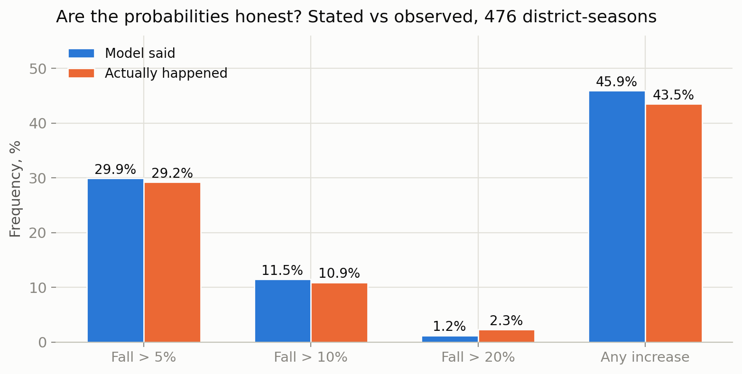
PART 6 · RESULTS
Are the probabilities honest? The most important table in the project
⚠ THE EXCEPTION
The extreme tail. The model says 1.2% for a collapse worse than 20%, where reality delivers 2.3%.
It is slightly over-confident about catastrophes — worth stating plainly, and unsurprising: those are exactly the events with the fewest examples to learn from.
A user planning for disaster scenarios should roughly double the model's stated probability of one.
When the model says “10% chance”, it happens about 10% of the time. That is what makes these numbers usable for decisions rather than decoration. Verified across all 476 district-seasons: stated 29.9% vs observed 29.2% (falls > 5%); 11.5% vs 10.9% (falls > 10%); 45.9% vs 43.5% (any increase).
Notes:
Calibration is checkable by any reader from the published CSV — no trust required. Lead with this table when reporting accuracy.

Slide 29
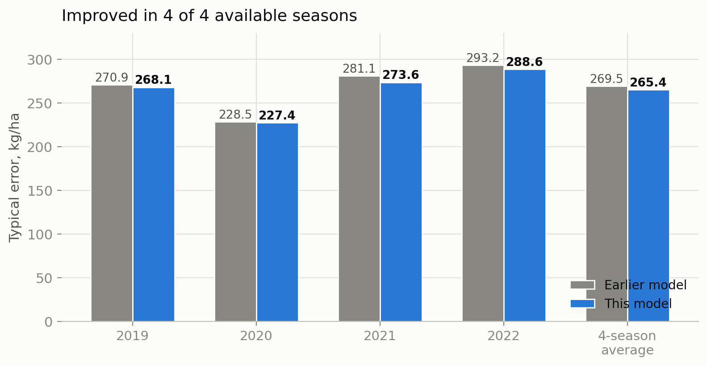
PART 6 · RESULTS
Accuracy: improved in 4 of 4 seasons — say it that way, not “100% confident”
Probability measure | Earlier | This model
Scoring rule (lower = better) | 151.9 | 149.7
80% interval coverage (should be 80%) | 78.4% | 80.9%
90% interval coverage (should be 90%) | 89.3% | 91.8%
Ranking skill — rises (1.0 = perfect) | 0.845 | 0.847
Ranking skill — >10% falls | 0.809 | 0.820
Ranking skill: pick one district that had a bad year and one that didn't — how often does the model give the bad one the higher probability? At 0.82: four times in five.
Direction accuracy is 78.8% — unchanged from the earlier model. The model calls up-vs-down right about four times in five; the gains above came from being closer in magnitude, not from calling more directions right. On a 4,500 kg/ha harvest, 265 kg/ha of typical error is about 5.9%. Stated plainly rather than glossed: the improvement is real, consistent — and small.
Notes:
With four seasons, a resampling test reports 'certainty' automatically when all four agree — so report the count (4 of 4), never a probability.

Slide 30
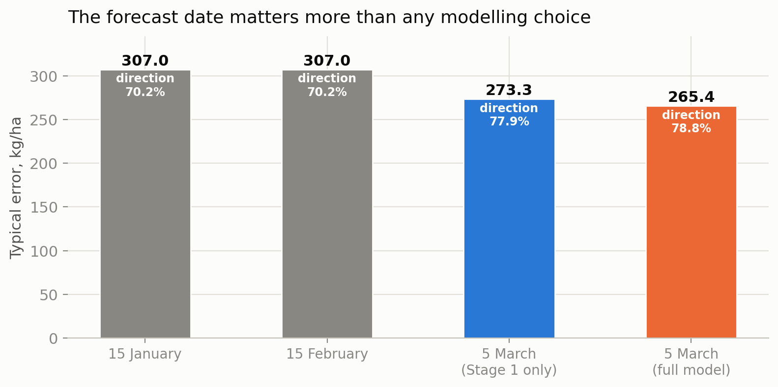
PART 6 · WHY 5 MARCH?
The forecast date matters more than any modelling choice
WHY MARCH KNOWS MORE
By early March the crop has stopped growing leaves and started filling grain — its condition is visible from orbit and its remaining weather exposure is short. In January, most of the season's story hasn't happened yet.
Still, January is not weak: ~307 kg/ha (≈6.7% error) two months before harvest is usable for early planning. The question is not “January or March?” but “what is each date's answer worth?”
Moving from a January to a March forecast is worth 34 kg/ha and nearly 8 points of direction accuracy — the improvement appears in every measure at once, which is what a genuine information gain looks like. Everything this project added on top is worth a further 8 kg/ha. January and February share one locked model by design (their point forecasts are identical); only the probability layer was updated between them.
Notes:
Like-for-like: the 273.3 March bar is Stage 1 only (what the earlier multi-date system issued); the full model reaches 265.4. Never mix rows across those tables.

Slide 31
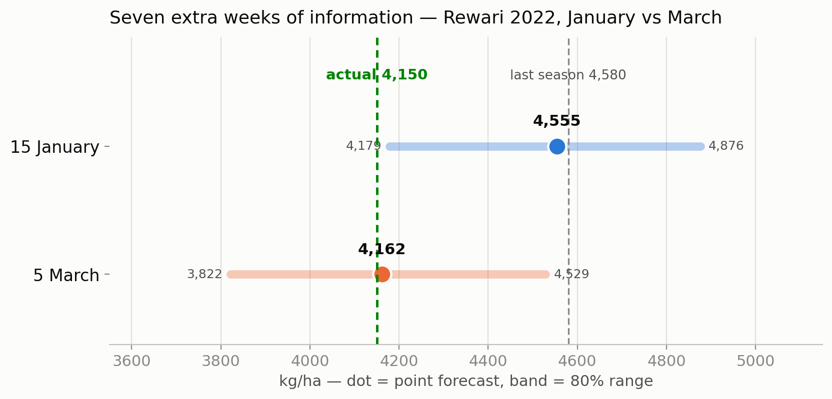
PART 6 · THE SAME DISTRICT AT BOTH DATES
What seven extra weeks of information did for Rewari
 | 15 Jan | 5 Mar
Point forecast | 4,555 | 4,162
Error vs actual 4,150 | 405 | 12
P(increase) | 43% | 8%
P(fall > 5%) | 23% | 75%
P(fall > 10%) | 9% | 46%
P(fall > 20%) | 1% | 4%
In January the model expected a decent year, put a serious decline at 9%, and sat 405 kg/ha too high — the outcome even fell below its 80% range. By March it had seen the crop: the forecast dropped 393 kg/ha, the decline probability rose to 46%, and it landed within 12 kg/ha of the truth. The information that arrives during February and early March is what turns a wrong answer into a right one — that is the substantive case for the 5 March clock. January is honestly calibrated on average; this district is simply one it got wrong, and its distribution said so only weakly. That is the cost of forecasting seven weeks earlier.
Notes:
One caveat: the OLD system's January intervals covered only 39.5% — rebuilt with the Stage-5 method they reach 79.3%. The January numbers shown here are the rebuilt, honest ones.

Slide 32
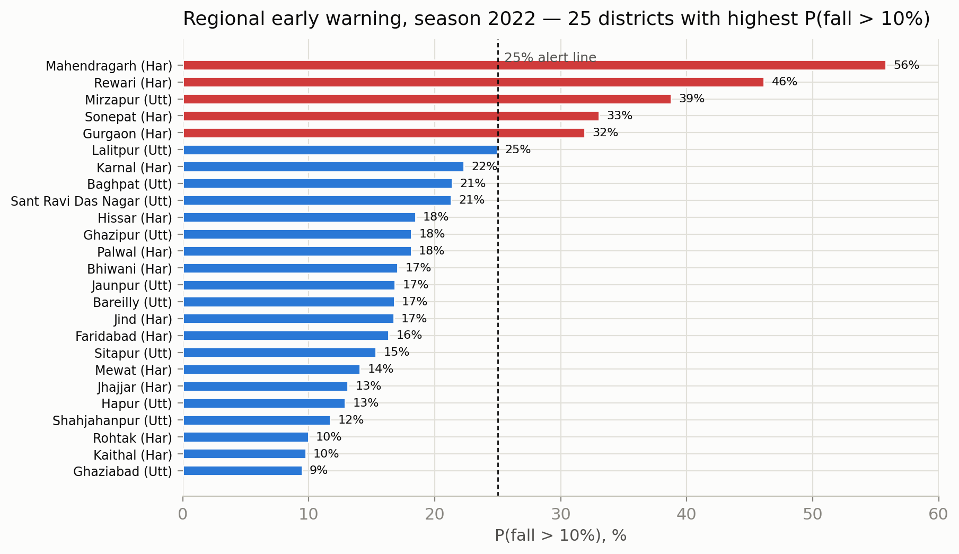
PART 6 · USING IT ACROSS A WHOLE REGION
Never average district probabilities — count and sum instead
Count the flagged districts “N of 119 districts carry a >25% chance of a 10% decline” — a sentence any minister can act on. In 2022, that count was 5.
Map or sort the risk a sorted bar chart of P(fall > 10%), worst first (left), or the same numbers on a map.
Sum expected production Σ (point forecast × district area), with a range built by summing the q10 and q90 columns.
⚠ Why not average probabilities? Districts fail together — regional weather hits everywhere at once. Averaging throws that dependence away. Summed quantile ranges are deliberately wide for the same reason; say which assumption you used.
Notes:
2022 was a calm year regionally — only 5 flagged districts. In a bad year this chart is the product.

Slide 33
PRACTICAL MATTERS
The whole pipeline runs on one laptop in about three hours
Stage | Time | Hardware
Satellite tile extraction (2,737 requests) | 123 min | Google Earth Engine (cloud)
Neural network training, all folds | ~45 min | laptop GPU
Decision-tree models, all folds | ~10 min | 6 CPU threads
Distribution and evaluation | < 1 min | CPU
Full pipeline from raw data | ≈ 3 hours | one laptop
67,359
learned numbers in the neural network — about one layer of a small language model. Nothing here needs a cluster or a GPU farm.
96 / 96
REPRODUCE A FULL RUN
python3 scripts/build_v16_panel.py # history + satellite
python3 scripts/build_v16_weather.py # weather summaries
python3 scripts/build_final_model.py # train + evaluate
python3 scripts/make_probability_output.py # probabilities
every number in the source walkthrough is machine-verified: a script recomputes each quoted figure from its source artifact and fails loudly on any mismatch.
Notes:
Reproducibility: four commands, one laptop, and a verification script that recomputes every quoted number. Rare and citable.

Slide 34
THE FIVE-MINUTE SUMMARY
What to remember
The task
Predict district wheat yield on 5 March, eight weeks before harvest, across 119 Indian districts — as a full, honest probability distribution.
The method
A conservative three-year average, corrected in four measured stages — a blend of five simple models, a controlled experiment on weather forecasts, a training-data fix, and a small neural network that reads crop condition — then the model's own past errors become its uncertainty.
The network's role
It never sees a harvest. It learns how wheat develops (thousands of examples) and hands 16 numbers to a simple model for the data-poor job. Those 16 numbers moved Rewari's forecast 126 kg/ha — onto the truth.
The results
265 kg/ha typical error (5.9%), better in 4 of 4 seasons. 80% intervals cover 80.9%. Stated probabilities match reality within ~1 point. Direction right 78.8% of the time.
The real lesson
Almost nothing survived honest measurement. The best improvement was removing fourteen useless inputs. The biggest apparent win flipped sign on a longer test. Resolution and sample size were the binding constraints — not architecture.
Notes:
Close on the lesson: in this problem, resolution and sample size were the binding constraints — not architecture. That sentence is the paper's thesis.

Slide 35
APPENDIX
The one-slide summary — for reuse in your paper or talk
Task | District wheat yield, forecast on 5 March, eight weeks before harvest
Coverage | 119 districts — Haryana, Punjab, Uttar Pradesh; evaluated on seasons 2019–2022 (476 district-seasons)
Output | Point forecast, 19 quantiles, probability of rise and of 5 / 10 / 20 / 30% falls — all relative to last season
Model | ŷ = Blend + 1.75·c_ahead + 0.25·c_data + 2.25·c_crop, then distribution from the model's own past errors
Accuracy | 265 kg/ha typical error (≈5.9%); direction right 78.8%; improved in 4 of 4 available seasons
Honesty | 80% ranges cover 80.9%; 90% cover 91.8%; stated probabilities match reality within ~1 point (except deep tail)
Early warning | Ranks a >10% collapse correctly 82% of the time (ranking skill 0.820)
Cost | ≈3 hours end-to-end on one laptop; the network has 67,359 parameters
Notes:
Everything on this card traces to a machine-verified number in the walkthrough or to the published forecast CSV.

Slide 36
APPENDIX
Glossary — every technical term used in this deck
Attention — the operation where each token scores all others for relevance and takes a weighted average of their content
BCE — binary cross-entropy: the standard penalty for yes/no predictions
Blend — Stage 1's weighted average of five separate yield estimates
Decision-tree ensemble — hundreds of tiny yes/no question-trees, averaged; reliable when data is scarce
GELU — a smooth activation function; lets small negative values leak through
LayerNorm — rescales a vector to mean 0, SD 1, for training stability
MAD — median absolute deviation — an outlier-proof measure of spread
Mask (M) — −∞ scores for forbidden tokens, so future data gets zero attention weight
MODIS / Sentinel-2 — NASA satellite (250 m, since 2000) / European satellite (10 m, since 2017)
Quantile (q10, q50…) — the value with a given chance of not being exceeded; q50 = median
Residual (r = y − b) — how much this season differs from business as usual
RMSE / typical error — root-mean-square error: square errors, average, square-root
Shrinkage — deliberately taking only a fraction of a noisy signal (the 0.25 in Stage 3)
Softmax — turns any list of scores into positive weights that sum to 1
Token — one row of numbers a transformer treats as a unit (19 here)
Transfer model — trained on wheat elsewhere in the world, applied here
Notes:
Leave this up during Q&A.

