Slide 1
Forecasting district wheat yield
System architecture and component specification
A probabilistic forecast for 119 Indian districts, issued on 5 March —
eight weeks before the harvest it predicts.

Slide 2
THE TASK
Predict the harvest before it happens
One number is not enough. The system outputs a full range of possible harvests and how likely each is.
Predict
wheat yield in kg/ha
for each district, each season
When
5 March
eight weeks before harvest
Where
119 districts
Haryana, Punjab, Uttar Pradesh
Typical yield
≈ 4,500 kg/ha
median district area 3,405 km²
The hard constraint
Nothing observed after 5 March may enter the forecast — no weather, no satellite image. Weather forecasts must have been published at least two days earlier. This is enforced in code, not by convention.

Slide 3
THE TASK
What the system produces
For every district and every season, a single row containing all of this.
Point forecast
4,162 kg/ha
the single best estimate
19 quantiles
q05 … q95
the full range of plausible harvests
P(yield rises)
8%
chance of beating last season
P(fall > 5%)
75%
chance of a mild decline
P(fall > 10%)
46%
chance of a serious decline
P(fall > 20%)
4%
chance of a severe decline
Values shown are the actual forecast for Rewari district, Haryana, in 2022 — used as the worked example later. Its harvest came in at 4,150 kg/ha.

Slide 4
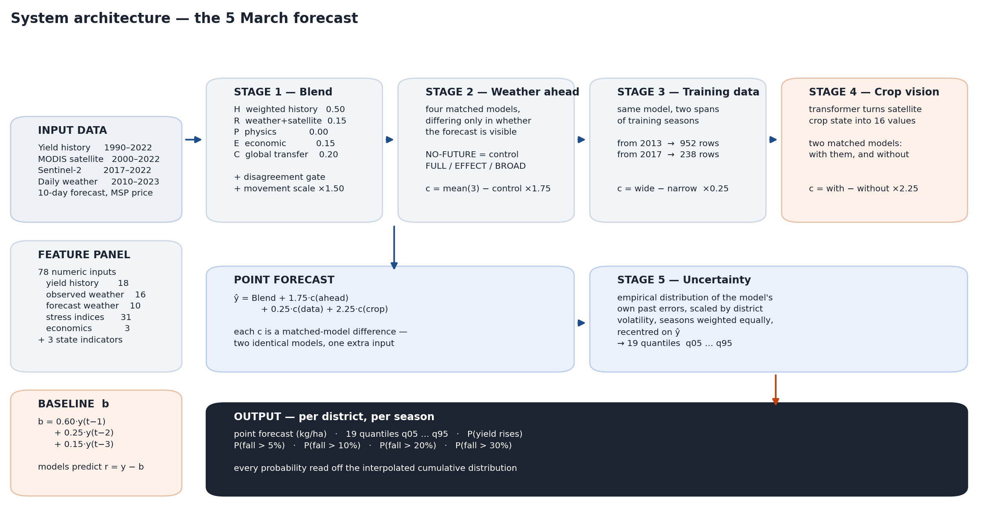
ARCHITECTURE
The complete system

Slide 5
ARCHITECTURE
How the pieces fit together
The system is a conservative estimate, adjusted four times. Nothing replaces the estimate; each stage only nudges it.
ŷ = Blend + 1.75 · c(weather ahead) + 0.25 · c(training data) + 2.25 · c(crop vision)
Stage 1
Blend
five simple estimates averaged, with a gate and a movement scale
Stage 2
Weather ahead
what changes when the model may see the 10-day forecast
Stage 3
Training data
what changes when the model is trained on four more seasons
Stage 4
Crop vision
what changes when a network summarises satellite crop condition
Stage 5
Uncertainty
turns the single number into 19 quantiles and every probability
Each “c” is a correction. The next slides define each one precisely.

Slide 6
INPUTS
Where the information comes from
Source
Coverage
Volume
What it contributes
Harvest records
1990–2022
3,658 seasons
ground truth and history
MODIS satellite
2000–2022
2,737 × 3 × 35
crop condition, coarse
Sentinel-2 satellite
2017–2022
2,142 × 126
crop condition, fine
Daily weather
2010–2023
546,805 days
temperature, rain, sunlight
Weather forecast
per season
10 × 5-day windows
conditions after the clock
Support price
annual
3 features
economic signal
Satellite indices measure how the crop reflects light: healthy plants reflect infrared strongly and red weakly, so the ratio tracks living plant material.

Slide 7
INPUTS
The 78 numbers the models actually see
Raw data is compressed into a fixed panel of 78 columns, computed identically for every district and season.
18
Yield history
lags 1–5, five- and ten-year summaries, state mean, district minus state
16
Observed weather and soil
early, mid and late season windows; soil moisture at three depths
10
Forecast weather
temperature, rainfall and solar anomalies, plus bias-corrected variants
31
Stress indices
heat degree-days above 32 °C and 34 °C, water balance, district and regional
3
Economics
support price level, one-year and three-year changes
Plus three binary state indicators, and a flag marking any value that was missing and had to be filled in.

Slide 8
STAGE 0
The starting estimate
Before any model runs, take a weighted average of the district's last three harvests.
b = 0.60 · y(t−1) + 0.25 · y(t−2) + 0.15 · y(t−3)
Why this works
What every model predicts instead
Yield is persistent — irrigation, soil and farming practice change slowly
A district that produced 4,500 kg/ha for three years will probably do so again
Weights decay because recent seasons are more informative
r = y − b
No model ever predicts yield directly. Each predicts the residual — how far this season departs from business as usual.
Why that matters more than it looks
No model has to learn that one district out-yields another — the baseline absorbs it. Every bit of learning capacity is spent on what is unusual about this season, which is the part that actually varies.

Slide 9
STAGE 1
The Blend — five estimates, averaged
Five separate models look at the season differently. Averaging cancels their independent mistakes.
H
Weighted history
the baseline from the previous slide
0.50
R
Weather + satellite
trees on observed weather and satellite to 5 March
0.15
E
Economic
trees on lagged prices and support-price changes
0.15
C
Global transfer
a model trained on wheat elsewhere in the world
0.20
P
Physics
soil water balance and heat stress
0.00
The physics member has weight zero — it did not improve the average. It is kept because its direction still votes in the gate on the next slide, and a direction can be informative even when a level is not.

Slide 10
STAGE 1
The disagreement gate
Normally trust history. But when the other models agree that this season is different, stop leaning on last year.
s = sign( member − last season ) for R, P, E and C
S = s(R) + s(P) + s(E) + s(C)
The gate fires when both are true:
Weights switch
| S | ≥ 2 — a majority agree on direction
that direction contradicts what history implies
normal 0.50 H · 0.15 R · 0.15 E · 0.20 C
fires 0.20 H · 0.30 R · 0.30 E · 0.20 C
In practice
The gate fires on 20.6% of district-seasons. On the other 79.4% the blend stays anchored to history, which is the safe default when nothing unusual is being signalled.

Slide 11
STAGE 1
Movement calibration
Averaging five models pulls the result toward the middle. The blend under-moves, so its movement is scaled back up.
Blend = L + 1.50 · ( Blend_raw − L ) where L = last season
How the 1.50 was obtained
What it means
Take historical cases. Let x be how far the raw blend moved from last season, and z how far the truth actually moved. Fit the single number that best rescales one into the other, by least squares through the origin:
The answer came out near 1.5.
When the blend says “up 100 kg/ha”, the truth has historically moved about 150. The scale undoes the shrinkage that averaging introduced.
s = Σ xᵢ zᵢ / Σ xᵢ²
Stage 1 produces one conservative yield estimate per district-season. Stages 2 to 4 adjust it; none of them replaces it.

Slide 12
STAGES 2–4
How each correction is measured
Train two models that are identical in every respect — same rows, same target, same settings, same random seeds — except that one is given an extra piece of information.
The difference between their predictions is what that information contributes, and nothing else.
This is the same logic as a drug trial: two groups treated identically apart from one thing, so any difference is attributable to that thing.
Stage 2
the 10-day weather forecast
mean(FULL, EFFECT, BROAD) − NO-FUTURE
×1.75
Stage 3
four more seasons of training data
trained-from-2013 − trained-from-2017
×0.25
Stage 4
16 values from the crop network
with-those-values − without
×2.25
Each weight is deliberately less than one: a correction that cannot be measured precisely is applied at a fraction of its face value, so noise cannot dominate.

Slide 13
STAGES 2–4
The prediction models underneath
Every correction is produced by gradient-boosted decision trees — hundreds of small yes/no question trees, averaged.
Settings
Why depth 2
Trees
350
Each tree may ask only two yes/no questions. With few independent harvests to learn from, a deeper tree would memorise districts instead of learning how they respond.
Maximum depth
2
Learning rate
0.025
Minimum child weight
25
Row subsample
0.85
Column subsample
0.65
Preparation
L2 penalty
50
Missing values filled with the column median, plus a flag
State encoded as three binary columns
Predictions clipped to 500–7,000 kg/ha
L1 penalty
5
Random seeds
42 and 73, averaged
Identical settings across every matched pair, so a measured difference can only come from the extra information — never from a different configuration.

Slide 14
STAGE 4
Why a neural network at all
The satellite sees the crop. The question is how to turn a large, messy pile of measurements into a few useful numbers.
The obvious approach
What a network does instead
Compute summary statistics — average greenness, its spread, its 10th percentile. This works, but the recipe is fixed by the analyst in advance, and it treats every part of a district as interchangeable.
It learns the recipe. Formally it is a function that maps the whole pile to 16 numbers — and the entire design question is which 16.
The decision that shapes everything: it is never shown a harvest figure
There are thousands of examples of how a crop changes between January and March, and only a handful of harvests. So the network is trained on the data-rich question — how does wheat develop — and its internal summary is handed to a simple model for the data-poor question of what the yield will be.

Slide 15
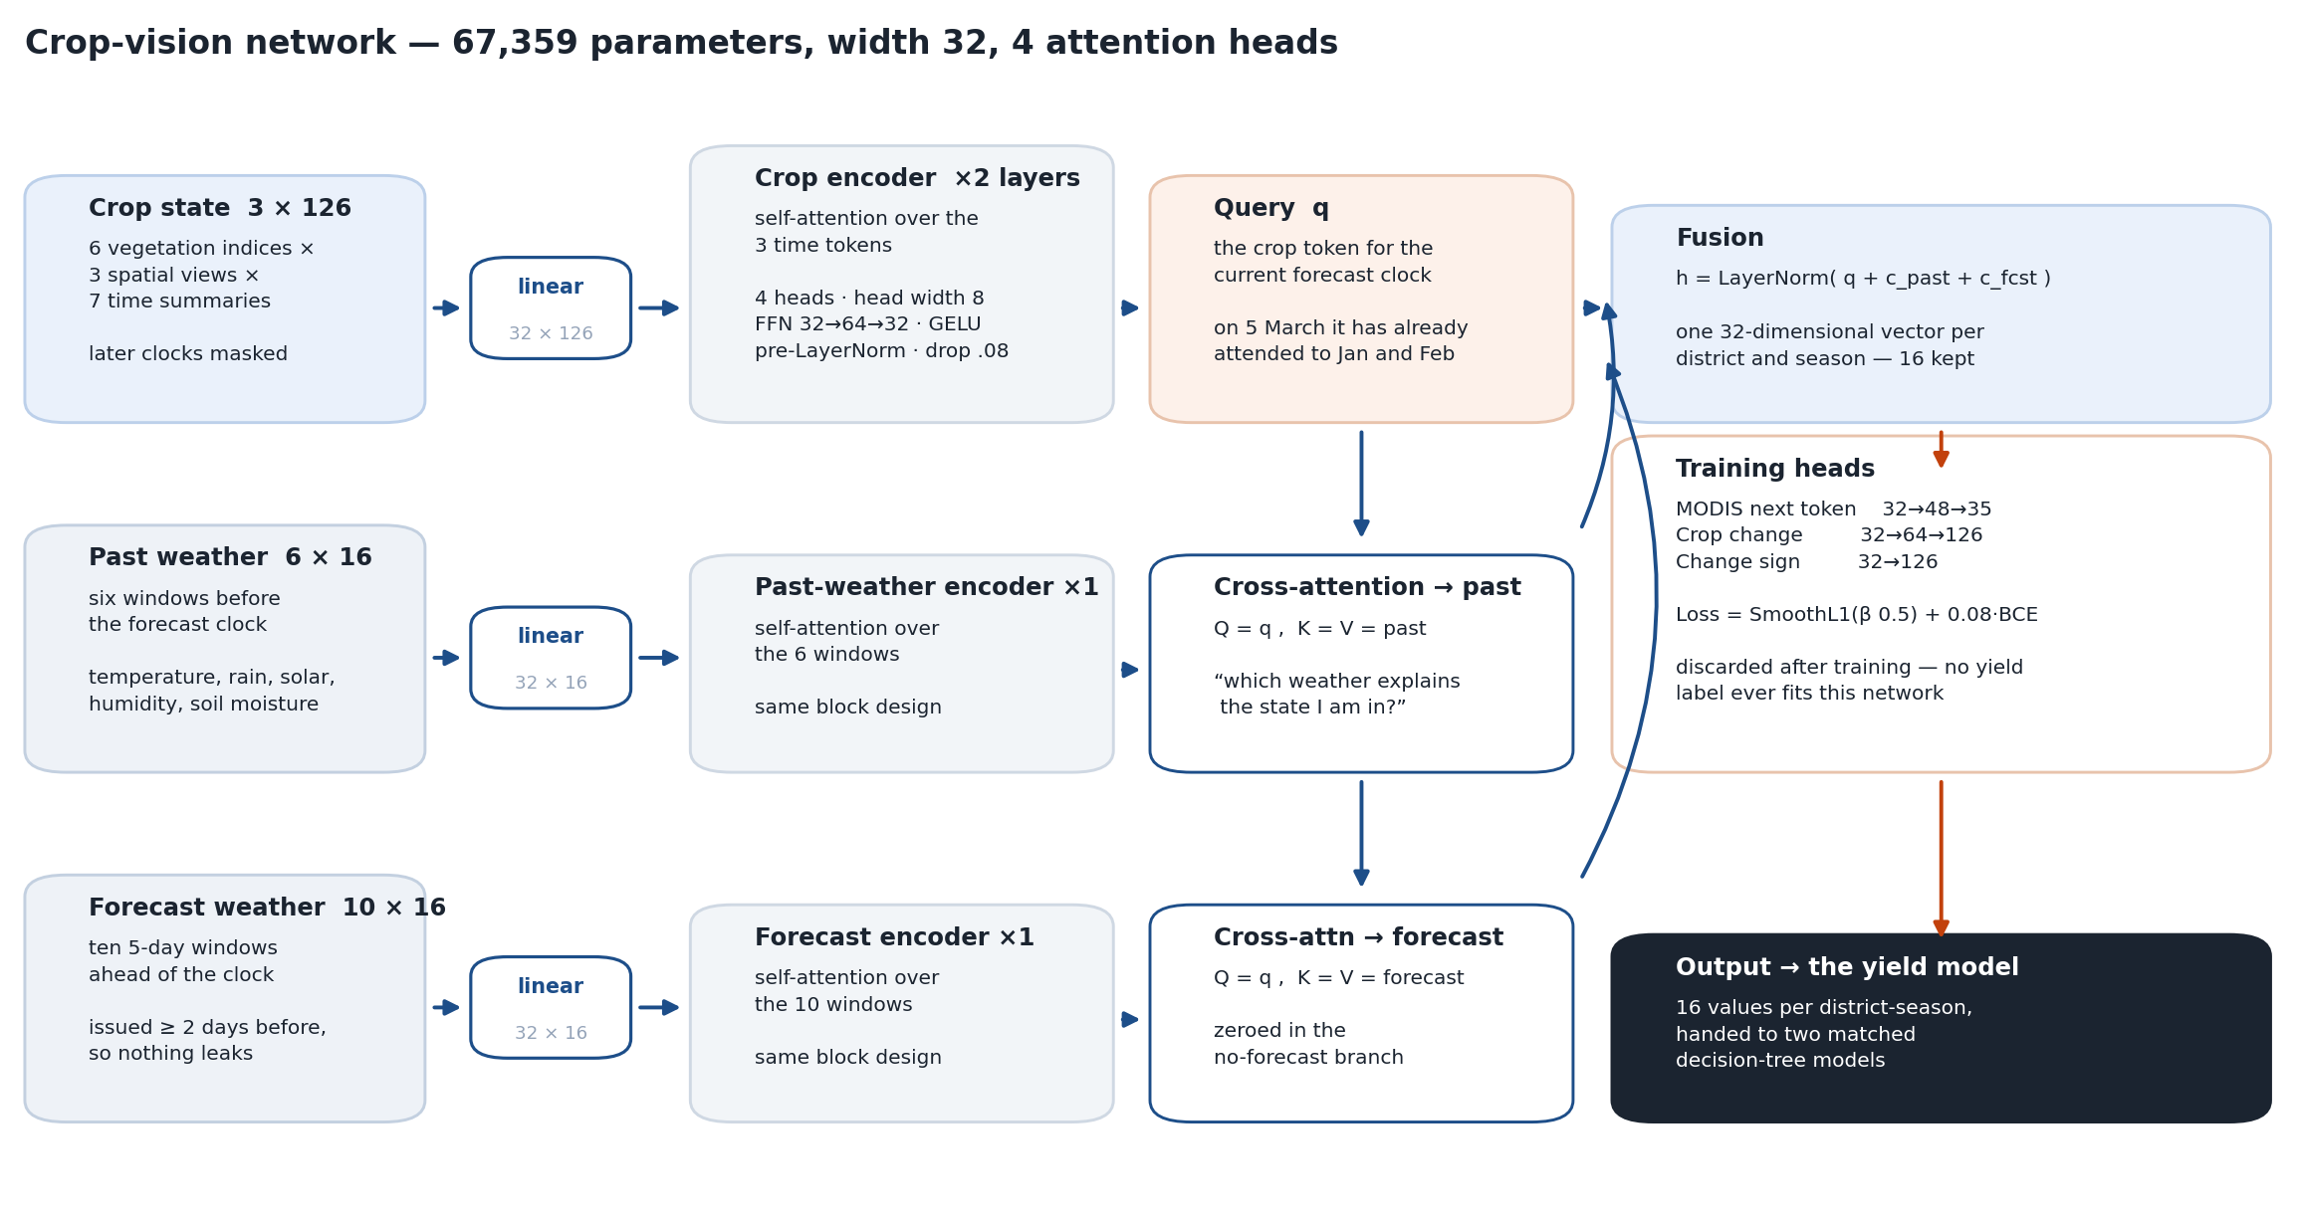
STAGE 4
The crop-vision network

Slide 16
STAGE 4
What the network is shown
Three streams of numbers. Each row of a stream is called a token — the unit the network reasons over.
Crop state
3 × 126
6 vegetation indices × 3 spatial views × 7 time summaries,
at 15 January, 15 February and 5 March
Past weather
6 × 16
six windows before the clock: temperature, rainfall, solar
radiation, humidity, wind, soil moisture at three depths
Forecast weather
10 × 16
ten dated five-day windows ahead, with spatial spread and
counts of days above 32 °C and 34 °C
Masking — how the leakage rule is enforced inside the network
At the 15 February clock the March token does not yet exist. Its attention score is set to minus infinity, so it receives exactly zero weight and cannot influence anything.

Slide 17
STAGE 4
Attention — the one operation to understand
Each token looks at all the others, decides how much each one matters, and takes a weighted average.
Attention( Q, K, V ) = softmax( Q · Kᵀ / √8 + M ) · V
Q · Kᵀ
every token's question is compared against every token's label — a large value means “you are relevant to me”
÷ √8
keeps those numbers in a sensible range as the network gets wider
+ M
the mask: minus infinity for anything not yet observable, so it gets zero weight
softmax
turns the scores into weights that are positive and add up to one
· V
the output is a weighted average of the other tokens' content
Four of these run in parallel with separate learned weights, so the network can attend to several different things at once.

Slide 18
STAGE 4
The crop asks the weather two questions
The crop token for the current date queries each weather stream separately.
c_past = MHA( q , past )
c_fcst = MHA( q , forecast )
“Which past weather explains the state I am in?”
“Which forecast weather threatens what happens to me next?”
h = LayerNorm( q + c_past + c_fcst )
LayerNorm rescales the vector to a stable range. Adding q back is a residual connection: information can bypass a layer that does not help it.
Result
one 32-value vector per district-season; 16 are kept

Slide 19
STAGE 4
How the network is trained
Two steps, neither of which uses a harvest figure.
Step 1 — learn general crop development
Step 2 — specialise on recent, sharper data
On coarse satellite data back to 2000, predict the next observation
from the previous ones.
On fine satellite data from 2017, predict how each of the 126 crop
measurements will change.
AdamW · lr 8e−4 · 24 epochs
AdamW · lr 6e−4 · 45 epochs · seeds 42, 73
Loss = SmoothL1( predicted change, actual change ) + 0.08 · BCE( predicted direction )
Smooth L1 behaves like squared error for small mistakes and like absolute error for large ones, so a cloud or a sensor fault cannot dominate training. Targets are standardised using the median and median-absolute-deviation for the same reason.

Slide 20
PROTOCOL
Preventing the model from cheating
Two mechanisms, both essential when the same districts appear in training and testing.
Time cutoffs
District cross-fitting
For a target season, nothing from that season or later is used anywhere
This includes the averages used to standardise inputs
Weather forecasts must predate the clock by two days
Districts are split into three groups. The 16 network values for a district in group 1 are produced by a network trained without group 1.
Otherwise those values would look informative simply because the network had memorised the district.
Evaluation protocol
Rolling origin — the model for each season is trained only on earlier seasons
Correction weights are chosen on development seasons and then held fixed
Later seasons are used once, for confirmation, never to choose anything

Slide 21
STAGE 5
Turning one number into a distribution
Rather than assuming a bell curve, use the errors the model has actually made in the past.
1
Collect past errors
e = y − ŷ, using only seasons before the target
2
Put them on a common scale
a = max( recent SD, 7% of normal yield, 150 ) u = e / a
3
Weight seasons equally
each row gets weight 1/n(t), so a big season cannot dominate
4
Take weighted quantiles
interpolate u at the 19 probability levels
5
Rescale and recentre
Q(α) = ŷ + a · u(α)
6
Enforce validity
running maximum so quantiles cannot cross, then clip
Step 2 matters: a 300 kg/ha error means something different in a stable district than a volatile one, so errors are divided by a district-specific size before being pooled.

Slide 22
STAGE 5
From quantiles to answers
The 19 quantiles are the distribution. Every question anyone asks is a lookup on it.
The quantiles define F
Every question is a lookup
F( Q(α) ) = α
P( rises ) = 1 − F( last )
F is the chance the harvest comes in at or below a given yield. It is known at 19 points and filled in between by straight lines.
P( fall > p ) = F( (1−p) · last )
Published at 5%, 10%, 20% and 30%.
The density curve is the slope of F
Where quantiles bunch together, a lot of probability sits in a narrow band of yields, so the curve is tall there. Where they spread out, the curve is low.
Output: one row per district-season with the point forecast, all 19 quantiles, and every threshold probability.

Slide 23
OPERATION
Running the model for one district
Nine steps, roughly three hours end to end from raw data on a single laptop.
1
Assemble lagged yield history and compute the baseline
2
Compute the 78 features from weather, soil, satellite and price data
3
Evaluate the five Blend members, apply the gate, apply the ×1.50 movement scale
4
Run the four weather-forecast models; take their difference; add at ×1.75
5
Run the two training-window models; take their difference; add at ×0.25
6
Build the crop tensors, mask anything after the clock, run the network, take 16 values
7
Run the two matched tree models with and without them; add the difference at ×2.25
8
Scale the historical error distribution to the district and recentre it
9
Interpolate the quantile curve and read off every threshold probability

Slide 24
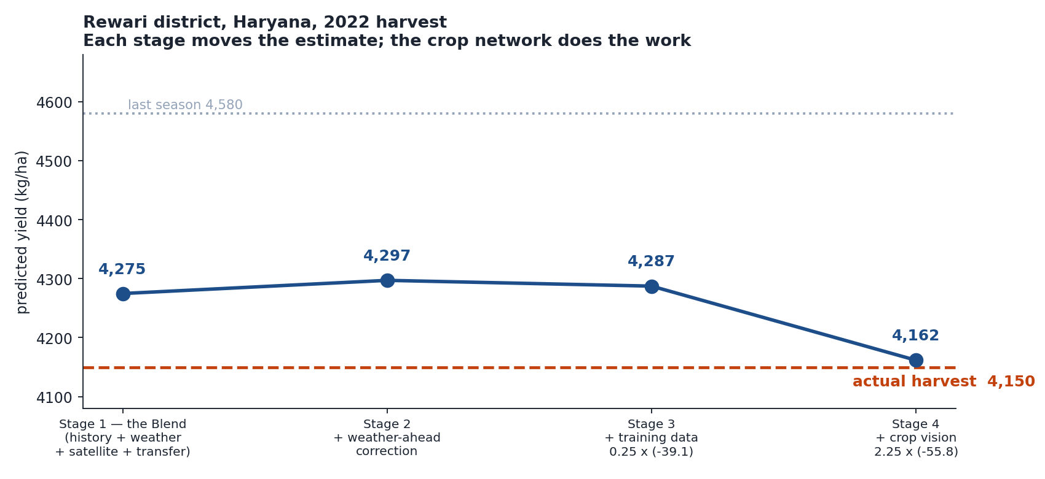
WORKED EXAMPLE
Rewari district, Haryana — 2022

Slide 25
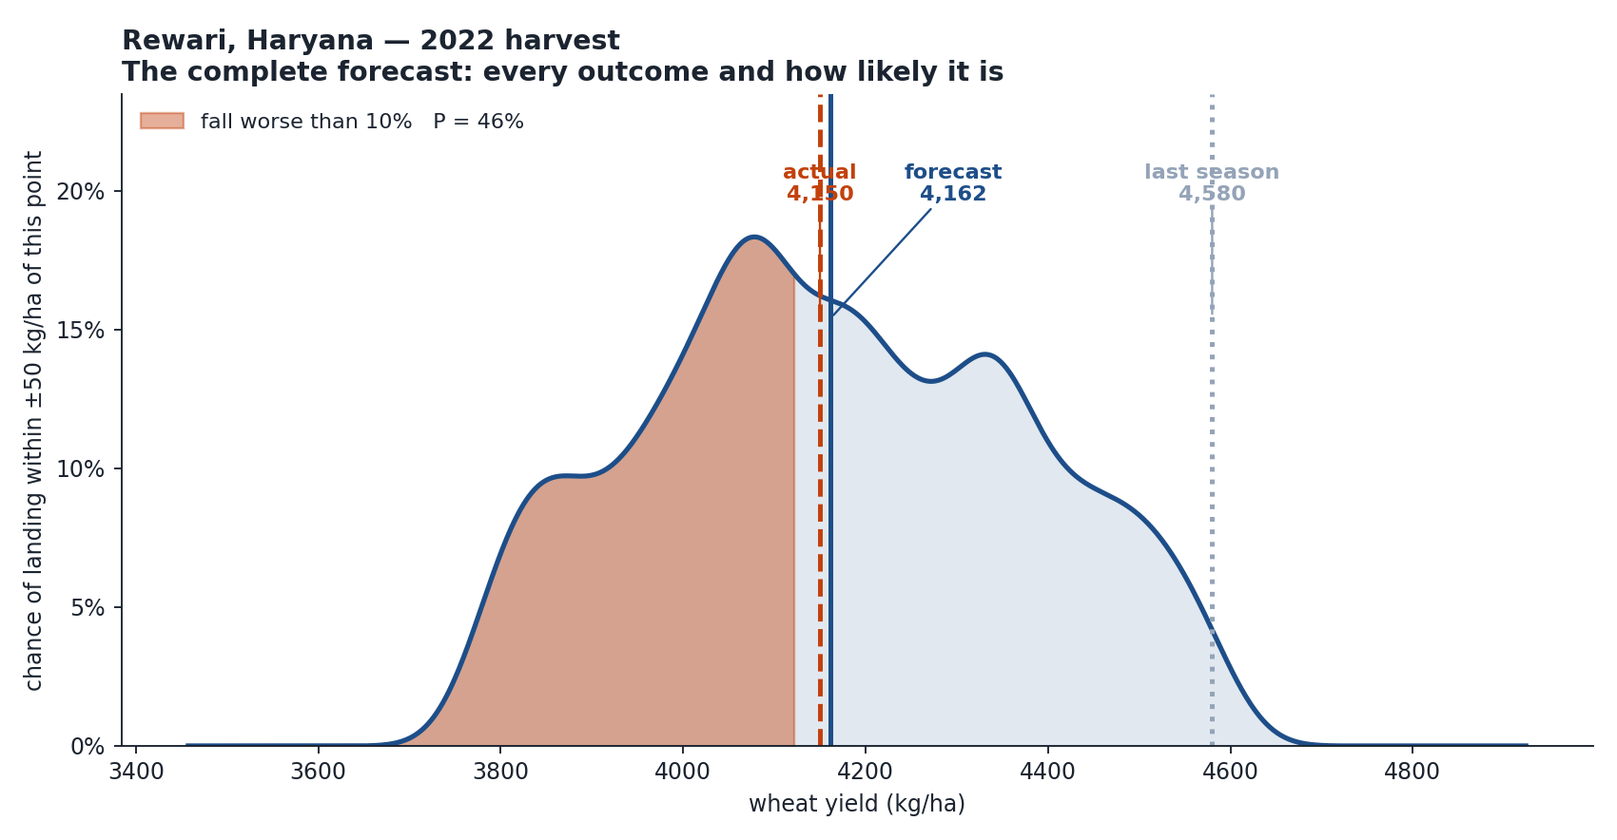
WORKED EXAMPLE
The forecast that is issued
Point forecast
4,162
80% range
3,822 – 4,529
P(increase)
8%
P(fall > 5%)
75%
P(fall > 10%)
46%
P(fall > 20%)
4%
Actual harvest 4,150
A 9.4% fall. The forecast placed it at the 10% boundary and put a decline at 92%.

Slide 26
RESULTS
Accuracy of the 5 March forecast
Measured on seasons the model never saw during fitting.
Model
2019–20
2021–22
four-year
direction
Baseline (3-season average)
—
—
333.1
—
Stage 1 — Blend
257.0
288.6
273.3
77.9%
+ Stage 2 weather ahead
254.1
288.1
271.7
78.8%
+ Stages 3 and 4 — full model
248.6
281.2
265.4
78.8%
Typical error of 265 kg/ha is about 5.9% of a 4,500 kg/ha harvest. Direction accuracy is the share of districts where the forecast landed on the correct side of last season.

Slide 27
RESULTS
The same system run seven weeks earlier
A forecast can also be issued on 15 January. It is usable, and clearly weaker.
Forecast date
2019–20
2021–22
four-year
direction
15 January
296.8
316.9
307.0
70.2%
5 March
248.6
281.2
265.4
78.8%
What waiting buys
Both dates are honestly calibrated
41.6 kg/ha less error — about 13% better
8.6 more percentage points of direction accuracy
The crop has entered grain filling and is visible to the satellite
15 Jan
5 Mar
80% ranges cover
79.3%
80.9%
90% ranges cover
90.5%
91.8%
Both should read 80% and 90%.

Slide 28
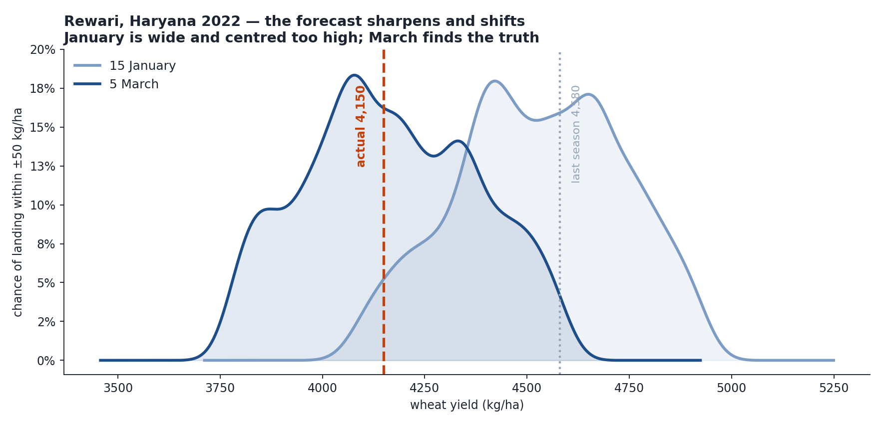
RESULTS
One district, both forecast dates
Rewari 2022. Last season 4,580 kg/ha; the harvest came in at 4,150.
15 Jan
5 Mar
Forecast
4,555
4,162
Error
405
12
P(increase)
43%
8%
P(fall > 10%)
9%
46%
In January the model expected a good year and put a serious decline at 9%. By March it had seen the crop, moved the forecast down 393 kg/ha, and raised that probability to 46%.

Slide 29
RESULTS
Are the probabilities honest?
A probability is only useful if it is true. Across all 476 district-seasons of the 5 March forecast:
When the model says…
stated
actually happened
Fall worse than 5%
29.9%
29.2%
80.9%
Fall worse than 10%
11.5%
10.9%
of harvests
land inside
the 80%
range
Fall worse than 20%
1.2%
2.3%
Any increase
45.9%
43.5%
An event the model calls 10% likely happens on about 10% of occasions. That is what makes these numbers usable for a decision rather than decoration.
One honest exception: the extreme tail is mildly over-confident — 1.2% stated for declines worse than 20%, against 2.3% observed.

Slide 30
The architecture in four sentences
A conservative baseline
a weighted average of the last three harvests; every model predicts the residual around it, so none has to learn what a district is normally worth
Four corrections
each measured as the difference between two otherwise identical models, and each deliberately shrunk before it is applied
One small network
67,359 parameters, trained on how crops develop rather than on yield, contributing 16 numbers to the final estimate
An empirical distribution
the model's own past errors, rescaled and recentred, giving 19 quantiles and every threshold probability
Output: a point forecast, a calibrated distribution, and an early warning of collapse — for 119 districts, eight weeks before harvest.

