Slide 1
Forecasting wheat yield
eight weeks before harvest
119 districts across Haryana, Punjab and Uttar Pradesh.
A point forecast, a full probability distribution, and an early warning of collapse.
Every figure in this deck is machine-verified — 96 checks, 96 pass
Notes:
The deck describes a 5 March forecasting system. All numbers are recomputed from source artifacts by scripts/verify_walkthrough.py.

Slide 2
THE TASK
Predict the harvest before it happens
5 March
119
4,500
the forecast date — eight weeks before harvest
districts, averaging 3,400 km² each
kg per hectare — the typical yield
Why it is hard
The crop is not finished — a late-March heatwave can still destroy 20% of it
Districts are huge — half can fail while the other half thrives
Ground truth arrives once a year, and neighbouring districts fail together

Slide 3
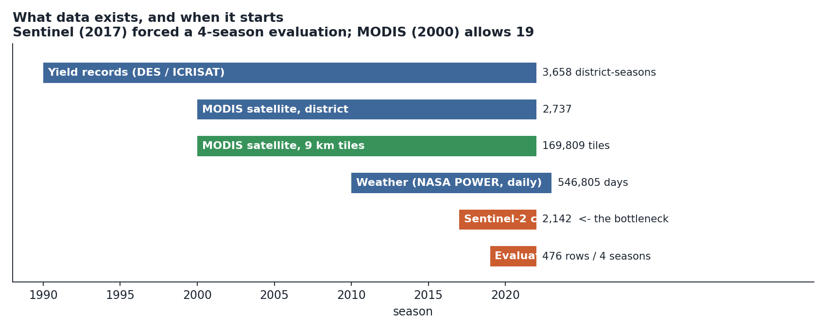
THE DATA
The sharpest data starts too late
Sentinel-2 begins in 2017, leaving four testable harvests. MODIS reaches back to 2000 — nineteen.

Slide 4
THE MODEL
Five stages, each a small correction
typical error, kg/ha →
0
Baseline
Weighted average of the last three harvests
333
1
The Blend
Five simple models, a disagreement gate, movement calibration
273
2
Weather ahead
What changes when the model may see the 10-day forecast
272
3
Training data
Train on more seasons (small, uncertain)
—
4
Crop vision
A transformer reads satellite crop condition
265
Never let a new component predict the harvest alone. Let it nudge a conservative estimate.

Slide 5
STAGE 4 — CROP VISION
A network that never sees a harvest figure
The problem Thousands of examples of how wheat develops. Only a handful of harvests.
67,359
The solution Train it on the data-rich question — how will the crop change between January and March — then hand its internal summary to a simple model for the data-poor one.
learned numbers — one layer of a small language model
16
values it hands to the yield model, down from 30
Attention, in one line
Each piece of input decides how much to listen to every other piece — then takes a weighted average.
±130
kg/ha — how far it can move a forecast

Slide 6
STAGE 4 — THE KEY FINDING
Removing inputs made it stronger
Before
After
30
16
6 raw satellite averages needing no network at all
8 weak change summaries
16 genuine network outputs
The 6 raw averages correlated 0.024 with the model's errors — nothing
They made accuracy worse
The remaining 16 could then be trusted at nearly double the weight
Removing features let the remaining signal be believed harder.

Slide 7
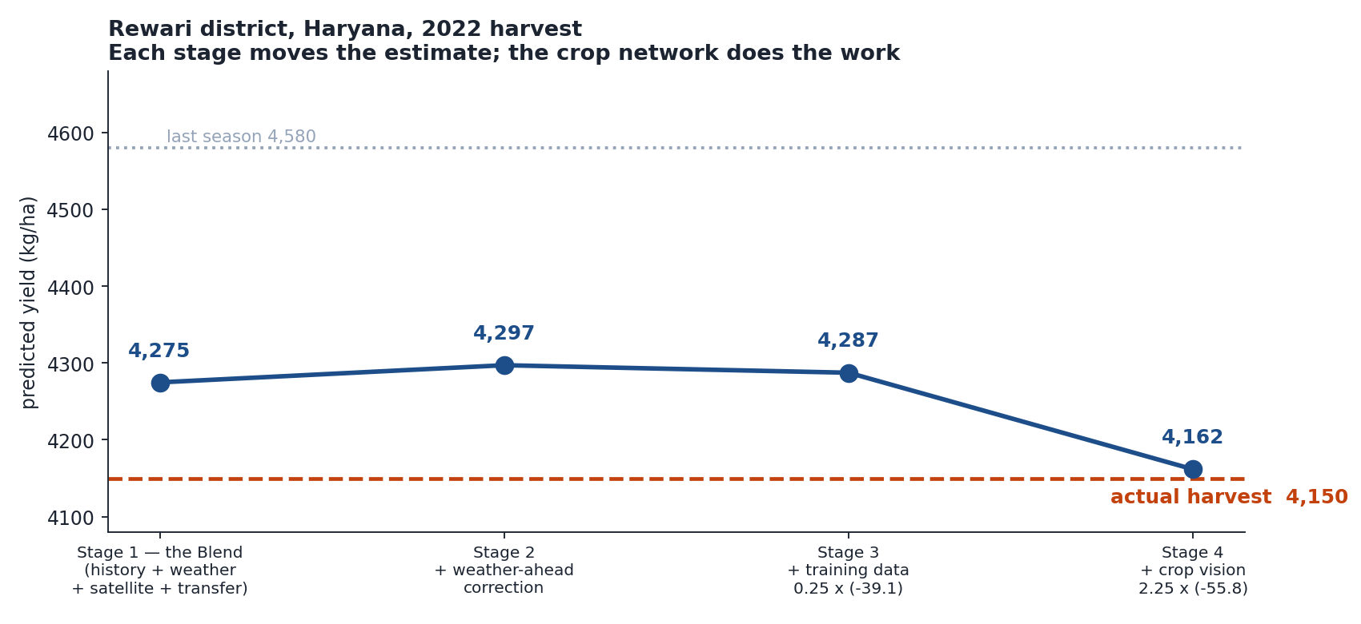
WORKED EXAMPLE
Rewari district, Haryana — 2022

Slide 8
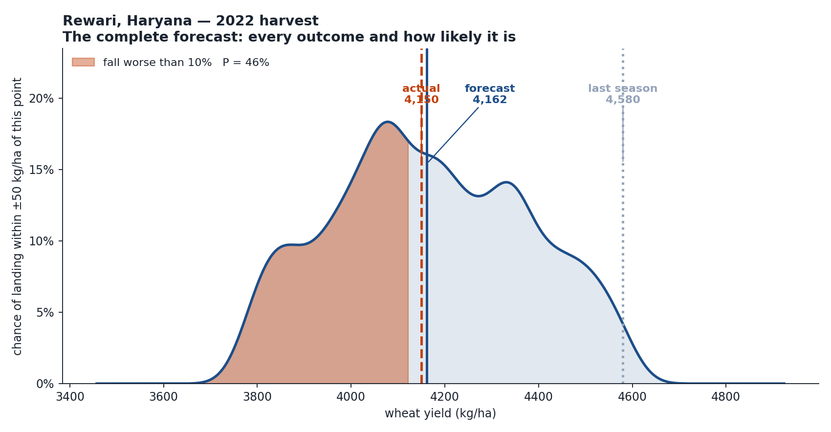
WORKED EXAMPLE
The forecast is a distribution, not a number

Slide 9
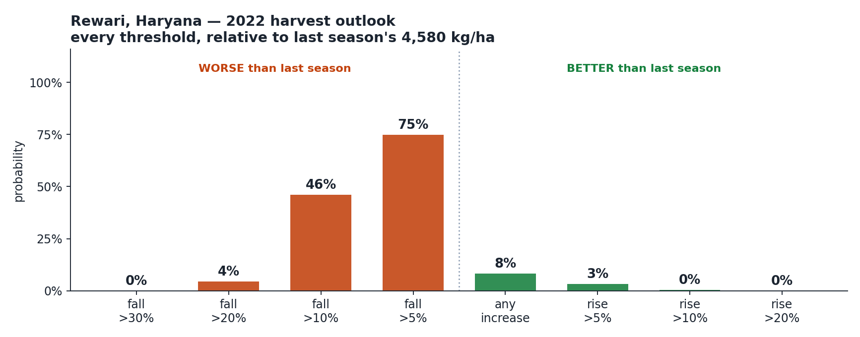
WORKED EXAMPLE
Every threshold a planner asks about
Rewari fell 9.4%. The model called a decline 92% likely and put it right at the 10% boundary.

Slide 10
DOES IT WORK?
The probabilities are honest
When the model says…
Stated
Actually happened
Fall worse than 5%
29.9%
29.2%
80%
ranges cover
Fall worse than 10%
11.5%
10.9%
80.9%
Fall worse than 20%
1.2%
2.3%
of the time
A 10% chance
happens 10% of the time.
Any increase
45.9%
43.5%
Across all 476 district-seasons
Slightly over-confident about catastrophes: 1.2% stated for falls worse than 20%, where 2.3% occur.

Slide 11
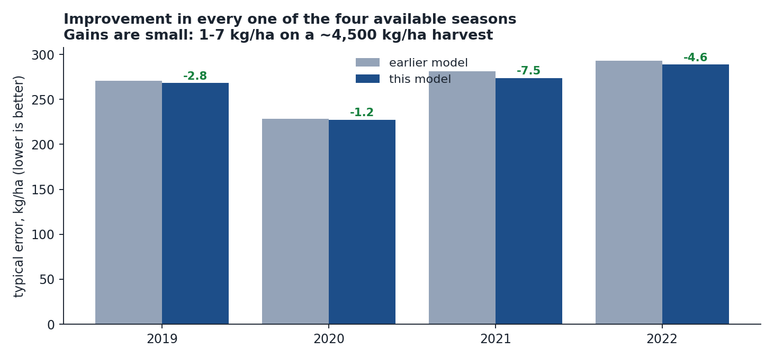
DOES IT WORK?
Better in every season available
265
kg/ha typical error — 5.9% of a harvest
4 of 4
seasons improved
78.8%
up-or-down called correctly
Never “100% confident” — with four seasons a resampling test reports certainty automatically whenever all four agree. Say “4 of 4” and let the reader judge.

Slide 12
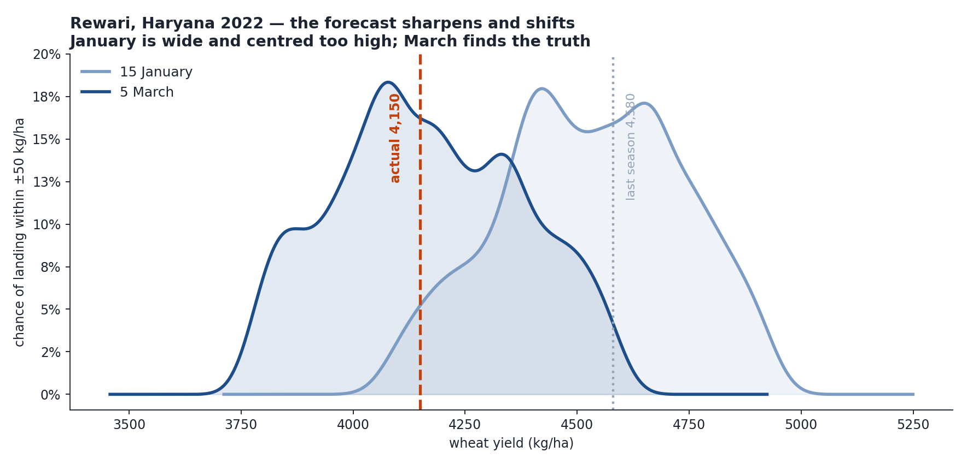
FORECAST DATE
What waiting until March buys you

Slide 13
FORECAST DATE
The same district, seven weeks apart
15 January
5 March
Point forecast
4,555
4,162
4,150
Error
405
12
the actual harvest
January said a serious
decline was 9% likely.
March said 46%.
P(increase)
43%
8%
P(fall over 10%)
9%
46%
The information arriving in February and early March is what turns a wrong answer into a right one.

Slide 14
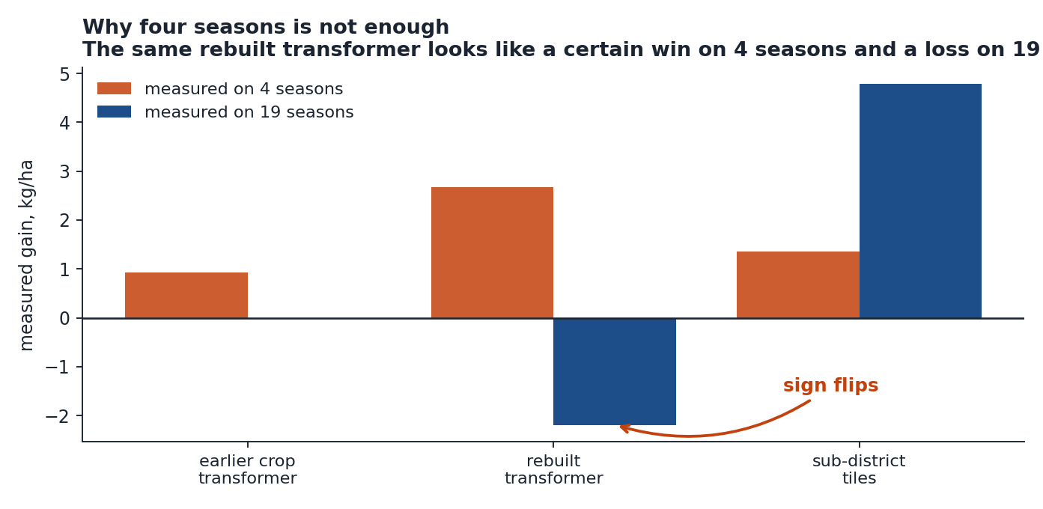
THE METHODOLOGY
Four seasons can point the wrong way
The noise floor
Re-run the model changing only the order the input columns are listed in. No information changes — but the score moves anyway.
±0.6
kg/ha of pure noise
The earlier model's headline result was 0.9 — inside its own noise floor.
A rebuilt network looked like a certain win on four seasons and a loss on nineteen. The sign flips.

Slide 15
THE METHODOLOGY
Most things did not work
Rebuilt network, better architecture
worse over 19 seasons
Sub-district tiles into the existing model
no effect
Network output as a direct correction
correlation 0.024 with real errors
Network output in the uncertainty model
coverage collapsed 79% → 60%
Fine-tuning the network directly on yield
378 kg/ha versus 265
Collapsing all five stages into one model
−77 kg/ha
Every intervention that supplied more or better data helped. Every cleverer network on the same data did not.

Slide 16
What it delivers
265
80.9%
kg/ha typical error — 5.9% of a harvest
of harvests land inside the 80% range
0.82
3 hrs
skill at ranking a >10% collapse
to run the whole pipeline on one laptop
The largest verified improvement came from removing fourteen useless inputs — not from adding anything.
Notes:
Close on the methodology point: resolution and sample size were the binding constraints, not architecture.

