Slide 1
Face Recognition, Built and Measured
A pretrained FaceNet versus our own ArcFace-trained MobileNetV2
Aaryan | Computer vision project | October 2026
Notes:
Introduce the project in one sentence: a face recogniser that works live on a webcam, plus our own trained model compared honestly against a pretrained one. The dots on the right are the idea of the whole talk: faces become points, and the same person lands close together.

Slide 2


Two questions a face system answers
Verification
1 : 1
Identification
1 : N
Are these two photos the same person?
Who is this, out of everyone enrolled?
photo A
photo B
same?
photo
N people
who?
1
A live recogniser
2
Our own model
3
An honest comparison
Webcam demo using a pretrained FaceNet
MobileNetV2 trained with ArcFace loss
ROC curves on people never seen in training
Notes:
Verification is a 1-to-1 question: are these two photos the same person. Identification is 1-to-N: who is this among everyone enrolled. Our demo does identification; our evaluation uses verification pairs because that is the standard way to score face models. Then state the three deliverables.

Slide 3
The core idea: faces become vectors
Embedding space (2-D sketch)
Face crop
CNN
(neural network)
[ 0.12, -0.41, 0.07, ... ]
128 or 512 numbers
Person B
A CNN turns each face crop into a fixed-length vector, the embedding
Same person: vectors point the same way (high cosine similarity)
Different people: vectors point apart (low similarity)
A new person needs no retraining, only their stored vectors
far apart
Person A
Close = same person
Notes:
A CNN maps a face crop to a fixed-length list of numbers, the embedding. If the network is good, two photos of the same person give vectors that point the same way, so their cosine similarity is high. Different people give low similarity. This is why we can add a new person without retraining: we just store their vectors.

Slide 4
System: enrol once, recognise live
1 ENROL (once per person)
Webcam
15 samples
Detect face
(MTCNN)
Crop and
resize
Embedding
model
Gallery
(saved vectors)
compare
2 RECOGNISE (every few frames)
Webcam
frame
Detect face
(MTCNN)
Crop and
resize
Embedding
model
Cosine match
vs gallery
Above threshold?
Name / Unknown
Dashed box: the only stage that changes between FaceNet and our model
Notes:
Walk the two rows. Top row, enrolment: we capture about fifteen frames of a person, detect and crop the face, turn it into an embedding and store it in the gallery file. Bottom row, recognition: every few frames we do the same up to the embedding, then compare to the gallery with cosine similarity and apply a threshold. Below the threshold we say Unknown. The dashed boxes are the only part that changes between FaceNet and our model.

Slide 5
Step one: find the face (MTCNN)
Input frame
many scales
P-Net
proposals
R-Net
refine
O-Net
final output
Face box
+ landmarks
Image pyramid, so faces of any size are found
Small fast CNN scans for thousands of candidate windows
Bigger CNN drops false hits and tightens boxes
Biggest CNN: box, eyes, nose and mouth corners
Keep only confidence of 0.95 or more
Why detect first?
Shared by both models
The embedding model should see only the face, not the background, so we crop to the box before embedding.
FaceNet and our model use the same detector, so any accuracy difference comes from the embedding model alone.
Notes:
MTCNN is a three-stage cascade. Each stage is a bigger and more selective network, so cheap early stages throw away most of the image and the expensive stage only looks at a handful of candidates. It outputs a box, a confidence score and five landmarks. We keep boxes with confidence at least 0.95. Both models share this detector, so any accuracy gap is down to the embedding model alone.

Slide 6
Model A: pretrained FaceNet
Face crop
160 x 160
Inception-
ResNet-v1
(pretrained)
512-number
embedding
The idea behind FaceNet: triplet loss
push away
A
N
Architecture from the FaceNet paper
Weights pretrained on millions of face images
Used as-is: we did not train it
Embedding is length-normalised, so comparison is cosine similarity
pull closer
P
A anchor P same person N different person
d(A, P) + margin < d(A, N)
Notes:
This is the model the live demo uses today. It is the FaceNet architecture, Inception-ResNet-v1, with weights somebody else trained on millions of face images. We did not train it. The panel on the right shows the idea behind FaceNet from its paper, the triplet loss: pull an anchor towards another photo of the same person and push it away from a different person, by at least a margin.

Slide 7
Model B: our MobileNetV2 embedder
Input
112 x 112 x 3
Rescale
0-255 to -1..1
Augment*
flip, rotate, zoom
MobileNetV2
(ImageNet start)
Global
average pool
Dropout
0.3
Dense
128
Batch
norm
L2
normalise
Embedding
128 numbers
* augmentation is active only while training
ArcFace head (training only): learns one direction per training person; discarded after training
Notes:
This is the model we train. Top row: a 112 by 112 image is rescaled, randomly flipped, rotated and zoomed during training only, then passed through MobileNetV2 that was pretrained on ImageNet, then global average pooling. Bottom row: dropout, a dense layer down to 128 numbers, batch norm and length normalisation give the embedding. The dashed ArcFace head only exists during training to teach the embedding; we discard it and save just the embedder.

Slide 8
ArcFace: forcing a gap between people
Plain softmax: clusters can touch
ArcFace: a margin is enforced
m
Tight packing: easy to confuse faces
Gap enforced: cleaner separation
logit = s × cos(θ + m)
s = 30 scale, m = 0.5 rad margin, θ = angle between the embedding and its true person's centre
Notes:
Plain softmax only asks that the right class wins, so clusters of different people can touch and be confusable. ArcFace puts every embedding on a hypersphere and adds an angular margin m to the angle between an embedding and its true class centre before the softmax. To still classify correctly, the network must pull each person's faces into a tight cluster with empty space around it. We use scale s equal 30 and margin m equal 0.5 radians.

Slide 9
How we trained it
LFW photos
10 or more per person
Split by person
80% train, 20% held out
Stage 1
freeze backbone
8 epochs, lr 1e-3
Stage 2
unfreeze top 40
12 epochs, lr 1e-4
Save
embedder.keras
Why two stages?
Why split by person?
The new layers start random. Training them first stops noisy gradients from damaging the pretrained backbone, which is then gently fine-tuned.
Held-out people never appear in training, so the test measures recognising strangers, exactly like the real demo.
Notes:
We use the LFW dataset, keeping people with at least ten photos. Crucially we split by identity: eighty percent of the people go to training and twenty percent are held out and never seen. Training has two stages. First we freeze the ImageNet backbone and train only the new layers, then we unfreeze the last forty backbone layers and fine-tune with a ten times smaller learning rate. The output is a single saved file, embedder.keras. Train on Colab with a T4 GPU.

Slide 10
How we measure it
Held-out people
never trained on
Build pairs
same / different
Embed both
faces
Cosine
similarity score
Sweep threshold
ROC curve
AUC
EER
TAR @ 1% FAR
Best accuracy
higher is better
lower is better
higher is better
higher is better
Chance a same-person pair scores above a different-person pair. 0.5 is guessing, 1.0 is perfect.
Error rate where false accepts equal false rejects. One number for overall quality.
Share of true matches accepted while only 1% of strangers get in.
Accuracy at the best threshold, which also sets the demo threshold.
Notes:
We score both models on the held-out people only. Build pairs of photos: genuine pairs of the same person and impostor pairs of different people. Embed both photos, take cosine similarity, and sweep a threshold to trace an ROC curve. We report four numbers: AUC, equal error rate, true accept rate at one percent false accepts, and best accuracy. The best-accuracy threshold also tells us what threshold to use in the live demo.

Slide 11
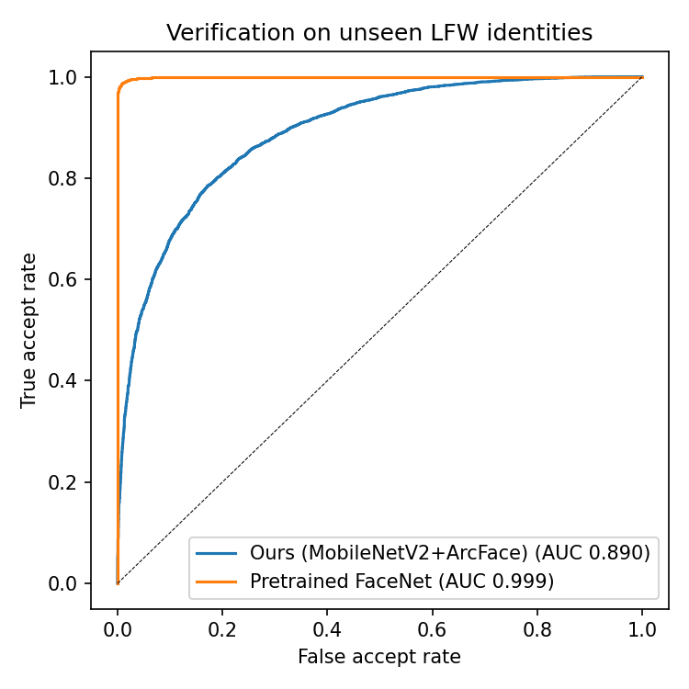
Results on people the models never saw
Metric | Ours MobileNetV2 + ArcFace | Pretrained FaceNet
AUC (higher) | 0.890 | 0.999
EER (lower) | 0.196 | 0.011
TAR @ 1% FAR (higher) | 0.277 | 0.989
Best accuracy (higher) | 0.806 | 0.989
FaceNet is expected to lead: it learned from millions of images, ours from a few thousand. The point is a measured, honest comparison.
Notes:
Read the table row by row, then the ROC curve: the curve closer to the top-left corner is better. Point out the gap and explain it: FaceNet saw millions of images, ours a few thousand. The thresholds in the last row are what we use in the live demo.

Slide 12
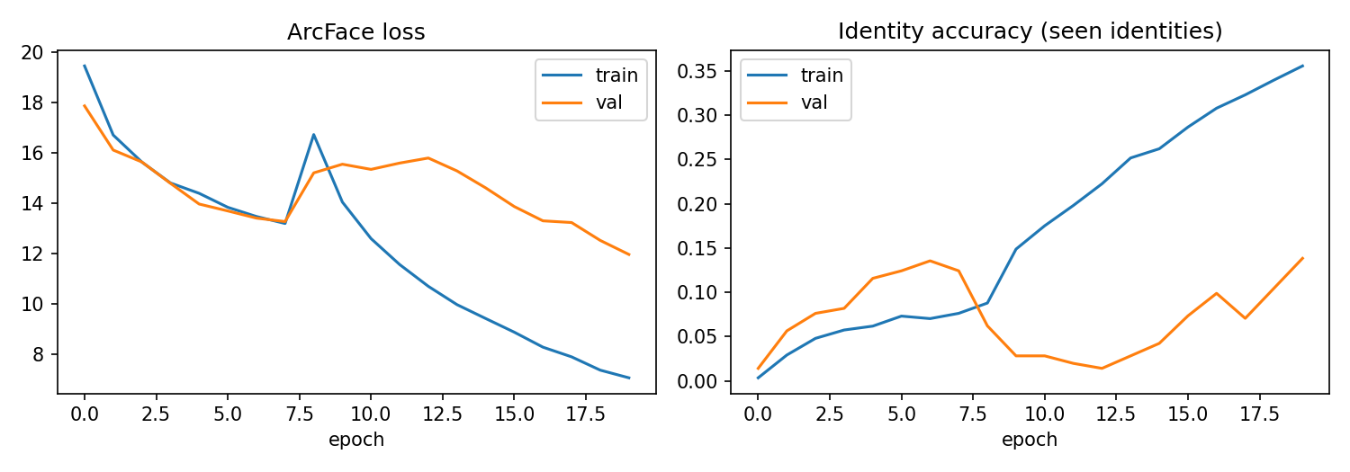
What training looked like
Loss falling
Train vs validation gap
Change at epoch 8
Embeddings of the same person are clustering.
Overfitting, expected with only thousands of images.
Backbone unfreezes and fine-tuning begins.
Notes:
Left plot is the ArcFace loss, right plot is identity accuracy on people the model trained on. Point out the change at the stage boundary when the backbone unfreezes, and the gap between training and validation, which is expected with a few thousand images. Paste training_curves.png if it is not filled in.

Slide 13
Live test: both models, same frames
MTCNN + FaceNet
embedding
Match vs
gallery.npz
Label
above box
One video,
two labels
Webcam
frame
MTCNN + ours
embedding
Match vs
gallery_custom.npz
Label
below box
Measured live with: python demo.py compare --truth YOURNAME
Metric | FaceNet | Ours
Average time per frame (ms) | - | -
Correct on single-face frames | - | -
Shown as Unknown | - | -
Named the wrong person | - | -
Notes:
Run python demo.py compare with your own name as truth. Both pipelines see exactly the same webcam frame. FaceNet's label is drawn above the box, ours below. When you quit, the script prints average time per frame and, for frames with a single face, how often each model was correct, said Unknown, or named the wrong person. Fill the table with those numbers.

Slide 14




Limits and responsibilities
Lighting and pose
Dataset bias
Accuracy drops in dim light, strong shadows or extreme head angles. Enrol varied samples.
LFW is mostly public figures with skewed demographics, so results may not carry over to everyone.
No liveness check
Privacy and consent
A printed photo or phone screen can fool the system. Real products add anti-spoofing.
Face data is personal. Enrol only people who agree, and store embeddings, not photos.
Notes:
Be upfront about what this system does not do. Lighting and pose change embeddings. LFW is mostly public figures and skews demographically, so results may not transfer. There is no liveness check, so a printed photo can fool it. And face data is personal: only enrol people who agree, and we store embeddings rather than photos.

Slide 15
Where this goes next
Now
More data
Alignment
Margin sweep
Robustness
1
2
3
4
5
Live demo, ArcFace model, ROC comparison
Train on CASIA-WebFace or VGGFace2 and use it in the demo
Rotate faces upright using MTCNN landmarks
Compare margins m = 0.3 and 0.5 and report the effect
Liveness check, plus TFLite export for speed
Notes:
Step one is what we have now. The biggest gain will come from more and better data, so training on CASIA-WebFace or VGGFace2 is next. Then align faces with MTCNN landmarks, sweep the ArcFace margin, and finally add anti-spoofing and a TFLite export for speed.

Slide 16
What we built
1
A working recogniser
Detect, embed and match, live on a webcam
2
A trained model
MobileNetV2 with ArcFace loss, tested on unseen people
3
A fair comparison
ROC, EER and TAR @ 1% FAR, plus a live test against FaceNet
Questions?
Notes:
Close with the three takeaways, then open for questions. If asked why FaceNet wins: far more training data. If asked what is novel: the full pipeline, ArcFace training and an honest evaluation on unseen identities.

