Slide 1

AES KEY RECOVERY
via Machine Learning on Power / EM Traces
Replication of Poudel & Rahimi (arXiv:2508.11817, 2025) on the ASCAD dataset,
with three extension milestones: architecture comparison, multi-task learning,
and desynchronization robustness.
SIDE-CHANNEL
CRYPTANALYSIS
Aaryan // Laboratory Project // 2026

Slide 2





ROADMAP
What we'll cover
01
02
03
The Threat
The Dataset
The Metric
What a side-channel attack is, and what the attacker sees vs. recovers
ASCAD electromagnetic traces, labels, and the attack pipeline
Why raw accuracy is meaningless here — Key Rank / Guessing Entropy
04
05
06
The Models
Three Milestones
The Result
Random Forest, SVM, CNN, ResNet, multi-task ResNet
Baseline -> architecture study -> five extension experiments
Key byte #2 recovered: 0xE0, correctly, in ~1,360 traces
02

Slide 3



THE THREAT
AES is unbreakable... on paper
AES-128 has no known practical mathematical attack. But a physical chip leaks information while it computes: power draw and electromagnetic emissions vary with the data being processed. That leakage is a side channel — and it can be learned by a model.
EM TRACE (SAMPLE)
The target
An AVR microcontroller (ATMega8515) running textbook AES-128 encryption.
The leakage
Electromagnetic emissions captured as a 700-sample trace per encryption.
highlighted window: leakage of the masked S-box operation for key byte #2
The goal
Recover the secret key from traces + known plaintexts — never the key itself.
~10,000 attack traces x 700 samples each
public dataset: ANSSI / ASCAD (CHES 2018)
03

Slide 4

THREAT MODEL
What the attacker has vs. what comes out
GIVEN TO THE ATTACKER
RECOVERED BY THE MODEL
~10,000 EM power traces (700 samples each)
the plaintext of every encryption (public)
the ASCAD device's leakage model / trace format
ONE KEY BYTE
0xE0
key byte #2 of 16 — the ASCAD benchmark target
NOT given: the secret key
correct — matches the true device key exactly, using ~1,360 attack traces
04

Slide 5


METHODOLOGY
The attack pipeline, end to end
1
2
3
4
5
->
->
->
->
Raw traces
Preprocess
Model
Key-rank
Recover
50k profiling + 10k attack traces, 700 samples
Standardize (fit on profiling only)
P(class = Sbox(p XOR k) | trace)
Accumulate log-likelihood over 256 key guesses
True byte reaches rank 0
score(g) = sum_i log P( class = Sbox(plaintext_i XOR g) | trace_i )
Rank the true key byte among all 256 hypotheses g. Rank 0 = recovered. This is what actually measures attack success — not classification accuracy.
05

Slide 6


EVALUATION
Why "accuracy" is the wrong scoreboard
Top-1 accuracy on the 256-class problem is 0.4-1% — barely above the 1/256 = 0.39% random-guess floor. A model that looks almost useless can still fully recover the key, because a tiny per-trace bias compounds over thousands of traces.
ACCURACY (misleading)
KEY RANK (ground truth)
0.67%
RANK 0
CNN top-1 accuracy — chance is 0.39%. Looks almost random.
by ~1,360 attack traces — the true byte is ranked #1 out of 256 hypotheses.
If you selected models on this metric, you'd throw away the one that actually works.
This is the metric used for every model comparison in this project.
06

Slide 7




MODELS UNDER TEST
Five model families, one benchmark
Random Forest
Weak
300 trees, tabular baseline
SVM (PCA-50 + RBF)
Weak
subsampled to 10k, O(n^2) cost
CNN (Zaid, compact)
Recovers
~17k-param 1D conv net, one-cycle LR
ResNet (1D, residual)
Recovers + robust
deeper, kernel-11 + SELU blocks
Multi-task ResNet
Best (fixed-key)
shared trunk, 3 joint heads
07

Slide 8
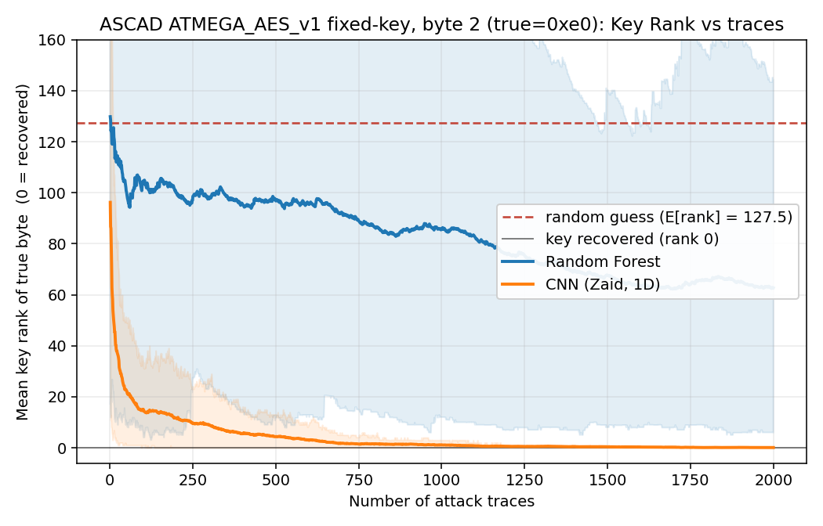
MILESTONE 1 - BASELINE
Random Forest vs. CNN — the first result
RANDOM FOREST
0.46%
attack accuracy (chance 0.39%)
never converges
CNN (ZAID, 1D)
0.67%
attack accuracy
rank 0 by ~1,360 traces
08

Slide 9
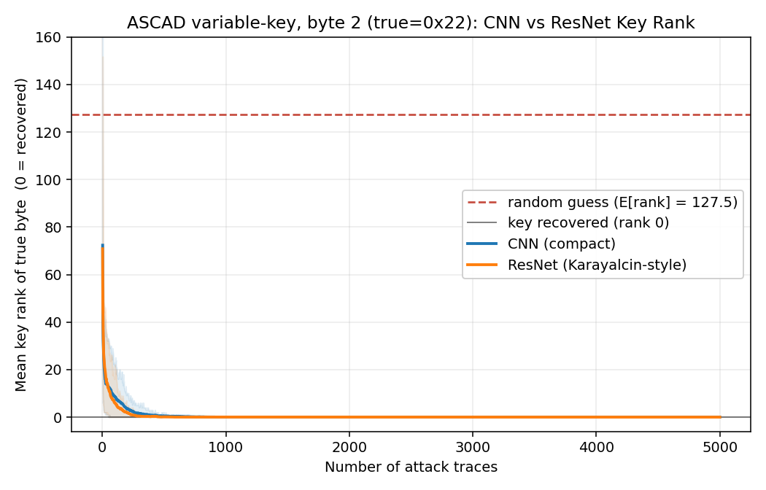
MILESTONE 2 - ARCHITECTURE
ResNet vs. CNN on the harder variable-key set
TRACES TO RANK 0
CNN, variable-key
516
ResNet, variable-key
276
ResNet, fixed-key
868
CNN, fixed-key
1,362
On the harder variable-key dataset, the ResNet needs under half the traces the CNN does — the paper's qualitative finding, reproduced.
09

Slide 10



MILESTONE 3 - EXTENSIONS
Six threads, stress-testing the pipeline
a
b
c
SVM baseline
Multi-byte attempt
Multi-task ResNet
Rank 138, no recovery — confirms only CNN/ResNet exploit the leakage
Bytes 3-4 stuck at chance — data-limited, not a modeling failure
3x fewer traces on fixed-key (270 vs 868) via auxiliary mask heads
d
e
f
Desync robustness
Seed variance
Shuffled-label control
CNN collapses under jitter; ResNet still recovers the key
276 vs 1,540 traces across 2 seeds — single-run results can mislead
Accuracy = exact chance (0.388%) — no label-artifact shortcut
10

Slide 11
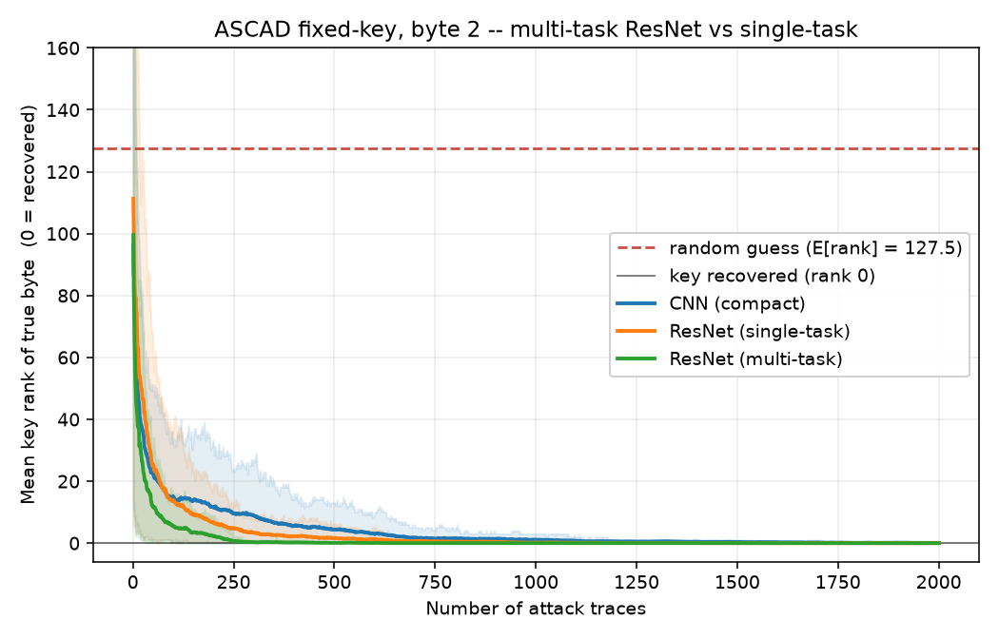
MILESTONE 3C - MULTI-TASK LEARNING
Auxiliary heads break the training plateau
3x
fewer traces to recover the key, fixed-key set (270 vs. 868 for single-task ResNet)
But not a free lunch
On the harder variable-key set, the auxiliary heads add noise instead of signal: 3,374 traces vs. 276 for the plain ResNet — worse, not better.
11

Slide 12
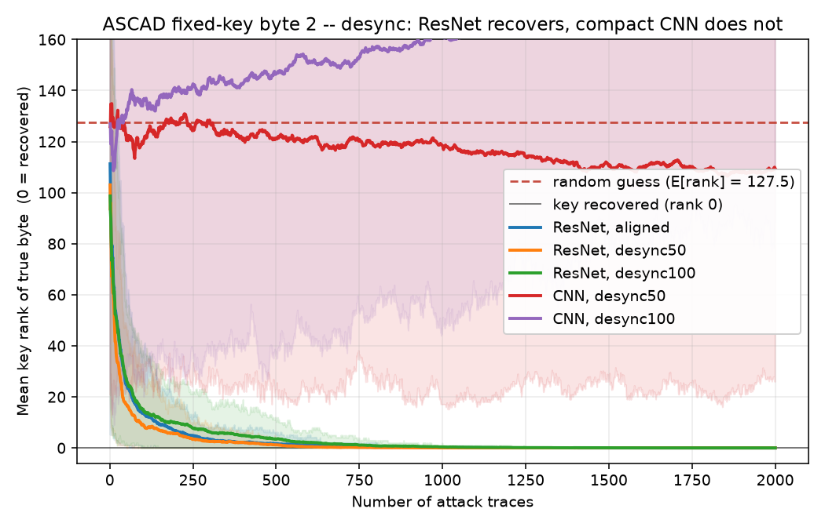
MILESTONE 3D - ROBUSTNESS
Misalignment breaks the CNN, not the ResNet
TRACES TO RANK 0
aligned
desync50
desync100
CNN
1,362
no recovery
no recovery
ResNet
868
608
979
The compact CNN has zero shift tolerance — any tested jitter drops it to chance. The ResNet still recovers the key at both jitter levels, with only a modest trace penalty.
12

Slide 13
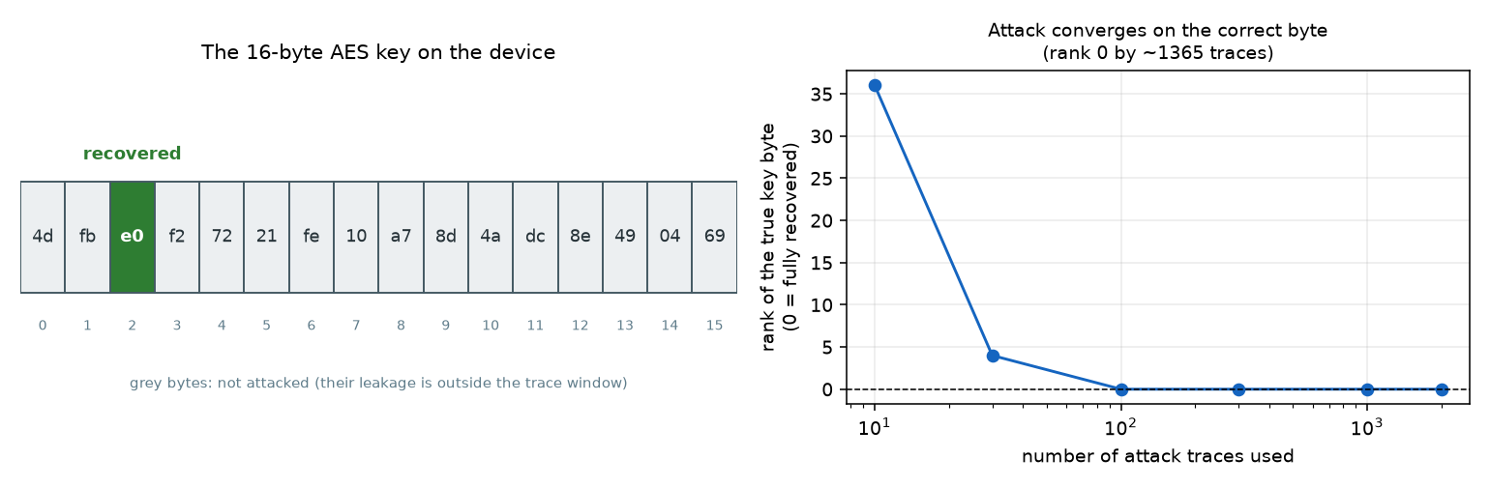
THE RESULT
The recovered byte, end to end
true key: 4d fb e0 f2 72 21 fe 10 a7 8d 4a dc 8e 49 04 69 byte #2 recovered correctly, ~1,360 traces
13

Slide 14
METHOD NOTES
Where this replication departs from the paper
Target byte
byte 2 (community standard — ASCAD masks only bytes 2-15)
CNN architecture
compact ~17k-param net (Zaid et al.), not the 60M-param VGG head — the VGG memorizes and never ranks the key here
Model selection
checkpoint chosen by validation Guessing Entropy, not validation loss — CE loss is flat/rising for ~20 epochs while the attack is already improving
Full-key recovery
out of scope — the extracted .h5 is a trace window around byte 2 only; bytes 3-15 need the ~60GB raw capture
14

Slide 15

TAKEAWAYS
What this project shows
A tiny per-trace statistical bias, invisible to top-1 accuracy, is enough for a neural net to fully recover a real AES key byte.
Architecture matters more than the paper's framing suggests: the ResNet beats the compact CNN specifically where alignment is imperfect.
Multi-task auxiliary losses can break the masked-SCA training plateau 3x faster — but only help on the dataset they were tuned for.
A shuffled-label control confirms the whole pipeline is exploiting real leakage, not a label-distribution artifact.
15

Slide 16
Thank you
Questions? — code, report, and results at the project repository
python -m src.demo · README.md · report/ASCAD_replication_report.pdf

