Slide 1
P19
Online Grocery Delivery Platform
A role-based quick-commerce backend - Node.js | Express | MongoDB
CIA-3 Project Development | 5th Semester, Christ University
Course: Backend Development with Node.js, Express, and Mongo
Team 19 | Section 5 BTCS B

Slide 2
SUBMISSION
Team Details
S.No | Student Name | Roll No. | Department | Section
1 | A Aaryan Dharrmik | 2460301 | B.Tech CSE | 5 BTCS B
2 | Abhishek R | 2460307 | B.Tech CSE | 5 BTCS B
3 | Adriel B John | 2460314 | B.Tech CSE | 5 BTCS B
4 | Abhay Job K J | 2460485 | B.Tech CSE | 5 BTCS B
GitHub Repository: https://github.com/Aaryan658/L-T-5th-sem-grocery-delivery-platform
Public repo - full Node.js + Express + MongoDB source, README, .env.example, Postman collection. node_modules and .env are git-ignored.

Slide 3
WHY THIS PROJECT
Problem Statement
Quick-commerce grocery delivery needs one backend that ties together four very different users:
Customers order daily essentials for home delivery.
One unified
order pipeline
Dark-store staff pick and pack orders from live per-store inventory.
placed -> picking -> packed -> assigned -> out-for-delivery -> delivered
Delivery partners handle last-mile delivery.
An admin oversees stores, catalog and performance.

Slide 4
WHAT IT DELIVERS
Objectives
Secure multi-role auth
Stores, catalog & stock
1
JWT + bcrypt for Customer, Store Staff, Delivery Partner, Admin.
2
Many dark-stores, a shared catalog, independent per-store stock.
Nearest-store + stock check
Guarded order state machine
3
Resolve the serviceable store by pincode; reject an order if any item is short.
4
Every status transition validated against one allow-list table.
Live status & history
Slots, alerts & reports
5
Real-time order status with a full append-only timeline; history + reorder.
6
Delivery time-slots, low-stock alerts, per-store performance report.

Slide 5
HOW IT IS BUILT
Technology Stack
Layer | Technology
Runtime / Framework | Node.js 18+, Express.js 4
Database / ODM | MongoDB, Mongoose 7 (6 collections, compound indexes)
Authentication | jsonwebtoken (JWT), bcrypt password hashing
Validation | Joi schema per write route via a validate() middleware
Error handling | One central errorHandler -> single JSON error envelope
API testing | Postman collection - every endpoint, token auto-captured
Demo frontend | Vanilla HTML / CSS / JS, served statically by Express

Slide 6
LAYERED REQUEST PIPELINE
System Architecture
1
HTTP request - CORS + JSON body parsing
2
Route -> maps URL + method to a controller
3
protect (auth.js) -> verify JWT, load live user -> req.user
4
authorize(...roles) -> route-level role allow-list (RBAC)
5
validate(schema) -> Joi validates & strips the body
6
Controller -> business logic + record-level access checks
7
Model (Mongoose schema + indexes) -> MongoDB
8
apiResponse -> single JSON envelope errorHandler catches all

Slide 7
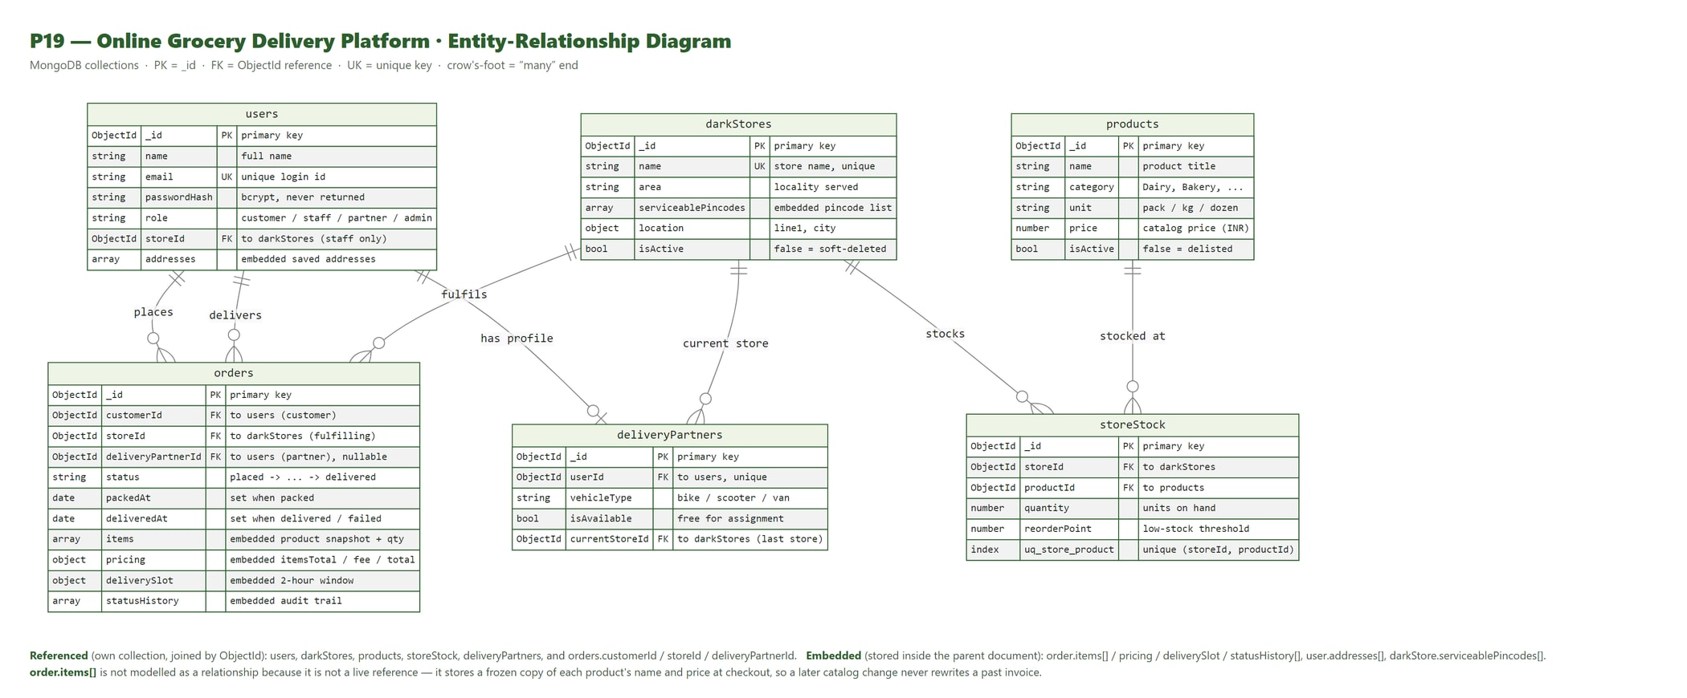
ENTITY-RELATIONSHIP DIAGRAM - SIX COLLECTIONS, EMBED VS. REFERENCE
Database Schema

Slide 8
CONFIG/CONSTANTS.JS - ORDER_STATUS_FLOW
Order Status State Machine
placed
>
picking
>
packed
>
assigned
>
out-for-delivery
>
delivered
Any transition not in the allow-list is rejected with 409 INVALID_TRANSITION.
out-for-delivery can also go to failed (frees the partner, stamps deliveredAt)
placed / picking / packed / assigned can also go to cancelled
delivered, failed and cancelled are terminal

Slide 9
ALL 13 IMPLEMENTED & VERIFIED (MIN. REQUIRED: 12)
Functional Modules
1 User Registration & Authentication
2 Dark-Store Management
3 Product Catalog & Store-Wise Stock
4 Order Placement + Nearest-Store Check
5 Order Picking & Packing Workflow
6 Delivery Partner Assignment
7 Delivery Status Tracking
8 Real-Time Order Status for Customer
9 Stock Replenishment Alerts
10 Delivery Time Slot Selection
11 Customer Order History & Reorder
12 Store & Delivery Performance Reports
13 Role-Based Access Control (route + record)

Slide 10
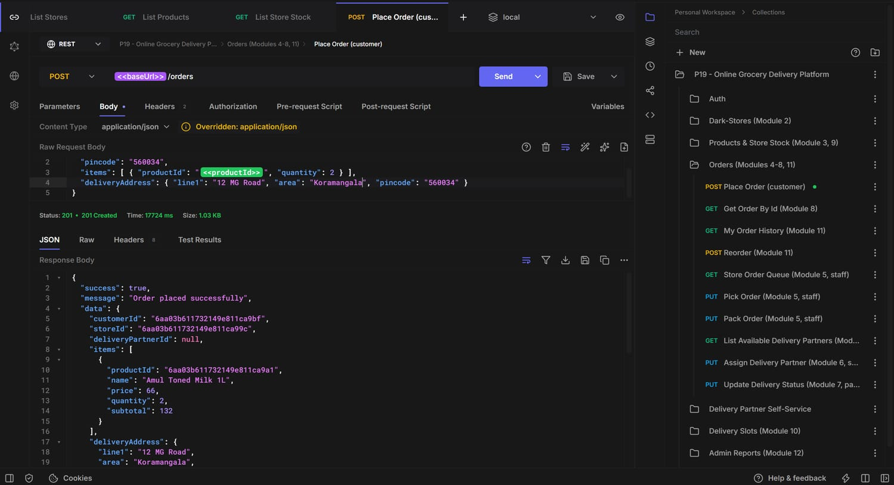
MODULE 4
Sample API Demo - Place Order
POST /api/orders -> 201 Order placed successfully itemsTotal 132, deliveryFee 30, total 162 stock decremented, 'placed' event recorded

Slide 11
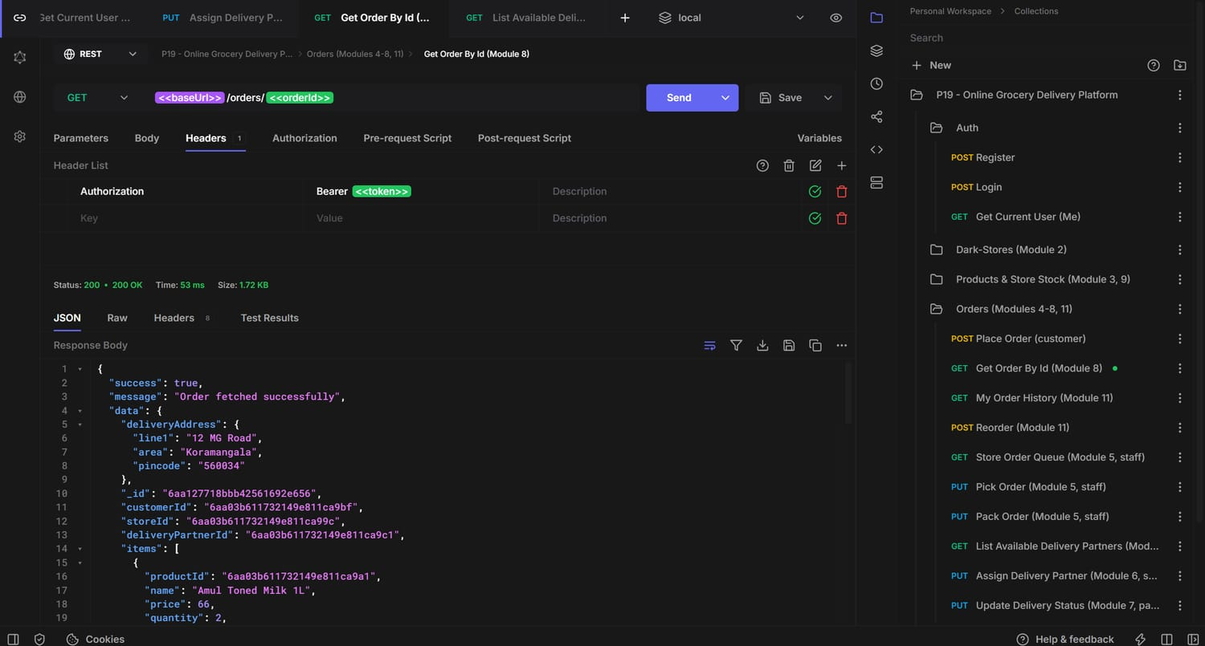
MODULE 8
Sample API Demo - Full Order Timeline
GET /api/orders/:id -> the order with its embedded statusHistory[] audit trail (placed -> picking -> packed -> assigned -> out-for-delivery -> delivered)

Slide 12
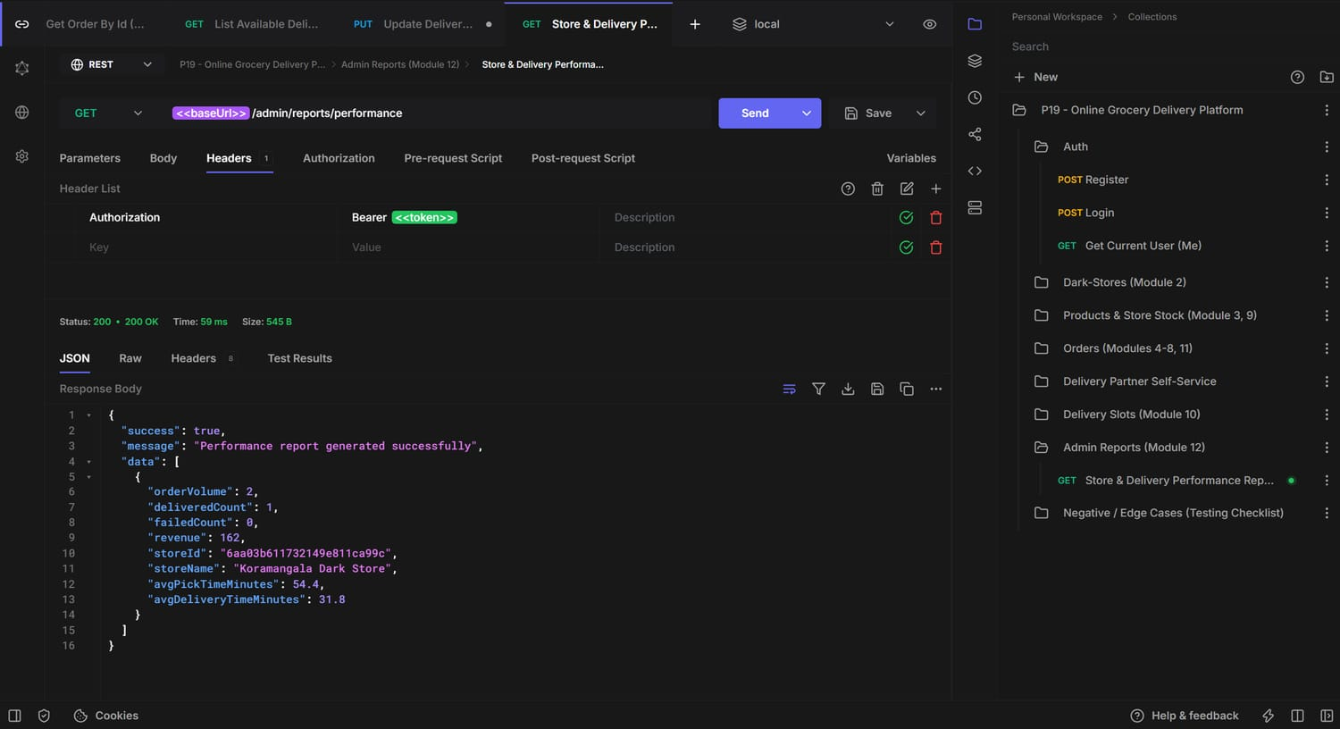
MODULE 12
Sample API Demo - Performance Report
GET /api/admin/reports/performance -> per-store order volume, avg pick / delivery time, revenue - from one MongoDB aggregation pipeline

Slide 13
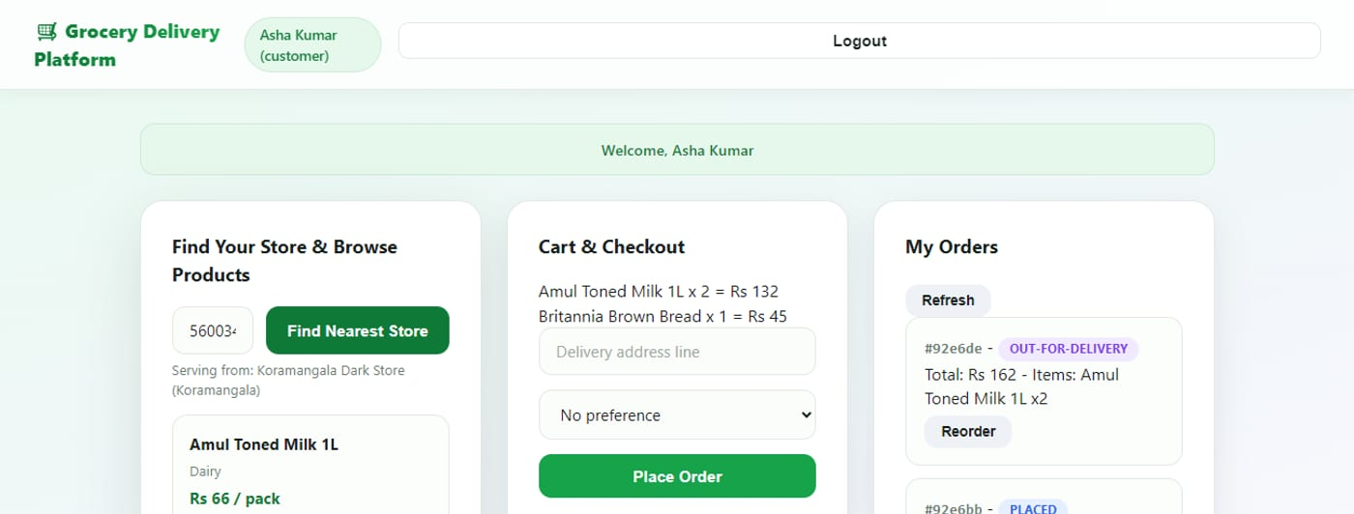
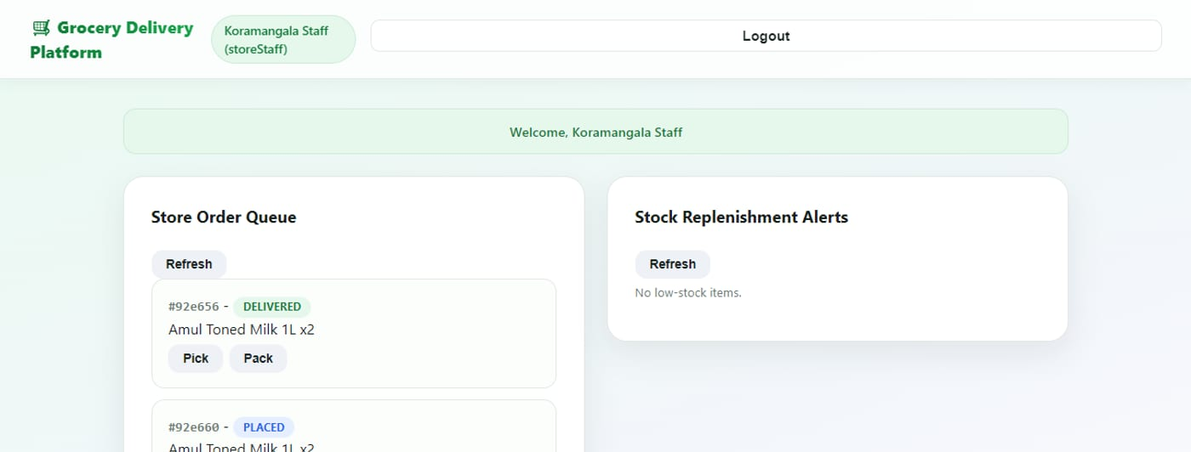
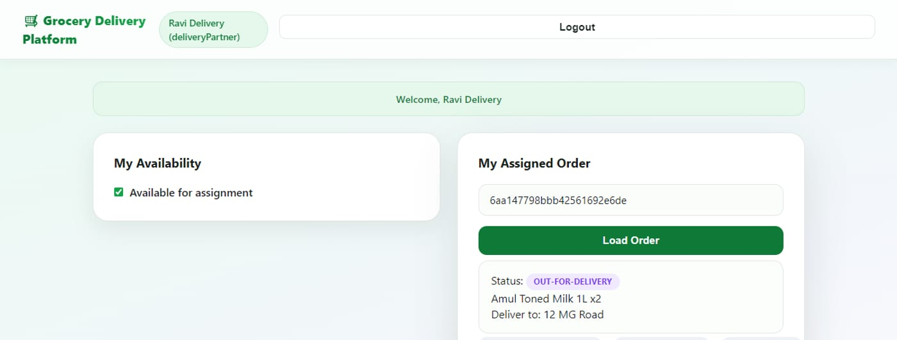
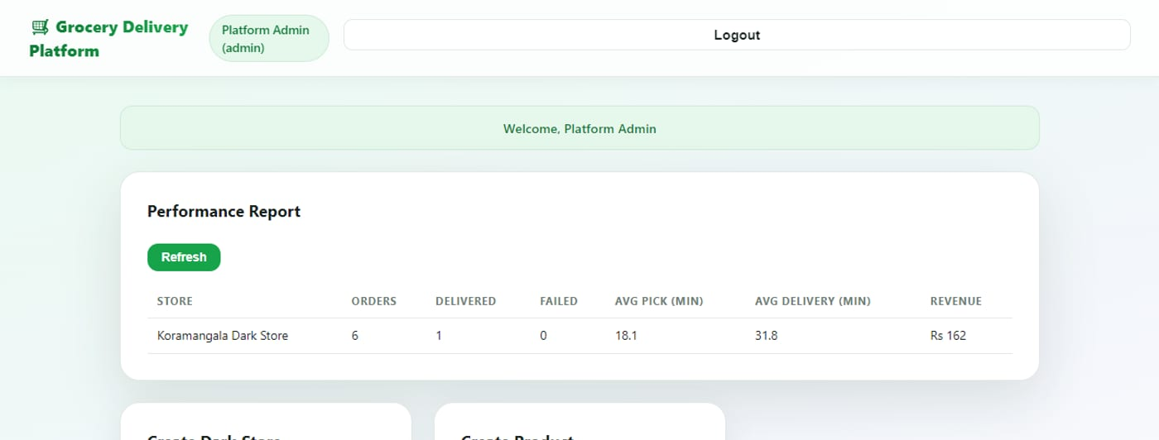
EVERY ROLE, LIVE AGAINST THE API
Demo Frontend
Customer - browse, cart, checkout
Store staff - pick / pack queue
Delivery partner - status updates
Admin - performance report

Slide 14
WHAT WE TOOK AWAY
Learnings & Challenges
State machine in one table
Declaring every legal transition once made the pick/pack/assign/deliver controllers tiny and impossible to misuse.
Embed vs. reference per field
Order items must be an embedded frozen snapshot; stock must be its own referenced collection, updated every order.
Two-layer RBAC is necessary
Route-level role checks alone still let one store's staff touch another store's orders; record-level canAccessOrder closes that.
One envelope + one error handler
Removed almost all try/catch from controllers and gave Postman a consistent shape to assert on.
Test role-by-role, end-to-end
Running the whole collection in sequence surfaced ordering bugs that isolated endpoint tests miss.

Slide 15
Thank You
P19 - Online Grocery Delivery Platform - Team 19 - 5 BTCS B
github.com/Aaryan658/L-T-5th-sem-grocery-delivery-platform

