Slide 1
Noise-realized operator selection for ADAPT-VQE
A controlled cross-framework benchmark on H₂ and LiH under calibrated depolarizing noise
Author Name · Department / Institution
CIA-3 research project · Qiskit + PennyLane · STO-3G active-space simulation
github.com/Aaryan658/noise-realized-adapt-vqe

Slide 2
What this talk covers
1
Background the ansatz problem in noisy VQE; how ADAPT-VQE builds a circuit
2
Research question is the energy gradient the right selection quantity under noise?
3
Methodology two molecules, a framework-matched noise model, four selection rules
4
Implementation one shared ADAPT driver; self-tests and analytic safeguards
5
Results — baseline compact qubit-ADAPT vs UCCSD, HEA and routed Qiskit ADAPT
6
Results — selection rules a cost penalty, a realised-energy score, a self-tuning controller
7
Limitations, fair test, conclusions what is established and what needs a larger active space
Noise-aware operator selection for ADAPT-VQE · CIA-3
2

Slide 3
BACKGROUND
The variational eigensolver hinges on the ansatz
VQE minimises ⟨ψ(θ)|H|ψ(θ)⟩ over the parameters of a quantum circuit; the reachable accuracy is set by that circuit.
A shallow ansatz (hardware-efficient, HEA) cannot represent the correlated wavefunction.
A chemically complete ansatz (UCCSD) needs hundreds of two-qubit gates — the state decoheres before it is measured.
ADAPT-VQE builds the circuit adaptively: add pool operators one at a time, largest energy gradient first, re-optimise after each.
Result: compact, problem-specific circuits at far fewer parameters than fixed UCCSD.
The trade-off
shallow low gate error, high representation error deep low representation error, high gate error adaptive grow only what the molecule needs
Noise-aware operator selection for ADAPT-VQE · CIA-3
3

Slide 4
BACKGROUND
One ADAPT-VQE iteration
1
Screen the pool compute |dE/dθ| for every candidate operator on the current state
2
Select standard ADAPT keeps the single largest-gradient operator
3
Append and re-optimise add the operator, re-optimise all θ (here: COBYLA, gradient-free)
4
Test for convergence stop on gradient norm, or — under noise — on an energy plateau
The selection quantity in step 2 is the lever this project examines.
Noise-aware operator selection for ADAPT-VQE · CIA-3
4

Slide 5
RESEARCH QUESTION
Is the gradient the right thing to select on under noise?
The gradient is noise-blind: it does not know the operator's contribution will be corrupted by decoherence.
Estimated on a noisy device, the gradient is also floored near the gate-error rate — it barely ranks operators (noise-induced flat landscape).
Q1
Realised vs predicted benefit score an operator by the energy it actually reaches after re-optimisation with the noise channel on
Q2
A circuit-cost penalty divide the score by (1 + λ · added CNOT count) — untested in the ADAPT literature
Q3
A self-tuning penalty make λ a feedback controller that rises in the noise-dominated tail
Noise-aware operator selection for ADAPT-VQE · CIA-3
5

Slide 6
RELATED WORK
Selection criteria beyond the gradient — and the open gap
Method | Selection quantity | Under noise?
Standard ADAPT [5] | energy gradient |dE/dθ| | no
QEB-ADAPT [7] | energy reduction of top-n candidates | no
Overlap-ADAPT [13] | overlap with a classical target state | no
Rotoselect [14] | closed-form noiseless energy landscape | no
Rossi et al. [15] | exact energy-based selection | no
This work — noise-realized | realised energy under the noise channel, per CNOT | yes
This work — resource-aware | |g| / (1 + λ · CNOT cost) | yes
No prior ADAPT variant re-optimises each candidate with the device noise applied and selects on the energy it delivers there; a CNOT-cost penalty on the score is likewise unstudied.
Noise-aware operator selection for ADAPT-VQE · CIA-3
6

Slide 7
METHODOLOGY 1/4
Molecular systems and reference energies
H₂ (d = 0.735 Å): full space, 4 spin-orbitals, 4 qubits.
LiH stretched to d = 3.0 Å, frozen core, (2e, 3o) active space, 6 qubits.
Why stretched: at equilibrium the (2e,3o) space holds ~1 mHa of correlation — below chemical accuracy, every ansatz sits on Hartree-Fock.
Stretching restores 16.3 mHa of active-space correlation and a multireference state, still at 6 qubits.
Integrals: PennyLane differentiable Hartree-Fock (no PySCF on Windows). The Qiskit Hamiltonian is built from the same integrals.
Error is measured against the active-space FCI, not full-space FCI.
Validation (noiseless)
dhf vs literature FCI 0.036 mHa (H₂), 0.041 mHa (LiH) Qiskit ↔ PennyLane spectrum ≤ 5 × 10⁻¹⁴ Ha Hartree-Fock ≥ FCI holds in every case
Noise-aware operator selection for ADAPT-VQE · CIA-3
7

Slide 8
METHODOLOGY 2/4
Noise on an equivalent footing for both frameworks
Feeding a raw FakeBackend model to Qiskit while PennyLane runs default.mixed is not comparable: different native gates, Qiskit inserts routing SWAPs, readout error does not transfer.
Instead: framework-independent depolarizing channels, rates read from real FakeManilaV2 calibration — p₁ = 3.5 × 10⁻⁴, p₂ = 1.0 × 10⁻².
The PennyLane channels are the exact 16-Kraus form of Qiskit-Aer's convention, not an approximation.
Noise is applied after decomposition to {RX, RY, RZ, H, CNOT}; a runtime guard rejects a silent no-op.
6.7 × 10⁻¹⁶
probe-observable agreement between the two stacks across noise scales 0×, 1×, 4×, 20× (spread 0.42 — the test is not vacuous)
Noise-aware operator selection for ADAPT-VQE · CIA-3
8

Slide 9
METHODOLOGY 3/4
Four selection rules, one shared ADAPT driver
Rule | Score for a candidate operator | Role
standard | |g| (gradient magnitude) | textbook baseline [5]
resource-aware | |g| / (1 + λ · CNOT cost) | proposed — cost penalty
noise-realized | max(0, ΔE_realised) / (1 + λ · CNOT cost) | proposed — measured benefit
noise-realized + adaptive λ | as above; λ is a clamped multiplicative controller | proposed — self-tuning
noise-realized: gradient-screen to the top 4, append each, re-optimise with the noise channel on, keep the best realised ΔE per CNOT; the winner's parameters are carried forward.
λ = 0 reproduces standard ADAPT exactly (checked). Cost of noise-realized: ~2–2.5× gradient selection.
Noise-aware operator selection for ADAPT-VQE · CIA-3
9

Slide 10
METHODOLOGY 4/4
Gradients, optimiser, stopping, and the matched-count control
Selection gradient: central difference on the trailing parameter at θ = 0, checked against exact parameter-shift to ~10⁻⁸ with noise present.
backprop on default.mixed returns NaN in this stack (silently) — not used.
Parameter re-optimisation: COBYLA, gradient-free — the same optimiser as the Qiskit baselines.
Two stopping rules for every selection rule: gradient norm < 10⁻³, and an energy-plateau rollback (ΔE < 10⁻⁵ Ha, patience 2). The plateau rule is what actually fires under noise.
fixed_k mode: disables both stops, forces exactly k operators, accepts every top-scored pick — isolates operator choice from circuit length (Result 4).
Noise-aware operator selection for ADAPT-VQE · CIA-3
10

Slide 11
IMPLEMENTATION
Pipeline and safeguards
Six modules, strict dependency order: molecules → noise_models → {qiskit_baselines, pennylane_resource_aware_adapt} → run_experiments → analyze_results.
One _adapt_loop holds all four selection rules and fixed_k; the novel rules do not touch the standard / λ = 0 paths.
Every module is its own self-test: pool-cost spread, noise actually applied, gradient-method agreement, noiseless convergence to FCI, λ = 1 divergence, λ = 0 ≡ standard.
Sweep CSV is written row-by-row — an interrupted multi-hour run leaves usable data.
Vacuous-selection diagnostic (verify_fix.py). Before any sweep it checks that the cost penalty can in principle change a pick — and shows analytically that on these molecules it cannot (Result 2).
Noise-aware operator selection for ADAPT-VQE · CIA-3
11

Slide 12
Results
2 molecules · 4 noise scales · 7 strategies · 56 free-running runs + a matched-k control
Noise-aware operator selection for ADAPT-VQE · CIA-3
12

Slide 13
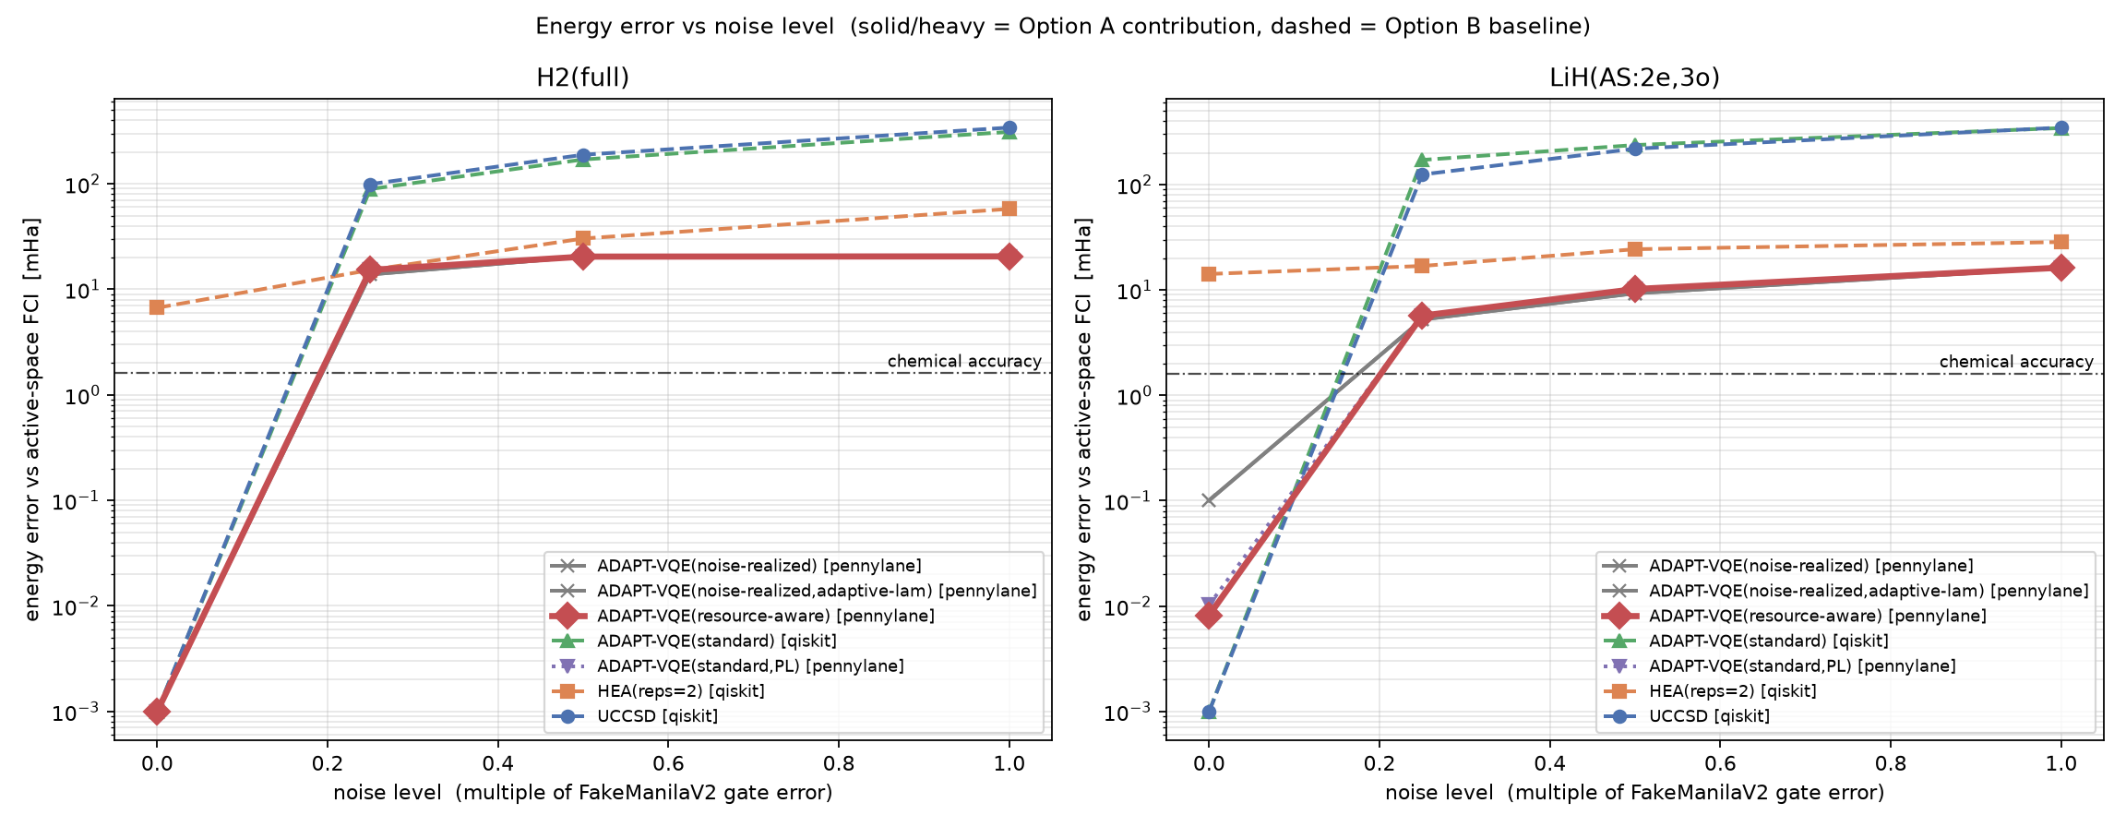
RESULT 1 · THE ROBUST FINDING
Adaptive qubit-ADAPT beats every fixed or routed baseline
Energy error vs noise (log scale). Red / grey (solid) = PennyLane qubit-ADAPT rules; green / blue (dashed) = UCCSD and routed Qiskit ADAPT; orange = HEA.
10–20× more accurate than UCCSD / HEA at every noise level, at a fraction of the two-qubit-gate count — depolarizing error tracks CNOT count, not depth [10].
Noise-aware operator selection for ADAPT-VQE · CIA-3
13

Slide 14
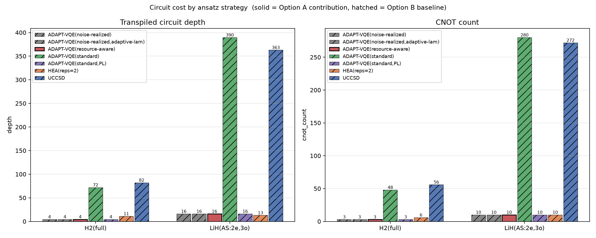
RESULT 1 · WHY THE ROUTED BASELINE COLLAPSES
Routing overhead, not the algorithm, breaks Qiskit ADAPT
Transpiled depth (left) and CNOT count (right). Qubit-ADAPT rules: 10 CNOTs / depth 16 on LiH. UCCSD and Qiskit ADAPT: 272–390 CNOTs.
LiH, 0.25× noise | qubit-ADAPT | UCCSD | Qiskit ADAPT (routed)
energy error / mHa | 5.7 | 124.7 | 171.3
CNOT count | 10 | 272 | 388
Noise-aware operator selection for ADAPT-VQE · CIA-3
14

Slide 15
RESULT 2 · THE COST PENALTY
Resource-aware selection is inert — with an analytic cause
resource-aware at λ = 1 gives a byte-identical ansatz to standard ADAPT at every non-zero noise level, both molecules. λ = 0 reproduces standard exactly.
Why (Brillouin + equal cost). Single excitations have zero gradient at Hartree-Fock, so the first operator is a double. In the qubit-ADAPT pool the gradient-carrying doubles (8/12 for H₂, 8/40 for LiH) all have weight 4 and cost 6 CNOTs. With the numerator varying but the denominator constant across the selectable set, |g| / (1 + λc) is a monotone rescaling of |g| — the arg-max never moves, for any λ.
The rules do diverge for noiseless LiH from operator 6 — but under noise the plateau stop truncates the ansatz at 1–2 operators, before that point.
Noise-aware operator selection for ADAPT-VQE · CIA-3
15

Slide 16
RESULT 3 · THE REALISED-ENERGY SCORE
Noise-realized: a small gain in the free-running sweep
Energy error / mHa | standard | resource-aware | noise-realized | NR + adaptive λ
H₂ 0.25× | 15.262 | 15.262 | 13.831 | 13.831
LiH 0.25× | 5.695 | 5.695 | 5.237 | 5.237
LiH 0.50× | 10.191 | 10.191 | 9.294 | 9.294
LiH 0.00 (CNOTs) | 36 | 34 | 26 | 26
0.5–1.4 mHa more accurate than standard at 0.25× / 0.50×, at the same operator and CNOT count — a different specific Pauli string within the same excitation class survives decoherence better.
Noiselessly it reaches chemical accuracy with 26 CNOTs vs 36 — a genuine efficiency point.
But does the different choice cause the gain, or does the stopping rule? → Result 4.
Noise-aware operator selection for ADAPT-VQE · CIA-3
16

Slide 17
RESULT 4 · THE HONEST CONTROL
Matched operator count: the gain does not survive
All four rules forced to k = 6 operators on LiH(2e,3o); both stopping rules disabled.
noise scale | standard | noise-realized | Δ (NR − standard) | CNOT std / NR
0.00 | 0.022 | 0.033 | +0.011 | 30 / 32
0.05× | 3.946 | 3.980 | +0.034 | 32 / 32
0.10× | 7.788 | 7.554 | −0.235 | 32 / 32
0.20× | 15.302 | 16.190 | +0.888 | 32 / 34
At matched k the rules do pick different operators (the guardrail did not trip), but Δ is inconsistent in sign and ≤ 0.9 mHa. The free-running advantage was mainly a circuit-length effect of the stopping rule, not a better operator choice. On LiH(2e,3o) a selection-quality advantage, if any, is below what the system can resolve.
Noise-aware operator selection for ADAPT-VQE · CIA-3
17

Slide 18
RESULT 5 · THE SELF-TUNING PENALTY
The λ controller tracks the regime but never acts
adaptive λ reproduces fixed-λ noise-realized in every cell — identical operators and energies.
The trajectory is the right shape:
LiH noise | 0.00 | 0.25× | 0.50× | 1.00× | matched-k 0.05× / 0.20×
λ_final | 0.91 | 0.37 | 0.49 | 2.53 | 8.0 (ceiling)
λ climbs when operators stop paying and relaxes while they deliver — the controller works.
It never changes a selection: the minimal-basis pool has no cheaper, gradient-competitive operator to switch to. Needs a cost-varied pool, e.g. a (2e,5o) active space.
Noise-aware operator selection for ADAPT-VQE · CIA-3
18

Slide 19
ASSESSMENT
Limitations
The proposed selection rules are not shown to work: the free-running gain is small and is attributed by the matched-k control mainly to circuit length.
H₂ and LiH(2e,3o) are too small — the noisy ansatz is 1–6 operators deep; the λ controller is never exercised.
Exact density-matrix expectation values — no shot noise; finite sampling would add 1/√shots variance to the realised-ΔE score.
At ≥ 1× the device rate, no method recovers correlation energy.
One molecule pair, one basis, one geometry, one noise family (depolarizing); the PennyLane sweep is scoped to ≤ 8 operators.
The one solid result is the pool-and-depth advantage of qubit-ADAPT over the fixed and routed baselines — a known effect, reproduced on a controlled footing.
Noise-aware operator selection for ADAPT-VQE · CIA-3
19

Slide 20
ASSESSMENT
What a conclusive test needs
LiH(2e,5o) — 10 qubits: a pool with a real cost-vs-gradient spread among gradient-competitive operators.
Noise scales {0, 0.05, 0.1, 0.2}: mild enough that a deep ansatz is not immediately destroyed.
≥ 16 operators, several bond distances, and a finite-shot run (~10⁴ shots) at the best noise level.
A deep-enough noisy ansatz so that operator choice past step 5 still matters.
≈ 30–50×
the compute of the present study — out of scope for the course timeline, but the natural next experiment
Noise-aware operator selection for ADAPT-VQE · CIA-3
20

Slide 21
Conclusions
1
The comparative result is clear and robust compact all-to-all qubit-ADAPT is 10–20× more accurate than UCCSD, HEA and routed Qiskit ADAPT under noise — depolarizing error tracks CNOT count.
2
The cost-penalty rule is structurally inert on minimal-basis H₂ / LiH the gradient-carrying operators are equal cost; recorded with its analytic cause so it is not re-attempted.
3
The realised-energy rule is not established a small free-running gain that a matched operator-count control attributes to circuit length, not operator choice; one robust by-product — a leaner circuit at chemical accuracy noiselessly.
4
The self-tuning controller is untested it tracks the noise regime correctly but the pool has nothing cheaper for it to choose; a 10-qubit active space is required.
Noise-aware operator selection for ADAPT-VQE · CIA-3
21

Slide 22
REPRODUCIBILITY
Everything is in the repository
github.com/Aaryan658/noise-realized-adapt-vqe — MIT licence, CITATION.cff.
make validate / selftest / baseline / selection / fixed-k / figures.
Every number on these slides is a cell in results/results.csv, results_novel.csv or results_fixed_k.csv.
Environment: CPython 3.14, qiskit 2.3, qiskit-aer 0.17, pennylane 0.45, numpy 2.5, scipy 1.16.
Full write-ups: docs/REPORT.md (course report), docs/MANUSCRIPT.md (IEEE), docs/NOVEL_RESULTS.md (the matched-k control in detail).
Noise-aware operator selection for ADAPT-VQE · CIA-3
22

Slide 23
Key references
[5] Grimsley et al. An adaptive variational algorithm for exact molecular simulations. Nat. Commun. 10, 3007 (2019).[6] Tang et al. Qubit-ADAPT-VQE. PRX Quantum 2, 020310 (2021).[7] Yordanov et al. Qubit-excitation-based adaptive VQE. Commun. Phys. 4, 228 (2021).[10] Long et al. Layering and subpool exploration for adaptive VQE. Phys. Rev. A 109, 042413 (2024).[13] Feniou et al. Overlap-ADAPT-VQE. Commun. Phys. 6, 192 (2023).[14] Ostaszewski et al. Structure optimization for parameterized quantum circuits (Rotoselect). Quantum 5, 391 (2021).[15] Rossi et al. Resource-efficient energy-based operator selection. arXiv:2606.04786 (2026).[19] Wang et al. Noise-induced barren plateaus in variational quantum algorithms. Nat. Commun. 12, 6961 (2021).[20] Yordanov et al. Quantifying the effect of gate errors on VQEs. npj Quantum Inf. 10, 43 (2024).[21] Bergholm et al. PennyLane. arXiv:1811.04968. [22] Qiskit contributors, 2024.
Full 22-entry list in docs/REPORT.md § VI.
Noise-aware operator selection for ADAPT-VQE · CIA-3
23

