Slide 1

SMART INDIA HACKATHON 2026
TITLE PAGE
Problem Statement ID – SIH26171
Problem Statement Title- On-Device Visual Perception for Light-weight Browser Agents
Theme- Space Technology (ISRO)
PS Category- Software
Team ID- SIH_CU_143
Team Name (Registered on portal): Orvyn

Slide 2
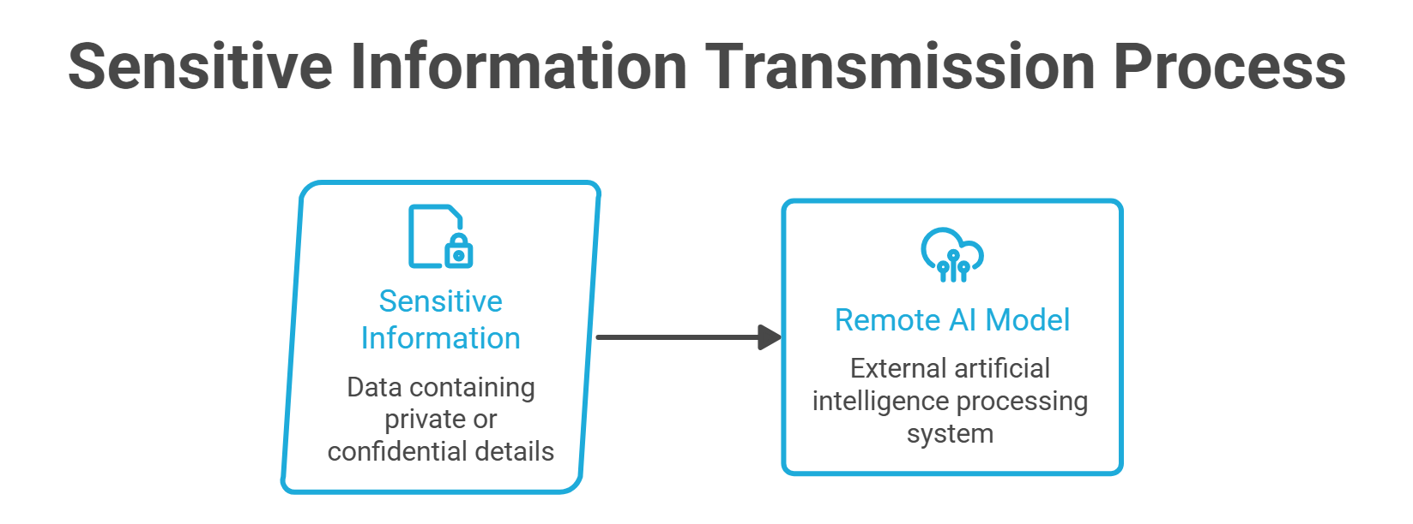
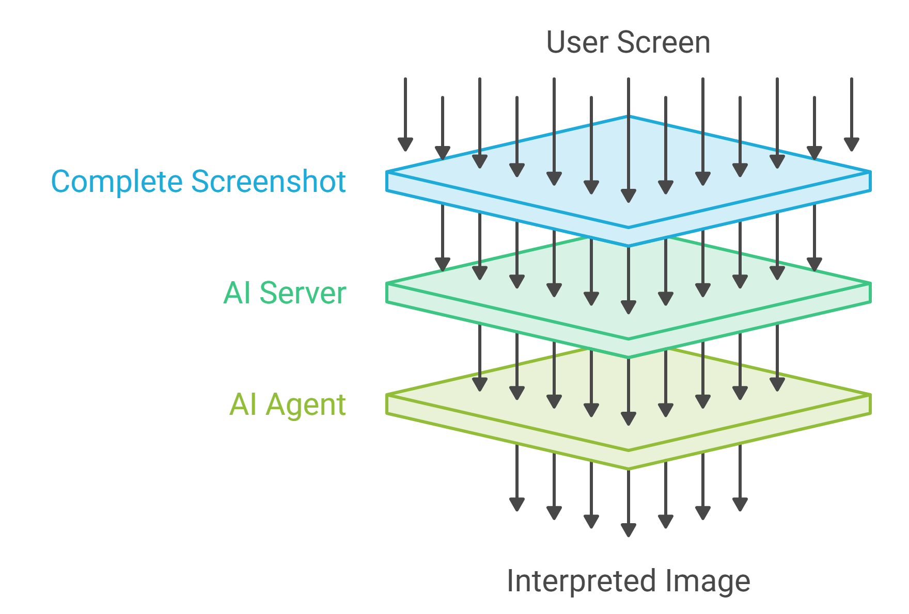
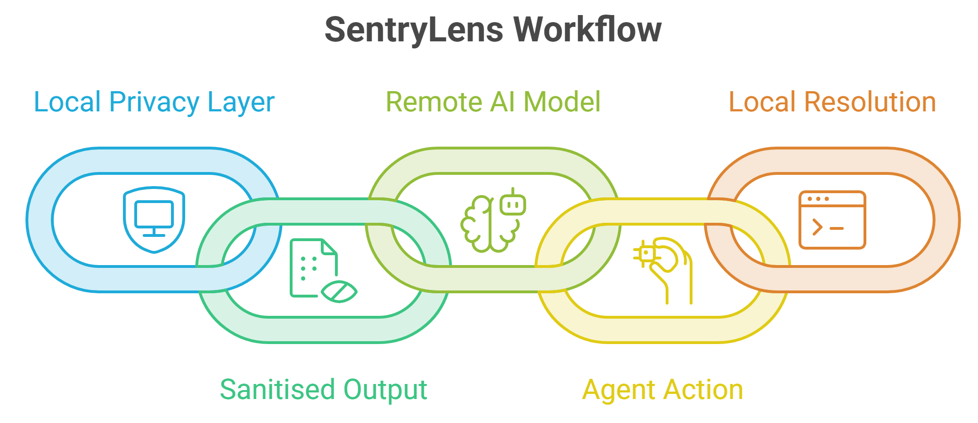
Privacy-Preserving Browser Automation
Orvyn
A browser extension that lets an AI agent finish your web task while faces, passwords and PII never leave your machine
Traditional AI Browser Agent

Slide 3
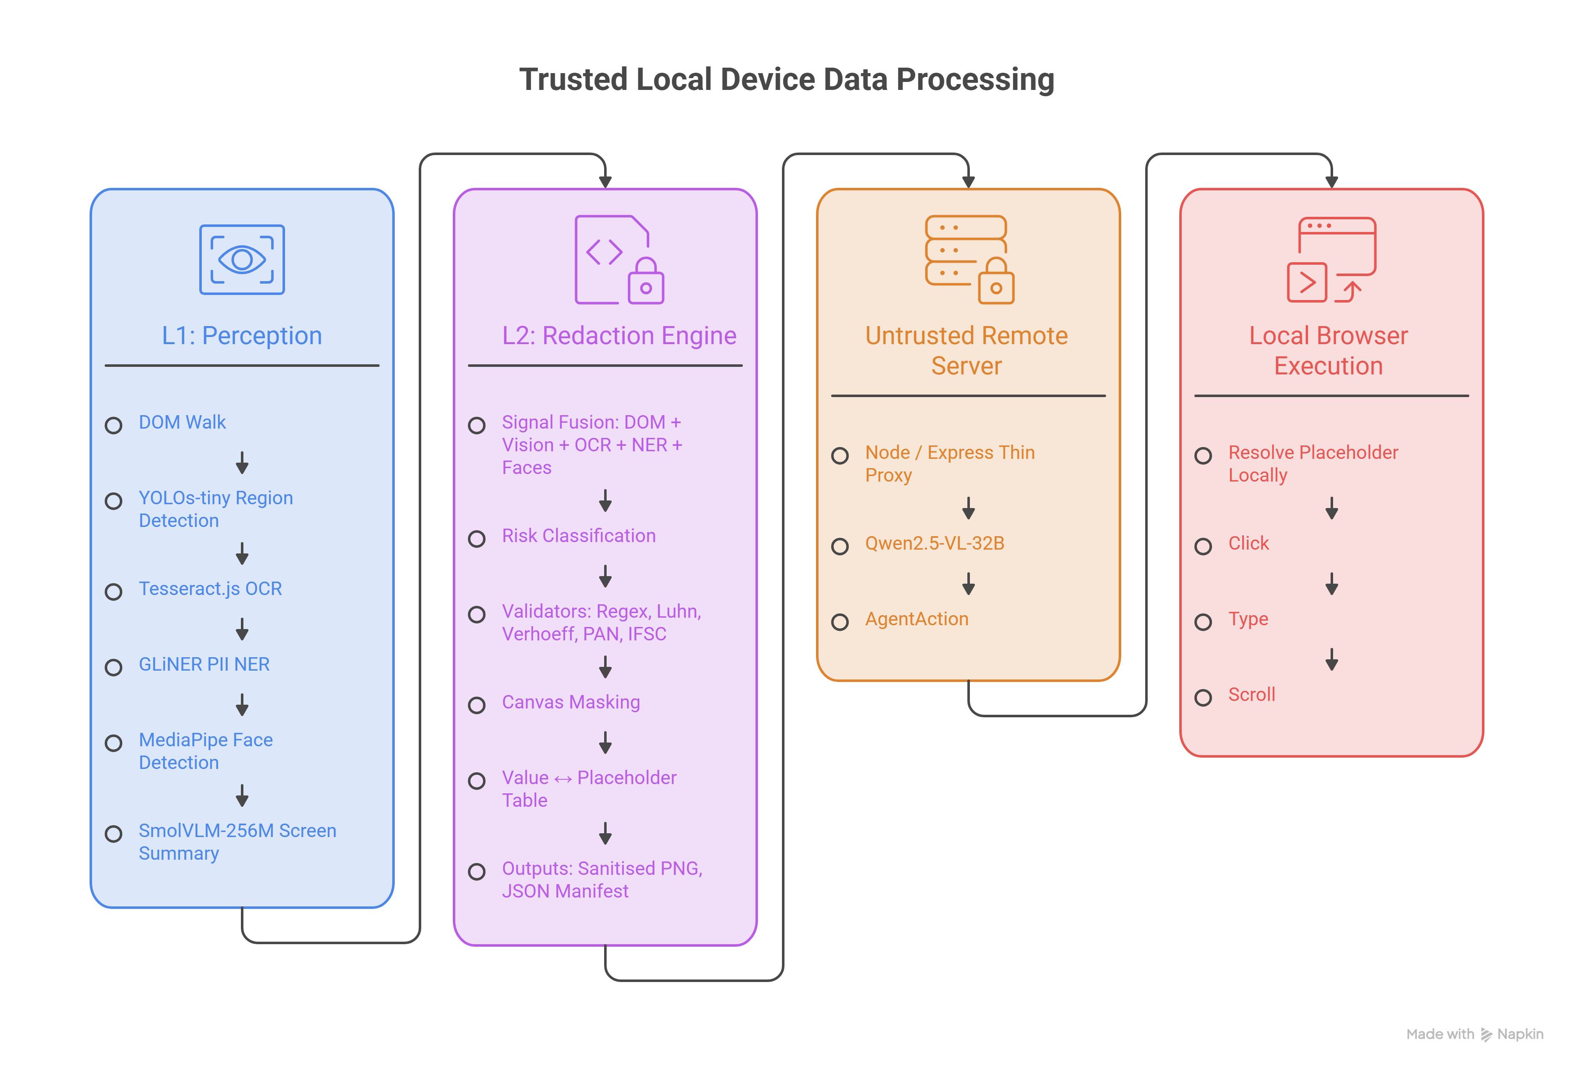
TECHNICAL APPROACH
Orvyn

Slide 4
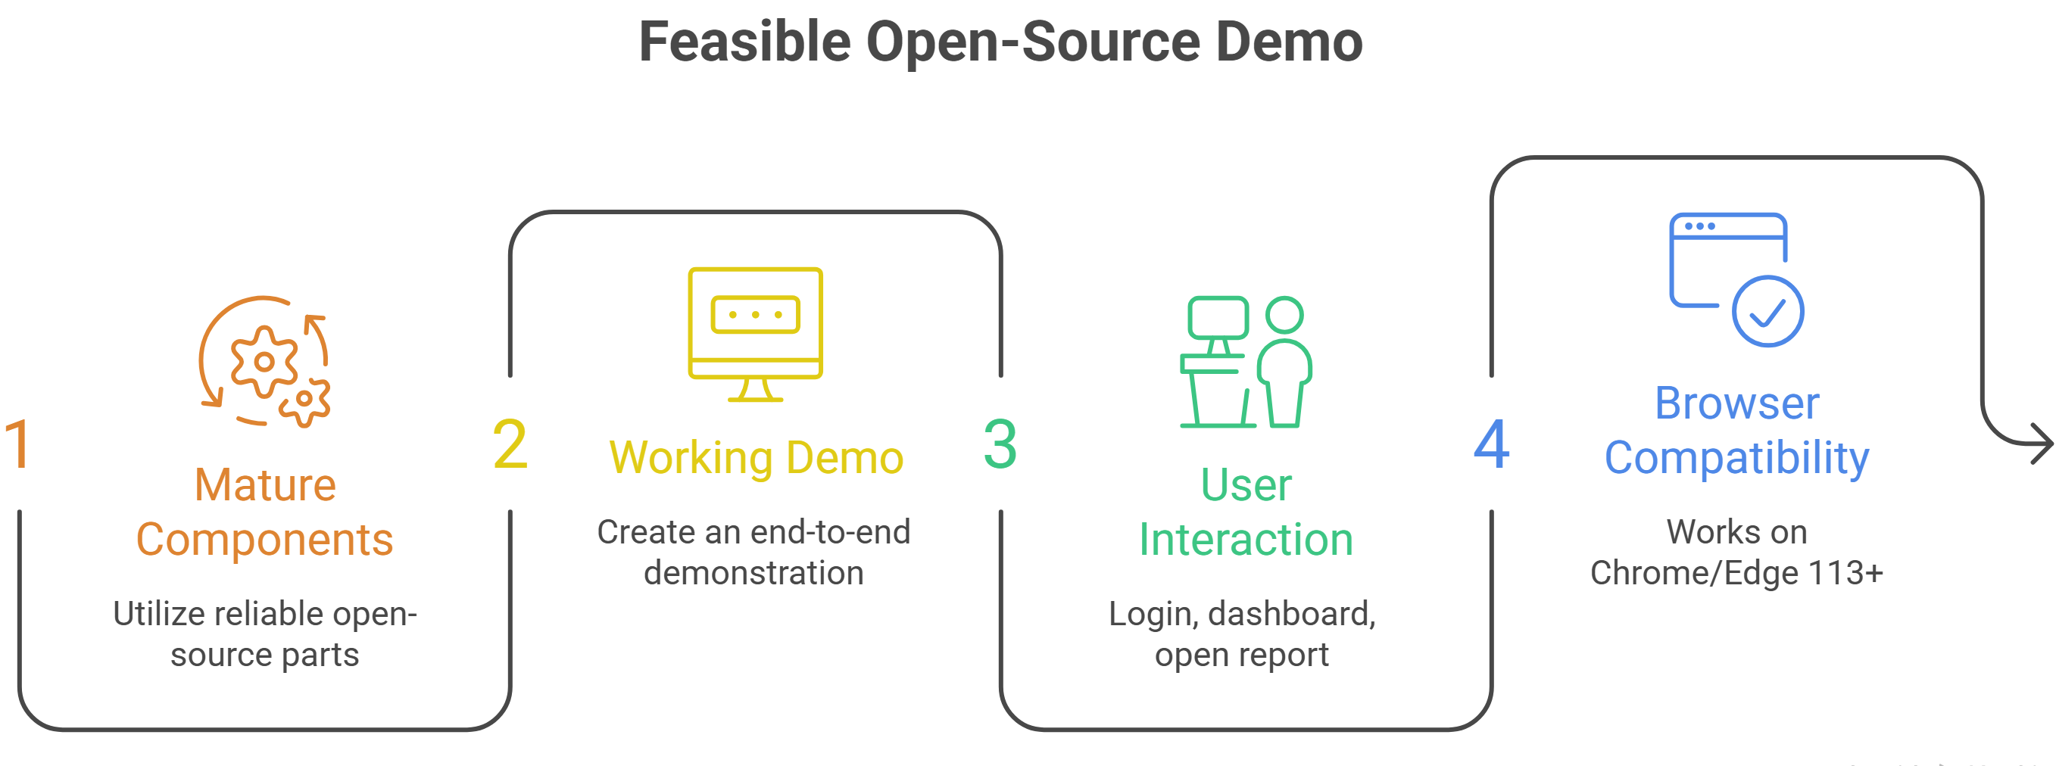
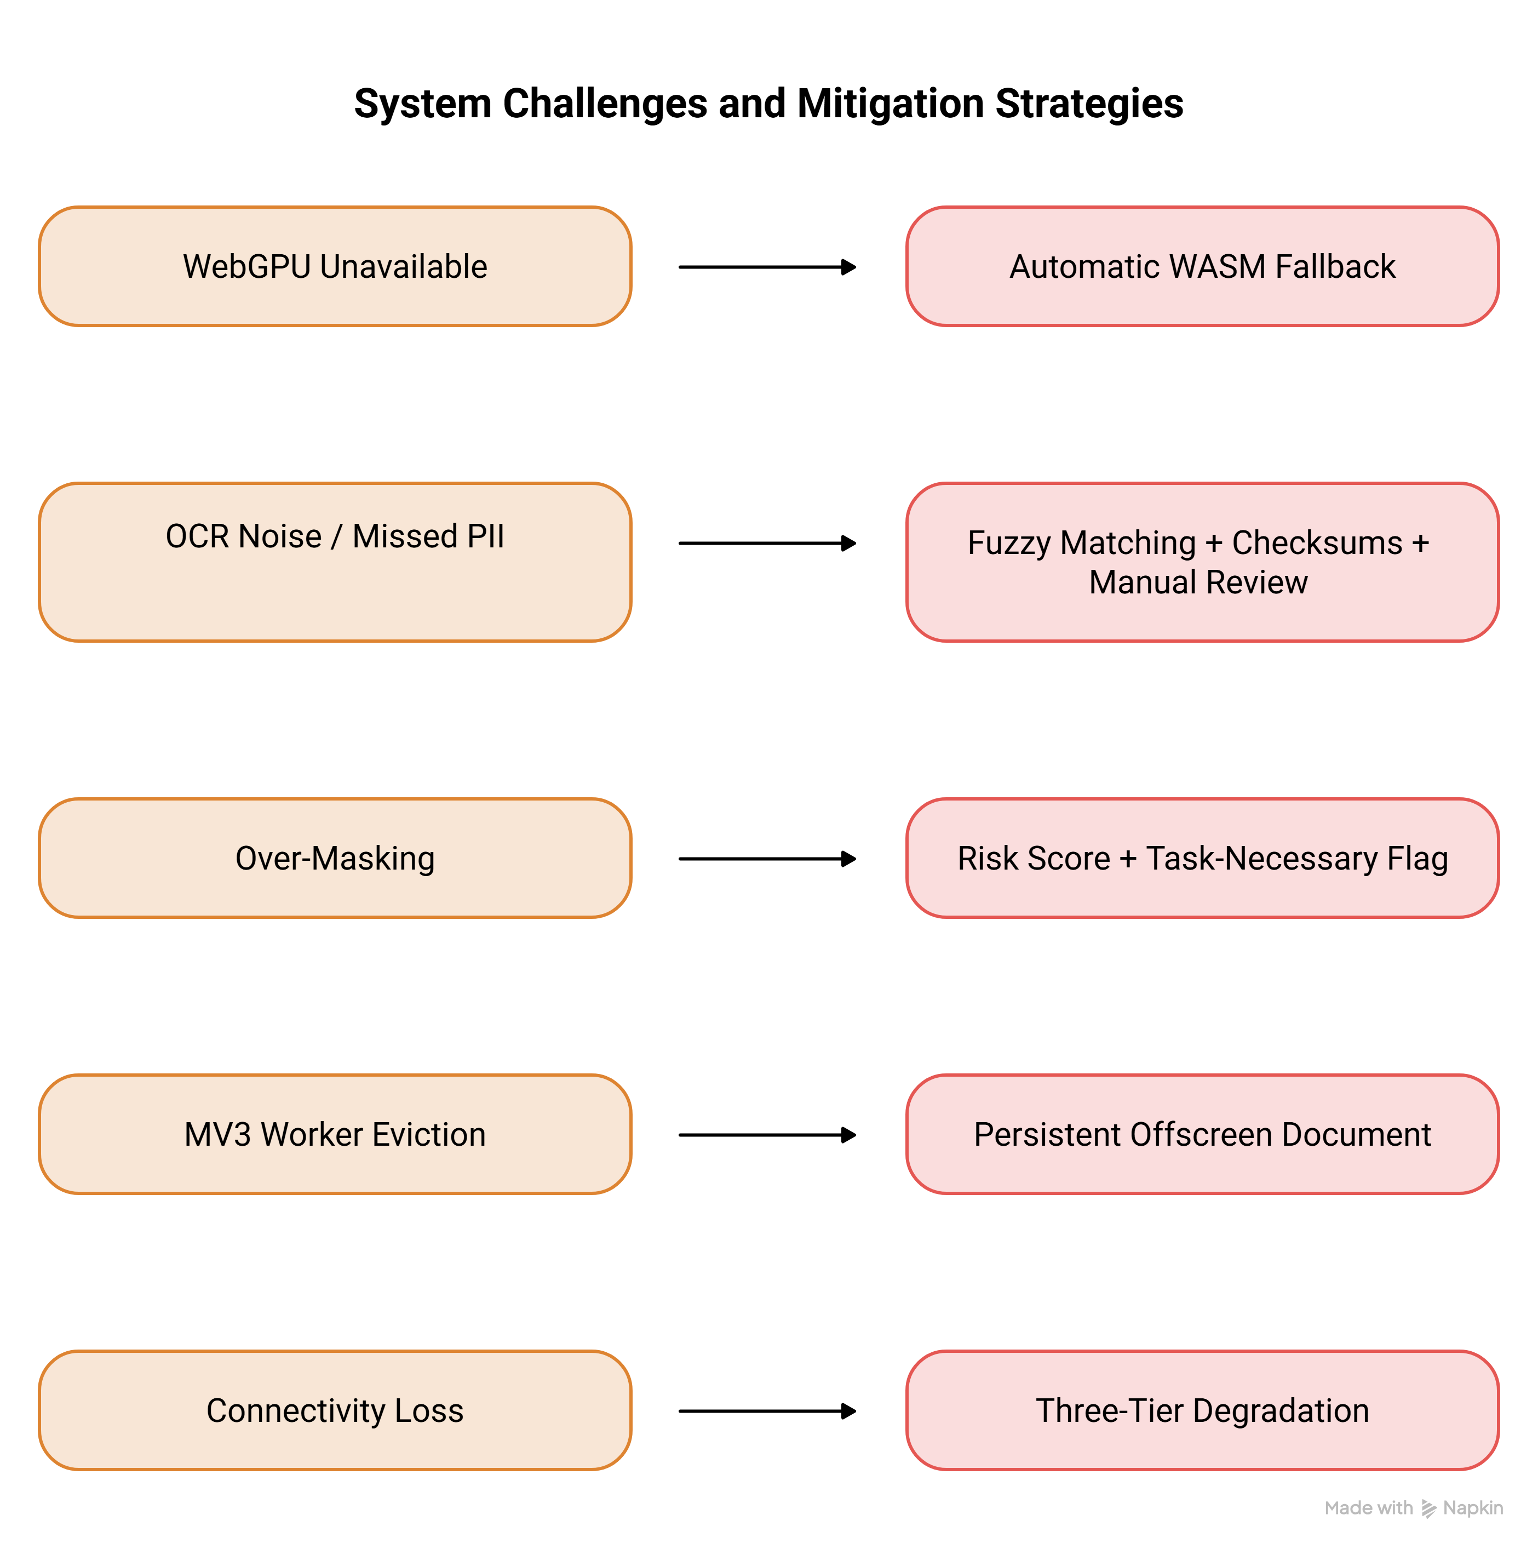
FEASIBILITY AND VIABILITY
Orvyn
Mode | Trigger Condition | Execution Strategy
Primary | WebGPU Available | Full GPU-accelerated local perception
Secondary | WebGPU Unavailable | CPU-bound WebAssembly (WASM) fallback
Offline | Server Disconnected | On-device model execution
Fail-Safe | Model Not Cached | DOM-only conservative redaction

Slide 5
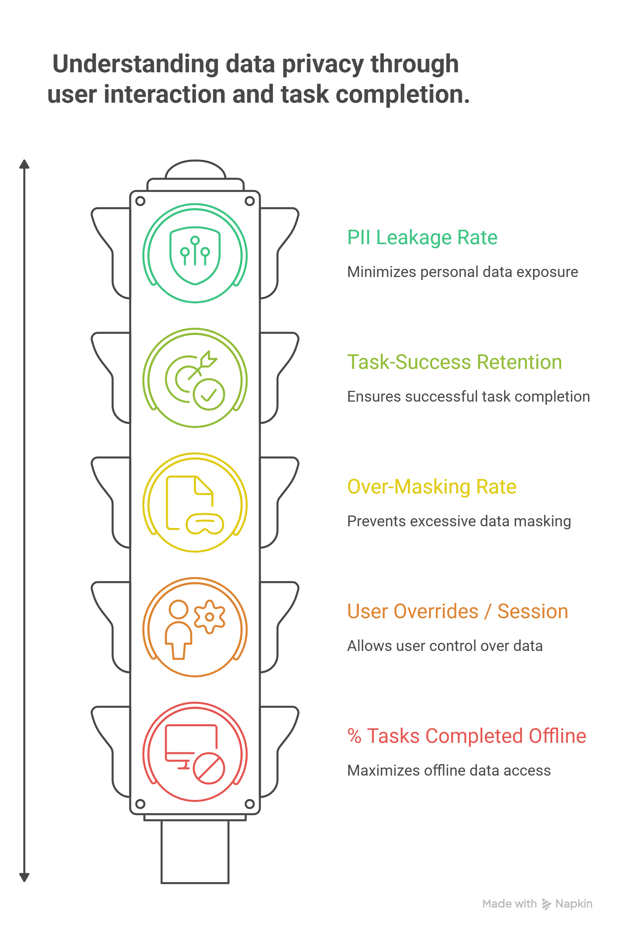
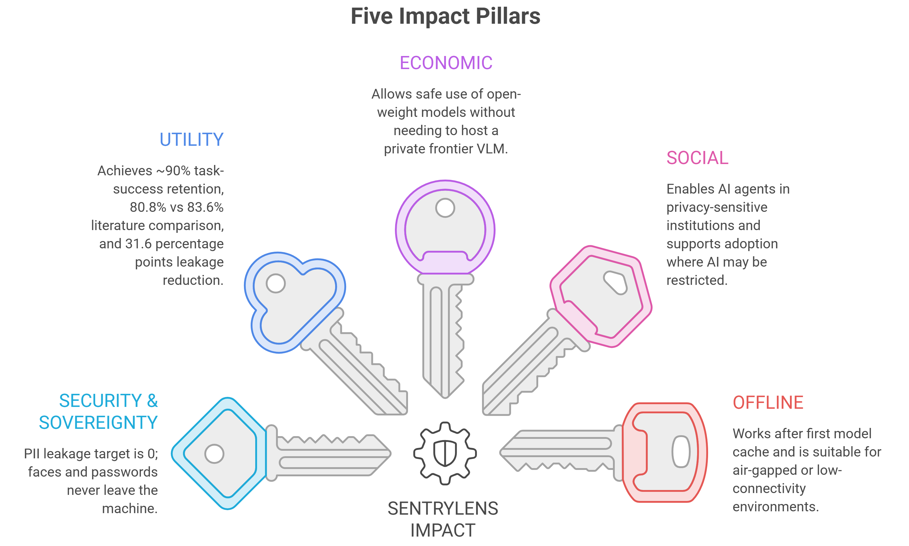
IMPACT AND BENEFITS
Orvyn

Slide 6
RESEARCH AND REFERENCES
Orvyn
Research Foundation
GUIGuard — Privacy recognition & secure GUI agents
https://arxiv.org/abs/2601.18842
Available but Invisible — PII detection & privacy-preserving UI
https://arxiv.org/abs/2602.10139
DualTAP + PrivScreen — Privacy–utility evaluation
https://arxiv.org/abs/2511.13248
Qwen2.5-VL — Visual UI understanding & grounding
https://arxiv.org/abs/2502.13923
OmniParser V2 — Screenshot-to-structured UI parsing
https://www.microsoft.com/en-us/research/articles/omniparser-v2-turning-any-llm-into-a-computer-use-agent/
SentryLens Implementation
Transformers.js + WebGPU — On-device browser ML
Chrome/Edge Extension — Local browser execution
Reversible Redaction — Placeholder-based PII protection
Network Firewall — Prevents data leakage
63 Unit Tests + E2E — Verified no-leak behavior
Research → Privacy Architecture → SentryLens

