Slide 1


SMART INDIA HACKATHON 2024
Krishi Mitra
Problem Statement ID: SIH1638
Problem Statement Title: AI-Driven Crop Disease Prediction and
Management System
Theme: Agriculture, FoodTech & Rural Development
PS Category: Software
Team Name: LocalHost:8080
Github Repo: https://github.com/AaryanAnand10/KrishiMitra

Slide 2
KrishiMitra
LocalHost 8080
Proposed Solution
Integrated AI Platform:
Comprehensive system designed to enhance agricultural practices by connecting farmers, researchers, and industry stakeholders.
Facilitates seamless information exchange across language and geographical boundaries.
Core Components:
AI-Driven Application:
Utilizes advanced computer vision algorithms to perform real-time pest and disease detection.
Provides immediate notifications and actionable insights to farmers for effective crop management.
Personalized RAG-Based Chatbot:
Incorporates Retrieval-Augmented Generation (RAG) techniques to offer tailored assistance.
Supports multilingual interactions, allowing farmers to receive data-driven guidance and answers in their preferred language.
Key Features:
Unified Interface:
Streamlined, user-friendly platform that integrates diverse agricultural tools and knowledge resources.
Sustainable Productivity:
Enhances crop protection and productivity through cutting-edge technology and real-time data, supporting sustainable agricultural practices.

Slide 3
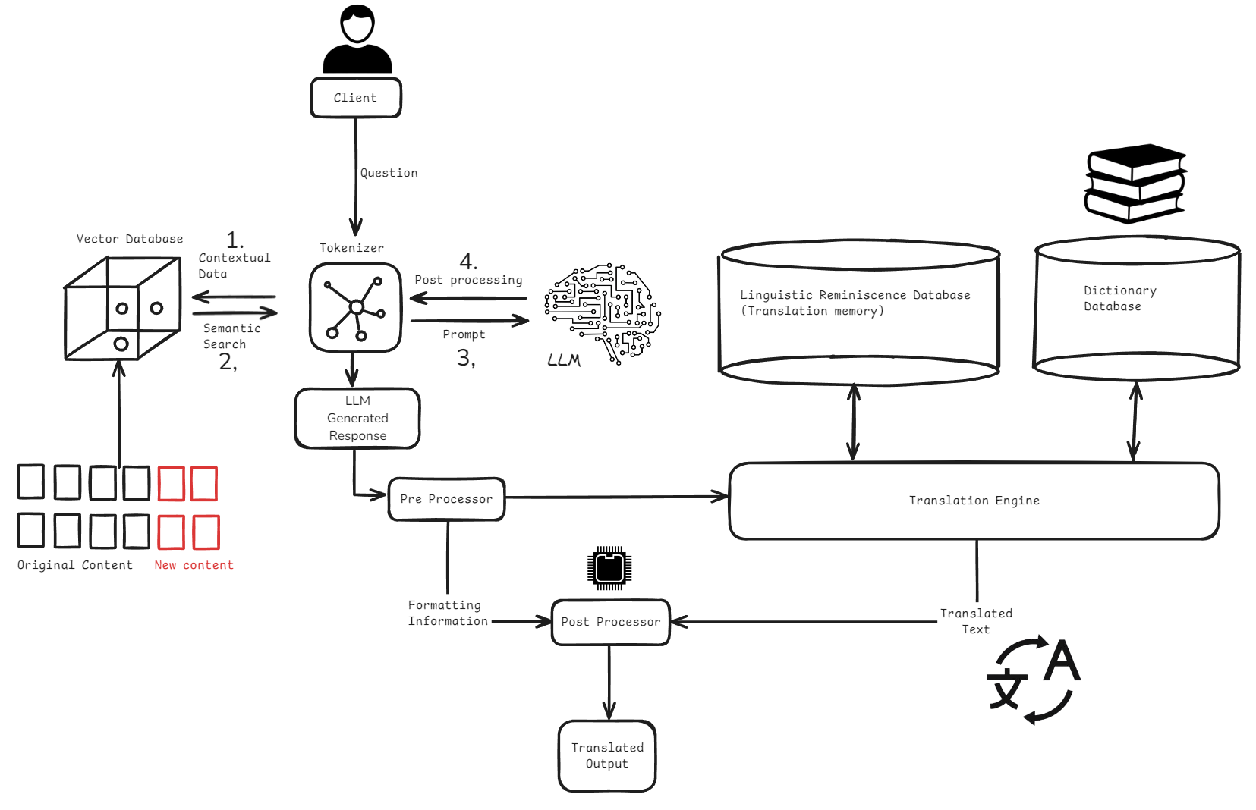

TECHNICAL APPROACH
LocalHost 8080

Slide 4
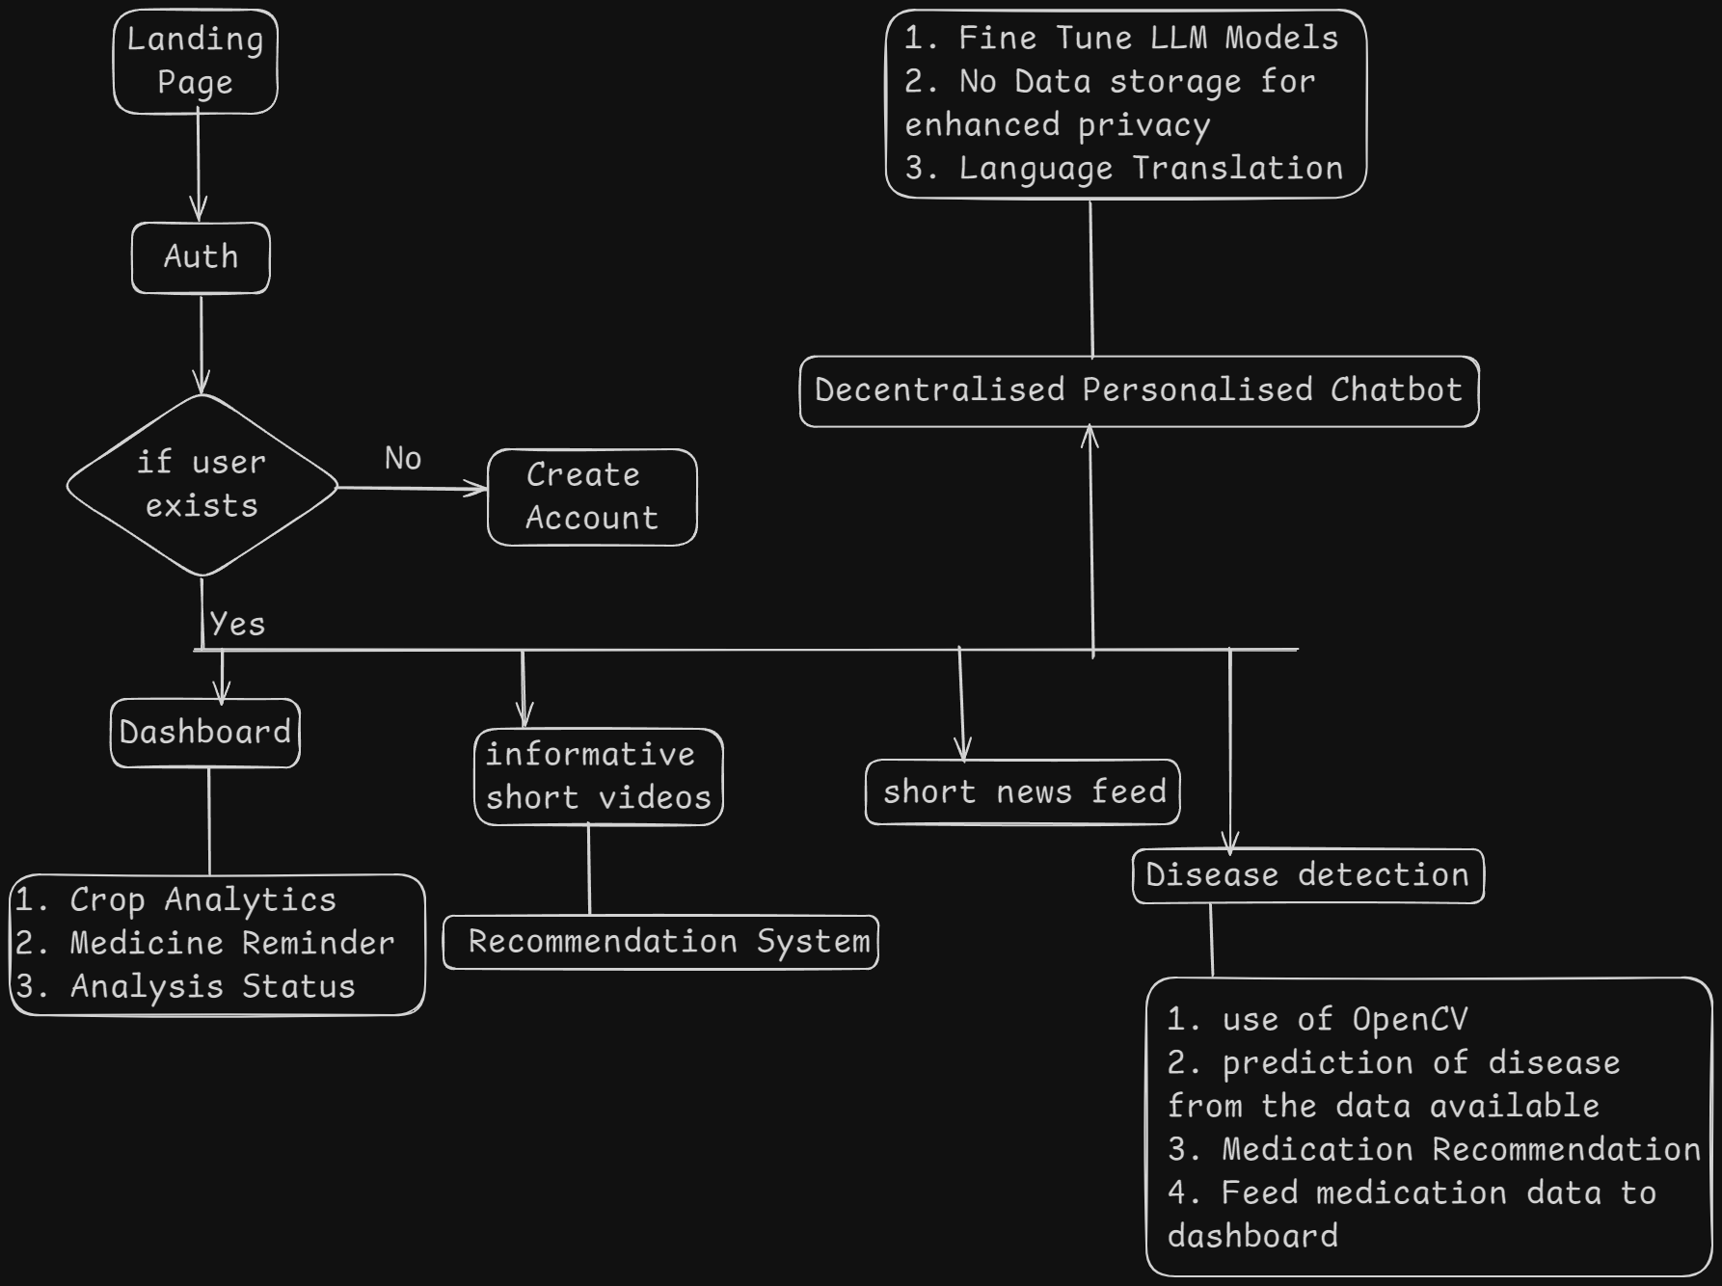
FEASIBILITY AND VIABILITY
LocalHost 8080
Technical Feasibility: Leveraging advancements in AI and drone technology, integrating AI-driven pest detection with drone surveillance is feasible, supported by existing agricultural tools.
Challenges:
Cost: High initial technology adoption costs.
Adoption: Resistance from farmers used to traditional methods.
Complexity: Adapting the platform for diverse languages and regions.
Mitigation Strategies:
Financial Support: Offer subsidies or incentives to lower adoption costs.
User Experience: Design a user-friendly platform with localized support for easy transition.
Security: Implement strong data security and a phased rollout for secure and gradual adoption.

Slide 5
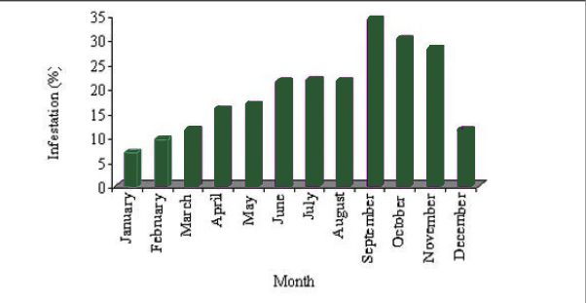
IMPACT AND BENEFITS
LocalHost 8080
Impact on Farmers:
Significantly improves pest management, crucial in regions like Assam where climate change has worsened pest issues.
Provides real-time detection and management tools, reducing crop losses and optimizing pesticide use.
Enhances income for farmers, particularly small tea growers, by addressing outdated methods and high costs.
Benefits of the Solution:
Economic: Lowers production costs, increases crop yields, and improves overall farm profitability.
Environmental: Reduces excessive pesticide use, mitigating crop toxicity and soil degradation.
Overall: Supports healthier farms, strengthens communities, and promotes a sustainable future for agriculture.
Recent trend of seasonal incidence of tea mosquito bug in sub Himalayan tea plantation

Slide 6

RESEARCH AND REFERENCES
LocalHost 8080
Hettige, Budditha. (2011). A COMPUTATIONAL GRAMMAR OF SINHALA FOR ENGLISH-SINHALA MACHINE TRANSLATION. 10.13140/RG.2.1.2330.6968.
Wang, Qiang & Wang, Hongfeng. (2022). Deep Learning Model-Based Machine Learning for Chinese and Japanese Translation. Wireless Communications and Mobile Computing. 2022. 1-8. 10.1155/2022/8762125.
Team Members :
Aaryan Anand
Chaitanya Negi
Hrishikesh Sarma
Jayesh Jain
Divyanshu Singh
Anushree Rathi

