Slide 1

Logistic Regression for Breast Cancer Classification
This project implements a Logistic Regression algorithm to classify breast cancer tumors as malignant or benign. Using the Wisconsin Breast Cancer Diagnostic dataset, the model achieves high accuracy in predicting tumor diagnosis based on cell nuclei characteristics. The project highlights the potential of AI-driven solutions in medical diagnostics and lays the groundwork for further exploration of advanced machine learning techniques in healthcare.

Slide 2

Project Objectives
1
Algorithm Understanding
Gain a thorough understanding of Logistic Regression's mathematical foundations, including the sigmoid function and gradient descent optimization.
2
Data Preprocessing
Clean and preprocess the dataset, handling missing values and standardizing features for model training.
3
Model Implementation
Implement the Logistic Regression algorithm from scratch, including functions for computing the sigmoid, cost, and gradients.
4
Model Training and Evaluation
Train the model on the WBCD dataset and evaluate its performance using metrics such as accuracy, precision, recall, and F1 score.

Slide 3
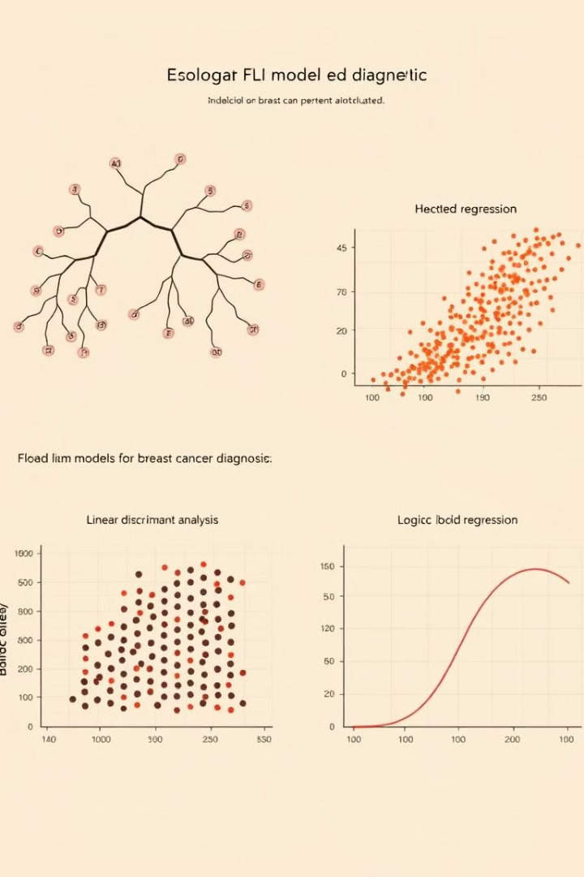



Early AI Models for Breast Cancer Diagnosis
Early AI models for breast cancer diagnosis included decision trees and linear discriminant analysis (LDA). Logistic Regression (LR) emerged as a prominent model due to its ability to deliver probabilistic outputs, which are critical in medical diagnostics for estimating malignancy likelihood. Unlike more intricate approaches, LR's simplicity and interpretability made it a preferred choice for initial AI applications in healthcare, laying the groundwork for subsequent advancements.
Decision Trees
LDA
Logistic Regression

Slide 4
Supervised Learning Techniques for Tumor Classification
Logistic Regression (LR)
Support Vector Machines (SVMs)
LR serves as a baseline model in medical diagnostics, valued for its simplicity and transparency. By employing the sigmoid activation function, LR outputs probabilities that are ideal for binary classification tasks such as tumor detection.
SVMs have gained popularity for their ability to identify an optimal hyperplane that separates malignant and benign cases with high accuracy. Kernelized SVMs improve performance by mapping data into higher-dimensional spaces.

Slide 5
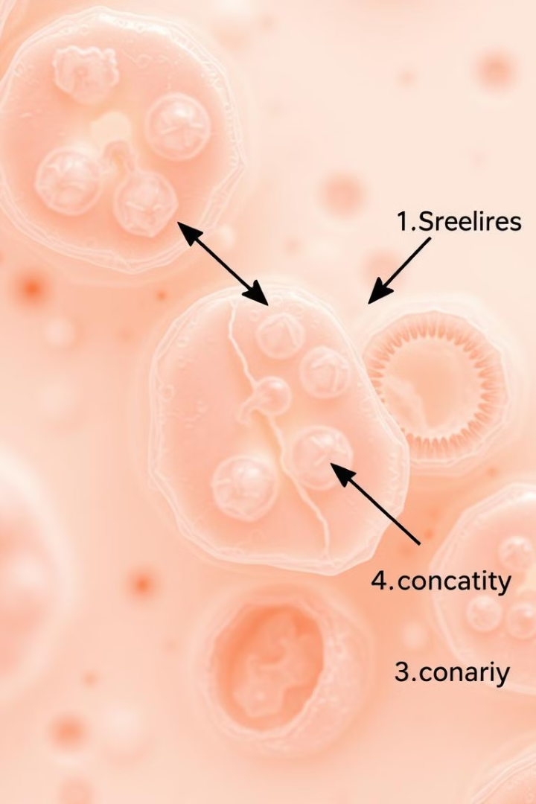
Dataset Overview
The dataset used in this project is the Wisconsin Breast Cancer Diagnostic (WBCD) dataset, sourced from the UCI Machine Learning Repository. It contains 569 samples with 32 features each, computed from digitized images of fine needle aspirates (FNA) of breast masses. The features describe characteristics of cell nuclei, such as radius, texture, perimeter, and concavity.
Samples
Features
569
32
Target
Diagnosis (M=malignant, B=benign)

Slide 6




Model Training & Optimization
The Logistic Regression model was trained using gradient descent, a first-order optimization algorithm. Weights were initialized as a zero vector, and bias was set to zero. The binary cross-entropy cost function was employed to quantify the error between predicted probabilities and actual labels. Gradients were computed for weights and bias, and parameters were updated iteratively.
Initialization
Cost Function
Gradient Descent

Slide 7
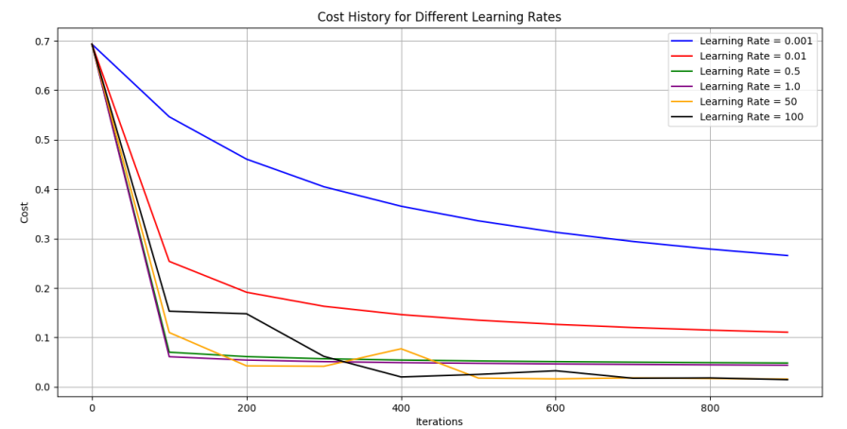

Slide 8
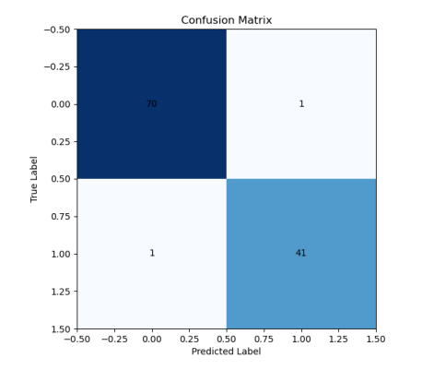
Model Evaluation
The trained Logistic Regression model was evaluated on both training and test sets to assess its generalization and performance. The model achieved an accuracy of 0.9825 on the training set and 0.9823 on the test set. These results demonstrate exceptional performance, with nearly identical metrics on training and test sets, suggesting minimal overfitting and robust generalization to unseen data.
98.23%
97.62%
Test Accuracy
Precision
Percentage of correctly classified samples
Proportion of true positives among predicted positives
97.62%
Recall
Proportion of true positives among actual positives

Slide 9
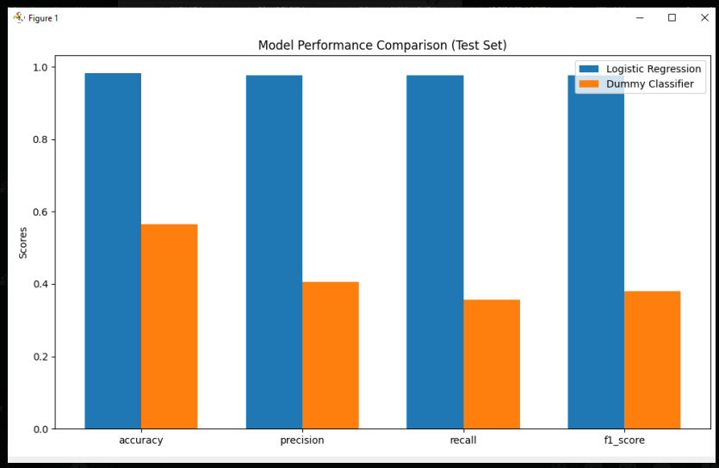

Slide 10



Conclusion
The project demonstrated the effectiveness of Logistic Regression for binary classification tasks, achieving high accuracy and robust generalization on the WBCD dataset. The results highlight the potential of AI-driven solutions in medical diagnostics. Future work will focus on addressing limitations and exploring advanced techniques to further improve model performance and applicability.
High Accuracy
Robust Generalization
Future Enhancements

