Slide 1
Cooking Methods
Sanghamitra Samanta
Guest Lecturer
Department of Humanities and Social Science,
National Institute of Technology, Goa
Cuncolim, South Goa, Goa-403703

Slide 2
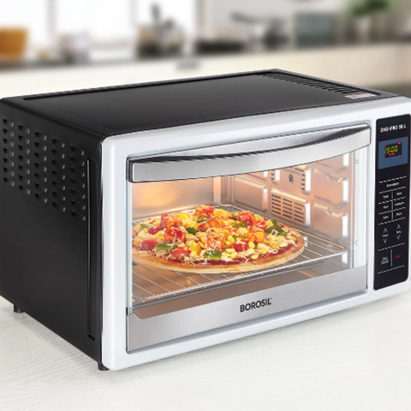
Cooking Methods
Top 10 Cooking Methods To Make Your Life Easy
First things first, based on the cooking style - either with water, no water or by using oil, you can divide the basics. Here, you have dry heat cooking, moist cooking and oil-based cooking. In all, along with water and oil, the amount of heat used to cook, the final output acts as a differentiating factor.
I-Dry Heat Cooking Style
Among all the cooking methods, in dry heat, there is no water used while preparing the food. When using this cooking style, you must be mindful and stay before the stove until the process is complete. Moving on, here is a list of the various cooking methods that come under the dry heat cooking style.
1. Baking
The baking method requires you to cook the food within an enclosed space without using any water. Typically, you need an oven to bake. In the process, you bake doughs or batters, altering the form of the starch present in the dish. You require an enclosed space to complete the process of baking. Under such conditions, the heat gets evenly distributed across all sides of the dish.

Slide 3
Broiling
2. Broiling
Many find the broiling technique quite similar to roasting. Unlike the latter, here, the food gets cooked by absorbing heat from the above the food. In the broiling method, you need to set the oven temperature at a minimum of 200 degrees Celsius and keep checking to prevent burning. Mostly it is meat, which is broiled. Other than that, one can also broil vegetables and fruits.

Slide 4
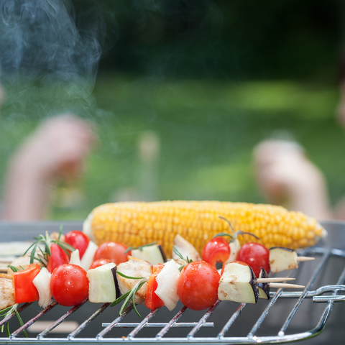
Grilling
3.Grilling
While grilling, your food (usually meats, burgers and fish) is directly placed over a heat source. You can adjust the source's temperature or continue moving and flipping the item for a uniformly cooked output.

Slide 5
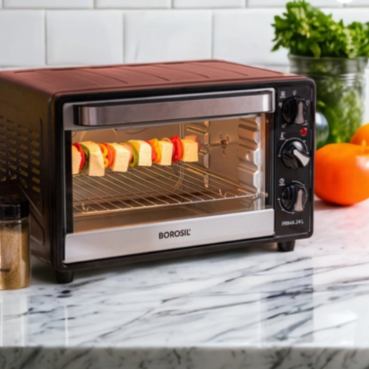
Roasting
4. Roasting
In this type of cooking, dry heat and hot air surrounding the food are used to cook the dish evenly across all sides. You can roast your raw ingredients over an open flame or in a specially curated oven. Roasted meat and vegetables have a unique taste of their own, which comes from browning or caramelisation of the same.

Slide 6
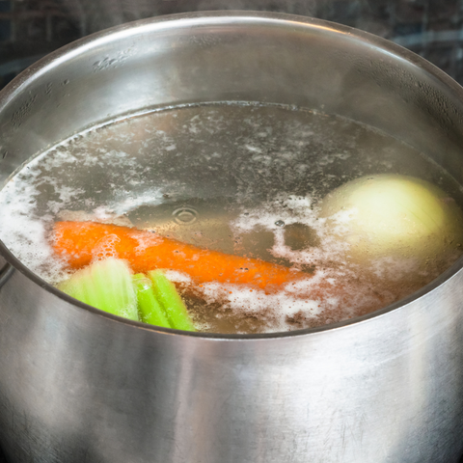
Boiling
II-Moist Heat Cooking Style
The moist cooking method relies on the presence of liquid to cook the main ingredient. It is the most appropriate cooking method to tenderise the tough fibers of any raw food item, especially meat.
5. Boiling
In the boiling cooking method, you need to immerse raw ingredients in water (may it be vegetable, meat, or fish), let them get all the heat and cook until the water reaches its boiling point (100 degrees Celsius). Boil fibrous raw materials to make them soft and easy to eat.

Slide 7
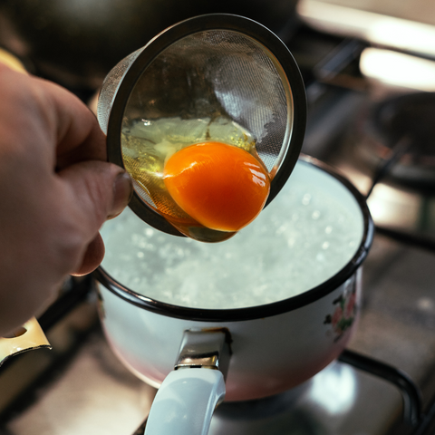
Poaching
6. Poaching
The poaching method requires you to immerse the food into the water, maintaining the temperature between 60 to 80 degrees Celsius. This type of low-heat cooking, among all other cooking methods, helps retain the moisture and flavour of the food without needing excess oil.

Slide 8
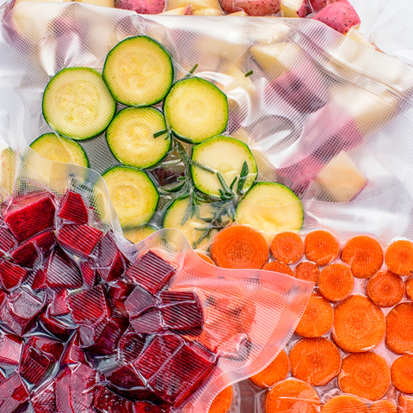
Sous Vide
7. Sous Vide
“Sous Vide” originates from the French term "under vacuum." Here, you must place the vacuum-sealed raw material in a hot water bath, letting it slow cook. The best part about the technique is that it reduces contamination risks, prep time, and energy consumption.

Slide 9
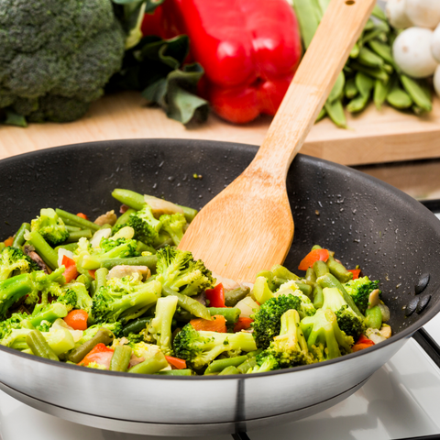
Sauteing
III-Cooking Using Oil
You can ditch water but cannot say no to oil always. Here are the various ways of cooking using oil.
8. Sauteing
It is the healthiest option among all other cooking methods using oil. When on a diet and determined to abide by a strict rule, you can saute your vegetables in less oil on a pan over a burner. The term saute is derived from the French word "to jump," where you keep moving the food by flipping or tossing it on the pan.

Slide 10
Searing
9. Searing
The searing technique requires cooking the ingredient at a high temperature, adding a crispy browning crunch on the outside. You can add small amounts of butter, oil or fat to enhance the dish's flavour.

Slide 11
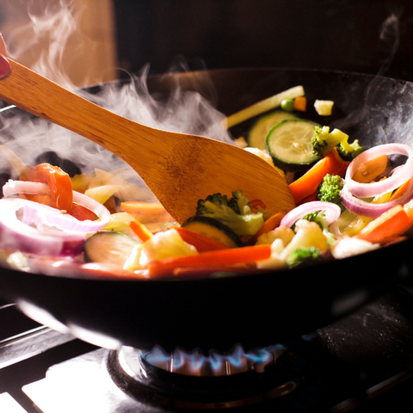
Stir-frying
10. Stir-frying
Stir-frying is a commonly used technique to cook Chinese or Korean dishes. Here you need an oiled kadhai and must continue stirring the ingredient using a pair of chopsticks or a spatula. This ensures the food is uniformly firm and thoroughly cooked from all sides. The stir-frying technique is further divided into the Bao and Chao methods.

Slide 12
Food Laws in India
Food laws in India are primarily governed by the Food Safety and Standards Act, 2006, and the regulations framed under this act. The objective of these laws is to regulate the manufacture, storage, distribution, sale, and import of food products to ensure their safety and quality.
In India, food laws and regulations include:
Food Safety and Standards Act, 2006This act establishes the Food Safety and Standards Authority of India (FSSAI) to regulate the safety and quality of food. The FSSAI is responsible for monitoring the manufacturing, processing, storage, distribution, sale, and import of food.
Other food laws
Some other food laws in India include:
The Vegetable Oil Products (Control) Order, 1947
The Fruit Product Order, 1955
The Solvent Extracted Oil, De-oiled Meal, and Edible Flour (Control) Order, 1967
The Meat Food Products Order, 1973
The Milk and Milk Products Order, 1992
The Edible Oils Packaging (Regulation) Order, 1998
Food laws and regulations also cover aspects like sanitation, licensing, and other permits that are required to run a food business.

Slide 13
Thank You

