Slide 1
Yoga
Sanghamitra Samanta
Guest Lecturer
Department of Humanities and Social Science,
National Institute of Technology, Goa
Cuncolim, South Goa, Goa-403703

Slide 2
What is Yoga?
Yoga is an ancient Indian practice that combines physical postures, breathing exercises, and meditation to improve health and promote harmony between the mind and body:
Definition: The word "yoga" comes from the Sanskrit word yuj, which means "to join" or "to yoke".
Purpose: Yoga's goal is to achieve self-realization and liberation from suffering.
History: Yoga originated as a spiritual practice thousands of years ago.
Practice: In the United States, yoga typically focuses on physical postures (asanas), breathing techniques (pranayama), and meditation (dyana).
Styles: There are many different styles of yoga, ranging from gentle to demanding.
Other practices: Yoga is sometimes called a "meditative movement" practice, along with tai chi and qigong.
Yoga is one of the six classical schools (Darshanas) of Indian philosophy. It's rooted in the idea that the individual self can be unified with the universal self. Some types of yoga include:
Karma Yoga: The Path of Action Bhakti Yoga: The Path of Devotion to Ishvar (God)
Jnana Yoga: The Path of Knowledge
Viniyoga: Focuses on form over function, breath and adaptation, repetition and holding, and sequencing

Slide 3
Advantages Of Yoga
Yoga has many advantages, including:
Physical health: Yoga can improve flexibility, balance, strength, muscle tone, and posture. It can also help with respiration, metabolism, and cardio and circulatory health.
Mental health: Yoga can reduce stress and anxiety, and improve mental health and well-being. It can also help with depression and burnout.
Sleep: Yoga can improve sleep quality.
Brain development: Yoga can help with brain development, memory, and concentration.
Other benefits: Yoga can help with immunity, eye strain, headaches, motivation, and productivity. It can also help with aging in a healthy way.
Yoga is an ancient practice that combines physical poses, breathing exercises, and meditation. The word yoga comes from the Sanskrit word yuj, which means "to join or yoke together".

Slide 4
Ashtanga Yoga
Ashtanga Yoga is one of the classifications of Yoga in Patanjali’s Yoga Sutras, which states that optimum mental and physical health can only be achieved by being ethically and morally right through karmas (deeds or actions), meditation, discipline, inner and outer cleansing, and physical exercises. Ashtanga Yoga aims to channel a person’s inner energy with the energy in his or her external world with the help of the right actions, meditation, discipline and exercises. To achieve this objective, individuals need to practise the "eight limbs" of Ashtanga Yoga, as described by Patanjali in his Yoga Sutras.

Slide 5
History Of Ashtanga Yoga
The traces of Ashtanga Yoga practices have been found in Patanjali’s writings dating back between the 2nd century BCE and the 4th century BCE. However, how long people have been practising this Yoga form is still unknown.
In the 1900s, an Indian Yoga guru, namely T. Krishnamacharya, taught Ashtanga Yoga to his student or disciple, K. Pattabhi Jois. Later on in the 20th century, Jois added fast pase Surya Namaskar or Sun Saltuation poses to Ashtanga Yoga and taught them to Indian wrestlers and gymnasts. Since then, this Yoga form has become popular among people. Cultural communication between India and other western nations made Ashtanga Yoga popular in the western world as well.
Meaning of Ashtanga Yoga: Ashtanga means "eight limbs" or "body parts" (Astha means eight and anga means body parts), which indicates eight components or paths of Ashtanga Yoga to achieve mental and physical health goals and spiritual goals.
However, Yoga means union. In the context of Yoga, union refers to the harmony between the mind and body of a person

Slide 6
8 Limbs Of Ashtanga Yoga
1. Yama (Principles): It refers to ethical rules or values in Hinduism to do morally right. They are dos for a person practising Ashtanga Yoga. Following these rules allows a person to achieve mental peace. The five Yamas are mentioned below:
Ahimsa (Nonviolence)
Satya (Truthfulness)
Asteya (Non-stealing)
Brahmacharya (Chastity / Purity)
Aparigraha (Non-avarice or not keeping entreme desire or greed for money)
2. Niyama (Personal Discipline): This second component of Ashtanga Yoga refers to specific habits for cleansing people’s mind and body. The Niyamas are the following:
Shaucha (Habits to clean the body, mind and speech)
Santosha (Contentment, patience and tolerance or acceptance towards others)
Tapas (Persistence and self-discipline to control and channel your emotions and actions in the right direction)
Svadhyaya (Self awareness)
Ishvarapranidhana (Knowing and contemplating the unchanging reality or the God that you believe)

Slide 7
3. Asana (Postures): Asanas refer to the postures for meditation. The main Asanas mentioned in Yoga Sutras are the following:
Padmasana
Svastikasana
Dandasana
Virasana
4. Pranayama (Breathing exercises / practices): Pranayamas refer to the control of a person on his or her breathing process. They include breathing exercises.
5. Pratyahara (Isolation): Pratyahar is the process of mitigating the effects of sensory experiences based on the external environment to introspect one’s own mind.
6. Dharana (Concentartion): Once a person controls sensory experience through Pratyahara, he or she can concentrate to introspect and keep his or her mind focused through Dharana. This limb of Ashtanga Yoga allows a person to control unconscious and abstract thoughts and focus on conscious ones.
7. Dhyana (Meditation): After making the mind calm through Dharna, a person can focus on a particular idea or object through Dyana to achieve true knowledge about it.
8.Samadhi (Salvation): Samadhi is the stage where a person liberates himself or herself from the awareness of the idea or object on which he or she was meditating. He or she can willingly liberate himself or herself from all types of suffering through detachment from desires related to ideas and objects.

Slide 8
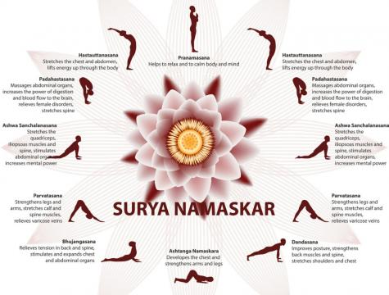
Ashtanga Yoga Poses
Ashtanga Yoga PosesModern Ashtanga Yoga consists of two types of Yoga poses: Surya Namaskar A and Surya Namaskar B (Sun Salutation A and Sun Salutation B). The Yoga poses in Surya Namaskar A and Surya Namaskar B have been listed below.Surya Namaskar A PosesCheck out the poses of Sun Salutation A below:
Pranamasana
Hasta Uttanasana
Padahastasana
Ashwa Sanchalana
Parvatasana
Dandasana
Ashtanga Namaskara
Bhujangasana
Parvatasana
Ashwa Sanchalana
Padahastasana
Hasta Uttanasana
Pranamasana

Slide 9
Benefits Of Ashtanga Yoga
The benefits of Ashtanga Yoga are the following:
Relaxes mind
Increased self-awareness
Increased self-discipline and self-control
Enhanced metabolism
Improved digestion
Reduces stress and anxiety
Provides strength and flexibility to body
Helps in weightloss
Improves blood circulation
Cleanses toxins from arteries and veins
Improves skin and delay ageing
Improves digestion and overall gut health
Increases happiness
Increases power to concentrate
Improves sleep cycle
Increase endurance and stamina
Muscle mass gain
Promotes the sense of belongingness compassion and empathy at spiritual level

Slide 10
Moon Salutation
Moon salutation, called Chandra Namaskar consists of two words, 'chandra' means 'moon' and 'namaskar' means 'to salute'. The practice of Moon Salutation is a reflection of Sun Salutation (Surya Namaskar), just as the moon has no light of its own but reflects the light of the sun. The sequence of asanas is the same as Surya Namaskar except that Ardha Chandrasana is performed after Ashwa Sanchalanasana (Horse-riding pose).
Ardha Chandrasan, the half-moon pose, is a significant posture as it develops concentration and balance. This pose helps activating the ida nadi, the lunar force in the system responsible for consciousness. Ardha Chandrasan works on the throat chakra or Vishuddhi chakra on a spiritual level.

Slide 11
When to do moon salutation?
Moon Salutation is best practiced in the evening or at night, especially when the moon is visible. Ensure that the stomach is empty before practising these asanas.
Moon Salutation benefits.
Moon Salutation helps you channelizing the lunar energy; which has cool, relaxing, and creative qualities. Chandra Namaskar also stretches and strengthens the spine, hamstrings, backs of legs and stomach muscles. It also balances the functioning of the circulatory, respiratory and digestive systems.

Slide 12
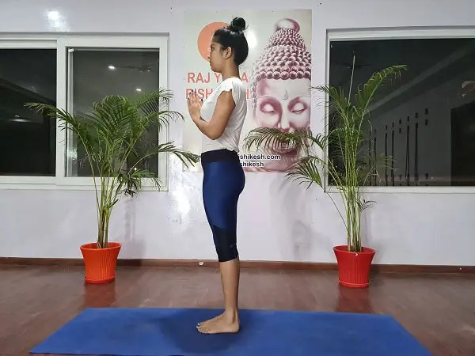
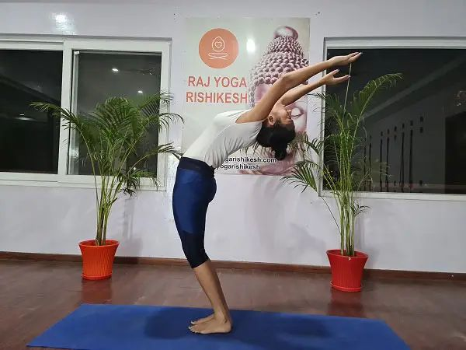
Steps To Perform Moon Salutation
Step 1: Exhale-PRANAMASANA
Step 2: Inhale-HASTA UTTANASANA

Slide 13
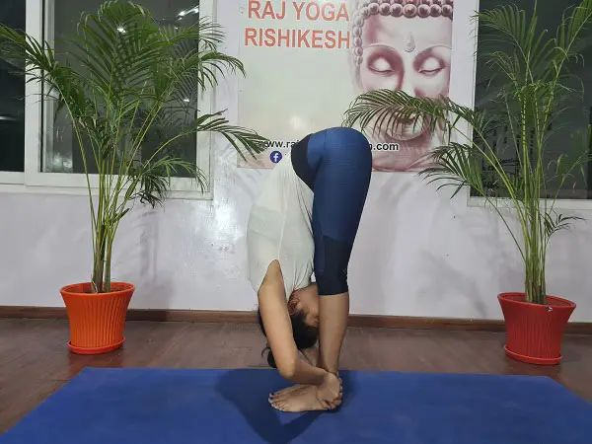
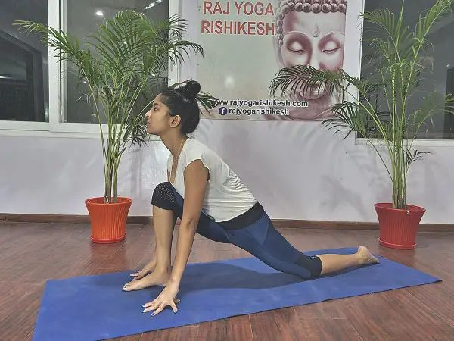
Step 3: Exhale-PADAHASTASANA
Step 3: Inhale-ASHWA SANCHALANASANA

Slide 14
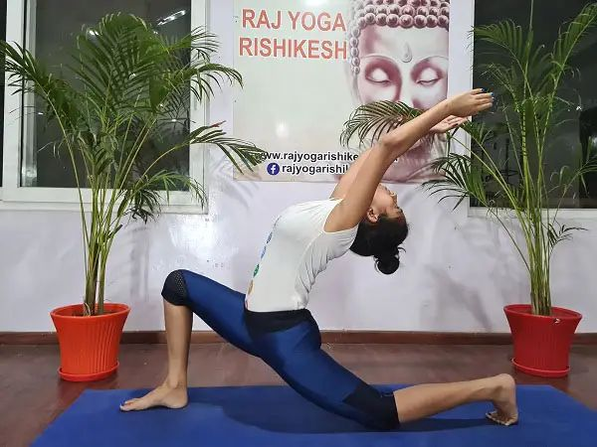
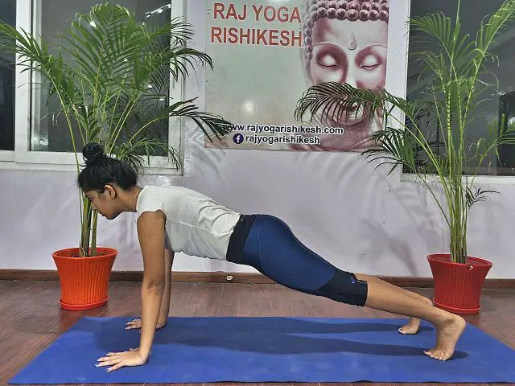
Step 5: Inhale-ANDRA CHANDRASANA
Step 6: Retain the breath-DANDASANA

Slide 15
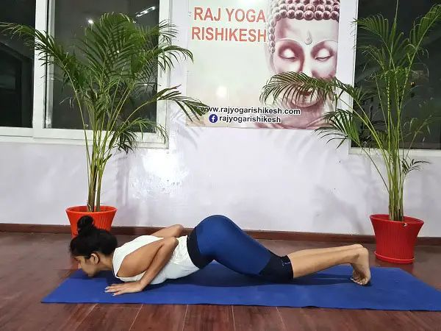
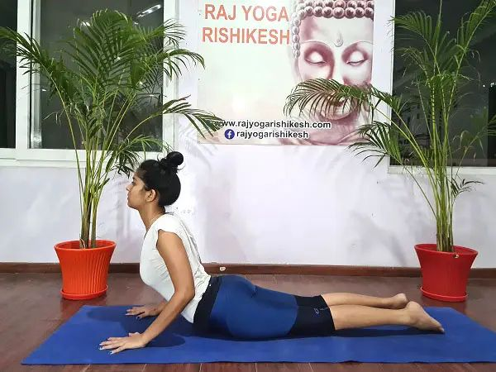
Step 7: Exhale-ASHTANGA NAMASKARA
Step 8: Inhale-BHUJANGASANA

Slide 16
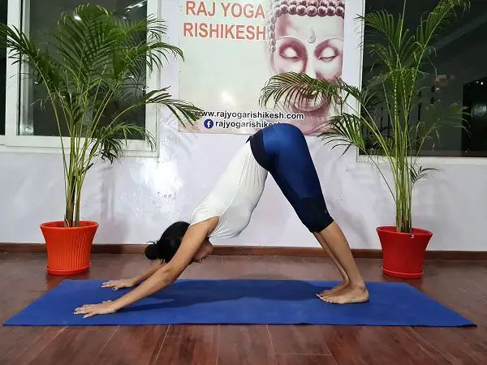
Step 9: Exhale-PARVATASANA
Step 10: Inhale-ASHWA SANCHALANASANA

Slide 17
Step 11: Inhale-ARDHA CHANDRASANA
Step 12: Exhale-PADAHASTASANA

Slide 18

Step 13: Inhale-HASTA UTANASANA
Step 14: Exhale-PRANAMASANA

Slide 19
Thank You

