Slide 1
Module 1
Introduction to Natyashastra
Bharatmuni
Dr.unais kt
Nit goa

Slide 2
Introduction
Natyashastra by Bharata is the most detailed and elaborate of all treatises on dramatic criticism and acting ever written in any language and is regarded as the oldest surviving text on stage craft in the world.
Bharata in his Natyashastra demonstrates every aspect of Indian drama whilst covering areas like music, stage-design, make up, dance and virtually every aspect of stagecraft.

Slide 3
Origin of Natyasastra
The origin of the Natyasastra is from the spoken or recited words that have been extracted from the Rigveda, the songs that have been extracted from samveda and the action has been taken from the Yajurveda.

Slide 4
Continue…
Natyashastra has offered a remarkable dimension to growth and development of Indian classical music, dance, drama and art.
Natyashastra indeed laid the cornerstone of the fine arts in India.
Bharat Muni is the first author to deal with theory of aesthetics. He analyses various sentiments and their portrayal through the permanent state of mind, the determinants and consequences.

Slide 5
On the Title
The Natyashastra, which has been described as the science of drama, is an ancient treatise on dramaturgy that throws light on Indian aesthetics, poetics and performing arts.
The title of the text is composed of two words, “Natya” and “Shastra”. The root of the Sanskrit word Natya is Nat which means “act, represent”.
The word Shastra means “precept, rules, manual, compendium, book or treatise”, and is generally used as a suffix in the Indian literature context, for knowledge in a defined area of practice.
The text consists of 36 chapters with a cumulative total of 6000 poetic verses describing performance arts.

Slide 6
Date of Composition
The composition date of Natyashastra is unknown as the estimates vary from 500 BC to 500 AD.
However, Bharata Muni in the second century BC is supposed to have composed this text on theatrical practice and theory that formulates Indian aesthetics.
The text of Natyashastra provides a system by which performance experience can be organised and made sense of and rendered comprehensible.
Scholars date the origin of Natyashastra as early as 200 BC, and as late as 600 AD.
The text in an oral form, similar to what we know as Natyashastra today, was most likely composed between 200 BC and 400 AD.

Slide 7
Objectives
The Natyashastra’s primary concerns are not philosophical or theoretical; rather, the text elucidates and elaborates how theatre is performed.
It prescribes in detail the construction of theatre spaces in India, the application of make-up, the design and building of props, arm, foot, eye and other body movements, ritual practices, the organization of theatre companies, the audience, dramatic competitions and the community of actors with additional chapters on music and audience appreciation

Slide 8
Continue…
It elaborates the effectiveness of theatre. Primarily dealing with stagecraft, the Natyashastra prescribes and influences Indian music, dance and literature.
It nourishes itself with mythology of classical India which was transcribed into drama and performed in the temples and courts.
Besides its relevance to the theatre, the Natyashastra shapes our understanding of music and dance in ancient India.

Slide 9
Structure of the Text
The most studied version of the text, consisting of about 6000 poetic verses, is structured into 36 chapters. The tradition believes that the text originally had 12,000 verses.
The structure of the text harmoniously compiles aspects of the theatrical arts into separate chapters.
The background of Natyashastra is framed in a situation where a number of munis approach Bharata to know about the secrets of Natyaveda. The answer to this question comprises the rest of the book.

Slide 10
Continue…
The text opens with the mythical genesis and history of drama, mentions the role of different Hindu deities in various aspects of the arts, and recommended Puja (consecration ceremony) of a stage before performance.
The text then describes the theory of Tandava dance (Shiva), the theory of rasa (emotion), of bhava (feelings), expression, gestures, acting techniques, basic steps & standing postures.

Slide 11
Contents of Natyashastra
The principal theme is the dramatic art which concerns the producers of the plays as well as those who compose them, the playwrights.
Bharata wanted the plays to be a Drisya Kavya that can be successfully and profitably represented on the stage.
Prakrita and allied native languages are meticulously dealt with by means of examples in the Natyashastra.

Slide 12
Continue…
References have been made to the languages of ancient tribes suchas Barbaras, Kiratas, Andhras, Dravidas, Sabaras, Candalar etc.
Natyashastra gives detailed directions about the dressing material, modes of wearing the garments and jewellery, articles to be used by the different characters in a play in accordance with their social status, profession, the cultural practice etc.

Slide 13
Chapters of Natyashastra
In the first chapter Bharata talks about the response and involvement of the spectator in drama.
The spectators come from all classes of society without any distinction, but are expected to be at least minimally initiated into the appreciation of theatre.
The second chapter lays down the norms for theatre architecture or the prekshagriha i.e. auditorium.
It describes the medium sized rectangular space as ideal for audibility and visibility, apparently holding about four hundred spectators

Slide 14
Continue…
The third chapter describes an elaborate puja for the gods and goddesses protecting the auditorium, and prescribes rituals to dedicate the space.
Fourth chapter also lays the foundation of angika abhinaya or physical acting developed in later chapters.
The fifth chapter however details the elements of Purvaranga (ceremonies connected with it are performed at the inauguration of the staging of play).

Slide 15
Continue..
Chapters 6 and 7 of The Natyashastra present the rasa theory in performing arts.
while chapters 8 to 13 are dedicated to the art of acting. Stage instruments such as methods for holding accessories, weapons, relative movement of actors and actresses, scene formulation, stage zones, conventions and customs are included in chapters 10 to 13 of the text.
The chapters 14 to 20 are dedicated to plot and structure of underlying text behind the performance.

Slide 16
Continue…
Chapter 17 presents the attributes of poetry and figures of speech.
While chapter 18 presents the art of speech and delivery in the performing arts. The text lists ten kinds of play, presents its theory of plot, costumes, and make-up.
The text dedicates several chapters exclusively to women in performing arts, (especially chap- 24 is on the participation of women in theatre.

Slide 17
Continue…
The training of actors is presented in chapter 26 and 35 of the text.
The theory of music, techniques for singing, and music instruments are discussed from chapters 28 to 34.
The text in its final chapters describes the various types of dramatic characters, their roles and need for team work, what constitutes an ideal troupe, closing out the text with its comments of the importance of performance arts on culture.

Slide 18
Origin of Theatre
Surviving texts and treatises suggest that theatre existed in the Indian subcontinent prior to the Vedic age.
The golden era of Indian theatre is believed to have continued until the 5th century, after which the prominence of Sanskrit drama gradually diminished.
Paul Kurtz suggests that the Rig Veda gives evidence that dramatic theatre in India came into being around the eighth century B.C.
According to Kurtz, the Jataka stories illustrating Indian life between 600 B.C. and 300 B.C. contain evidences of theatre

Slide 19
Continue..
Like its Greek counterpart Indian drama and theatre owes its origin to religion.
The two great Indian epics, the Ramayana and the Mahabharata have contributed vastly to performing arts in ancient times.
Kurtz observes In the fourth century B.C, actors were employed to perform at temples in the honour of Gods. Also, some villages exhibited public performances in the form of Stree Preksha (women’s drama) and Purusha Preksha (men’s drama).

Slide 20
Continue..
The Natyshastra of Bharata Muni brings out the evidence of theatre arts at festivals and public celebrations during the Maurya Dynasty, founded by King Chandragupta (reigned 321 B.C -297 B.C).
The Maurya Dynasty ruled India for a long period. During this period, kings sent Buddhist missionaries to various places like Ceylon, Syria, Egypt, Greece, Tibet, China and Japan to spread Buddhism. The missionaries used various forms of arts including drama, to teach Buddhist dogma.

Slide 21
Continue..
In a similar way, the Gupta Dynasty (A.D. 320- A.D. 535) accompanied in India’s golden or classical age in which the Buddhism accepted by King Asoka (reigned 274B.C- 232 B.C) and the dramatic theatre flourished.
The great playwright Kalidasa was patronized by King Vikramaditya (A.D. 373 – A.D. 415) and also gathered a unique group of poets and scholars.

Slide 22
Description of the playhouse in Natyashastra
Natyashastra, the ancient Indian text, has provided valuable insights into various aspects of performing arts, including the playhouse.
According to the Natyashastra, the playhouse should be rectangular, square, or triangular in shape, with the rectangular one being most common.
The dimensions are carefully laid out to ensure proper audibility and visibility for the audience.

Slide 23
Continue..
Three Sections: The playhouse is divided into three sections—the stage area (rangaśīrṣa), the backstage (nepathya), and the audience area (rangapīṭha).
The stage was raised and decorated elaborately, providing space for actors to perform.
Size: The playhouse could be of three sizes—small, medium, or large, depending on the scale of performances. The small ones could accommodate around 300 spectators, while the large ones could hold about 500.

Slide 24
Continue..
Decorative Elements: The interiors were adorned with ornamental pillars, murals, and artistic carvings, with attention to aesthetics.
Audio Design: Special attention was given to acoustics to ensure the performers’ voices were audible throughout the playhouse. This included the use of certain materials and design elements that helped in sound projection.

Slide 25
Continue..
Audience Seating: The audience seating was tiered, ensuring clear visibility from all parts of the playhouse. The Natyashastra also outlines the placement of spectators based on social hierarchy.
Curtains and Props: Curtains were used to separate the backstage from the stage, and various props were placed to create an immersive theatrical experience

Slide 26
Ten kinds of plays
The Natyashastra categorizes plays into ten distinct types, known as Daśarūpaka (ten forms of drama), each with its own structure, themes, and styles.
These classifications are based on the nature of the story, the characters involved, and the dramatic composition.
1. Nāṭaka (Heroic or Epic Play): The most prominent and grand form, Nāṭaka typically deals with stories of heroic figures, especially kings, and is based on epics or historical events. It has five to ten acts and focuses on high ideals and morals.

Slide 27
Continue..
2. Prakaraṇa (Social Play): A fictional play revolving around middle-class or common people, often dealing with love, social issues, or domestic life. The hero is usually a Brahmin or merchant. It has five to ten acts, like Nāṭaka.
3. Bhaṇa(Monologue Play): A one-act monologue play where a single actor portrays multiple characters, often narrating a humorous or satirical story.

Slide 28
Continue..
4.Samavakara (Mythological Play): A mythological play in three acts, usually involving gods, demons, and supernatural events. It depicts intense conflicts and resolutions, often of cosmic significance.
5. Vithi – Farcical Play: A one-act farce that combines prose and poetry, characterized by wit and humor. It often includes humorous dialogues and situations.
6. Anka – Tragic Play: A one-act play focusing on sorrowful or tragic events. It generally involves noble characters in distress and ends in tragedy or loss.

Slide 29
Continue..
7. Vyayoga – Heroic Conflict Play: A one-act heroic play that involves conflicts between great warriors or supernatural beings. It focuses on battle, strength, and valor but lacks romantic elements.
8. Dima – Supernatural Play: A mythological or supernatural drama in four acts, often involving conflict between gods and demons. It is characterized by fear, supernatural elements, and battles.
9. Ihamṛga – Adventure Play: A complex play in one act, dealing with the pursuit of unattainable desires, often involving a combination of romance and adventure.

Slide 30
Continue..
10. Prahasana – Comic Play: A farcical comedy, usually divided into two types—superior (involving noble characters) and inferior (dealing with commoners). It satirizes social, religious, or political issues in a lighthearted manner.

Slide 31
Dharmi-Acting
In Natya Shastra, Dharmi refers to the styles or modes of acting. There are two main Dharmis:
Natyadharmi (Theatrical style)- This is a stylized, exaggerated, and symbolic mode of acting, commonly used in classical and traditional forms like Kathakali or Bharatanatyam. It does not focus on realism but on heightened expressions and gestures.
L0kadharmi (Realistic style) – This style focuses on realistic, everyday behavior and emotions, often used in modern drama or films. It mimics real-life situations and interactions more closely.

Slide 32
Rasa & Bhav
In Indian classical performing arts, particularly in Natya Shastra, “Rasa” and “Bhava” are central concepts in understanding the emotional and aesthetic experience of drama and performance.
Bhava represents the emotions expressed by the actor, and Rasa is the emotional response evoked in the audience.
The combination of different Bhavas gives rise to various Rasas in the spectators, thus creating the aesthetic and emotional essence of the performance.

Slide 33
Bhava (Emotion or Mood)
Bhava refers to the emotional states or feelings portrayed by the actor or performer.
It is the foundation upon which the Rasa is evoked in the audience.
There are different types of Bhavas that correspond to specific emotions. The Natya Shastra identifies eight primary emotional states, called Sthayi Bhavas:

Slide 34
Sthayi Bhavas
1.Rati (Love)
2.Hasya (Laughter)
3.Shoka (Sorrow)
4.Krodha (Anger)
5.Utsaha (Energy or Heroism)
6.Bhaya (Fear)
7.Jugupsa (Disgust)
8.Vismaya (Wonder)
These emotional states are communicated through facial expressions, gestures, and body language by the actor.

Slide 35
Rasa
Rasa is the emotional flavor or essence that is experienced by the audience when the actor performs.
The concept of Rasa is the aesthetic experience that arises from the Bhavas portrayed in the performance.
There are nine main types of Rasas (called Nava Rasas), which correspond to the eight Sthayi Bhavas

Slide 36
Nava Rasas
Śhṛiṅgāra (Love or Romance) – linked with Rati
Hāsya (Laughter or Comedy) – linked with Hasya
Karuna (Compassion or Pathos) – linked with Shoka
Raudra (Anger or Fury) – linked with Krodha
Veera (Heroism or Courage) – linked with Utsaha
Bhayanaka (Terror or Fear) – linked with Bhaya
Bībhatsa (Disgust or Aversion) – linked with Jugupsa
Adbhuta (Wonder or Awe) – linked with Vismaya
Śhānta (Tranquility or Peace) – which stands apart as a neutral, serene sentiment.

Slide 37
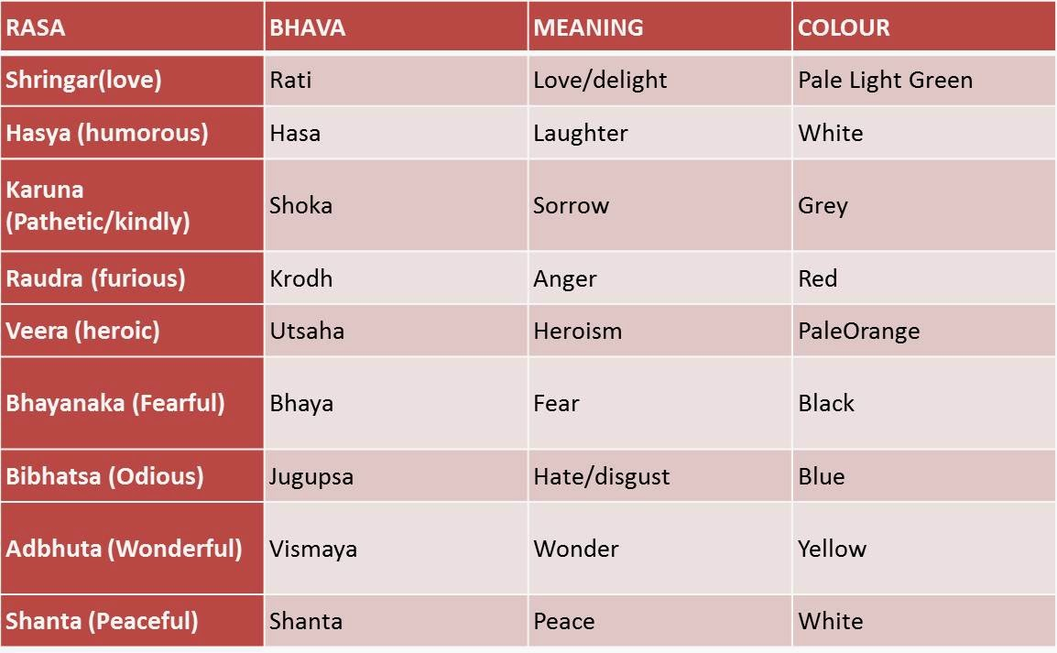
Image

Slide 38
38
Thank You!

