Slide 1
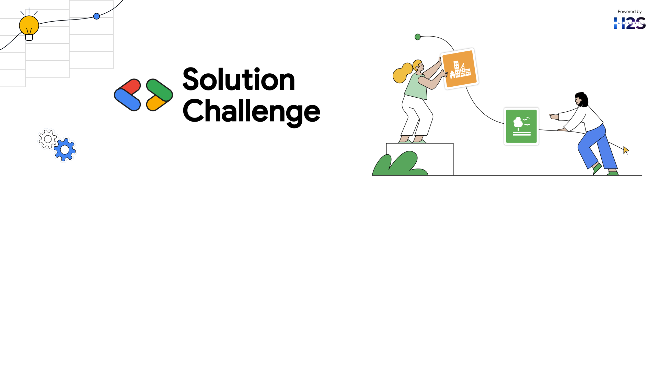
Team Details
Team name: Codebreakers.
Team leader name: Aaryan Rajesh Khedekar.
Problem Statement: Library & Tool for analysis & synthesis of Indian Classical Music.

Slide 2

Brief about your solution
SangeetAI is an innovative web application developed using Next.js, designed to revolutionize the way musicians and enthusiasts engage with Indian Classical Music. At its core, the platform features an intelligent AI-powered assistant, driven by Google Gemini, which provides users with insightful answers, personalized guidance, and contextual information about various aspects of Indian classical traditions, including ragas, talas, instruments, and theory.
In addition to the conversational assistant, SangeetAI integrates practical tools such as a digital tuner for precise pitch alignment and a metronome to support rhythm practice and maintain tempo accuracy. Together, these features offer a holistic learning and practice environment, catering to both beginners and advanced practitioners of Indian classical music.
The application was developed using Google's Project IDX, a modern cloud-based development platform that streamlines coding workflows and fosters seamless collaboration among developers. By combining advanced AI capabilities with essential musical tools, SangeetAI aims to make classical music more accessible, interactive, and engaging for a global audience.

Slide 3
Opportunities
How different is it from any of the other existing ideas?
AI Chatbot for Indian Classical Music – Uses Google Gemini to answer queries about ragas, talas, instruments, and more. Most platforms lack this focus.
All-in-One Tool – Combines tuner, metronome, and AI assistant in one place, avoiding the need for multiple apps.
Culturally Specific – Designed specifically for Indian classical music, unlike most Western-focused music tools.
For All Skill Levels – Supports both beginners and advanced musicians with accessible tools and guidance.
Modern Tech Stack – Built with Next.js and Google’s Project IDX for efficient development and collaboration.

Slide 4
b. How will it be able to solve the problem?
Lack of Guidance in Indian Classical Music: The AI chatbot provides instant answers, explanations, and suggestions tailored to Indian classical concepts reducing dependency on scarce or inconsistent resources.
Tool Fragmentation: Instead of using separate apps for tuning, rhythm, and theory, SangeetAI brings everything together improving convenience and workflow for musicians.
Accessibility & Reach: Being a web app, it’s easily accessible from anywhere, making quality learning tools available to students regardless of their location.
Time-Consuming Practice Setup: With integrated tools, users can get into focused practice faster no need to set up or switch between multiple tools.
Gap in Digital Music Education for Indian Genres: SangeetAI helps fill the gap by offering structured, intelligent help tailored to Indian classical learning styles — something most mainstream apps ignore.

Slide 5

c. USP of the proposed solution:
“An AI-powered, all-in-one platform dedicated to Indian Classical Music — combining intelligent guidance, essential practice tools, and cultural relevance in a single web application.”
“SangeetAI - where tradition meets technology.”

Slide 6
List of features offered by the solution
AI-Powered Chatbot: Utilizing Google Gemini, SangeetAI can answer questions about Indian Classical Music theory, history, concepts (Raag, Taal, etc.), and famous musicians.
Built-in Tuner: A precise tuner helps you tune your instruments accurately for optimal performance.
Versatile Metronome: A customizable metronome assists in practicing with perfect timing and rhythm.
User-Friendly Interface: Built with Next.JS and styled with Tailwind CSS and HeroUI components for an intuitive and visually appealing experience.

Slide 7
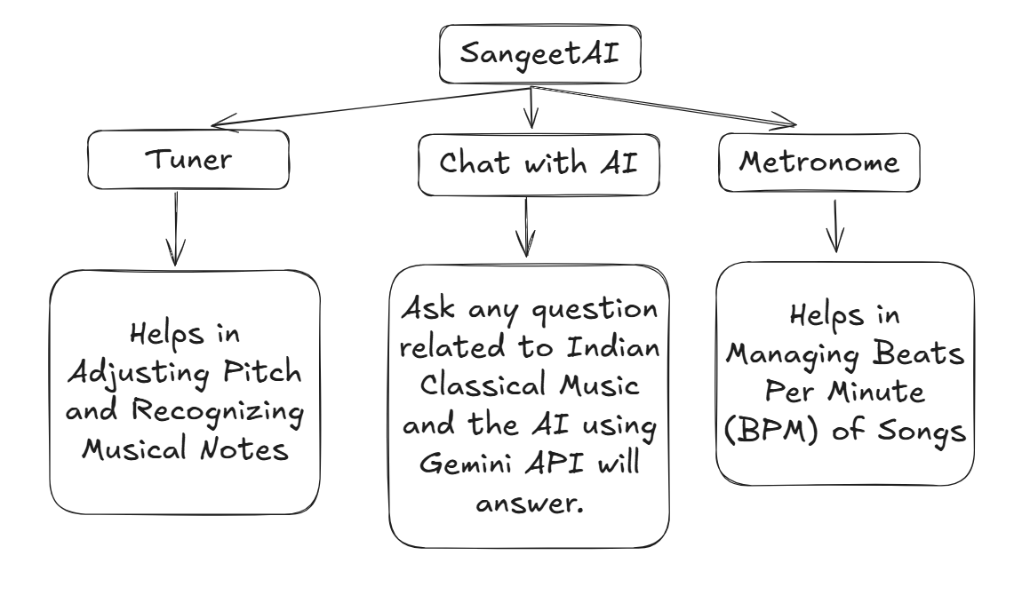
Use-case diagram

Slide 8
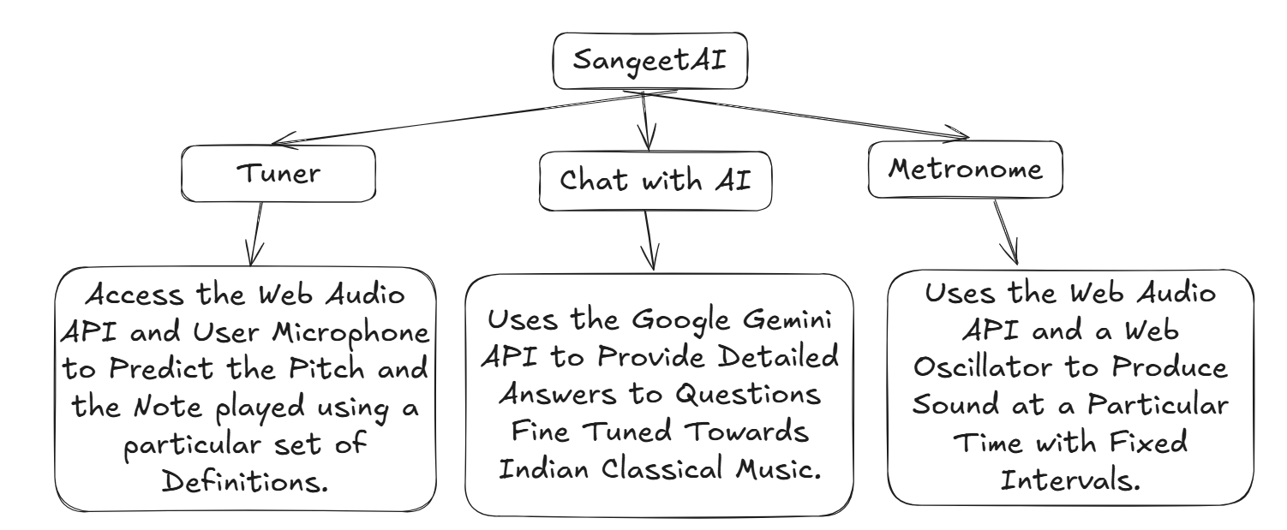
Architecture diagram

Slide 9
Technologies to be used in the solution:
Next.js: React framework for building performant and scalable web applications.
React: JavaScript library for building user interfaces.
Tailwind CSS: Utility-first CSS framework for rapid UI development.
HeroUI: Set of pre-designed UI components for a polished look and feel.
Google Gemini (Generative AI): Powers the AI chatbot functionality.
Google Project IDX: Cloud-based development environment.

Slide 10
Estimated implementation cost
Development Costs :
The development of such a platform would additionally require certain more things like AI & ML Integration, Cloud Hosting & Storage, Music Content Creation, UI/UX & Graphic Design and Pre-launch Marketing. That would estimate about $50,000 – $140,000.
Running Costs :
The Running costs includes App Maintenance & Updates, Cloud Hosting & AI Processing, Marketing & User Acquisition, Cloud Hosting & AI Processing. That would estimate around $7,000 – $25,000/month.

Slide 11
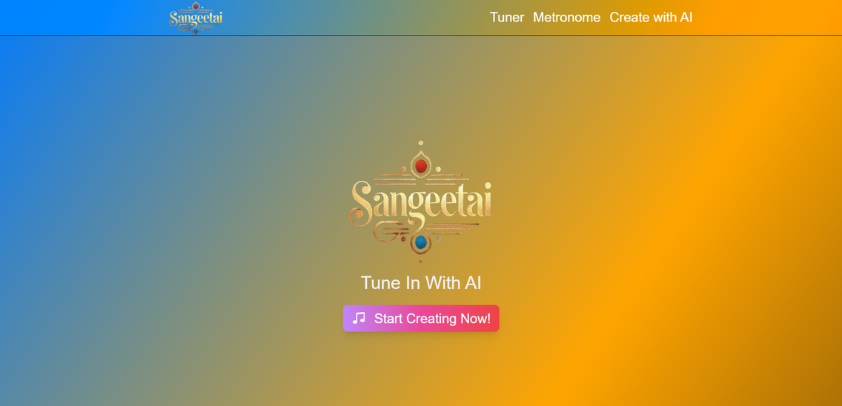
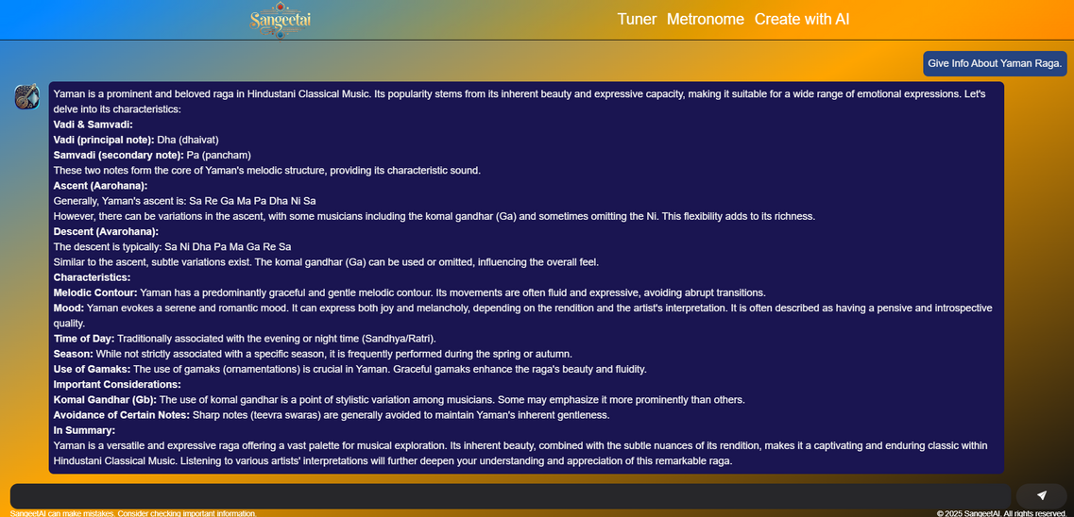
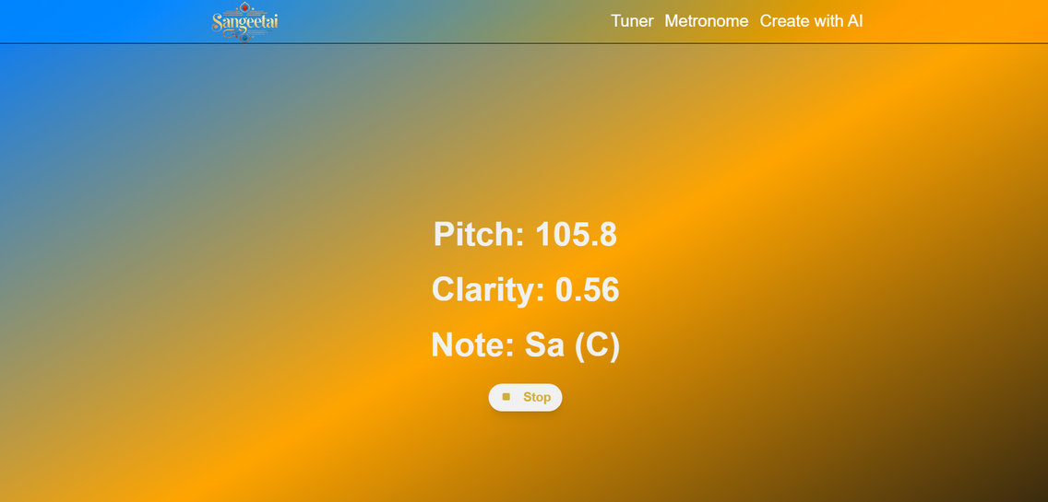
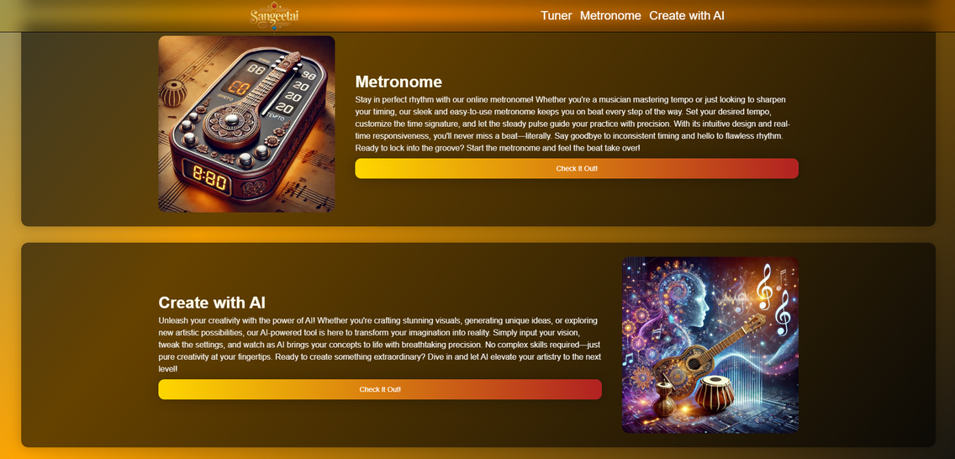
Snapshots of the MVP
Home Page
ChatBot
Tuner
Additional features

Slide 12
Additional Details/Future Development
Voice Input & Singing Feedback: Allow users to sing or play an instrument into the mic and get real-time feedback on pitch, raga, or rhythm accuracy and get AI-powered analysis onto their input.
Improve the overall UI of the application: The UI of SangeetAI can be improved with a unique title font, subtle Indian-themed visuals, and better mobile responsiveness. Smooth animations, tooltips, and real-time feedback would enhance usability and create a more polished experience.
Mobile version of the application: Build dedicated mobile apps for on-the-go practice, offline access, and a more seamless user experience.
Virtual Instruments Integration: Add a digital tanpura, tabla, harmonium, or even a virtual synthesizer to simulate accompaniment during practice.
Bugfix and Improvement of existing features: Bugfix the tuner and add more features to the metronome like tap tempo and sound customizations.

Slide 13
GitHub Repository Link:
https://github.com/AaryanKhClasses/SangeetAI
Video Link:
https://github.com/AaryanKhClasses/SangeetAI/blob/main/SangeetAI.mp4
https://youtu.be/6zbYdPkekaY
MVP Link:
https://sangeetai-xi.vercel.app/

Slide 14


