Slide 1
Data Mining from Two Line Element(TLE) sets
CS685A COURSE PROJECT
Name - Aaryansh Mohan Bansal
Email: arynshmb@iitk.ac.in
Group No - 45
Third Year Undergraduate
Roll No -190013

Slide 2
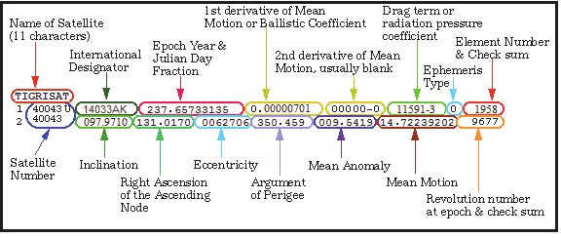
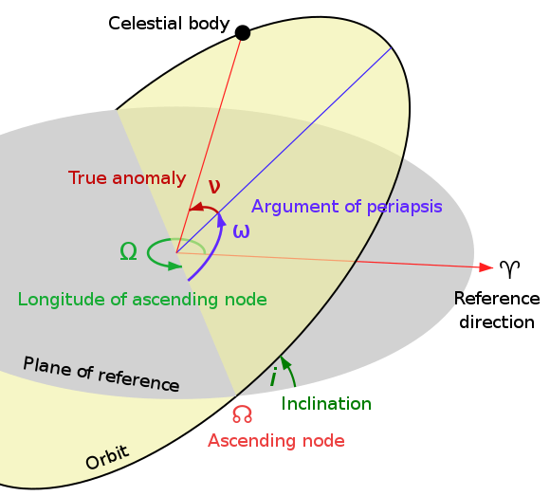
TLE Data and its Interpretation

Slide 3
Project Work
1
2
3
4
5
Error Analysis
Clustering and Patterns
Debris Prediction
Maneuver Detection
Catalogue Formation
Classifier for predicting an celestial object as Space Debris or satellite.
A Catalogue is created from recent TLE data, which contains several important fields in tabular format.
Satellites within same orbital planes are grouped by clustering & patterns of orbital arrangements.
The Error in propagation of position and velocities through TLEs is analysed.
Algorithms to detect possible maneuvers done for an active satellite.

Slide 4
Data Mining Methodology
7
State-of-Art ML models
6
Basic prediction models
5
Add more Features
4
3
Filtering Data
3
Interpretable form
3
2
1
Integration of Data
1
Accuracy of Data
1

Slide 5
Data Mining Algorithms Used
K-Means Clustering
Random Forest Trees
DBSCAN
Principal Component Analysis(PCA)
Statistical Prediction Model
Fuzzy-C-Means Clustering

Slide 6
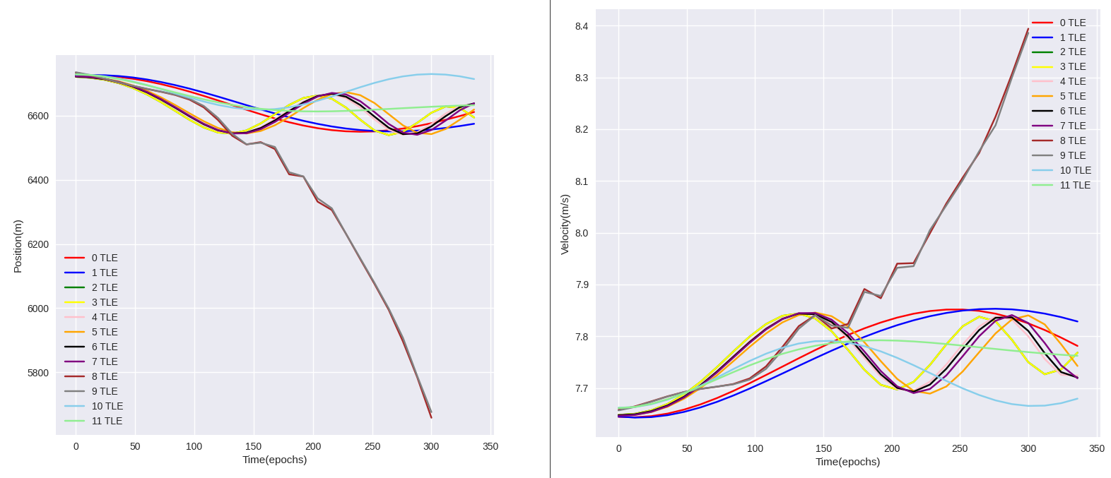
Some Results
ERROR ANALYSIS OF TLE DATA
The graphs are plots of future estimates of position and velocity respectively. The variation is observed across 11 TLEs of the same object(ISS-ZARYA) on a timespan of 350 epochs

Slide 7
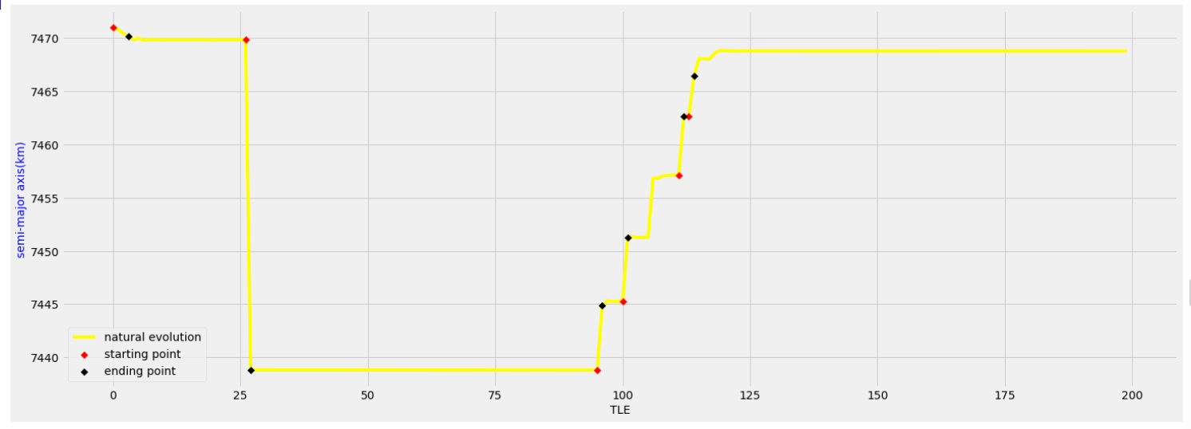
Some Results
MANEUVER DETECTION BY USING K-MEANS FOR YAOGAN 9A SATELLITE
Semi-major axis curve marked with orbit control points by the K-means clustering method: the yellow line indicates the natural evolution process; the red asterisk indicates the starting point of the orbital maneuver; and the black asterisk indicates the end point of the orbital maneuver.

Slide 8
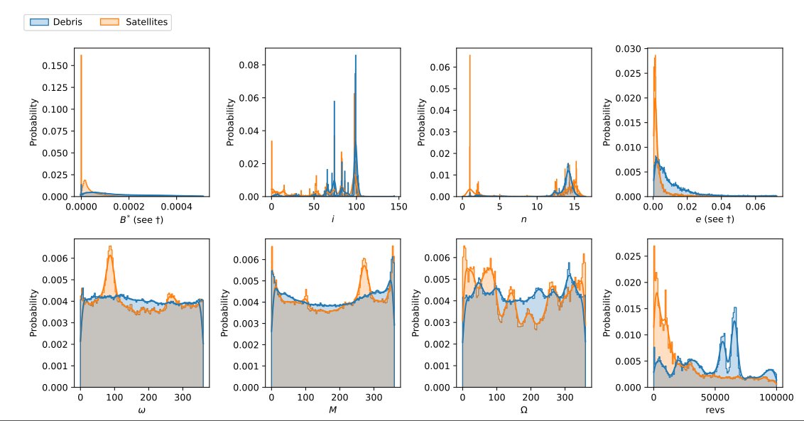
Some Results
DEBRIS AND SATELLITE CLASSIFICATION
Distribution of orbital elements by object type

Slide 9
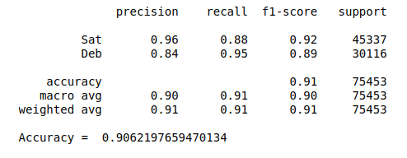
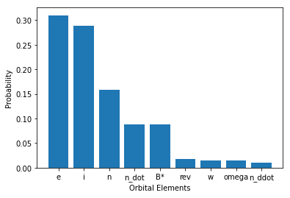
Some Results
DEBRIS AND SATELLITE CLASSIFICATION
Results of Random Forest Classifier
Random Forest Feature Importances

Slide 10
Important Links for Project Work:
References:
https://www.researchgate.net/publication/242742404_Satellite_Maneuver_Detection_Using_Two-line_Elements_Data
https://ieeexplore.ieee.org/document/8830454
https://www.researchgate.net/publication/222413947_Improved_orbit_predictions_using_two-line_elements
LINK TO PROJECT REPOSITORY: https://github.com/Aaryansh7/CS685_G45_project
LINK TO DETAILED DOCUMENTATION: https://drive.google.com/file/d/1aS3vejtcCvXKGEEbKBBCp3sjcmPoqeuR/view?usp=sharing

Slide 11
THANK YOU

