Slide 1
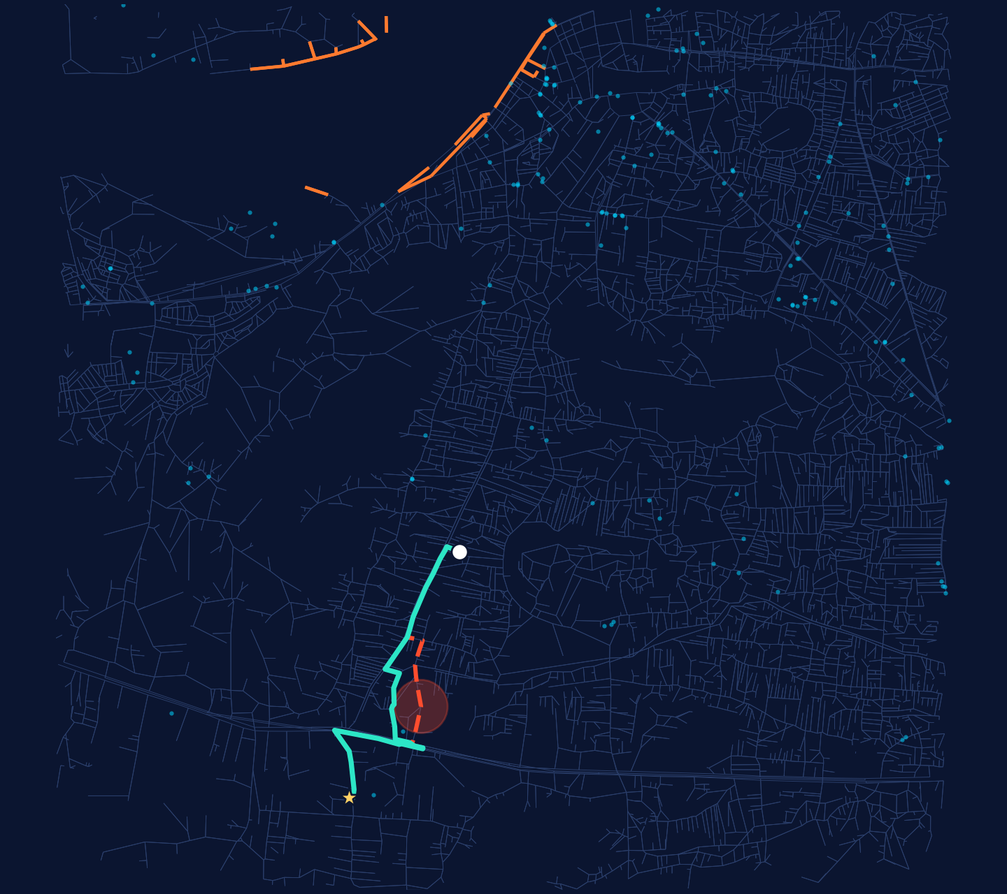
GeoFlood-AI
ACADEMIC INNOVATION PROJECT · PBL PROTOTYPE
From flood prediction to evacuation intelligence
AI-powered flood intelligence and evacuation decision support
Aryan · B.Tech CSE · Manipal University Jaipur
RESEARCH PROTOTYPE · NOT FOR OPERATIONAL USE
Illustrative scenario on real OpenStreetMap roads, central Guwahati. Orange: roads with historical flood exposure. Cyan dots: candidate shelters.
Notes:
SAY:
Good morning everyone. My project is GeoFlood-AI. In one sentence: it takes flood analysis one step further, from "where is the flood risk?" to "which way should people actually go?"
The map on the right is not a stock image. It is the real road network of central Guwahati from OpenStreetMap, drawn from the data cached in my repository. The orange roads carry historical flood exposure, the cyan dots are candidate shelters, and the green and red lines are an illustrative evacuation scenario that I will explain in a few minutes.
This is an academic prototype built as a PBL project. I will be clear throughout about what is implemented, what is tested and what is still future work.
VISUAL: the real Guwahati network render (route_demo.png).
TRANSITION: To see why this matters, let me start with the problem.
LIKELY QUESTIONS:
Q: Is this a real-time flood warning system? A: No. It is a retrospective, event-based prototype; real-time forecasting is listed as future scope.

Slide 2




Flood maps show risk, not a way out
Information is fragmented
Visualization is not guidance
Flood data is often spread across satellites, maps and reports.
A risk map does not tell a family which road to take.
Roads change during floods
Shortest is not safest
A road that was open an hour ago may not be passable now.
The fastest route can run straight through the most exposed ground.
Emergency planners need spatially organised information to decide, not scattered layers.
Notes:
SAY:
Most flood tools stop at showing you a map. That is useful, but it leaves four gaps.
First, flood information is often fragmented across several sources, so someone has to stitch it together. Second, a visualization is not guidance: a map of risky areas does not tell a family which road to take. Third, road accessibility changes during a flood, so yesterday's route may be unusable today. Fourth, and this is the idea my project is built on, the shortest route is not necessarily the safest one.
Finally, emergency planners need spatially organised information to make decisions. I want to be careful here: I am not claiming that existing disaster-management systems lack all of this. I am positioning GeoFlood-AI as an integrated decision-support approach that connects these steps in one place.
VISUAL: four problem cards, one planner strip.
TRANSITION: So what would a better approach look like? That is the vision.
LIKELY QUESTIONS:
Q: Don't Google Maps or government portals already do routing? A: General routing optimises time and does not take flood exposure into account; and I am not claiming no flood-aware system exists. My contribution is an open, inspectable prototype that combines flood exposure with road-network routing.

Slide 3
From flood prediction to evacuation intelligence
TRADITIONAL APPROACH
Flood monitoring
Flood visualization
Risk awareness
…and it stops here.
GEOFLOOD-AI APPROACH
Flood intelligence
Spatial risk analysis
Road-network assessment
Candidate shelter identification
Risk-aware evacuation support
The shift: from “where is the risk?” to “where do I go, and how?”
Notes:
SAY:
This slide is the heart of the project. The traditional chain is: monitor the flood, visualize it, and leave people with risk awareness. It stops there.
GeoFlood-AI extends that chain. We start with flood intelligence, which means understanding where flooding affected the ground. Then spatial risk analysis. Then we look at the road network and ask which roads are exposed. Then we identify candidate shelters. And the final step, highlighted in orange, is risk-aware evacuation support.
So the shift is from "where is the risk?" to "where do I go, and how?"
One important honesty point: the flood-intelligence part is retrospective. It learns from documented historical floods; it does not forecast the next one.
VISUAL: two rows of connected steps, final step in orange.
TRANSITION: Let me show you what the system actually consists of.
LIKELY QUESTIONS:
Q: What exactly is "new" here? A: Not A* or flood mapping individually. The contribution is connecting flood analysis to road-network and shelter decisions in one interactive prototype, and being transparent about validation.

Slide 4



One platform, four building blocks
Flood Intelligence
Evacuation Intelligence
AI & Analytics
Interactive Dashboard
Event-based flood susceptibility on a 249,200-cell grid of the Brahmaputra floodplain.
OSM road graph, candidate shelters and A* routing that weighs travel time against flood exposure.
Logistic Regression, Random Forest and a PyTorch network, checked with spatial and cross-event validation.
One Streamlit interface for maps, scenarios, validation and the evacuation router.
IMPLEMENTED
IMPLEMENTED · GUWAHATI
IMPLEMENTED · TESTED
IMPLEMENTED LOCALLY
In the code today, the ML susceptibility models and the evacuation router run as separate analyses that meet in one dashboard. Linking them is the first roadmap item.
Notes:
SAY:
GeoFlood-AI has four building blocks.
Flood Intelligence: for each cell of a 249,200-cell grid over the Brahmaputra floodplain, models estimate the probability that the cell was flooded in a documented historical event.
Evacuation Intelligence: this is the key innovation. It builds a road graph from OpenStreetMap, finds candidate shelters, and uses A* to find routes that balance travel time against flood exposure.
AI and Analytics: three models, Logistic Regression, Random Forest and a PyTorch neural network, evaluated with spatial and cross-event validation, plus a fuzzy-logic interpretability layer.
And the Interactive Dashboard in Streamlit ties it together. I say "implemented locally" because I have not verified that the hosted deployment is fully operational.
I want to be upfront about one thing: in the code today, the ML models and the evacuation router are separate analyses that meet in the dashboard. Feeding model probabilities directly into the router is the first item on my roadmap.
VISUAL: four module cards with status chips.
TRANSITION: Let me open each block, starting with flood intelligence.
LIKELY QUESTIONS:
Q: Does the router use your neural network's predictions? A: Not yet. Today it uses historical flood observations from the Dartmouth Flood Observatory rasters. Connecting the model's probabilities is the next step.

Slide 5


Flood intelligence: where was the ground at risk?
For each grid cell, the models estimate the probability that it was inundated in a documented historical flood, using terrain and rainfall features.
249,200
9
Retrospective susceptibility, not a real-time forecast.
grid cells (400 × 623, ~250 m)
terrain and rainfall features
INPUTS
SRTM terrain: elevation, slope, TPI, relative elevation, river distance
3
2
Antecedent and event rainfall: 3-day, 7-day, event sum
models compared
flood events: June and August 2015
Flood labels from the Global Flood Database (MODIS-derived)
Notes:
SAY:
The flood-intelligence module answers: where was the ground at risk? For every grid cell, roughly 250 metres across, the models estimate the probability that the cell was flooded during a documented historical event.
The inputs are terrain from the SRTM elevation model, including elevation, slope, topographic position and distance to the river, rainfall features from satellite-derived data, and flood labels from the Global Flood Database, which derives flood extents from MODIS imagery.
The numbers on the right are straight from the repository: 249,200 cells, nine features, three models, and two flood events, June and August 2015.
The orange line matters: this is retrospective susceptibility mapping, not a forecast. One of the features, event-sum rainfall, is only known after the event, and I document that limitation openly.
VISUAL: stat callouts from the repository.
TRANSITION: That is the flood side. Now the part I consider the main innovation: evacuation.
LIKELY QUESTIONS:
Q: Why 250 m? A: It is the resolution of the MODIS-derived flood labels and the grid I built; it limits detail, e.g. embankments narrower than a cell cannot be resolved.
Q: Why is event-sum rainfall a problem? A: It uses rain that falls during the event, so it would not be available before a flood. That is why I describe the system as retrospective.

Slide 6

Evacuation intelligence: the key innovation
Road network (OSMnx)
8,088 junctions and 18,839 road segments within 5 km of central Guwahati
Candidate shelters
170 OSM facilities: schools, hospitals, places of worship, community centres
Flood exposure on roads
Historical flood observations sampled onto each road segment
Interactive scenarios
Candidates from OSM tags. They are not officially approved emergency shelters.
Draw a flood zone, then penalise or close the roads inside it
Notes:
SAY:
This is where GeoFlood-AI goes beyond a flood map.
I download the real road network around central Guwahati using OSMnx: 8,088 junctions and 18,839 road segments inside a 5 km radius. I treat it as a graph, so junctions are nodes and road segments are edges.
I also pull candidate shelters from OpenStreetMap tags: 170 facilities, mostly places of worship, hospitals and schools. I want to stress the word candidate. These come from OSM tags; they are not officially approved shelters, and a real deployment would need verification with local authorities.
Then each road segment gets a flood-exposure value from historical flood observations, and the user can draw a flood zone on the map to penalise or close the roads inside it.
VISUAL: capability list plus a native chart of shelter types.
TRANSITION: So how does the router use that exposure to choose a path? Let me show the mechanism.
LIKELY QUESTIONS:
Q: Where do shelters come from? A: OpenStreetMap tags for schools, hospitals, community centres, places of worship and assembly points.
Q: Is capacity considered? A: Not currently. Shelter capacity and occupancy are future enhancements.

Slide 7
How risk-aware routing works
cost = travel time
+ λ × (−ln(1 − exposure))
λ = minutes of detour you accept per unit of flood exposure (default 10). λ = 0 gives the plain fastest route.
1
Build the road graph with travel times
2
Attach flood exposure to each road segment
3
A* finds the least-cost route; closed roads are removed
10.64 min
10.77 min
fastest route, 4.82 km, crosses the zone
detour, 4.99 km, avoids the zone
━ ━ fastest ━━ detour ● hypothetical flood zone (300 m)
ILLUSTRATIVE SCENARIO: hypothetical zone on real OSM roads, computed with the project's A* router. Not a validation result.
Notes:
SAY:
Here is the mechanism. Each road segment costs its travel time plus a flood penalty. The penalty is lambda times minus the natural log of one minus the exposure. I use that form because logarithms add up along a route, so minimising total cost corresponds to maximising the chance that every segment stays passable, if exposure is read as a failure probability. Lambda is a dial: how many minutes of detour I accept per unit of risk. At zero you simply get the fastest route.
The route search is A*. The heuristic is straight-line distance divided by a maximum speed, so it never overestimates and A* stays optimal. I checked in a run that A* and Dijkstra give identical cost, 10.64 minutes.
On the map is an illustrative scenario. I placed a hypothetical 300-metre flood zone on the fastest route. The fastest route is 4.82 km and 10.64 minutes and crosses the zone. When those roads are closed, A* finds a 4.99 km detour in 10.77 minutes. This is a demonstration of the mechanism, not a validation result, and the zone is hypothetical.
Something I should say honestly: in the Guwahati study area only 46 of the 18,839 road segments carry non-zero historical exposure, so the drawn flood zones are what make the comparison visible.
VISUAL: real Guwahati network with fastest route (red dashed), detour (mint) and the hypothetical zone.
TRANSITION: Let me show how all of this fits together as a system.
LIKELY QUESTIONS:
Q: Why log? A: Probabilities multiply along a route; logs turn products into sums, which A* can add up edge by edge.
Q: Is the exposure a probability? A: No. It is a historical flood-observation screening value, labelled in the code as not a probability. Treating it as a failure probability is a modelling convenience.
Q: Is the heuristic admissible? A: Yes. Distance divided by a maximum speed of 130 km/h never exceeds true remaining travel time, and the penalty term is non-negative.

Slide 8
System architecture
FLOOD INTELLIGENCE LANE
Data sources
Preprocessing
Features and models
Validation
SRTM · rainfall · Global Flood Database
Raster alignment and leakage checks
LR · Random Forest · PyTorch NN · fuzzy overlay
Spatial, buffered and cross-event tests
src/data/acquisition
src/geospatial, src/data/validation
src/models
src/evaluation
Streamlit dashboard
EVACUATION LANE
app.py
src/ui
evacuation/ui_tab
Inputs
Graph and exposure
Candidate shelters
Risk-aware routing
OpenStreetMap roads · DFO flood rasters
NetworkX graph with exposure per road
OSM schools, hospitals, worship, community
A* · cost model · route statistics
src/evacuation/osm_loader
graph_builder · risk_mapper
shelters.py
astar_engine · routing · planner
The two lanes meet in the dashboard. Feeding model probabilities into the router is the next step.
Notes:
SAY:
This is the actual repository architecture, with module names under each box.
The top lane is flood intelligence. Data comes in from SRTM, rainfall and the Global Flood Database. Preprocessing aligns the rasters and runs leakage checks, which means making sure no information from after the event leaks into a model meant for earlier use. Then we build features and train three models, and finally the validation module tests them on held-out areas and on a separate flood event.
The bottom lane is evacuation. OpenStreetMap roads and flood rasters go in, a NetworkX graph is built with a flood-exposure value on each road, candidate shelters are found, and the A* router with its cost model and route statistics produces recommendations.
Both lanes meet in the Streamlit dashboard. I will be honest that today they are parallel lanes. Connecting the top lane's probabilities to the bottom lane's edge risk is the most valuable next step.
VISUAL: two swim lanes feeding one dashboard.
TRANSITION: Next, the technologies behind it, which I verified one by one in the code.
LIKELY QUESTIONS:
Q: What is LeakageGuard? A: A module that rejects features that would not be known at prediction time, depending on the operating mode.
Q: Why a graph? A: Roads form a network; graph algorithms like A* find optimal paths efficiently.

Slide 9
Technology stack, verified in the repository
Python
Streamlit
PyTorch
scikit-learn
SciPy
Pipeline, models, app
Interactive dashboard
Neural-network model
LR, RF, metrics
Filters, interpolation
GeoPandas
Rasterio
Shapely
OSMnx
NetworkX
Vector and shelter data
Raster and flood layers
Geometry, drawn zones
Road network, shelters
Road graph and paths
Folium
Plotly
OpenStreetMap
GitHub
Render
Interactive maps
Charts
Roads, buildings, facilities
Source and versioning
Hosting target (Dockerfile)
Render: Dockerfile present; the live deployment is not verified as fully operational. Also in code: scikit-fuzzy (fuzzy layer), PyDeck (3D view), XGBoost and LightGBM (experimental, not in reported results).
Notes:
SAY:
I checked each of these in the repository before putting it on this slide, so every item is something the code actually imports.
Python is the backbone. Streamlit is the dashboard. PyTorch builds the neural network. Scikit-learn gives me Logistic Regression, Random Forest and the metrics, and SciPy is used for raster filtering and interpolation. For geospatial work: GeoPandas for vector data and shelters, Rasterio for flood and terrain rasters, and Shapely for geometry, including the flood zones a user draws. OSMnx downloads the road network and shelters from OpenStreetMap, and NetworkX holds the road graph. Folium and Plotly draw the maps and charts. GitHub hosts the code.
Render is in amber on purpose. There is a Dockerfile for deployment, but the live deployment has hit runtime issues during testing, so I do not claim it is fully operational. I would rather demo the app running locally.
Also in the code but not headline: scikit-fuzzy for the fuzzy layer, PyDeck for the 3D view, and XGBoost and LightGBM code that is experimental and not part of my reported results.
VISUAL: technology grid, Render flagged.
TRANSITION: Now let me show how these pieces appear to a user in the dashboard.
LIKELY QUESTIONS:
Q: Why is Render flagged? A: Because I have not verified a stable live deployment; the app runs locally.
Q: Why PyTorch for a tabular problem? A: It lets me compare a neural network, with batch normalisation and class weighting, against simpler baselines; in my results the simpler Logistic Regression and the NN generalised better than Random Forest across events.

Slide 10
One dashboard, two ways to present it
PRESENTATION MODE (4 TABS)
Overview
Flood Intelligence
Evacuation Intelligence
Research & Validation
FULL MODE (9 TABS)
Overview
Flood Intel Map
Flood Commander
Scenario Lab
Satellite Analysis
Model Intelligence
Location Explorer
Research & Validation
Evacuation Router
INSIDE THE EVACUATION TAB
2D map and point selection
3D digital twin (OSM roads and buildings)
Historical flood reveal slider
Draw a flood zone: penalty or closure
No screenshots shown here. Run “streamlit run app.py” and demonstrate the live app.
Notes:
SAY:
The app has two modes. For presentations it shows four tabs: Overview, Flood Intelligence, Evacuation Intelligence, and Research and Validation. The full mode has nine tabs, including a Flood Commander scenario game, a Scenario Lab for rainfall what-ifs, Satellite Analysis, Model Intelligence and a Location Explorer.
Inside the Evacuation tab you can switch between a 2D map where you pick an origin and a destination, and a 3D digital twin built from OpenStreetMap roads and buildings. A slider reveals the historical 2015 flood observations step by step, and you can draw a flood zone and choose whether roads in it are penalised or closed. Then you calculate and compare routes.
I deliberately have no screenshots on this slide. I will show the running application instead, so nothing here is staged.
VISUAL: tab map, evacuation features. (Replace with real screenshots only if taken from the running app.)
TRANSITION: Now the question every evaluator should ask: how do we know any of this is trustworthy?
LIKELY QUESTIONS:
Q: Does the 3D view show water depth? A: No. The extrusion is a visual index of historical flood-screening cells, not water depth or a forecast.
Q: What is Flood Commander? A: A scenario game on the 2015 Brahmaputra flood where you allocate a budget; it is a separate educational feature.

Slide 11
Validated honestly, including where it fails
IMPLEMENTED
LR, RF and PyTorch models, A* router, OSM shelters, Streamlit app
TESTED
pytest suites for A*, road graph, planner, OSM loader, risk mapping
EXPERIMENTAL
Fuzzy layer, 3D twin, XGBoost and LightGBM code, Ujjain region
FUTURE
Random Forest drops from 0.901 to 0.485 on the unseen event (0.5 is chance).
Live data, ML-driven route risk, mobile alerts
Historical flood observations are not future flood probabilities
OSM candidate shelters are not officially approved shelters
Risk-aware routes are decision support, not certified safe routes
Notes:
SAY:
This slide separates four things: what is implemented, what is tested, what is experimental, and what is future work, so nothing is overstated.
The chart uses numbers from my own validation pipeline. Blue bars are held-out area tests: the grid is split into spatial blocks, so the model is tested on places it has not seen. Orange bars are the harder test: train on the June 2015 flood, test on the August 2015 flood. Random Forest scored 0.901 on the held-out area but dropped to 0.485 on the unseen event, below chance. The neural network held up better at 0.672 and Logistic Regression at 0.713. So the model that looked best on a standard test was the worst on the realistic one. That is exactly why I did the harder test.
Evaluators should also know the limits, shown at the bottom. Historical flood observations are not future flood probabilities. Shelters from OpenStreetMap are candidates, not approved shelters. And risk-aware routes are decision support, not certified safe routes. Other limitations: one river basin, two events, MODIS label resolution, and no real-world validation of the routes yet.
VISUAL: native chart from reports/phase3_metrics.csv values.
TRANSITION: So where does this add value, and who could benefit?
LIKELY QUESTIONS:
Q: Why did Random Forest collapse? A: Likely overfitting to location-specific patterns from a single event; with only two events the conclusion is tentative.
Q: Did you validate the routes? A: Not against real evacuations. I demonstrate the mechanism and run tests on routing logic; real-world validation is future work.
Q: What is the SAR figure in your README? A: It is on synthetic data and measures algorithm consistency, not real Sentinel-1 accuracy, so I do not present it as a result.

Slide 12





Where GeoFlood-AI adds value
WHAT IS DIFFERENT
WHO COULD USE IT
From prediction to action
Disaster response teams
Flood analysis continues into road, shelter and route decisions.
Compare routes and shelter access
Local authorities
Honest validation
See which roads carry flood exposure
Leakage-aware features and cross-event tests show where models fail.
Emergency planners
Test road-closure scenarios in advance
Interactive and inspectable
Communities
Draw scenarios, compare routes, and see the cost model.
Understand why shortest is not always safest
Potential impact only: not yet tested with agencies or communities.
Notes:
SAY:
Where does GeoFlood-AI add value? Three things.
One, it moves from prediction to action: flood analysis continues into roads, shelters and routes instead of ending at a map. Two, it is honest about validation: leakage-aware features and cross-event testing show where models fail, instead of reporting only the best-looking number. Three, it is interactive and inspectable: you can draw a scenario, compare routes, and see exactly how the cost is calculated.
On the right is who it could help. Disaster response teams could compare routes and shelter access. Local authorities could see which roads carry flood exposure. Emergency planners could test road-closure scenarios before a flood. Communities could understand why the shortest route may not be the safest.
I say "could" deliberately. This is potential impact, and I have not tested it with agencies or communities.
VISUAL: differentiators on the left, stakeholders on the right.
TRANSITION: Finally, where I would take it next.
LIKELY QUESTIONS:
Q: How is this different from existing systems? A: I do not claim existing systems lack these capabilities. This is an open, inspectable prototype combining flood exposure, road-network routing and transparent validation.

Slide 13
Roadmap: proposed enhancements
PROPOSED · NOT IMPLEMENTED
1
NEXT
2
THEN
3
LATER
Feed model probabilities into route risk
Live flood monitoring
Mobile evacuation alerts
Real-time rainfall integration
Improved shelter verification
Multi-city expansion
Dynamic road-closure updates
Population-density integration
Integration with emergency-response agencies
Notes:
SAY:
Everything on this slide is proposed, not completed.
The first item is the most important: feed the model's flood probabilities into the router as road risk, so the two lanes of the architecture become one pipeline. Alongside that, real-time rainfall integration and dynamic road-closure updates move the system from retrospective toward live use.
Next come live flood monitoring, better shelter verification, and population-density data so we can reason about how many people a route or shelter serves.
Longer term: mobile evacuation alerts, expansion to more cities, and integration with emergency-response agencies. That last step needs institutional validation and approval, which is beyond a student project, but it is the direction that makes the work useful in practice.
VISUAL: three phases, each with three proposed items.
TRANSITION: Let me close with the one idea I want you to remember.
LIKELY QUESTIONS:
Q: What would you do first with more time? A: Connect the ML probabilities to the router, then validate routes against observed flood extents for a past event.
Q: Could this be used operationally? A: Not as is. It would need live data, validation, and approval from the relevant agencies.

Slide 14
A smarter approach to flood resilience
GeoFlood-AI does not stop at identifying flood risk.
It takes the next step toward helping people make better-informed evacuation decisions.
Thank you · Questions welcome
github.com/Aaryansinngh/GeoFlood-AI
Notes:
SAY:
To close. GeoFlood-AI does not stop at identifying flood risk. It takes the next step toward helping people make better-informed evacuation decisions.
To recap: the flood-intelligence module asks where the ground was at risk; the evacuation module turns that into roads, candidate shelters and risk-aware routes; the validation work shows where the models can and cannot be trusted; and the roadmap shows how to make it live.
It is a prototype with honest limits, and I would be glad to demonstrate it and take your questions.
VISUAL: closing message, repository link.
LIKELY QUESTIONS:
Q: What is your single biggest limitation? A: The evacuation router uses historical flood observations, not forecasts, and has not been validated against real evacuations.
Q: What is your biggest strength? A: The pipeline is honest and inspectable: leakage-aware, cross-event tested, and every claim on the slides traces to code.

