Slide 1
GIT AND GITHUB
Aaryash Shakya

Slide 2
TABLE OF CONTENTS
01
02
03
04
05
06
Introduction
What is Git?
Git Key Concepts
What is GitHub?
Git Vs GitHub
Demo

Slide 3

01
Introduction

Slide 4

“Software is born not out of a desire for lines of code, but from a problem that demands a solution.”

Slide 5
PROBLEM STATEMENT:
VERSION CONTROL
How can you make changes to a file so that you can undo your changes when needed?
-> Making a copy of the file
-> Issues: Unorganized long naming, Redundant data
E.g. project, project-1, project-2, project-final, project-final-again,
project-final-errorfix

Slide 6
INTRODUCTION:
VERSION CONTROL
Version is a snapshot/instance of directory.
A software system that provides a way to manage files and directories.
Manages and keeps record of changes made to files.
Allows to view and revert any changes and go back to previous state.
Examples: Git, BitKeeper, Mercurial, Apache Subversion, etc.

Slide 7

02
What is Git?

Slide 8
What is Git?
Created by Linus Torvald in 2005 to aid in Linux Kernel development
Distributed Version Control (Repository is stored in a remote server and each user works on the clone of the remote repository)
Command line version control program
Cross-platform (Linux, Windows, Mac)
Open source, free

Slide 9
Benefits of using Git
All the benefits of Version Control
No need to connect to central server
Can work without internet connection
Independent developers can merge their work later
Allows for collaborative development
Allows you to know who made what changes and when
Allows the repository owner to review changes before merge their code

Slide 10

03
Git Key Concepts

Slide 11
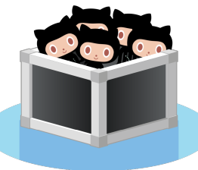
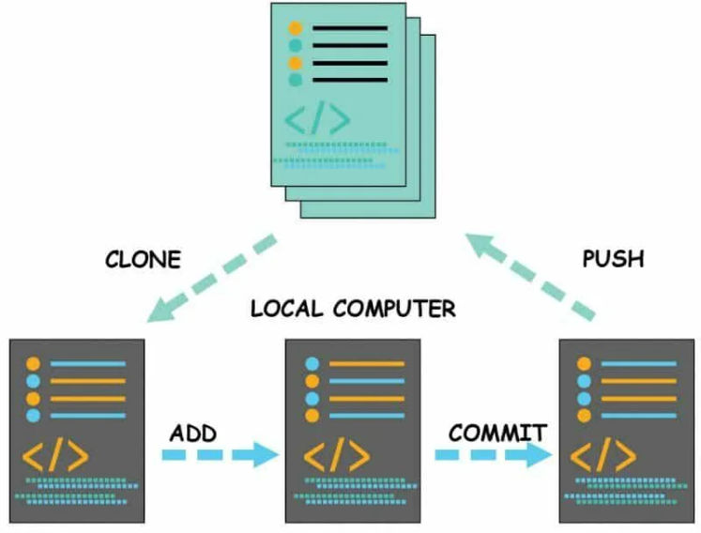
Git Key Concepts: Repository
Referred as repo
Collection of all your files and change history
Repo can exist on your local machine or remote server
Copying a repo from remote server to local machine is called cloning
Process of downloading commits from remote server to local machine is pulling
Process of uploading commits to remote server from local machine is pushing

Slide 12

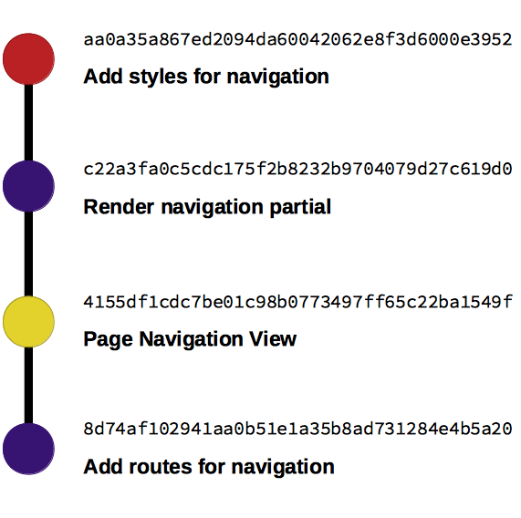
Git Key Concepts: Commit
A snapshot that records what the files looks like at any given point of time
Each commit serves as a checkpoint.
You can go visit or revert to any commit
Commit contains 3 piece of information
How files have changed from the previous commit
Reference to the previous commit (parent commit)
SHA-1 hash code
(e.g. fb2d2ec5069fc6776c80b3ad6b7cbde3cade4e)

Slide 13

GOOD COMMIT MESSAGE
Separate title and body | Title/Subject to summarize change, body to explain changes in detail
Start title with a verb | E.g. add, fix, update, refactor, etc
Limit the title | Subject line should be less than 50 characters followed by a empty line before body
Use Imperative mood for title | E.g. "Add feature" rather than "Added feature" or "Adding feature"
Don’t end title with period | Don’t end title line with a “.”
No Redundancy | Avoid repeating information that can be easily inferred from the diff
Add references | If the commit relates to a specific issue or task, include a reference to it

Slide 14

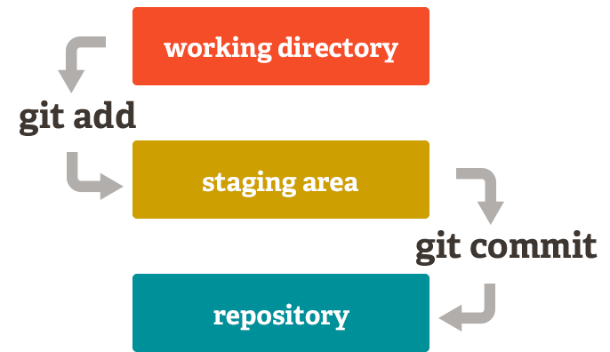
Git Key Concepts: Staging
Intermediate step before making a commit
Selecting the changes that we want to include in the commit.
Staging area is like a temporary storage area that sits between your working directory and the Git repository
Staging area keeps track of changes to commit.

Slide 15

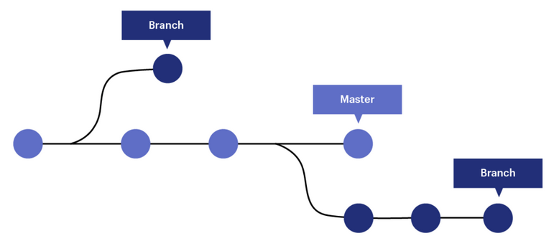
Git Key Concepts: Branch
A branch is a reference to a specific commit in Git commit history.
All commits in git live on some branch.
The main branch of the repo is called master/ main branch
Allows creation of independent lines of development.

Slide 16
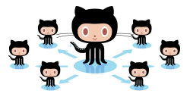
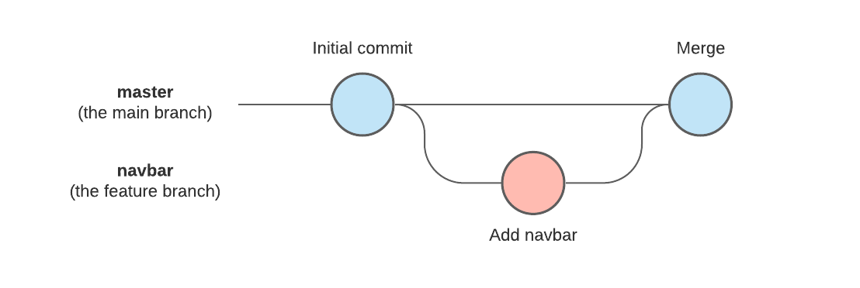
Git Key Concepts: Branching and Merging
Branching is the process of creating a new independent line of development from a specific commit.
Merging the the process of combining the changes from one branch into another branch

Slide 17

04
What is GitHub?

Slide 18
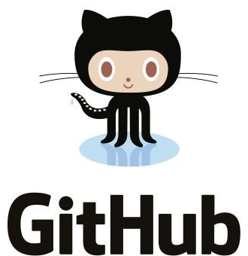
What is GitHub?
Free cloud based Git repository hosting service (remote repository)
Adds extra functionality on top of git (E.g. pull requests, issue tracking, code review)
Largest web-based Git repo hosting service. (Alternatives: GitLab, BitBucket)
Serves as a social networking site where developers can openly network, collaborate, and pitch their work.
Github allows users to build a personal profile and brand for themselves.

Slide 19

05
Git Vs GitHub

Slide 20
GIT VS GITHUB
 | GIT | GitHub
What is it? | Software | Service
Focus | Version Control and Code sharing | Web-based centralized repo hosting
Installation Location | Installed locally | Hosted in the cloud
Ownership | The Linux Foundation | Microsoft
Access | Offline | Online
User Management | No | Yes
User Interface | Primarily a command line tool | Primarily a web app
Desktop Interface | Git GUI | GitHub Desktop
Cost | Open Source and free | Includes a free tier

Slide 21
06
Demo

Slide 22
For more resources
Documentation:
https://git-scm.com/docs
Sandbox:
https://learngitbranching.js.org

Slide 23
THANKS!

