Slide 1




1Vision Media presents:
Community on Tap
BUS 465-602 Group 1:
Emma Collins, Aaryan Sharma, Gloria Chien, Ashton Zuburg, Isabelle Huller, Emma Chapman, Ryan Christensen

Slide 2

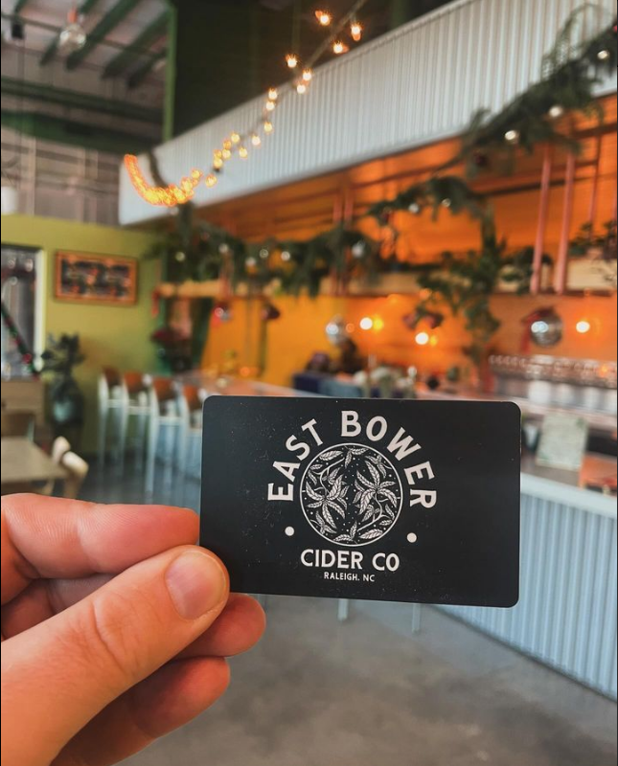
Agenda
Research and Insights
  East Bower Core Brand Associations
  “What to post, where, and why?”
  Insight
  Customer Personas
Creative
  Instagram Revamp
  Customer Interaction
  Behind the scenes
Notes:
Take you through our analysis and strategy brief
and then to our creative media plan

Slide 3
Scope
Social Media
Where, why, and at what level?

Slide 4
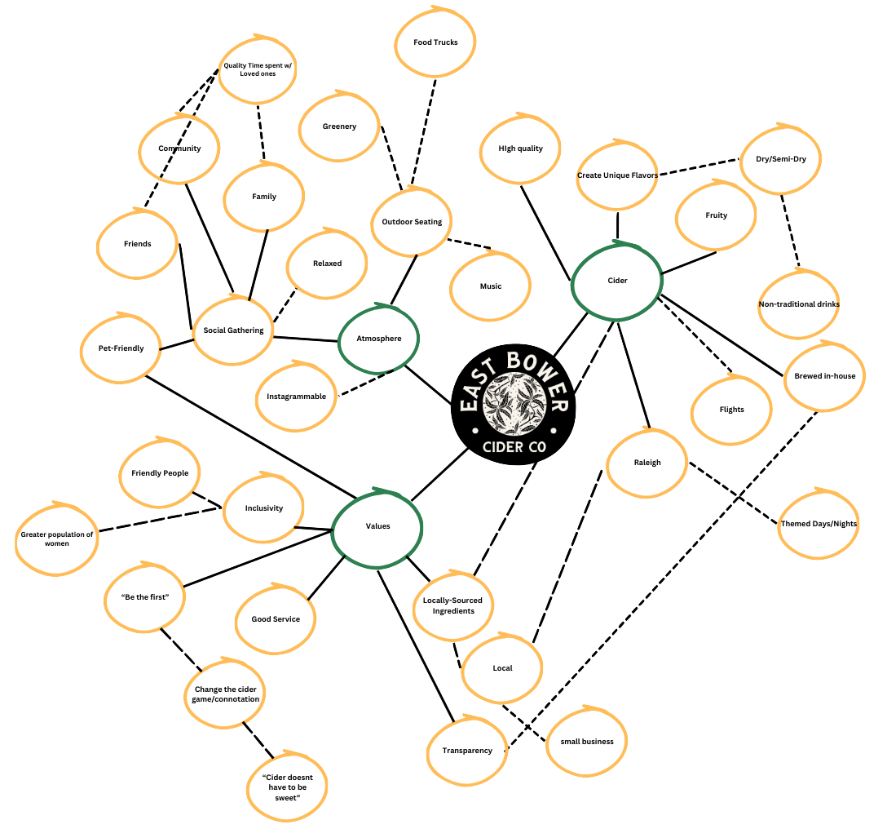
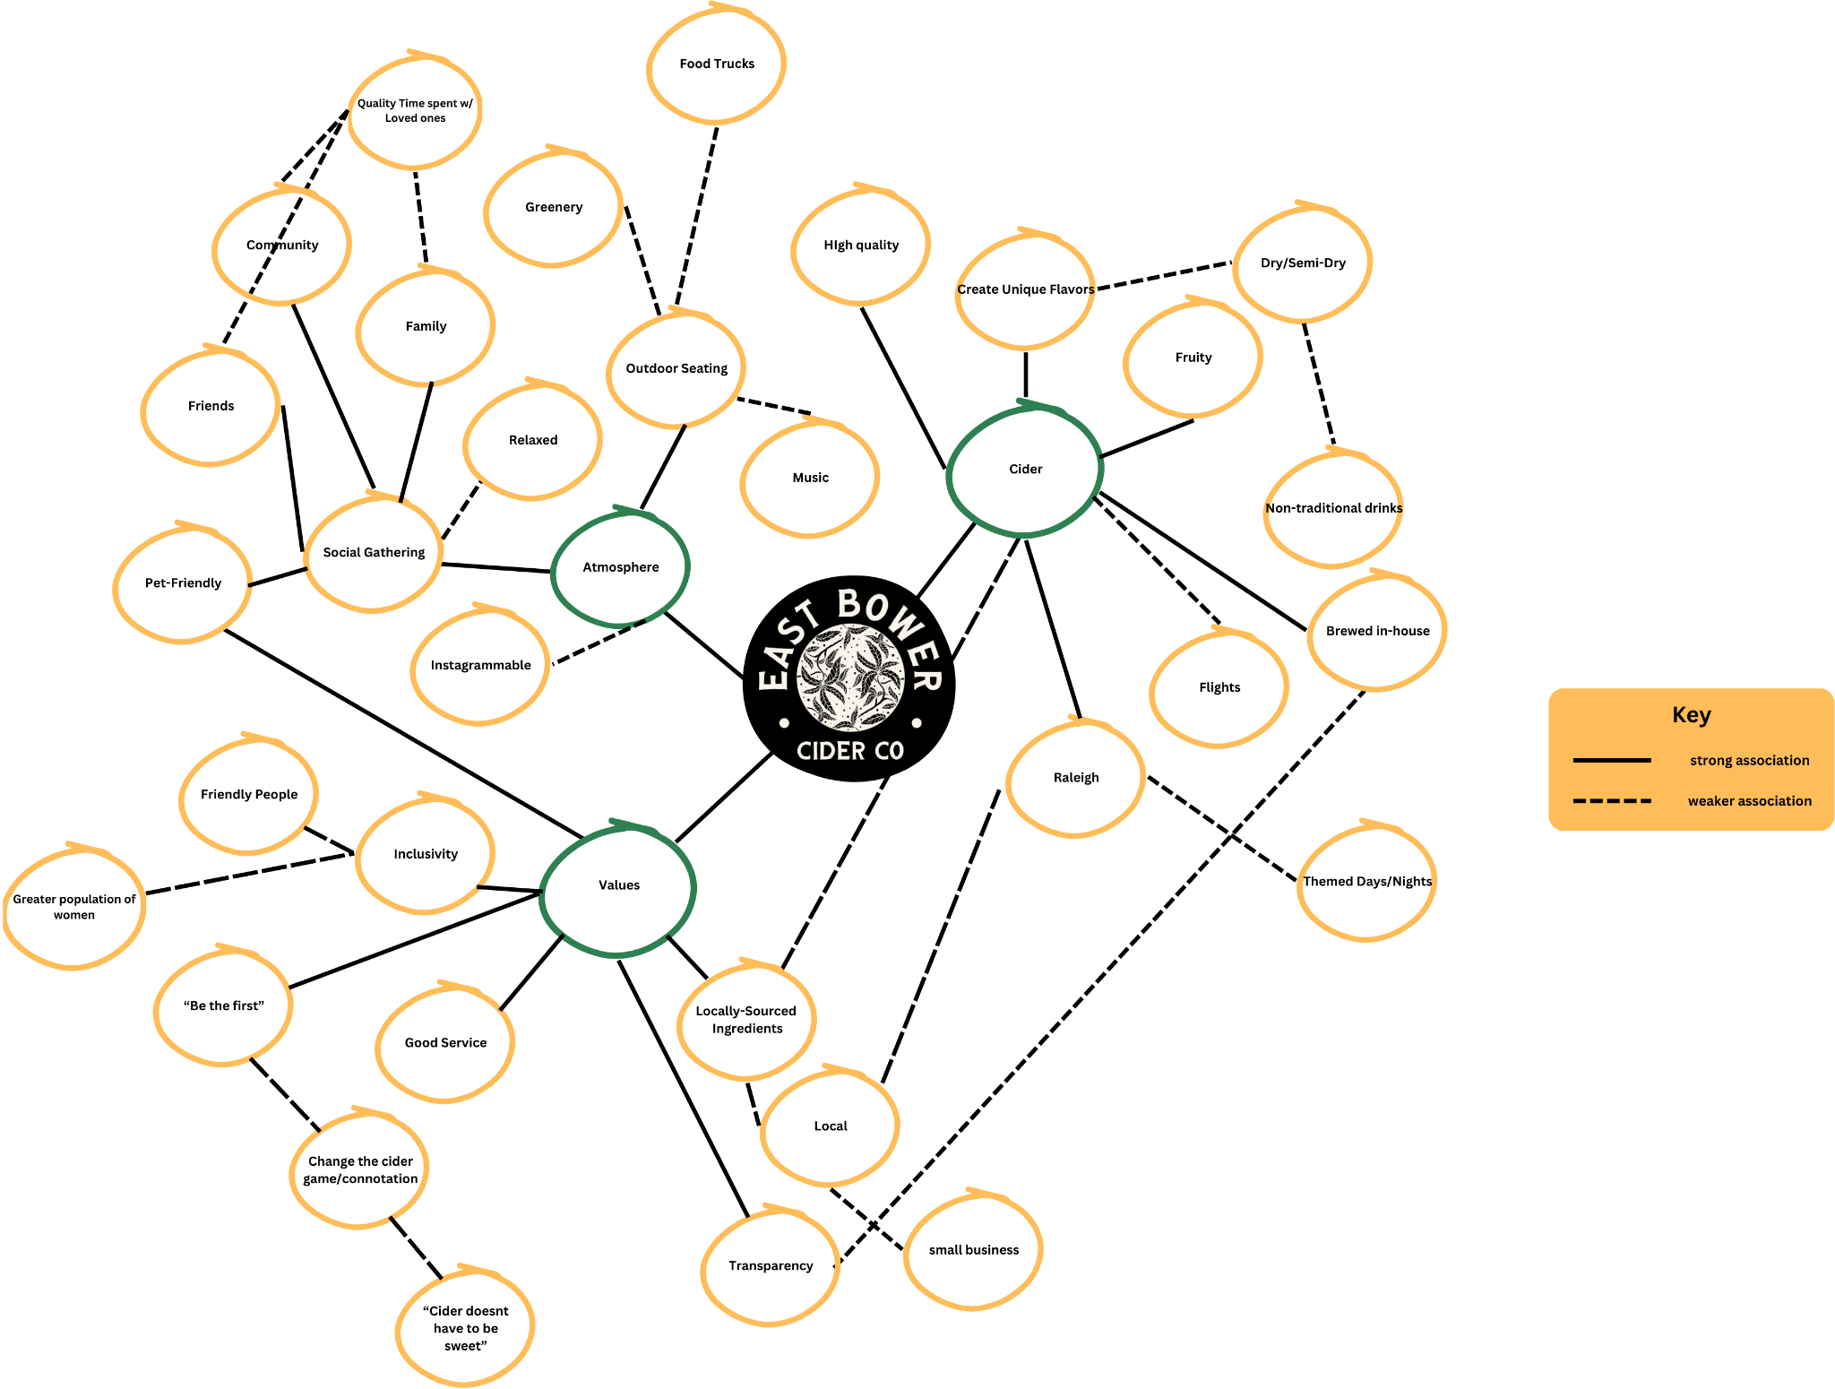
Core Brand Associations
Brand Concept Map
Values
•Transparency, Friendly, Inclusivity
Atmosphere
•Outdoor, Instagrammable, Music
Cider
•Quality, Range of Products, Local
Notes:
Emma
During our initial discovery on East bower, we saw that these associations were very prominent in peoples reviews and the east bower Instagram

Slide 5
“What to post, where, and why”
Commonly Used Platforms
Popular Posts
Instagram, Facebook, LinkedIn, and TikTok
Used to keep up with local businesses, events and brands
Pictures of drinks and people enjoying the space
Gets more likes and attention
Capture Attention
Ideal KPI’s
Colorful posts with dogs, people, events, and food
More posts of people enjoying the space, upcoming events/drinks, and food
Instagram – ~5200 followers
1 - 5% engagement rate
User Generated Content
Instagram Ads vs Facebook
Notes:
Aaryan
Instagram: Attention goes to posts first, and then reels
Instagram gathers a lot of attention and traction, facebook not as much. A lot of todays millennials are transition to instagram. Tiktok does not fit east bower demographic

Slide 6

Quotes from Consumers
“Highlighting the venue when it is full of customers. Showcasing pictures of people enjoying their experience at this venue.”
“Need more posts that are interacting with customers.”
“I think more pops of color would be nice and hearing people's viewpoints”
“Include more details about what the bluegrass sundays normally look and sound like. Include the ABS percentages for the ciders shown.”
“I would recommend putting more pictures and videos of the events that they have.”
“Some more customer feedback/experiences”
Notes:
Isabelle : Talk about how we integrated customer feedback into our insights and ideas

Slide 7
Insight
Customers love the vibe and space that EBCC brings. Showcasing this online can drive engagement and inspire/convince people to come visit.
-Instagram is a great place to promote a business.
-Most said that they would love to see more posts about the food and customers interacting with the space/environment.
-Customers want to feel like they are familiar with the space before visiting the actual storefront.
- Authentic posts would do well to bring in that community vibe

Slide 8
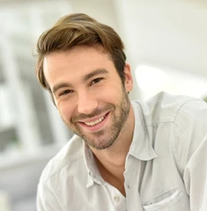

Customer Personas
Name: John Cooper
Age: 35
Location: Raleigh, NC
Occupation: Project Manager
Psychographics
Values: Community, authenticity
Interests: Family time, local social scene
Social Media: Active on Instagram, TikTok, occasional Facebook
Connection to East Bower:
Values align with community engagement and authenticity
Enjoys local flavors and laid-back atmosphere
Responsive to email ads for events or deals
Name: Melissa Davis
Age: 27
Location: Raleigh, NC
Occupation: Communications Specialist
Psychographics
Values: Friendships, Consistency, Sustainability
Interests: Travelling, Photography, Her dog
Social Media: Active on Instagram and TikTok
Connection to East Bower:
Sees EBCC has a place to relax with friends after a long day of work
Enjoys the nice atmosphere and the music selection (most importantly)
Looks out for EBCC events on Instagram
Notes:
“this is the user we hope will see this content on your media vehicle(s) because it should resonate with them on a “place to chill after work” level”
Ryan and Emma

Slide 9

Vehicles for Creative
Behind the scenes
-Process behind creating cider
-Employee takeover
-After-Event posts
Instagram Revamp
-Introduce a weekly calendar
-Family-Oriented Post
-User Generated Content
Customer Interaction
-Customer ‘takeover’ – #ebcc, #eastbower, #showushowyoucider
-Customer testimonials

Slide 10
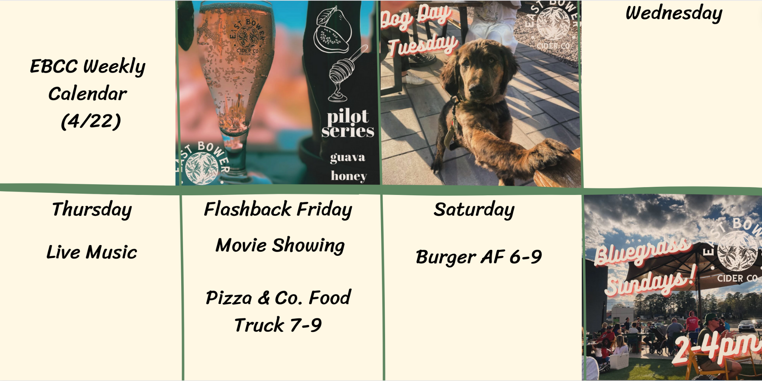
Instagram Revamp
Weekly Calendar (Idea)
Notes:
Gloria
Get sponsorship from raleigh accounts
User generated content → connect with customer takeover
It’s consistent with east bowers current instagram brand
The class concept this is tied to is integrating social media and matching the right platforms to the right content

Slide 11
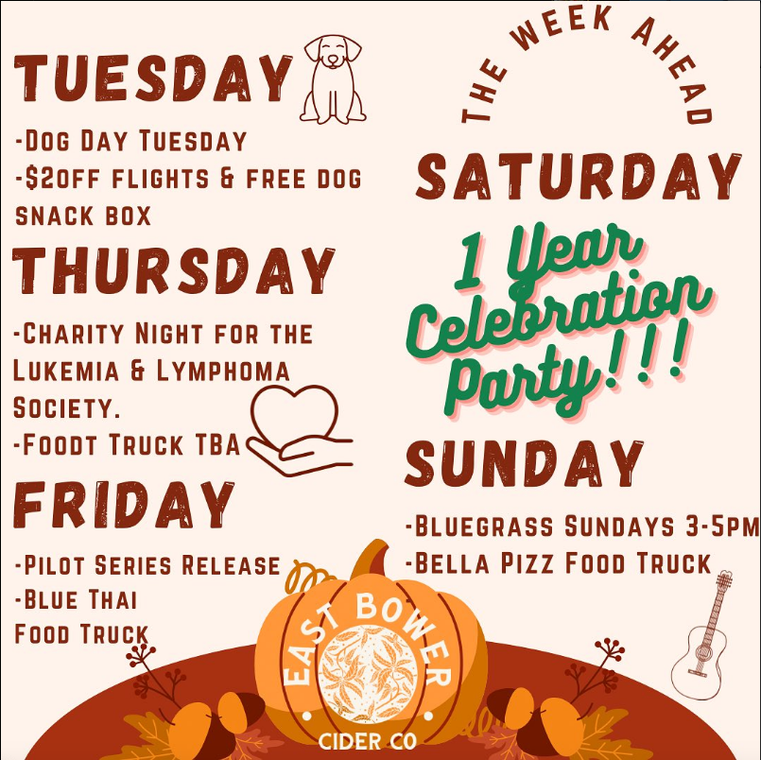

Instagram Revamp
Weekly calendar (Previously)
Family-Oriented Post
Notes:
Gloria
Calendar depicted above is from 27 weeks ago. This post got a lot of likes. Same as the pumpkin patch post
The class concept this is tied to is art & design in order to post the right content to social media to show the core values of the brand and offerings
Elements used: Unity, Contrast & Dominance, Proportion, Balance
Use of Color: Orange (associated with drinks, warm, energizing)

Slide 12
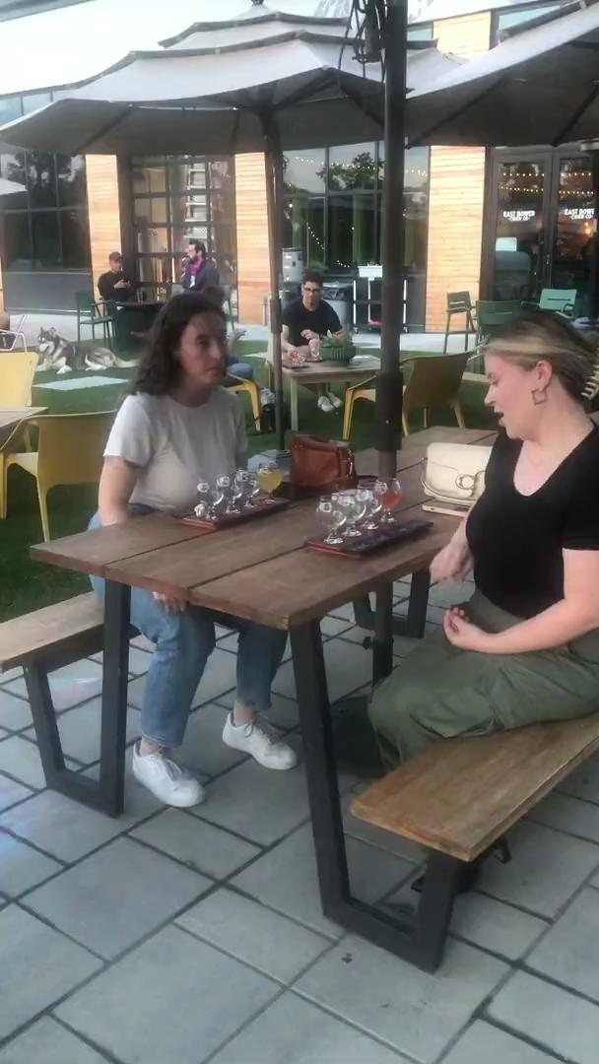
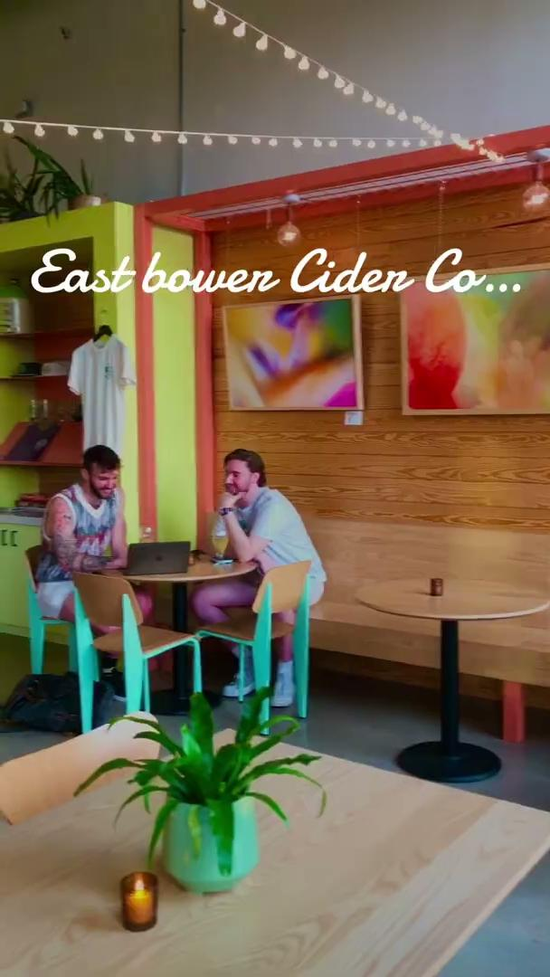
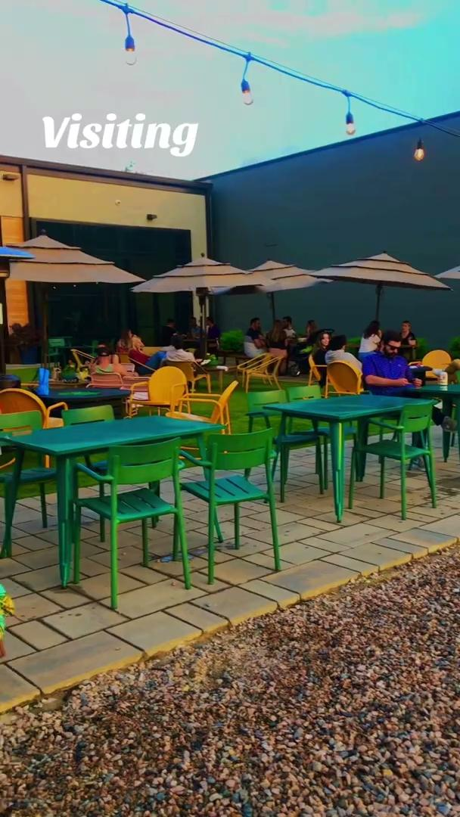
Customer Interaction
“Show us how you East Bower“
Testimonials
What’s your go to drink?
What do you like about the atmosphere?
What keeps you coming back (why would you want to come back)?
What’s your favorite thing about East Cider?
Notes:
Gloria:
Takeover comparing to ads:
User-generated content is cost-effective and more personal to the users scrolling on instagram.
potentially offer a free drink as an incentive (recieve if their post is chosen) → winner wednesday?
With testimonials, professional agency can help set-up what a good testimonial should look like on recording.
Also ask (off camera):
Did you see this place on social media prior to coming here
What did you think about it
What social media did you see
The class concept this is tied to is creativity in advertising. The 5 elements are elaboration, artistic value, originality, flexibility, and synthesis. “Show us how you east cider” are hitting artistic value, originality, and flexibility.
This will increase attention and lead to positive attitudes towards the brand and its offerings.

Slide 13
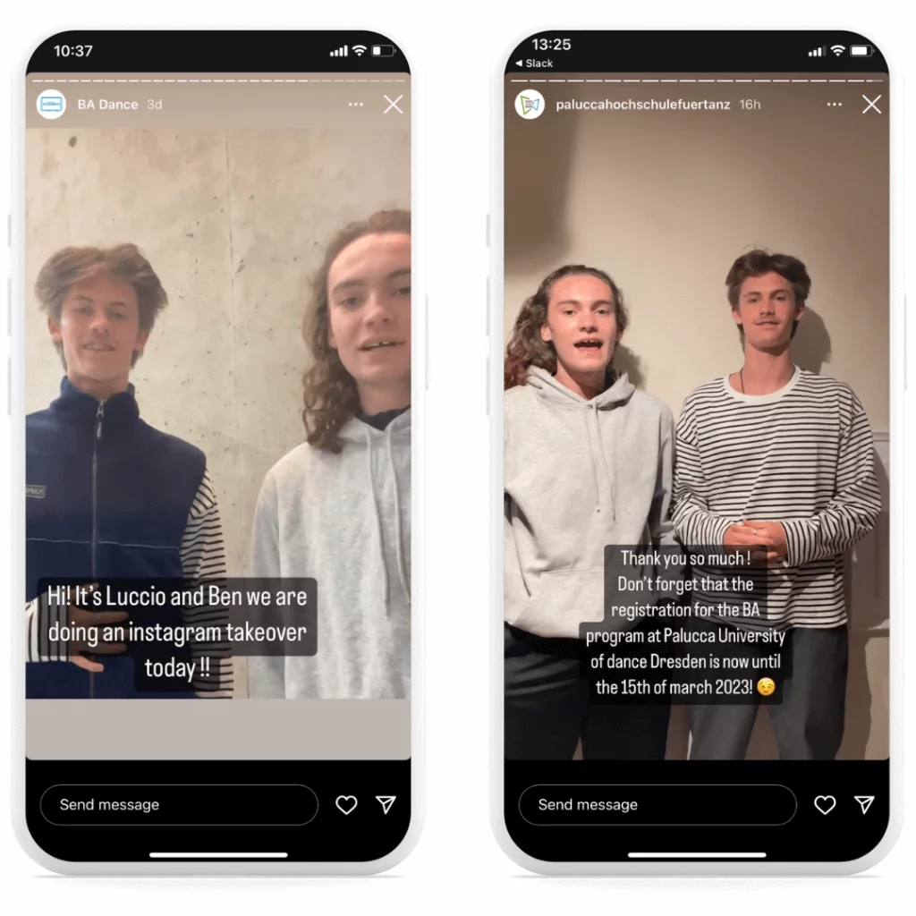
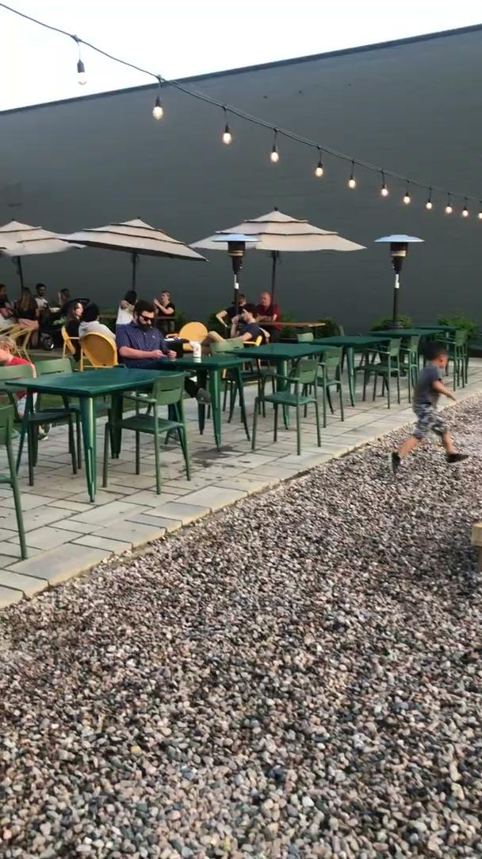
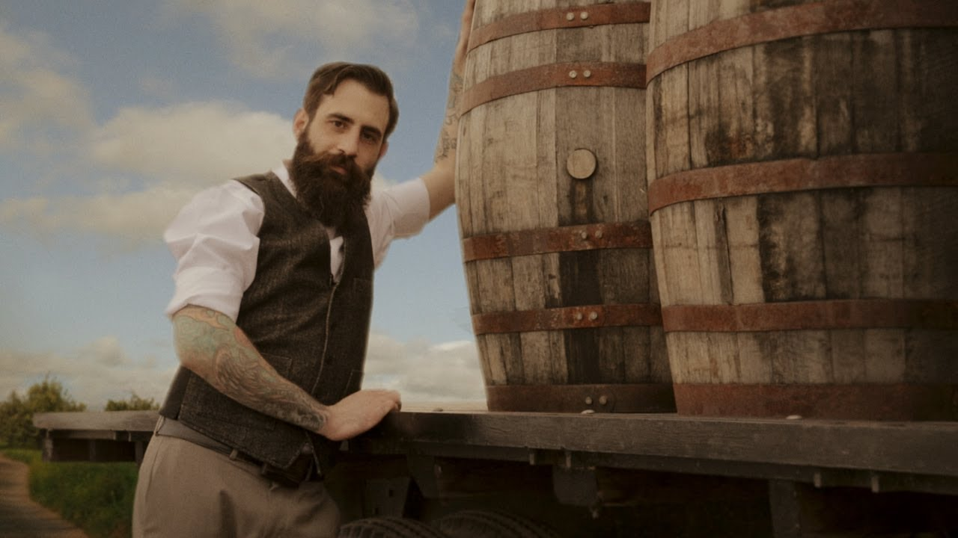
Behind the Scenes
After-Event Posts:
Employee Takeover:
Cider-Making:
Notes:
Ashton:
Takeover: Use this as a way to connect with customers on a personal level. Regulars want to feel in the know and included in some way. It fulfills their need of belongingness. It creates transparency between the customer and the business and gives customers an “inside scoop” of what goes on to keep their favorite businesses up and running. It is also an excellent way to attract new employees.
Cider-making: Connect with the customers based on shared values. Be artistic and original. Similar to the takeover, customers
Currently the posts show how the business operates and what events it holds at the surface level. What if we could go deeper and showcase who EBCC really are, and why people should come out to their events. Let the videos speak for itself – Flexibility and Originality. Customers love a brand that is open and honest. When you go in, they want to know what they’re going to get.

Slide 14
Impact: The Power of Creativity and Class Concepts
Integrating Social Media
Matching the right platforms to the right content
Shows understanding of customer journey
Use hashtags to create community and drive engagement (likes, follows, UGC)
Art & Design
Show the core values of the brand and offerings
Elements used: Unity, Contrast & Dominance, Proportion, Balance
Use of Color: Orange (associated with drinks, warm, energizing)
Creativity in Advertising
Elements used: Artistic Value, Originality, and Flexibility
Originality is rated as most effective
Increases attention and leads to a positive attitude towards the brand and its offerings
Notes:
Emma
Highlight 3 class concepts and how we used them in the media plan
For Integrating Social Media…
We explained how matching the right platforms to the right content is vital
Integrating social media effective also shows a connection and understanding of the customer journey
We also know that the use hashtags is great for creating community and driving engagement (likes, follows, UGC)
Art & Design
The Elements we used are Unity, Contrast & Dominance, Proportion, Balance
Having proper design allows you to show the core values of the brand and offerings
Something great you are already doing that we want to continue to highlight is the use of Color. Especially Orange as it is associated with drinks, warm, energizing
Creativity in Advertising
We were able to use 3 out of the 5 elements
(5 elements are elaboration, artistic value, originality, flexibility, and synthesis)
It was really important for us to have originality in this media plan because that is rated as the most effective element
Overall having creativity in advertising increases attention and leads to a positive attitude towards your brand

Slide 15
Impact: Social Media Optimization
We found that:
Instagram is the place to be
Ideal # of followers is ~5200 for local businesses
Paid ads and organic content have to work hand-in-hand
Boosting in the Triangle
Ads = create connection | Authentic content = reinforce connection
Keeping a consistent content calendar reinforces brand perception, while unique and creative content builds brand awareness
Notes:
Aaryan
Instagram is the most effective media for East Bower
Ideal # of followers is ~5200 for local businesses | EBCC exceeds that
Paid ads and organic content have to work hand-in-hand | Paid to attract, organic to keep
with paid, you want to promote customer interaction videos, such as those seen in glorias creative, videos/pictures of new ciders. The more creative and out of this world, the better
With organic, promote calendars, upcoming events, pictures of new ciders
It is worth to boost, as Raleigh is a wide area? | 37% of Raleigh's population falls under the 25-44 age range → about 25% fit our target audience → ~25,000 people
Ads will enable East Bower to connect to new consumers in their desired market. Authentic content will establish that connection and keep consumers interested
Keeping a consistent content calendar reinforces brand perception, while unique and creative content builds brand awareness

Slide 16
Thank you!
We are excited to help blossom your
Community on Tap
1Vision Media
Notes:
Aaryan

