Slide 1

Bird Tracking with google map
- Aarzin Todiwala(at485)
Date: 16-09-2019
SUPERVISOR: Dr Fer-Jan De Vries
SECOND MARKER: Prof. Thomas Erlebach

Slide 2
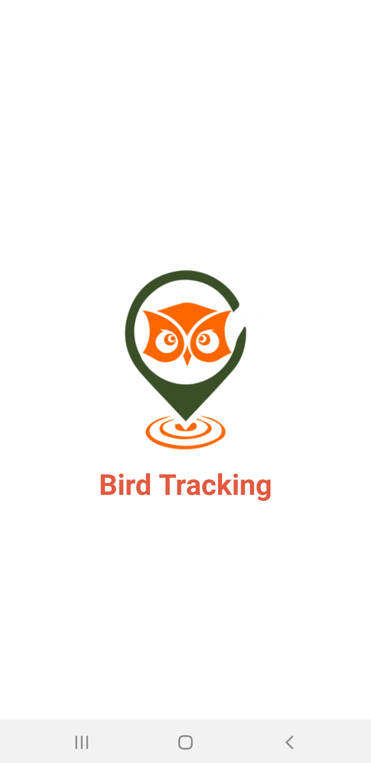
Introduction of the Application
BIRD Tracking (Birding with Google Maps)

Slide 3
  Hardware Requirements:
  - Processor (CPU) with 2 gigahertz (GHz) frequency or above.
  - A minimum of 2 GB of RAM.
  A minimum of 20 GB of available space on the hard disk.
  - Internet Connection Broadband (high-speed) Internet connection with a speed of 4 Mbps or higher.
  - Keyboard and a Microsoft Mouse or some other compatible pointing device.
Software Requirement:
- Windows 10 Operating System.
- Android Studio Version 3.5
- Android Platform Version: API 29: Android 10.0

Slide 4
Introduction About Android Studio with kotlin:
Java is Android's most widely used language, but that doesn't mean it's always the best choice. Java is old, verbose, mistaken, and slow to upgrade. Kotlin is a valuable option. Open JDK developers are beginning to bridge the gap with Java 8, but not all Java 8 characteristics are being used by Android. Developers are still stuck in the old Java 7 and 6 worlds, and in the foreseeable future, this will not improve much. That's where Kotlin comes in: With the Android software Engineering, this comparatively fresh open-source language, based on the Java Virtual Machine (JVM), gains traction. There are other JVM languages you can attempt to use on Android, but Kotlin provides Android Studio integration, Google's main Android IDE, which has no language, other than Java. Here's why now is the time for your Android development projects to begin using this contemporary, advanced, pragmatic language.

Slide 5
Advantages of kotlin(1):
Lambda expressions + Inline functions = performant custom control structures
lock(l) { foo() }
l.lock()
try {
foo()
}
finally {
l.unlock()
}

Slide 6
Advantages of kotlin(2):
Null-safety
Kotlin's type system is aimed at eliminating the danger of null references from code. [2]
To allow nulls, we can declare a variable as a nullable string, written String? [4]:
var b: String? = "abc"
b = null // ok
print(b)

Slide 7
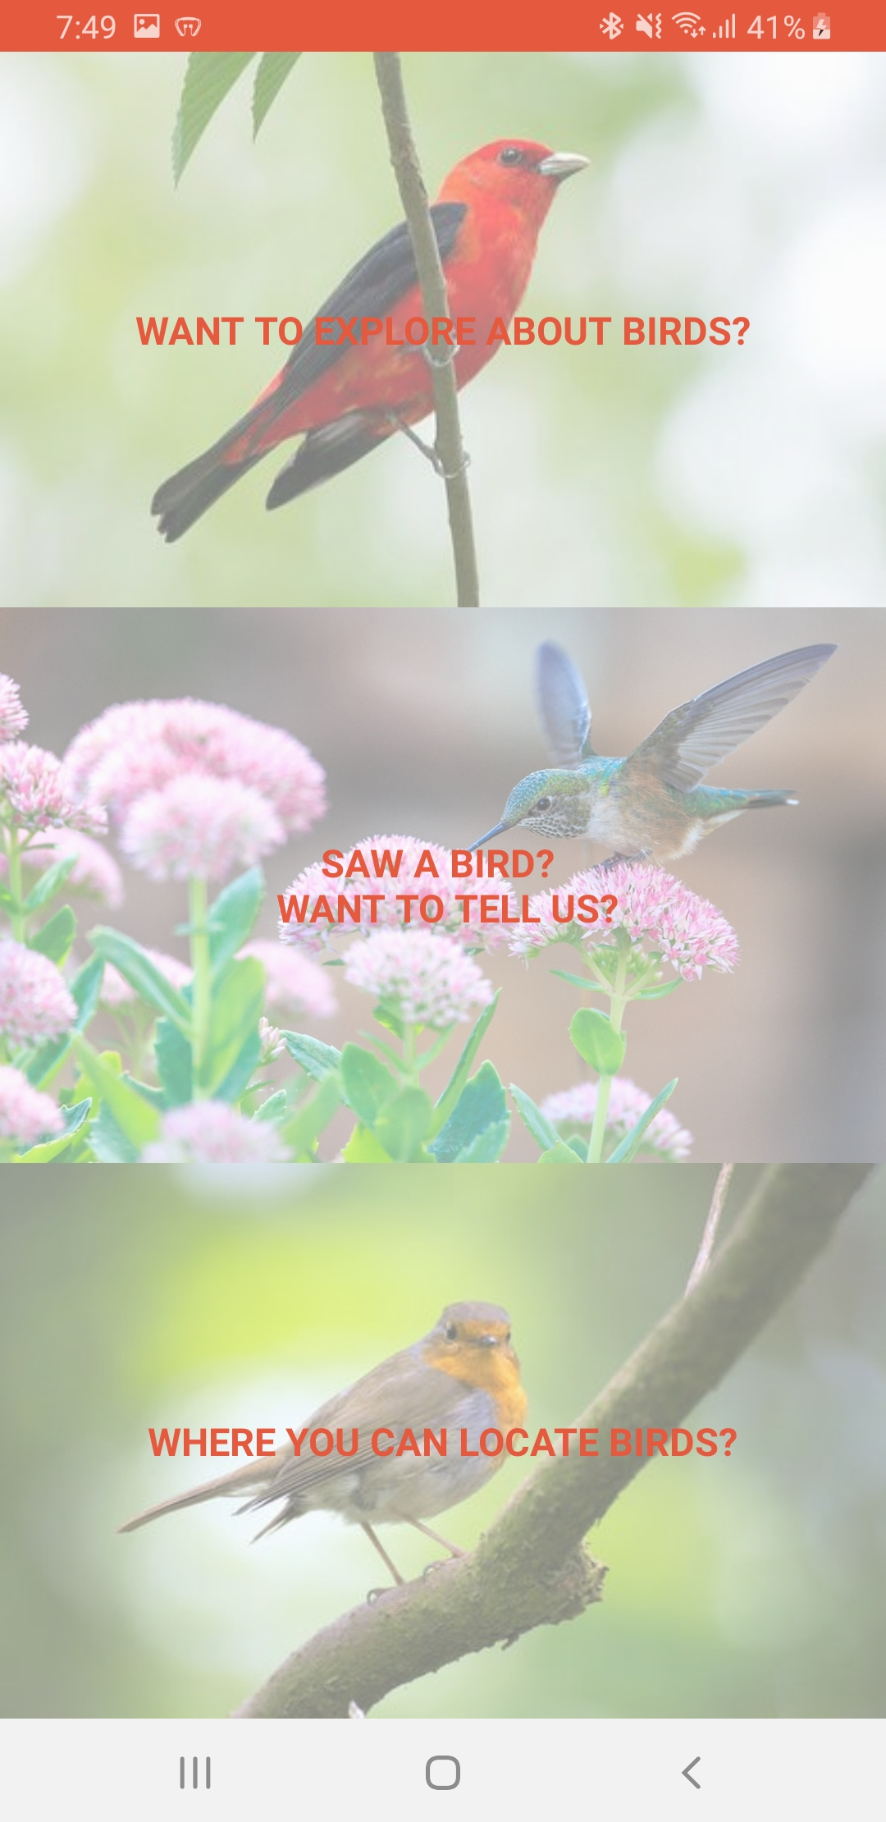
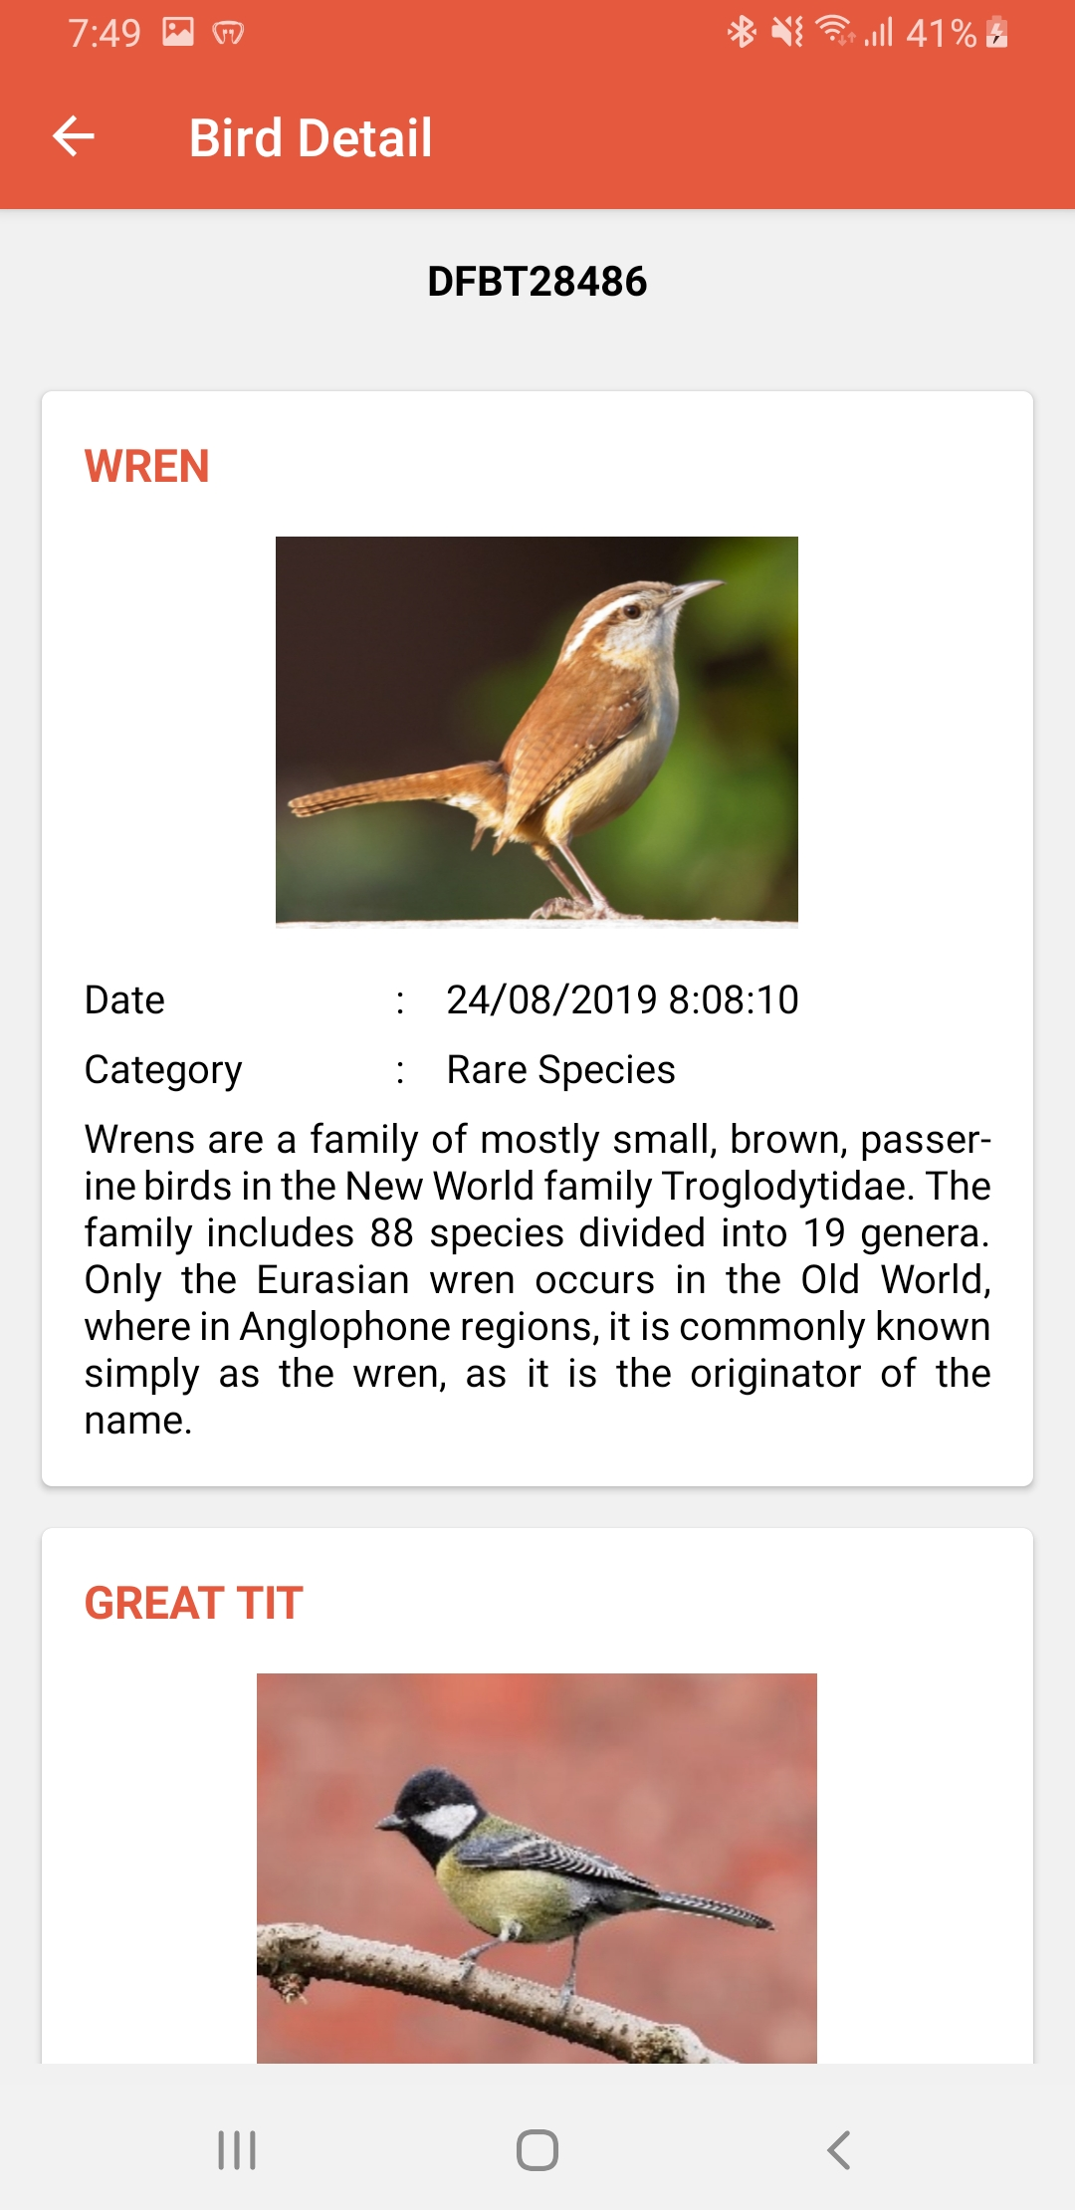
Snapshots(1):

Slide 8
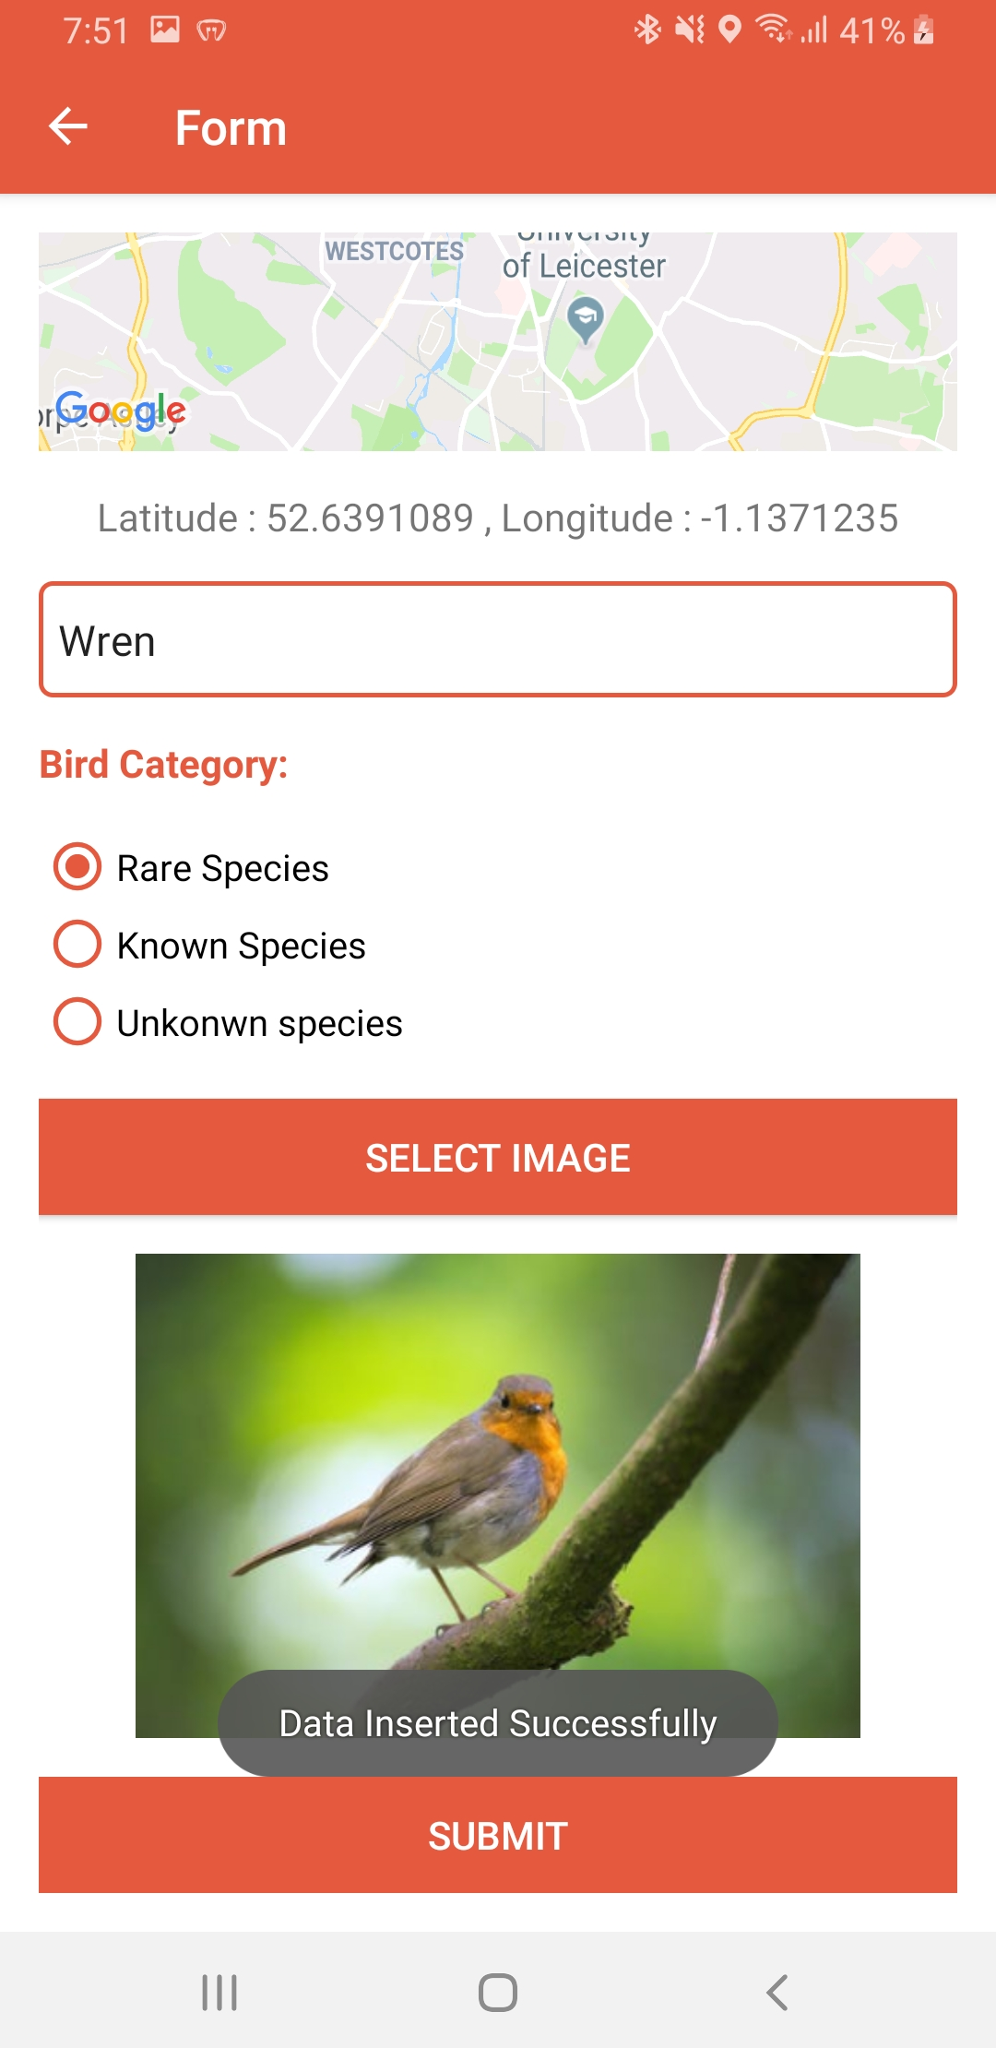
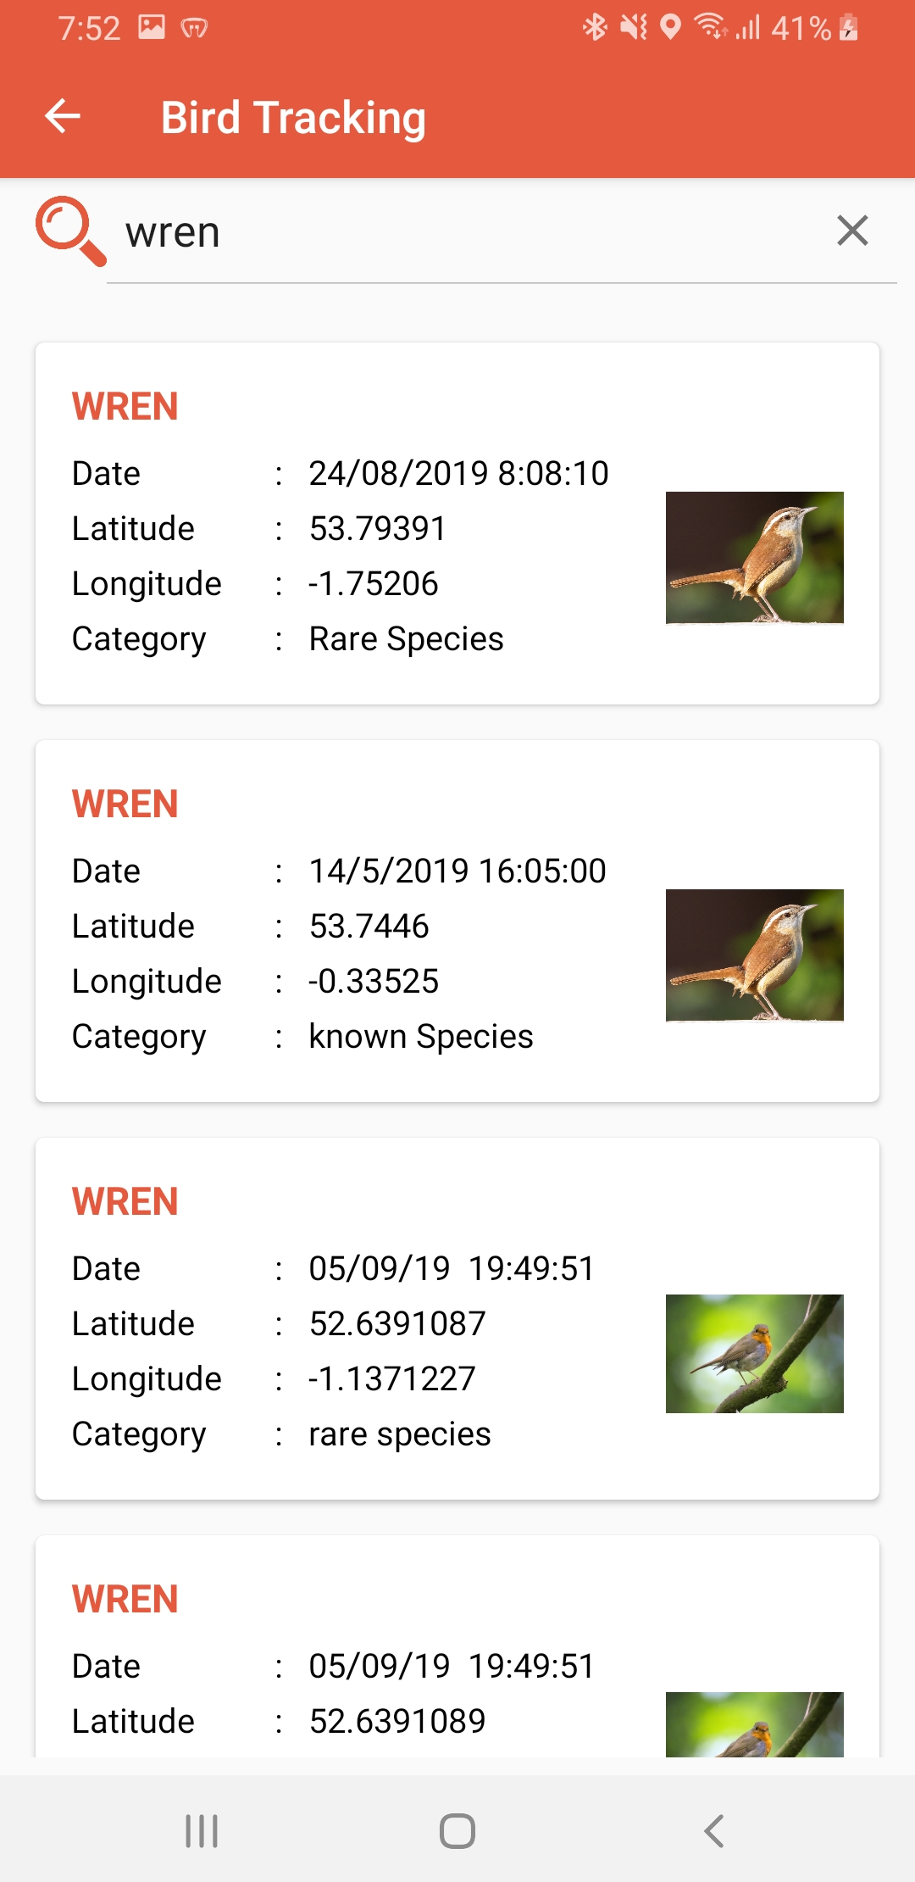
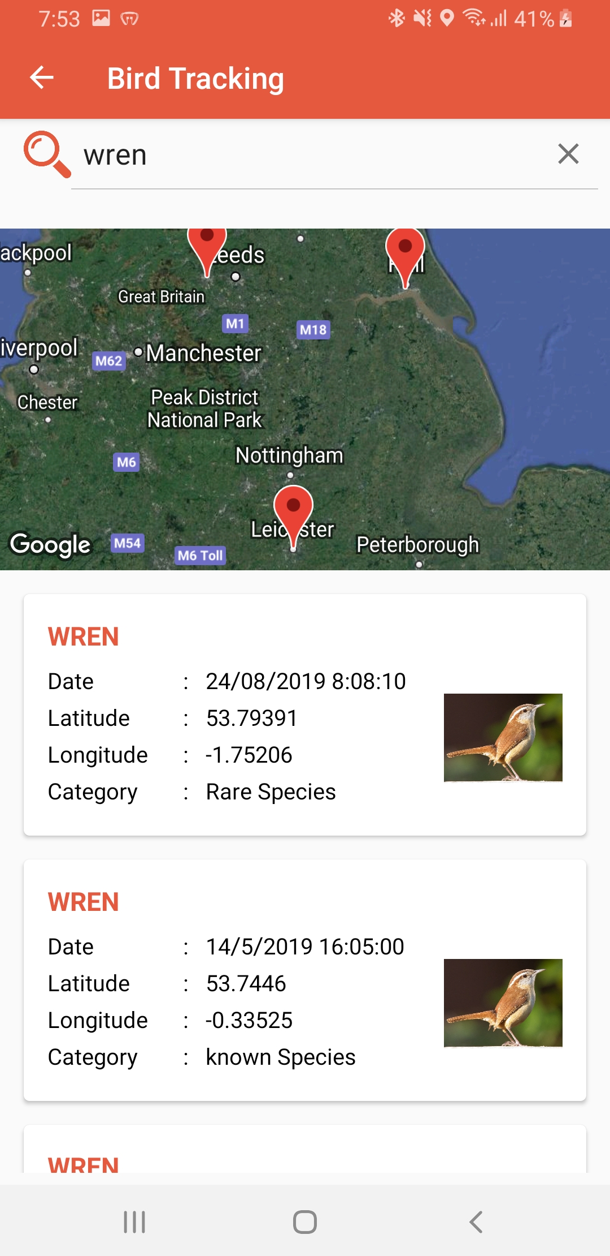
Snapshot(2):

Slide 9
Conclusion:
This application was made in consideration of the user who is keen to locate the birds nearby. By knowing the name of the bird and by uploading the location, the location of the bird last sighted can be confirmed. Even you can upload a picture of the bird for giving more accurate information of the bird. The accuracy of the birds' location is accurate, the zooming on the google map gives the exact location of the bird. In this application for viewing the birds location the google street map is used. This Application is beneficial for users who are fanatic of birds.

Slide 10

Thank You!!
“Any Questions??”

