Slide 1

Team - 4
Beri Rishi Yadav
Abhiram Gopisetty
Abhishek S. Patil
Kandula Shiva Narayana
Mahesh Doiphode
Araju Isak Mulla

Slide 2


Slide 3
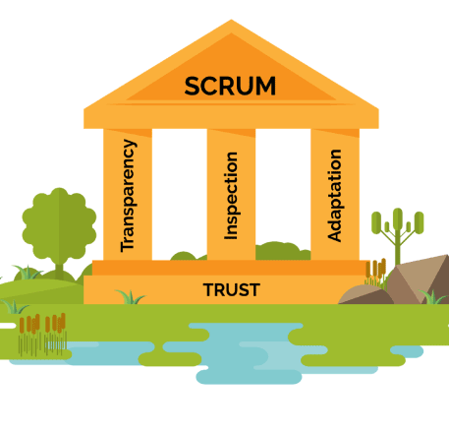
What is SCRUM?
Scrum is an empirical process, where decisions are based on observation, experience and experimentation.
The Scrum Team has a Scrum Master, a Product Owner and Developers.

Slide 4
Why SCRUM is IMPORTANT?
BETTER PRODUCT QUALITY
MONEY AND TIME SAVINGS
FASTER ROI
FLEXIBILITY
MINIMUM RISKS
BETTER CONTROL AND TRANSPERENCY

Slide 5
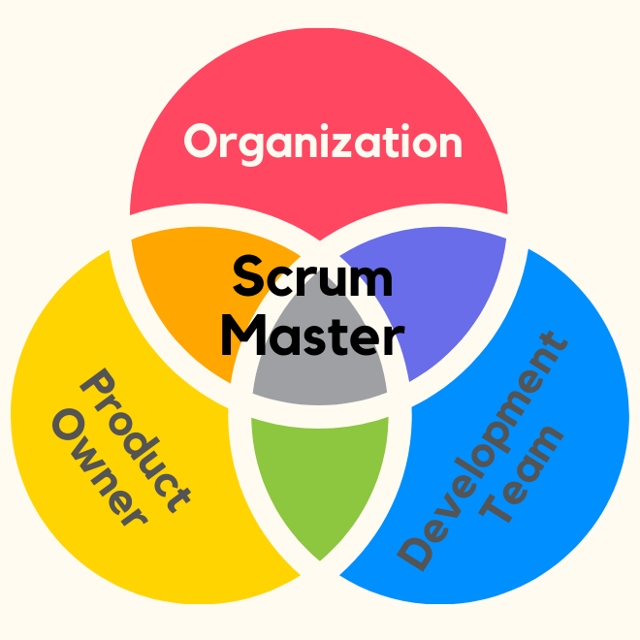
SCRUM MASTER
Scrum Master basically leads the Scrum.
He is someone who is responsible for managing the entire scrum like conducting standups, retrospective, etc.
Responsibilities of Scrum Master:
Clearing Obstacles.
Establishing an Environment where the team can be effective.
Addressing team dynamics.
Ensure that all Scrum events take place and are positive, productive, and kept within the timebox.

Slide 6
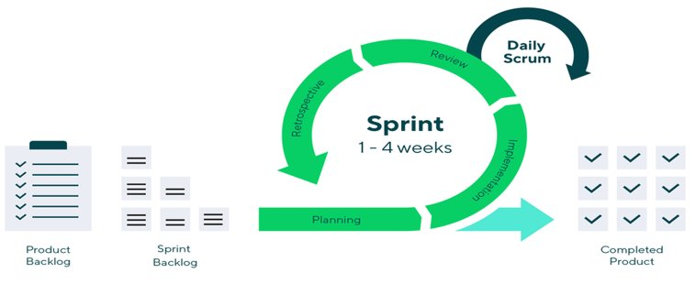
What is Sprint?
Sprints are the heartbeat of scrum, Where ideas turned into value.
The Sprint is a scrum event that encompasses all of the other scrum events.

Slide 7

What is a Product Owner?
A project’s key stakeholder
Maximizing the value of the product
Motivates the team with clear goals

Slide 8
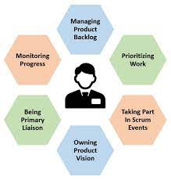
Key Responsibilities of Product Owner -
Defining Vision and Goal
Prioritizing the product backlog
Overview of development stages
Handling Communications
Knowing Client Needs
Evaluating Progress

Slide 9
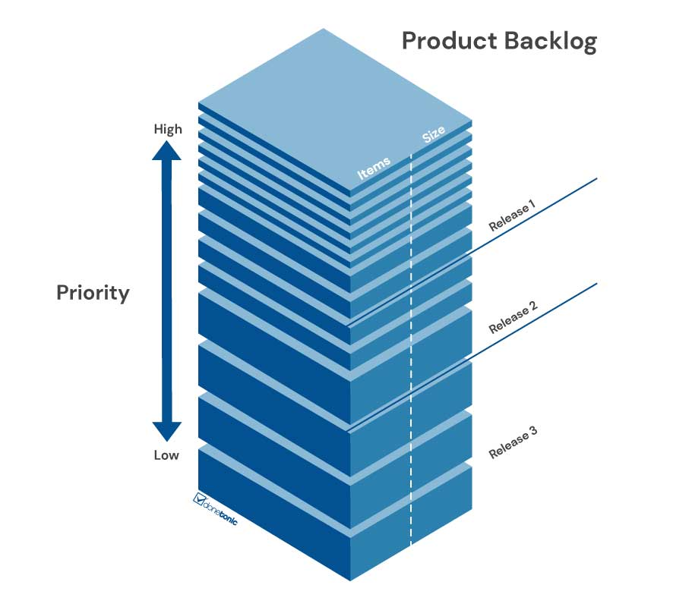
What is Product Backlog?
Ordered List of Features
Prepared and Maintained By Product Owner
It Includes Features Idea, Enhancement, Bug, Fix, and Documentation
It is- Never Complete and Dynamic

Slide 10

What is JIRA??
Why JIRA??
Project management software
Used by Agile development teams
Allows teams to prioritize, assign, track, report, and audit issues or tickets
Customizable workflows and integrations with a wide range of tools and platforms
Only used by Agile development teams ?
Improves productivity and quality
Tracks issues, bugs, and tasks throughout the SDLC
Customized workflows with statuses such as Open, In Progress, and Closed
Reporting – tracking progress, identify trends, monitoring performance
Integrations with tools and platf.

Slide 11
Why JIRA??
How JIRA??
Efficient and effective management of development projects
Enables data driven decision making
Facilitates collaboration and communication
Scalable and flexible for different teams and projects.
Different Agile boards for customizing workflows.
Prioritizing, Assigning, tracking, and reporting on "ISSUES" or "TICKETS"

Slide 12



