Slide 1


Climate Dynamics of Western-Central Hindu Kush Himalayas
MS Thesis Presentation
Under Supervision of – Prof. Prasanta Sanyal
-Aasadeep Singh
16MS013
DES
Silika Lab

Slide 2
Contents:
Introduction
Study Area
Objectives
Data & Methodology
Results
Conclusion
Future Goals

Slide 3
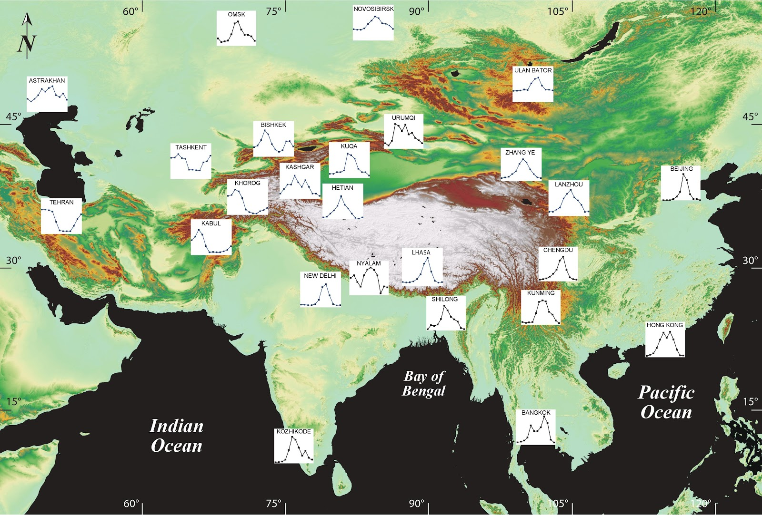
Motivation
DJFM Dominated
JJAS Dominated
IAEA Precipitation Dataset for Southeast Asia (Decadal Average)

Slide 4
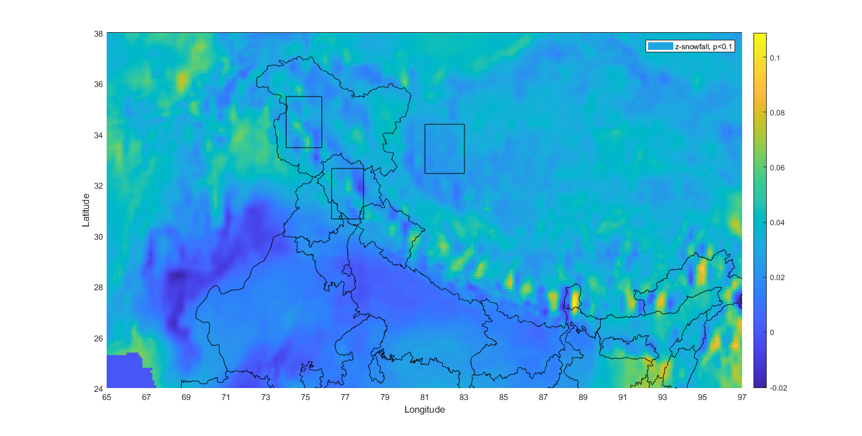
Study Area
2.1° x 2.1°
N
Figure 1: Study Areas – NWH, WH & TH.
Generated through MATLAB of the ERA-5 dataset of Indian subcontinent
NWH
TH
Latitude
WH
Longitude

Slide 5
Objectives:
Controlling factors of snow cover area (SCA) w.r.t climate variables for selective HKH region.
Comparison of SCA trends among regions of Study Area.
Modelling of climatic parameters among them & with temporal scale.

Slide 6

Dataset: Monthly Reanalysis ERA5
Type | Gridded
Horizontal Coverage | Global
Horizontal Resolution | Reanalysis: 0.25° x 0.25° ≈ (0.25° ≈ 27.75 km) (atmosphere)
Temporal coverage | 1979-2018
Temporal resolution | Monthly

Slide 7
Meteorological Variables:
Snowfall (mm of we) -Sf
Snow Cover Area (%) - SCA
Snow Depth (m) - SDE
Surface Temperature (K) – t2m
Surface sensible heat flux (J/m²) - SSHF
Surface net thermal radiation (J/m²). - STR

Slide 8
Methodology :
Statistical Analysis Methods
Kendall Tau’s
Mann-Kendall Test
Sen’s Slope
Innovative Trend Analysis
Spearman & Pearson’s Correlation Method
Procedure & Platform
MATLAB
R

Slide 9
Statistical Analysis Methods:
Kendall tau’s test
Z>0, increasing trend exists and vice versa. (0-1)
Mann Kendall Test
Z>0, increasing trend exists and also gives absolute trend. (Z value)
Sen’s Slope [Sen et al., 1968]
𝛽>0, upward trend exists and also gives slope of the trend. (𝛽-value)
Innovative Trend Analysis (ITA) [Sen et al., 2012]
ITA trend slope, data points – lies below y=x, monotonically decreasing and vice versa, also differentiate between low and high magnitude of data.
Spearman & Pearson’s Correlation Method
Pearson checks for linearity & spearman for non-linearity.
Regression Analysis

Slide 10
Procedure & Platform
MATLAB : Data Processing
Kendall Tau of all variables were calculated for each raster data point (lat, lon)
Appropriate square boxes were selected for all variables
In those 3 selected study regions, NWH, WH & TH, box average was computed and converting them to 3 temporal scales Yearly, DJFM & JJAS Average on a yearly basis.
Spearman Correlation was calculated of SCA with t2m & Sf.
Curve Fitting Tool was employed for Regression & extracted these variables-3 scale temporal data in .csv from it.
R : Statistical Trend Analysis
Those .csv data files were called and Mann-Kendall trend test, Sen’s slope and ITA was estimated.

Slide 11
Results
Trend Analysis of climatic variables. (MK, Sen’s Slope & ITA)
Analyzing Mean DJFM SCA of all 3 locations
Comparison of SCA trends among regions of Study Area.
Correlations Analysis of SCA with t2m & Sf.
(Efforts for) Modelling climatic parameters among them & with temporal scale.

Slide 12
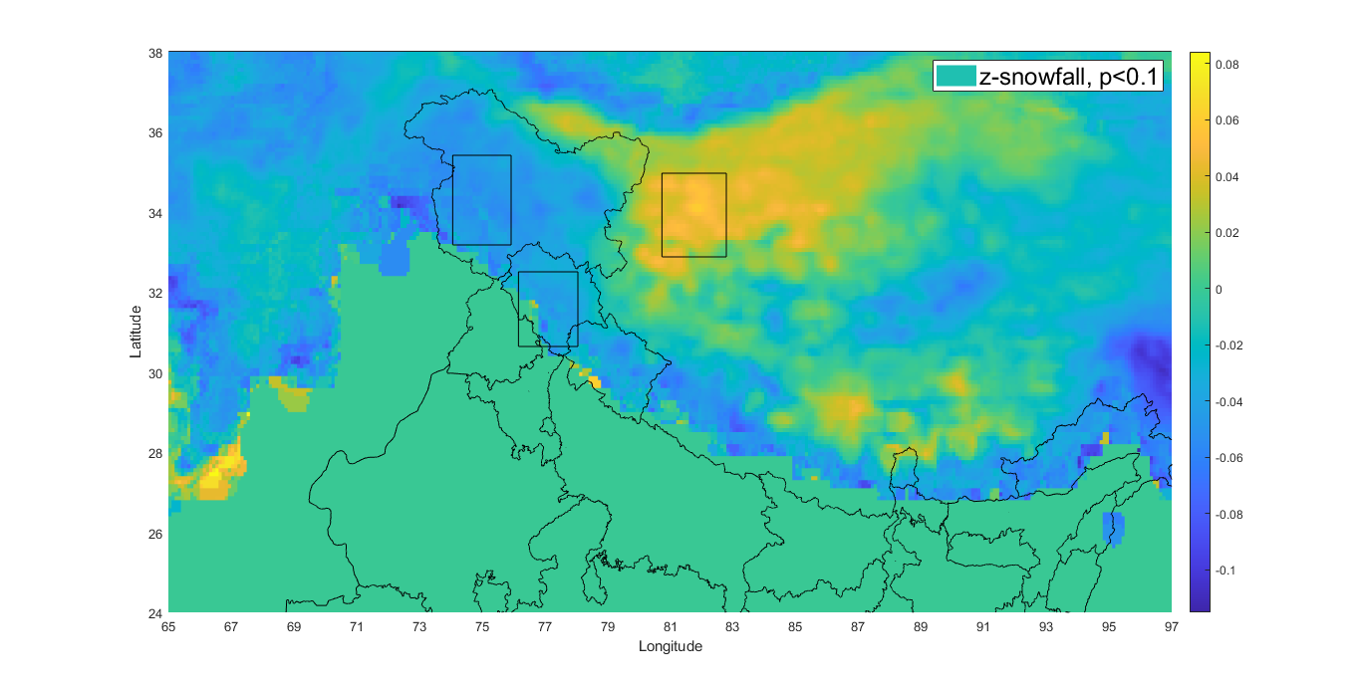
Spatial Trend Plot of Snowfall
NWH
TH
~ -0.04
~ 0.06
Figure 2 | Kendall Tau Test (Z) for Snowfall for 40 years of monthly averaged data, square box – 2.1° x 2.1° for 3 study areas : NWH, WH, TH with 90% confidence. (MATLAB)
Latitude
~ 0.04
Snowfall
WH
Note : Spatial plots of SCA, t2m, str, sshf & sde have also been generated.
Longitude

Slide 13
Trend Analysis of Climatic Variables
Snow Cover Area | Temporal Scale | Z (Mann-Kendall), p value | Sen’s Slope (%/year) | Trend
NWH | Annual* | -2.80, 0.005 | -0.35 | Decreasing
 | JJAS* | -2.52, 0.011 | -0.13 | Decreasing
Temp. | Temporal Scale | Z (Mann-Kendall), p value | Sen’s Slope (°C/year) | Trend
NWH | Annual* | 2.30, 0.021 | 0.018 | Increasing
WH | Annual* | 2.11, 0.035 | 0.016 | Increasing
Snowfall | Temporal Scale | Z (Mann-Kendall), p-value | Sen’s Slope (mm/yr) | Trend
NWH | Annual* | -2.32, 0.020 | -0.012 | Decreasing
TH | JJAS* | 2.38, 0.016 | 0.0058 | Increasing
Snow Depth | Temporal Scale | Z (Mann-Kendall), p value | Sen’s Slope (m/year) | Trend
NWH | Annual* | -2.90, 0.004 | -0.007 | Decreasing
 | JJAS* | -2.36, 0.018 | -0.004 | Decreasing
TH | JJAS* | +2.29, 0.022 | +0.01 | Increasing
SSHF | Temporal Scale | Trend
NWH | Annual* | Decreasing
TH | JJAS* | Increasing
STR | Temporal Scale | Z (Mann-Kendall), p value | Sen’s Slope (J/m² year) | Trend
TH | JJAS* | 2.94, 0.003 | 33607.75 | Increasing
*Statistically Significant (95%)

Slide 14
Analyzing Mean DJFM(Winter) Sf of all 3 Study Areas (40 Years)
Yadav et al., 2012
Himalayas Sf Mean (mwe) | NWH | WH | TH
Annual | 0.0012 | 0.0007 | 0.00040
DJFM | 0.0030 | 0.0010 | 0.0002
JJAS | 0.0001 | 0.0007 | 0.00017

Slide 15
*Statistically significant
Comparison of SCA trends among regions of Study Area (40 Years)
Himalayas SCA trends | NWH | WH | TH
Annual | Decreasing* | Nil | No trend
DJFM | No trend | Nil | No trend
JJAS | Decreasing* | Nil | No trend

Slide 16
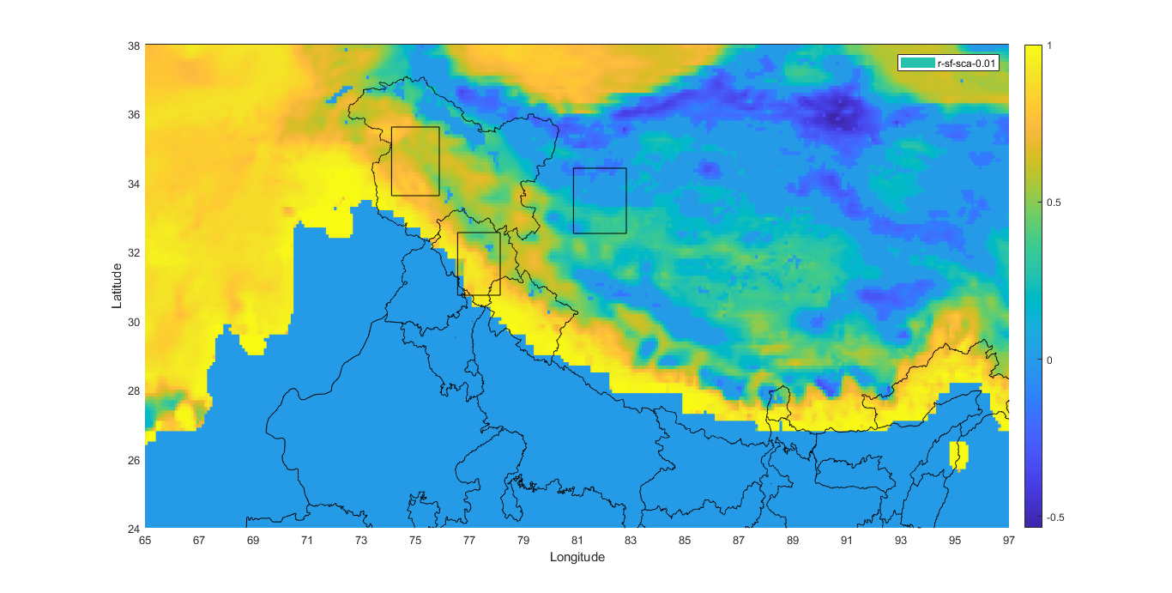
Spatial Correlation Plots : SCA & Snowfall (Sf)
NWH
TH
~ 0.7
Figure 3 | Correlation (r) for SCA and Sf for 40 years of monthly averaged data, square box – 2.1° x 2.1° with 99% confidence.
~ -0.2
Latitude
~ 0.7
WH
Longitude

Slide 17
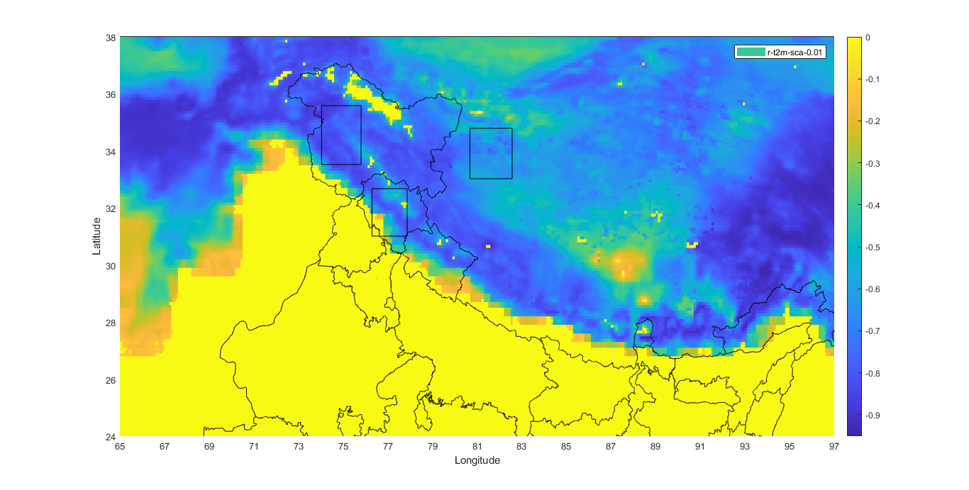
Spatial Correlation Plots : SCA & t2m
NWH
Figure 4 |Correlation (r) for t2m and SCA for 40 years of monthly averaged data, square box – 2.1° x 2.1° with 99% confidence.
TH
~ -0.8
~ -0.6
Latitude
~ -0.75
WH
Longitude

Slide 18
Association of SCA with Sf & t2m
TH
SCA With | Annual | DJFM | JJAS
T2m | r = -0.77* p = 1.4 x 10⁻⁷ | r = -0.82* p = 1.2 x 10⁻⁸ | r = -0.61* p = 3.8 x 10⁻⁵
Sf | r = 0.52* p = 8.1 x 10⁻⁴ | r = 0.88* p = 0 | r = 0.91* p = 0
NWH
SCA with | Annual | DJFM | JJAS
T2m | r = -0.81* p =2.5 x 10⁻⁸ | r = -0.33* p = 0.036 | r = -0.73* p = 4.1 x 10⁻⁷
Sf | r = 0.78* p = 2.1 x10⁻⁹ | r = 0.19 p= 0.22 | r = 0.61* p =3.2 x 10⁻⁵
WH
SCA With | Annual | DJFM | JJAS
T2m | r =-0.82* p = 1.2 x 10⁻⁸ | r = -0.74* p = 3.4 x 10⁻⁷ | r = -0.63* p = 2 x 10⁻⁵
Sf | r = 0.56* p = 2.5 x 10⁻⁴ | r =0.57* p = 1.8 x 10⁻⁴ | r = 0.23 p = 0.13
*statistically significant

Slide 19
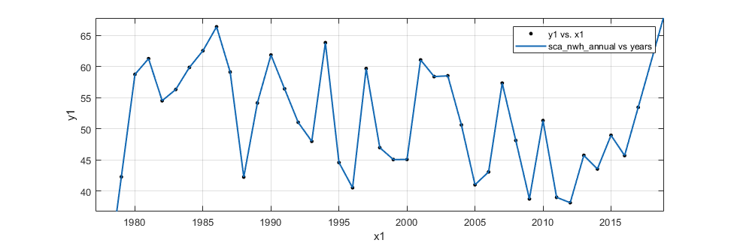
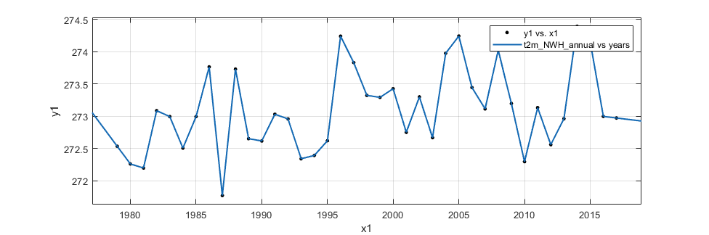
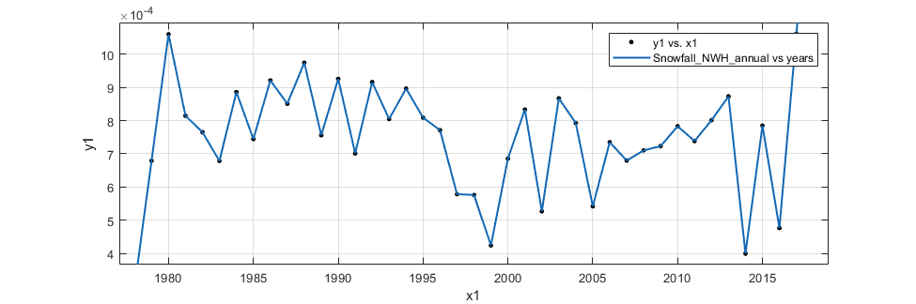
Interpolant Plots for SCA, t2m and Sf for NWH region of Annual Scale
SCA (%)
t2m (K)
For the year 1995
Sf (mwe)
YEARS

Slide 20
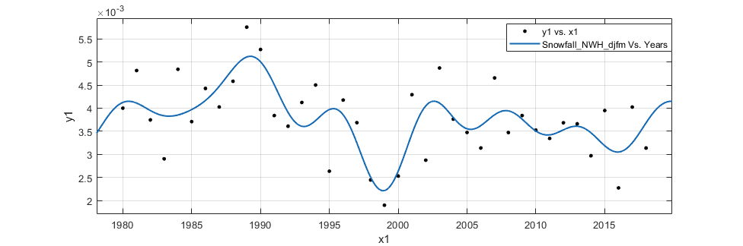
Modelling Efforts
How good the fit is?: |  | not good fit
R-square | Adjusted R square | RMSE | SSE
0.5106 | 0.1914 | 0.000752 | 1.3x10⁻⁵
Snowfall (mwe)
YEARS
Fourier Fit, 7 terms
Equation : f(x) = a₀ + a₁Cos(wx) + b₁Sin(wx) + ….. + a₇Cos(7wx) + b₇Sin(7wx) , where a₀, b₀ …., a₇, b₇ & w are coefficients
Temporal : DJFM (Winter), Region : NWH

Slide 21
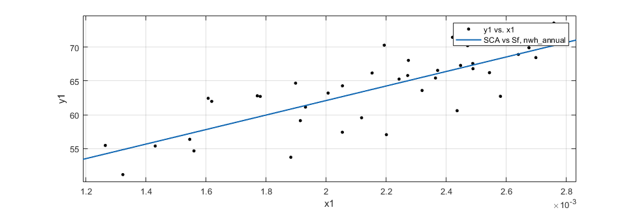
Modelling Efforts
How good the fit is?: |  | not good fit
R-square | Adjusted R square | RMSE | SSE
0.6247 | 0.6146 | 3.416 | 431.5
Snow Cover Area (%)
Snowfall (mwe)
Linear Fit, 2 coefficients
Equation : f(x) = p₁x + p₂,
where p₁ & p₂ are coefficients, p₁ = 1.07 x 10⁴ & p₂ = 40.69
Temporal : Annual, Region : NWH

Slide 22
Conclusion
Strength of inter correlation between SCA & climatic parameters exists - SCA with surface temperature & snowfall at multi-spatial temporal our 3 study regions.
The model fit by regression, is mostly Fourier for Sf, SCA & t2m with temporal scale and mostly linear for SCA with Sf & SCA with t2m.

Slide 23
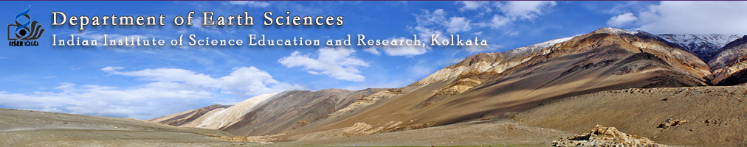


Thanks to Professor Prasanta Sanyal Sir & Bibhasvata Dasgupta Asiya & Sarthak (Special Mention)
From Geo-Science
To
Climate Science

