Slide 1

C Language Training

Slide 2
C History
C is a programming language developed at AT & T’s Bell Laboratories of USA in 1972. It was designed and written by a man named Dennis Ritchie.
In the late seventies C began to replace the more familiar languages of that time like PL/I, ALGOL, etc.
Possibly why C seems so popular is because it is reliable, simple and easy to use.

Slide 3
Getting started
Major parts of popular operating systems like Windows, UNIX, Linux is still written in C. This is because even today when it comes to performance (speed of execution) nothing beats C. Moreover, if one is to extend the operating system to work with new devices one needs to write device driver programs. These programs are exclusively written in C.

Slide 4
Getting started
I believe that nobody can learn C++ or Java directly. This is because while learning these languages you have things like classes, objects, inheritance, polymorphism, templates, exception handling, references, etc. do deal with apart from knowing the actual language elements.
C++, C# or Java make use of a principle called Object Oriented Programming (OOP) to organize the program. This organizing principle has lots of advantages to offer. But even while using this organizing principle you would still need a good hold over the language elements of C and the basic programming skills.

Slide 5
Where is C used?
In embedded systems
For the development of system applications
For the development of desktop applications
For the development of a majority of Adobe applications
For the development of browsers and the different extensions for these browsers
In the development of databases like MySQL
In the development of operating systems
To produce compilers
In IoT-related applications

Slide 6
Getting started
At times one is required to very closely interact with the hardware devices. Since C provides several language elements that make this interaction feasible without compromising the performance it is the preferred choice of the programmer.

Slide 7
IDE
Visual studio
Eclipse
Code::Blocks
Net beans
Dev C++
Clion
Code Lite

Slide 8
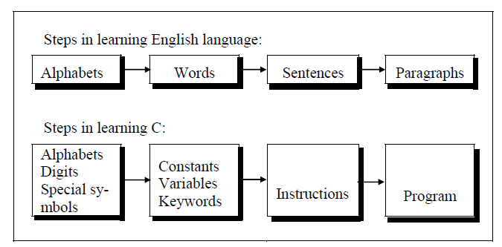
Steps in learning C Language

Slide 9
Structure of C Language program
1 ) Comment line
2) Preprocessor directive
3 ) Global variable declaration
4) main function( )
{ Local variables; Statements; }
5) User defined function { }

Slide 10
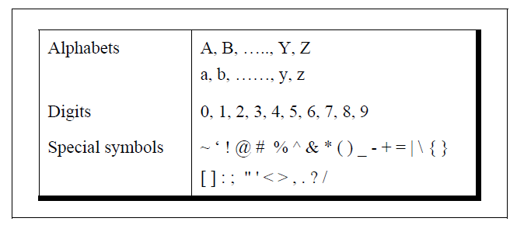
C Character set
A character denotes any alphabet, digit or special symbol used to represent information.

Slide 11
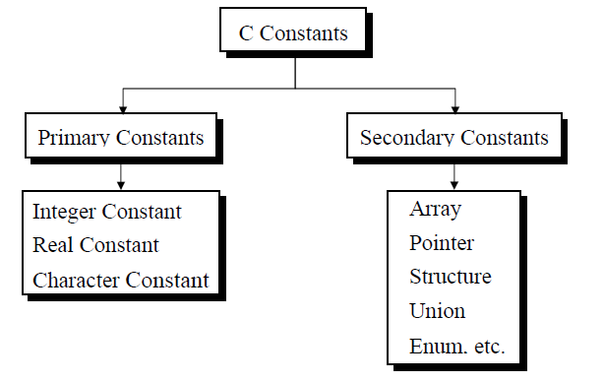
Types of C Constants
C constants can be divided into two major categories:
Primary Constants
Secondary Constants

Slide 12
Printf() and scanf() in C
The printf() and scanf() functions are used for input and output in C language. Both functions are inbuilt library functions, defined in stdio.h (header file).
Printf() function
It is used for output. It print the given statement to console
Syntax: printf("format string",argument_list);
The format string can be %d (integer), %c (character), %s (string), %f (float) etc.

Slide 13
Printf() and scanf() in C
The printf() and scanf() functions are used for input and output in C language. Both functions are inbuilt library functions, defined in stdio.h (header file).
scanf() function
It is used for input. It read the input data from the console
Syntax: scanf("format string",argument_list);
The format string can be %d (integer), %c (character), %s (string), %f (float) etc.

Slide 14
Format specifiers in C
The Format specifier is a string used in the formatted input and output functions. The format string determines the format of the input and output. The format string always starts with a '%' character.

Slide 15
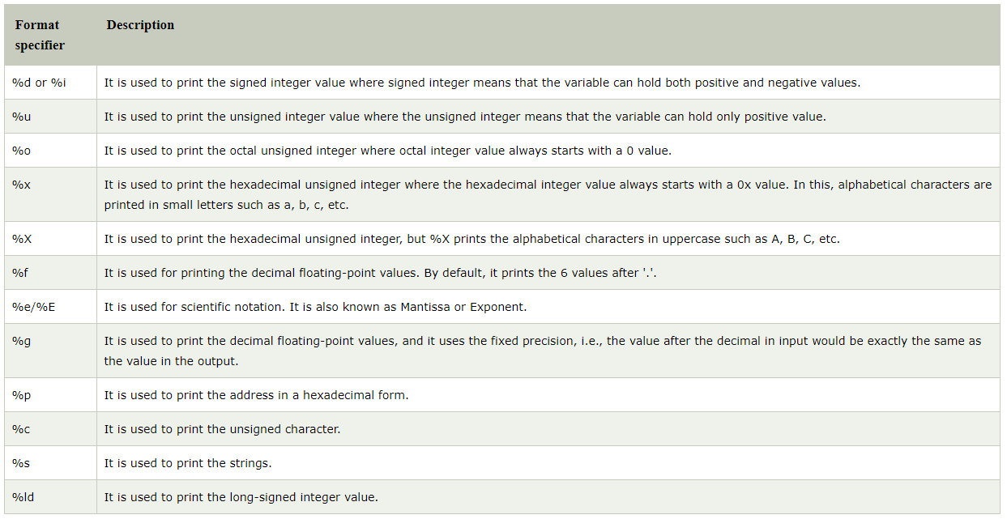

Slide 16
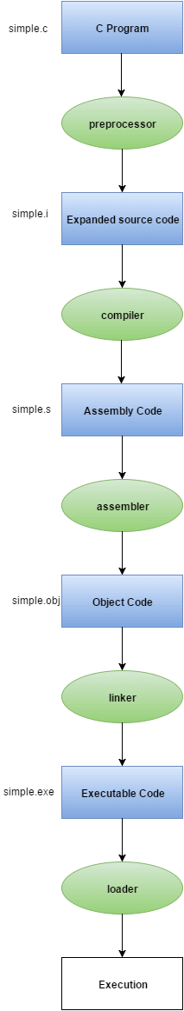
C Program Execution flow

Slide 17
Variables & Assignment in C
In the simplest terms, you can think of variables as a named box. A box that acts as a storage place and location for holding different information that can vary in content.
The process of naming a variable is called assignment. You set a specific value that is on the right, to a specific variable name that is on the left. You use the = or the assignment operator to do this.

Slide 18
How to declare vs initialise a variable in C
#include <stdio.h>
int main(void)
{
int a = 30;
// int is the data type
// n is the name
// n is capable of holding integer values
// positive/negative whole numbers or 0
// = is the assignment operator
// 27 is the value
}

Slide 19
What is the difference between initializing and declaring a variable?
int a; // declaration, create a variable called n capable of holding integer values
int a = 30; // initialization, creating a variable called n and assigning a value, storing a number in that variable

Slide 20
Rules for naming variables in C
Variable names must begin either with a letter or an underscore, for example age and _age are valid.
A variable name can contain letters (uppercase or lowercase), numbers, or an underscore.
There can be no other special symbols besides an underscore.
Variable names are case sensitive, for example age is different from Age.

Slide 21
Local vs Global variable
Definition:
Those variables which are defined within some function and are accessible to that function only are called Local Variables.
Those variables which are defined outside of function block and are accessible to entire program are known as Global Variables.
Scope:
Scope is local to that block or function where they are defined.
Scope is global i.e., they can be used anywhere in the program.
Default:
Default value is unpredictable (garbage).
Default value is Zero (0).

Slide 22
Example 1:
#include<stdio.h>
void main()
{
int x=23, y=4;
printf(“x = %d and y=%d”, x, y);
}
Example 2:
#include<conio.h>
int a=10,b;
void main()
{
printf(“a = %d and b=%d”, a, b);
}

Slide 23
Data types
Each variable in C has an associated data type. Each data type requires different amounts of memory.
char: The most basic data type in C. It stores a single character and requires a single byte of memory in almost all compilers.
int: As the name suggests, an int variable is used to store an integer.
float: It is used to store decimal numbers (numbers with floating point value) with single precision.
double: It is used to store decimal numbers (numbers with floating point value) with double precision.

Slide 24
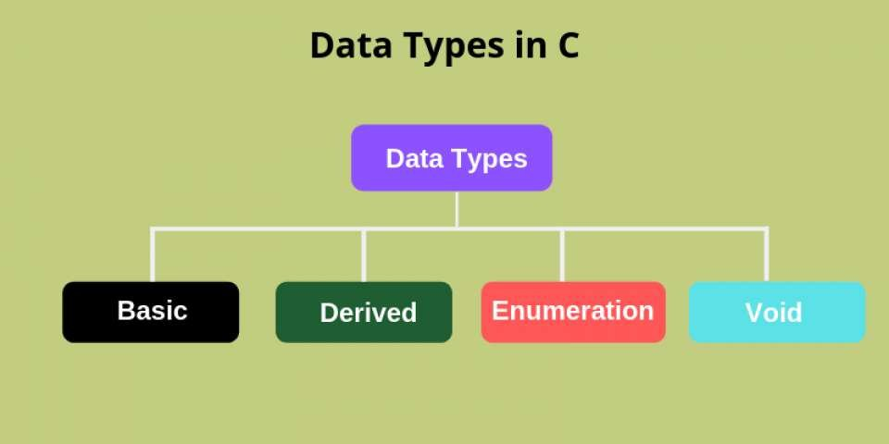

Slide 25
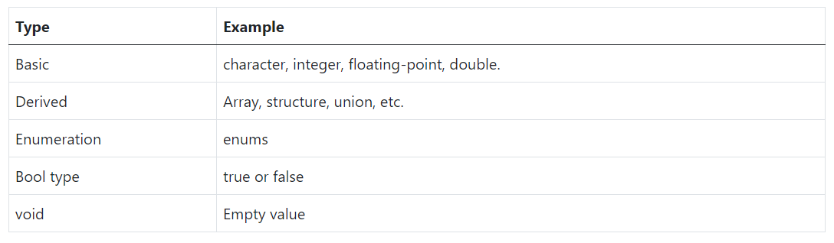

Slide 26
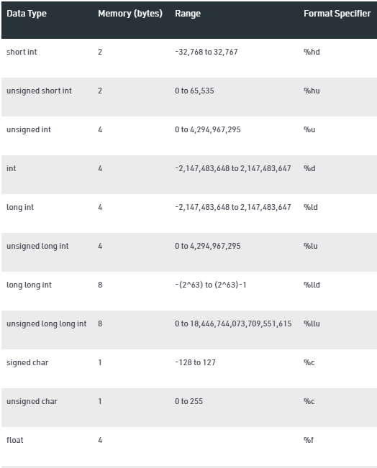
Data types and its range

Slide 27
C Datatype Modifiers:
Following are the modifiers:
signed
unsigned
long
short

Slide 28
What does signed and unsigned means?
In simple words, the unsigned modifier means all positive values, while the signed modifier means both positive and negative values.
When the compiler gets a numeric value, it converts that value into a binary number, which means a combination of 0 and 1. For example, 32767 in binary is 01111111 11111111, and 1 in binary is 01 (or 0001), 2 is 0010, and so on.

Slide 29
What happens if the value is out of Range?
#include <stdio.h>
int main() {
// allowed value up to 0 - 255
unsigned char a = 256;
return 0;
}
warning: large integer implicitly truncated to unsigned type [-Woverflow]
unsigned short int x = 256;

Slide 30
C Operators
Arithmetic Operators
Relational Operators
Shift Operators
Logical Operators
Bitwise Operators
Ternary or Conditional Operators
Assignment Operator
Misc Operator

Slide 31
The most commonly used operators are:
+ for addition
- for subtraction
* for multiplication
/ for division
% for modulo division (calculating the remainder of the division)

Slide 32
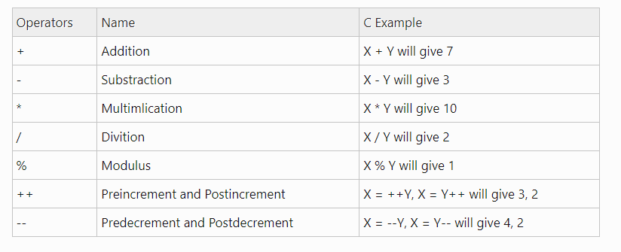

Slide 33
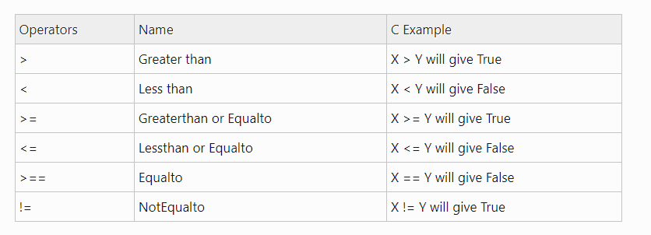

Slide 34
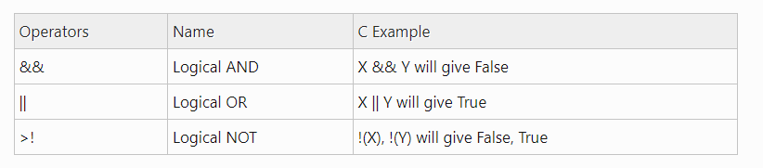

Slide 35
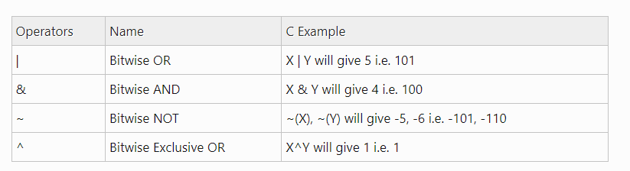

Slide 36
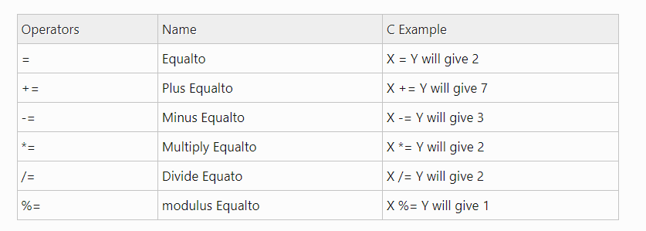

Slide 37
Precedence of Operators in C
The precedence of operator species that which operator will be evaluated first and next. The associativity specifies the operator direction to be evaluated; it may be left to right or right to left.
Example
int value=5+2*10;

Slide 38
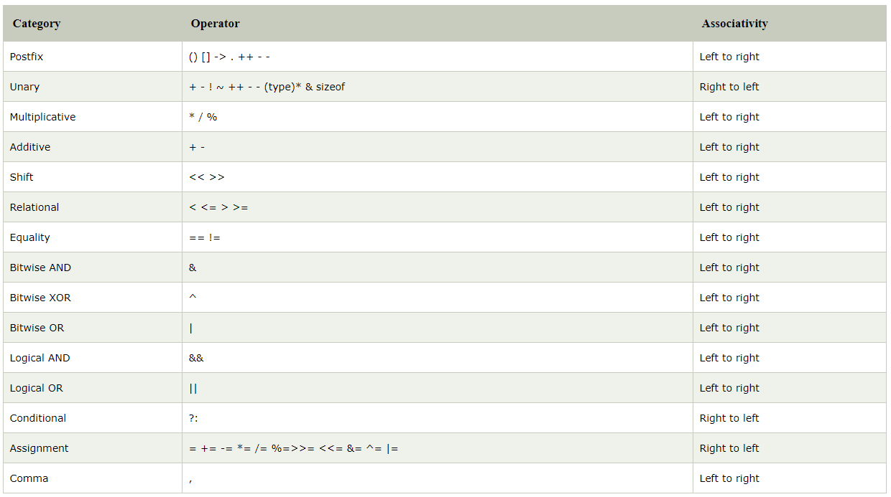

Slide 39
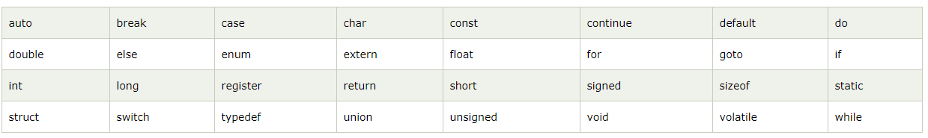
Keywords in C
A keyword is a reserved word. You cannot use it as a variable name, constant name, etc. There are only 32 reserved words (keywords) in the C language.

Slide 40
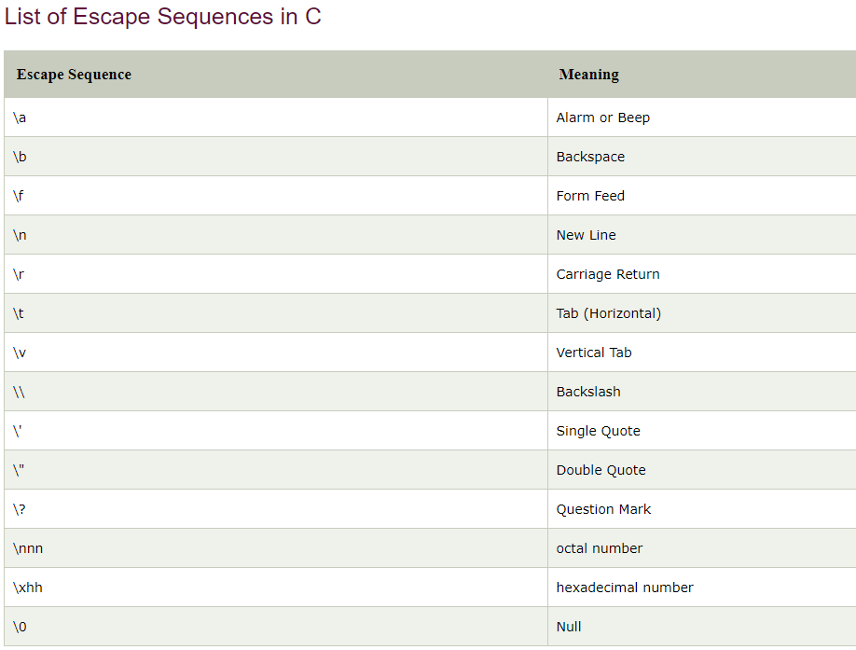
Escape sequence in C
An escape sequence in C language is a sequence of characters that doesn't represent itself when used inside string literal or character.

Slide 41
ASCII Value in C
The full form of ASCII is the American Standard Code for information interchange. It is a character encoding scheme used for electronics communication. Each character or a special character is represented by some ASCII code, and each ascii code occupies 7 bits in memory.
Character variable does not contain a character value itself rather the ascii value of the character variable. The ascii value represents the character variable in numbers, and each character variable is assigned with some number range from 0 to 127. For example, the ascii value of 'A' is 65.

Slide 42
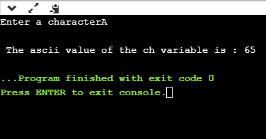

Slide 43
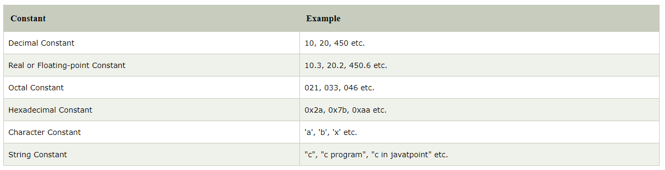
Const in C
A constant is a value or variable that can't be changed in the program

Slide 44
Special characters in c
Square brackets [ ]: The opening and closing brackets represent the single and multidimensional subscripts.
Simple brackets ( ): It is used in function declaration and function calling. For example, printf() is a pre-defined function.
Curly braces { }: It is used in the opening and closing of the code. It is used in the opening and closing of the loops.
Comma (,): It is used for separating for more than one statement and for example, separating function parameters in a function call, separating the variable when printing the value of more than one variable using a single printf statement.
Hash/pre-processor (#): It is used for pre-processor directive. It basically denotes that we are using the header file.
Asterisk (*): This symbol is used to represent pointers and also used as an operator for multiplication.
Tilde (~): It is used as a destructor to free memory.
Period (.): It is used to access a member of a structure or a union.

Slide 45
Boolean in C
In C, Boolean is a data type that contains two types of values, i.e., 0 and 1. Basically, the bool type value represents two types of behavior, either true or false. Here, '0' represents false value, while '1' represents true value.
Syntax: bool variable_name;

Slide 46
Programming errors in c
Syntax error
Run-time error
Linker error
Logical error
Semantic error

Slide 47
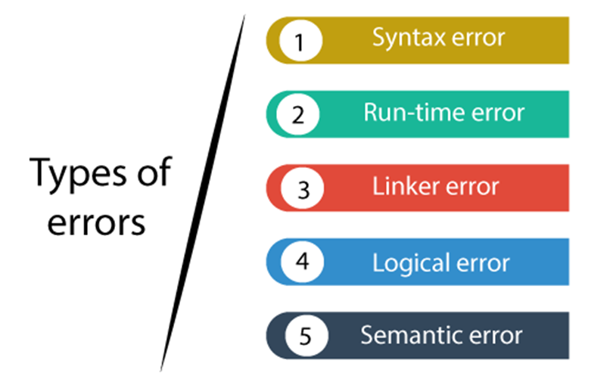

Slide 48
Syntax error
Syntax errors are also known as the compilation errors as they occurred at the compilation time, or we can say that the syntax errors are thrown by the compilers. These errors are mainly occurred due to the mistakes while typing or do not follow the syntax of the specified programming language. These mistakes are generally made by beginners only because they are new to the language. These errors can be easily debugged or corrected.

Slide 49
Common syntax errors
If we miss the parenthesis (}) while writing the code.
Displaying the value of a variable without its declaration.
If we miss the semicolon (;) at the end of the statement.

Slide 50
Syntax error example
#include <stdio.h>
int main()
{
a = 10;
printf("The value of a is : %d", a);
return 0;
}

Slide 51
Runtime error
Sometimes the errors exist during the execution-time even after the successful compilation known as run-time errors. When the program is running, and it is not able to perform the operation is the main cause of the run-time error. The division by zero is the common example of the run-time error. These errors are very difficult to find, as the compiler does not point to these errors.

Slide 52
Example Division by zero
#include <stdio.h>
int main()
{
int a=2;
int b=2/0;
printf("The value of b is : %d", b);
return 0;
}

Slide 53
Linker error
Linker errors are mainly generated when the executable file of the program is not created. This can be happened either due to the wrong function prototyping or usage of the wrong header file.

Slide 54
Example
#include <stdio.h>
int Main()
{
int a=78;
printf("The value of a is : %d", a);
return 0;
}

Slide 55
Logical error
The logical error is an error that leads to an undesired output. These errors produce the incorrect output

Slide 56

Example logical error
#include <stdio.h>
int main()
{
int a,b,c;
a=2;
b=2;
If(a=b)
{
Printf(“both are eqal “);
}
return 0;
}

Slide 57
Semantic error
Semantic errors are the errors that occurred when the statements are not understandable by the compiler.

Slide 58
Example semantic error
#include <stdio.h>
int main()
{
int a,b,c;
a=2;
b=3;
c=1;
a+b=c; // semantic error
return 0;
}

Slide 59
Control statement - if
The if statement is used to check some given condition and perform some operations
if(expression){
//code to be executed
}
Task 1: write a program to check the number is even or odd.
Task 2: write a program to find largest numbers of the three.

Slide 60
If-else statement
The if-else statement is used to perform two operations for a single condition.
if(expression){
//code to be executed if condition is true
}else{
//code to be executed if condition is false
}

Slide 61
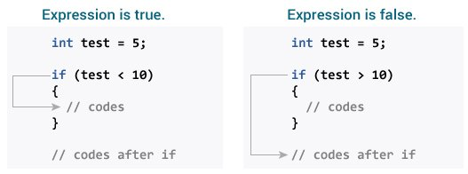

Slide 62
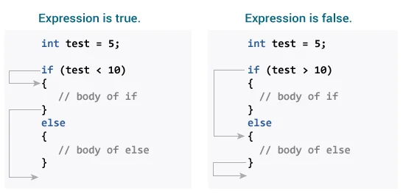

Slide 63
If else-if ladder statement
The if-else-if ladder statement is an extension to the if-else statement. It is used in the scenario where there are multiple cases to be performed for different conditions.
if(condition1){
//code to be executed if condition1 is true
}else if(condition2){
//code to be executed if condition2 is true
}
else if(condition3){
//code to be executed if condition3 is true
}
...
else{
//code to be executed if all the conditions are false
}

Slide 64
C switch statement
execute multiple operations for the different possible values of a single variable called switch variable.
Syntax of switch:
switch(expression){
case value1:
//code to be executed;
break; //optional
case value2:
//code to be executed;
break; //optional
default:
code to be executed if all cases are not matched;
}

Slide 65
Rules for switch statement in C
The switch expression must be of an integer or character type.
The case value must be an integer or character constant.
The case value can be used only inside the switch statement.
The break statement in switch case is not must. It is optional. If there is no break statement found in the case, all the cases will be executed present after the matched case. It is known as fall through the state of C switch statement.

Slide 66
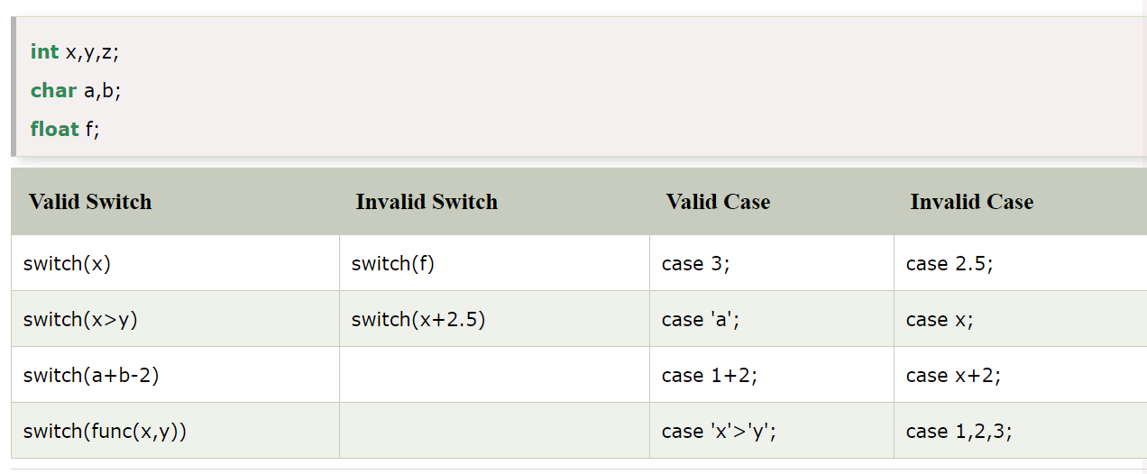

Slide 67
C Loops
Three types of loops
Do while
While
For
The looping simplifies the complex problems into the easy ones. It enables us to alter the flow of the program so that instead of writing the same code again and again, we can repeat the same code for a finite number of times. For example, if we need to print the first 10 natural numbers then, instead of using the printf statement 10 times, we can print inside a loop which runs up to 10 iterations.

Slide 68
For loop
The for loop in C language is used to iterate the statements or a part of the program several times.
Syntax of for loop in C:
for(Expression 1; Expression 2; Expression 3){
//code to be executed
}
Task: Print table for the given number using C for loop

Slide 69
While loop
While loop is also known as a pre-tested loop. In general, a while loop allows a part of the code to be executed multiple times depending upon a given condition.
Syntax
While(condition)
{
//code to executed
}

Slide 70
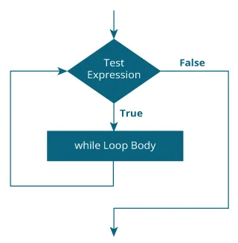
While loop

Slide 71
Do while loop
The do while loop is a post tested loop. Using the do-while loop, we can repeat the execution of several parts of the statements. The do-while loop is mainly used in the case where we need to execute the loop at least once.
Syntax
do{
//code to be executed
}while(condition);

Slide 72
Infinite loop
An infinite loop is a looping construct that does not terminate the loop and executes the loop forever. It is also called an indefinite loop or an endless loop. It either produces a continuous output or no output.
An infinite loop is useful for those applications that accept the user input and generate the output continuously until the user exits from the application manually. In the following situations, this type of loop can be used:
All the operating systems run in an infinite loop as it does not exist after performing some task. It comes out of an infinite loop only when the user manually shuts down the system.
All the servers run in an infinite loop as the server responds to all the client requests. It comes out of an indefinite loop only when the administrator shuts down the server manually.
All the games also run in an infinite loop. The game will accept the user requests until the user exits from the game.

Slide 73
Infinite loop
for(; ;)
{
// body of the for loop.
}
while(1)
{
// body of the loop..
}

Slide 74

Infinite loop
do
{
// body of the loop..
}while(1);

Slide 75
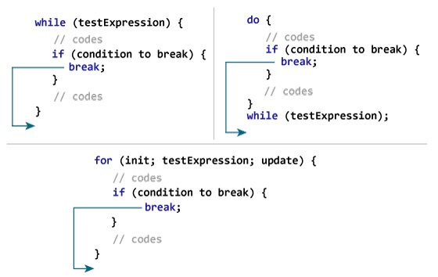
Break and continue in loops
Notes:
The break statement ends the loop immediately when it is encountered. Its syntax is:

Slide 76
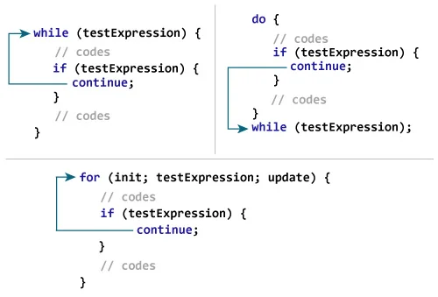
Break and continue in loops
Notes:
The continue statement skips the current iteration of the loop and continues with the next iteration. Its syntax is:

Slide 77
Functions in C
In c, we can divide a large program into the basic building blocks known as function.
The function contains the set of programming statements enclosed by {}.
A function can be called multiple times to provide reusability and modularity to the C program.
The function is also known as procedureor subroutinein other programming languages.

Slide 78
Advantage of functions in C
By using functions, we can avoid rewriting same logic/code again and again in a program.
We can call C functions any number of times in a program and from any place in a program.
We can track a large C program easily when it is divided into multiple functions.
Reusability is the main achievement of C functions.
However, Function calling is always a overhead in a C program.

Slide 79
Function Aspects
Function declaration
A function must be declared globally in a c program to tell the compiler about the function name, function parameters, and return type.
Function call
Function can be called from anywhere in the program. The parameter list must not differ in function calling and function declaration. We must pass the same number of functions as it is declared in the function declaration.
Function definition
It contains the actual statements which are to be executed. It is the most important aspect to which the control comes when the function is called. Here, we must notice that only one value can be returned from the function.

Slide 80
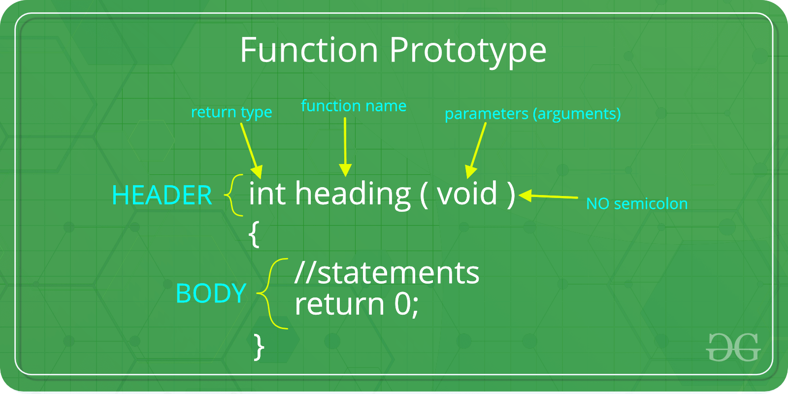
Function prototype

Slide 81
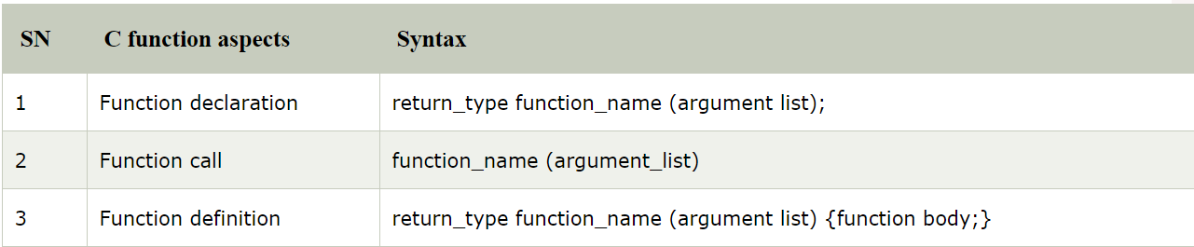
Aspects

Slide 82
Types of functions
Library Functions: are the functions which are declared in the C header files such as scanf(), printf(), gets(), puts(), ceil(), floor() etc.
User-defined functions: are the functions which are created by the C programmer, so that he/she can use it many times. It reduces the complexity of a big program and optimizes the code.

Slide 83
Return value
A C function may or may not return a value from the function. If you don't have to return any value from the function, use void for the return type.
void hello(){
printf("hello c");
}

Slide 84
Example with return value:
int get(){
return 10;
}

Slide 85
Example with return value:
float get(){
return 10.2;
}

Slide 86
Different aspects of function calling
function without arguments and without return value
function without arguments and with return value
function with arguments and without return value
function with arguments and with return value

Slide 87
C Library Functions
Stdio.h
Conio.h
String.h
Stdlib.h
Math.h
Time.h
Ctype.h
Signal.h

Slide 88
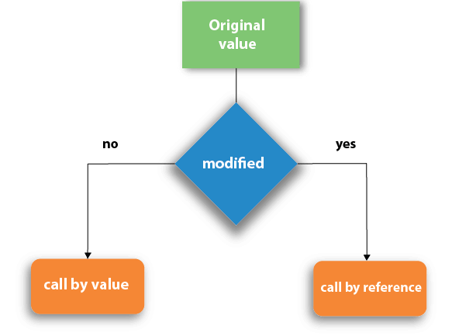
Call by value and Call by reference in C
There are two methods to pass the data into the function in C language, i.e., call by value and call by reference.

Slide 89
Call By value
In call by value method, the value of the actual parameters is copied into the formal parameters. In other words, we can say that the value of the variable is used in the function call in the call by value method.
In call by value method, we can not modify the value of the actual parameter by the formal parameter.
In call by value, different memory is allocated for actual and formal parameters since the value of the actual parameter is copied into the formal parameter.
The actual parameter is the argument which is used in the function call whereas formal parameter is the argument which is used in the function definition.

Slide 90
Example
#include<stdio.h>
void change(int num) {
printf("Before adding value inside function num=%d \n",num);
num=num+100;
printf("After adding value inside function num=%d \n", num);
}
int main() {
int x=100;
printf("Before function call x=%d \n", x);
change(x);//passing value in function
printf("After function call x=%d \n", x);
return 0;
}

Slide 91
Call by reference
In call by reference, the address of the variable is passed into the function call as the actual parameter.
The value of the actual parameters can be modified by changing the formal parameters since the address of the actual parameters is passed.
In call by reference, the memory allocation is similar for both formal parameters and actual parameters. All the operations in the function are performed on the value stored at the address of the actual parameters, and the modified value gets stored at the same address.

Slide 92
Example
#include<stdio.h>
void change(int *num) {
printf("Before adding value inside function num=%d \n",*num);
(*num) += 100;
printf("After adding value inside function num=%d \n", *num);
}
int main() {
int x=100;
printf("Before function call x=%d \n", x);
change(&x);//passing reference in function
printf("After function call x=%d \n", x);
return 0;
}

Slide 93
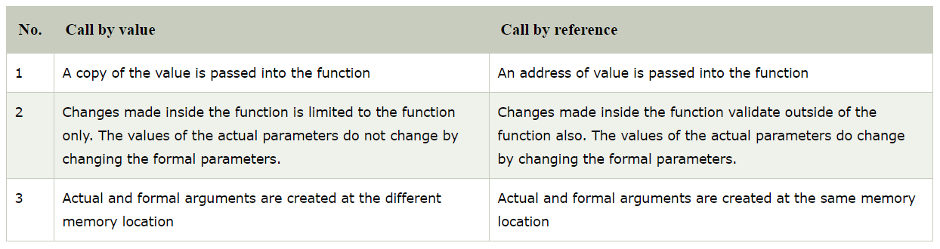

Slide 94
Storage Classes in C
Storage classes in C are used to determine the lifetime, visibility, memory location, and initial value of a variable. There are four types of storage classes in C
Automatic
External
Static
Register

Slide 95
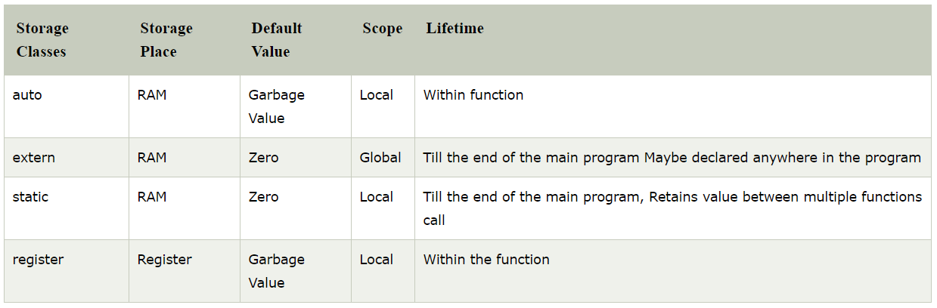

Slide 96
Automatic
Automatic variables are allocated memory automatically at runtime.
The visibility of the automatic variables is limited to the block in which they are defined.
The scope of the automatic variables is limited to the block in which they are defined.The automatic variables are initialized to garbage by default.
The memory assigned to automatic variables gets freed upon exiting from the block.
The keyword used for defining automatic variables is auto.
Every local variable is automatic in C by default.

Slide 97
Example
#include <stdio.h>
int main()
{
int a; //auto
char b;
float c;
printf("%d %c %f",a,b,c); // printing initial default value of automatic variables a, b, and c.
return 0;
}

Slide 98
Static
The variables defined as static specifier can hold their value between the multiple function calls.
Static local variables are visible only to the function or the block in which they are defined.
A same static variable can be declared many times but can be assigned at only one time.
Default initial value of the static integral variable is 0 otherwise null.
The visibility of the static global variable is limited to the file in which it has declared.
The keyword used to define static variable is static.

Slide 99
Program
#include<stdio.h>
static char c;
static int i;
static float f;
static char s[100];
void main ()
{
printf("%d %d %f %s",c,i,f); // the initial default value of c, i, and f will be printed.
}

Slide 100
Register
The variables defined as the register is allocated the memory into the CPU registers depending upon the size of the memory remaining in the CPU.
We can not dereference the register variables, i.e., we can not use &operator for the register variable.
The access time of the register variables is faster than the automatic variables.
The initial default value of the register local variables is 0.
The register keyword is used for the variable which should be stored in the CPU register. However, it is compiler?s choice whether or not; the variables can be stored in the register.
We can store pointers into the register, i.e., a register can store the address of a variable.
Static variables can not be stored into the register since we can not use more than one storage specifier for the same variable.

Slide 101
Example
#include <stdio.h>
int main()
{
register int a; // variable a is allocated memory in the CPU register. The initial default value of a is 0.
printf("%d",a);
}

Slide 102
External
The external storage class is used to tell the compiler that the variable defined as extern is declared with an external linkage elsewhere in the program.
The variables declared as extern are not allocated any memory. It is only declaration and intended to specify that the variable is declared elsewhere in the program.
The default initial value of external integral type is 0 otherwise null.
We can only initialize the extern variable globally, i.e., we can not initialize the external variable within any block or method.
An external variable can be declared many times but can be initialized at only once.
If a variable is declared as external then the compiler searches for that variable to be initialized somewhere in the program which may be extern or static. If it is not, then the compiler will show an error.

Slide 103
Example
#include <stdio.h>
int main()
{
extern int a;
printf("%d",a);
}

Slide 104
Example
#include <stdio.h>
int a;
int main()
{
extern int a = 0; // this will show a compiler error since we can not use extern and initializer at same time
printf("%d",a);
}

Slide 105
Example
#include <stdio.h>
int main()
{
extern int a; // Compiler will search here for a variable a defined and initialized somewhere in the pogram or not.
printf("%d",a);
}
int a = 20;

