Slide 1
MESSMATE
Eat Better.
Choose Smarter.
By-
Aasandi(70022400133)
Harkirat Kaur(70022400577)

Slide 2
Problem statement
01 • PROBLEM
Students living in a hostel or accessing canteen often have limited visibility into meal options and little structured support for choosing food that fits their preferences.
• Meal information can be scattered or difficult to compare.
• Students may have different dietary types and spice preferences.
• Students need a simple way to view meals and submit feedback.
• Feedback is more useful when it can be stored and reviewed systematically.
Focus: make meal discovery clearer and support more informed choices.
MESSMATE • 02

Slide 3
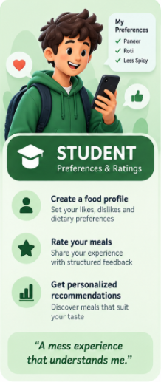
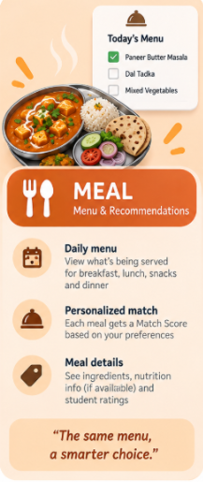
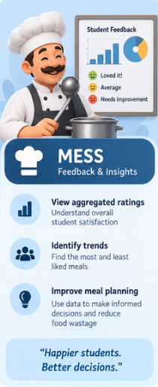
Proposed solution
01 • SOLUTION
MessMate is an Android app that brings meal discovery, preference capture, meal feedback and recommendation logic into one place.
Discover
Personalize
Improve decisions
View meals and their details, category, availability and ratings.
Capture food type, spice level, favourite foods and dislikes.
Use rating data and a rule-based engine to support meal recommendations.
MESSMATE • 03

Slide 4
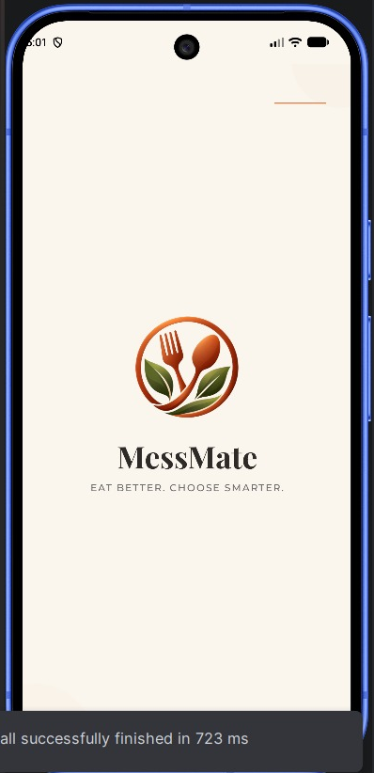
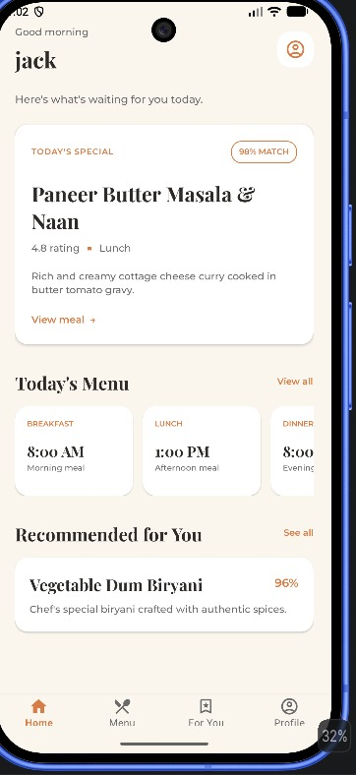
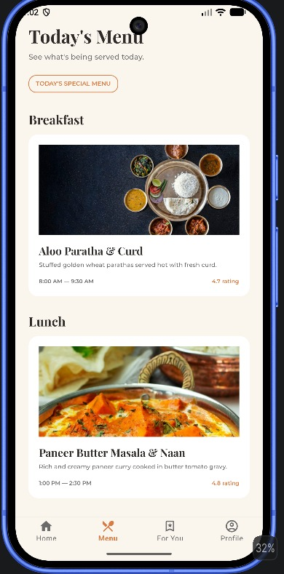
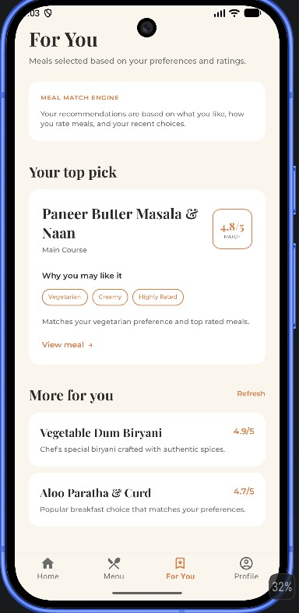
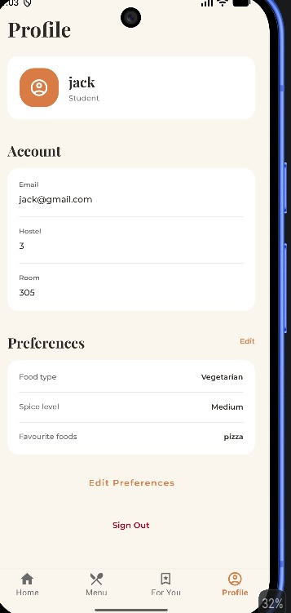
MESSMATE • 04

Slide 5
Why is the code divided into folders?
02 • CODE ORGANIZATION
activities/
fragments/
Screen-level logic and navigation.
Reusable sections hosted inside an Activity.
models/
adapters/
Java objects representing meals, users, preferences and ratings.
Bind lists of objects to RecyclerView rows/cards.
repository/
viewmodel/
Centralize Firestore reads and writes.
Hold screen data and expose observable state.
recommendation/
utils/
Keep scoring/filtering rules separate from UI.
Shared constants, Firebase helpers and demo-data setup.
Benefit: easier debugging, reuse, testing and maintenance; one class can change without rewriting the whole app.
MESSMATE • 05

Slide 6
Activities folder: screen controllers
02 • FILE STRUCTURE
Activities manage a full screen, connect XML views to Java, react to taps, and navigate to other screens.
SplashActivity.java
App entry point; checks current Firebase user after splash delay.
LoginActivity.java
Email/password login and password reset.
SignupActivity.java
Creates Firebase account and writes profile data.
MainActivity.java
Hosts bottom navigation and student fragments.
PreferenceActivity.java
Collects and saves food preferences.
MealDetailActivity.java
Reads and displays a selected meal.
RateMealActivity.java
Collects and saves a student's feedback.
Activity lifecycle entry point: onCreate() → setContentView() → findViewById() → listeners.
MESSMATE • 06

Slide 7
Fragments folder: sections inside the app
02 • FILE STRUCTURE
HomeFragment.java
Greeting, special meal and home shortcuts.
MenuFragment.java
Loads available meals by category.
RecommendationFragment.java
Loads and ranks candidate meals for the recommendation screen.
ProfileFragment.java
Displays profile and handles logout/preferences navigation.
AdminHomeFragment.java
Dashboard summary and shortcuts in the current source.
ManageMenuFragment.java
Selects meals and saves date-specific menu data.
AnalyticsFragment.java
Summarizes rating distribution.
MESSMATE • 07

Slide 8
Models folder: the shape of app data
02 • FILE STRUCTURE
Meal.java
One meal: ID, name, category, description, food type, spice, price/rating and availability.
Preference.java
User food preferences and lists such as favourite/disliked foods.
Rating.java / MealRating.java
Feedback data: meal/user references, scores, comment and timestamp.
User.java / UserProfile.java
Account/profile fields; separate classes used in different code paths.
Recommendation.java
A Meal plus score and explanation.
Models do not draw the UI; they carry structured values between Firestore, repositories, adapters and logic.
MESSMATE • 08

Slide 9
Adapters and ViewHolder
03 • COMPONENTS
RecyclerView
Adapter
Efficiently displays scrollable lists by reusing row views instead of creating every row from scratch.
Connects each data object to a row layout and binds values to the row's views.
@Override
public void onBindViewHolder(ViewHolder holder, int position) {
Meal meal = meals.get(position);
holder.name.setText(meal.getName());
holder.rating.setText(String.valueOf(meal.getRating()));
}
ViewHolder stores references to the row's views. The adapter reuses holders as items scroll on and off screen.
• MealAdapter → item_meal.xml
• RecommendationAdapter → item_recommendation.xml
• FeedbackAdapter → item_feedback.xml
• getItemCount() returns the number of displayed objects.
MESSMATE • 09

Slide 10
Other Android components used
03 • COMPONENTS
Activity / Fragment
Intent + extras
EditText / TextView / Button
Screen and reusable screen-section lifecycle.
Navigate and pass values such as mealId and mealName.
Input, display and trigger actions.
RadioGroup / CheckBox / Switch
Toast / setError()
AlertDialog
Collect exclusive choices, multiple selections and on/off states.
Show short messages and field-level validation.
Display selectable meal choices in a dialog.
Handler + Looper
LiveData / ViewModel
Callback / lambda
Schedule the splash navigation after a delay.
Expose screen state and data updates.
Handle asynchronous completion and UI events.
The XML resource IDs (R.id...) are the bridge between Java code and the views defined in layout XML.
MESSMATE • 10

Slide 11
Firebase, Glide and data libraries
03 • COMPONENTS
Firebase Authentication
Cloud Firestore
Glide — image loading
Creates accounts, signs in/out and requests password-reset emails.
Stores and queries user, meal, preference, rating and daily-menu documents.
If configured in a screen, loads remote image URLs into ImageViews and handles caching/recycling. Verify actual usage in source before presenting as implemented.
Other important APIs
• FirebaseFirestore.getInstance() — obtain Firestore client.
• FirebaseAuth.getInstance() — obtain auth client.
• Query / DocumentSnapshot — read collections and document fields.
• addOnSuccessListener / addOnFailureListener — handle async results.
• ArrayAdapter — turn choices into dropdown/dialog rows.
• SimpleDateFormat / Date — format dates and timestamps.
MESSMATE • 11

Slide 12
Code pattern: Activity creation and navigation
03 • COMPONENTS
@Override
protected void onCreate(Bundle savedInstanceState) {
super.onCreate(savedInstanceState);
setContentView(R.layout.activity_login);
email = findViewById(R.id.edtEmail);
login = findViewById(R.id.btnLogin);
login.setOnClickListener(v -> signIn());
}
• onCreate() is called as Android creates the screen.
• setContentView() inflates the XML layout for the Activity.
• findViewById() connects Java variables to XML IDs.
• setOnClickListener() registers an event callback.
• Intent + startActivity() opens another Activity.
• finish() removes the current Activity from the back stack.
MESSMATE • 12

Slide 13
App working: high-level student flow
04 • APP WORKING
SplashActivity
LoginActivity
SignupActivity
PreferenceActivity
MainActivity
1.8-second splash + auth check
Sign in or go to signup
Create account + profile
Save preferences
Home / Menu / For You / Profile
Returning user: SplashActivity checks FirebaseAuth.getCurrentUser(); if non-null, it opens MainActivity directly.
MESSMATE • 13

Slide 14
Start of app: SplashActivity → LoginActivity or MainActivity
04 • APP WORKING
DataSeeder.seedInitialDataIfEmpty();
new Handler(Looper.getMainLooper()).postDelayed(() -> {
Class<?> next = FirebaseAuth.getInstance().getCurrentUser() == null
? LoginActivity.class : MainActivity.class;
startActivity(new Intent(this, next));
finish();
}, 1800);
• Seeds sample data if the meals collection is empty.
• Waits 1,800 ms on the main thread's message queue.
• Checks whether Firebase has a signed-in user.
• No current user → LoginActivity.
• Existing signed-in user → MainActivity.
• finish() prevents Back from returning to splash.
Why: the app has one entry point and routes the user based on current authentication state.
MESSMATE • 14

Slide 15
Login: how credentials reach Firebase
04 • APP WORKING
auth.signInWithEmailAndPassword(e, p)
.addOnCompleteListener(task -> {
login.setEnabled(true);
if (task.isSuccessful()) {
startActivity(new Intent(this, MainActivity.class));
finish();
} else {
Toast.makeText(this, "Login failed", Toast.LENGTH_SHORT).show();
}
});
• Read and trim email; read password.
• Reject empty fields before network call.
• Firebase verifies email/password asynchronously.
• Success → MainActivity; failure → message.
• Sign-up link → SignupActivity.
• Forgot password → sendPasswordResetEmail().
MESSMATE • 15

Slide 16
Signup and preferences: what is stored
04 • APP WORKING
String uid = auth.getCurrentUser().getUid();
db.collection("users").document(uid).set(data);
SignupActivity
Creates Authentication account, gets UID and writes profile fields into users/{uid}.
db.collection("users").document(uid)
.set(data, SetOptions.merge());
PreferenceActivity
Writes food type, spice level, favourite/disliked foods and cuisine selections; merge preserves existing fields.
Important: Authentication and Firestore are separate operations. An account may exist even if saving the profile fails.
MESSMATE • 16

Slide 17
MainActivity: how bottom navigation works
04 • APP WORKING
• BottomNavigationView emits the selected menu item ID.
• MainActivity maps each ID to a Fragment object.
• FragmentManager starts a transaction.
• replace() changes content inside mainFragmentContainer.
• commit() applies the transaction.
if (id == R.id.nav_home) fragment = new HomeFragment();
else if (id == R.id.nav_menu) fragment = new MenuFragment();
else if (id == R.id.nav_recommendation) fragment = new RecommendationFragment();
else if (id == R.id.nav_profile) fragment = new ProfileFragment();
getSupportFragmentManager().beginTransaction()
.replace(R.id.mainFragmentContainer, fragment).commit();
MESSMATE • 17

Slide 18
From MenuFragment to MealDetailActivity
04 • APP WORKING
MenuFragment
Intent extras
MealDetailActivity
RateMealActivity
Query available meals
mealId + mealName
Read meals/{mealId}
Receive mealId
• The meal ID is the stable reference to a Firestore document.
• MealDetailActivity can show passed name immediately, then fetch full details.
• The rate button passes the same meal ID to RateMealActivity.
• This connects feedback to the correct meal.
intent.putExtra("mealId", mealId);
intent.putExtra("mealName", mealName);
startActivity(intent);
MESSMATE • 18

Slide 19
Rating workflow: app → Firestore
04 • APP WORKING
• RatingBar supplies overall stars.
• SeekBars supply taste/quality/quantity values.
• Map<String,Object> represents document fields.
• add(data) creates a rating document with an automatic ID.
• Success/failure callbacks update the UI.
data.put("mealId", mealId);
data.put("userId", FirebaseAuth.getInstance().getCurrentUser().getUid());
data.put("rating", (double) stars);
data.put("comment", feedback);
data.put("createdAt", System.currentTimeMillis());
FirebaseFirestore.getInstance().collection("ratings").add(data);
MESSMATE • 19

Slide 20
Recommendation engine: what it does
05 • RECOMMENDATION ENGINE
RecommendationEngine.java is a rule-based scoring algorithm, not a trained machine-learning model.
Input
Filter
Score + sort
Available meals + food type + spice level + favourites + dislikes.
Skip unavailable/null meals and exclude disliked text matches.
Add points for matches, cap at 100 and sort highest first.
double score = 50;
if (foodType.equalsIgnoreCase(preferredFood)) score += 20;
if (spice.equalsIgnoreCase(preferredSpice)) score += 10;
if (favoriteMatch) score += 10;
score += Math.min(10, Math.max(0, meal.getRating() * 2));
score = Math.min(100, score);
MESSMATE • 20

Slide 21
Recommendation engine: scoring and explanation
05 • RECOMMENDATION ENGINE
Starting score
50 points for each eligible meal.
Food-type match
+20 when meal foodType matches student's preferred type.
Spice match
+10 when spice level matches.
Favourite match
+10 when meal name/description matches favourite text.
Rating contribution
Meal rating × 2, bounded from 0 to 10.
Disliked filter
Exclude meal when name or description contains disliked text.
Final score
Maximum 100; results sorted descending.
The reason field explains which matching rules contributed to the recommendation.
MESSMATE • 21

Slide 22
Firebase Firestore: collections and keys
06 • FIREBASE
users/{uid}
meals/{mealId}
name, email, hostel, room, foodType, role, preferences
name, category, description, price, rating, available, isSpecial, isRecommended
ratings/{autoId}
dailyMenus/{date}
mealId, mealName, userId, rating, taste/quality/quantity, comment, createdAt
meals map: category → selected meal ID; updatedAt
Firestore document fields are keyed by the strings supplied to Map.put("fieldName", value) or by fields in a model object.
MESSMATE • 22

Slide 23
How code creates Firestore keys and documents
06 • FIREBASE
Map<String, Object> m1 = new HashMap<>();
m1.put("name", "Aloo Paratha & Curd");
m1.put("category", "Breakfast");
m1.put("price", 45.0);
m1.put("rating", 4.7);
m1.put("available", true);
m1.put("isRecommended", true);
db.collection("meals").document("meal_breakfast_1").set(m1);
• "name" is the field key; the meal title is its value.
• "price" stores a numeric value; "available" stores a boolean.
• document("meal_breakfast_1") explicitly sets the document ID.
• set(m1) writes/replaces that document's fields.
• Queries must use matching field names and compatible value types.
MESSMATE • 23

Slide 24
How Firebase sends data back to the app
06 • FIREBASE
Java request
Firebase SDK
Cloud Firestore
Task callback
UI / model
collection / query / get / set
Sends asynchronous request
Checks rules and reads/writes
Success snapshot or failure
Convert, display or report error
db.collection("meals").get()
.addOnSuccessListener(snapshot -> {
for (DocumentSnapshot doc : snapshot) {
Meal meal = doc.toObject(Meal.class);
}
})
.addOnFailureListener(error -> showError(error));
• Firestore requests are asynchronous; do not block the UI thread waiting.
• QuerySnapshot contains matching documents.
• DocumentSnapshot exposes field values and document ID.
• toObject(Meal.class) maps fields into a Java model.
• Failure callbacks handle permissions, network or query errors.
MESSMATE • 24

Slide 25
From Firestore document to Java object
06 • FIREBASE
Firestore fields
toObject(Meal.class)
setId(doc.getId())
MealRepository callback
Fragment / adapter
name, category, rating...
Convert matching fields
Preserve document identity
Return List<Meal>
Render cards
Meal meal = doc.toObject(Meal.class);
if (meal != null) {
meal.setId(doc.getId());
meals.add(meal);
}
callback.onSuccess(meals);
Why set the ID separately?
The Firestore document ID may not exist as a field inside the document. Assigning doc.getId() lets the app later open, update or relate to the exact document.
MESSMATE • 25

Slide 26
DataSeeder: sample data and initialization
06 • FIREBASE
db.collection("meals").limit(1).get()
.addOnSuccessListener(snapshot -> {
if (snapshot.isEmpty()) {
seedMeals(db);
seedRatings(db);
}
});
• Checks whether at least one meal document exists.
• If the query is empty, seeds sample meals and ratings.
• Uses explicit document IDs for demo meals, e.g. meal_breakfast_1.
• Seeded fields power the Home and Menu screens.
• Both SplashActivity and MainActivity invoke the seeder.
MESSMATE • 26

Slide 27
How the code components work together
07 • SYSTEM INTEGRATION
XML
Activity / Fragment
Repository
Model
Adapter
Screen layout
User events
Firestore access
Typed data
List row
ViewModel
Observable state
The current source does not route every screen through a ViewModel or repository. This diagram explains the roles and a typical data path; direct Firestore calls also exist.
MESSMATE • 27

Slide 28
MESSMATE
THANK YOU

