Slide 1
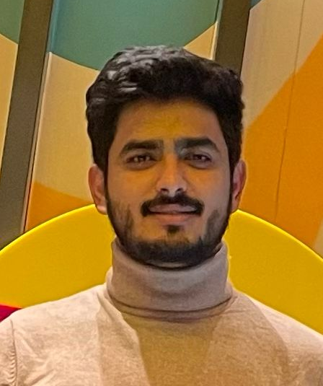
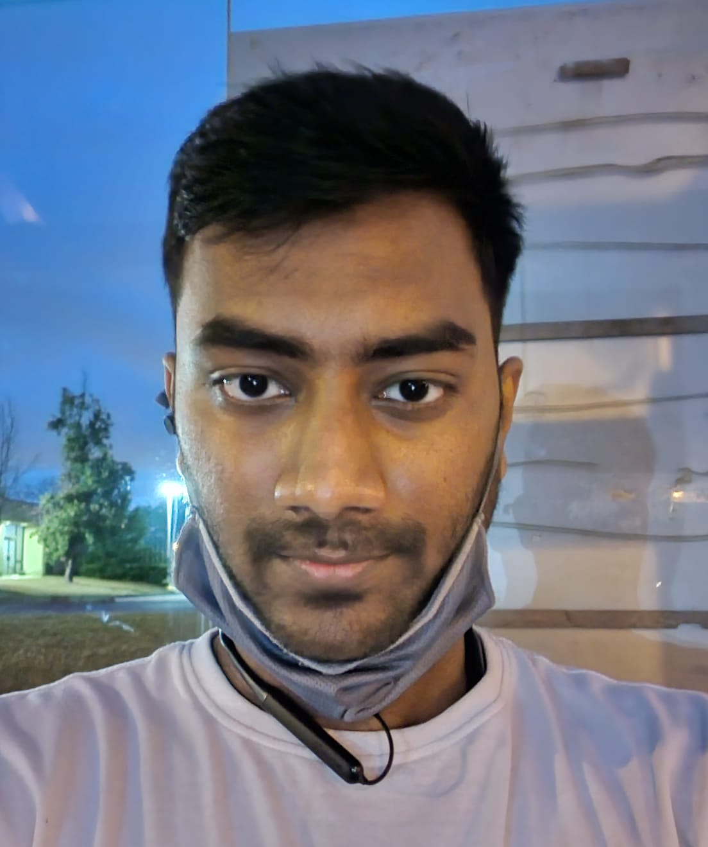
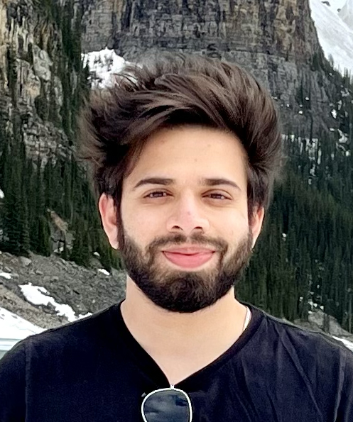
Calculator App
Murtuza Haider Naqvi
301289355
Dhanush Sriram
301299251
Mobile Application Development
iOS Development – MAPD714 F22
Group 25
Asem Javed Syed
301274803

