Slide 1
Cell Composition Analysis using Deep Learning
May 2018
Chair for Biological Imaging
Dr. Pouyan Mohajerani

Slide 2
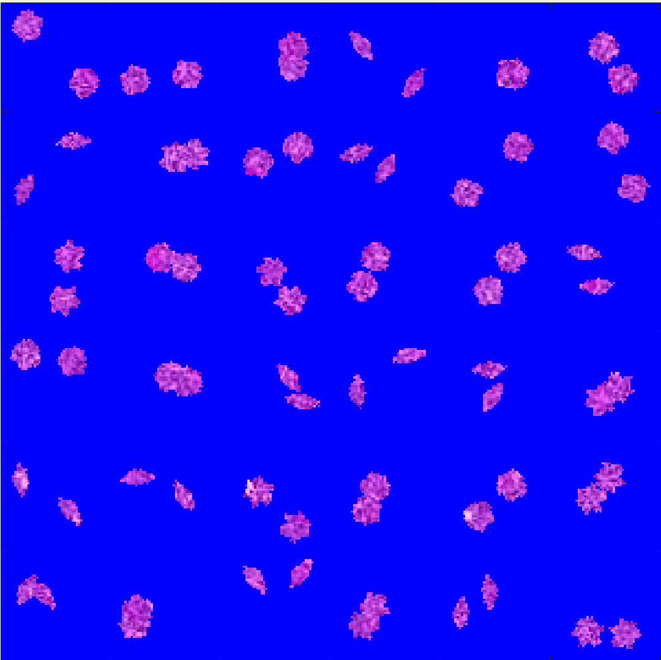
What problem are we going to solve
Given an image determine the % composition

Slide 3
Some “traditional” solutions
A conventional image problem solution might look like this:
Segment the image (get the pink parts)
Get the boundaries of a segment
Find out which type does the boundary match
The problem with this approach:
What if we have overlapping cells?
Can get complicated with noise
Needs a lot of programming and hand design

Slide 4
Enter (supervised) Machine Learning
What is machine learning?
The machine (the computer) is told that some entities relate to each other:
Sample cell image ←→ cell label
The machine then finds out “how” they relate
It uses a learning algorithm for that
Examples: NN, SVM, etc.

Slide 5
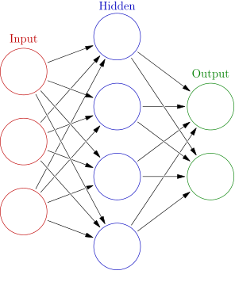
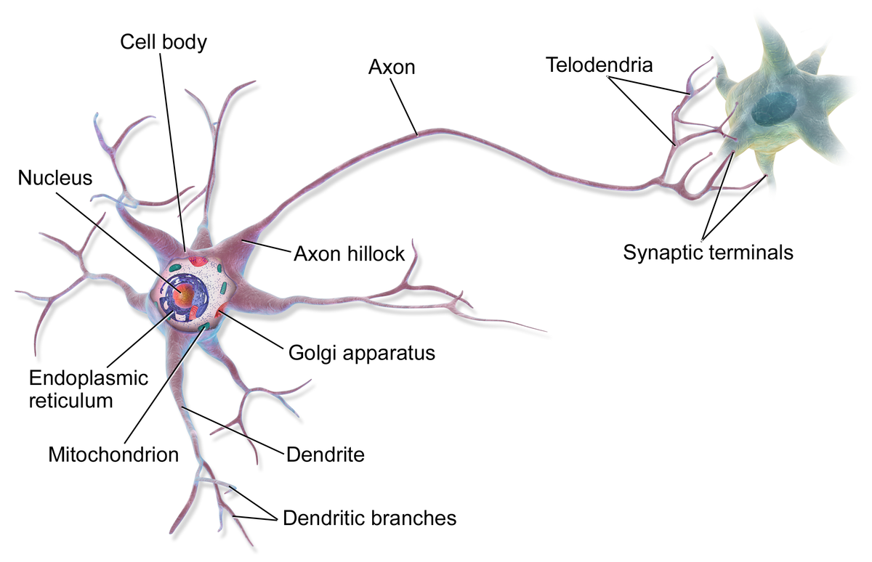
What are neural networks?
Neural networks immitate the nervous slide
They keep mixing input in different non-linear ways until the desired output is achieved.

Slide 6
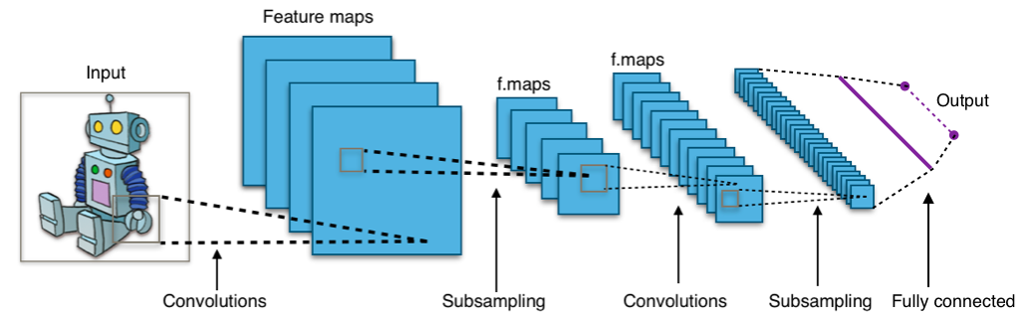
Deep Learning applied to our problem
Deep learning is a special learning method
We are specifically interested in CNNs
Convolution neural networks
Very popular for image classification
By Aphex34 - Own work, CC BY-SA 4.0, https://commons.wikimedia.org/w/index.php?curid=45679374

Slide 7
Where to start?
You need
the neural network toolbox in MATLAB 2018
You will get
Labelled training data
The final task is
To create a MATLAB program that gets an composite image and determines the composition (in %)
The first step:
Create a neural network that classifies the labeled data.

Slide 8
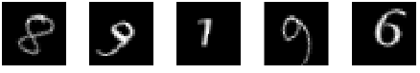
How can I get started with the first task?
Read MATLAB’s tutorial on CNNs:
https://de.mathworks.com/help/nnet/examples/create-simple-deep-learning-network-for-classification.html
This tutorial shows you how to solve the classification problem for digit images (MNIST dataset)

