Slide 1

IV Drip Level Monitoring System
Akshata Nalavade 21104003
Manjiri Gole 21104006
Shweta Bhutada 21104007
Vedanti Nandvikar 21104024

Slide 2
Contents
Introduction
Problem Statement
Objectives
Scope
State Diagram/Workflow
Circuit Diagram
Hardware and Software Requirement
Project Timeline
Conclusion
References

Slide 3
1. Introduction
Problem Identified :
Traditionally, nurses would need to physically check each saline bag to see how much fluid is left. This is highly time-consuming, with many patients requiring intravenous (IV) treatments.
A nurse might misjudge the amount of saline left or forget to check a bag in a timely manner, leading to errors in patient care.
Solution Proposed :
Integrating an ultrasonic sensor which is attached to the saline bag to constantly checks the level of the saline solution. When the saline reaches a low level, the system sends out message which gets displayed on LCD and triggers a buzzer to notify the nurses.

Slide 4
2.Problem Statement
Whenever there is a saline dripping, there is a need for a person to monitor the glucose level and the glucose flow rate may be at regular intervals of time. The concerned patient should be in careful observation.
The manual monitoring of saline levels in intravenous (IV) fluid bags poses significant challenges, including time-consuming tasks for healthcare staff, the risk of treatment interruptions, potential errors in fluid management, increased workload in hospital operations.
Therefore, by leveraging ultrasonic sensor technology for saline level monitoring, hospitals can significantly improve operational efficiency, enhance patient care.

Slide 5
3. Objectives
To utilize ultrasonic sensors for continuous monitoring of saline levels, ensuring uninterrupted fluid therapy and preventing treatment complications.
To achieve precise measurement of IV fluid levels using ultrasonic technology, enhancing the reliability of fluid therapy and reducing the risk of errors.
To enables nurses to deliver timely and precise interventions based on accurate data.

Slide 6
4. Scope
Can integrate timely alerts which helps in preventing complications associated with empty IV bags. This directly contributes to improved patient safety and care quality.
Can implement data logging of the system to log data regarding saline usage and alert history for each patient.

Slide 7
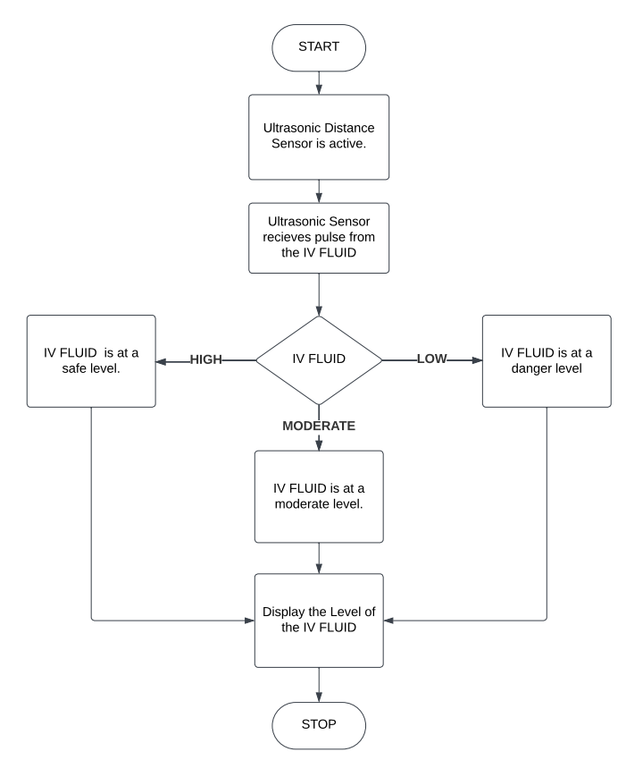
5. State Diagram/Workflow
Buzzer buzzes to send alerts

Slide 8
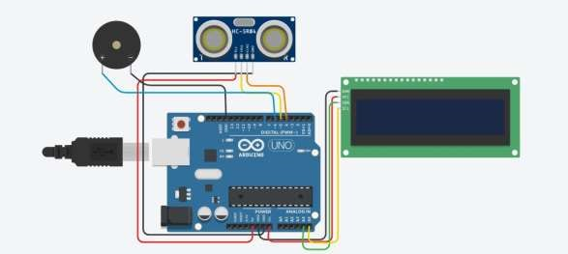

6. Circuit Diagram

Slide 9
7. Hardware and Software Requirement
HARDWARE USED | SOFTWARE USED
1. Arduino board (e.g., Arduino Uno) | 1. Arduino IDE
2. HC-SR04 Ultrasonic Sensor | 2. Required Arduino library
3. I2C LCD Display (e.g., 16x2 characters)
4. Jumper wires
5. Laptop

Slide 10
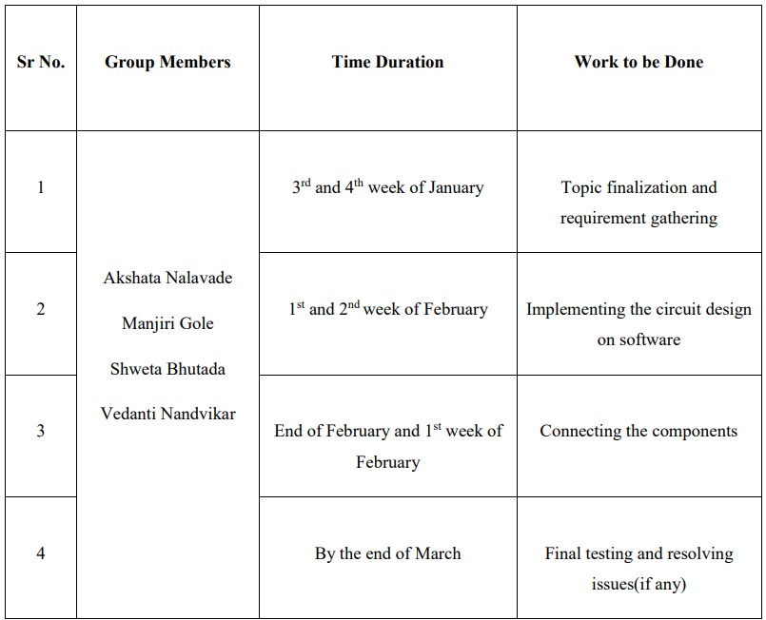
8. Project Timeline

Slide 11
9. Conclusion
In summary, the saline drip monitoring system with ultrasonic sensors stands as a transformative tool in healthcare, promising to enhance patient care, streamline staff workflows, and usher in a new era of efficiency and safety in IV therapy management.
It offers broad benefits for patients, healthcare providers, and the overall healthcare industry.

Slide 12
10. References
Vidyadhar V. Kamble, Prem C. Pandey, Chandrashekar P. Gadgil, and Dinesh S. Choudhary “Monitoring of Intravenous Drip Rate” ICBME, Dec 21-24, 2001
Sri Mathi V , Suganya MB , Sandhiya K , Nivetha D Assistant Professor Myilsamy G “Intravenous Drip Monitoring System Using IOT” International Journal of Advances in Engineering and Management (IJAEM) Apr. 2021
Sumalatha Bandari, Gauri Deshmukh, Pooja Pawar, Rutuja Yadav, Komal Jagadale, Dipti Chavan “IV Drip Monitoring and Control System” IJRASET44635 June

Slide 13
Thank You...!!

