Slide 1
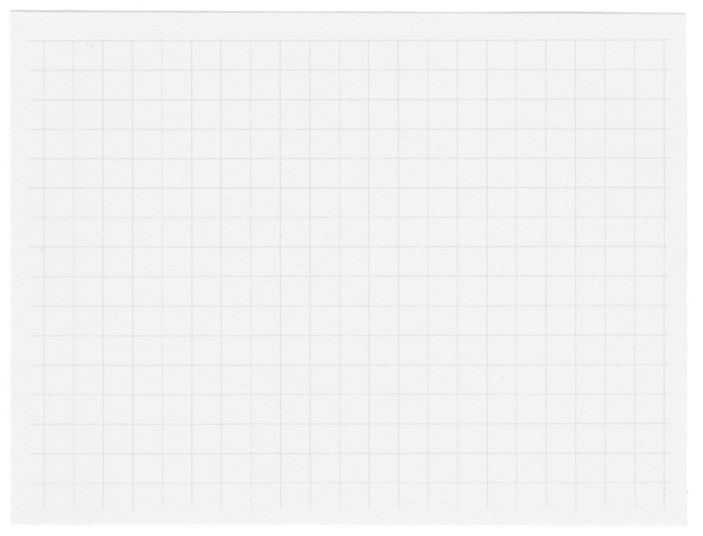
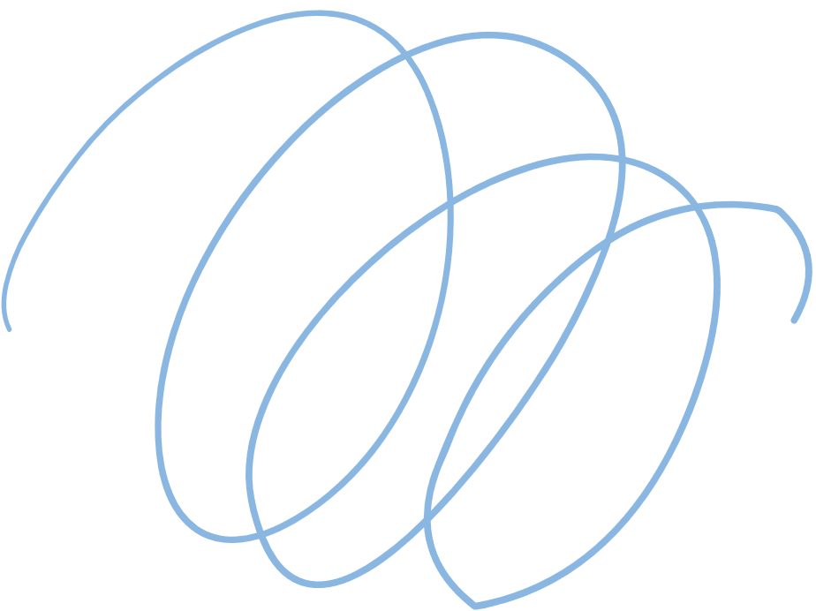
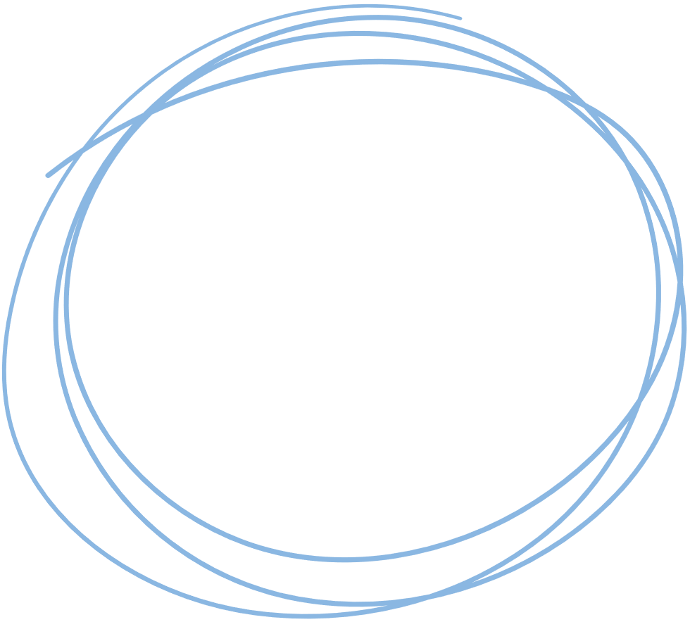

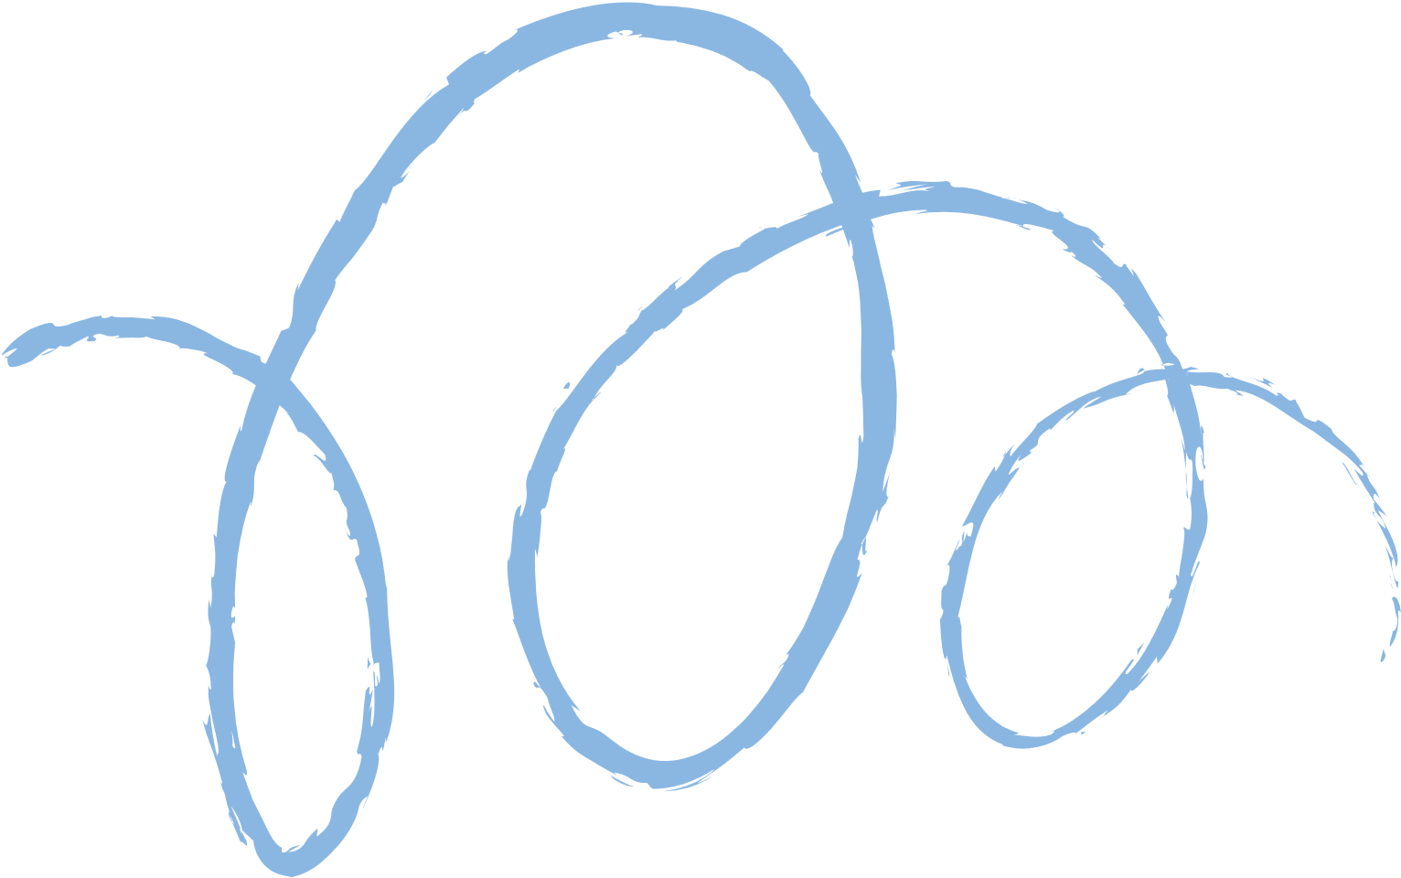









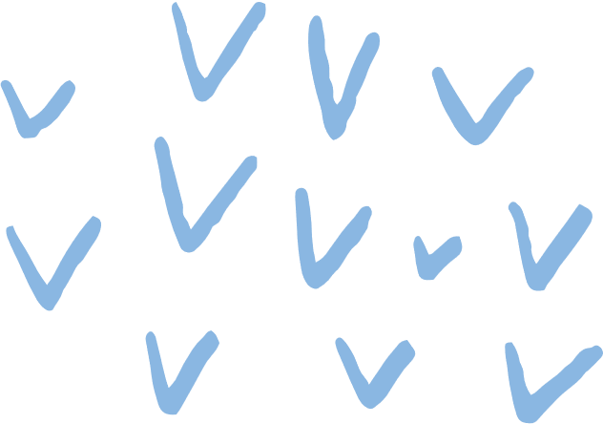
Player rating prediction

Slide 2

Overview of scribble game
Scrabble is a classic word game where players take turns placing letter tiles on a square board to form words. Each letter has a specific point value, and players score points based on the words they create and the premium squares they occupy, such as double or triple letter and word scores.
The objective of Scrabble is to accumulate the highest score by the end of the game. Players must strategically manage their tiles, consider potential words, and block opponents from scoring high by utilizing the board’s premium squares.

Slide 3
Project objective
This project involves predicting the ratings of Scrabble players on Woogles.io based on gameplay data. The main goal is to use metadata and gameplay information to predict the ratings of human opponents in the test dataset (test.csv) using a machine learning model. The evaluation metric for this prediction is Root Mean Squared Error (RMSE).

Slide 4
Ideation process
Data Preparation
Model Definition
Model Evaluation
Model Prediction
To identify the best-performing model, I implemented cross-validation, which divides the training data into smaller subsets for multiple training and testing iterations.
After evaluating the models, I chose the Random Forest Regressor as the best-performing model based on its evaluation metrics. .
We prepared data and divided into train and test sets ready to use.
We defined a set of regression models for predicting user ratings.

Slide 5

Data preparation
The dataset was divided into training and testing subsets. The training set (train_df) was created by filtering out entries where the user_rating was available, while the testing set (test_df) comprised entries where the user_rating was missing. The indices of both data frames were reset for clean organization:

Slide 6

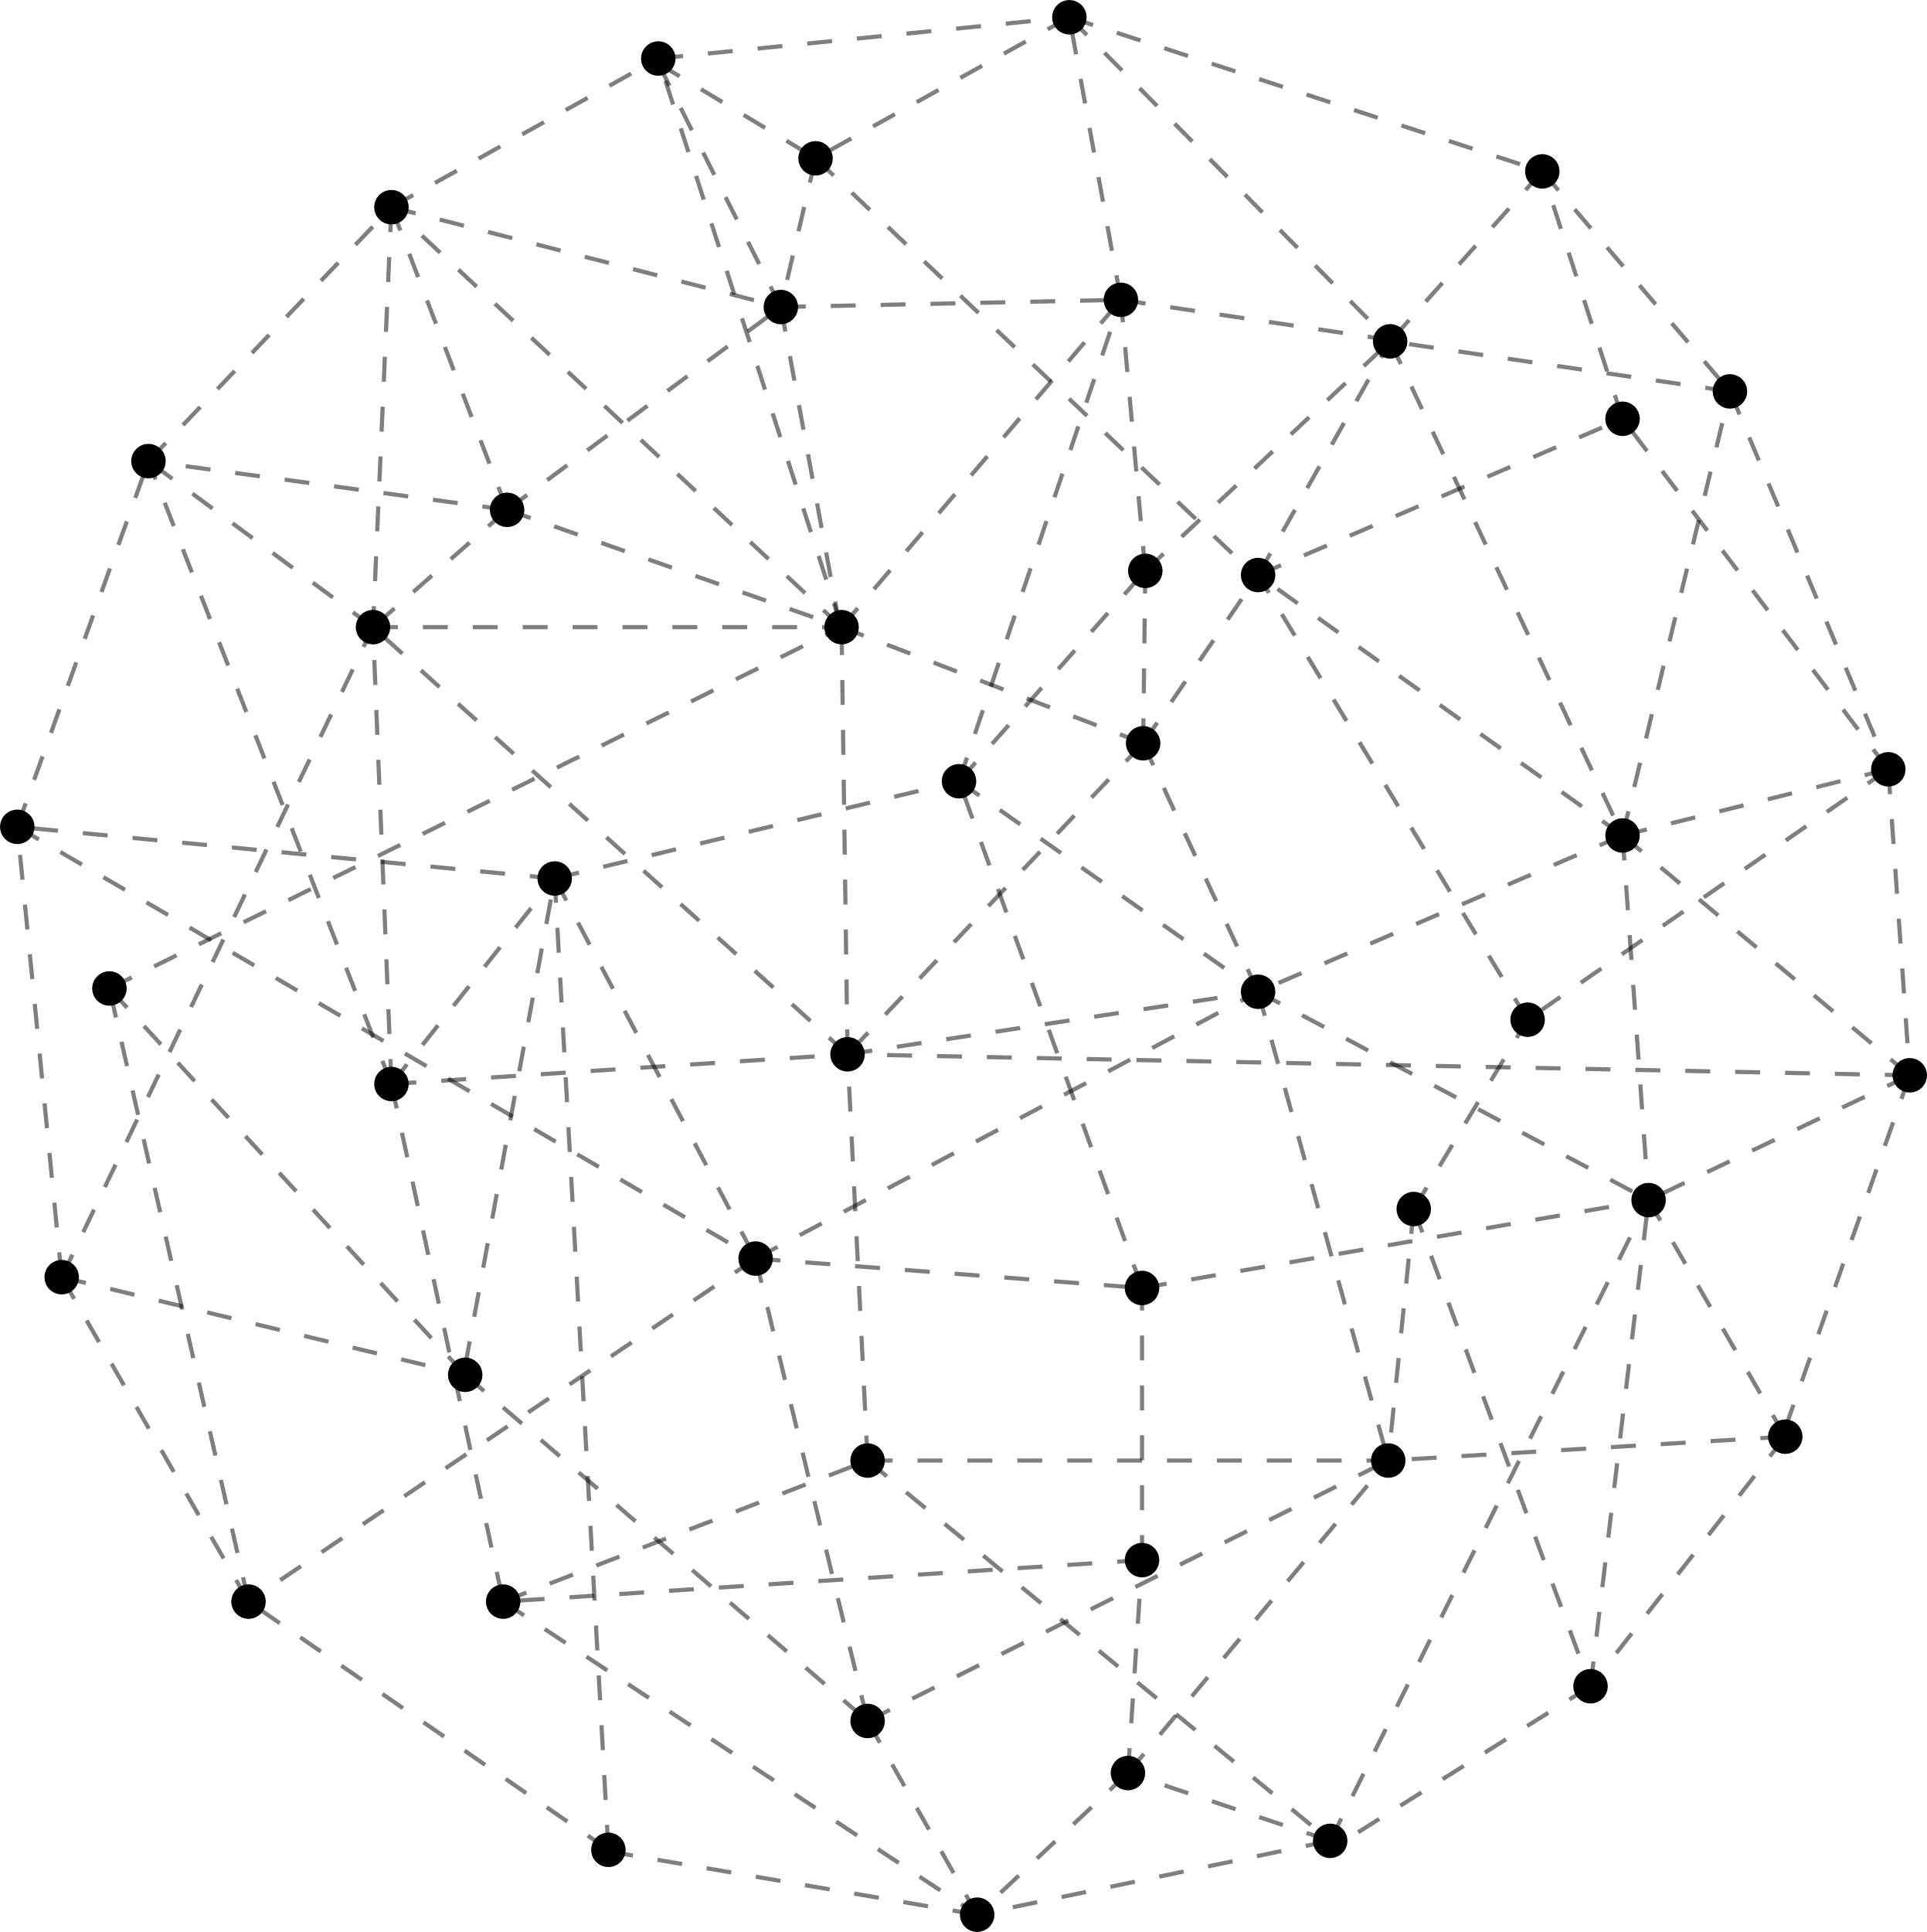
Model Definition
We defined a set of regression models for predicting user ratings. The selected models included:
Linear Regression
Decision Tree Regressor
Random Forest Regressor
Neural Network Regressor (MLP)
XGBoost
KN-Regressor
This variety of models allows for comparison across different algorithms to identify the best performer for our specific dataset.

Slide 7


Model Evaluation
To determine which model performs best, I created an evaluation process using cross-validation. This method splits the training data into smaller subsets, allowing each model to be trained and tested multiple times on different parts of the data. During this evaluation, we calculated three important metrics:
R² Score: This measures how well the model explains the variability of the ratings.
RMSE: This tells us the average difference between predicted ratings and actual ratings, with lower values indicating better performance.
MAE: This measures the average magnitude of the errors in predictions, providing a straightforward interpretation of accuracy.
MAPE: MAPE measures the accuracy of a forecasting method by calculating the percentage error between predicted and actual values.

Slide 8
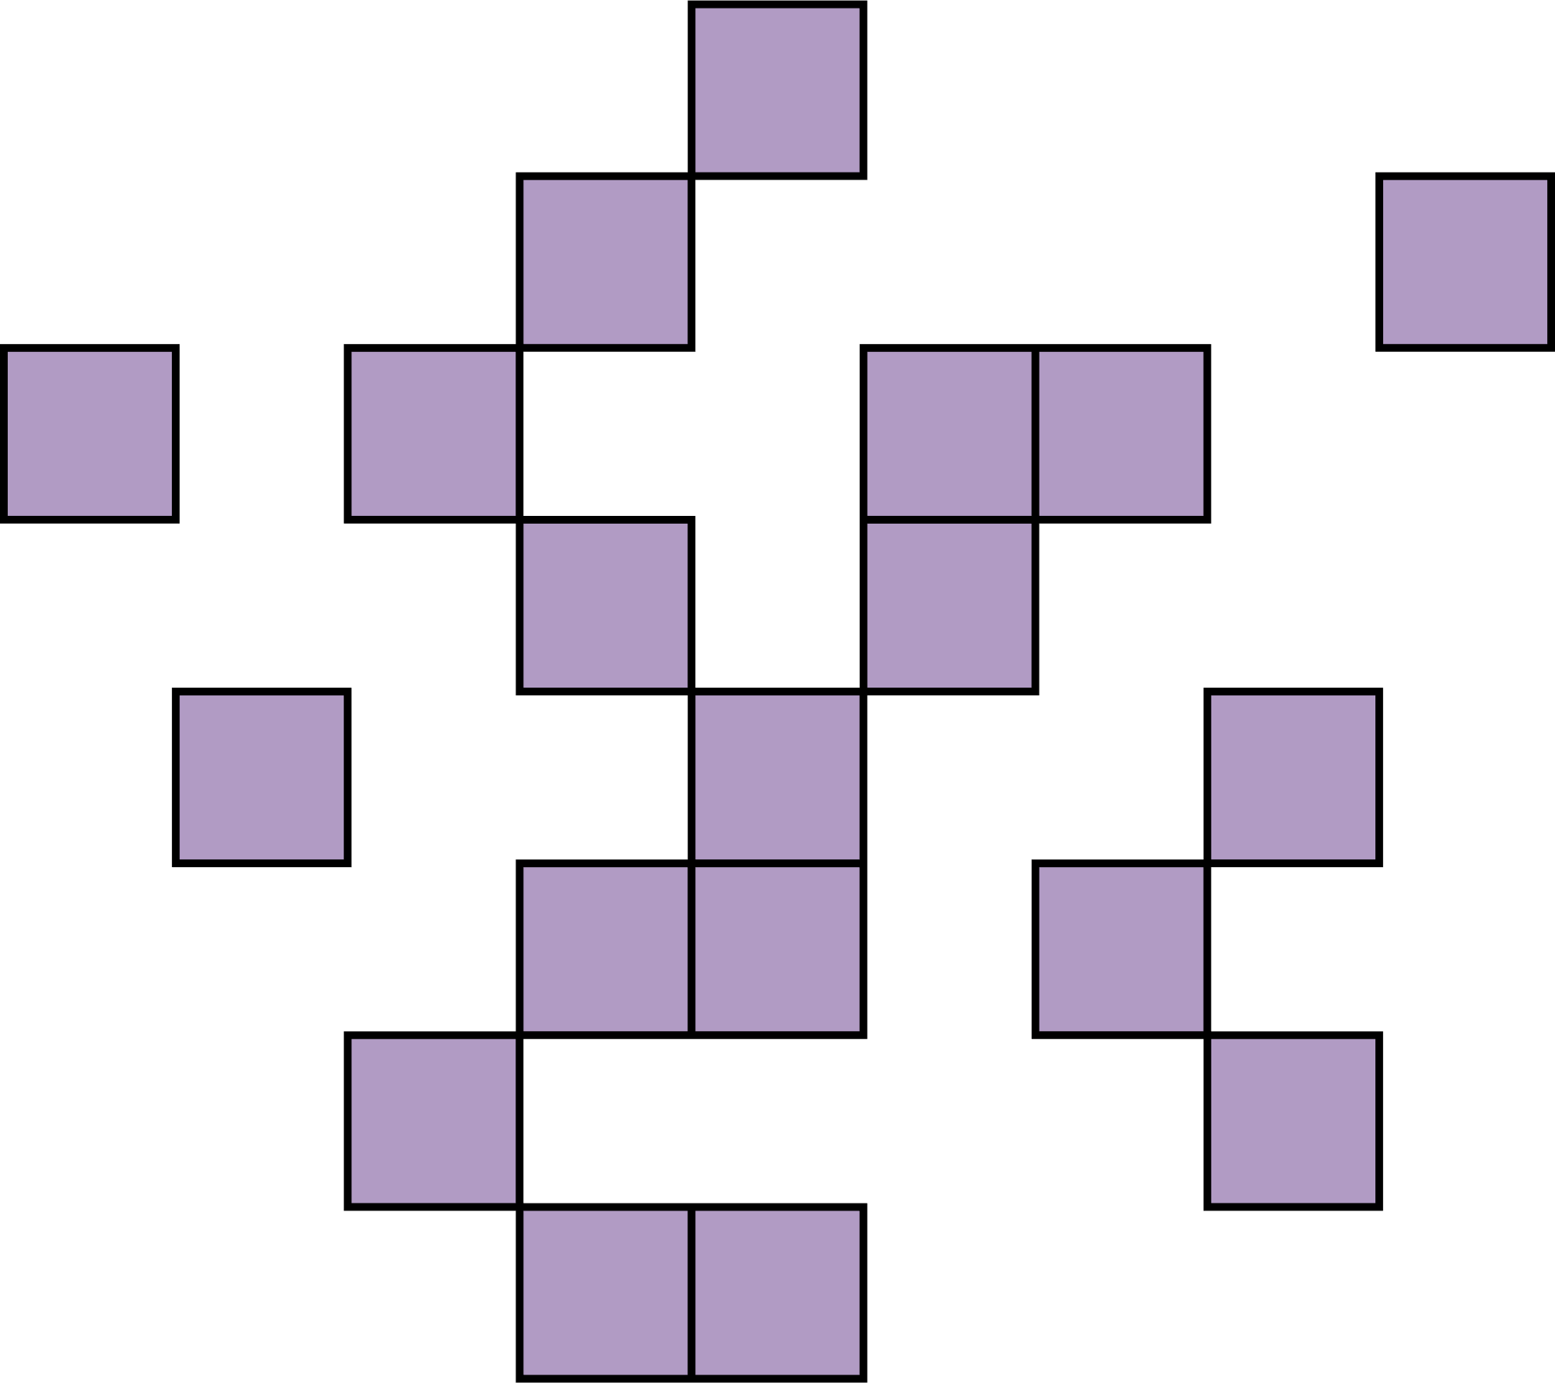
Model prediction
After evaluating the models, we chose the Random Forest Regressor as the best-performing model based on its evaluation metrics. . The model was trained on the X_train features and y_train ratings:
Using the trained model, we made predictions for the test_df, specifically populating the user_rating field for entries without an existing rating:
Model | R2 | RMSE | MAE
random_forest_regressor | 0.8399 | 91.8726 | 56.0584
decision_tree_regressor | 0.6708 | 131.6862 | 73.6955
linear_regression | 0.5569 | 152.8632 | 113.6215
neural_network_regressor | -0.6332 | 285.2400 | 232.1575

Slide 9
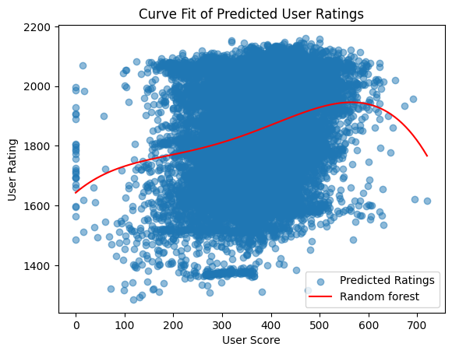
Final Model
Prediction
After evaluating the models, we chose the Random Forest Regressor as the best-performing model based on its evaluation metrics.Using the trained model, I made predictions for the test_df, specifically populating the user_rating field for entries without an existing rating

Slide 10
Thank you

