Slide 1
HACKATHON 2026 · INCLUSIVE EDUCATION · SDG 4
Education is available.
Learning isn't.
A child who learns by seeing is handed a wall of text.
A child who loses focus after 90 seconds is given a 40-minute lecture.
The content was “available” to both. Neither of them learned.
Pragya
Learners with disabilities are 2.5× more likely to never attend school.
Empowering Every Mind
UNESCO
Notes:
(35s) Good morning. I want to start with two children.
The first learns by seeing — we hand him a wall of text.
The second loses focus after ninety seconds — we give her a forty-minute lecture.
Here's the uncomfortable part: for both of those children, the content WAS available.
Captions existed. A PDF existed. And neither of them actually learned.
UNESCO tells us learners with disabilities are two and a half times more likely to never attend school —
but the ones who DO make it into the classroom are often still excluded, just more quietly.
That's the gap we built Pragya for.

Slide 2
THE INSIGHT
Accessibility is not the same as adaptability.
The industry solved “can the learner reach the content?” The unsolved half is “did the content reach the learner?”
TODAY'S PLATFORMS
PRAGYA
Content
Content
One fixed format
Teacher's existing PDF
+ Accessibility layer
+ Learner profile
Captions · transcript · TTS
How this student actually engages
Same path for everyone
Path adapts, continuously
The learner adapts to the platform
The platform adapts to the learner
Coursera, Khan Academy and screen readers already solved accessibility well. We are not rebuilding that — we start where it stops.
Notes:
(40s) Here's our core insight, and it's the whole pitch in one line:
accessibility is not the same as adaptability.
Coursera, Khan Academy, screen readers, captions — they solved a genuinely hard problem:
CAN the learner reach the content. They did it well, and we're not rebuilding it.
But look at the left column. Even with a perfect accessibility layer,
every learner still walks the same path, in the same format, at the same pace.
The learner is expected to adapt to the platform.
We flip the arrow. Same content — but the path itself changes based on how that specific
student actually engages. That's the half nobody has automated.

Slide 3
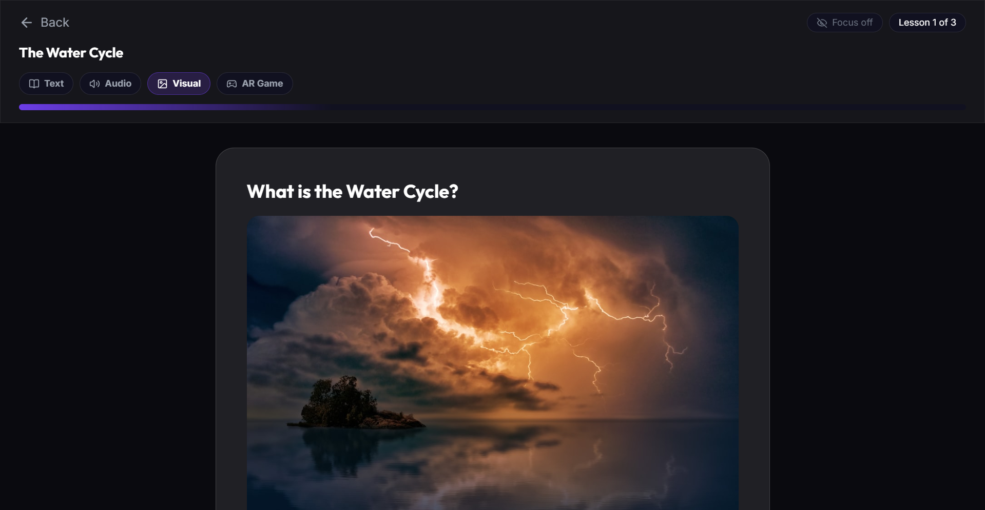
THE SOLUTION
Meet Pragya
An adaptive inclusive learning layer that turns a teacher's existing curriculum into a multimodal experience — and reshapes it around each learner.
Works on content teachers already have
Four ways to learn the same lesson
Adapts from what the learner actually does
Not another course library.
A layer that sits on top of the ones you already use.
Live product — one lesson, four modes, learner-selectable
Notes:
(40s) So this is Pragya — and the name means wisdom.
One sentence: it's an adaptive inclusive learning LAYER that takes the curriculum a teacher
already has, and turns it into a multimodal experience that reshapes itself around each learner.
Three things matter here. It works on content teachers already own — no new library to build.
Every lesson exists in four modes at once. And it adapts from what the learner actually does,
not from a form they filled in.
What you're seeing on the right is not a mockup. That's the running product —
one water-cycle lesson, and those four buttons are Text, Audio, Visual and AR Game.

Slide 4
HOW IT WORKS
One curriculum in. Every way to learn it, out.
1
2
3
4
5
TEACHER
AI ENGINE
MULTIMODAL
LEARNER
SIGNALS
Uploads the
PDF they already use
Reads it end-to-end,
splits into lessons
Text · Audio · Visual
· AR · Questions
Learns in the mode
that works for them
Focus, answers,
mode switches
↺ ADAPTIVE ENGINE — the next lesson is presented differently, and the teacher sees where attention dropped
This loop is the product. Everything above it is plumbing.
The teacher never creates five versions of one lesson. They upload once — generation runs on a background queue,
so by the time a student opens the unit, the text, the pictures, the questions and the AR game are already waiting.
Notes:
(50s) This is the most important slide, so let me walk it left to right.
A teacher uploads the PDF they already teach from. Our engine reads the WHOLE document —
not the first few pages — and splits it into properly sequenced lessons.
Each lesson is then produced in every modality at once: text, narrated audio,
a real image, a knowledge check, and an AR game built from that unit's own questions.
The student learns in whichever mode works for them.
And then the important bit — we collect signals. Which answers they got right,
where their focus dropped, which mode they kept switching back to.
That feeds the adaptive engine, and the next lesson is presented differently.
The loop at the bottom IS the product. Everything above it is plumbing.
And critically — the teacher never hand-builds five versions of one lesson.
They upload once; it's generated in the background before any student arrives.

Slide 5
WHY THIS IS DIFFERENT · WORKING TODAY
The loop is actually closed.
Most “personalised learning” asks the student to pick a preference once. Ours watches whether it is working.
Observe
Adapt live
Carry it forward
The webcam reads face,
eye contact and gaze —
processed by our own
computer-vision service.
If attention drops for long
enough during assessment,
the app switches modality
mid-session, by itself.
The mode that held their
attention becomes the
default when they open
their next lesson.
Low attention is a signal to change how we teach — never a diagnosis of the child.
We do not screen, label, or diagnose any condition. Frames are analysed for engagement and are not stored.
Teacher stays in control: they preview, regenerate, or override anything the AI produces.
Notes:
(50s) This is the slide I'd ask you to remember.
Almost everything marketed as "personalised learning" asks a student to pick a preference once,
in a form, and then never checks whether that choice was right.
Ours observes. We run our own computer-vision service — real face and gaze detection —
and while a student is working, we're reading engagement, not identity.
If their attention drops for a sustained period, the app switches modality mid-session.
It doesn't wait for them to give up and it doesn't wait for a teacher to notice.
And that finding persists: the mode that actually held their attention becomes the default
next time they open a lesson.
Now the ethical line, because you should push me on it — and I'll say it before you do:
low attention tells us to change how WE teach. It is never a diagnosis of the child.
We don't screen for autism or any condition. We analyse frames for engagement; we don't store them.

Slide 6
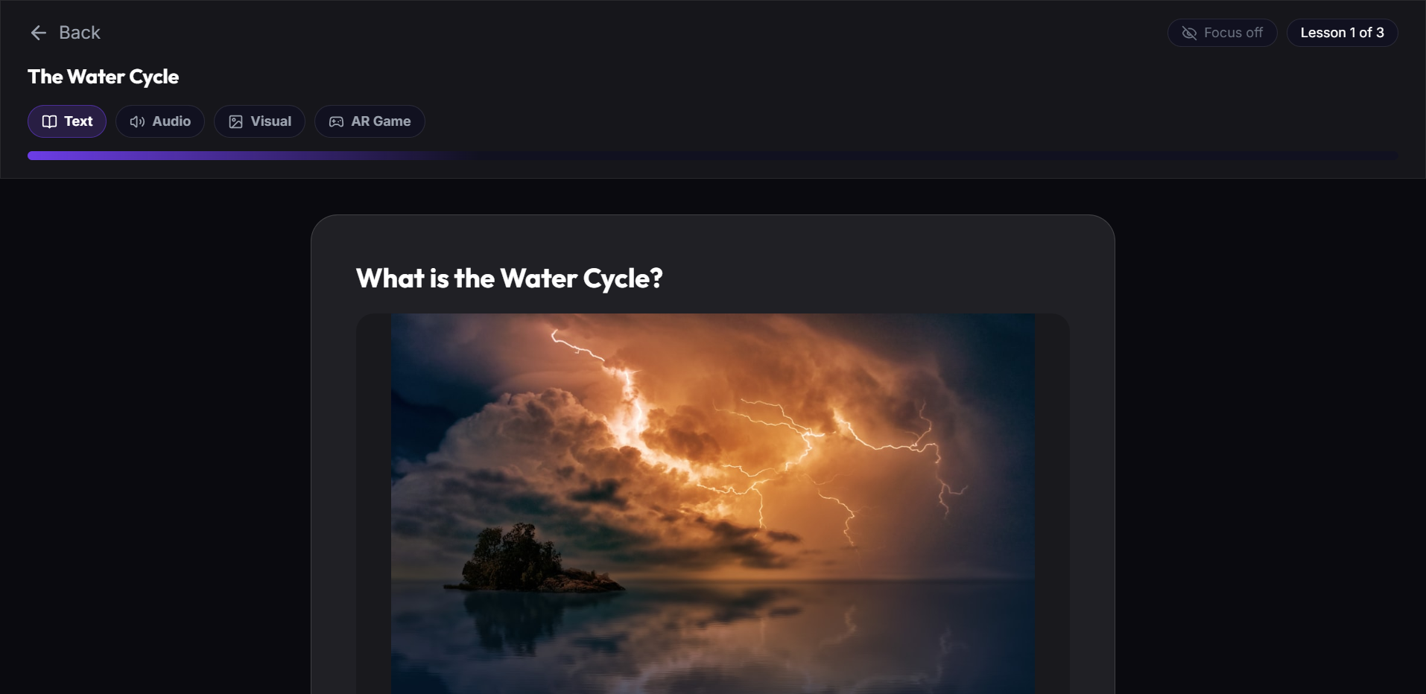
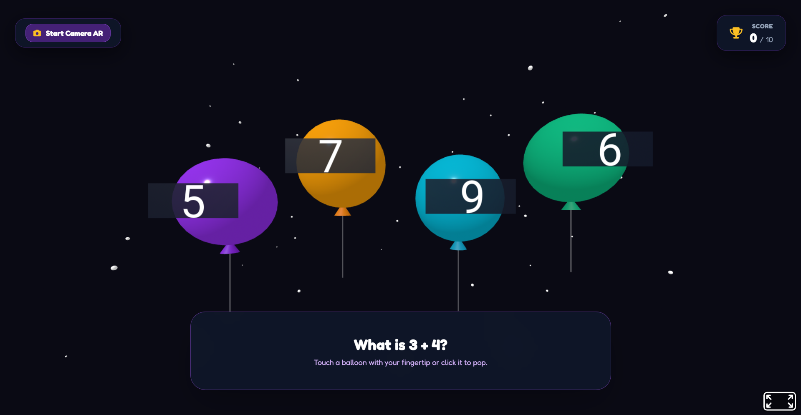
LIVE PRODUCT
The same lesson. Four genuinely different experiences.
TEXT · read at your pace
VISUAL · image-led, larger type
AR GAME · pop the right answer
AUDIO mode auto-narrates each lesson. AR mode is built from that unit's own questions — no extra AI cost.
Switching mode never regenerates content or loses the student's place — they can move freely mid-lesson.
There is also a second door: any student can read the teacher's original PDF instead, and it remembers their page.
Notes:
(55s) These are three real screens from the running app, same lesson each time.
On the left, text — clean, paced, nothing fighting for attention.
In the middle, visual mode — the picture leads and the type gets larger.
That larger type isn't decoration: if a learner's attention score is low, we simplify automatically.
On the right is the AR game. It's a 3D scene, and a student can pop the balloon with the
correct answer using their fingertip through the camera — or just click, if they can't or don't want to.
The clever part is the AR questions come from that unit's OWN knowledge checks,
so it costs us nothing extra to generate.
Switching modes never regenerates anything and never loses their place —
so a child who's struggling can move to a different format mid-lesson without penalty.
And for a learner who just wants the original document, that door is there too, with page memory.

Slide 7
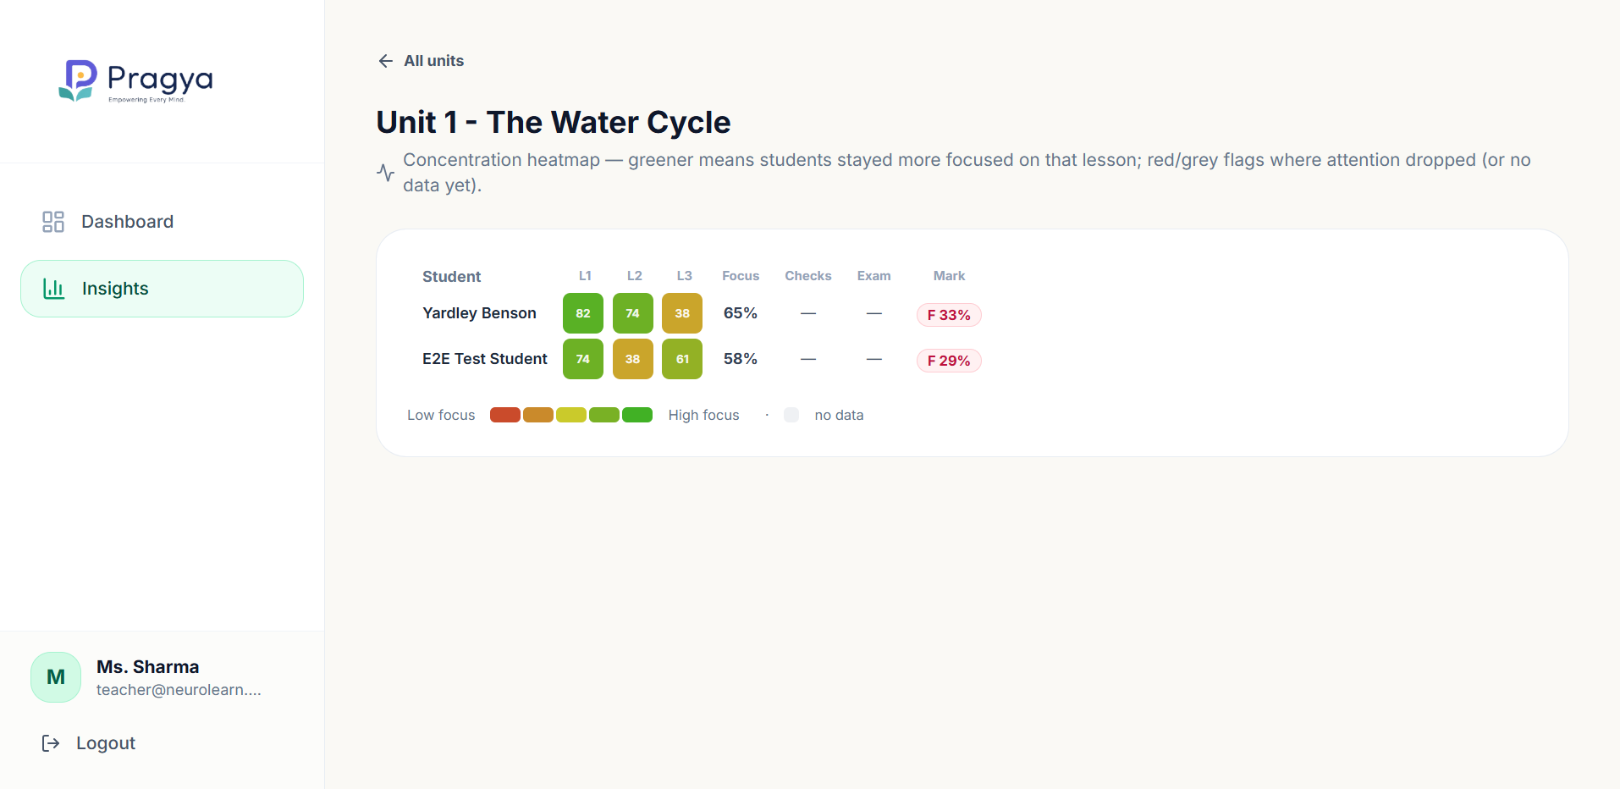
FOR THE TEACHER
One upload. Five formats. And it tells you where you lost the class.
Existing PDF
Full-document
lesson plan
Images +
narration
Knowledge checks
+ final exam
AR game
Generated on a background queue with real progress —
the teacher keeps working while it runs.
Every unit stays under their control: preview it,
regenerate the visuals, or regenerate the whole plan.
THE INSIGHT TEACHERS DON'T GET TODAY
“Lesson 3 lost half the room.”
Not a guess at the end of term — visible the same day, per student, per lesson.
Concentration heatmap — students × lessons
Notes:
(45s) Now the teacher's side, because none of this works if it adds to their workload.
They upload the PDF they already have. From that one file we produce the lesson plan across the
whole document, the images, the narration, the knowledge checks, the final exam and the AR game.
It runs on a background queue with real progress, so they carry on working — and every piece
stays under their control. They can preview it, regenerate just the visuals, or redo the whole plan.
But this is the part teachers tell us they've never had.
That's a concentration heatmap: every student down the side, every lesson across the top.
Green means they stayed with you. That amber 38 means lesson three lost them.
Today a teacher finds that out from exam results at the end of term.
Here they see it the same day — per student, per lesson — while they can still do something about it.

Slide 8
OUR USP
Don't make every learner
adapt to education.
Make education adapt to every learner.
Learner-adaptive
Multimodal by default
Transforms your content
not merely accessible
not one format with add-ons
not another course library
Existing platforms help a learner reach the content.
We help the content reach the learner.
Notes:
(45s) If you forget everything else, keep this.
Don't make every learner adapt to education. Make education adapt to every learner.
Three ways we're different. We're learner-adaptive, not merely accessible —
the experience changes based on evidence, not a checkbox.
We're multimodal by default, not one format with accessibility bolted on afterwards.
And we transform the content a teacher already owns — we are not asking anyone
to abandon Khan Academy or their own materials and move to yet another library.
The one-liner: existing platforms help a learner reach the content.
We help the content reach the learner.

Slide 9
IMPACT · SCALE · SUSTAINABILITY
From one classroom to inclusive-education infrastructure.
PROBLEM
SOLUTION
IMPACT
Learners excluded by
one-size-fits-all delivery —
and teachers without the
hours to fix it themselves.
Adaptive multimodal learning
generated from the curriculum
schools already own.
More learners can access,
stay engaged with, and
finish what they start.
WHO PAYS · B2B / B2G
BUILT FOR NEPAL FIRST
Schools and colleges subscribe per classroom.
NGOs and government inclusive-education programmes deploy at district scale.
Students never pay to reach their own classroom's material.
eSewa payments already integrated.
Runs on modest hardware.
Designed for schools with no
specialist support staff.
SDG 4 — inclusive, equitable quality education. Not by building new schools, but by making the ones that exist reach further.
Notes:
(40s) Quickly on impact and how this survives past the hackathon.
The problem: learners excluded by one-size-fits-all delivery, and teachers who don't have
the hours to fix it by hand. Our solution generates adaptive multimodal learning
from curriculum schools ALREADY own. The impact we're aiming at is completion —
more learners who can access it, stay with it, and actually finish.
On money: it's B2B and B2G. Schools subscribe per classroom;
NGOs and government inclusive-education programmes deploy across a district.
A student never pays to reach their own classroom's material.
And we built this from Nepal, for Nepal first — eSewa is already integrated,
it runs on modest hardware, and it's designed for schools that have no specialist support staff,
which is most of them. That's SDG 4 — not by building new schools,
but by making the ones that already exist reach further.

Slide 10
Education should adapt
to the learner —
not the other way around.
Pragya
One curriculum.
Multiple ways to learn.
A platform that learns how you learn.
Empowering Every Mind
Hackathon 2026 · Inclusive Education · SDG 4
Notes:
(25s) So — three things to take with you.
One: accessibility and adaptability are not the same problem, and only one of them is solved.
Two: we turn a teacher's existing PDF into four ways to learn, without adding to their workload.
Three: the loop is genuinely closed — the system observes, adapts, and shows the teacher
exactly where attention was lost.
Education should adapt to the learner, not the other way around.
That's Pragya. Thank you — happy to take questions.

