Slide 1
Book1
File created on: 29-09-2021 23:57:09

Slide 2
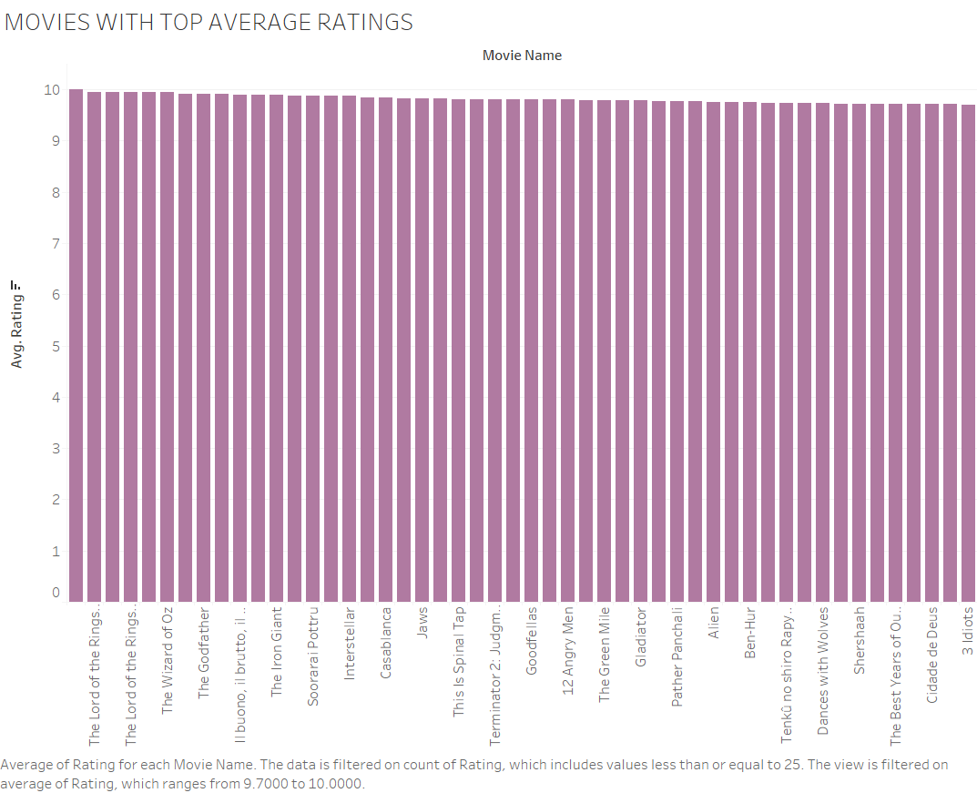

Slide 3
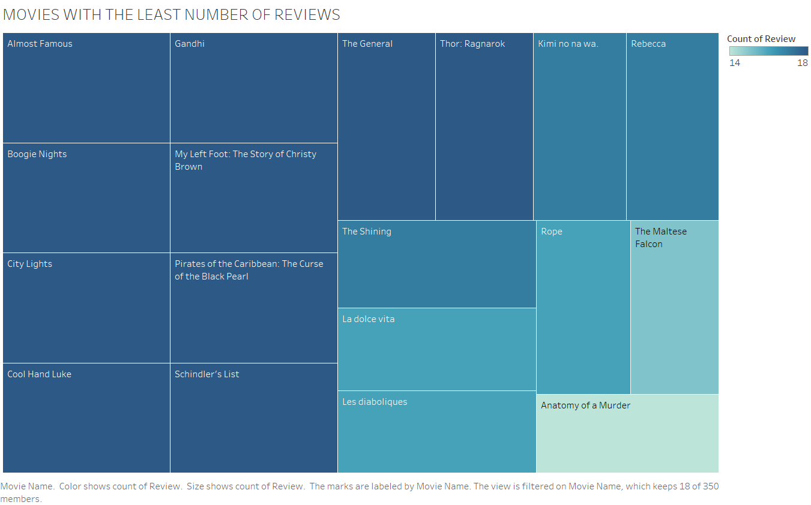

Slide 4
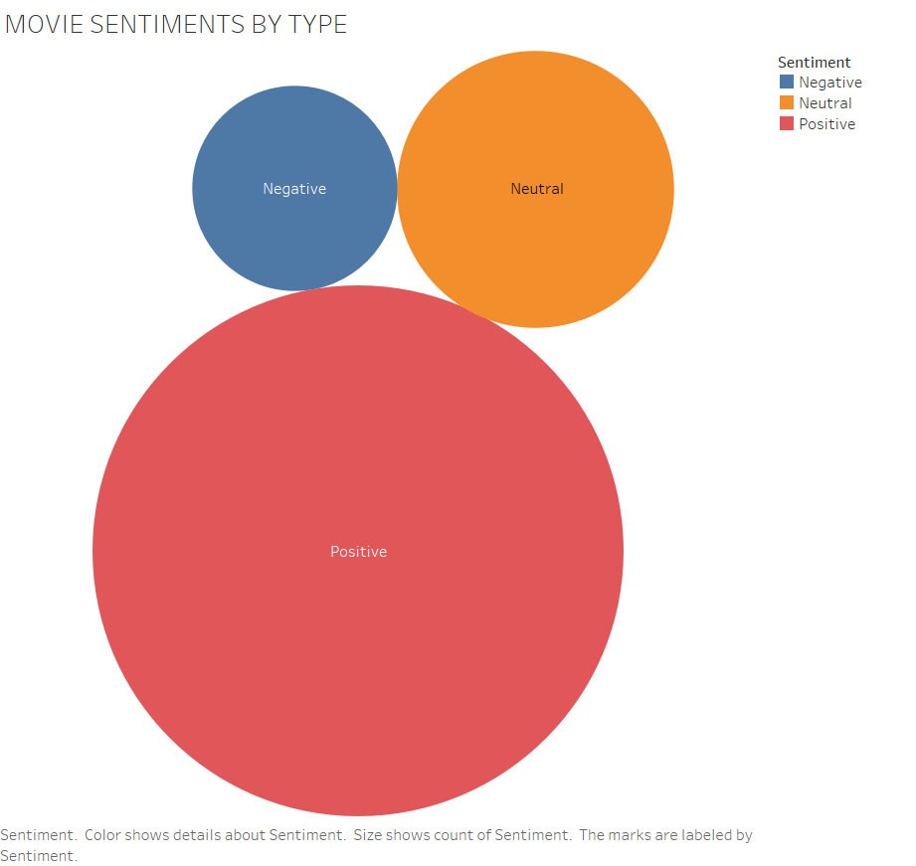

Slide 5


Slide 6
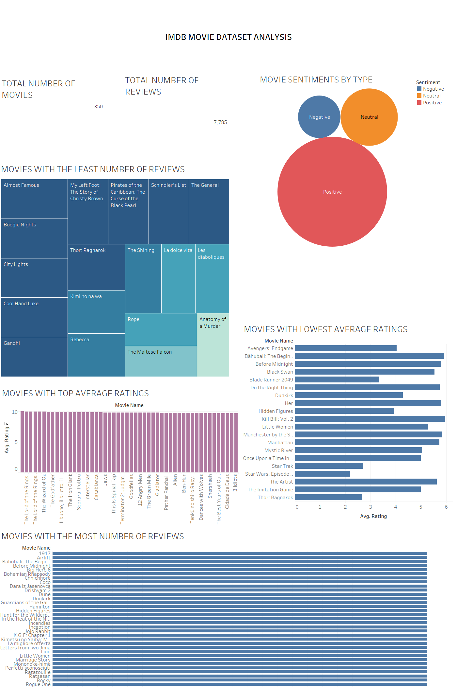

Slide 7


Slide 8
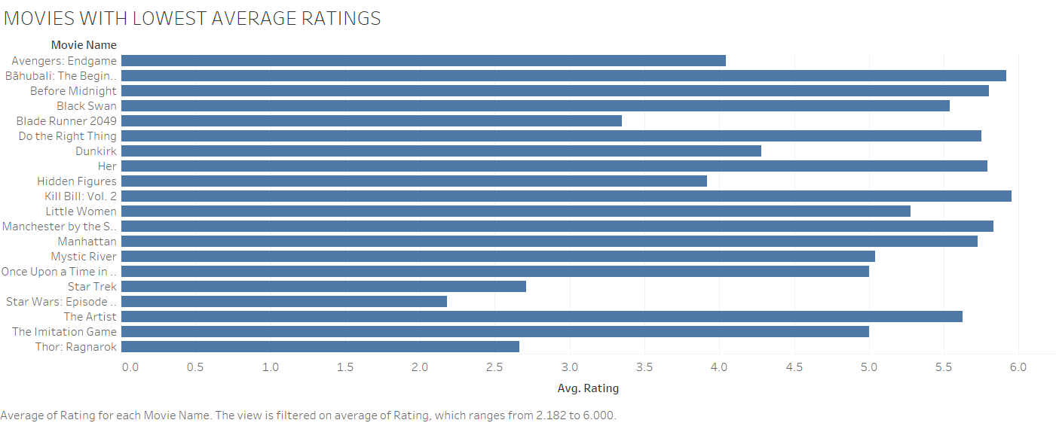

Slide 9
