Slide 1
EggShell Home Builders
Database Migration Overview
Group 2: Aashi Gupta, Gautham Vedam, Yuran Zhu, Yingzhe Jin

Slide 2
Case Description
Background: The company Eggshell is a local home builder who mainly builds midsize subdivision style houses. To make current paperwork more manageable, The owner wants to migrate this paperwork to a computer system
Subdivision, Lot and Styles: Each subdivision is divided into lots, each lot has a specific house style already assigned to a subdivision. Buyers select lot and house, and to have some variety, buyers can choose the elevation type for their house, each with a slightly different exterior.
Buyer Options and Construction Stages: To minimize costs, the builder provides a limited number of options from which the buyers can choose. The options are divided by categories like Electrical, Interior design, etc. The construction process is divided into 7 stages, but the buyer is only aware of 3 stages. Choices have different costs based on when the choices are made.
Legal Agreement and Sales: The initial sale of the house involves buyers writing a check for the escrow amount, with details of house and lot being recorded. There is a time limit of one year from signing the contract before which the house construction must be completed.

Slide 3
Business Rules
1. House Related
One subdivision has three or four styles of houses. Each style has a variety of elevations for buyers to choose from.
Different styles will have different room designs. A specific house is assigned to one unique lot.
2. Option Related
There are totally 3 options categories: electrical, plumbing, and interior. Each option is corresponding to one specific category.
Each option can be made at different stages, but only applicable to stage 1, 4 and 7.
For different stages, the cost of one option will vary, additional costs will be added as the stage moves award.
3. Construction Progress Related
Construction Progress related tables are to provide information to buyers for checking houses remotely.
Each lot generates several construction progresses/stages. Each stage includes tasks with separate est. completion time.
The overall estimated completion time is the estimated completion time of the latest task.
4. Sale Related
Buyers pay a check for the escrow amount and then sales records are generated.
Buyers can cancel the contract if the houses are not completed within one year after signing contracts.
Sales are typically made before the house construction is finished.
The estimated completion date is always up-to-date and will be the proof of whether this contract can be canceled or not.

Slide 4
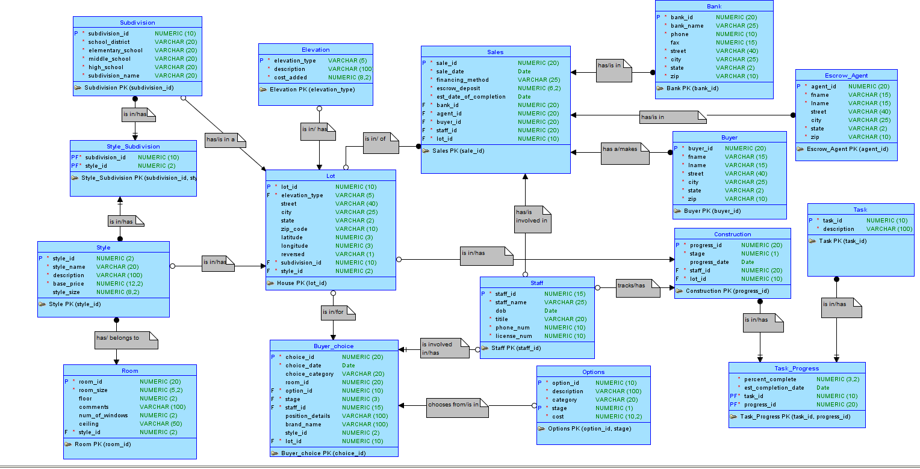
Logical Model (Entity Relationship Diagram)

Slide 5
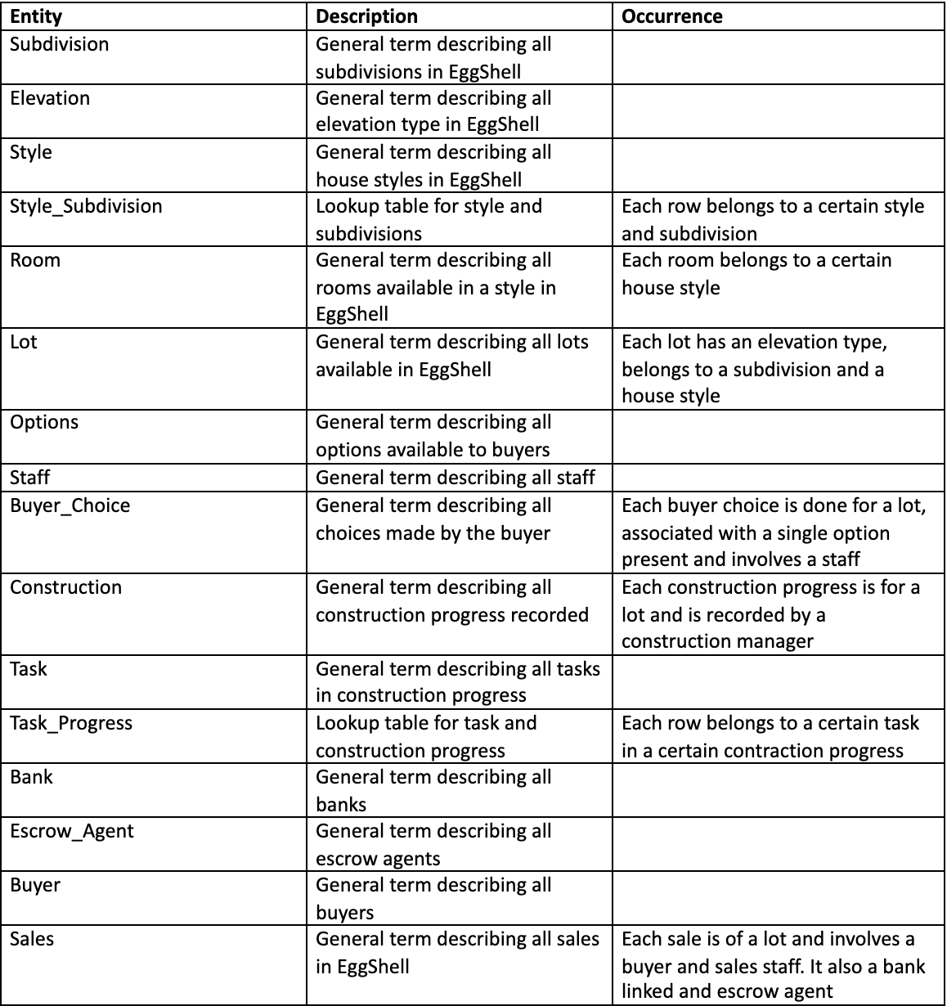
Description of the entities
We have identified 16 logical entities in our model.
Two of them are lookup tables.
In the snapshot , we have a description of each entity along with its occurrence.

Slide 6
Functionalities
Sequences(6)
subdivition_seq, room_seq, choice_seq, sales_seq, staff_seq, buyer_seq
Views(2)
sales_view, staff_view
Procedures(4)
display_house_style, construction_progres, sale_contrac, check_cancel
Functions(2)
calc_pct, if_can_cancel
Package(1)
house_details
Database Triggers(2)
print_option_change, staff_deleting
Index(2)
index_sale_date, index_lot_sub_style

Slide 7
Functionalities (Cont.)
With our designs for triggers and procedures/functions/package, the database will return useful messages in important business scenarios.
1. When user want to change the stage for option(s):
Return the change and display the cost that user should pay more/could save
SQL> UPDATE buyer_choice
2 SET stage = 7
3 WHERE choice_id = 1;
Old option: option 1027 at stage 4
New option: option 1027 at stage 7
The buyer should pay $225 more for changing the option.
2. When staff leaves Eggshell:
Return all related constructions, sales and choices that the staff used to be responsible for
SQL> DELETE FROM staff
2 WHERE staff_id = 1;
The deleting staff has follow buyer_choice job:
CHOICE ID CHOICE DATE LOT ID
1 26-MAY-20 1
2 02-MAY-19 1
3 02-OCT-20 2
The deleting staff has follow sales job:
SALES ID SALES DATE LOT ID
1 24-MAY-19 1
2 24-JAN-19 2
The deleting staff has follow construction job:
PROGRESS ID STAGE HOUSE ID

Slide 8
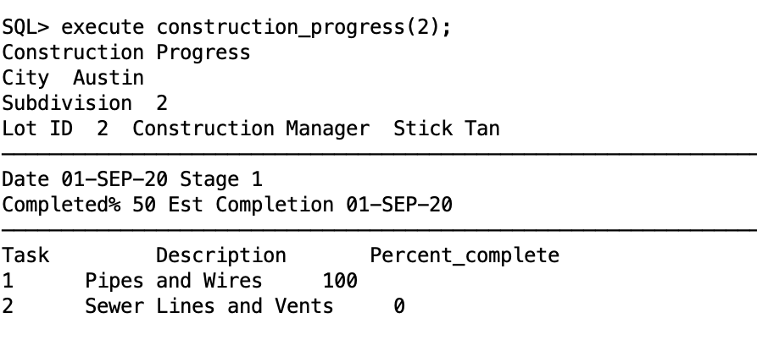
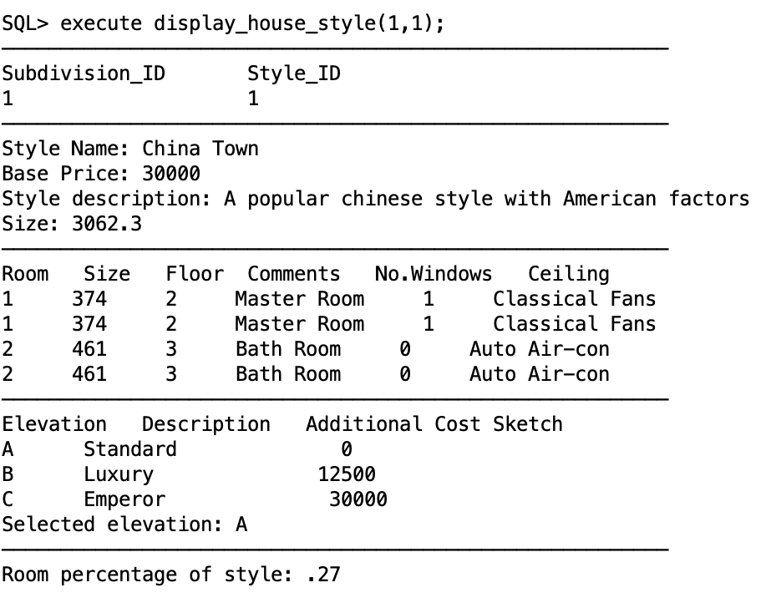
Functionalities (Cont.)
3. Display house details
Execute display_house_style(subdivision_id, style_id);
4. Display a construction progress
Execute construction_progress(progress_id);

Slide 9
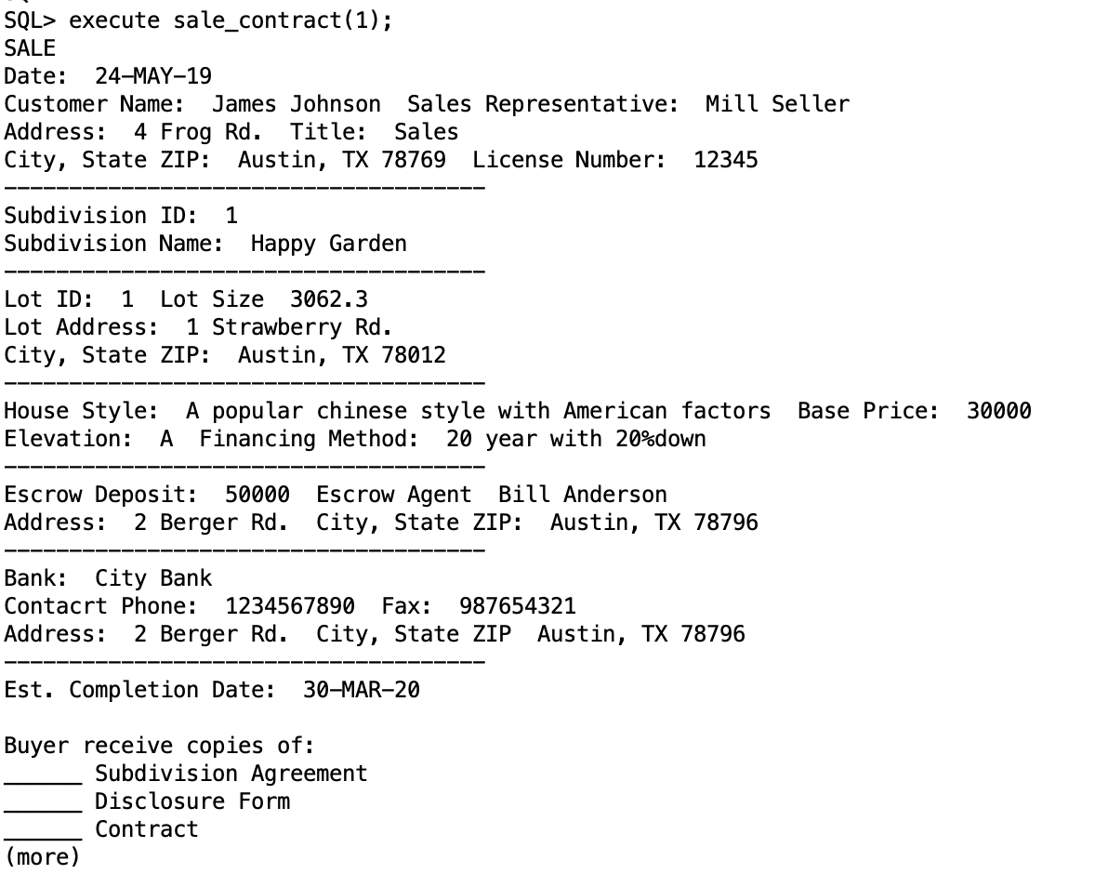
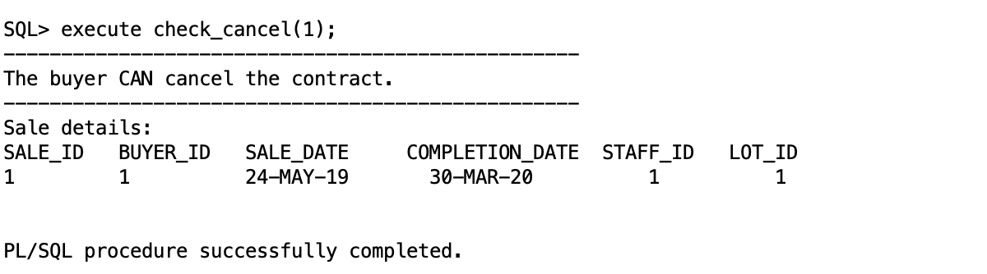
Functionalities (Cont.)
5. To determine whether a buyer can cancel the contract or not
Execute check_cancel(sale_id);
6. Display the information of a sale record
Execute sale_contract(sale_id);

Slide 10
Roles & Scheduled Job
1. Roles
The two roles created for this project are: Lot_Buyer and Sales_Staff.
Lot_Buyer is a role given to the buyer who has only select access on the following tables: Lot, Subdivision, Options and Room.
Sales_Staff, the second role, is related to the tasks that a Sales staff performs, in this case the role has select, insert, update and delete privileges over the following tables: Sales, Buyer_choice and Options.
2. Scheduled Job
In the Eggshell builders case, The corporation wants to keep track of latest construction progress like overall process and estimated time of completion to directly update the buyers via website.
In order to have the latest updates available periodically, we have scheduled an oracle called View_Construction_Progress. This job displays the latest updates within the last 15 days from the Construction table and displays it. Currently the frequency of this job is set to a minute, but in a real world scenario, this will be run every week, to view latest updates.

Slide 11
De-normalization Instance
There is a frequent search which needs a join between lot and style.
Since a lot is tailored to a specific style and buyers might be both interested in lot information as well as style information, they always request to check both of them. So a potential denormalization instance could be to merge the lot table and style table.

Slide 12
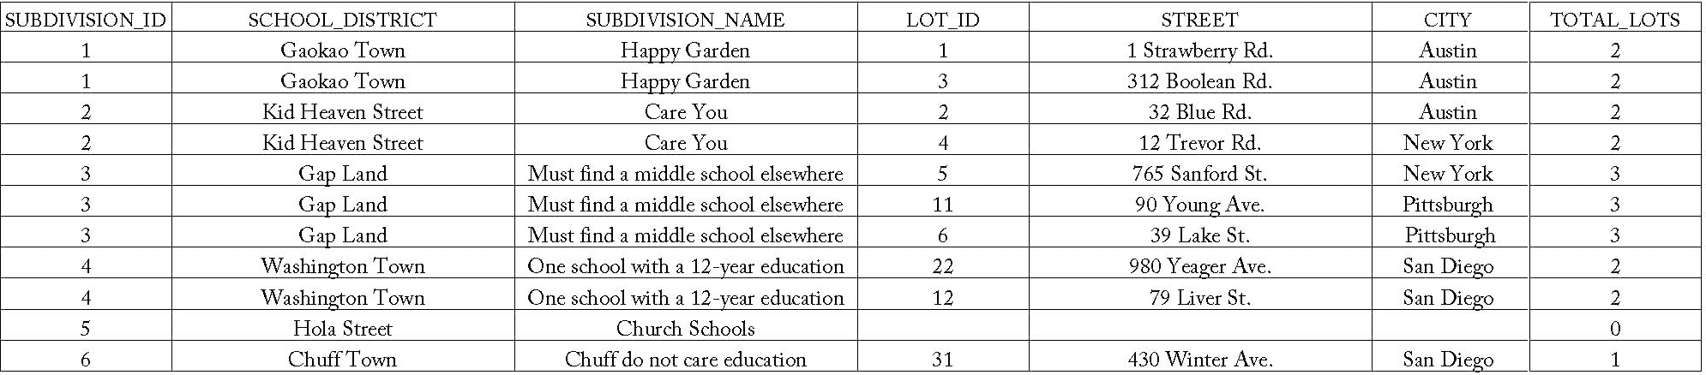
Reports
Report 1: Information of all lots for each subdivision, counting the total number of lots in the last column

Slide 13
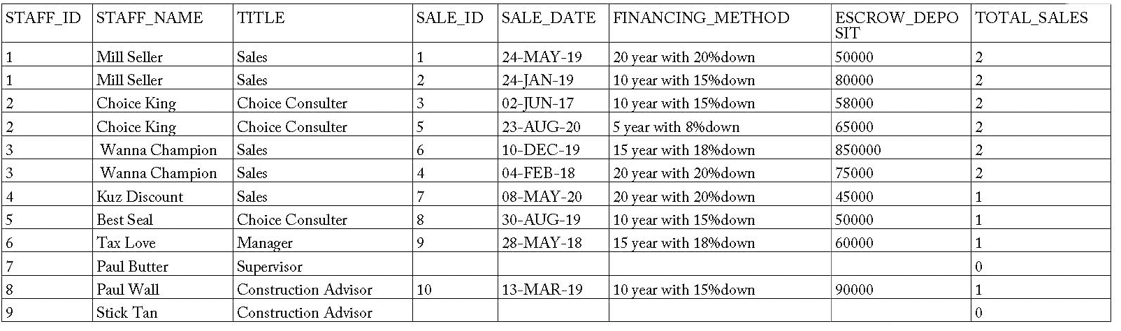
Reports (Cont.)
Report 2: The summary of sales record for each employee, counting the number of total sales record in the last column

Slide 14
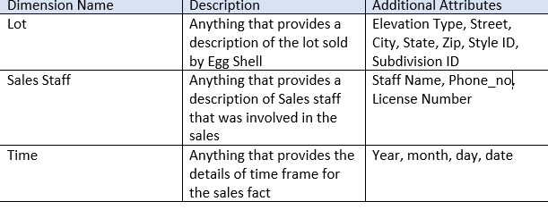
Data Warehouse Migration Scope
Data warehouse is a multi-dimensional model, we will be utilizing 3 dimensions as part of our project.
The Fact or measure will be Sales, which specifies the details of the lot sales.
The 3 dimensions are as follows:
In this 3-D model each Lot_ID, Staff_ID and Time_ID will give a unique Sales associated with them, as they are unique identifiers of each dimension

