Slide 1
STUDENT CONCENTRATION ANALYZER
Group - 9

Slide 2
INTRODUCTION
Emotion recognition is pivotal in identifying and understanding human emotions through facial expressions, voice tone, and body language. Within the realm of computer vision and affective computing, facial emotion recognition plays a crucial role.
The Student Concentration Analyzer aims to interpret the concentration levels and emotional states of learners by analyzing their facial cues during live online classes.

Slide 3
PROBLEM STATEMENT
Online education struggles to maintain student engagement and accurately assess learner focus. The rapid evolution of this field necessitates sophisticated tools that can dynamically respond to students' emotional and attentional states to foster a more effective learning environment.

Slide 4
PROJECT FOCUS
Utilizing the FER dataset and CNNs, this project develops a system to detect and analyze students' emotions in real-time. It addresses the need for improved interaction in virtual classrooms by enabling a responsive and adaptive educational experience.

Slide 5
Applications
Educational Enhancement
Personalized Learning
Engagement Metrics
Emotional Intelligence Development
Accessibility Enhancements
These applications demonstrate the versatility of the Student Concentration Analyzer in enhancing the educational landscape and supporting diverse learning needs.

Slide 6
DATASET
Introduction of FER+ dataset for analyzing learner’s facial emotion in LIVE environment.
Total of 65520 images in the dataset.
Preprocessing techniques including resizing to 48x48 pixels and converting to gray scaling for efficiency.

Slide 7
Emotion Class Distribution in FER+ Dataset
Description of emotion classes:
Anger
Disgust
Fear
Happy
Sad
Surprise
Neutral

Slide 8
Understanding the Convolutional Neural Network (CNN) Model Architecture
CNNs are utilized as the backbone of the Student Concentration Analyzer.
Hierarchical feature detection: CNNs automatically identify patterns on the face, aiding in emotion recognition.
Translation Invariance: Emotions can be recognized regardless of their location in the image due to shared weights in convolutional layers.
Feature Hierarchies: CNNs progressively learn higher-level features, enhancing the model's ability to discriminate emotions effectively.

Slide 9
Deep Emotion CNN Model Architecture
Two convolutional layers (conv1 and conv2) with ReLU activation functions.
MaxPooling layers (pool1 and pool2) for down sampling spatial dimensions.
Dropout layers (self.dropout) to prevent overfitting by deactivating neurons during training.
Three fully connected layers (fc1, fc2, and fc3) with Batch Normalization, ReLU activation, and Dropout.
Final dense layer (fc3) with SoftMax activation function, comprising seven neurons for emotion classification.

Slide 10
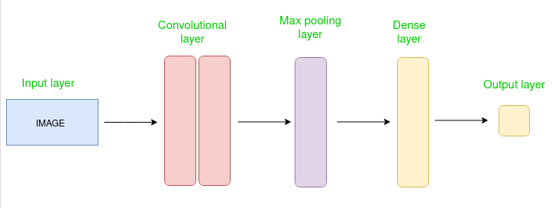

Slide 11
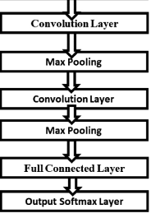

Slide 12
Training Process and Optimization Techniques
Adam optimizer used for dynamic learning rate adjustment during training.
Learning rate set to 0.0001 for optimized model training.
Categorical cross-entropy loss function chosen for multi-class classification problem in emotion recognition.
Development of a web application using Streamlit for user-friendly interaction with the emotion recognition system.

Slide 13
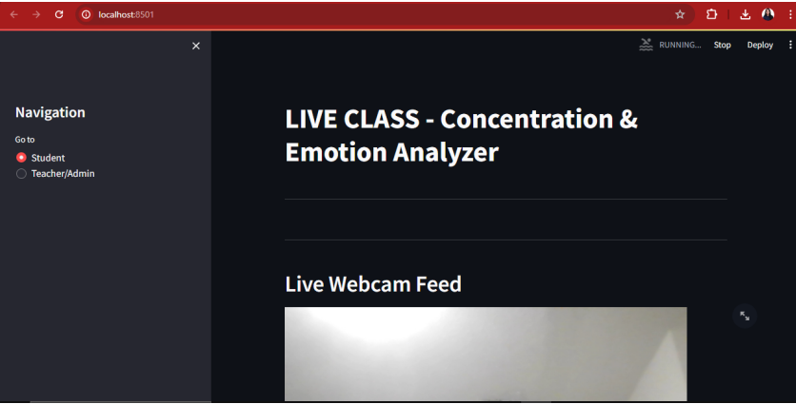
INTERFACE

Slide 14
EXPERIMENTS
TRAINING LOOP
7 FEATURES
(PHASE 1)
EACH FEATURES
(PHASE 2)

Slide 15
PHASE 1 EXPERIMENTS
Utilization of the train_model function for training the CNN model over 30 epochs.
Training on batches containing all 7 facial feature images combined.
Adam optimizer employed for parameter adjustment and gradient propagation.
Monitoring of training accuracy and validation loss for performance evaluation.
Implementation of early stopping mechanism to prevent overfitting.
Visualization of training and validation losses using Matplotlib plots for insights into model dynamics.

Slide 16
PHASE 2 EXPERIMENTS
Novel method of evaluating each facial feature batch individually.
Fine-grained analysis enabling targeted optimizations for specific facial characteristics.
Utilization of early stopping mechanisms to ensure optimal model generalization and mitigate overfitting.
Visualization of training and validation dynamics for comprehensive performance assessment.
Emphasis on the efficiency of phase 2 despite lower accuracy compared to phase 1.

Slide 17
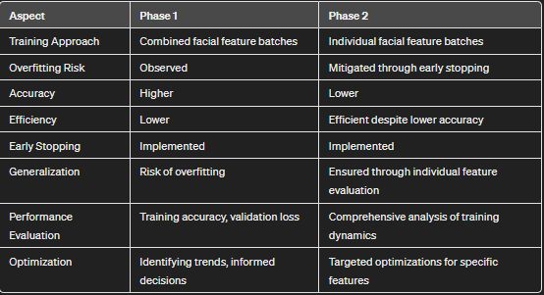
COMPARING PHASE 1 AND 2

Slide 18
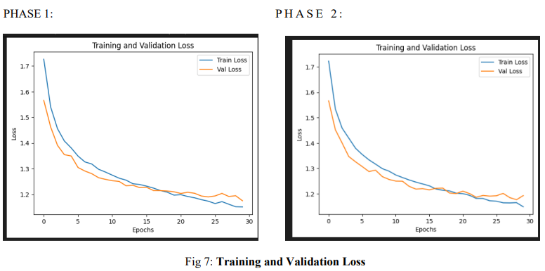

Slide 19
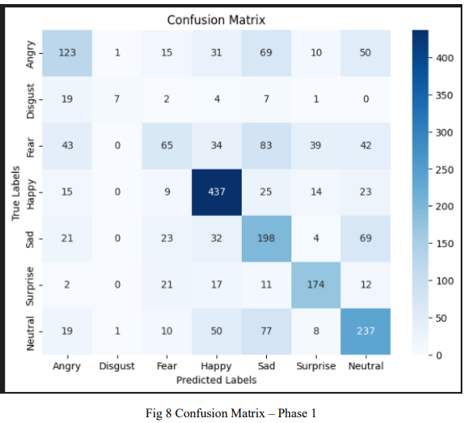
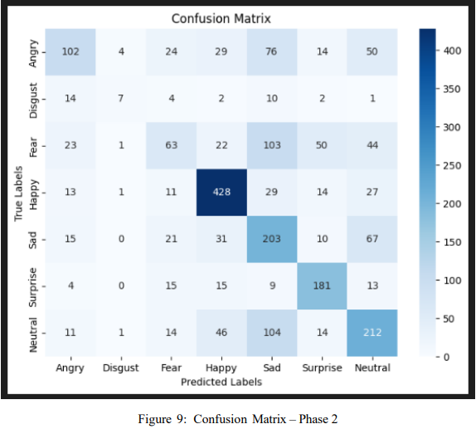
CONFUSION MATRIX

Slide 20
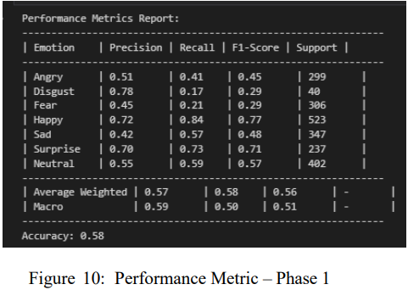
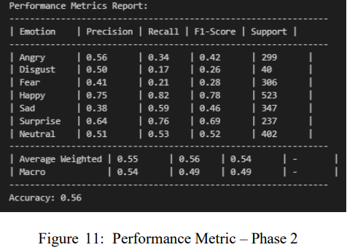
PERFORMANCE METRICS

Slide 21
Limitations and Challenges
Distinguishing between anger and disgust poses a challenge due to similar facial expressions.
Lighting variations during testing can lead to inaccuracies.
Emotion detection for multiple faces simultaneously may cause delays.
Covered faces result in low accuracy as the system relies on facial features.
Privacy concerns arise from using facial data as input.
Generalizing to novel facial expressions is difficult due to wide variations.
Future improvements may include better face recognition in dim-light and improved emotion differentiation.

Slide 22
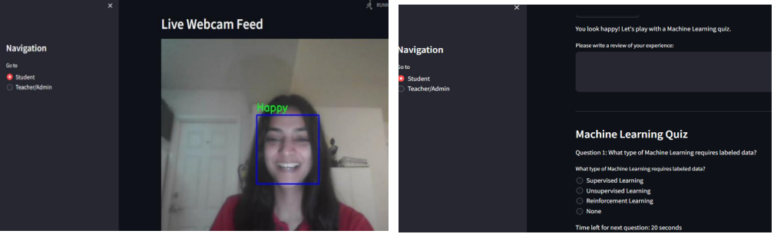

Slide 23
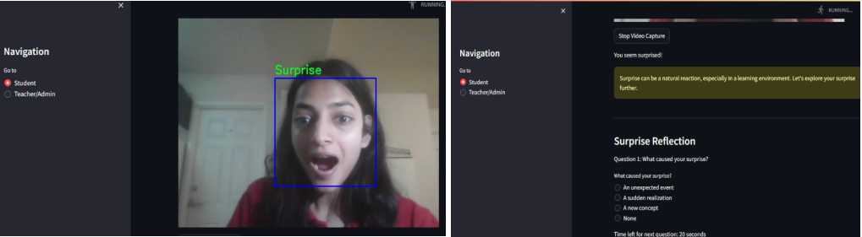
RESULTS

