Slide 1
Topic:- Optical Packet Switching Network
ACTIVITY-1
CS-602
Submitted by: Submitted to:
Nagesh Mudgal Ms. Neelam Joshi 0905CS191110 Asst. prof (CSE dept)

Slide 2
Content
Optical Switch
Optical Networks
Optical Networks with varying Degree of Tranparency
All-optical Networks
Optical Switching
Optical Packet Switching

Slide 3
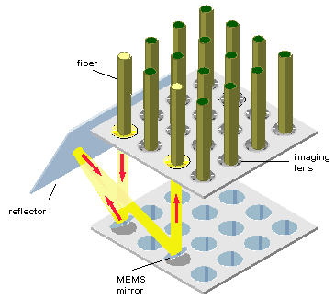
WHAT IS AN OPTICAL SWITCH?
DEFINITION:
A switch that enables signals in optical fibers or integrated optical circuits (IOCs) to be selectively switched from one circuit to another.

Slide 4
Continue
TYPES OF OPTICAL SWITCHES(SPEED):
Slow optical switches, such as those using moving fibers, may be used for ALTERNATE ROUTING of an optical transmission path, e.g., routing around a fault.
Fast optical switches, such as those using electro-optic or magneto-optic effects, may be used to perform logic operations.

Slide 5
OPTICAL NETWORKS
A data network built on fiber-optics technology, which sends data digitally, as light, through connected fiber strands.
OPTICAL NETWORKS TYPES:
1) SDH/SONET SYSTEM
2) OEO(OPAQUE OPTICAL NETWORK)
3) OPTICAL NETWORKS WITH VARYING DEGREE OF TRANSPARENCY.
4) ALL-OPTICAL NETWORKS

Slide 6
OPTICAL NETWORKS WITH VARYING DEGREE OF TRANSPARENCY
WDM(wavelength division multiplexing) and Optical Switching are used.
Switch and network control is carried out by electronics.
CLASSIFIED INTO 3 TYPES:
i) If all nodes utilize opto-electronics conversion, the network becomes OPAQUE(OEO).
ii) If no nodes utilize opto-electronics conversion, the network becomes TRANSPARENT.
iii) Between both extremes is PARTIALLY TRANSPARENT.

Slide 7
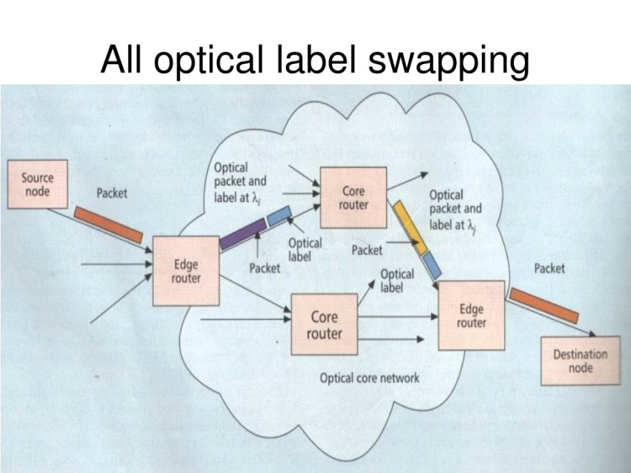
ALL-OPTICAL NETWORKS
Networks where all the network operations and functions ,including switch control & network control , would be perform optically.

Slide 8
Continue
Transparency involves the network being able to transfer any type of information without regard to protocol and coding formats , data rates and modulation techniques.
Advantages:
Enables network to be designed cost-effectively.
Evolve easily in future together with protocols and technologies.

Slide 9
OPTICAL SWITCHING
OPTICAL CIRCUIT SWITCHING
OPTICAL PACKET SWITCHING
OPTICAL BURST SWITCHING

Slide 10
OPTICAL PACKET SWITCHING
Must be all-optical.
It requires a Packet header, header processing.
Control is fully performed in optical domain on a packet-by packet basis.
Increased bandwidth compared to optical circuit switching.
Supports bursty data traffic more efficiently than OCS by means of statistical multiplexing.

Slide 11
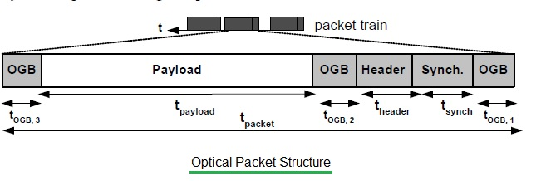
Continue
General optical packet format consists of :
Header
Payload
Additional guard bands before & after payload OPTICAL PACKET FORMAT

Slide 12


