Slide 1









Faculty Research Area: AI
Title of the project: AI Based Coding Assistant for Differently-Abled People
Faculty In charge : Ms. M. Rajalakshmi

Slide 2




















Slide 3
Introduction
Programming environments are traditionally designed around intensive keyboard and mouse usage, which creates accessibility barriers for developers with physical or motor impairments. Although assistive technologies such as screen readers and voice typing exist, they provide limited support for programming-specific tasks such as code generation, editing, navigation, and execution. The proposed AI-Based Voice-Driven Coding Assistant is a Visual Studio Code extension that enables hands-free coding through natural voice commands. By integrating speech-to-text processing with artificial intelligence–based intent interpretation, the system allows users to write, modify, navigate, and execute code using voice interaction. This approach promotes inclusive and accessible software development while preserving professional IDE workflows.

Slide 4
Inductive base documents for conducting research project
Literature survey
Category | Base Document Required
Publication Category | • Voice-Based Programming for Developers with Motor Disabilities, IEEE Access, 2023 • Accessible Software Development Using Speech and AI Techniques, IEEE Transactions on Human-Machine Systems, 2022 • Natural Language Interfaces for Programming: A Survey, ACM Computing Surveys, 2023 • AI-Powered Developer Tools: Enhancing Productivity and Accessibility, Microsoft Research Technical Report, 2022
Patent Category | • System and Method for Voice-Controlled Code Generation, US Patent, 2023 • Assistive Programming Interface Using Speech Recognition, WIPO Patent, 2022 • Voice-Driven Software Development Environment, European Patent Office, 2023 • Accessibility-Focused Programming Interfaces, IEEE Q1 Journal Article, 2022

Slide 5
Literature survey
Feature / Parameter | Base Document 1 | Base Document 2 | Base Document 3 | Base Document 4 | Observed Gap / Limitation | Proposed Modification / Improvement
Mode of Interaction | Voice-assisted coding | Voice + keyboard input | Speech-to-text programming | Text-based coding assistant | Voice not used as primary control | Fully voice-driven coding workflow
Accessibility Support | Partial support | General users | Limited disability focus | No accessibility focus | Lack of inclusive design | Designed specifically for developers with disabilities
IDE Integration | Standalone tool | Web-based editor | Custom environment | External assistant | No native IDE integration | Native VS Code extension
AI Command Understanding | Rule-based | Basic NLP | Keyword mapping | Manual commands | Poor intent understanding | AI-based natural language command interpretation
Language Support | Single language | Limited languages | Few popular languages | Language-specific | Limited scalability | Multi-language coding support

Slide 6
Objectives
To design a voice-based coding assistant that enables hands-free programming for developers with disabilities.
To integrate speech-to-text and AI-based intent interpretation for natural language voice commands.
To support code generation, modification, navigation, and execution within Visual Studio Code.
To provide real-time feedback and context-aware actions for improved usability.
To promote inclusive and accessible software development practices.

Slide 7
Problem Statement
Most Integrated Development Environments rely heavily on keyboard and mouse input, making programming difficult for individuals with physical or motor disabilities. Existing assistive tools such as speech-to-text systems are not optimized for programming tasks and fail to handle syntax, structure, and contextual coding operations effectively.
Additionally, many voice-based coding solutions operate as standalone systems or depend on rigid command templates, limiting adaptability and real-world usability. There is a lack of accessible, AI-driven, IDE-integrated solutions that allow developers to code naturally using voice while maintaining professional workflows.

Slide 8
Novelty of the work
The novelty of the proposed work lies in integrating AI-based intent understanding with voice-driven interaction directly inside Visual Studio Code.
Unlike existing rule-based or standalone voice coding systems, this project focuses on natural language interpretation, context awareness, and multi-language adaptability.
The system leverages free and local AI models and speech-to-text engines to ensure privacy, accessibility, and independence from paid cloud services.
By enabling inclusive coding within an industry-standard IDE, the proposed approach represents a significant advancement in accessible software development tools.

Slide 9
Proposed work
Design and implement a voice-driven coding assistant as a VS Code extension.
Users issue spoken commands, converted to text via speech-to-text processing.
AI model interprets intent and maps it to coding actions: generation, modification, navigation, or execution.
Real-time interaction with VS Code enables insertion or modification of code based on programming context.
Provides immediate feedback for continuous hands-free coding.
Modular architecture allows future expansion to additional programming languages and advanced accessibility features.

Slide 10
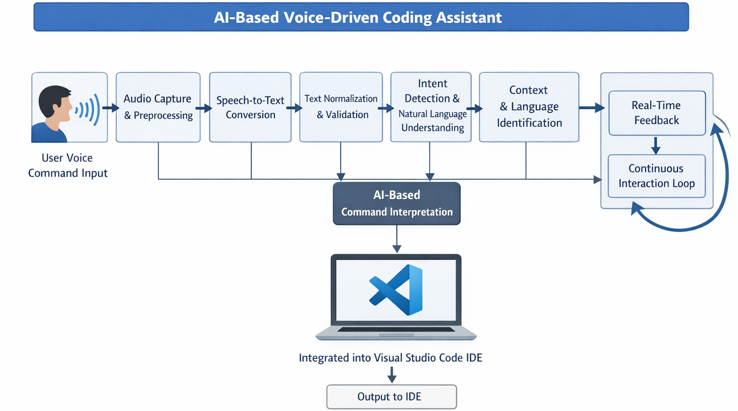
Methodology

Slide 11
2. Tools / Technologies to be Used
IDE Platform: Visual Studio Code
Extension Development: JavaScript / TypeScript
Backend Processing: Python
Speech-to-Text: Free offline/open-source STT engine (e.g., Vosk)
AI Model: Xiaomi MiMo v2 Flash
Communication: REST API / local server
Development Tools: VS Code, Git, Postman

Slide 12
3. Datasets / Experimental Setup
Datasets:
Sample voice commands for programming tasks
Intent categories (code generation, modification, navigation, execution)
Programming language templates (Python, Java, etc.)
Experimental Setup:
Local development environment
Controlled testing with predefined voice commands
Evaluation based on response time, command accuracy, and successful code execution
Testing across multiple programming scenarios

Slide 13
Applications of the proposed work
Accessible programming for developers with disabilities
Hands-free coding for individuals with temporary injuries or repetitive strain conditions
Educational support for beginner programmers
Voice-assisted coding in low-interaction environments
Inclusive developer tools in academic and professional settings

Slide 14
Committed Outcome
Category | Project Research Outcome (any one)
Indexed International Conference | The outcome of this project is intended for presentation at an indexed international conference. The research focuses on developing an AI-assisted voice coding system for differently-abled users, demonstrating both technical innovation and practical applicability. The work will be submitted to a peer-reviewed conference recognized in databases such as IEEE Xplore, Scopus, or Web of Science.
Indexed Book Chapter
Indexed Journal Publication
Patent Filling
Patent Grant

Slide 15
References
Subhash S., P. N. Srivatsa, S. Siddesh, A. Ullas, and B. Santhosh, AI-Based Voice Assistant for Accessibility, 2020 Fourth World Conference on Smart Trends in Systems, Security and Sustainability (WorldS4), pp. 593–596, 2020.
Felix S. M., S. Kumar, and A. Veeramuthu, A Smart Personal AI Assistant for Visually Impaired People, 2018 2nd International Conference on Trends in Electronics and Informatics (ICOEI), pp. 112–117, 2018.
Chen R., Z. Tian, H. Liu, F. Zhao, and S. Zhang, Construction of a Voice-Driven Life Assistant System for Visually Impaired People, 2018 International Conference on Artificial Intelligence and Big Data (ICAIBD), pp. 87–92, 2018.
Rani P. J., J. Bakthakumar, B. P. Kumaar, U. P. Kumaar, and S. Kumar, Voice Controlled Home Automation Using Natural Language Processing (NLP) and IoT, 2017 Third International Conference on Science Technology Engineering & Management (ICONSTEM), pp. 45–50, 2017.
Iannizzotto G., L. L. Bello, A. Nucita, and G. M. Grasso, A Vision and Speech Enabled Customizable Virtual Assistant for Smart Environments, 2018 11th International Conference on Human System Interaction (HSI), pp. 50–56, 2018.

Slide 16


