Slide 1

Dr.Mahalingam College of Engineering & Technology
Department of Artificial Intelligence & Data Science
19ADPN6601 – Innovative and Creative Project
Second Review
Title: AI Based Model for Predicting Agri-horticultural Commodities
Batch Number : 15
Team Name : 23BADA15
Domain : Agriculture / Foodtech
Team Members
1. Sharanya T | (727622BAD007)
2. Santhosh S | (727622BAD073)
3. Aashif Shadin K N | (727622BAD099)
Guide: Mr. M. Viyajakumar, AP/AI&DS

Slide 2
Title
AI Based Model for Predicting Agri-horticultural Commodities

Slide 3
Contents
Introduction
Problem Statement
Literature Identified and Findings
Objective
Block Diagram
Software Requirements
References
Weekly Plan

Slide 4
Problem Statement
Agricultural commodity prices are highly volatile and because of this, traditional forecasting models often fail to provide accurate predictions, leading to inefficient buffer stock management and ineffective market interventions. This project leverages deep learning to develop a robust price prediction model that enhances forecasting accuracy while supporting strategic decision-making. By integrating AI-driven real-time data analysis, the solution aims to improve price stability, optimize government interventions, and reduce economic uncertainty in the agricultural sector.

Slide 5
Literatures Identified and Findings
"Forecasting Agricultural Commodity Prices Using Model Selection Framework With Time Series Features and Forecast Horizons" (2020) Dabin Zhang, Shanying Chen, Liwen Ling, Qiang Xia
Model Selection Framework: The study introduces a novel framework that selects the optimal forecasting model based on specific time series features and forecast horizons. This approach tailors the model choice to the unique characteristics of the data and the desired prediction timeframe, enhancing forecasting accuracy. IEEE Xplore
Feature Reduction with MRMR: The research employs the Minimum Redundancy Maximum Relevance (MRMR) method to reduce feature redundancy. This technique selects the most informative features, improving the performance of the forecasting models by eliminating irrelevant or redundant data. IEEE Xplore
Integrating these insights can enhance the precision of commodity price predictions by ensuring that the most suitable models and features are utilized for each forecasting scenario.

Slide 6
Algorithms used
1. Data Collection & Preprocessing
Open Government Databases – Collect real-time details of various commodities from agmarknet.gov.in and historical agricultural commodity price data from data.gov.in .
Data Cleaning (Pandas) – Handle missing values, outliers, and inconsistencies.
Feature Engineering – Extract seasonality trends, inflation impact, and market signals.
2. Price Prediction Models
ARIMA– Traditional time series forecasting for baseline comparison.
XGBoost / Random Forest – Enhances predictive accuracy by combining statistical features.

Slide 7
Objective
This project aims to develop an AI-driven agricultural commodity price prediction system that enhances forecasting accuracy and aids in strategic market interventions. By integrating deep learning models (XGBoost, ARIMA) with real-time data, the system will analyze historical trends, seasonal patterns, and external market factors to predict price fluctuations. The goal is to provide farmers, traders, and policymakers with data-driven insights for better buffer stock management, price stability, and risk mitigation, ultimately reducing economic uncertainty in the agricultural sector.

Slide 8
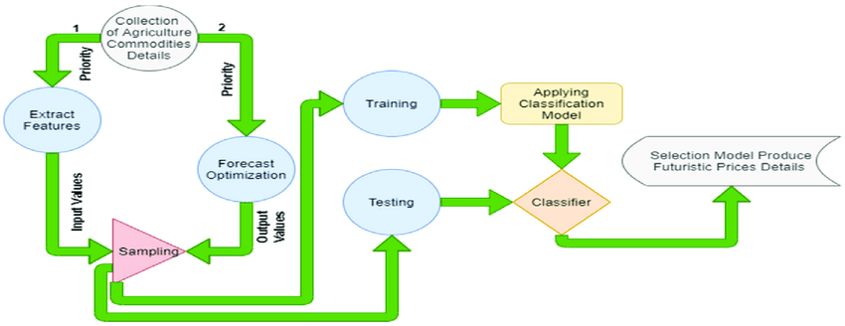
Existing System Block Diagram

Slide 9
Proposed System Flow Chart
Data Collection
AGMARKNET, Government Reports, Market APIs.
Data Preprocessing
Data Cleaning, Feature Engineering, Time-Series Processing.
Price Prediction Models
ARIMA, XGBoost, Random Forest.
Volatility Analysis
Sentiment Analysis, Anomaly Detection.
Buffer Stock Optimization, Explainable AI, Market Intervention Strategies.
Decision Support
Visualization & Deployment
Interface Design & Visualization of results

Slide 10
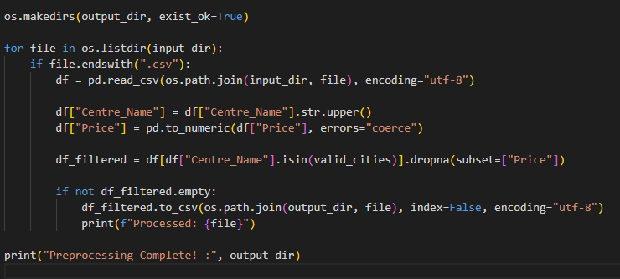
Data Preprocessing

Slide 11
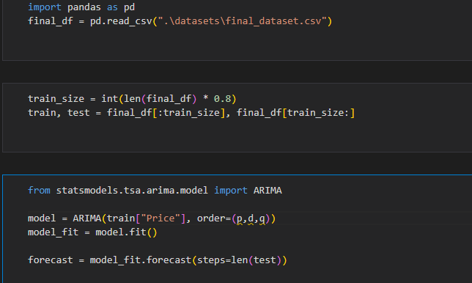
Model Building

Slide 12
Software Requirements
Operating System – Windows 11
Programming Languages: Python (Pandas, NumPy, Sklearn, TensorFlow/PyTorch)
Data Processing: MS Excel, Pandas
ML/DL Frameworks: Scikit-learn, TensorFlow, PyTorch, Statsmodels (for ARIMA)

Slide 13
References
Artificial Intelligence Technology in the Agricultural Sector: A Systematic Literature Review (2022) Ersin Elbasi, Nour Mostafa, Zakwan Alarnaout, et al., IEEE
AgTech: Volatility Prediction for Agricultural Commodity Exchange Trading Applied Deep Learning (2024) Ngoc-Bao-Van Le, Yeong-Seok Seo, Jun-Ho Huh, IEEE
Forecasting Agricultural Commodity Prices Using Model Selection Framework With Time Series Features and Forecast Horizons (2020) Dabin Zhang, Shanying Chen, Liwen Ling, Qiang Xia, IEEE

Slide 14
Weekly Plan
Week 1 : | Data Collection, Preprocessing & Literature Review
Week 2 : | Model Selection & Implementation for price prediction
Week 3 : | Model Optimization & Integration with Decision System
Week 4 : | Testing, Visualization, and Final Report Preparation

Slide 15


