Slide 1
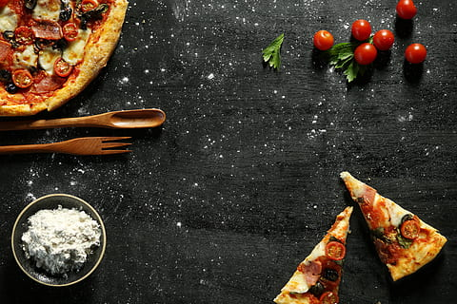
PIZZA SALES ANALYSIS
PRESENTED BY
AASHIF EKBAL

Slide 2
Hello!
My name is Aashif Ekbal. In this Project, I have utilized SQL queries to
solve questions related to pizza sales.

Slide 3
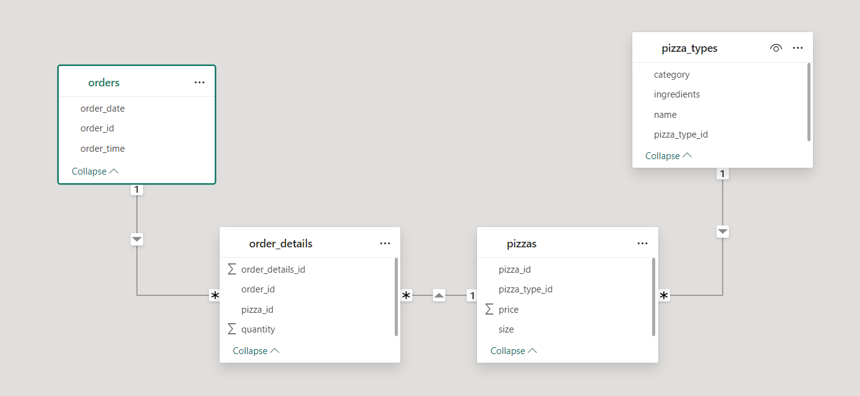
SCHEMA

Slide 4
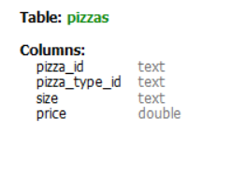
Schema
PIZZAS TABLE
pizzas:
pizza_id: Unique identifier for each pizza.
pizza_type_id: Identifier linking to the type of pizza (foreign key referencing the pizza_types table).
size: Size of the pizza (e.g., small, medium, large).
price: Price of the pizza.
pizzas:
pizza_id: Unique identifier for each pizza.pizza_type_id: Identifier linking to the type of pizza (foreign key referencing the pizza_types table).
size: Size of the pizza (e.g., small, medium, large).

Slide 5
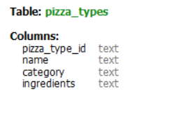
Schema
PIZZA_TYPES TABLE
pizza_types:
pizza_type_id: Unique identifier for each type of pizza.
name: Name of the pizza type (e.g., Greek, Pepperoni, Italian).
category: Category of the pizza (e.g., Chicken, Classic, Veggie).
ingredients: Ingredients used in the pizza type.
pizzas:
pizza_id: Unique identifier for each pizza.pizza_type_id: Identifier linking to the type of pizza (foreign key referencing the pizza_types table).
size: Size of the pizza (e.g., small, medium, large).

Slide 6
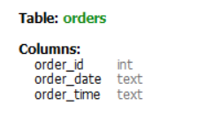
Schema
ORDERS TABLE
orders:
order_id: Unique identifier for each order.
date: Date when the order was placed.
time: Time when the order was placed.
pizzas:
pizza_id: Unique identifier for each pizza.pizza_type_id: Identifier linking to the type of pizza (foreign key referencing the pizza_types table).
size: Size of the pizza (e.g., small, medium, large).

Slide 7
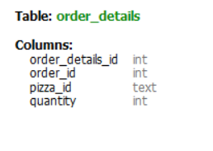
Schema
ORDER_DETAILS TABLE
order_details:
order_details_id: Unique identifier for each order detail.
order_id: Identifier linking to the order (foreign key referencing the orders table).
pizza_id: Identifier linking to the pizza ordered (foreign key referencing the pizzas table).
quantity: Quantity of the specific pizza ordered in the order.
pizzas:
pizza_id: Unique identifier for each pizza.pizza_type_id: Identifier linking to the type of pizza (foreign key referencing the pizza_types table).
size: Size of the pizza (e.g., small, medium, large).

Slide 8
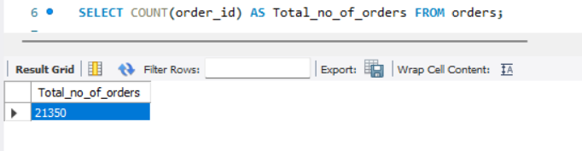
Retrieve the total number of orders placed.

Slide 9
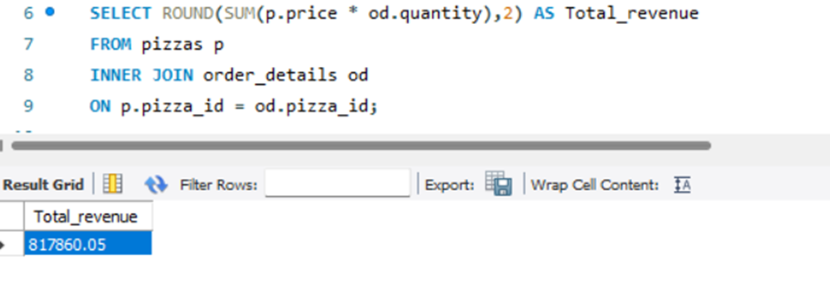
Calculate the total revenue generated from pizza sales.

Slide 10
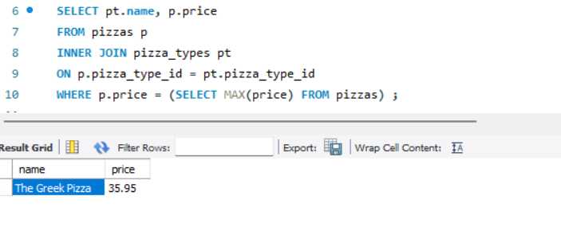
Identify the highest-priced pizza.

Slide 11
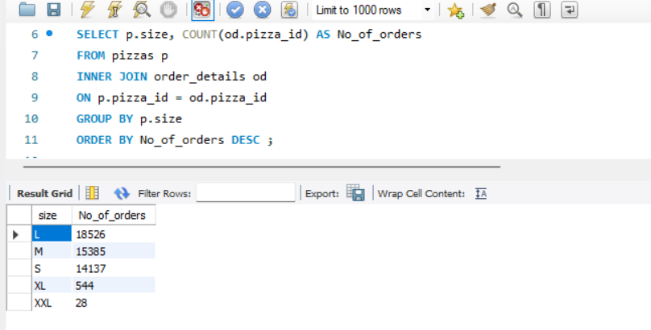
Identify the most common pizza size ordered.

Slide 12
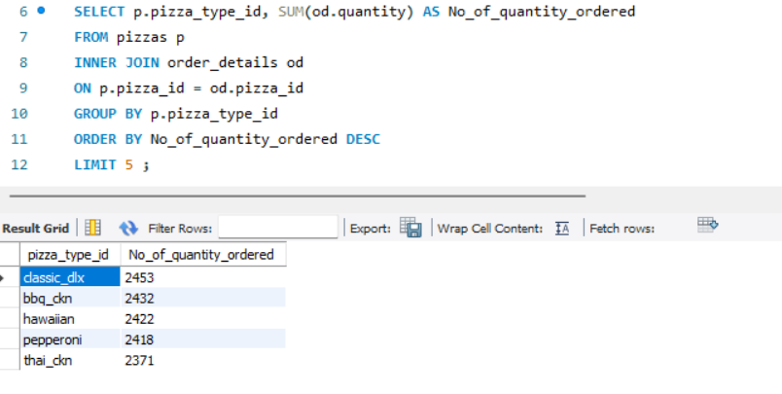
List the top 5 most ordered pizza types along with their quantities.

Slide 13
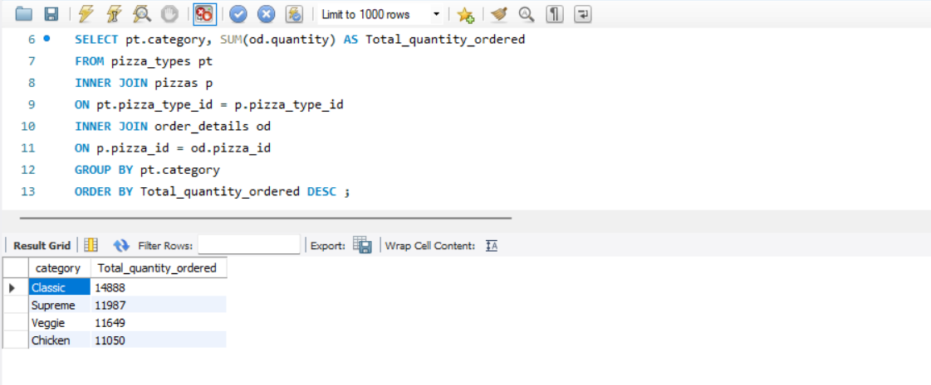
Join the necessary tables to find the total quantity of each pizza category ordered.

Slide 14
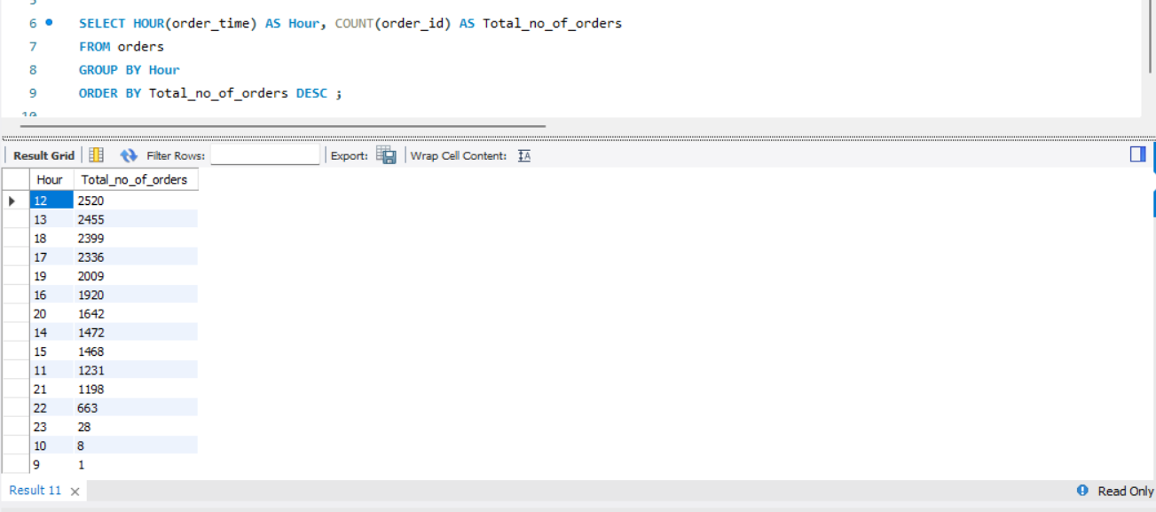
Determine the distribution of orders by hour of the day.

Slide 15
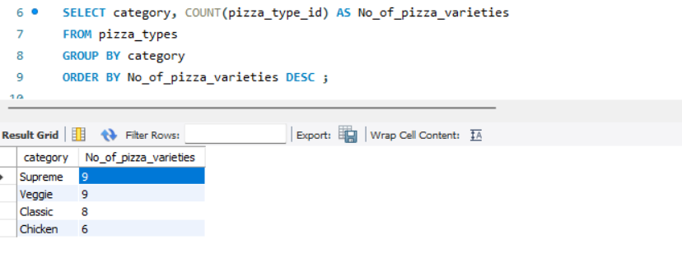
Join relevant tables to find the category-wise distribution of pizzas.

Slide 16
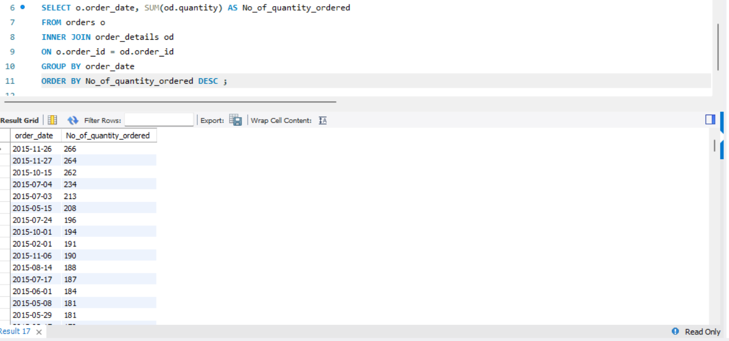
Group the orders by date and calculate the number of pizzas ordered per day.

Slide 17
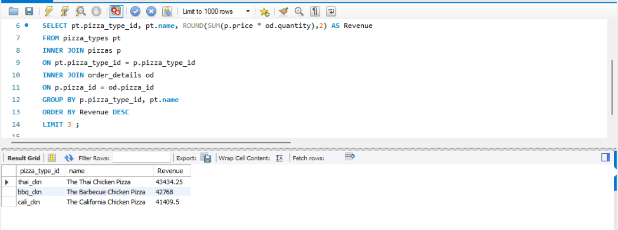
Determine the top 3 most ordered pizza types based on revenue.

Slide 18
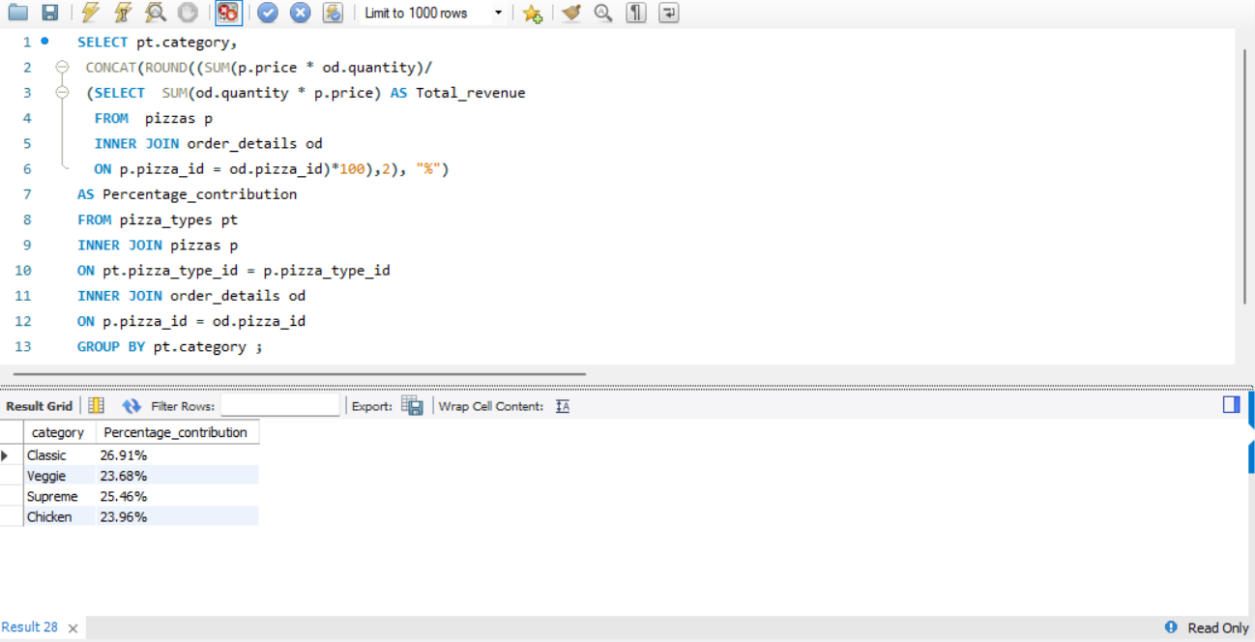
Calculate the percentage contribution of each pizza type to total revenue.

Slide 19
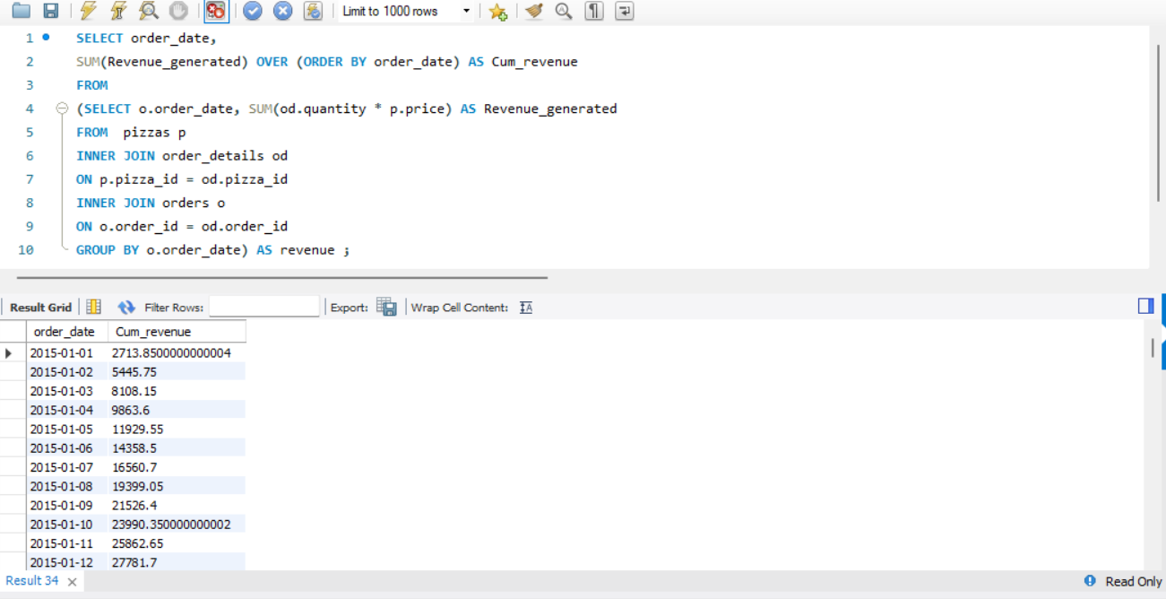
Analyze the cumulative revenue generated over time.

Slide 20
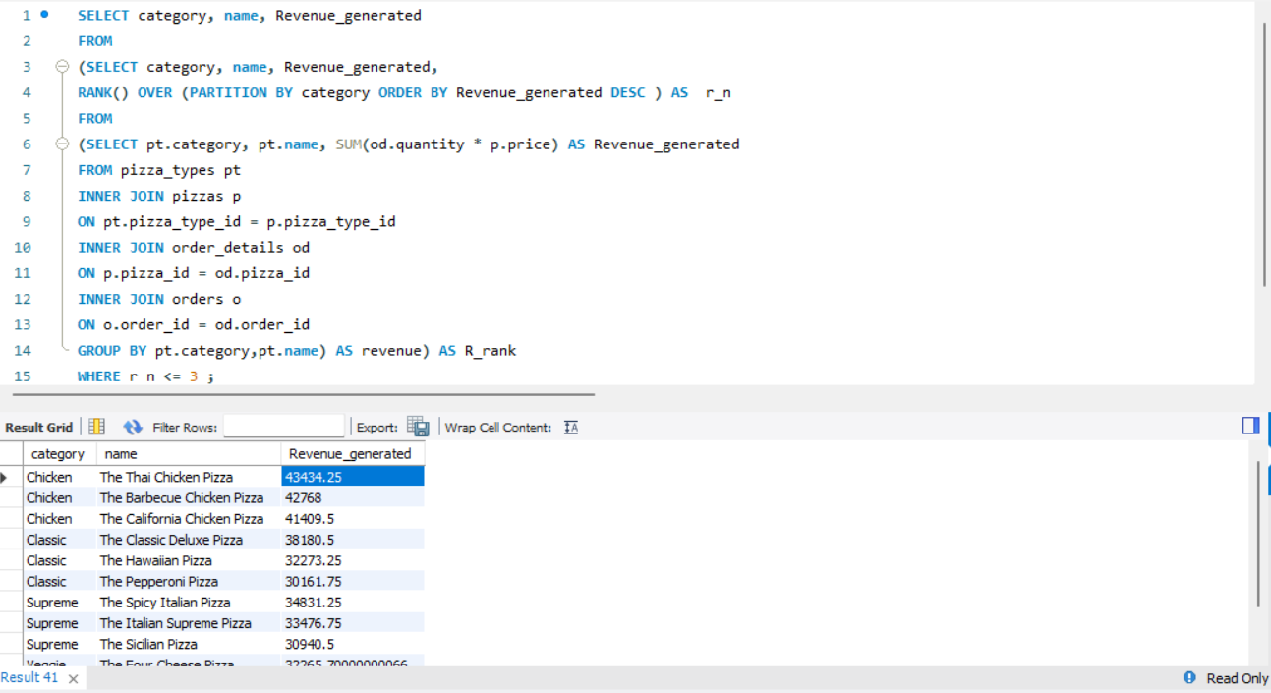
Determine the top 3 most ordered pizza types based on revenue for each pizza category.

Slide 21
CONCLUSION
A total of 21,350 orders have been placed, generating a revenue of $817,860.
'The Greek Pizza' is the most expensive pizza and 'L' size is the most common size pizza ordered.
The most popular pizza category is 'classic' and the most ordered pizza type is 'classic_dlx’.
The busiest times for ordering are between 12:00-14:00 and 16:00-19:00.
"The Thai Chicken Pizza" generated $434,34 in revenue, followed by "The Barbecue Chicken Pizza".
‘Classic’ and ‘Supreme pizzas comprise the largest revenue share, followed by ‘Chicken’ and ‘Veggie’.

Slide 22
THANK YOU
Thank you for your attention. I appreciate your time and interest in my Pizza Sales Analysis project.
If you have any questions, feedback, or suggestions, please feel free to contact me. Your insights and comments are valuable to me as I continue to improve my analysis.
Have a great day!

