Slide 1












Kiddofit PITCH DECK
Team Members:
Jaya salomi C
Mohammed Aashik F
Giridharan R E
Srilekha R

Slide 2
TABLE OF CONTENTS
01
Problem &
Solution
Features & demo
02
Business model & Target audience
03
04
summary

Slide 3
problem
Excessive Screen Time
Decreased Physical Activity
Limited Parental Control
Mobile Phone Addiction
Lack of Motivation for Outdoor Activities

Slide 4
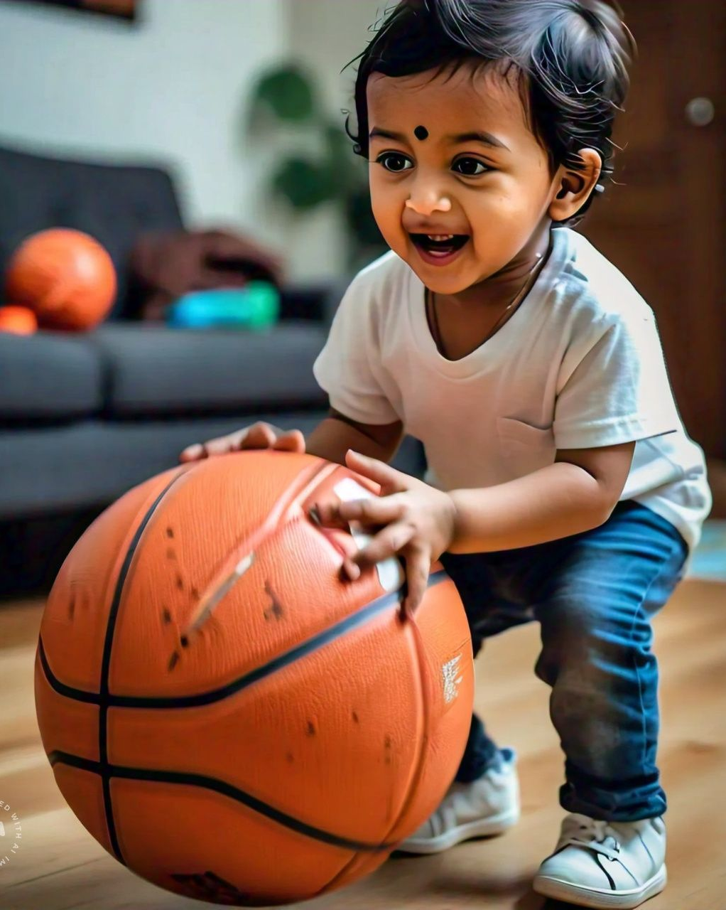
solution
Develop an engaging app that encourages children to participate in physical activities through interactive sports exercises, using live animations and gamified challenges to maintain interest.

Slide 5
Business model & target audience
Collaborations
In-App Purchases
Freemium Subscription Model

Slide 6
feature
Encourages Physical Activity
Improves Health & Fitness
Parental Control & Monitoring
Builds Healthy Habits
Physical Development

Slide 7
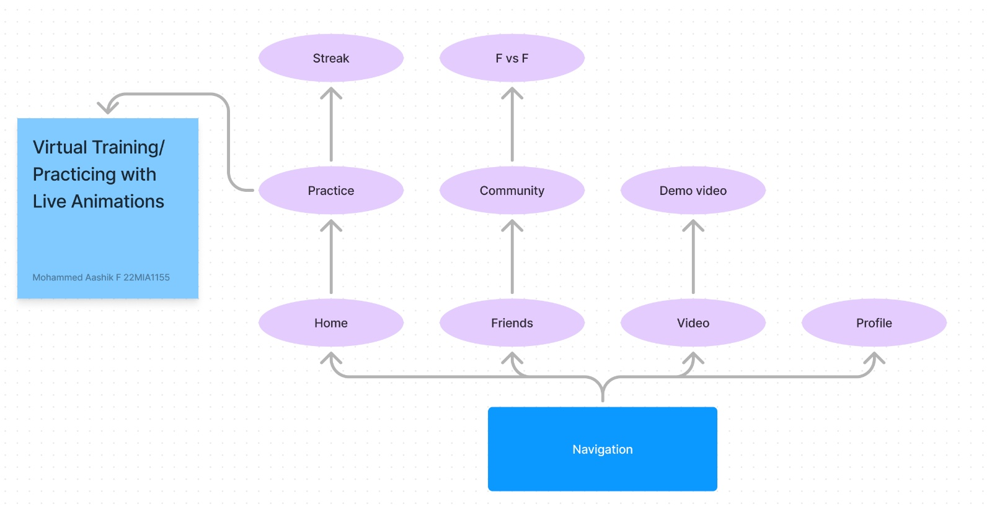
demo

Slide 8
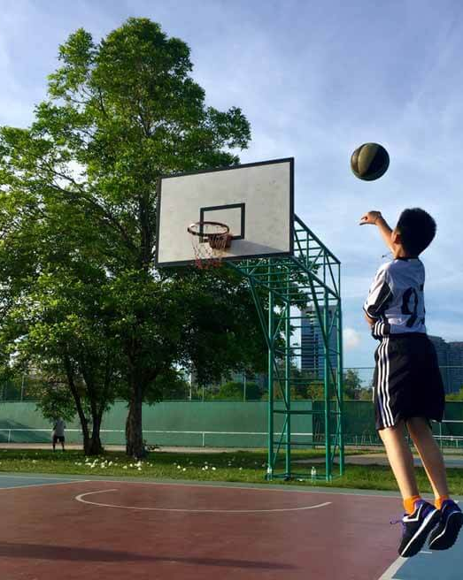
summary
This personalized sports app encourages children aged 10 to 16 to shift from excessive screen time to active physical engagement. Through virtual sports training, fun challenges, and parental monitoring, the app motivates kids to stay consistent with their fitness goals. With features like streak tracking, friend competitions, and rewards tied to real-world sports products, the app makes physical activity exciting and rewarding, fostering a healthier and more active lifestyle.

Slide 9
Thank you

