Slide 1
DATABASE MANAGEMENT SYSTEM PROJECT REVIEW
Department of Artificial Intelligence and Data Science
Academic Year: 2024 – 2025 (Even Semester)
Register Number : 2303811724321098
Name : SATHIYAJITH AASHIM G
Year : II
Semester : IV
Section : B
Date : 04-06-2025

Slide 2
Title of the Project
Campus Recruitment Management System

Slide 3
Problem Identified
Recruitment is done manually, causing delays and inefficiencies.
No centralized system for managing job posts and student data.
Poor communication between companies and students.
Difficulty in tracking application status.
No support for multimedia job content.
Risk of data loss and insecurity.

Slide 4
Objective
To develop a Campus Recruitment System using Python and MySQL.
To simplify job posting, student registration, and application tracking.
To enable admins to send replies through app and email (Gmail).
To store and manage all activities securely in a centralized database.
To enhance user experience with a colorful GUI and media support (images/videos).

Slide 5
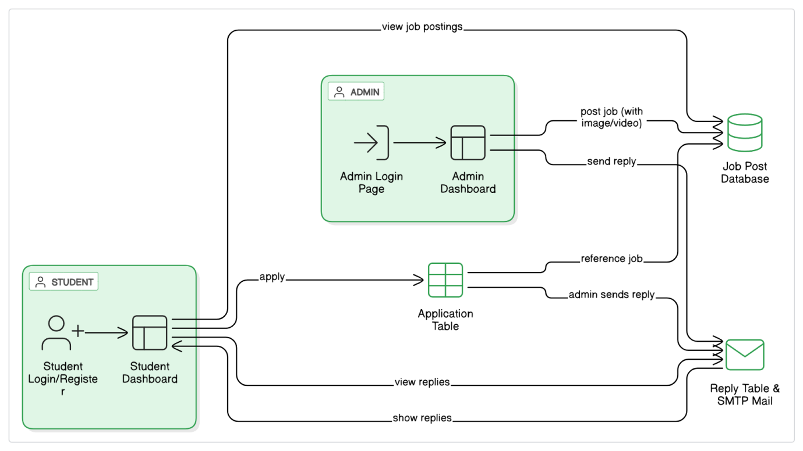
Proposed Architecture

Slide 6
Module List
Job Management Module
Student Management Module
Application Management Module
Admin Reply Module
Login and Registration Module

Slide 7
Module Implemented
Job Management Module
Admins can post and manage job listings.
Job details are stored and displayed for student access.

Slide 8
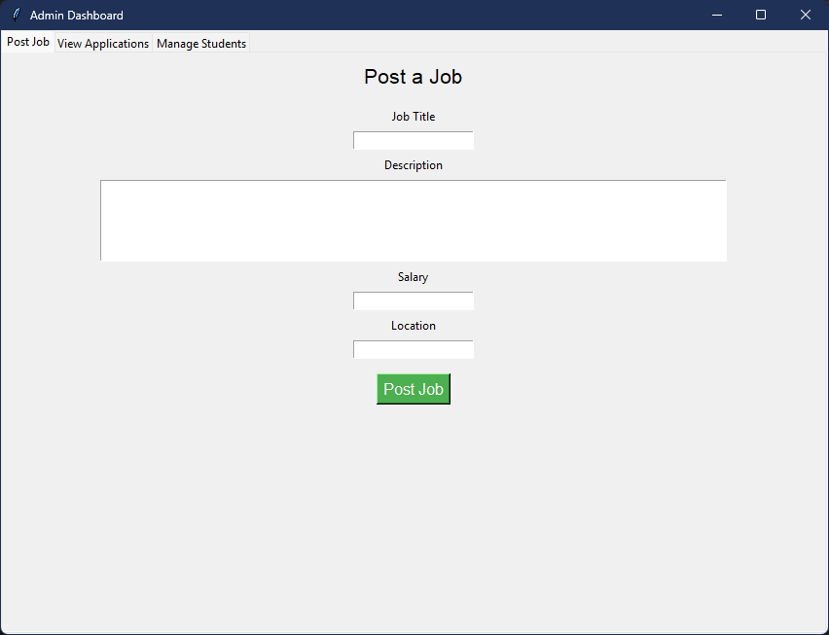
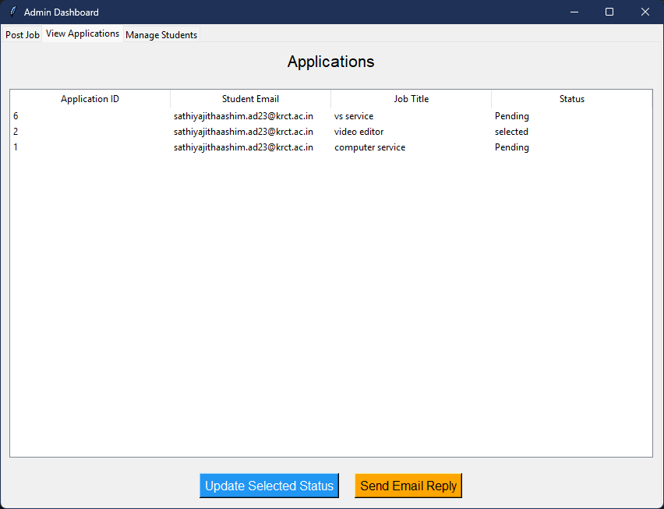
Module Implemented
Job Management Module

Slide 9
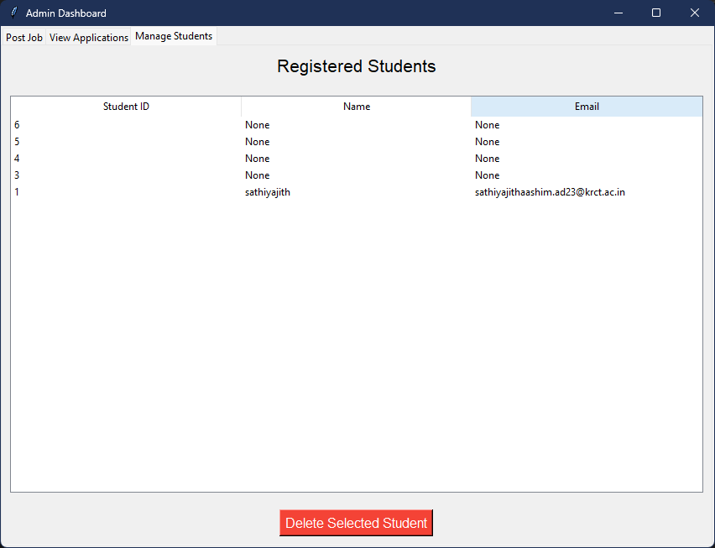
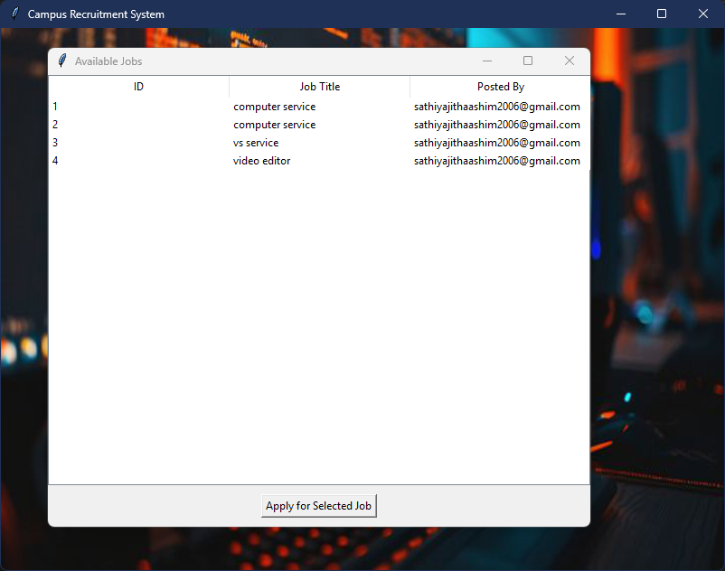
Module Implemented
Job Management Module

Slide 10
Module Implemented
Student Management Module
Students can register, log in, and update their profiles.
Allows students to view and apply for available jobs.

Slide 11
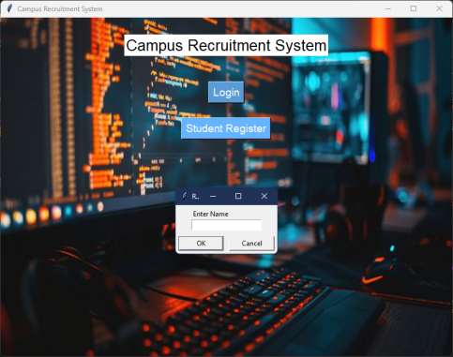
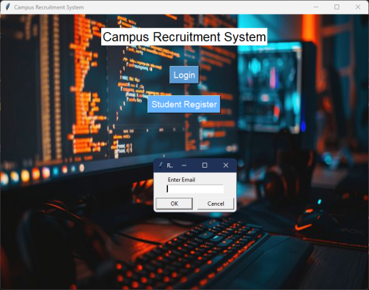
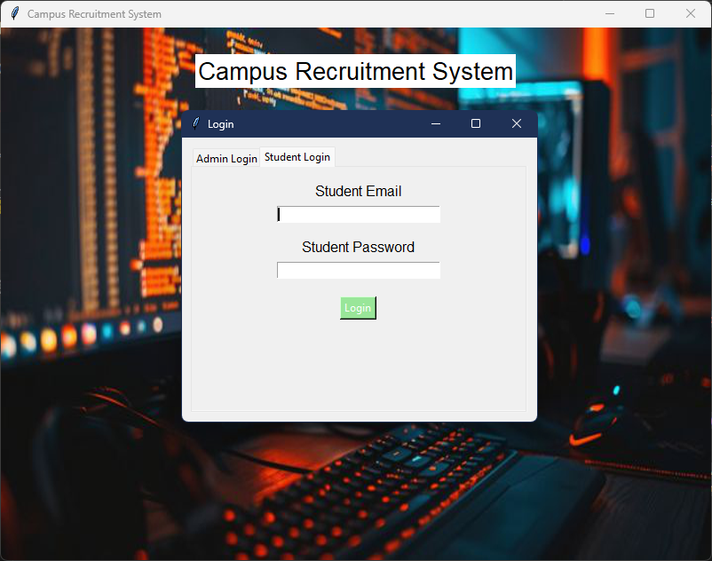
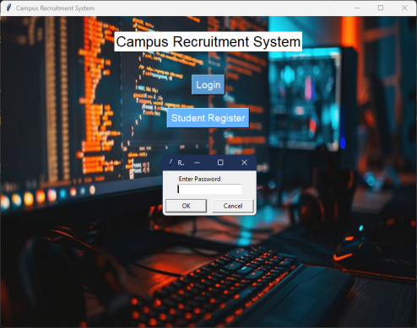
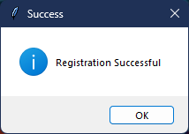
Module Implemented
Student Management Module

Slide 12
Module Implemented
Application Management Module
Stores job applications submitted by students.
Admins can view and manage all received applications.

Slide 13
Module Implemented
Application Management Module

Slide 14
Module Implemented
Admin Reply Module
Admins can send replies to student applications.
Replies are visible both in-app and sent via email.

Slide 15
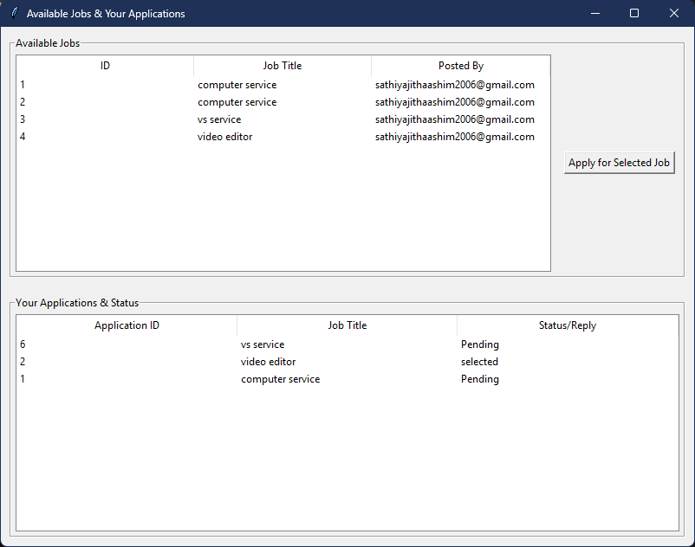
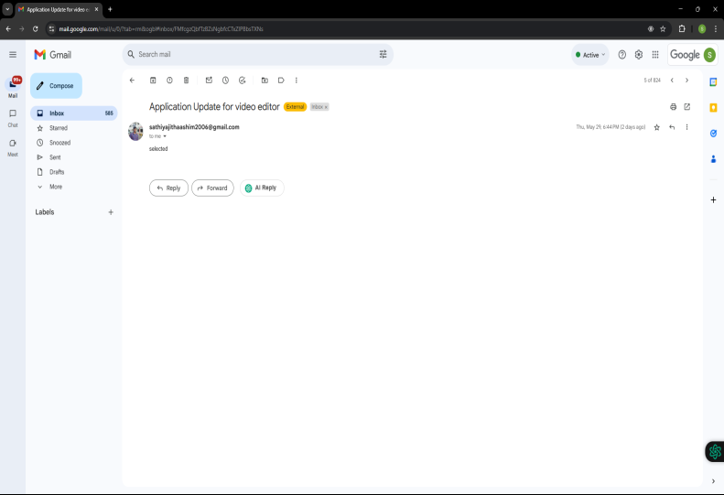
Module Implemented
Admin Reply Module

Slide 16
Module Implemented
Login and Registration Module
Provides login authentication for admins and students.
Handles new user registrations with role-specific access.

Slide 17
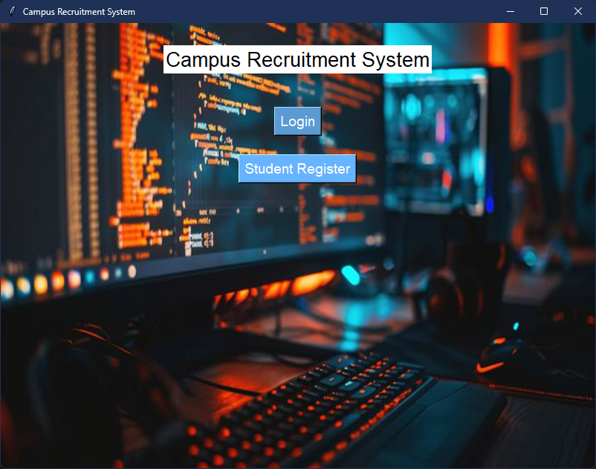
Module Implemented
Login and Registration Module

Slide 18
CONCLUSION & REFERENCES
Conclusion :
The project provides a structured, user-friendly platform for managing campus recruitment activities.
It simplifies the interaction between students and companies, reducing manual effort and errors.
Future Scope Enhancements:
Integrate AI for resume screening and job matching to improve selection efficiency.
Expand to a mobile-friendly version or app to improve accessibility and reach.

Slide 19
Thank You
Any queries???

