Slide 1





Project EMILA
Group Ashido
Aashin Shazar

Slide 2

Project Description
Electromyography Muscular Interface Limb Assist
To interpret surface muscular EMG data to control a prosthetic limb
Further research interest in human computer interfaces
Explore machine learning under a biomedical context

Slide 3
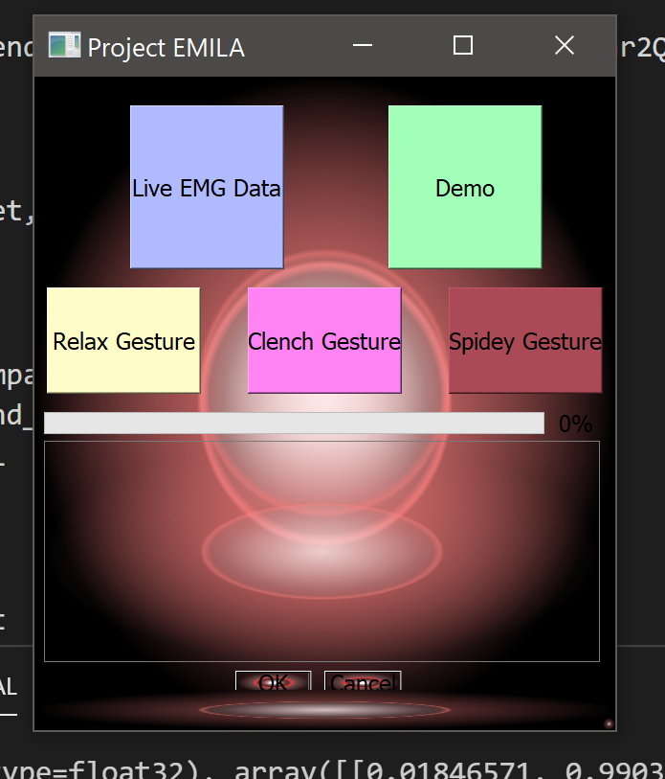
Project Criteria
Multitasking / Realtime
Sensor Data Acquisition
Plotting EMG Data
ML Classifier
Gesture movement
Interrupts
ML Classifier Verification for continued calibration
Data sampling time

Slide 4

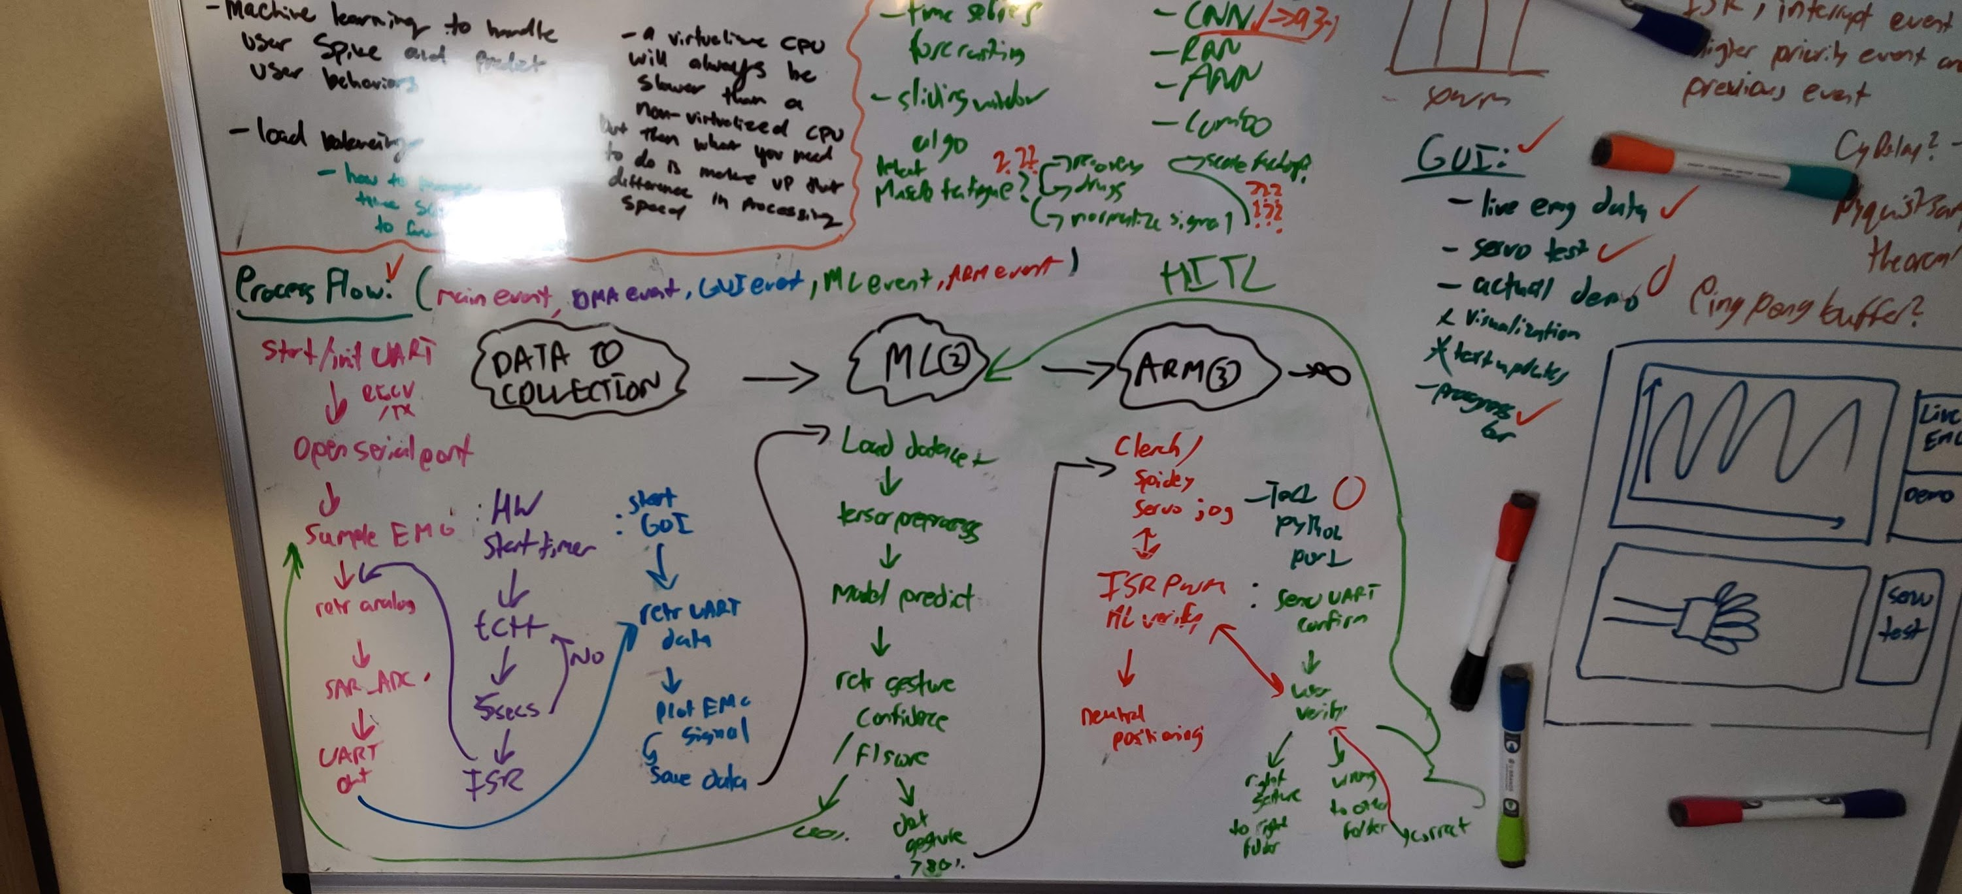
Process Flow

Slide 5
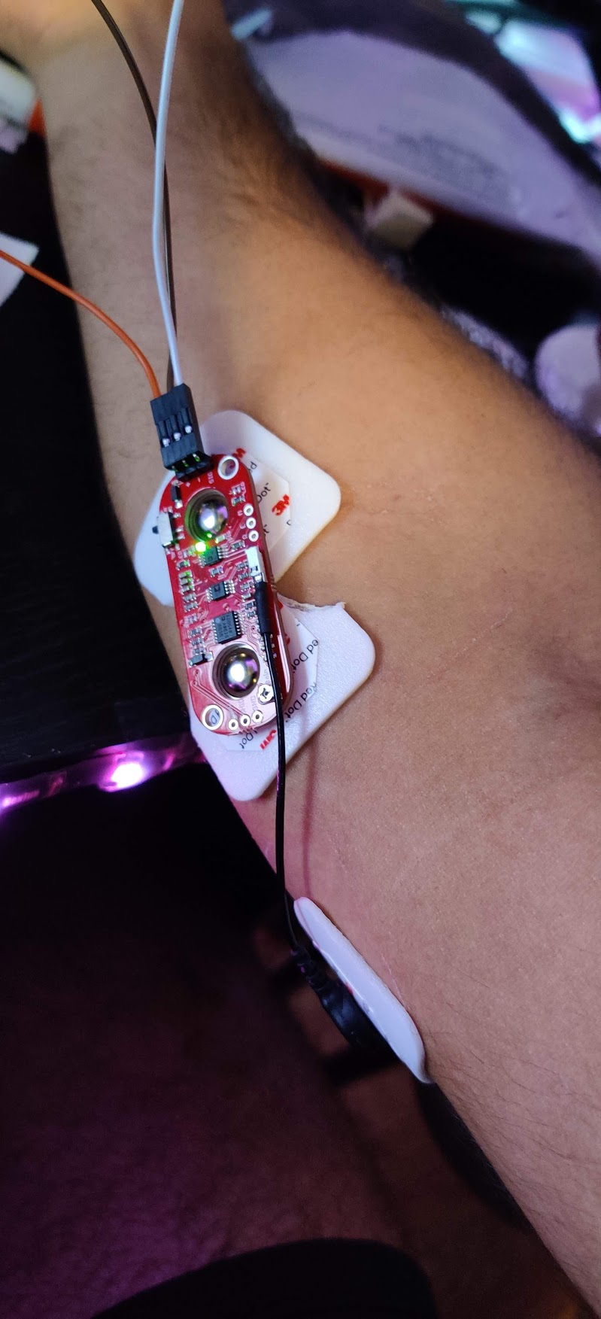
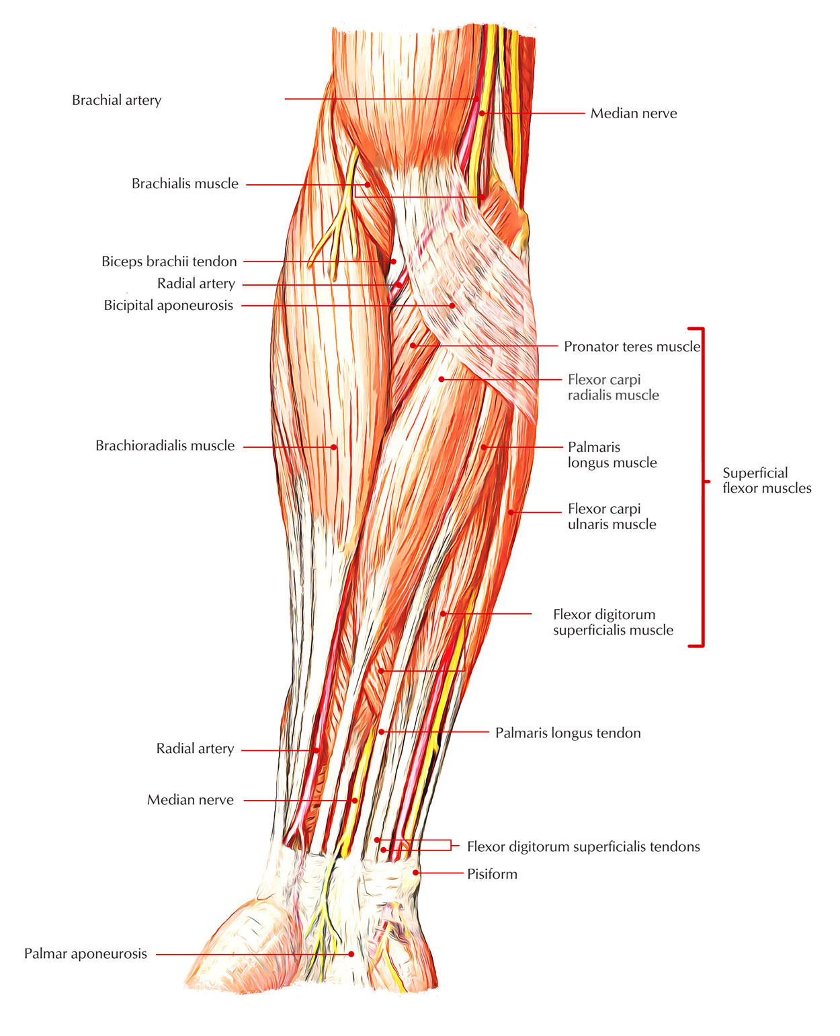
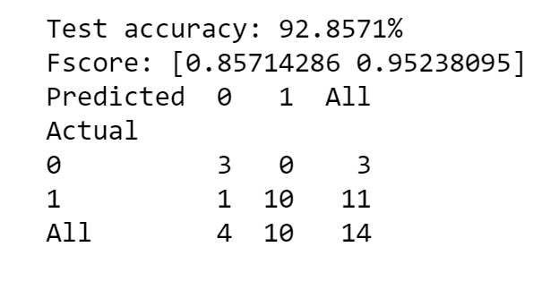
Challenges
EMG electrode array placement
Muscle fatigue
Muscular “crosstalk”
Machine learning approaches

