Slide 1
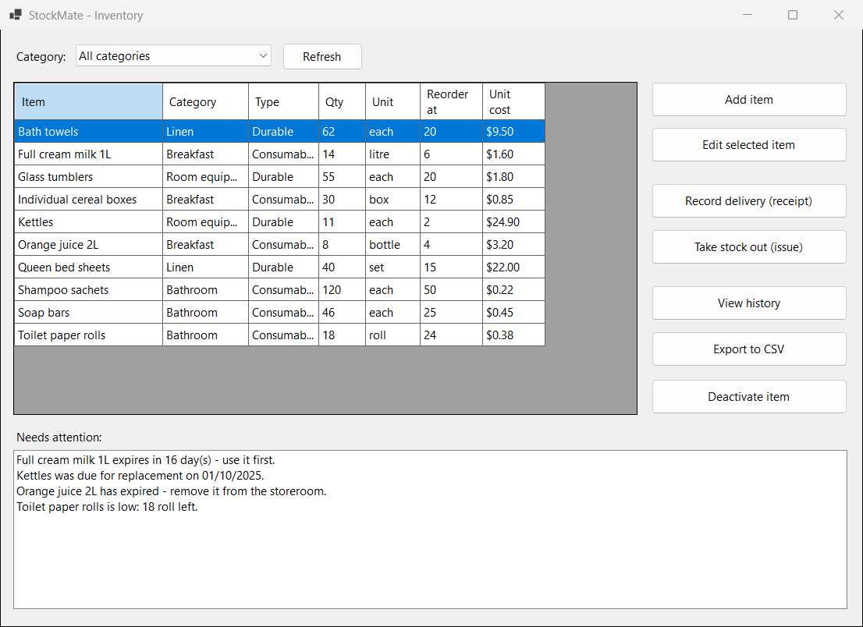
StockMate
A stock tracker for a small motel
Aashir Bhusal · s2400901
ITS203 Object-Oriented Design and Programming
Assessment C · Milestone 3 presentation
C# · Windows Forms · SQLite
Notes:
Good morning. I'm Aashir, and this is StockMate, a stock tracker for a small motel. It is a Windows desktop program written in C# with Windows Forms, with its data in a SQLite file. I will explain the problem, show the program working, and then walk through the parts of the code that show the OOP principles from this unit.

Slide 2



The problem: a storeroom run on paper
Small motels go through towels, sheets, soap and breakfast items every day. Most keep the count on a piece of paper in the storeroom, or do not keep it at all.
Runs out mid-shift
No clean towels at 9 am means someone drives to the shops and pays full price.
Over-orders, then throws away
Nobody knows what is left, so staff order extra. Milk and sanitiser go out of date on the shelf.
Who uses it
The motel manager and the housekeeping supervisor. They are not computer experts, so there is one main window, number boxes that only take numbers, and a question before anything that cannot be undone.
No record of who took what
Stock leaves the storeroom and nobody can say where it went.
Notes:
I help out at a motel in Sydney where the storeroom is managed on paper, and I have seen both problems: towels running out in the middle of a shift, and breakfast stock thrown away because nobody knew it was there. The users are the manager and the housekeeping supervisor, who are not computer people, so the program has to be simple.

Slide 3






What StockMate does
Add and edit items
Receipts and issues
Warnings on start-up
Consumables have a use-by date; durables have a replacement interval.
Every movement saves the date and the staff member's name.
Low stock, expiring within 30 days, expired, due for replacement.
History for one item
Export to CSV
Deactivate, never delete
Every receipt and issue, newest first, with a copy-as-text button.
The list on screen, with its total value, in a file Excel opens.
The item leaves the list but its history is kept.
All eight functional requirements from my Milestone 1 proposal are built, including the two I had marked as extras.
Notes:
Six things the program does. Staff add items, record deliveries and issues, and the program warns them when it opens. Each item has a history, the list exports to CSV with a total value, and an item that is no longer stocked is deactivated rather than deleted, so its history stays. All eight requirements from my proposal are built, including the two I marked as extras.

Slide 4
Live demo
1
Open StockMate — the warning list fills itself
2
Add an item — try a blank name first, then a real one
3
Record a delivery — quantity goes up, movement saved with my name
4
Take out more than is on hand — refused, with the reason
5
View history — newest first; copy it as text
6
Filter by category, export to CSV — total value at the bottom
Deactivate an item — it leaves the list, its history stays
Demo data: a 10-item motel storeroom
7
Notes:
Demo, about two and a half minutes. 1: open the program - point at the four kinds of warning. 2: Add item - press Save with a blank name to show the message, then add a real item. 3: Record a delivery of 20 on an item. 4: Take stock out - type more than is on hand to show 'Not enough stock', then a real amount. 5: View history on Bath towels, press Copy as text. 6: Filter to one category, Export to CSV, show the total in the message. 7: Deactivate an item, say No, then Yes.

Slide 5
How it is built
Forms
Models
Data
MainForm
stock list, filter, warnings, buttons
«interface» IReportable
ToReportLine()
Database
all the SQL; builds the right
subclass from the ItemType column
ItemForm
add or edit one item
«abstract» StockItem
Name, QuantityOnHand, Receive(), Issue()
NeedsAttention(), AttentionMessage()
stockmate.db (SQLite)
StockItems
Transactions
MovementForm
receipt or issue
ConsumableItem
use-by date
DurableItem
replacement interval
CsvExporter
writes a List<StockItem> to CSV
HistoryForm
movements for one item
StockMovement
one receipt or issue
Notes:
Three folders, three jobs. The forms are the windows; they never contain SQL and they cannot change a quantity directly. The models hold the classes and the rules: StockItem is abstract, ConsumableItem and DurableItem inherit from it, and StockMovement is a separate class for one receipt or issue. IReportable is an interface that both StockItem and StockMovement implement. The Database class holds every line of SQL and builds the right subclass from the ItemType column. CsvExporter writes a list of items to a file.

Slide 6
Abstraction
StockItem is abstract; IReportable is an interface
A plain stock item cannot say whether it needs attention today. Only a consumable (its use-by date) or a durable (its age) can, so StockItem leaves that to its subclasses and can never be created on its own.
IReportable is an interface, not a method on StockItem, because StockMovement needs a report line too and it is not a stock item.
The forms never see SQL. They call methods like GetHistory() on Database.
public abstract class StockItem : IReportable
{
// Each child class must fill these in.
public abstract string ItemType { get; }
public abstract bool NeedsAttention();
public abstract string AttentionMessage();
...
}
Models/StockItem.cs
// Anything that can describe itself as one line of
// text in a report.
public interface IReportable
{
string ToReportLine();
}
Models/IReportable.cs
Notes:
Abstraction. StockItem is abstract because a plain stock item cannot answer whether it needs attention today - that depends on whether it is a consumable with a use-by date or a durable with an age. So those three members are abstract and each subclass supplies its own answer. IReportable is an interface rather than a method on StockItem because StockMovement is not a stock item but still needs a report line. The forms are also kept away from SQL: everything goes through the Database class.

Slide 7
Inheritance
ConsumableItem and DurableItem extend StockItem and add only what is different
Inherited from StockItem: name, category, unit, quantity, reorder level, unit cost, the validation, Receive(), Issue(), IsLowStock and TotalValue.
Added here: a use-by date and the rule for when it needs attention.
DurableItem adds a replacement interval and a last-replaced date instead.
base(name, category, quantity) passes the shared values up to StockItem's constructor.
public class ConsumableItem : StockItem
{
// Warn this many days before the use-by date.
public const int ExpiryWarningDays = 30;
public ConsumableItem(string name, string category,
int quantity, DateTime expiryDate)
: base(name, category, quantity)
{
ExpiryDate = expiryDate;
}
public DateTime ExpiryDate { get; set; }
public override bool NeedsAttention()
{
return IsLowStock || IsNearExpiry || IsExpired;
}
}
Models/ConsumableItem.cs
Notes:
Inheritance. ConsumableItem and DurableItem both extend StockItem. They get everything shared for free - the fields, the validation, Receive and Issue, IsLowStock and TotalValue - and add only what is different about them. A consumable adds a use-by date; a durable adds a replacement interval and the date it was last replaced. The constructor passes the shared values up with base.

Slide 8
Encapsulation
The quantity can only change through Receive() and Issue()
The setter is private, so no form can write a number into the quantity.
Receive() and Issue() check the rules first and are the only way in.
Name, Category, ReorderLevel and UnitCost keep their values in private fields and validate in the setter. A blank name throws.
Seen in testing: every refused issue left the quantity and the database untouched, and it could not have been otherwise.
// Other code can read the quantity but cannot assign to it.
public int QuantityOnHand { get; private set; }
public void Receive(int quantity)
{
if (quantity <= 0)
throw new ArgumentException("...must be more than zero.");
QuantityOnHand = QuantityOnHand + quantity;
}
public void Issue(int quantity)
{
if (quantity <= 0)
throw new ArgumentException("...must be more than zero.");
if (quantity > QuantityOnHand)
throw new InsufficientStockException(
Name, quantity, QuantityOnHand);
QuantityOnHand = QuantityOnHand - quantity;
}
Models/StockItem.cs (messages shortened)
Notes:
Encapsulation. QuantityOnHand has a private setter, so nothing outside the class can assign to it. It only changes through Receive and Issue, and both check the rules first. The other properties keep their values in private fields and validate in the setter - a blank name or a negative cost throws an ArgumentException. In testing this paid off: every refused issue left the quantity and the database exactly as they were.

Slide 9
Polymorphism
The same call, a different answer for each type
foreach (StockItem item in _items)
{
// Does not need to know which
// subclass it is holding.
if (item.NeedsAttention())
{
lstWarnings.Items.Add(item.AttentionMessage());
}
}
List<IReportable> lines = new List<IReportable>();
lines.Add(_item);
foreach (StockMovement movement in _movements)
lines.Add(movement);
foreach (IReportable line in lines)
text.AppendLine(line.ToReportLine());
Forms/MainForm.cs ShowWarnings()
Forms/HistoryForm.cs btnCopy_Click()
ConsumableItem.NeedsAttention()
low stock, or within 30 days of its use-by date, or expired
DurableItem.NeedsAttention()
low stock, or past its replacement date
Reused by CsvExporter
the Status column comes from the same two calls
Notes:
Polymorphism, in two forms. On the left, ShowWarnings loops over a list of StockItem and calls NeedsAttention and AttentionMessage. It never checks the type: a consumable answers from its use-by date, a durable from its age. CsvExporter reuses the same two calls for its Status column. On the right, through the interface: the history window puts an item and its movements - two unrelated classes - into one list of IReportable and calls ToReportLine on each.

Slide 10
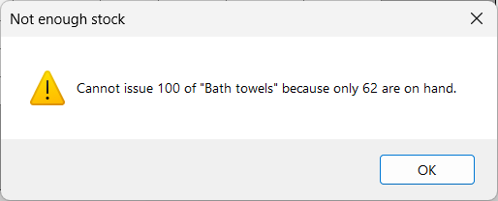
Exception handling and validation
A custom exception, caught in its own block before the general one
public class InsufficientStockException : Exception
{
public string ItemName { get; }
public int QuantityRequested { get; }
public int QuantityAvailable { get; }
...
}
// MainForm.RecordMovement()
try
{
selected.Issue(form.Quantity);
_database.SaveMovement(selected, movementType, ...);
}
catch (InsufficientStockException ex)
{
MessageBox.Show(ex.Message, "Not enough stock", ...);
}
catch (Exception ex)
{
ShowError("Could not save the movement.", ex);
}
Order matters: the specific catch comes first, so a shortage gets a plain message and real errors still surface.
ItemForm catches the ArgumentException thrown by the setters: “Item name cannot be blank.”
The export catches IOException when the file is open in Excel; Program.Main shows a message if the database is damaged.
Models/InsufficientStockException.cs · Forms/MainForm.cs
Notes:
Exception handling. Issue throws my own InsufficientStockException, which carries the item name, the quantity asked for and the quantity on hand. RecordMovement catches it in its own block, placed before catch Exception - the order matters - so a shortage gets a plain message while a real error still surfaces. Validation lives in the model setters: a blank name throws an ArgumentException and ItemForm shows it. The export catches IOException for a file open in Excel, and Program.Main shows a message instead of crashing if the database file is damaged.

Slide 11
Data: SQLite, two tables, one transaction
StockItems
ItemId, Name, Category, ItemType, Unit, QuantityOnHand, ReorderLevel, UnitCost, IsActive, ExpiryDate, ReplacementMonths, LastReplacedDate
public void SaveMovement(StockItem item,
string transactionType, int quantity, string staffName)
{
using (SqliteConnection connection = Open())
using (SqliteTransaction transaction =
connection.BeginTransaction())
{
// 1. add the movement
insert.CommandText = "INSERT INTO Transactions (...)";
insert.Parameters.AddWithValue("$id", item.ItemId);
insert.ExecuteNonQuery();
// 2. store the item's new quantity
update.CommandText = "UPDATE StockItems " +
"SET QuantityOnHand = $qty WHERE ItemId = $id";
update.ExecuteNonQuery();
// both or neither
transaction.Commit();
}
}
Transactions
TransactionId, ItemId, TransactionType, Quantity, TransactionDate, StaffName
Rows are never changed or deleted, so the history stays true.
ReadItem() looks at the ItemType column and builds a ConsumableItem or a DurableItem, so the rest of the program only ever sees objects.
Data/Database.cs (shortened)
Notes:
Data. Two tables in one SQLite file next to the program. Every movement is a row in Transactions and those rows are never edited or deleted. Saving a movement writes two things - the new Transactions row and the item's new quantity - inside one database transaction, so either both are saved or neither is. Queries use named parameters, so a quote mark in a name cannot break them. When rows are read back, ReadItem looks at the ItemType column and builds the right subclass.

Slide 12
Testing
38 scenarios through the real windows, against a separate test database, checked afterwards with SQL
38
36
2
scenarios run
passed first time
failed, fixed, passed again
Found: the database followed the start folder
Started from a different folder, the program showed an empty list and created a second database. Fix: build the path from AppContext.BaseDirectory.
Found: a crash on Edit above 100,000
The read-only quantity box still had a maximum of 100,000 and threw. Fix: raise the maximum before showing the value.
Speed with 2,000 items: start-up 0.73–0.80 s (target 1 s, met) · filter 0.12 s (met) · refresh after a save 1.4–1.6 s (target 1 s, not met — the whole list is reloaded)
Notes:
Testing. 38 scenarios, each done through the real windows against a separate test database, and after each group I read the database with a separate query to check what was really saved. Boundaries were part of it: a use-by date 30 days away warns and 31 does not; a quantity equal to the reorder level warns and one above does not. Two scenarios failed. Started from a different folder, the program created a second, empty database - fixed by building the path from the program's own folder. And editing an item holding more than 100,000 crashed, because the read-only quantity box still had a maximum - fixed by raising it first. With 2,000 items start-up and filtering meet my one-second target, but refresh after a save takes about one and a half seconds, which I have not fixed.

Slide 13
Looking back
24 commits, 23 August to 4 October
23 Aug
9 Sep
21 Sep
23 Sep
4 Oct
3 commits
solution, models, notes
3 commits
database and the three forms
2 commits
progress report, screenshots
5 commits
deactivate, history, bug fix
11 commits
CSV export, testing, fixes, reflection
What changed from the proposal
What I would do differently
Three tables became two: the Categories lookup table was not worth a join and an extra form.
One window with tabs became a main window with small pop-up forms.
FR-07 and FR-08 were extras; both are built, and FR-07 needed a class the proposal never had, StockMovement.
Test from week one. Both failures had been in the code since August.
Work steadily instead of in a few long sittings; the timeline above shows it.
Update one row after a save instead of reloading the whole list.
Notes:
Looking back. The commit history is honest: twenty-four commits, but in five blocks rather than a little each week, and the last block was on the final day. From the proposal, three tables became two, tabs became pop-up forms, and both extras were built - the history needed a new class, StockMovement, which is also where IReportable finally earned its place. If I started again I would test from the first week, because both bugs had been there since August, I would work more steadily, and I would update one row after a save instead of reloading the whole list.

Slide 14
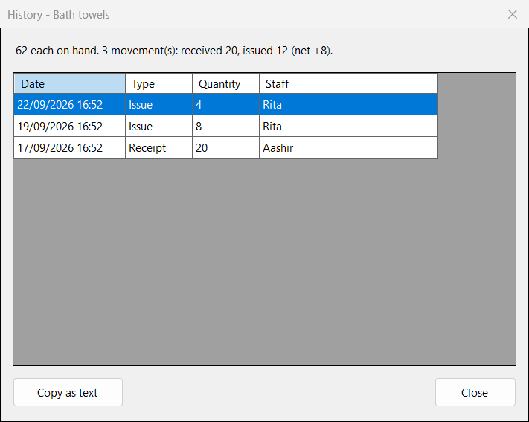
Questions
github.com/AashirBhusal/StockMate
Source code, README, test record, proposal, progress report and reflection
Aashir Bhusal · s2400901
Notes:
Thank you. The repository is public at github.com/AashirBhusal/StockMate. Happy to take questions on the code, the design decisions, validation, exception handling or the commit history.

