Slide 1



Artificial Neural Networks
By Aashirya Kaushik

Slide 2
History
The first artificial neural network was invented in 1958 by psychologist Frank Rosenblatt. Called Perceptron, it was intended to model how the human brain processed visual data and learned to recognize objects.

Slide 3
Artificial Neural Network
Neural networks are a set of algorithms, modeled loosely after the human brain, that are designed to recognize patterns.
They interpret sensory data through a kind of machine perception, labeling or clustering raw input. The patterns they recognize are numerical, contained in vectors, into which all real-world data, be it images, sound, text or time series, must be translated.

Slide 4
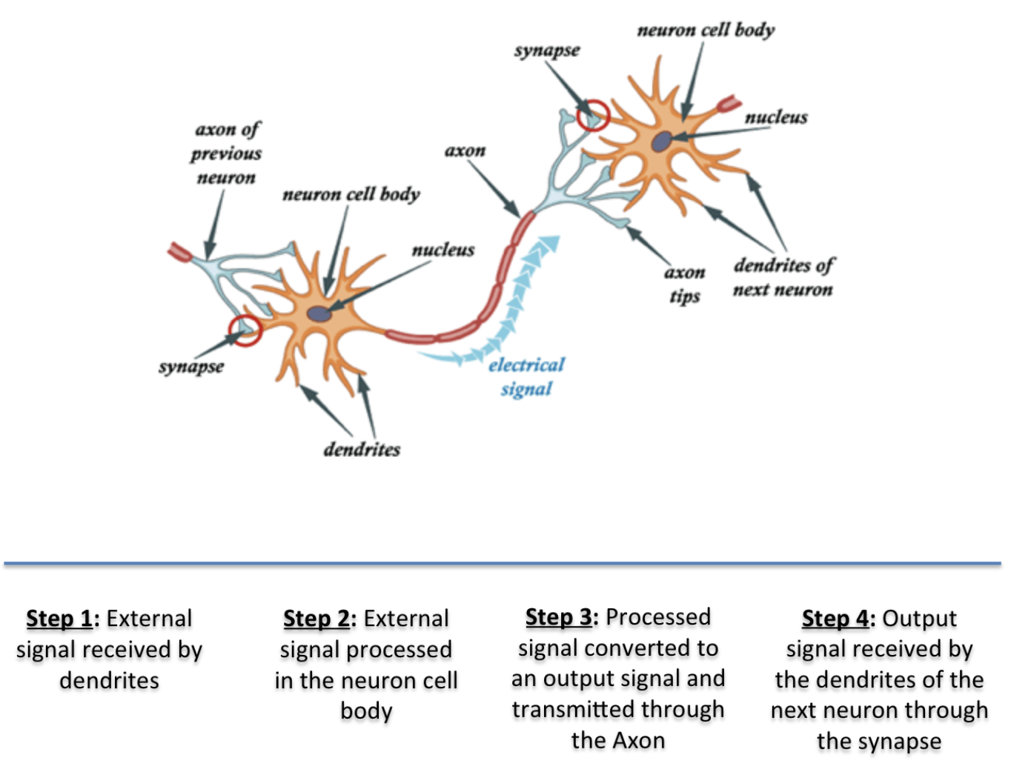
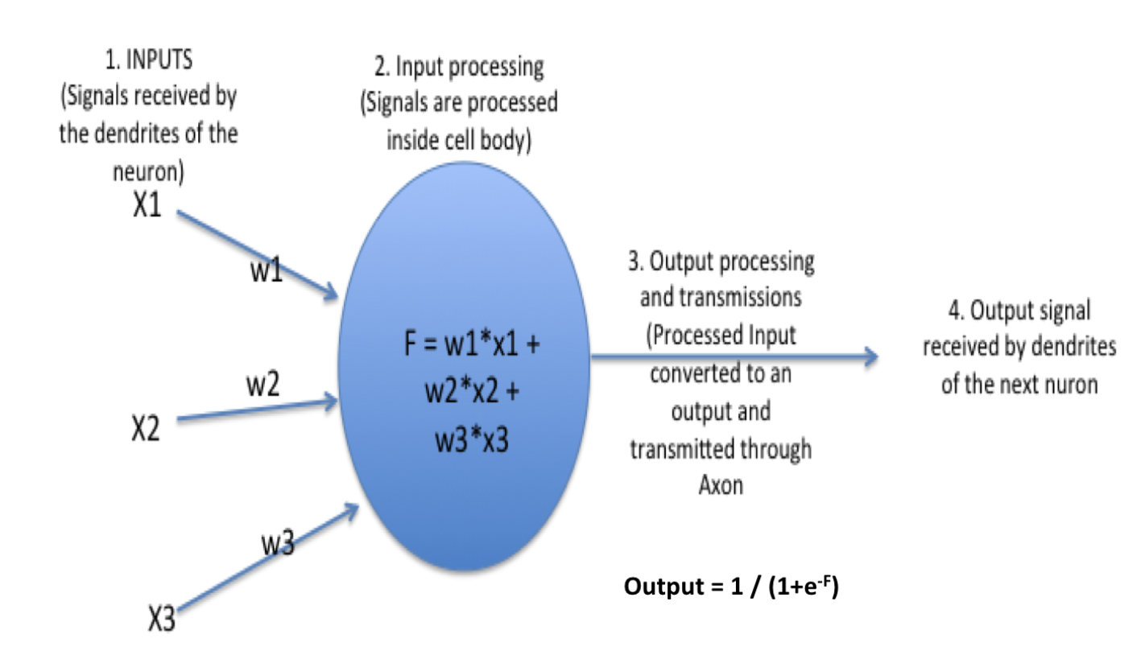
Similarity between working of neuron and Neural Network
In our brain, there are billions of cells called neurons, which processes information in the form of electric signals. External information/stimuli is received by the dendrites of the neuron, processed in the neuron cell body, converted to an output and passed through the Axon to the next neuron. The next neuron can choose to either accept it or reject it depending on the strength of the signal.

Slide 5
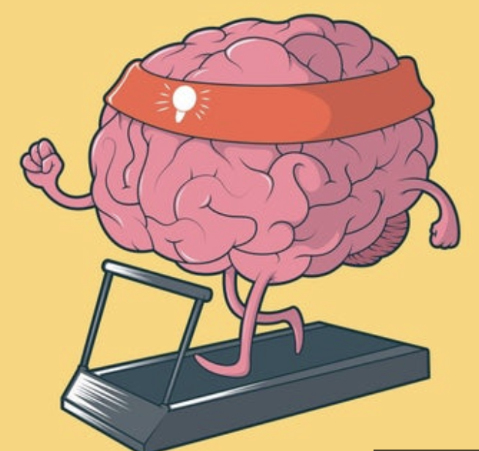
How do Artificial Neural Networks Learn?
Artificial neural networks learn primarily by three ways:
Supervised Learning
Unsupervised Learning
Reinforcement Learning

Slide 6
Types of Artificial Neural networks
Feedforward Neural Network
Radial basis Function Neural Network
Multilayer Perceptron
Convolutional Neural Networks

Slide 7
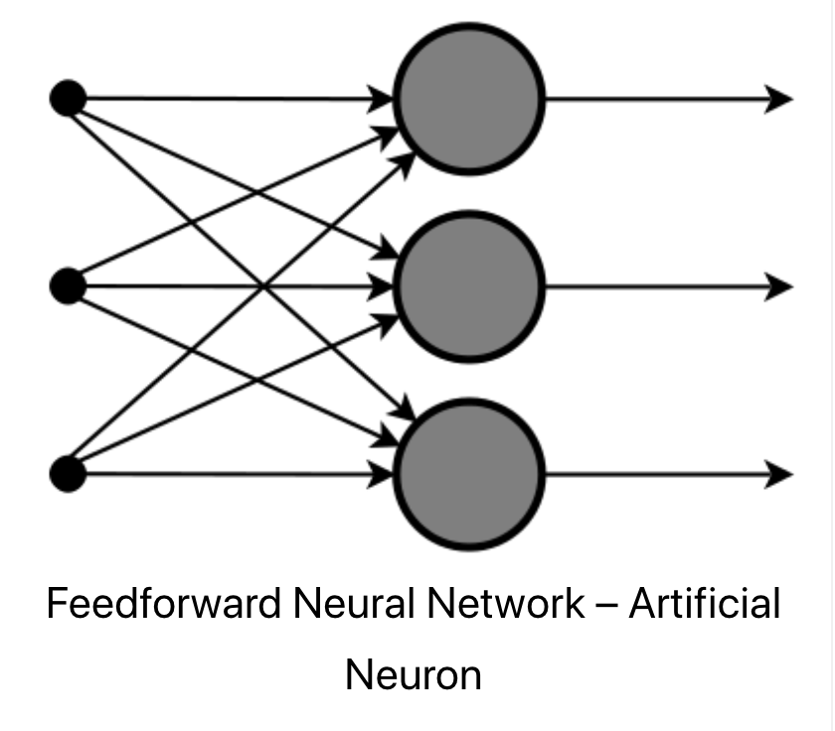
Feedforward neural network
This is one of the simplest types of artificial neural networks. In a feedforward neural network, the data passes through the different input nodes till it reaches the output node.
In other words, data moves in only one direction from the first tier onwards until it reaches the output node. This is also known as a front propagated wave which is usually achieved by using a classifying activation function.

Slide 8
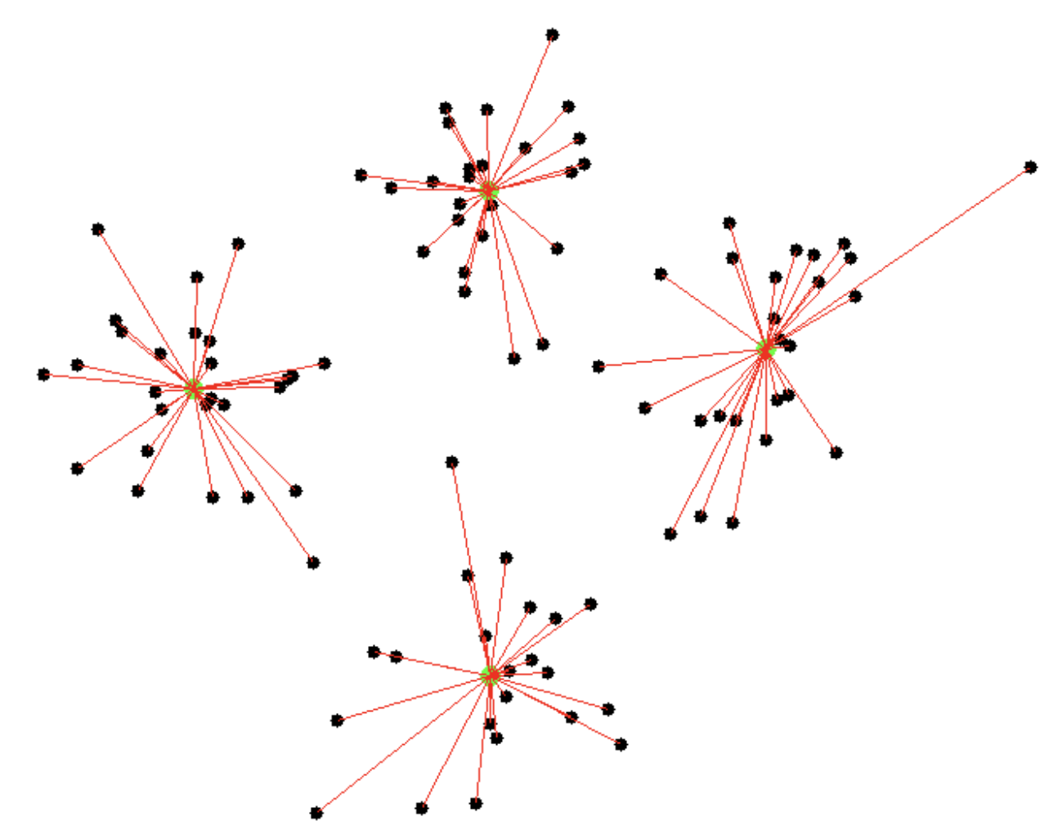
Radial basis function neural network
A radial basis function considers the distance of any point relative to the center. Such neural networks have two layers. In the inner layer, the features are combined with the radial basis function.
Then the output of these features is taken into account when calculating the same output in the next time-step.
The radial basis function neural network is applied extensively in power restoration systems. In recent decades, power systems have become bigger and more complex.
This increases the risk of a blackout. This neural network is used in the power restoration systems in order to restore power in the shortest possible time.

Slide 9
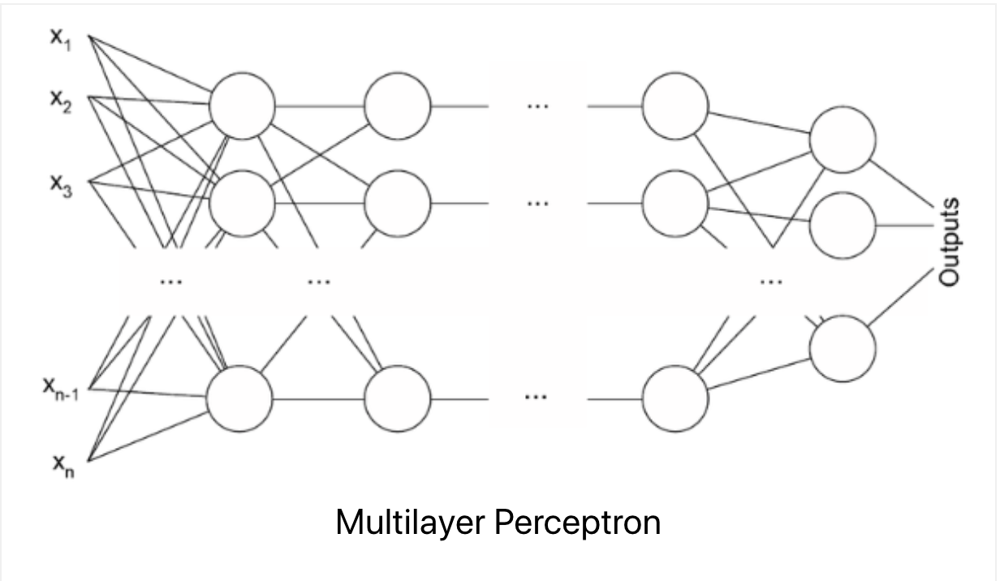
Multilayer perceptron
A multilayer perceptron has three or more layers. It is used to classify data that cannot be separated linearly. It is a type of artificial neural network that is fully connected. This is because every single node in a layer is connected to each node in the following layer.
A multilayer perceptron uses a nonlinear activation function (mainly hyperbolic tangent or logistic function).
This type of neural network is applied extensively in speech recognition and machine translation technologies.

Slide 10
Convolutional Neural networks
A convolutional neural network(CNN) uses a variation of the multilayer perceptrons. A CNN contains one or more than one convolutional layers. These layers can either be completely interconnected or pooled.

Slide 11
Advantages of Artificial Neural Networks
Storing information on the entire network
The ability to work with inadequate knowledge
It has fault tolerance
Having a distributed memory
Gradual corruption
Ability to train machine
Parallel processing ability

Slide 12
Disadvantages of Artificial neural networks
Hardware dependence
Unexplained functioning of the network
Assurance of proper network structure
The difficulty of showing the problem to the network
The duration of the network is unknown

Slide 13
Applications of Artificial neural networks
Image Processing and Character recognition - Given Artificial Neural Networks ability to take in a lot of inputs, process them to infer hidden as well as complex, non-linear relationships, ANNs are playing a big role in image and character recognition. Character recognition like handwriting has lot of applications in fraud detection (e.g. bank fraud) and even national security assessments. Image recognition is an ever-growing field with widespread applications from facial recognition in social media, cancer detention in medicine to satellite imagery processing for agricultural and defense usage. The research on ANN now has paved the way for deep neural networks that forms the basis of “deep learning” and which has now opened up all the exciting and transformational innovations in computer vision, speech recognition, natural language processing famous examples being self-driving cars.

Slide 14
Applications of Artificial neural networks
Forecasting: Forecasting is required extensively in everyday business decisions (e.g. sales, financial allocation between products, capacity utilization), in economic and monetary policy, in finance and stock market. More often, forecasting problems are complex, for example, predicting stock prices is a complex problem with a lot of underlying factors (some known, some unseen). Traditional forecasting models throw up limitations in terms of taking into account these complex, non-linear relationships. ANNs, applied in the right way, can provide robust alternative, given its ability to model and extract unseen features and relationships. Also, unlike these traditional models, ANN doesn’t impose any restriction on input and residual distributions.

Slide 15
QUESTIONS?

