Slide 1
FORMAL LANGUAGE AND AUTOMATA THEORY
INSTRUCTED BY SANJANA SRI MAM
FINAL PROJECT PRESENTATION

Slide 2
TEAM MEMBERS
AMEEN ASHADULLAH M
CB.EN.U4AIE20004
GHAAYATHRI DEVI K
CB.EN.U4AIE20017
GORANTLA V N S L VISHNU VARDHAN
CB.EN.U4AIE20019
MENTA SAI AASHISH
CB.EN.U4AIE20039
V SAI ARAVIND
CB.EN.U4AIE20062

Slide 3
LEXICAL ANALYZER

Slide 4
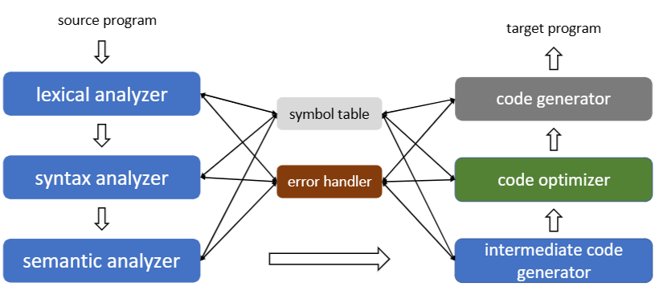
An Overview of Compilation

Slide 5
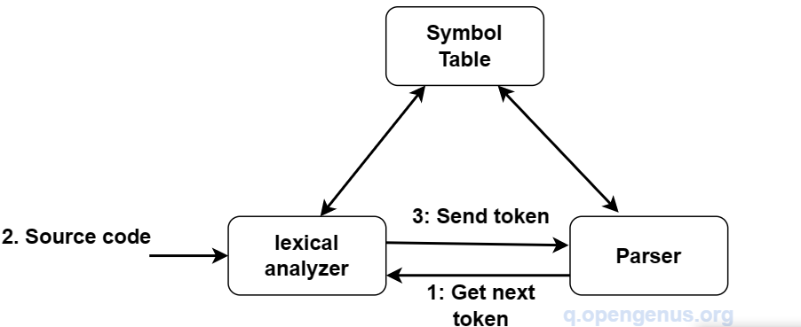
Description of Lexical Analysis
Input:
A high-level language program, such as a C or Java program, in the form of a sequence of ASCII characters .
Output:
A sequence of tokens along with attributes corresponding to different syntactic categories that is forwarded to the parser for syntax analysis
Lexical Analysis is the first phase of compiler design where input is scanned to identify tokens

Slide 6
FUNCTIONALITY OF A LEXICAL ANALYZER
Functionality: Strips off blanks, tabs, newlines, and comments from the source program • Keeps track of line numbers and associates error messages from various parts of a compiler with line numbers • Performs some preprocessor functions in languages like C
We can either hand code a lexical analyzer or use a lexical analyzer generator to design a lexical analyzer.
Hand-coding the steps involve the following;
Specification of tokens by use of regular expressions.
Construction of a finite automata equivalent to a regular expression.
Recognition of tokens by a constructed finite automata

Slide 7

Recognizing Word “new”
c = getNextChar();
if (c == ‘n’)
c = getNextChar();
if (c == ‘e’)
c = getNextChar();
if (c == ‘w’)
report success;
else
// Other logic
else
// Other logic
else
// Other logic

Slide 8
TOKENS
A string of characters which logically belong together in a syntactic category •
Sentences consist of a string of tokens
For example, float, identifier, equal, minus, intnum, semicolon
Tokens are treated as terminal symbols of the grammar specifying the source language
May have an optional attribute

Slide 9
Pattern
The rule describing the set of strings for which the same token is produced
The pattern is said to match each string in the set • float, letter(letter|digit|_)*, =, -, digit+ , ;
Lexeme
• The sequence of characters matched by a pattern to form the corresponding token
Eg: “float”, “abs_zero”, “=”, “-”, “273”, “;”

Slide 10
FSM CONCEPTS USED
NFA
NFA is a finite state machine that allows multiple transitions for a single input symbol and/or has transitions that do not consume an input symbol
REGULAR EXPRESSION
DFA
A regular expression is a sequence of characters that defines a search pattern. It is mainly used to match or extract patterns from text. Regular expressions can be used to check if a string contains the specified search pattern.
DFA is a finite state machine that has a unique transition for every input symbol and state. It means that for each state and input symbol, there is only one transition to the next state.
MEALY MACHINE
MOORE'S MACHINE

Slide 11
REQUIRED CONVERSION CONCEPTS
A lexical analyzer generator systematically translates regular expressions to NFA which is then translated to an efficient DFA.
From Regular expression to NFA
From NFA to DFA.
Regular expression to Nondeterministic Finite Automaton (NFA) conversion is the process of constructing an NFA that recognizes the language described by a given regular expression.
by constructing a new DFA that has the same set of states and transitions as the original NFA.

Slide 12

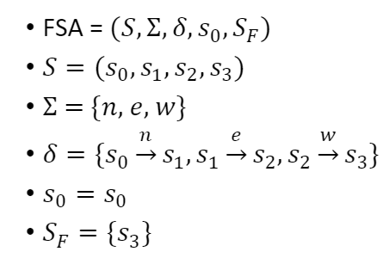
FSA for recognizing “new”

Slide 13
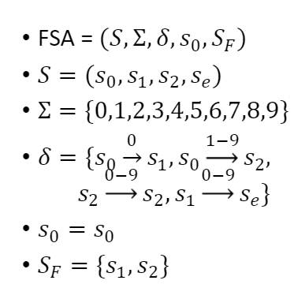
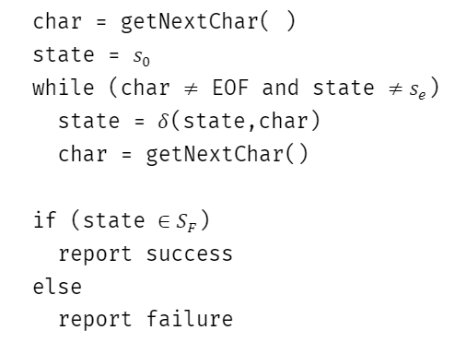
FSA for Unsigned Integers

Slide 14
ROLE OF FSA IN LEXICAL ANALYSER
The role of a Finite State Automaton (FSA) in a lexical analyzer is to recognize the tokens in the input character stream and to group them into lexemes. A lexeme is a sequence of characters that form a token.
For example, in a programming language, a lexeme may be a keyword like "while" or "for", an identifier like a variable name, a constant like a number, or a symbol like a punctuation mark. The lexer uses an FSA to identify the lexemes in the input and to determine their corresponding tokens.
The FSA is constructed from a set of rules called regular expressions, which specify the patterns that the lexeme must match. The FSA reads the input character by character and transitions between states according to the rules until it reaches an accepting state, indicating that it has recognized a valid lexeme. The lexer then returns the corresponding token for that lexeme to the parser, which is responsible for interpreting the meaning of the tokens in the context of the programming language.

Slide 15
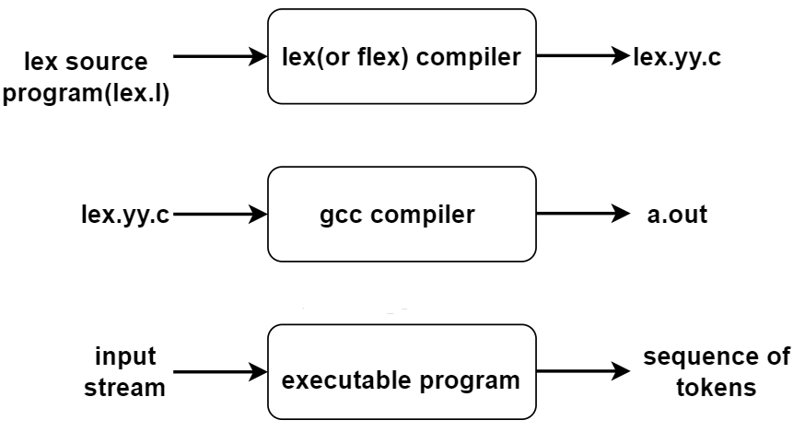
Generating a lexical analyzer
A lex or flex is a program that is used to generate a lexical analyzer. These translate regular definitions into C source code for efficient lexical analysis.

Slide 16
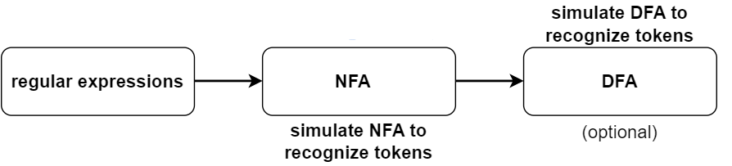
A lexical analyzer generator systematically translates regular expressions to NFA which is then translated to an efficient DFA.

Slide 17
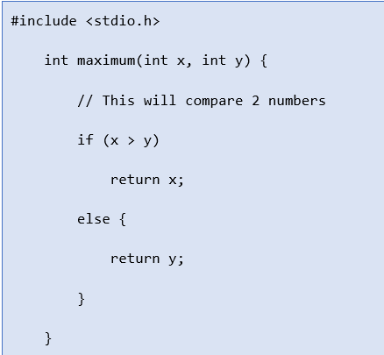
Example of Lexical Analysis, Tokens, Non-Tokens
Consider the following code that is fed to Lexical Analyzer

Slide 18
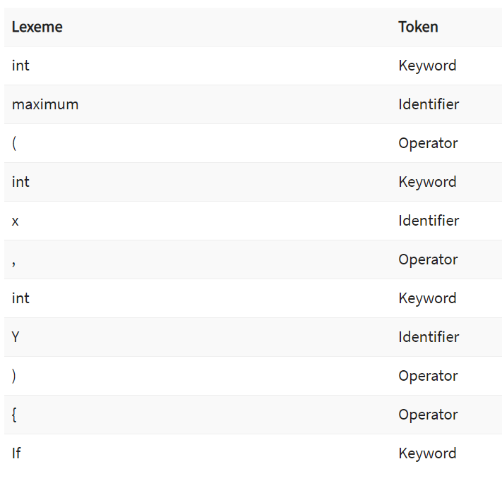
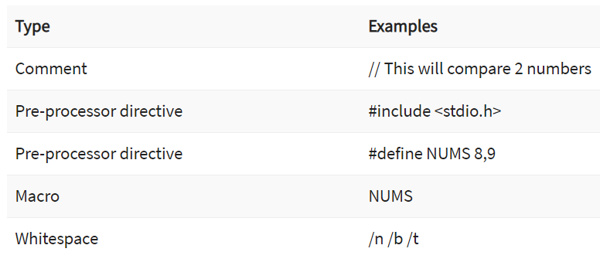
Examples of Tokens Created
Examples of Non-tokens

Slide 19
Lexical Errors
A character sequence which is not possible to scan into any valid token is a lexical error. Important facts about the lexical error:
Lexical errors are not very common, but it should be managed by a scanner
Misspelling of identifiers, operators, keyword are considered as lexical errors
Generally, a lexical error is caused by the appearance of some illegal character, mostly at the beginning of a token.

Slide 20
Error Recovery in Lexical Analyzer
Here, are a few most common error recovery techniques:
Removes one character from the remaining input
In the panic mode, the successive characters are always ignored until we reach a well-formed token
By inserting the missing character into the remaining input
Replace a character with another character
Transpose two serial characters

Slide 21
Roles of lexical analyzer.
Correlation of error messages with the source code.
Removal of white spaces and comments from source program.
Expansion of macros if found in source program.
Identification of tokens.
Reading of input characters from source program.
Notes:
A lexical analyzer, also known as a lexer or tokenizer, is a software component that performs lexical analysis. Lexical analysis is the process of converting a sequence of characters in a source program into a sequence of tokens, which are strings with a specific meaning.
The role of a lexical analyzer is to break the source code into tokens that can be understood by the compiler or interpreter. This process involves several tasks:
Reading of input characters from the source program: The lexer reads the characters in the source program one by one, creating a stream of input characters.
Removal of white spaces and comments: The lexer ignores white spaces (such as spaces, tabs, and newlines) and comments, as they are not necessary for the compiler or interpreter to understand the program.
Expansion of macros: If the source program contains macros, the lexer expands them into their corresponding code before further processing.
Identification of tokens: The lexer identifies the tokens in the source code by matching patterns of characters to specific token types (such as keywords, identifiers, and operators).
Correlation of error messages with the source code: If the lexer encounters an error while processing the source code (such as an invalid character or an unterminated string), it can provide an error message that includes the line number and position in the source code where the error occurred. This helps developers locate and fix errors in the source code.
Macros?
In computer programming, a macro is a piece of code that represents a sequence of instructions. Macros are often used to define short, frequently-used code snippets that can be easily reused in a program.
Macros are typically defined using a preprocessor directive, which is a line of code that is processed before the main program is compiled. The preprocessor replaces each occurrence of the macro with the corresponding code snippet, allowing the programmer to use the macro as if it were a regular function or statement.
For example, a programmer might define a macro to represent a loop that prints the numbers from 1 to 10. Instead of writing out the loop code every time it is needed, the programmer can simply use the macro name wherever the loop is needed in the program. When the program is compiled, the preprocessor will replace each occurrence of the macro with the actual loop code.
Macros can be useful for reducing the amount of code that needs to be written and for making code easier to read and maintain. However, they can also make code more difficult to debug, since the actual code that is executed may not be visible in the source program.

Slide 22
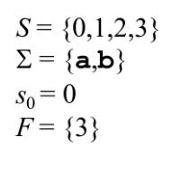
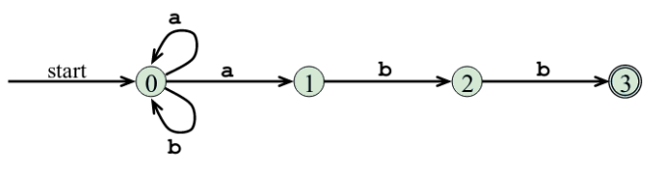
Structure of the generated analyzer.
The lexical analyzer comprises of a program to simulate automata and 3 components created from the lex program by the lex
a transition table for the automaton
functions passed directly through lex to the output and
actions from the input program which appear as fragments of code to be invoked by the automaton simulator at the appropriate time.
A transition graph is an equivalent way of representing an NFA, for each state s and an input symbol x(and ε), the set of successor states x leads to from s. The empty set φ is used where there is no edge labeled x from s.
Notes:
A lexical analyzer is a program that breaks down an input string into its individual tokens (also known as lexemes). These tokens are then used by the parser to build the syntax tree of the input string.
The lexical analyzer typically consists of three components:
An automaton simulator: This is a program that simulates the operation of a finite automaton (such as a deterministic finite automaton or DFA) on the input string. The automaton reads the input string character by character and transitions from one state to another based on the transition function of the automaton.
A transition table: This is a table that specifies the transition function of the automaton. It consists of a list of states and the input symbols that cause the automaton to transition from one state to another.
Actions: These are fragments of code that are associated with certain states of the automaton. When the automaton enters one of these states, the corresponding action is executed. Actions are typically used to perform tasks such as adding the current token to a list of tokens or setting a flag to indicate that the input string has been accepted by the automaton.
The lexical analyzer is typically generated by a program called "lex", which takes as input a specification of the tokens to be recognized and generates the automaton and associated code needed to perform the lexical analysis. The output of the lex program consists of the transition table and actions, which are combined with the automaton simulator to form the complete lexical analyzer.

Slide 23
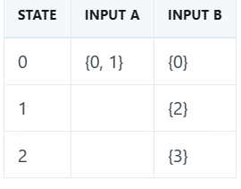
A transition table is the mapping of δ of an NFA. δ(0, a) = {0, 1} δ(0, b) = {0} δ(1, b) = {2} δ(2, b) = {3}
Construction of an automaton begins by taking each regular expression pattern in the lex program and converting it to an NFA. An NFA accepts an input string x if there is some path with edges labeled with symbols from x in a sequence from start to an accepting state in the transition graph.
The result is a single automaton which will recognize lexemes matching any patterns in the program so that we can combine all NFAs into one by using a new start with e-transitions for each of the start states of the NFSs.

Slide 24
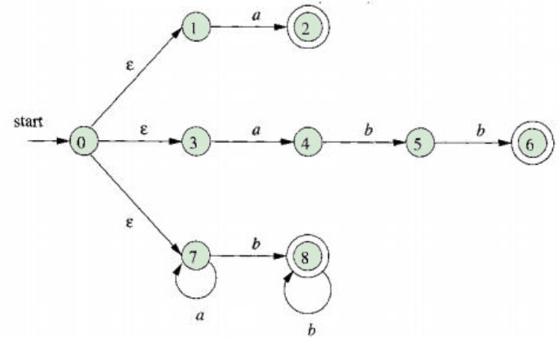
Pattern matching based on NFAs.
It will read input from lexemeBegin and as it moves the forward pointer ahead in the input, It will calculate the set of states it is in at each point. When the simulation reaches a point where there are no states remaining it will determine the longest prefix that is a lexeme matching a pattern. This is because there will be no longer prefix of an input that will get the NFA to an accepting state because the will be no more states at this point

Slide 25
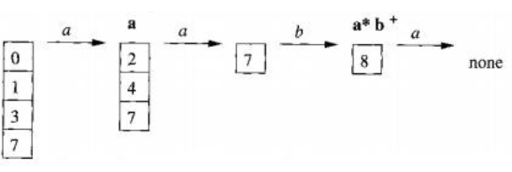
To determine the longest prefix, we look backwards in the sequence of sets of states until we find a set including one or more accepting states. If there is a case where there are several such states, we select the one associated with the earliest pattern pi in the list from the lex program. To do this we move the forward pointer to the end of the lexeme and perform the action Ai associated with patterns pi.

Slide 26
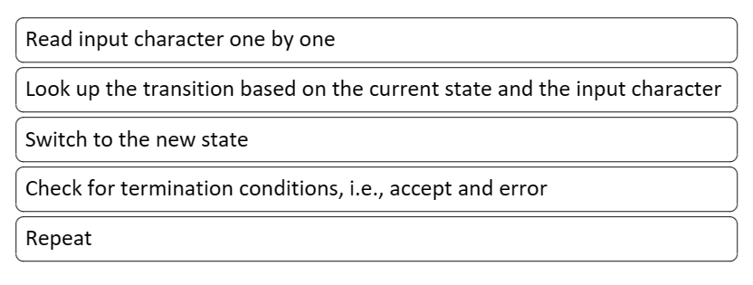
High-Level Idea in Implementing Scanners (lexical analyzer)

Slide 27
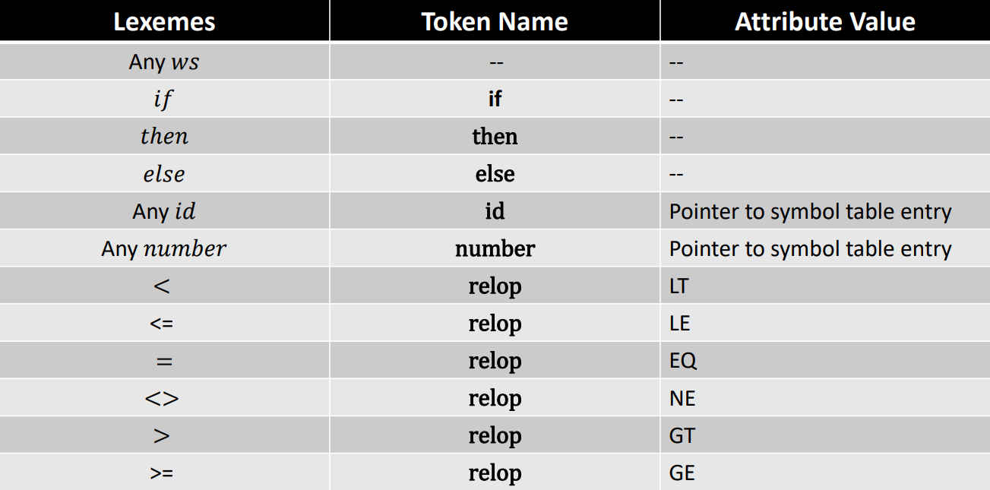
Tokens, Lexemes, and Attributes

Slide 28
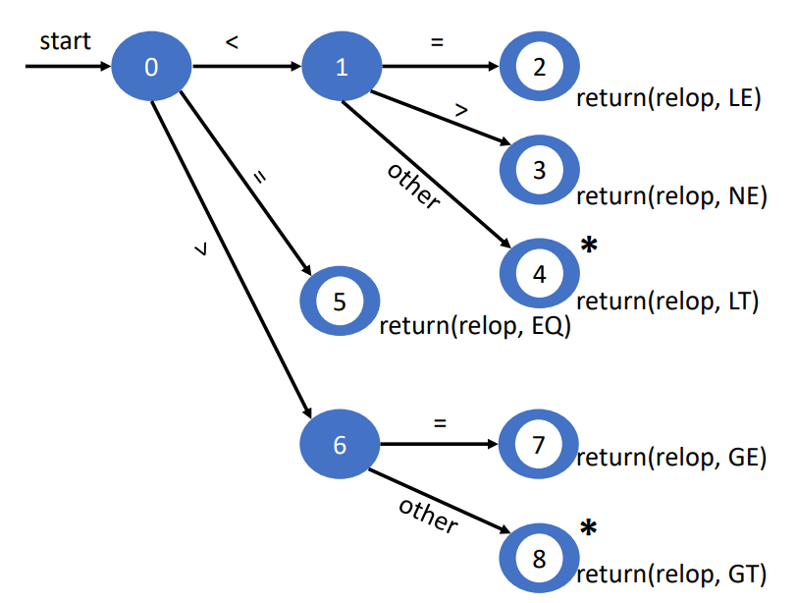
Transition Diagram for relop

Slide 29
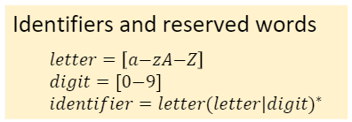
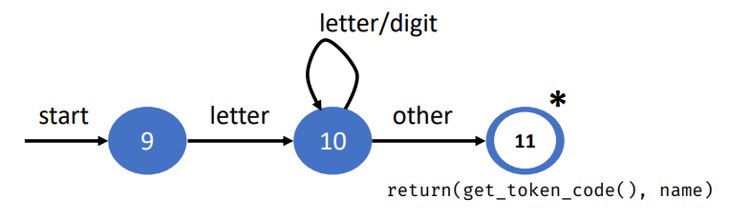
Transition Diagrams for IDs and Keywords

Slide 30
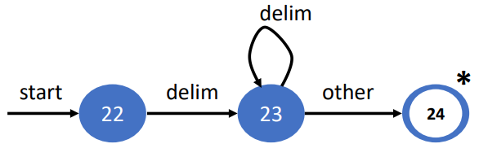
Transition Diagrams for Whitespaces

Slide 31
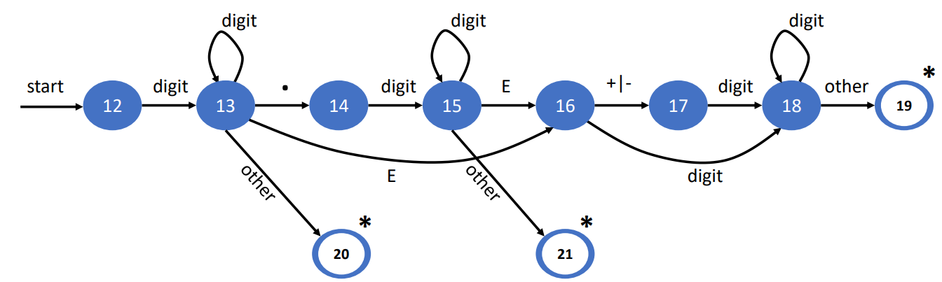
Transition Diagram for Unsigned Numbers

Slide 32
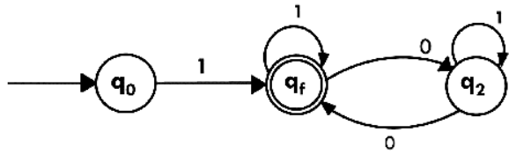


Slide 33
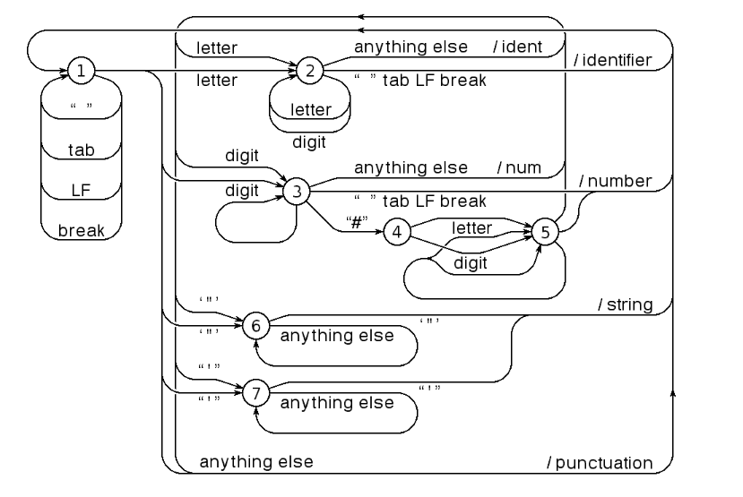
Lexical Analyzer with meele moore

Slide 34
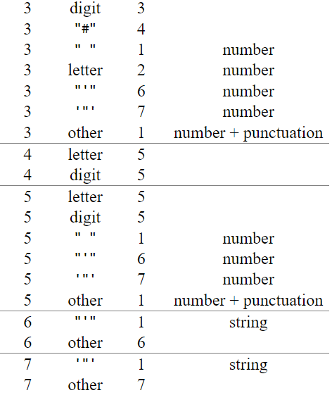
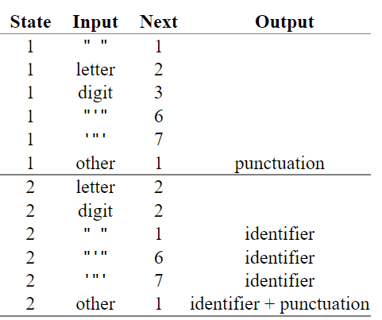
State table

Slide 35
Advantages of Lexical analysis
Lexical analyzer method is used by programs like compilers which can use the parsed data from a programmer’s code to create a compiled binary executable code
It is used by web browsers to format and display a web page with the help of parsed data from JavsScript, HTML, CSS
A separate lexical analyzer helps you to construct a specialized and potentially more efficient processor for the task

Slide 36
Disadvantage of Lexical analysis
You need to spend significant time reading the source program and partitioning it in the form of tokens
Some regular expressions are quite difficult to understand
More effort is needed to develop and debug the Lexer and its token descriptions
Additional runtime overhead is required to generate the Lexer tables and construct the tokens

Slide 37
“
— Team 05
THANK YOU

