Slide 1
Enterprise Resource Planning (ERP)
Presentation By
Aashish Adhikari

Slide 2
What is ERP?
ERP is a business process management software.
typically a suite of integrated applications—that an organization can use to collect, store, manage and interpret data from many business activities
Helps business managers to implement erp. in business activities such as inventory control, order tracking, customer service, finance e.t.c.

Slide 3
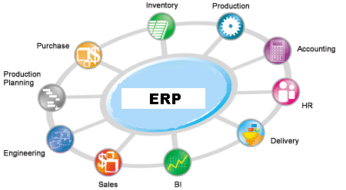

Slide 4
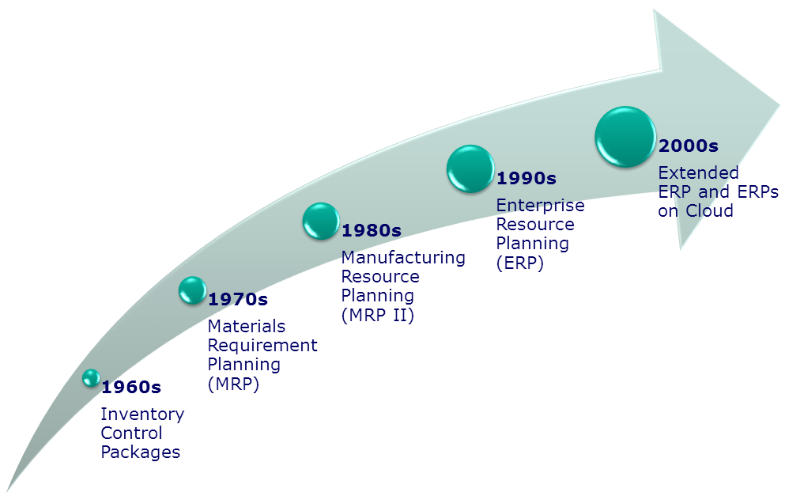
Evolution Of ERP
Notes:
1960’s - Systems Just for Inventory Control
1970’s - MRP – Material Requirement Planning. (Inventory with material planning & procurement)
1980’s - MRP II – Manufacturing Resources Planning. (Extended MRP to shop floor & distribution Mgmt.).
Mid 1990’s - ERP – Enterprise Resource Planning. (Covering all the activities of an Enterprise)
2000 onwards – ERP II – Collaborative Commerce. (Extending ERP to external business entities)

Slide 5
Why ERP?
One common system - less duplication more efficient.
Consumer Focus – best consumer service.
Open communication among business partners.
Offers solution for all business functions.
Support for multiple currencies and languages.
Adherence to standard business practice.

Slide 6
Disadvantages
Implementation is expensive and lengthy.
Lack of trained people.
System is complex.
Maintenance is costly and time consuming.
Data errors are replicated through system.

Slide 7
Selecting ERP vendors?
Depending on your organizations size and needs there are a number of enterprise resource planning software vendors to choose from.
  Large Enterprise ERP(ERP Tire I)
    For large enterprise
    Dominated by 3 companies: SAP, Oracle and Microsoft
  Mid market Enterprise ERP (ERP Tire II)
    For mid-market vendors includes infor, QAD, Lawson, Epicor, Sage
  Small Business ERP (ERP Tire III)
    Exact globe, Syspro, Netsuite, Visibility, Consona, CDC and activant solution.

Slide 8
ERP Softwares
Software | Platform Technology | Description
ERP5 | Python, JS or Mysql | Based on unified model for mid to large size organizations
Front Accounting | PHP, Mysql | Web application/ web based
GNU Enterprise | Python | Tools to develop interactive database applications
ERPNEXT | Python, JS, Mysql | ERP for small and medium-size businesses

Slide 9
Success Stories
Autodesk (computer aided design software maker)
  Reduced delivery time form two weeks to less than 24 hours.
IBM Storage System Division
  Reduced Time to replacement part – 22 to 3 days
  Time to complete a credit check – 20 min to 3 seconds

Slide 10
THANK YOU

