Slide 1
DBMS Project: UPI PAYMENT
Prepared by:
Aashish Rampal: 21CSB0A03
Dhyey Gokani: 21CSB0A19
Btech CSE-A (2021-2025)
Submitted To:
DR. T. Ramakrishnudu
Department of Computer Science and Engineering,
National Institute of Technology, Warangal

Slide 2
Problem Statement
User details: This includes personal information such as name, phone number, email address, and UPI ID.
Transaction history: This includes details of all transactions made through UPI, including the date, time, amount, sender UPI ID, receiver UPI ID, and transaction status (success/failure).
Bank account information: This includes the bank name, account number, and IFSC code for each UPI user.

Slide 3
Problem Statement
Merchant information: This includes the name and UPI ID of each registered merchant, along with the products/services they offer.
Payment methods: This includes the available payment methods for each merchant, such as UPI, credit/debit card, net banking, etc.
Bill information: This includes the bill amount, due date, and status (paid/unpaid) for each user.

Slide 4
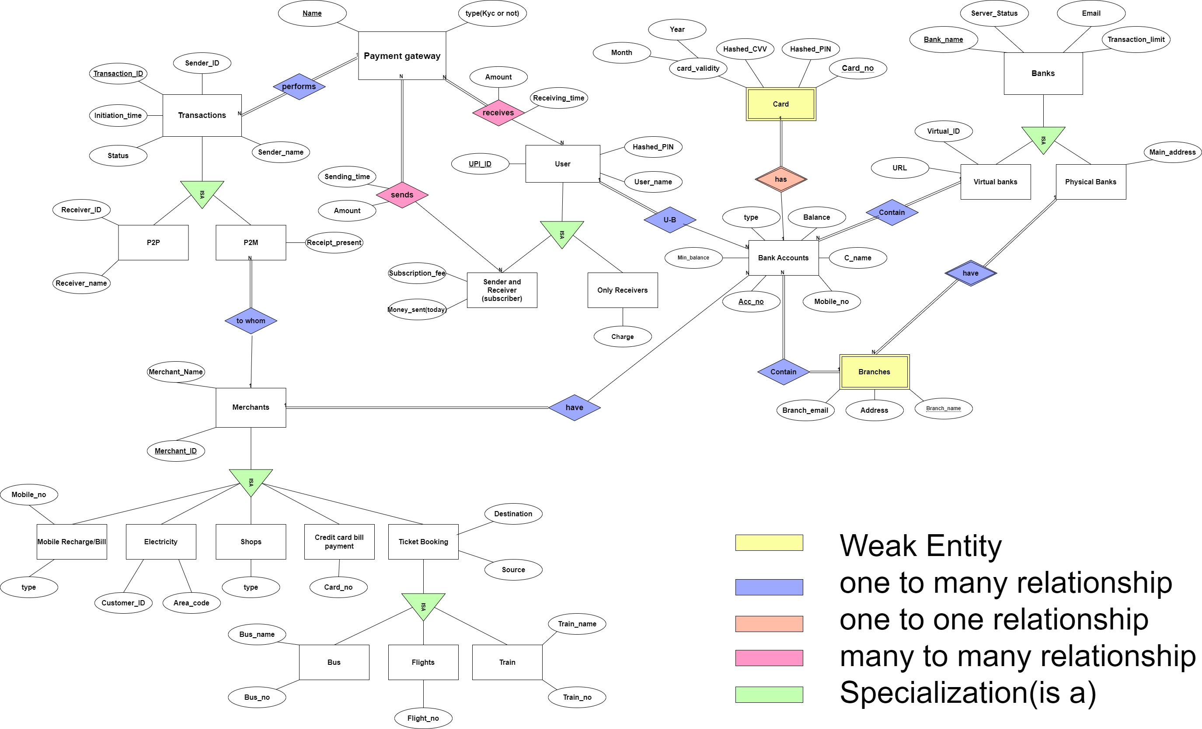
ER Model

Slide 5
ER Model Explanation
The ER model shows the working and data arrangement in a UPI-based payment system.
Banks:
Different banks are present in the bank’s relation which is divided into 2 relations, signifying virtual and physical banks. Virtual banks are banks having no physical presence therefore they have no branches, but physical banks may have multiple branches.
Branches:
Branches are a weak entity that is dependent upon the presence of physical banks, the relation between branches and the physical bank is many to one because a physical bank may have many branches, but a branch is only of a single bank.

Slide 6
ER Model Explanation
Bank Account:
Bank account contains attributes such as account no., account type(saving or current), etc… The relation between branches and bank accounts, and virtual banks and bank account represents in which bank the account is which is useful in determining the server status, maximum daily transactions limit, etc.. which is useful in determining the result of a transaction performed by the payment gateway.
Card:
A card signifies a debit card and is a weak entity of a bank account, as only a person with an account can hold a card. The relation between a card and a bank account Is one-to-one because an account can have a maximum1 card and a card is for a single account only. A card entity is necessary for UPI based payment system because only a person with the card can become a subscriber.

Slide 7
ER Model Explanation
User:
User entity is used to signify the users of UPI which are divided into subscribers(senders and receivers) who pay a subscription fee for the service and just receivers from whom a charge is deducted every time they receive money from UPI. User has a one-to-many relation with a bank account because a user can in UPI if have multiple bank accounts linked with the same mobile no. then the user can switch between any of those accounts but a bank account can’t have multiple users.
Payment Gateway:
Payment gateway signifies which payment gateway (eg. Paytm, pay, etc) is used and if using the gateway KYC is necessary or not. The payment gateway receives money-sending requests from subscribers at a given time and then does transactions and if the transaction is successful then the receiver receives the amount sometime later. The relations between subscribers and payment gateway, and users(both subscribers and receivers can receive) and payment gateway are both many to many because an individual can send/receive money from different gateways and a gateway is used by more than one subscriber/user.

Slide 8
ER Model Explanation
Transactions:
It shows the transactions occurring through different payment gateways. The relation between them is many to one because a payment gateway can perform multiple transactions but a specific transaction occurs through only one payment gateway. Transactions are further divided into P2P and P2M, the former signifies the transactions from one person to another whereas the latter signifies transactions from a person to merchants.
Merchants:
Merchants entity signifies different merchants accepting money through UPI. Merchants have a one-to-one relationship with bank accounts because an account is of a single merchant and a merchant has a single universal account. Merchants is divided into different types of merchants with different services available on UPI like shops, electricity, mobile recharge, ticket booking, and credit card payments. Ticket booking is further divided into tickets for buses, trains, and flights.

Slide 9
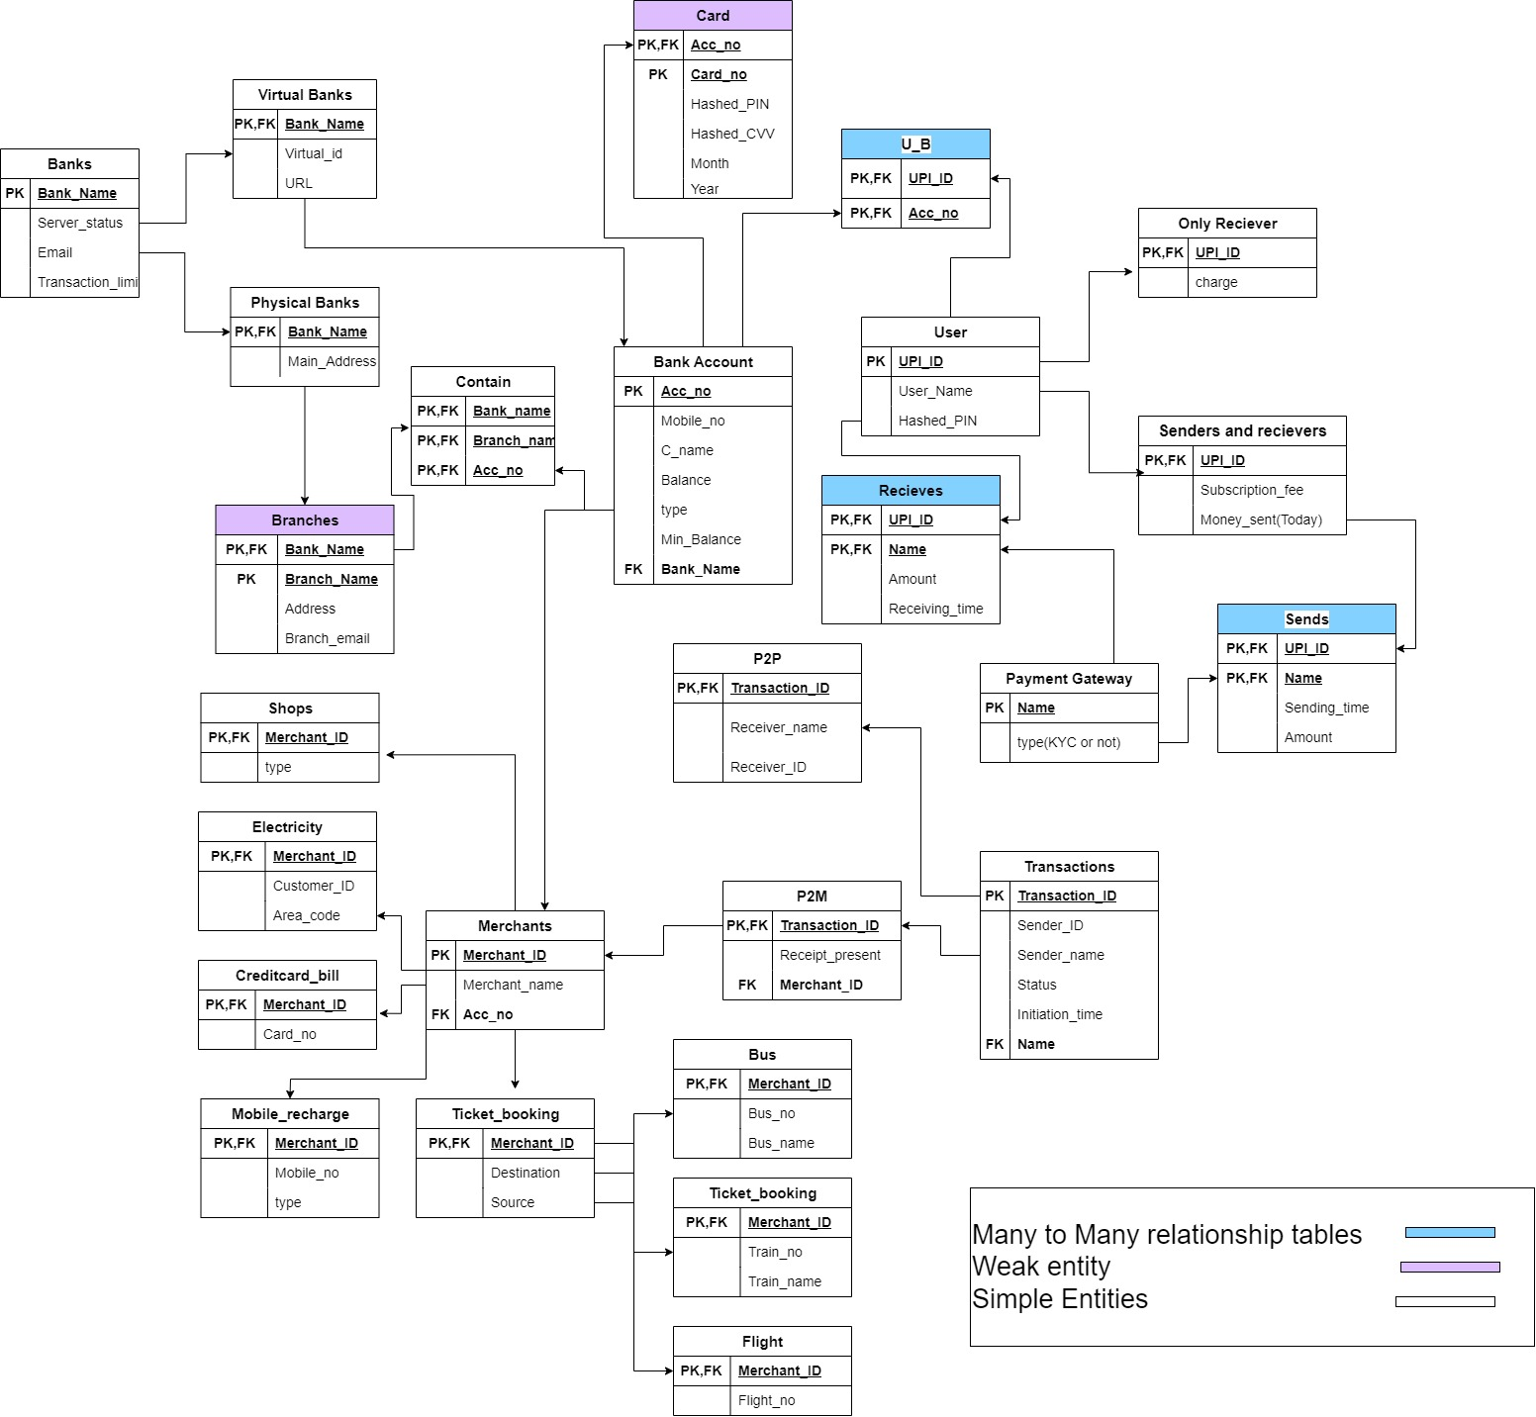
Relation Schema

Slide 10
Functional Dependencies
Bank_name → Bank_name,Server_status, Email,Transaction_time
Bank_name→ Bank_name,Virtual_id,URL
Bank_name→ Bank_name,Main_address
Bank_name,Branch_name→Bank_name,Branch_name,Address, Branch_email
Acc_no→Acc_no,Mobile_no,C_name,Balance,type,Min_balance,Bank_name
Bank_name,Branch_name,Acc_no→Bank_name,Branch_name, Acc_no
Acc_no,Card_no→Acc_no,Card_no,Hashed_PIN,Hashed_CVV, Month,Year
UPI_ID→UPI_ID,User_name,Hashed_PIN
UPI_ID,Acc_no→UPI_ID,Acc_no
UPI_ID→UPI_ID,charge

Slide 11
Functional Dependencies
UPI_ID→UPI_ID,Subscription_fee,Money_sent_today
Name→Name, type
UPI_ID→UPI_ID,Name,Sending_time,Amount
UPI_ID→UPI_ID,Name,Amount,Receiving_time
Transaction_ID→Transaction_ID,Sender_ID,Sender_Name, Status,Initiation_time,Name
Transaction_ID→Transaction_ID,Receiver_name,Receiver_ID
Transaction_ID→Transaction_ID,Receipt_present,Merchant_ID
Merchant_ID→Merchant_ID,Merchant_name,Acc_no

Slide 12
Functional Dependencies
Merchant_ID→Merchant_ID,type
Merchant_ID→Merchant_ID,Customer_ID,Area_code
Merchant_ID→Merchant_ID,Card_no
Merchant_ID→Merchant_ID,Mobile_no,type
Merchant_ID→Merchant_ID,Destination,source
Merchant_ID→Merchant_ID,Bus_no,Bus_name
Merchant_ID→Merchant_ID,Train_no,Train_name
Merchant_ID→Merchant_ID,Flight_no

Slide 13
Functional Dependencies
Transitive Dependencies: Has to be removed to convert to 3NF
P2P RECEIVER_ID→RECEIVER_NAME
Partial Dependencies: Has to be removed to convert to 2NF
and then 3NF.
SENDS UPI_ID ->TIME
RECEIVES UPI_ID->TIME

