Slide 1


Fiori Introduction
Jerry Wang
2016 Jan
Internal

Slide 2
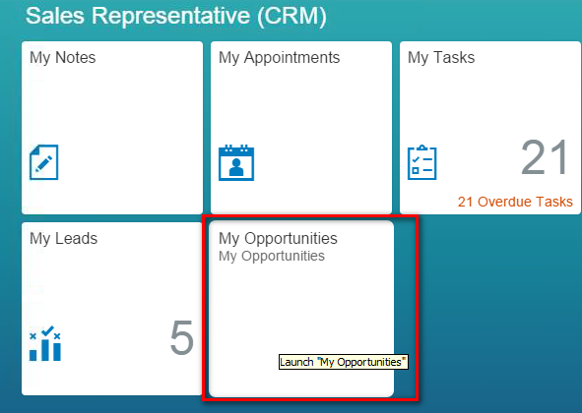
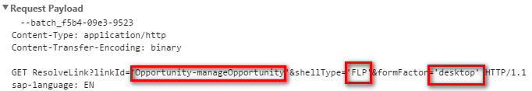
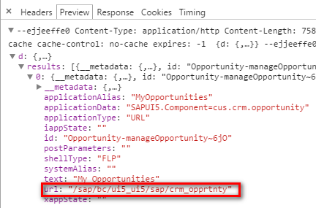
Connects UI Tile to BSP Application

Slide 3
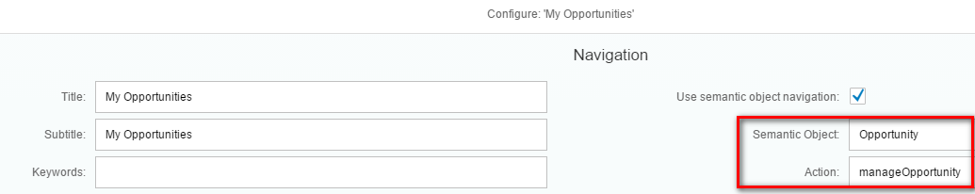
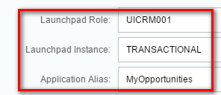
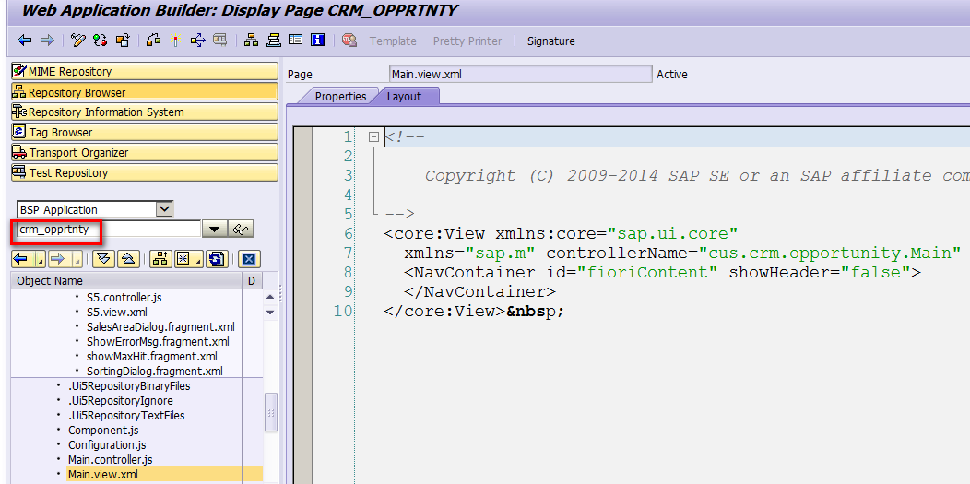
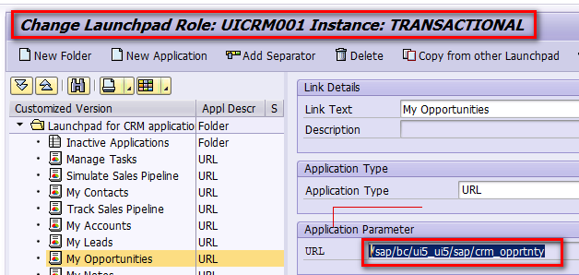
Connects UI Tile to BSP Application

Slide 4
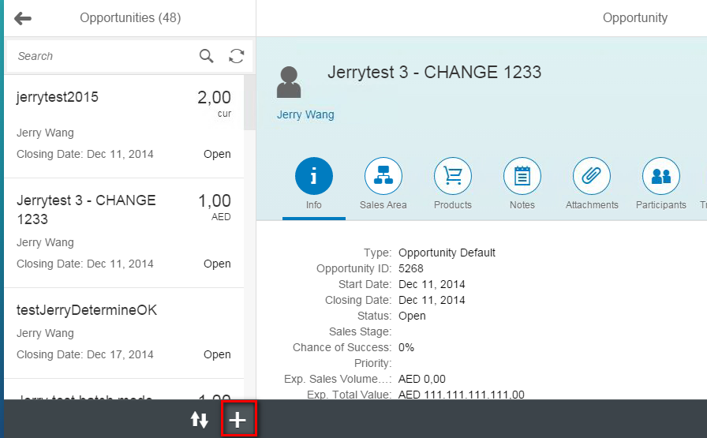
Create button in Toolbar

Slide 5
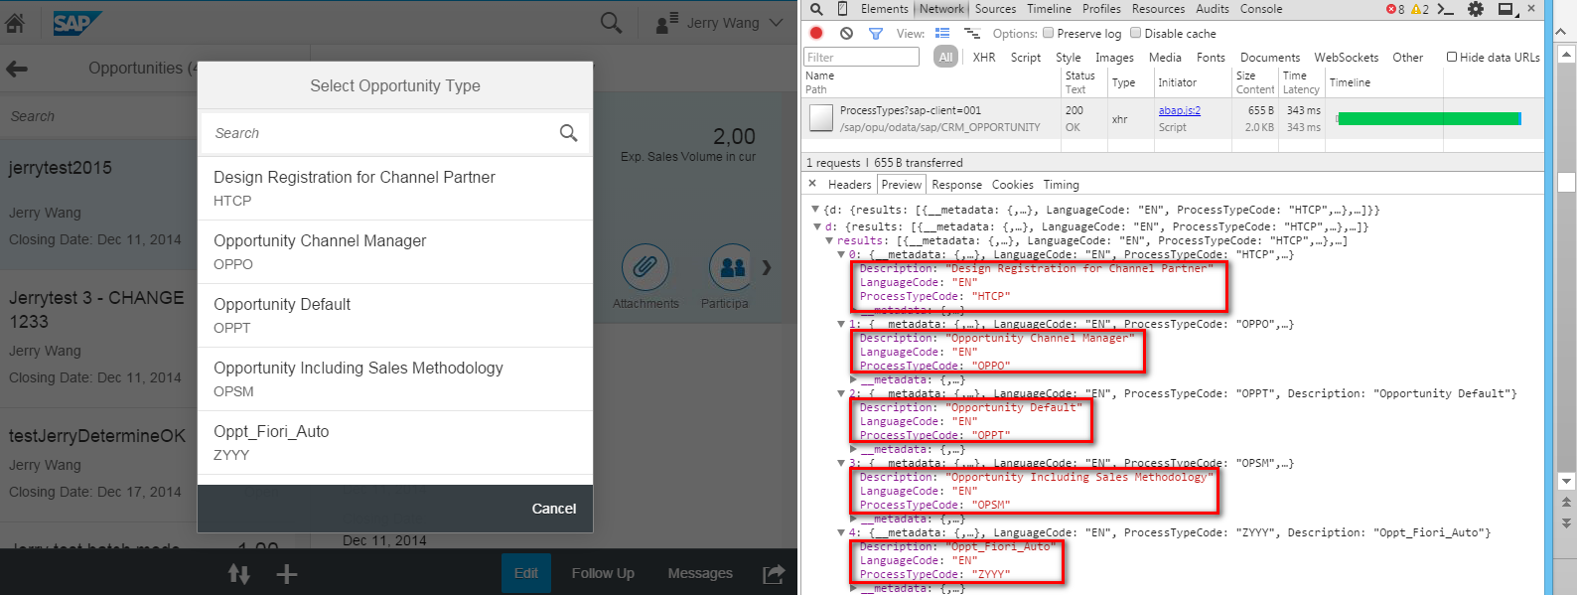
Transaction Type popup

Slide 6
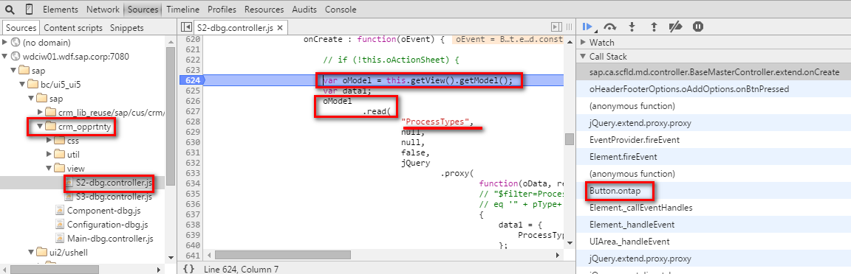
1. BSP Application sends OData Request

Slide 7
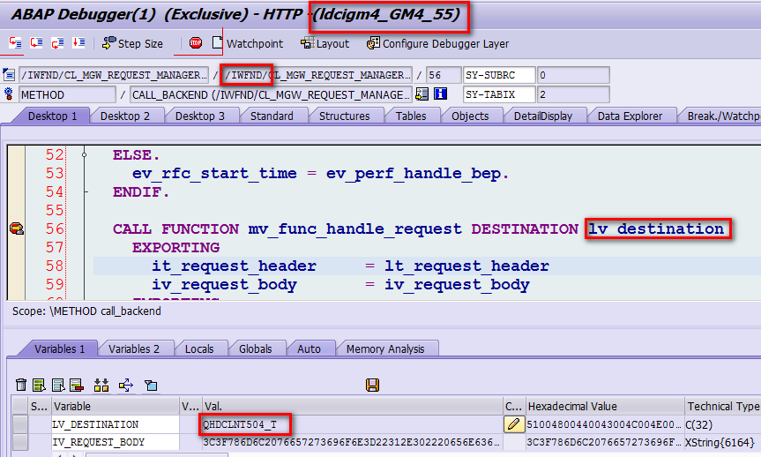
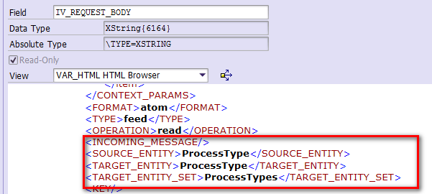
2. Gateway Frontend Add-on calls Trusted RFC to Backend

Slide 8
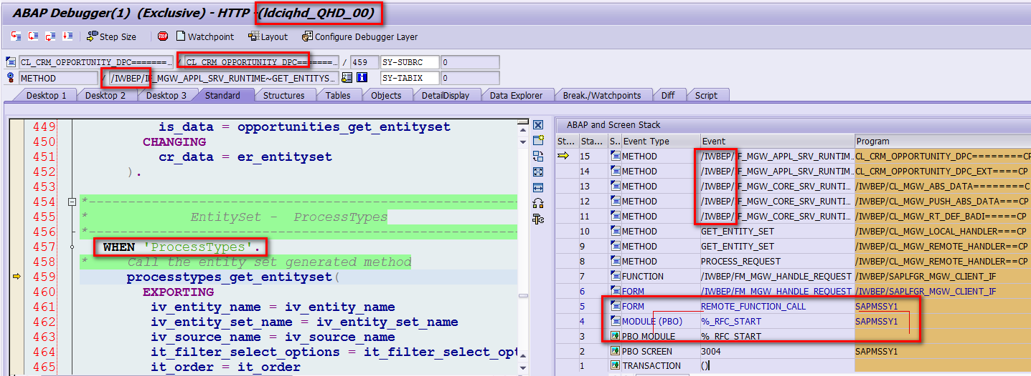
3. Gateway Backend Add-on Delegates to Service Provider

Slide 9
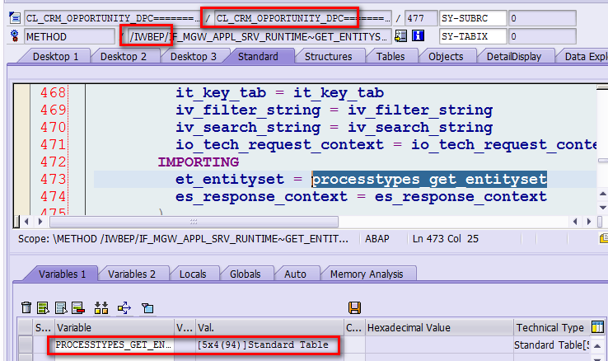
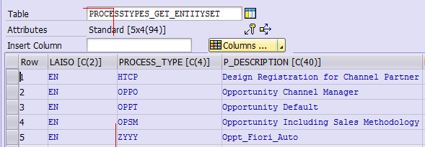
Response in ABAP Format

Slide 10
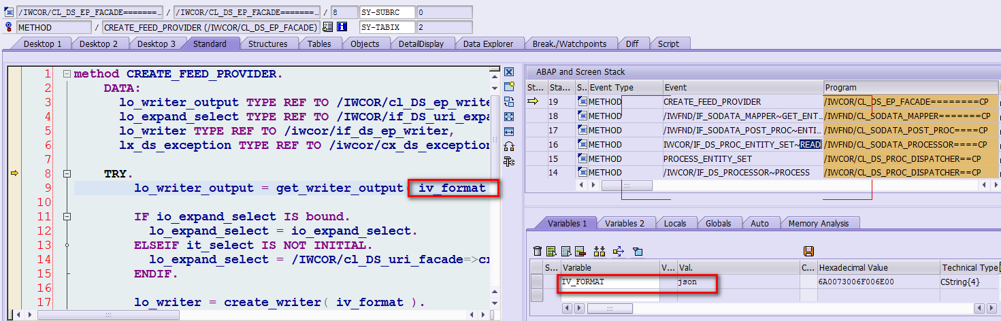
4. Gateway Frontend Add-on converts response to JSON format

Slide 11
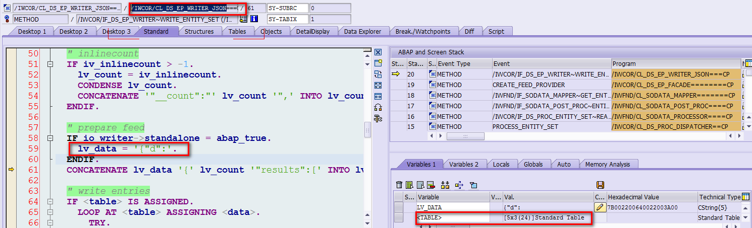
4. Gateway Frontend Add-on converts response to JSON format

