Slide 1


UI5 Globalization
Jerry Wang
2016 April
Internal
Notes:
30 minutes

Slide 2
Objective
Ensure a consistent formatting across the applications
Reduce Application development cost
Notes:
https://wiki.wdf.sap.corp/wiki/display/fiorisuite/Globalization

Slide 3
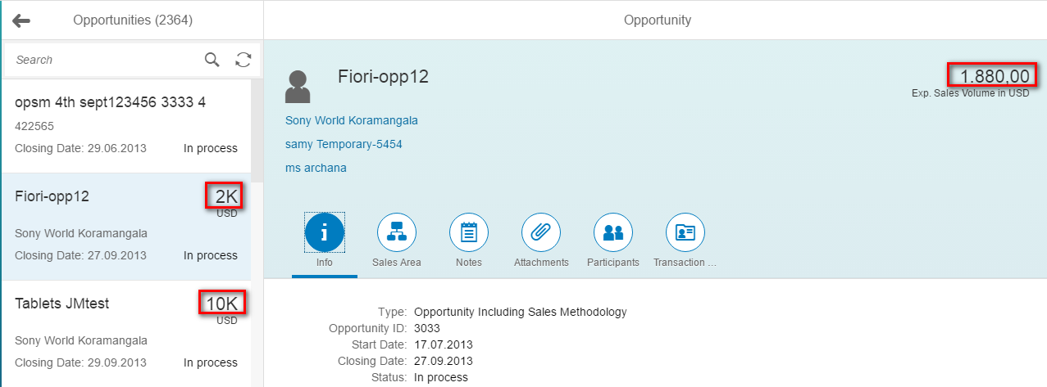
Number Format
Example: GM4/001

Slide 4
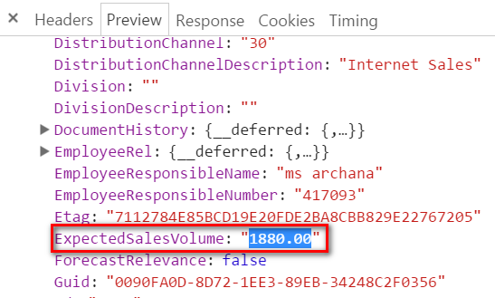
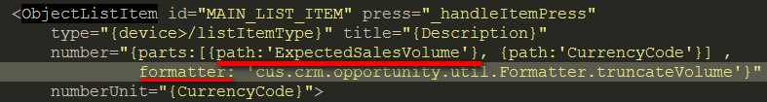
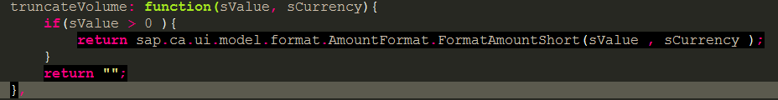
How is this 1880.00 formatted as 2K?

Slide 5
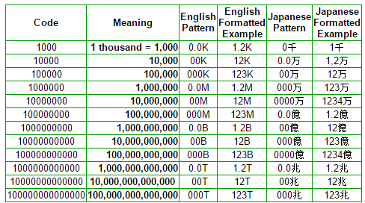
CLDR - Unicode Common Locale Data Repository
The Unicode CLDR provides key building blocks for software to support the world's languages, with the largest and most extensive standard repository of locale data available. This data is used by a wide spectrum of companies for their software internationalization and localization, adapting software to the conventions of different languages for such common software tasks.

Slide 6
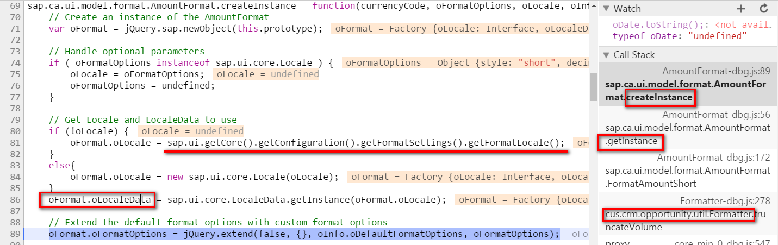
Locale Specific Format Data

Slide 7
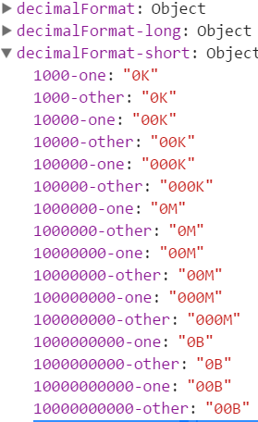
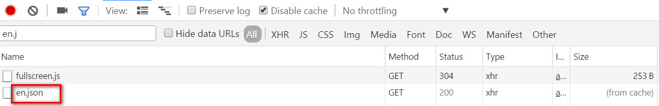
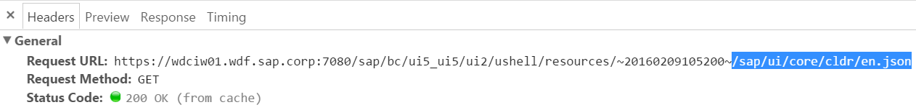
oFormat.oLocaleData

Slide 8
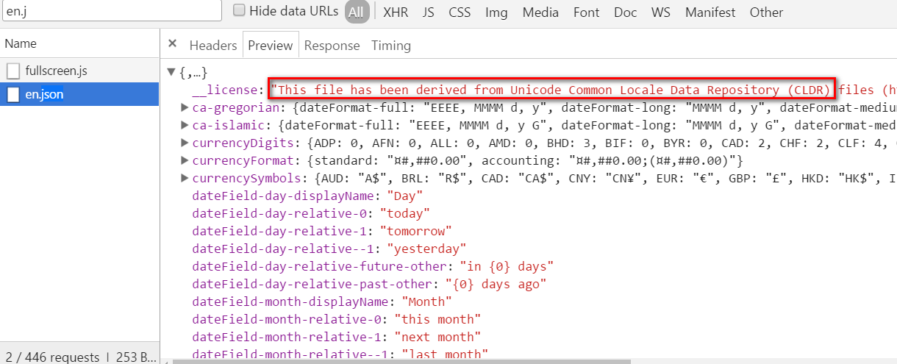
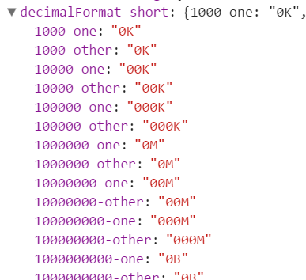
en.json
Notes:
https://wdciw01.wdf.sap.corp:7080/sap/bc/ui5_ui5/ui2/ushell/resources/~20160209105200~/sap/ui/core/cldr/en.json

Slide 9
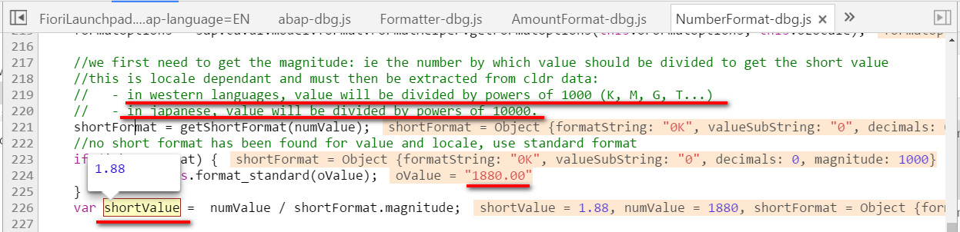
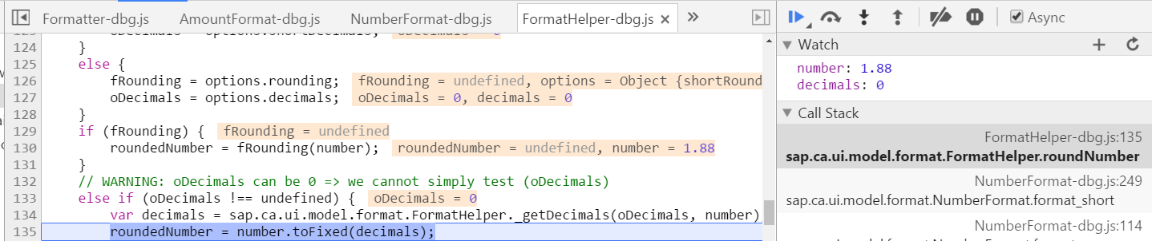
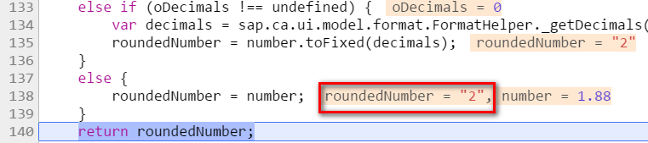
How is “1880” formatted to “2K”

Slide 10
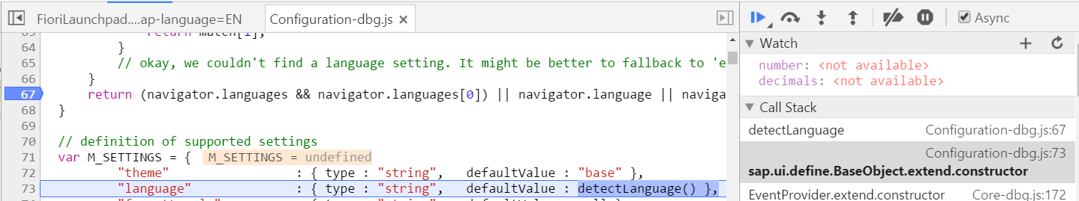
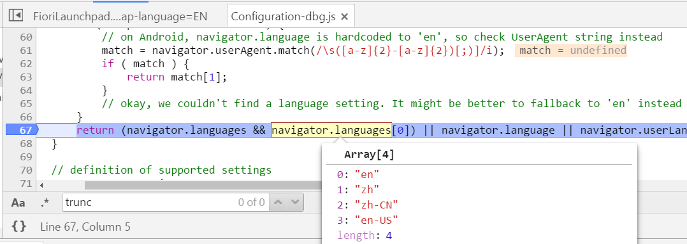
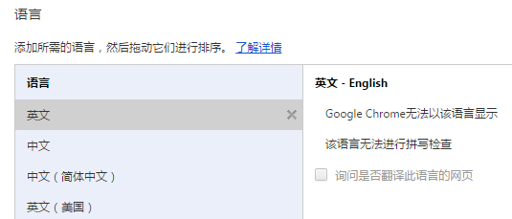
How is English version of CLDR loaded

Slide 11
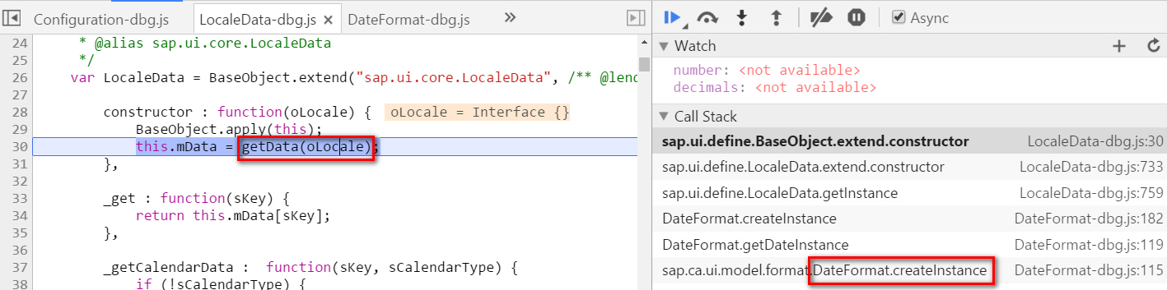
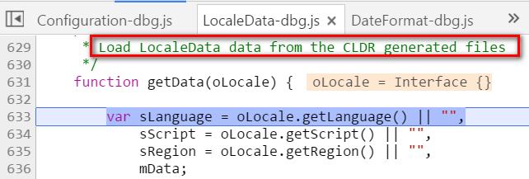
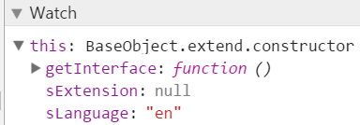
Load CLDR file according to Language

Slide 12
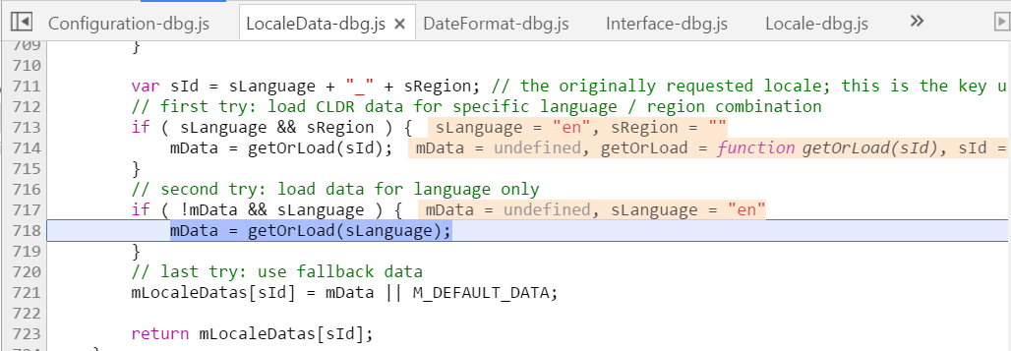
Load CLDR file according to Language ( 2 )

Slide 13
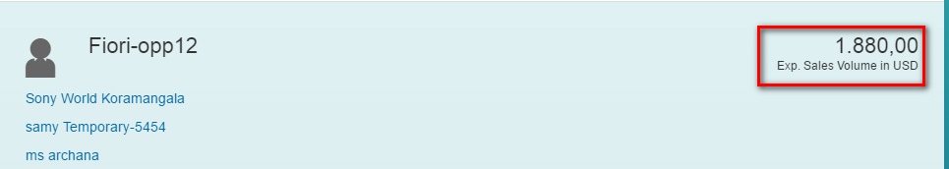
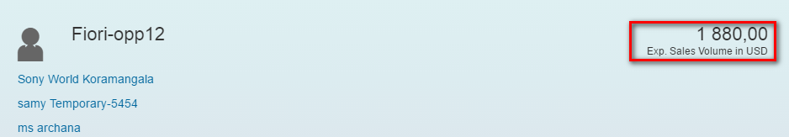
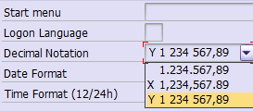
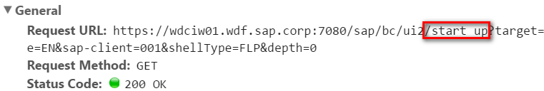
Number Format ( 2 )
Notes:
Jerry 2016-03-04 15:13PM – format is determined by gateway system setting, not CRM backend.

Slide 14
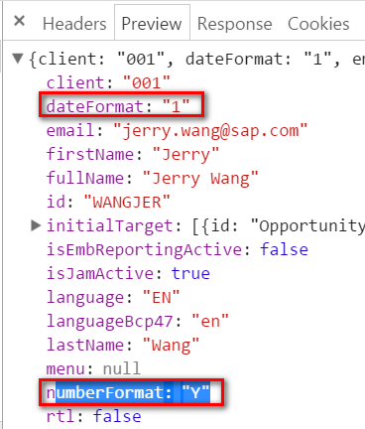
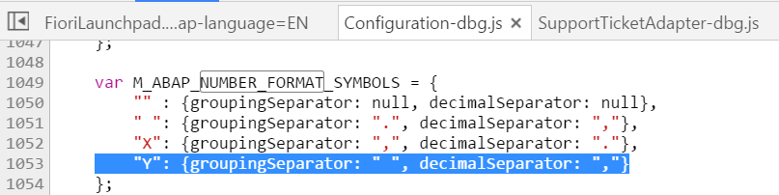
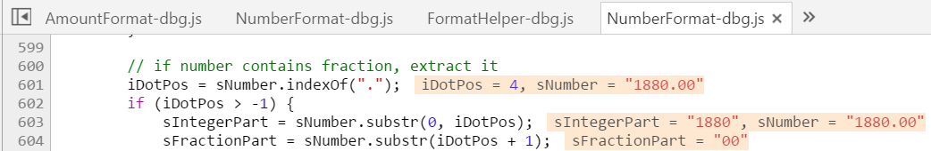
How is “1880” formatted to “1880,00”

Slide 15
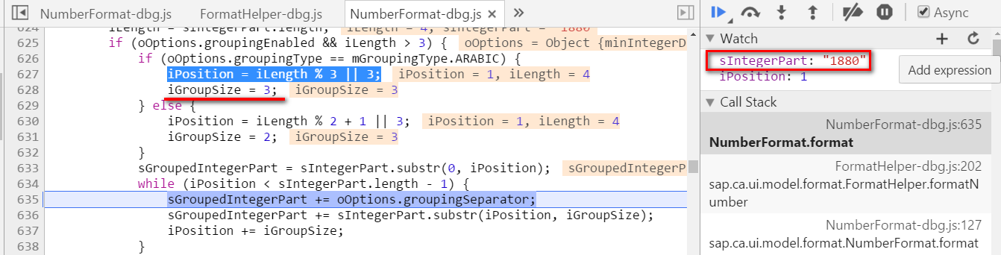
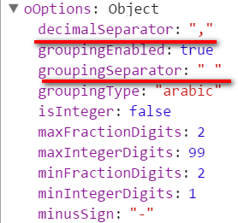
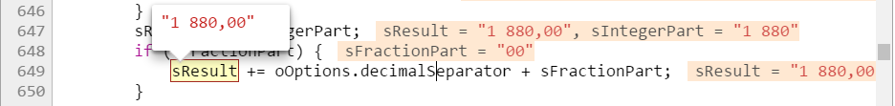
oOptions

Slide 16
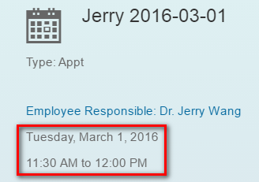
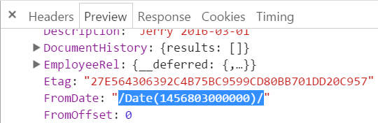
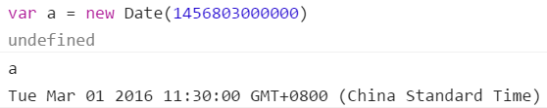

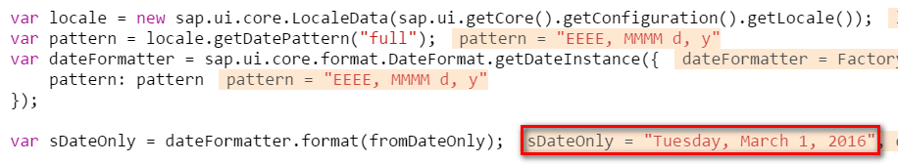
Date Format

Slide 17
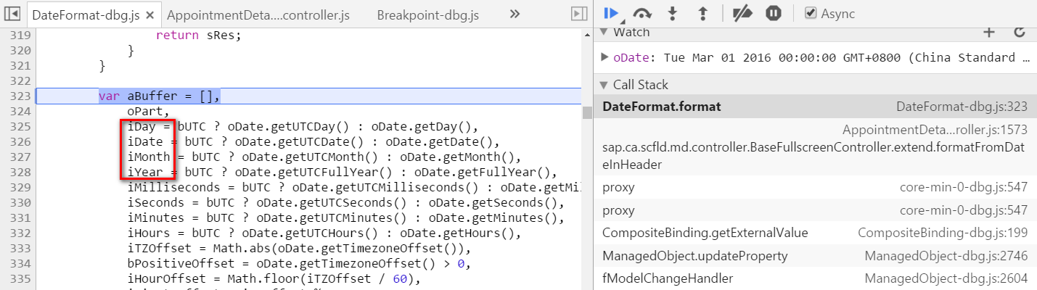
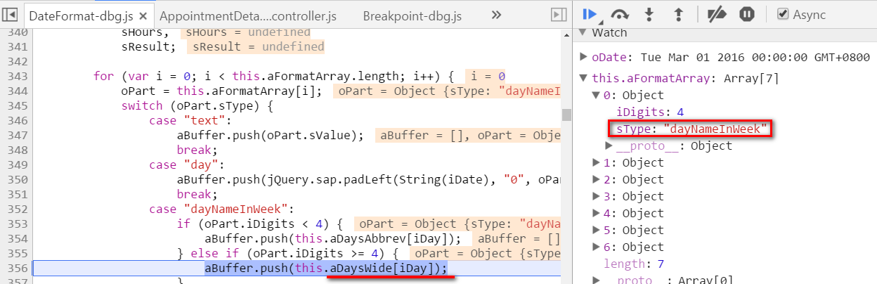
How is Date formatted

Slide 18
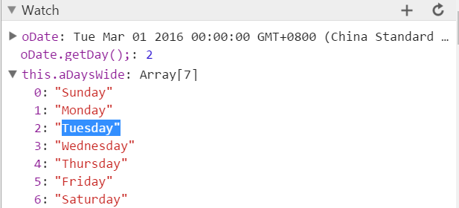
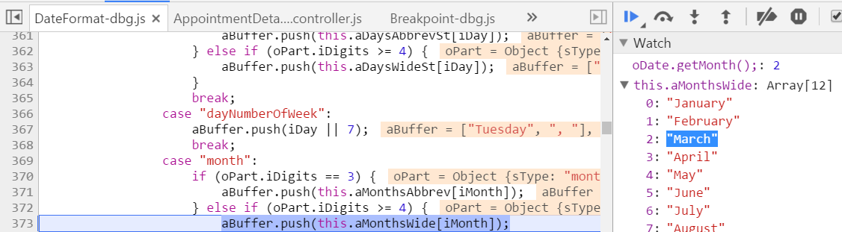
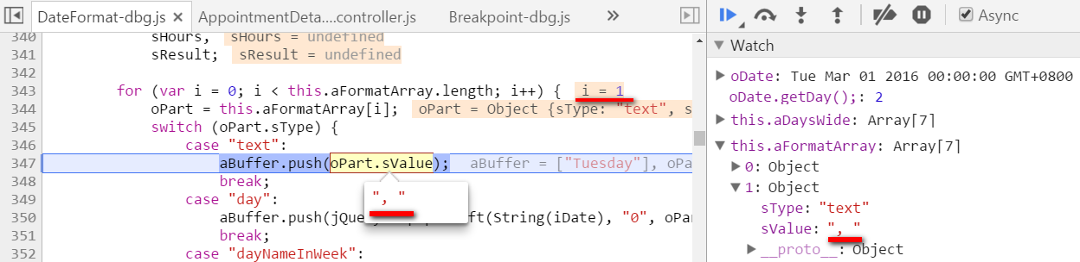
How is Date formatted (2)

