Slide 1


Fiori Introduction
Jerry Wang
2016 Jan
Internal

Slide 2
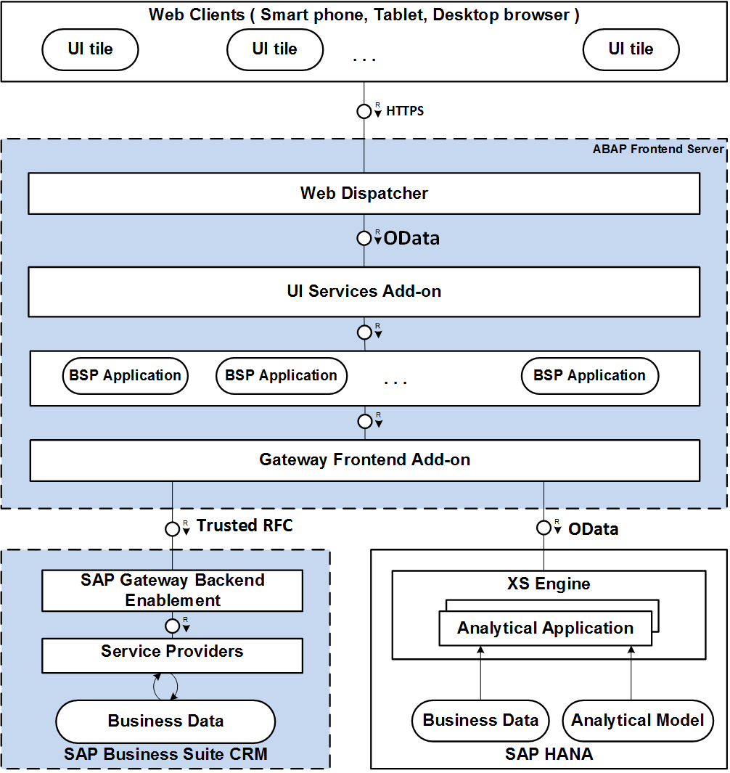
Fiori Architecture ( CRM on Premise )
Notes:
Gateway frontend add-on: request route / dispatch.
Sales manager – sales representative – Asian, European, American

Slide 3
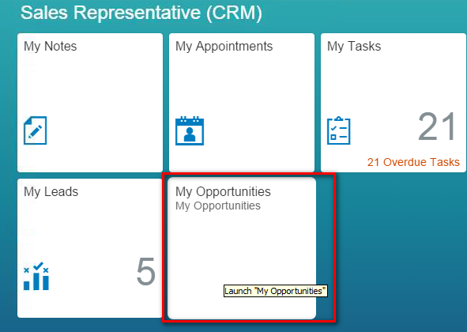
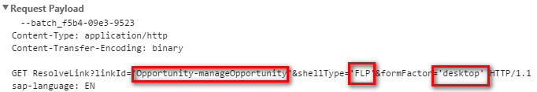
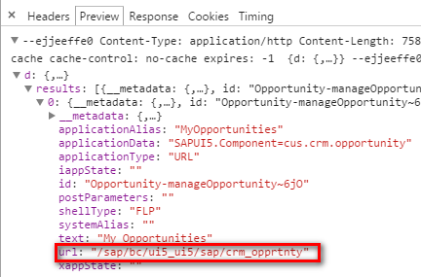
Connects UI Tile to BSP Application

Slide 4
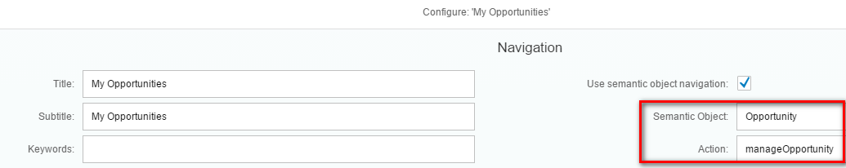
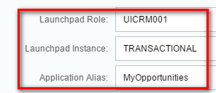
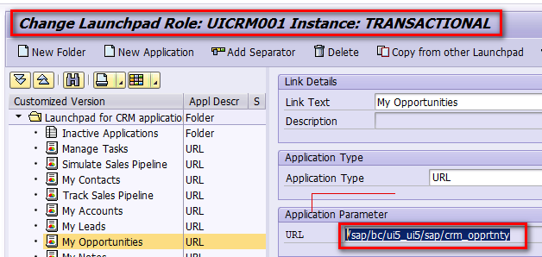
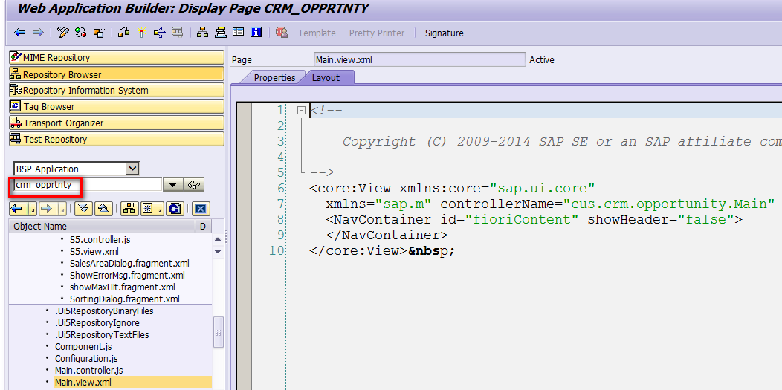

Connects UI Tile to BSP Application

Slide 5
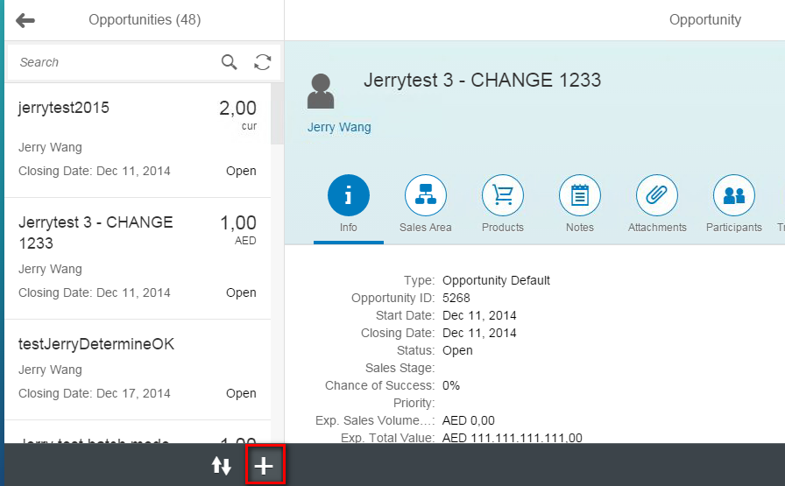
Create button in Toolbar

Slide 6
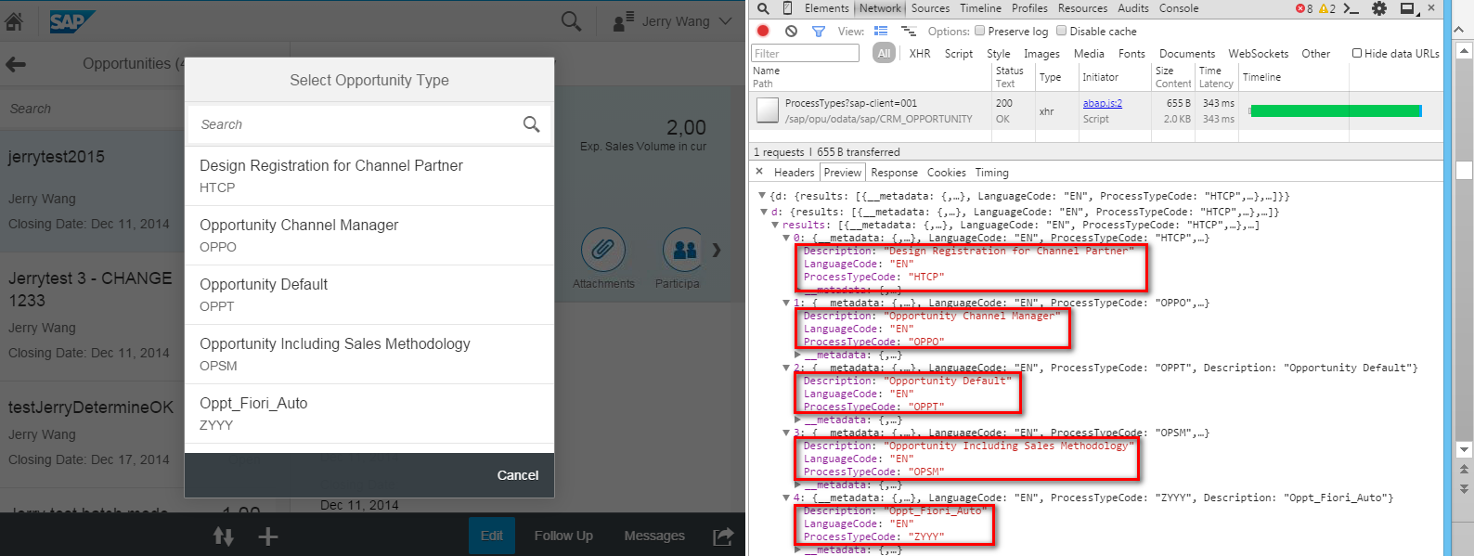
Transaction Type popup
GM4/001: frontend server
QHD/504: backend server

Slide 7
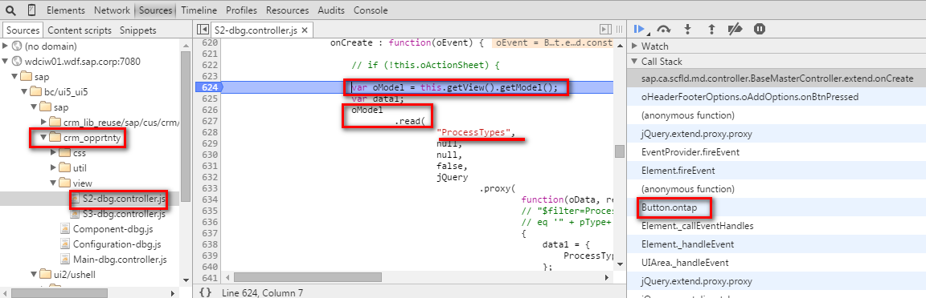
1. BSP Application sends OData Request

Slide 8
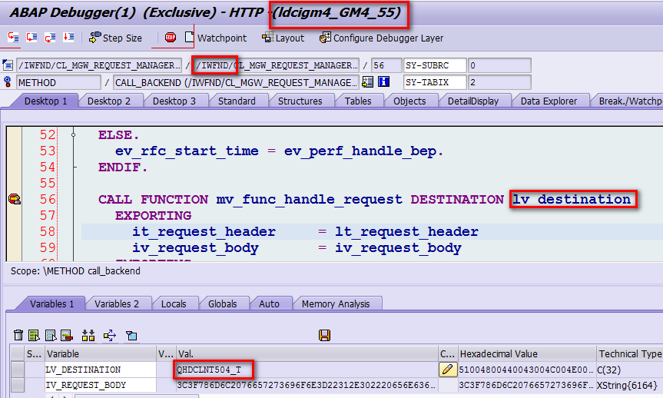
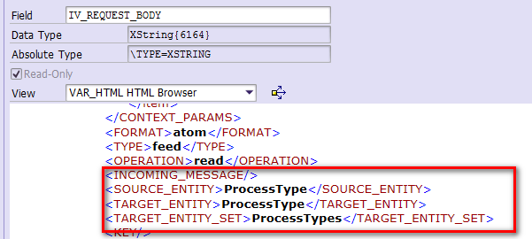
2. Gateway Frontend Add-on calls Trusted RFC to Backend

Slide 9
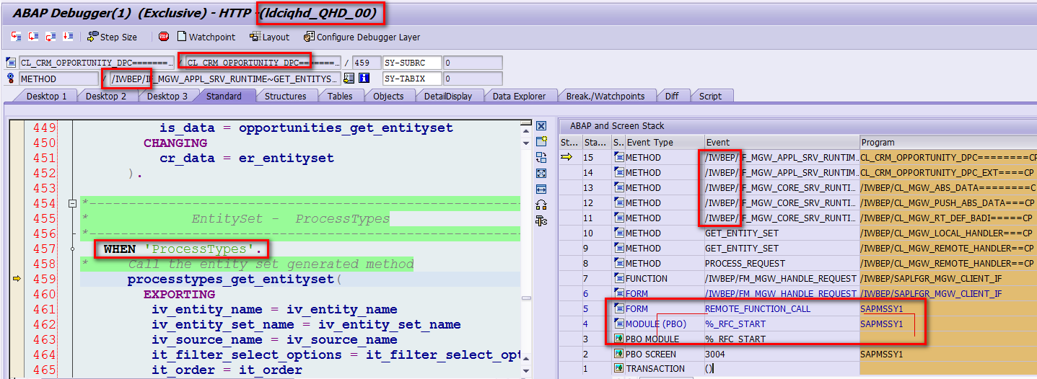
3. Gateway Backend Add-on Delegates to Service Provider

Slide 10
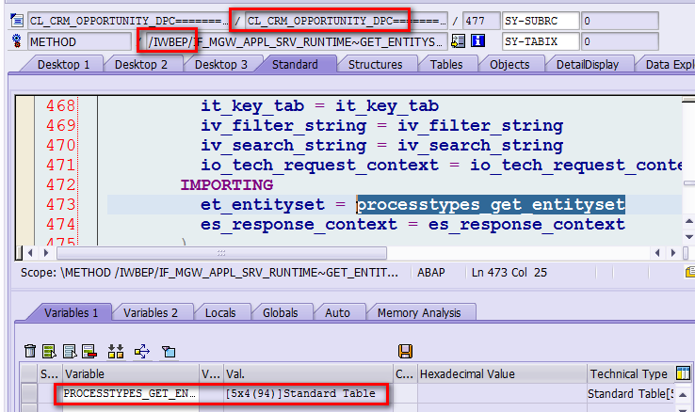
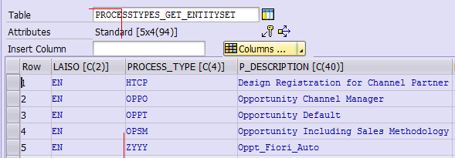
Response in ABAP Format

Slide 11
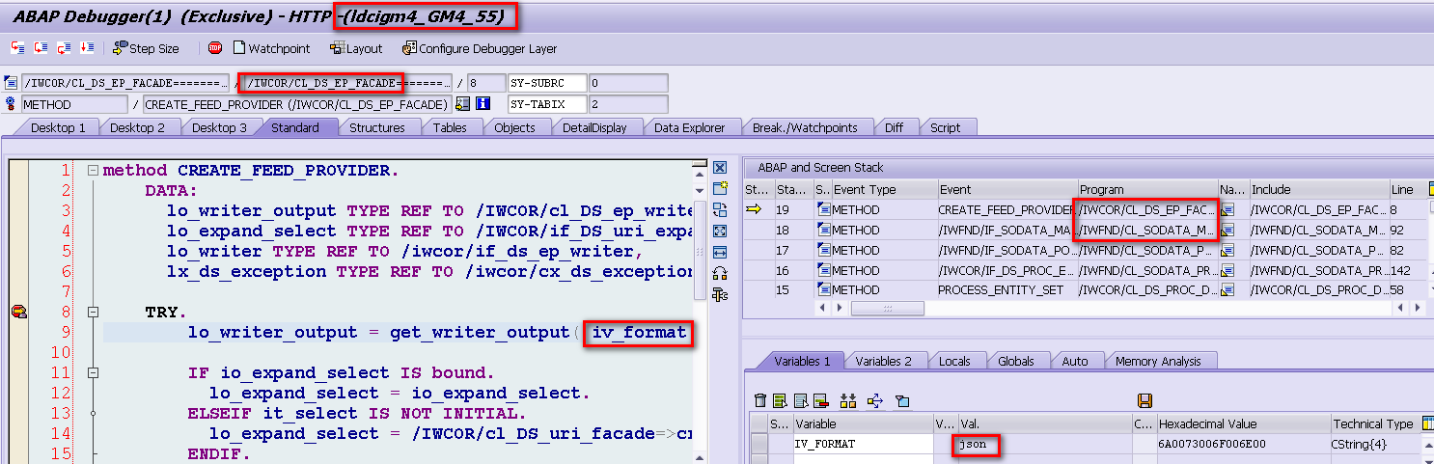
4. Gateway Frontend Add-on converts response to JSON format
Notes:
2016-01-18 16:44PM confirmed by Jerry – this screenshot is done in Gateway system

Slide 12
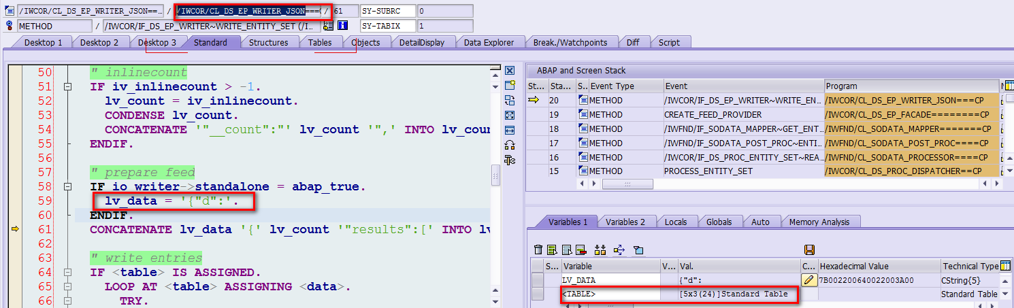
4. Gateway Frontend Add-on converts response to JSON format

