Slide 1


Code Refact Related Topics
Jerry Wang
2015 Oct
Internal

Slide 2
Related Tools for Code Review & Code Refact
Java
JAD
javap
Java Decompiler
Source Monitor
Visual VM
Refactor Menu in Eclipse
ABAP
Code inspector
Refactor feature in AIE
Code coverage
JavaScript
ESLint for Fiori Apps
Check Jenkins build log
JSlint for Sublime Text 2
Code check in WebIDE
Profile in Chrome

Slide 3
Is it wrong to use a Boolean parameter to determine behavior
Discussion in stackoverflow
A developer defines a method with a Boolean as one of its parameters, and that method calls another, and so on, and eventually that Boolean is used, solely to determine whether or not to take a certain action.
One incident in Fiori team
Another incident 671830 2015

Slide 4
How to define constant in Java
http://developer.51cto.com/art/201509/492085.htm

Slide 5
Avoid using Array in interface in Java
http://eclipsesource.com/blogs/2014/04/11/3-good-reasons-to-avoid-arrays-in-java-interfaces

Slide 6
Colons in JavaScript
function a() {
console.log("I was called!");
return "Jerry";
}
var b = a(), a;
console.log(b);
var d = (function c(){
return a(),a;
})();
console.log(d);
will print:
I was called!
function a() {
console.log("I was called!");
return "Jerry";
}
// Jerry
(function() {
var e = f = 1;
})();
"use strict";
Uncaught ReferenceError: f is not defined

Slide 7
; in JavaScript
var b = function(para) {
return {
doSomething: function() {
console.log("hello: " + para);
return para;
}
}
}
var a = 1, x = 3, y = 4, s
s = a + b
(x + y).doSomething()
console.log(s)
function test(i){
var result = i++;
return
result
}
console.log("test: " + test(3))
// test: undefined
// hello: 7
// 8

Slide 8
; in JavaScript
s = function(x){ console.log("called: " + x ); return x}
(1 + 2).toString()
s = function(x){ console.log("called: " + x ); return x}(1 + 2).toString()
// called: 3

Slide 9
Inject your own logic in a legacy function
var bigFunction = function() {
// big logic
console.log("big logic");
}
// solution3
var bigFunction = function() {
// big logic
console.log("big logic");
}
bigFunction = ( bigFunction || function() {} ).after( function() {
console.log("our own logic");
});
bigFunction();
console.log(“new logic”); // solution1
// Solution2:
var _old = bigFunction;
bigFunction = function() {
if ( _old ) {
_old();
}
console.log("our own enhancement");
}
bigFunction();

Slide 10
Add performance measurement in your code
var append_doms = function() {
var d = new Date(); // dirty code - nothing to do with application logic!!!
for( var i = 0; i < 100000; i++) {
var div = document.createElement( "div");
document.body.appendChild(div);
}
// dirty code - nothing to do with application logic!!!
console.log(" time consumed: " + ( new Date() - d));
};
function test() {
append_doms();
}

Slide 11
Solution
var append_doms = function() {
for( var i = 0; i < 100000; i++) {
var div = document.createElement( "div");
document.body.appendChild(div);
}
};
var log_time = function( func, log_name) {
return func = ( function() {
var d;
return func.before( function(){
d = new Date();
}).after( function(){
console.log( log_name + ( new Date() - d));
});
})();
};
function test() {
log_time(append_doms, "consumed time: ")();
}

Slide 12
Validity check before sending Odata request
var send = function() {
var value = input.value;
if( value.length === '' ) {
return false;
}
else if( value.length > MAX_LENGTH) {
return false;
}
... // lots of else
else {
// call OData API
}
}

Slide 13
Solution
var valid_rules = {
not_empty: function( value ) {
return value.length !== '';
},
max_length: function( value ) {
return value.length <= MAX_LENGTH ;
}
}
var valid_check = function() {
for( var i in valid_rules ) {
if ( vali_rules[i].apply( this, arguments) === false ) {
return false;
}
}
}
var send = function( value ) {
if ( valid_check( value ) === false ) {
return;
}
// call OData API
}

Slide 14
Chain of Responsibility
var uploadAPI;
if ( isActiveXSupported()) {
// lots of initialization work
uploadAPI = { "name": "ActiveX"};
}
else if( isHTML5Supported()) {
// lots of initialization work
uploadAPI = { "name": "HTML5"};
}
else if( isFlashSupported()) {
// lots of initialization work
uploadAPI = { "name": "Flash"};
}
else {
// lots of initialization work
uploadAPI = { "name": "Form"};
}
console.log(uploadAPI);
// Priority: ActiveX > HTML5 > Flash > Form(default)
function isActiveXSupported(){
//...
return false;
}
function isHTML5Supported(){
//...
return false;
}
function isFlashSupported(){
//...
return false;
}

Slide 15
Solution
var getActiveX = function() {
try {
// lots of initialization work
return { "name": "ActiveX"};
}
catch (e) {
return null;
}
}
var getHTML5 = function() {
try {
// lots of initialization work
return { "name": "HTML5"};
}
catch (e) {
return null;
}
}
var uploadAPI = getActiveX.after(getHTML5).after(getFlash).after(getForm)();
console.log(uploadAPI);

Slide 16
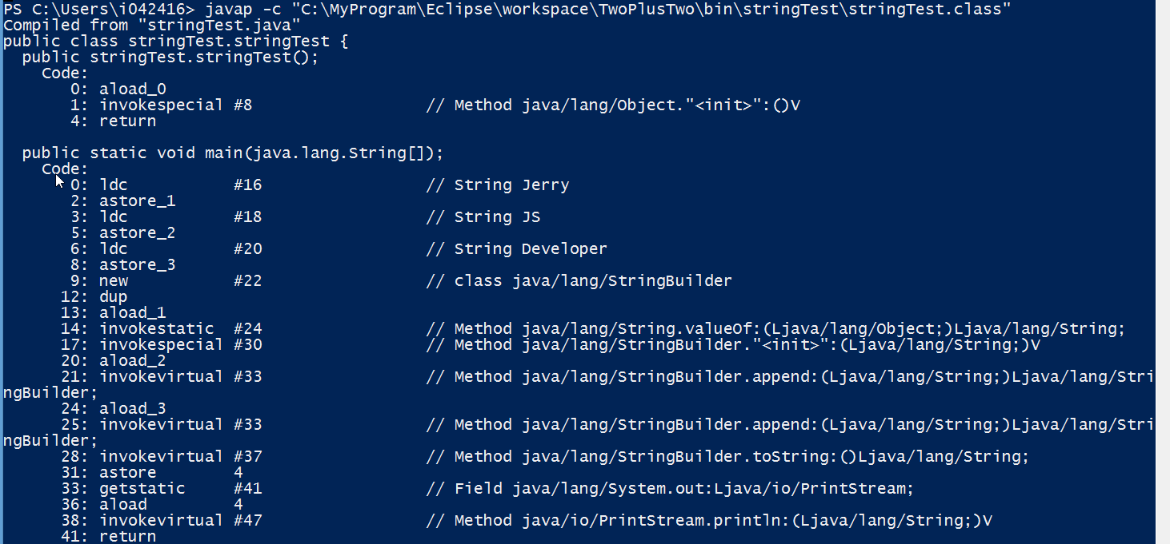
String in Java
public class stringTest {
public static void main(String[] args) {
String userName = "Jerry";
String skill = "JS";
String job = "Developer";
String info = userName + skill
+ job;
System.out.println(info);
}
}

Slide 17
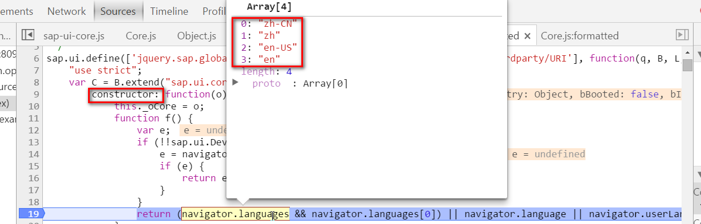
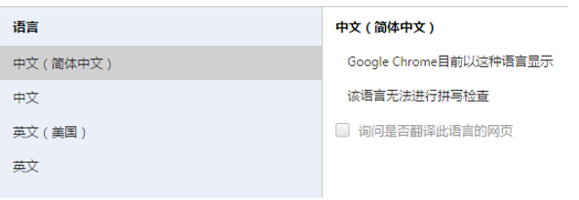

Slide 18
UI5 Application
UI specific OData derived from CDS DDL
Gateway / OData
SADL framework
Annotations for UI in CDS DDL
CDS Consumption View
Annotations for BO Definition in CDS DDL
CDS BO View
Database table
Database table

Slide 19
UI5 Application
Only CDS view and CDS consumption view must be created by developer.
The old way to create SEGW project and include CDS consumption to generate OData service can still be used, or use the annotation in consumption view to avoid manual work.
UI5 application is automatically generated by WebIDE.
UI specific OData derived from CDS DDL
Gateway / OData
SADL framework
Annotations for UI in CDS DDL
CDS Consumption View
Annotations for BO Definition in CDS DDL
CDS BO View
Database table
…
Database table

