Slide 1


Application running on Spark
Sept 2015 Jerry Wang

Slide 2
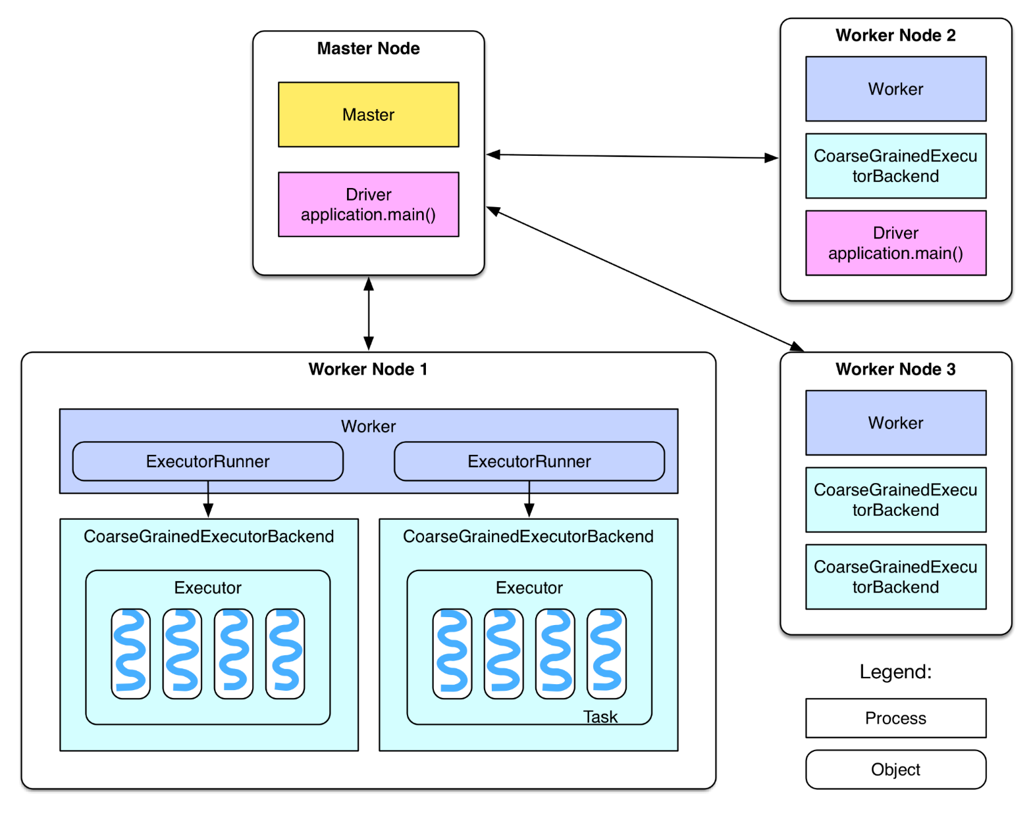
Spark Platform Architecture
Notes:
Driver: The process running the main() function of the application

Slide 3
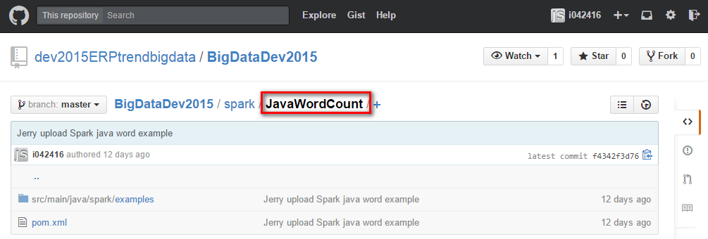
A Sample Java Application: Word Count
https://github.wdf.sap.corp/dev2015ERPtrendbigdata/BigDataDev2015/tree/master/spark
Notes:
1

Slide 4
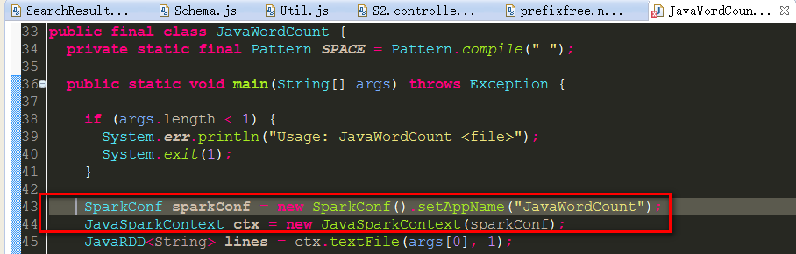
1. SparkContext: Main entry point for Spark functionality
A SparkContext represents the connection to a Spark cluster, and can be used to create RDDs on that cluster.

Slide 5
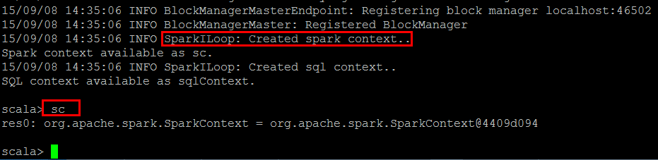
SparkContext created in Scala Commandline
You can find the source code of SparkContext in your local Eclipse or in the installation folder of Spark instance.

Slide 6
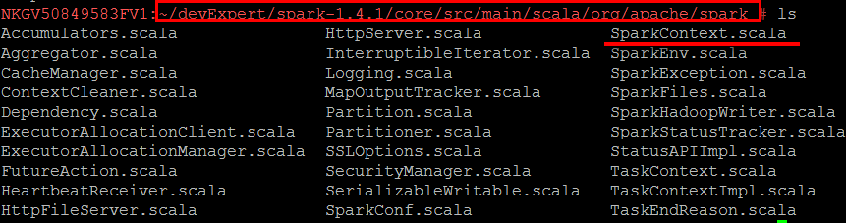
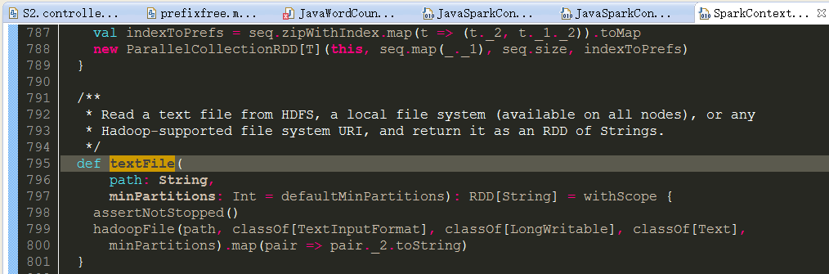
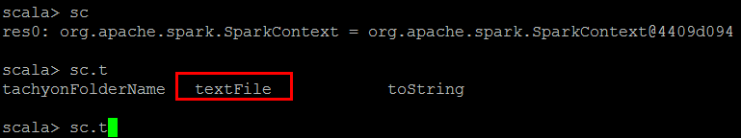
TextFile method in SparkContext

Slide 7
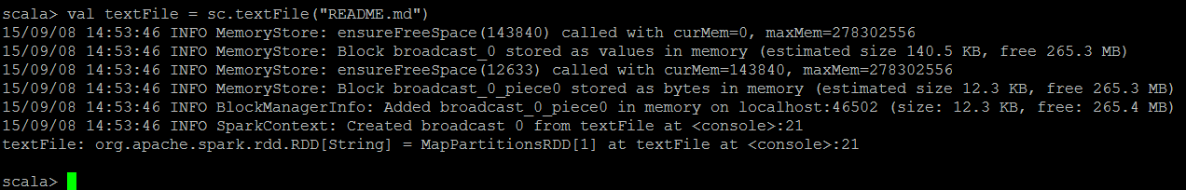
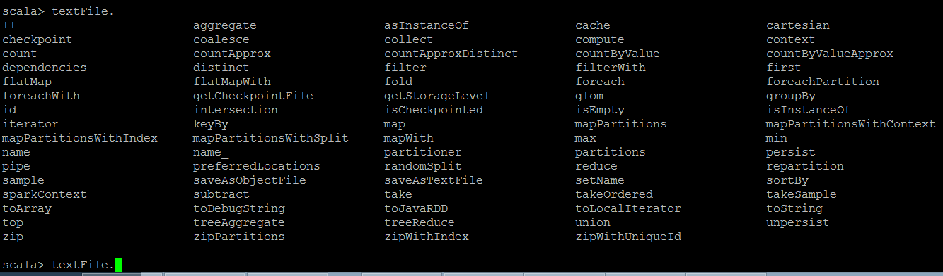
TextFile will return a RDD
http://spark.apache.org/docs/latest/api/scala/index.html#org.apache.spark.rdd.RDD

Slide 8
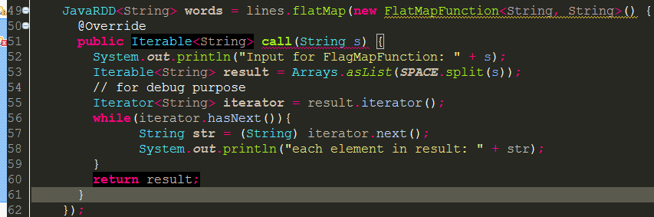
TextFile.flatMap
Return a new RDD by first applying a function to all elements of this RDD, and then flattening the results.

Slide 9
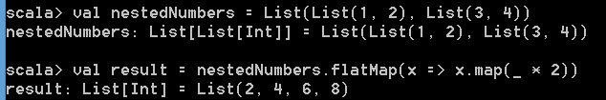
How to understand flatMap
Notes:
line.flatMap(_.split(" ")).map((_, 1)).reduceByKey(_+_).collect().foreach(println)

Slide 10
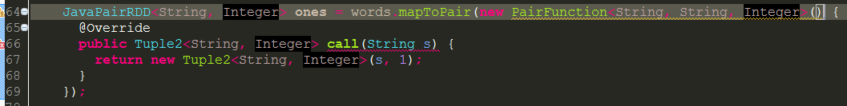
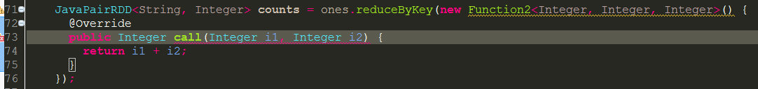
mapToPair - reduceByKey
Notes:
MASTER=local bin/spark-shell
val textFile = sc.textFile("README.md")
textFile.flatMap(_.split(" ")).map((_, 1)).reduceByKey(_+_).collect().foreach(println)
res61.sortWith((x, y) => x._2 < y._2)

Slide 11
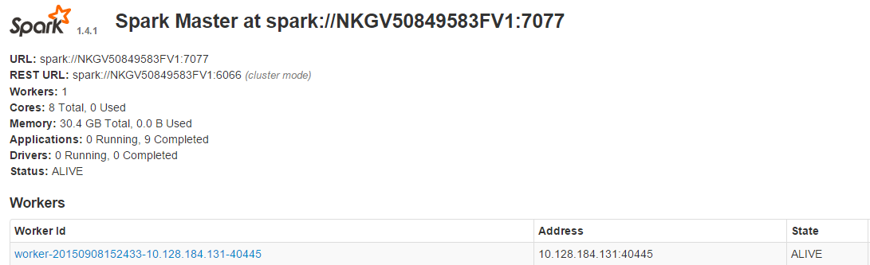
How this sample program is executed in Spark
1. Submit the job to platform
spark://NKGV50849583FV1:7077

Slide 12
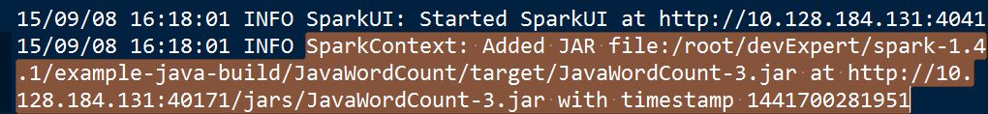
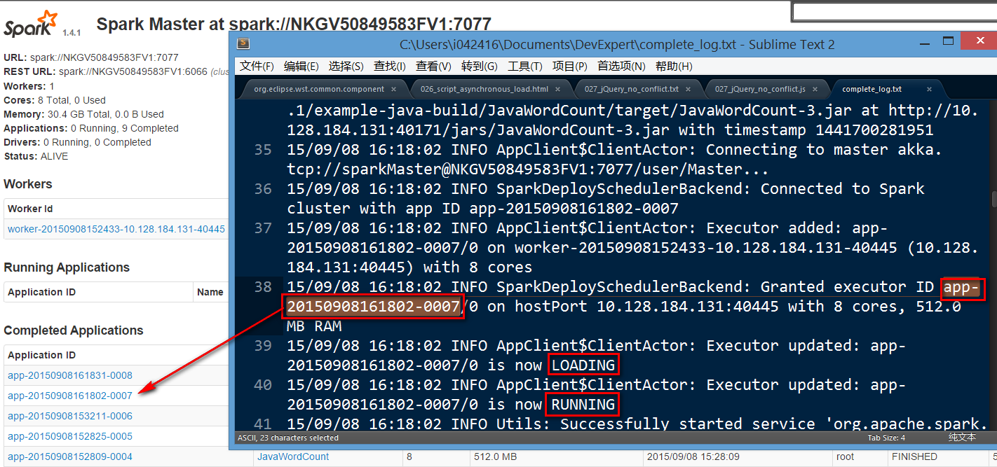
How this sample program is executed in Spark
SparkContext created in the runtime:

Slide 13
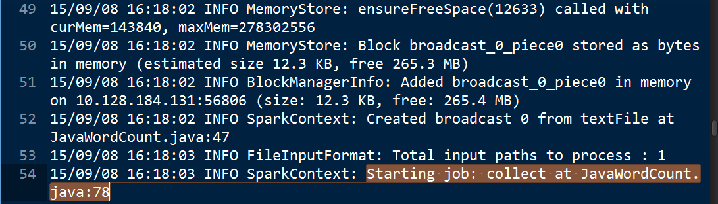
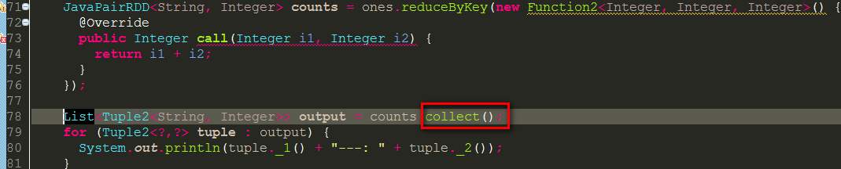
Transformation VS Map
Notes:
Transformation: map,filter, flatMap, mapPartitions, mapPartitionsWithIndex, sample, pipe, union, intersection,distinct, groupByKey, reduceByKey, sortByKey, join, cogroup, cartesian, coalesce,repartition
Action: reduce, collect, count, take,first, takeSample, saveAsTextFile, saveAsSequenceFile, saveAsObjectFile, countByKey,foreach
Collect: Return an array that contains all of the elements in this RDD.

Slide 14
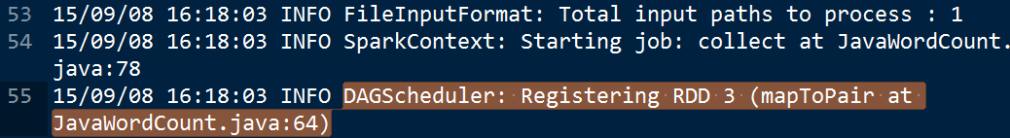
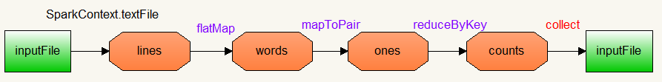
RDD and DAG
Spark will generate a DAG when the real calculation is triggered, that is, a certain action is called in the application.
Spark just maintains the RDD generation and their dependency and no real calculation is done, until the action “collect” is called on RDD.
Notes:
Directed Acyclic Graph

Slide 15
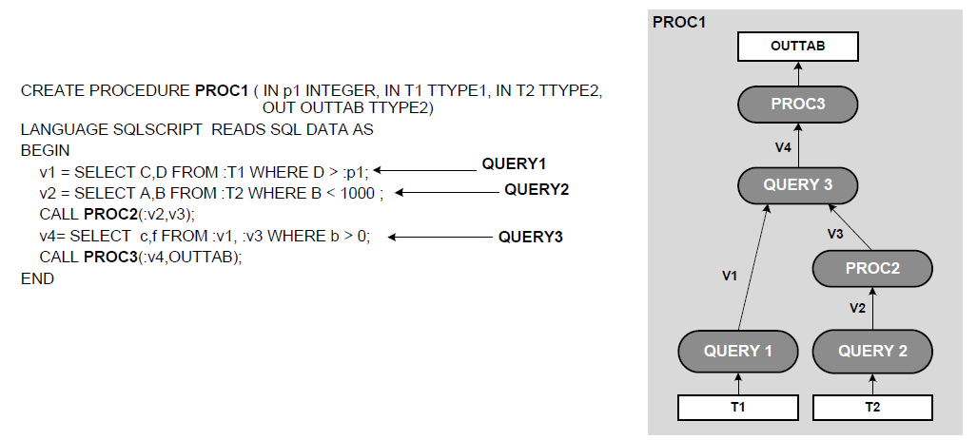
DAG for Parallel Calculation in HANA

Slide 16
Stage ( to be translated )
A stage is a set of independent tasks all computing the same function that need to run as part of a Spark job, where all the tasks have the same shuffle dependencies.
org.apache.spark.rdd.RDD.count
org.apache.spark.SparkContext.runJob
org.apache.spark.scheduler.DAGScheduler.runJob
org.apache.spark.scheduler.DAGScheduler.submitJob
org.apache.spark.scheduler.DAGSchedulerEventProcessActor.receive
org.apache.spark.scheduler.DAGScheduler.handleJobSubmitted
Notes:
有了计算的DAG图，Spark内核下一步的任务就是根据DAG图将计算划分成任务集，也就是Stage，这样可以将任务提交到计算节点进行真正的计算。Spark计算的中间结果默认是保存在内存中的，Spark在划分Stage的时候会充分考虑在分布式计算中可流水线计算（pipeline）的部分来提高计算的效率，而在这个过程中，主要的根据就是RDD的依赖类型。根据不同的transformation操作，RDD的依赖可以分为窄依赖（Narrow Dependency）和宽依赖（Wide Dependency，在代码中为ShuffleDependency）两种类型。窄依赖指的是生成的RDD中每个partition只依赖于父RDD(s) 固定的partition。宽依赖指的是生成的RDD的每一个partition都依赖于父 RDD(s) 所有partition。窄依赖典型的操作有map, filter, union等，宽依赖典型的操作有groupByKey, sortByKey等。可以看到，宽依赖往往意味着shuffle操作，这也是Spark划分stage的主要边界。对于窄依赖，Spark会将其尽量划分在同一个stage中，因为它们可以进行流水线计算。

Slide 17
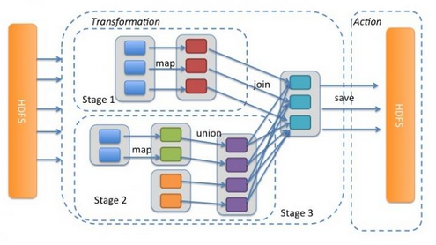
Stage

Slide 18
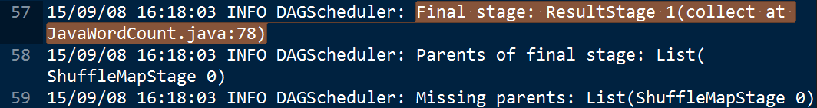
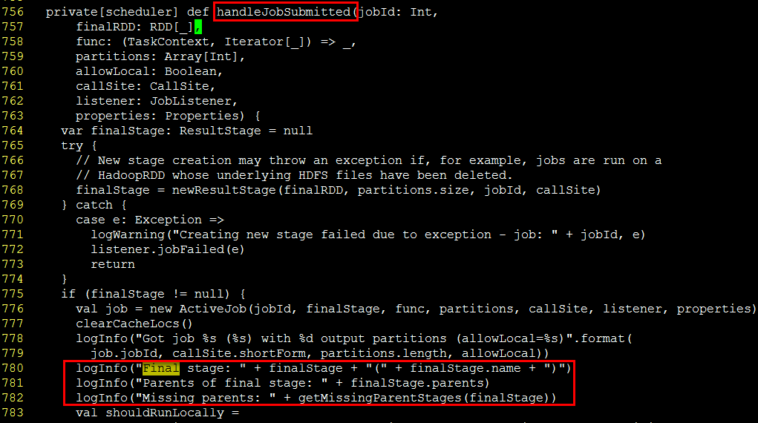
DAGScheduler.scala

Slide 19
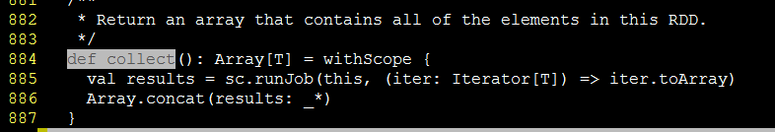
RDD.collect will trigger job execution
Source code: /root/devExpert/spark-1.4.1/core/src/main/scala/org/apache/spark/rdd/RDD.scala
Go through source code:
DAGSchedule.runJob -> submitJob->JobSubmitted->handleJobSubmitted->runLocally->runLocallyWithThread->job.func
Notes:
SparkContext拥有DAGScheduler的实例，在runJob方法中会进一步调用DAGScheduler的runJob方法。在此时，DAGScheduler会生成DAG和Stage，将Stage提交给TaskScheduler。TaskSchduler将Stage包装成TaskSet，发送到Worker节点进行真正的计算，同时还要监测任务状态，重试失败和长时间无返回的任务。

Slide 20
Further reading
https://spark.apache.org/docs/latest/
Spark API
Spark programming guide
Spark example
Scala standard API

Slide 21
RDD.action
rdd.action() 会调用 DAGScheduler.runJob(rdd, processPartition, resultHandler) 来生成 job
runJob() 会首先通过rdd.getPartitions()来得到 finalRDD 中应该存在的 partition 的个数和类型：Array[Partition]。然后根据 partition 个数 new 出来将来要持有 result 的数组 Array[Result](partitions.size)
最后调用 DAGScheduler 的runJob(rdd, cleanedFunc, partitions, allowLocal, resultHandler)来提交 job。cleanedFunc 是 processParittion 经过闭包清理后的结果，这样可以被序列化后传递给不同节点的 task
DAGScheduler 的 runJob 继续调用submitJob(rdd, func, partitions, allowLocal, resultHandler) 来提交 job

Slide 22
DAGScheduler.submitJob
submitJob() 首先得到一个 jobId，然后再次包装 func，向 DAGSchedulerEventProcessActor 发送 JobSubmitted 信息，该 actor 收到信息后进一步调用dagScheduler.handleJobSubmitted()来处理提交的 job。之所以这么麻烦，是为了符合事件驱动模型
handleJobSubmmitted() 首先调用 finalStage = newStage() 来划分 stage，然后submitStage(finalStage)。由于 finalStage 可能有 parent stages，实际先提交 parent stages，等到他们执行完，finalStage 需要再次提交执行。再次提交由 handleJobSubmmitted() 最后的 submitWaitingStages() 负责

