Slide 1


Closure
Jerry Wang
2015 December
Internal

Slide 2
Lexical Scope vs. Dynamic Scope (in SML)
Lexical (static) scope refers to a type of evaluation: an expression is evaluated against its static local environment (the environment where the expression is defined, the scope of an identifier is fixed at compile time)
In contrast in a dynamic scope an expression is evaluated against its dynamic environment (the environment when the expressions is executed)
Example: val x = 2 fun f (y) = x * y val x = 3 val y = 2 val z = f(x - y)
Lexical scope | Dynamic scope
val z = 2 | val z = 3
Notes:
词法作用域 vs 动态作用域
1. 在词法作用域下，一个符号参照到语境中符号名字出现的地方(可以理解为参照到定义)
2. 变量的作用域是在定义时决定而不是执行时决定，也就是说词法作用域取决于源码，通过静态分析就能确定，因此词法作用域也叫做静态作用域。

Slide 3
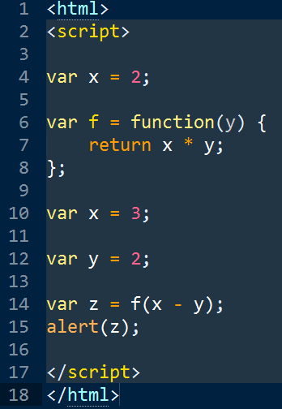
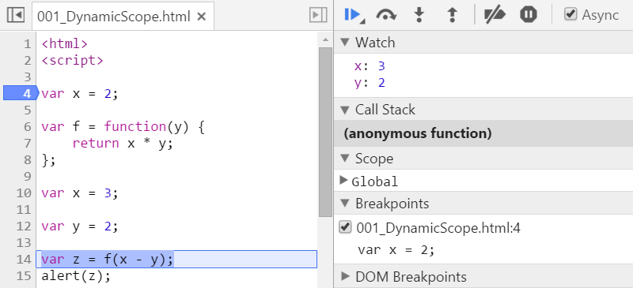
Dynamic Scope ( JavaScript )
x and y are global variable here.
z = 3
Notes:
Demo: 001_DynamicScope.html

Slide 4
Closures
A closure is a function that consists of the function itself and its lexical environment. The free variables are bound to the lexical environment.
A free (non-local) variable is one that is not declared locally in the function.
Hence, a closure has access to non-local variables even called outside the immediate lexical scope where it was defined.
Example (in SML): val x = 2 fun f (y) = x ^ y
x is a free variable and is bound to ‘2’.
Notes:
A function with variables that are not passed as parameters or declared locally → free variables
These free variables are bound to values of the lexical environment at declaration

Slide 5
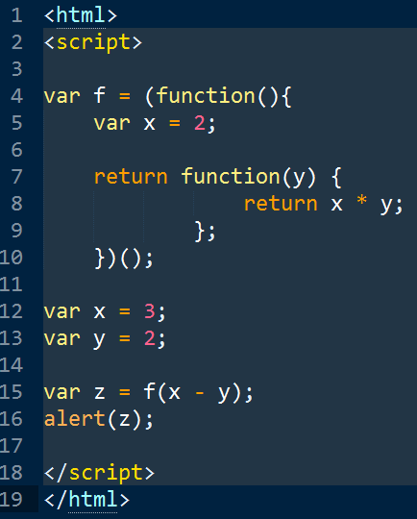
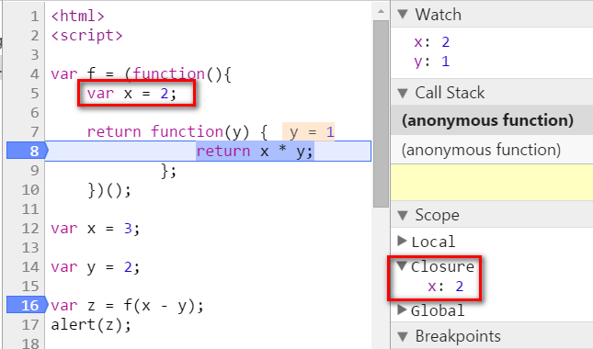
Lexical Scope ( JavaScript )
Notes:
Demo: 002_LexicalScope.html

Slide 6
Closure Idiom: Callbacks
Well known closures are callbacks
A callback is a closure that is registered centrally or passed as an argument and is expected to be “called back” after something happened or is executed
Example: Event callbacks in AJAX applications
Notes:
idiom英[ˈɪdiəm]美[ˈɪdiəm]
n.习语，成语; 方言，土语; （语言） 风格; 惯用语法;

Slide 7
Closure Idiom: Callbacks - Demo
Old approach – do not use Closure
<div>
<button id="button1" width = "100px">button1</button>
<button id="button2" width = "100px">button2</button>
</div>
function registerEvent(buttonID) {
var oButton = document.getElementById(buttonID);
if( !oButton)
return;
oButton.onclick = function(oEvent) {
alert("button clicked, id: " + oEvent.srcElement.id);
};
}
Notes:
Demo: 003_closure_callback.html

Slide 8
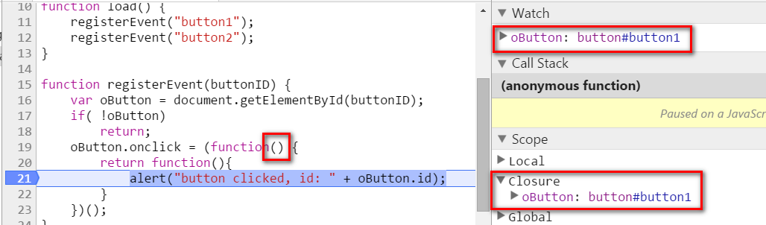
Use Closure to Reimplement
function registerEvent(buttonID) {
var oButton = document.getElementById(buttonID);
if( !oButton)
return;
oButton.onclick = (function() {
return function(){
alert("button clicked, id: " + oButton.id);
}
})();
}
Notes:
Demo: 004_closure_callback2.html

Slide 9
Lazy Evaluation With Closures: Delay and Force
Thunk: a closure with no arguments Used to delay evaluation of an expression until it is needed Example (in pseudo SML): parameters of a function fun f (x, y, z) = if x then y else z
f (true, print “true”, print “false”) → would print “true””false””true” f (true, fn _ => print “true”, fn _ => print “false”) → would print “true” or print “false”
This works due to the fact that a function body is evaluated only if the function is called
thunk
thunk
Notes:
Sometimes one wants to control when an expression is evaluated and that is evaluated exactly once:
Result is used many times
Computing is expensive

Slide 10
Lazy Evaluation With Closures: Delay and Force
Thunk: a closure with no arguments Used to delay evaluation of an expression until it is needed Example (in pseudo SML): parameters of a function fun f (x, y, z) = if x then y else z
f (true, print “true”, print “false”)
would print “true””false””true”
This works due to the fact that a function body is evaluated only if the function is called.
Notes:
Sometimes one wants to control when an expression is evaluated and that is evaluated exactly once:
Result is used many times
Computing is expensive

Slide 11
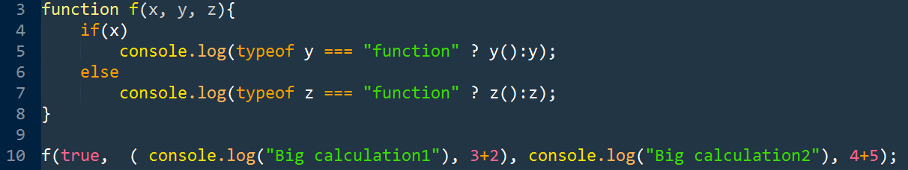

JavaScript Example

Slide 12
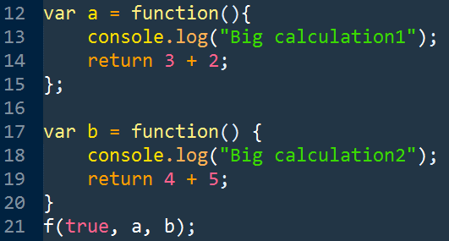

JavaScript Example 2
Notes:
Demo: 005_lazy_evaluation.html

Slide 13
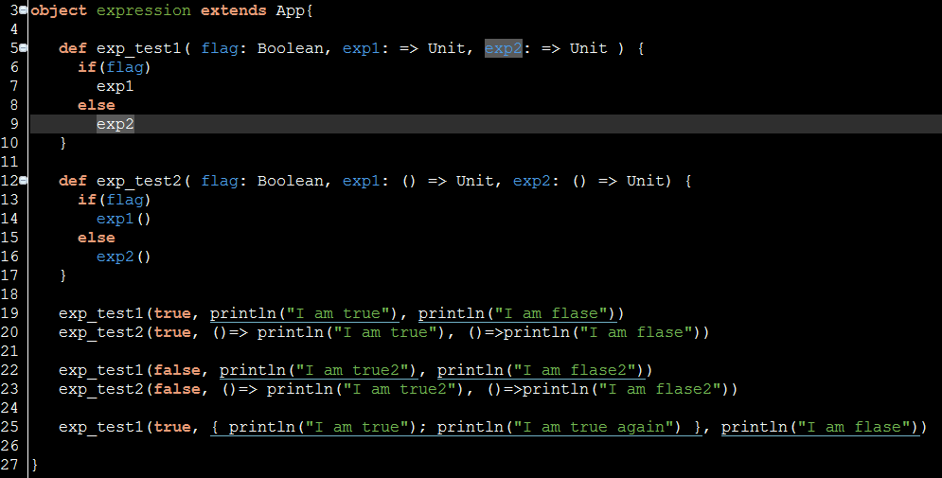
Scala Example

Slide 14
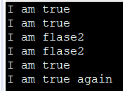
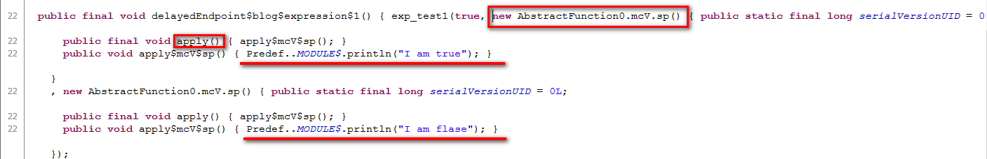
Scala Example
println("I am true") is converted into an anonymous function in Java

Slide 15
Lazy Evaluation: Delay and Force Example (in SML)
fun some_heavy_computation(x) = <…>
fun repeat_n_times(n, a_promise) = case n of 0 => 0 | 1 => my_force a_promise | n > 1 => repeat_n_times(n – 1, a_promise) my_force a_promise
val _ = repeat_n_times(100, my-delay(fn () => some_heavy_computation(4.23)))
Notes:
Here delay & force is shown with a recursion:
Base condition are 0 and 1; for 1 the heavy computation is performed; all other function calls use the result of the succeeding function

Slide 16
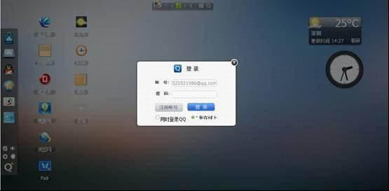
JavaScript Example: Lazy Load Scenario
Suppose when we try to log on WebQQ, the desktop background color should become dark to highlight the logon dialog.
var createMask = function(){
return document,body.appendChild( document.
createElement(div) );
}
$(‘#logon_button').click(function(){
Var mask = createMask();
mask.show();
})
Drawback: It makes sense for the mask div element to be a singleton, or else every time we click log on button, there will be a new div generated.

Slide 17
JavaScript Example: Lazy Load Scenario – version2
var mask = document.body.appendChild(document.createElement(''div' ) );
$( '‘#logon_button').click(function(){
mask.show();
})
Drawback: If log on button is never clicked, the mask div element is then not necessary. In this solution, the mask div is always created although not necessary.

Slide 18
JavaScript Example: Lazy Load Scenario – version3
var mask;
var createMask = function(){
if(mask)
return mask;
else{
mask = document,body.appendChild( document.createElement(div) );
return mask;
}
}
Drawback: here a global variable outside createMask function is used and it is changed inside createMask. This is not safe since there is possibility that other JS file could also change it.

Slide 19
JavaScript Example: Lazy Load Scenario – version4
var createMask = function() {
var mask;
return function() {
return mask || ( mask = document.body.appendChild(document.createElement('div')))；
}
}();
Now the mask variable is wrapped inside Closure and not visible to outside consumers. The creation of mask div is delayed until it is really necessary.

Slide 20
JavaScript Example: Lazy Load Scenario – final version
We can also write a generic function to enable any other function to behave as singleton style:
var singleton = function(fn){
var result;
return function() {
return result || ( result = fn.apply(this,arguments));
}
}
The singleton function accepts a function as input, and return a new function which behaves like singleton.
var createMask = singleton(function(){
return document.body.appendChild(document.createElement('div'));
});

Slide 21
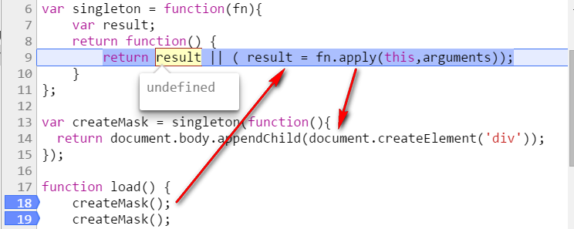
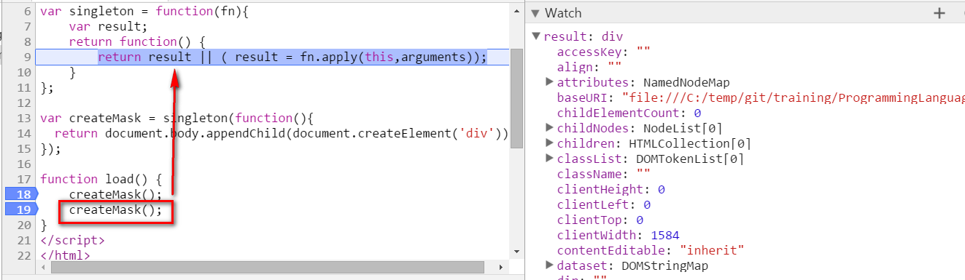
JavaScript Example: Lazy Load Scenario – final version
Bridge Pattern: decouple the abstract part and the concrete implementation part, so that each of both could change independently.
Notes:
Demo: 007_singleton.html

Slide 22
An example in UI5 Application
This pattern is widely used in JavaScript Libraries and applications.
An example in Fiori: jQueryproxy.wrf
Notes:
http://localhost:8090/cus.crm.mycalendar/?responderOn=true

Slide 23

Currying
In mathematics and computer science, currying is the technique of translating the evaluation of a function that takes multiple arguments (or a tuple of arguments) into evaluating a sequence of functions, each with a single argument.
Haskell Curry
https://en.wikipedia.org/wiki/Currying
function simpleGreet(greeting, name) {
console.log(greeting + ", " + name);
}
simpleGreet("Hello", "Orlando");
simpleGreet("Hello", "Jerry");

Slide 24
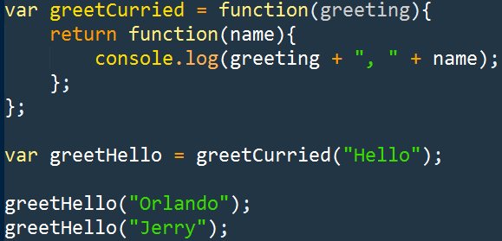
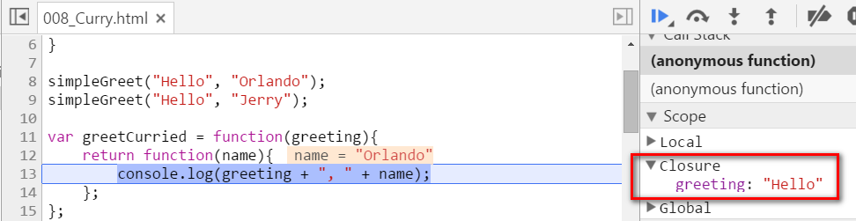
Currying

Slide 25
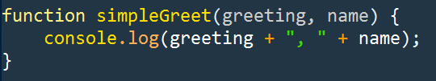
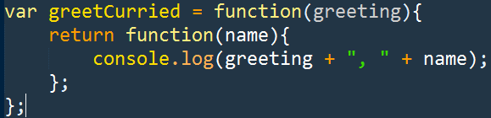
Why and When Currying
It is a natural product in a given programming language where the function could be treated as first class.
approach1
approach2
Approach1: Could be used when multiple arguments only makes sense when they work as a whole.
Approach2: Could be used if it makes sense to specify some arguments in a sequential way.

Slide 26

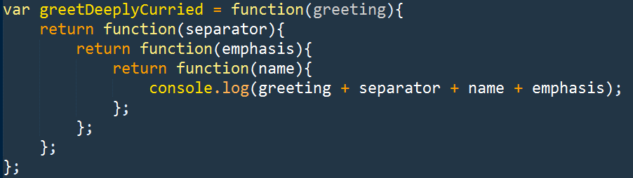
Currying
Currying can enable us to combine the functions in a more fine grained way, to build some customized functions.

Slide 27
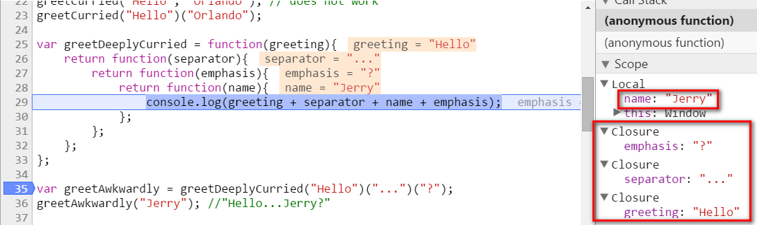
Currying

Slide 28
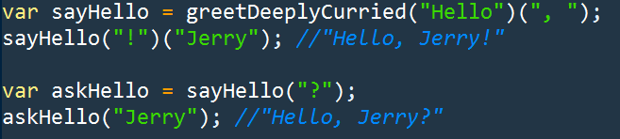
Currying – build customized functions

Slide 29
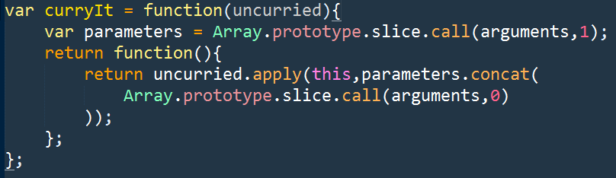
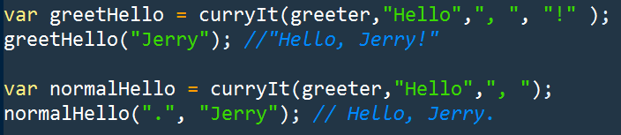
Currying – using Bridge Pattern
Abstract part and concrete implementation part is decoupled.

